Slide 1
The 8 Elements of Data Governance
Amber O’Connell – Director of Data Governance
Kim Wienzierl - Chief Data Officer
June 2021

Slide 2
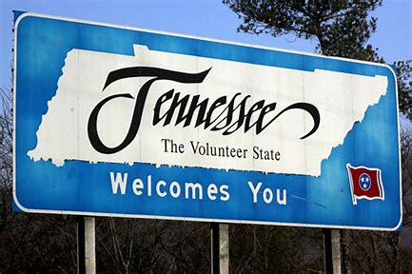

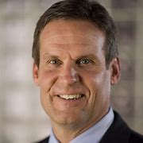
About Tennessee
36th largest state in the United States by area
16th most populous of the 50 states
The Appalachian Mountains dominate the eastern part of the state and the Mississippi River forms its western border
State agencies:
Alcoholic Beverage Commission
Agriculture
Arts Commission
Board of Parole
Children’s Service
Commerce & Insurance
Commission on Aging & Disability
Commission on Children & Youth
Correction
Council on Development Disabilities
Economic & Community Development
Education
Environment & Conservation
Finance & Administration
Financial Institutions
General Services
Health
Housing Development Agency
Human Resources
Human Rights Commission
Human Services
Intellectual & Developmental Disabilities
Labor & Workforce Development
Mental Health & Substance Abuse Services
Military
Revenue
Safety & Homeland Security
State Board of Education
TN Department of Transportation
TennCare
TN Advisory Commission
TN Bureau of Investigation
TN Emergency Management Agency
TN Higher Education Commission
TN State Museum
Tourist Development
TN Wildlife Resources Agency
Veteran Services
Governor Bill Lee

Slide 3
Data Governance Framework
Data Governance
Manage – Control - Sustain
1
2
3
4
5
6
7
8
Organization
Policies
Procedures
Standards/
Definitions
Architecture
Data Admin/
Controls
Metrics/
Reporting
Audits
Chances are you are already governing data informally - Robert Seiner
This framework will streamline the data governance process for reuse and completeness.

Slide 4


ORGANIZATION
Goals
Define the scope of the data domain
Assign ownership
Define the business value and uses of the data
Build plan for operationalizing data governance
1
Organization
DATA GOVERNANCE OPERATING MODEL
DATA STRATEGY
ROLES
COMMITTEES
RESPONSIBILITIES
DECISION RIGHTS
PRODUCERS & CONSUMERS
HIGH LEVEL BUSINESS NEEDS
ACTION PLAN
ENGAGEMENT PROCESSES
Templates & Tools
Organization Charts
Responsibility Chart (RACI)
SMART Goals for Roles

Slide 5
POLICIES
Goals
Define/Update data policies to guide business conduct regarding the creation and use of data as an asset
2
Policies
TERMS & DEFINITIONS
DATA NAMING STANDARD
BUSINESS RULES
QUALITY STANDARDS
INFORMATION SECURITY
DATA POLICY
ALIGNMENT WITH OTHER POLICIES
COMMUNICAITON PLAN
AUTHORING
ACCESS
USAGE
MAINTENANCE
RETENTION
STORAGE
Templates & Tools
Policy Template
Enterprise Document Storage

Slide 6
PROCEDURES
Goals
Define how data will be managed to meet requirements
Ensure responsibility and steps for tasks are clear
3
Procedures
ENTERPRISE POLICIES
DATA POLICIES
DATA PROCEDURES
DATA PROCEDURES ROLES
STANDARD WORK
Templates & Tools
Procedure Template
Process Swim Lane Chart
Responsibility Chart (RACI)

Slide 7
STANDARDS/DEFINITIONS
Goals
Definitions & standards documented for all key or critical fields in a data set
System of record & system of reference defined
4
Standards/
Definitions
DATA MODELS
DATA SCHEMAS
DATA NAMING RULES
BUSINESS RULES
TERMS & DEFINITIONS
DATA QUALITY STANDARDS
SAFE SOURCE IDENTIFIED
DATA VALID VALUES
Templates & Tools
Business Glossary
Data Dictionary
Metadata Repository
Data Models

Slide 8
ARCHITECTURE
Goals
Define a conceptual data model that meets business needs
Identify the critical or key fields that need to be governed and managed
Document data flows & business processes
Document reference architecture for data stores
5
ROLES
RESPONSIBILITIES
DECISION RIGHTS
PRODUCTERS & CONSUMERS
HIGH LEVEL BUSINESS NEEDS
ACTION PLAN
STANDARD METHODOLOGY & TOOLS
DATA MODELING GUIDELINES
DATA NAMING GUIDELINES
Architecture
DATA MODEL
DATA CATEGORY CHART
ALIGNMENT TO EXISTING DATA MODELS
KEY OR CRITICAL DATA FIELDS
ALIGNMENT TO BUSINESS PROCESSES
DATA FLOW DIAGRAMS
Templates & Tools
Business process swim lane map
Data model
Data flow diagram
System reference architecture diagram

Slide 9
DATA ADMIN/CONTROLS
Goals
Understand the data risk for the entire lifecycle of the data and define a strategy to manage it
Design and implement process controls where appropriate
Define a privacy and confidentiality strategy end-to-end
6
Data Admin/
Controls
PROCESS & DATA FLOWS
DATA REFERENCE ARCHITECTURE
STANDARD WORK
DATA PROCEDURES
RISK MANAGEMENT STRATEGY
ALIGNMENT WITH OTHER CONTROLS
DATA DOMAIN SPECIFIC CONTROLS
STANDARD WORK
Templates & Tools
Control plan for data security
Data security plan template

Slide 10
METRICS/REPORTING
Goals
Define the vital few metrics needed for continuous data improvement
Ensure the measurement plan aligns with business needs
Ensure the method for producing metrics is sustainable
Establish a reliable and repeatable process for acting on metrics
7
Metrics/
Reporting
POLICIES
PROCEDURES
STANDARDS
ESTABLISHED CONTROLS
DATA QUALITY METRICS
DATA QUALITY CERTIFICATION
POLICY/CONTROLS COMPLIANCE METRICS
MONITORING & MANAGEMENT PROCESS
Templates & Tools
Accuracy
Timeliness
Accessibility
Completeness
Consistency
Data Quality metrics definition
Root cause corrective action process
Control charts
Data audit template

Slide 11
AUDITS
Goals
Continually improve the Data Governance operating model
Identify new risks and opportunities as they emerge
Identify and replicate best practices across data domains
Self audit and external audit preparedness
8
Audits
POLICIES
PROCEDURES
STANDARDS
ESTABLISHED CONTROLS
MATURITY ASSESSMENT RATING & TARGETS
SELF-AUDIT CHECKLIST
SELF-AUDIT SCHEDULE AND ROLES
SCHEDULE OF KNOWN EXTERNAL AUDITS
Templates & Tools
Maturity Assessment template
Enterprise Data Governance documentation
Evidence storage for audit purposes

Slide 12
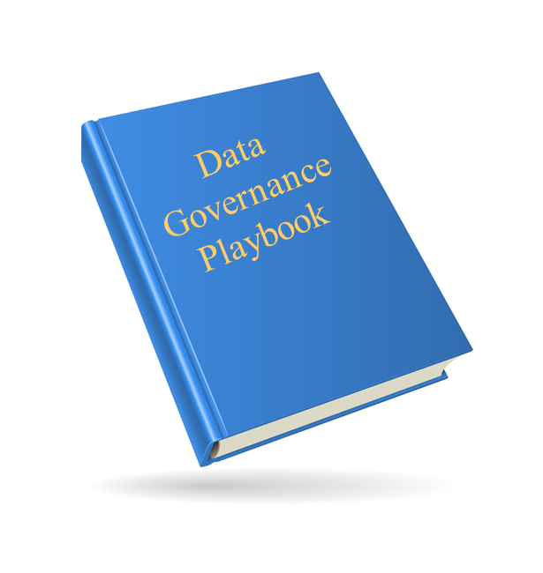
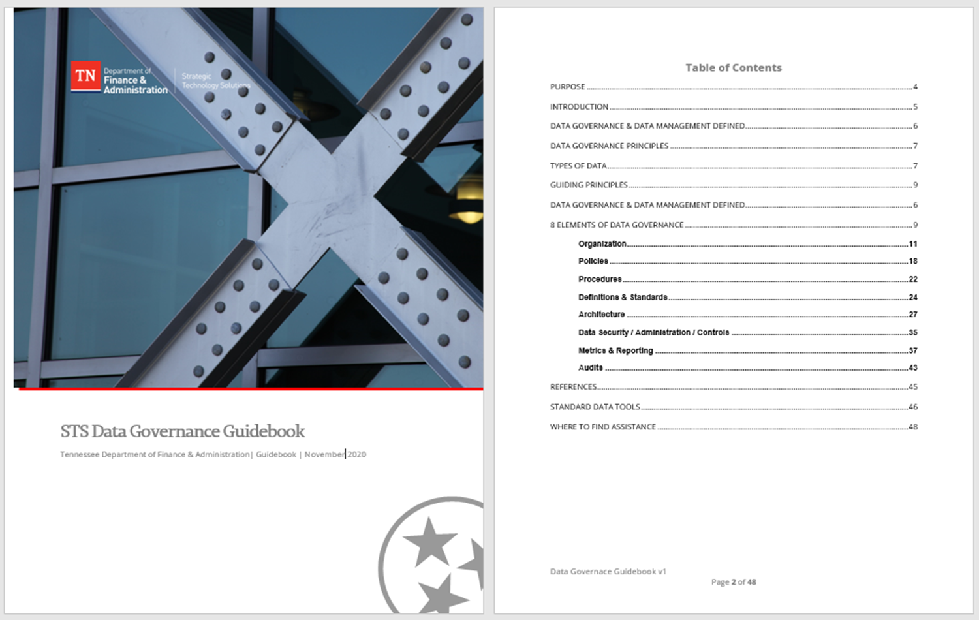
Data Governance Framework
Data Governance
Manage – Control - Sustain
1
2
3
4
5
6
7
8
Organization
Policies
Procedures
Standards/
Definitions
Architecture
Data Admin/
Controls
Metrics/
Reporting
Audits
Data Governance Guidebook & Playbook

Slide 13
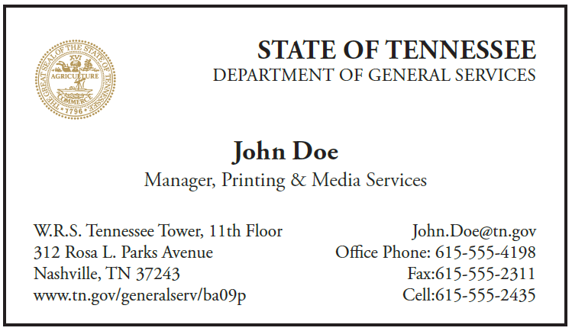
Questions?
DEPARTMENT OF FINANCE & ADMINISTRATION
Kim Wienzierl
Chief Data Officer
Strategic Technology Solutions
State of Tennessee Data Center – North
901 5th Avenue North
Nashville, TN 37219
Kimberly.Wienzierl@tn.gov
615-532-4716
919-609-5936

