Slide 1
GOODWILL INDUSTRIES - KNOXVILLE, INC.
WORKFORCE DEVELOPMENT
AYOKA HUFF-JOHNSON
AMERICAN JOB CENTER,
EAST TN LWDA
ONE STOP OPERATIONS
JENNIFER EPPLEY

Slide 2
Goodwill Knoxville
Provides short-term job training programs with industry-recognized certifications, career counseling, readiness, job placement and retention supports to individuals with barriers to employment in fifteen counties in East Tennessee.

Slide 3
American Job Center ETLWDA
Provides opportunities, resources, and support services for training, employment, career and business development through a network of AJC and Community partners in a sixteen county area.

Slide 4
SNAP 3rd Party Partnership
The first in Tennessee to jump on board!

Slide 5
SNAP 3rd Party Partnership
Since starting a formal partnership with SNAP Employment & Training Goodwill has been able to serve hundreds more participants and received our 300th referral this week!

Slide 6
SNAP & WIOA
Goodwill is a 3rd party partner and has training programs on the Eligible Training Provider List (ETPL), and thus are able to accept referrals from either program, providing greater flexibility when braiding funding and maximizing supports.

Slide 7
WIOA Youth Partnerships
Goodwill serves as a host site in retail stores for Paid Work Experience for
out of school youth.

Slide 8
Multi-layer partnership
Goodwill is a First job opportunity for individuals with limited work experience
Goodwill works to hire Justice Involved Individuals within AJC community re-entry efforts
Goodwill works with AJC Business Services Team/LVERs to fill open positions

Slide 9
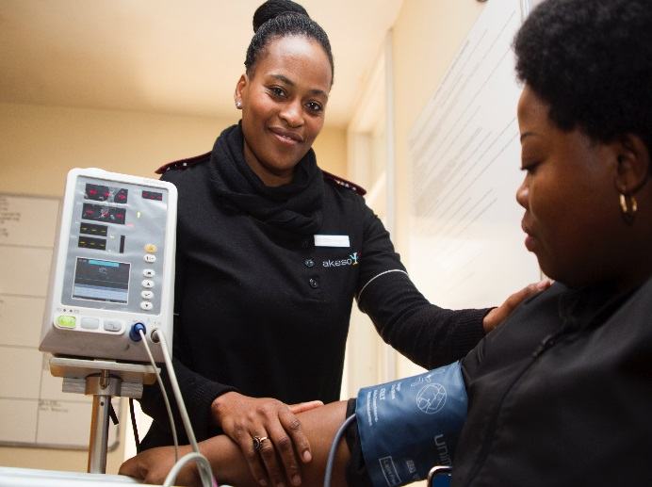
Goodwill Training Programs
Certified Nurse Assistant Hospitality
Call Center Office Administration
IT Helpdesk Retail

Slide 10
Good Jobs, Great Careers
Grant-funded program from Walmart dedicated to the advancement of incumbent workers in service sector industries.

Slide 11
Good Jobs, Great Careers
Provides additional career counseling, employer connections, and support services that can assist SNAP E&T and WIOA Title I Services to achieve desired outcomes.

Slide 12
Impact
Career path with immediate increase in earnings
Development of workability skills and habits
Exposure/Connection to in-field employers leading to development of professional network
Discontinuation of reliance on public assistance
Increase in self-esteem
Demonstration of lifelong learning to children

Slide 13
Why It Works
As a non-profit, Goodwill has greater flexibility when developing short-term training programs in high-growth industries.

Slide 14
Why It Works
In the East Local Workforce Development Area (LWDA), Goodwill and the AJC has developed a strong partnership which has been in existence for many years.

Slide 15
How Can You Make It Happen?
? ? ?

Slide 16
COMMUNICATE
Non-profits, AJCs, additional training/workforce providers need to talk frequently about what is lacking in your community.

Slide 17
CREATE
Think outside the box—just because it hasn’t been done before doesn’t mean it can’t start now!

Slide 18
COLLABORATE
Work together to develop pathways to serve customers with workforce needs.

Slide 20
THANK YOU!

