Slide 1
ONE AGENCY – ONE SYSTEM
Focusing on our Collective Efforts - Better Together
Notes:
A title slide background to enhance your Microsoft PowerPoint presentations.
You can download this design and over 10,000 more at www.presentationpro.com

Slide 2
SERVING MORE – SERVING BETTER
Notes:
A title slide background to enhance your Microsoft PowerPoint presentations.
You can download this design and over 10,000 more at www.presentationpro.com

Slide 3
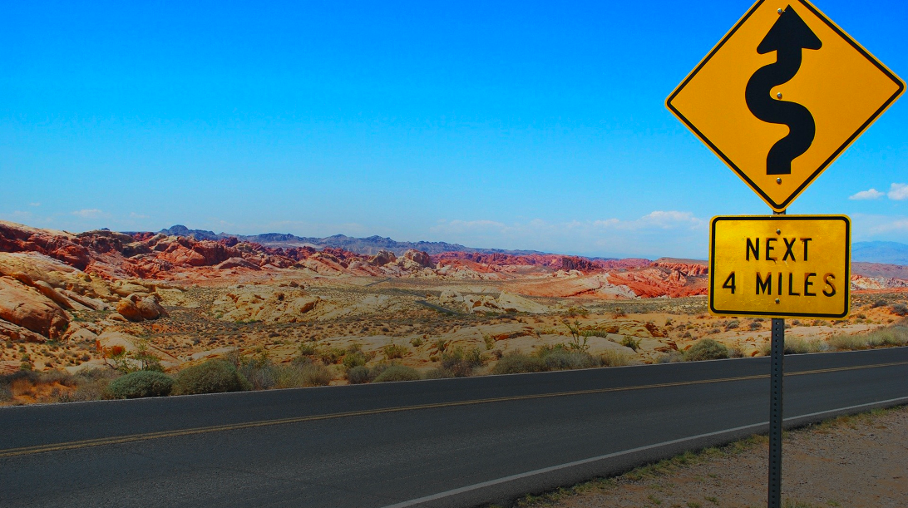

Slide 6
Resiliency
Nothing ever goes away until it teaches us what we need to learn
Notes:
A text slide background to enhance your Microsoft PowerPoint presentations.
You can download this design and over 10,000 more at www.presentationpro.com

Slide 7
Relationship Building
Indifference is expensive
Hostility is unaffordable
Trust is priceless
It’s all about relationships
Notes:
A text slide background to enhance your Microsoft PowerPoint presentations.
You can download this design and over 10,000 more at www.presentationpro.com

Slide 8
Relevancy
Nothing ever goes away until it teaches us what we need to learn
Notes:
A text slide background to enhance your Microsoft PowerPoint presentations.
You can download this design and over 10,000 more at www.presentationpro.com

Slide 9
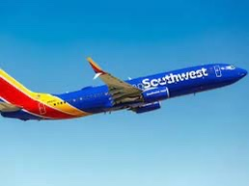
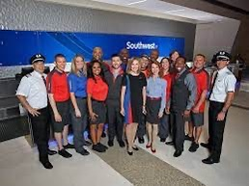
Hire the Smile, Teach the Skill
Notes:
A text slide background to enhance your Microsoft PowerPoint presentations.
You can download this design and over 10,000 more at www.presentationpro.com

Slide 11
We are what we repeatedly do, Excellence then, is not an art, but a habit
Aristotle

