Slide 1
STATE OF TENNESSEE
PROJECT R.E.A.P.
August 2021

Slide 2
Statistics
Statistics show that 97% of offenders currently incarcerated in Tennessee will return home one day.
Within three years of their release, 46% will be rearrested and return to prison or jail.
Recidivism studies reveal that two out of every three people released from state prison are rearrested for a new offense; about half return to prison within three years.
Nationally, approximately 70 million adults have a criminal record of some kind, meaning roughly 1/3 of our eligible workforce is affected by a prior interaction with law enforcement.

Slide 3
How Do WE Address This Issue?
Investment and equitable access to resources like:
Formal correctional education and vocational training
Post-release employment
Finding employers open to hiring justice-involved individuals (JII)
Notes:
Correctional education and vocational training programs have played a crucial role in terms of increasing employability and decreasing recidivism among released offenders. (Ability to customize education and training for industries in communities which JII will return)
Educated inmates are less likely to be recidivist offenders after their release from prison/jails.
Previous researchers (Finn, 1998; Harrison & Schehr, 2004; Solomom, et al., 2008; Visher, et al., 2008; Uggen, 2000; Uggen & Staff, 2001; Wadsworth, 2006) indicated that post-release employment could serve as an important mechanism to prevent ex-offenders from involvement in criminal activities when reentering the community.

Slide 4
Education, Training, and COVID-19
CRISIS
OPPORTUNITY
Notes:
Crisis—Adult Education Division offers corrections education in local/county jails. COVID hit and we were unprepared to continue services in these facilities. Lost 65% of our CE students. Local programs were preparing paper packets to deliver to facilities, but it became unsustainable. Many facilities did not have the infrastructure to hold distance education/virtual classes.
Opportunity—Wireless based tablet available to provide AE, Re-Entry Services, Workforce Development Training, and rehabilitative services.

Slide 5
Project R.E.A.P. (Re-Entry, Employment and Adult Education Program)

Slide 6
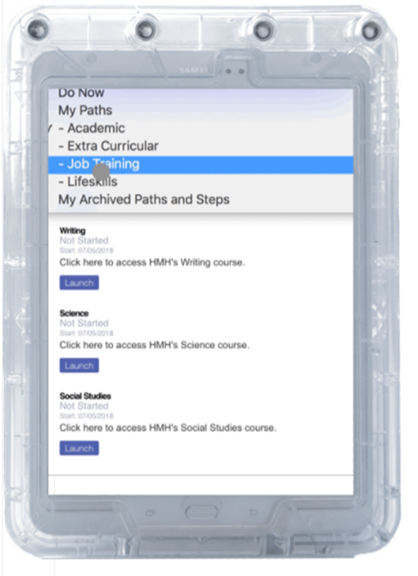
American Prison Data System (APDS) Tablet
10.1” Galaxy TabA devices
Military-grade cases
Wi-Fi-enabled on a secure network independent of the facilities’ networks
24/7 live-agent monitoring

Slide 7
Programs Available on APDS Tablets
Adult Education
HiSET/TABE Academy
CASAS Academy
Rehabilitation
Cognitive Behavioral Therapy
Recovery Library
Workforce Development
Basic Work Skills Programs
Ready to Work Credentials
Re-Entry
Financial Literacy Planning
Plan Building Program
Live Video Classrooms
Launching Fall 2021
180 Skills
OSHA Certification
Professional Development
APDS provides training for users

Slide 8
Current Pilot
Updates:
120 Participants
65,354 minutes of engagement
218 assigned CBT rehab tools
315 library books checked out
Blount, Gibson, and Grundy counties
72 tablets across 3 facilities (24 at each)

Slide 9
THANK YOU

