Slide 1
Project SEARCH
A Tennessee Overview
Blake Shearer | VR Transition Director | Aug. 2021

Slide 3
Project SEARCH Goal
The goal is to prepare young people with significant disabilities for success in integrated, competitive employment.
The Project SEARCH® Transition-to-Work Program is a unique, business-led, one-year employment preparation program that takes place entirely at the workplace. Total workplace immersion facilitates a seamless combination of classroom instruction, career exploration, and hands-on training through worksite rotations. The program culminates in individualized job development.

Slide 4
What does a program year look like?
Interns:
Participate in an internship immersion program during their last year in high school
Participate in 3 10-week internships
Gain competitive, marketable skills
Receive support and instruction by a full-time special education instructor and skills trainers
Mentored by host business staff who guide the tasks to be learned
Practice employability and communication skills with internship department staff
Create resume of marketable skills
Gain employment in their communities using the skills they gain after the program concludes

Slide 5
Link to video and news story:
https://www.newschannel5.com/news/cerebral-palsy-autism-blindness-dont-keep-interns-from-job-opportunities-at-vanderbilt

Slide 6
Annual Project SEARCH Calendar
Mirrors the local school calendar – 36 weeks in duration, excluding breaks.
August
June
1st Internship 10 weeks
2nd Internship 10 weeks
3rd Internship 10 weeks
Complete Program & Begin Work at Host Site or in Community
Transition Week
Transition Week
3 Week Orientation
Regular Employment Planning Meetings
held twice each internship and led by the intern.

Slide 7
Sample Typical Schedule
Daily Schedule
8:00 Employability Skills Curriculum/Daily Agenda (in training room)
9:00 Internship sites
11:30 Lunch
12:00 Internship site
2:00 Review, Assess, Plan,(in training room)
2:30 Depart for home

Slide 8
National and State Statisitcs

Slide 9
National Program Statistics
10
Countries
48 U.S. States
628 Program Sites
29,933 People Served
(Since 2010)

Slide 10
Tennessee Program Statistics
10
Counties
17 Program Sites
597 People Served (Since 2012)
Fantastic Employment Outcomes!

Slide 14
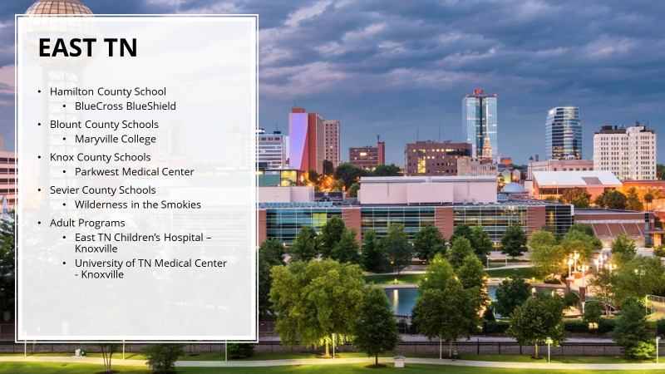

Slide 15
TN Project SEARCH Programs
School-Based Model
BlueCross BlueShield – Chattanooga
Embassy Suites – Murfreesboro
Embassy Suites – Nashville
Le Bonheur Children’s Hospital – Memphis
Maryville College – Maryville
Methodist North Hospital - Memphis
Parkwest Medical Center – Knoxville
Sheraton Hotel – Memphis
Tennova – Clarksville
The Peabody – Memphis
Welch College* - Gallatin
West TN Healthcare – Jackson
Wilderness in the Smokies – Pigeon Forge
Adult Model
Amerigroup – Nashville
East TN Children’s Hospital – Knoxville
University of TN Medical Center – Knoxville
Vanderbilt Children’s Hospital - Nashville

Slide 16
2020-21 Intern Class (1 of 2)
Host Site | # of Interns
Amerigroup | Hiatus
BlueCross Blue Shield | 8
East TN Children’s Hospital | 2
Embassy Suites – Murfreesboro | 7
Embassy Suites - Nashville | 0
Le Bonheur Children’s Hospital | 7
Maryville College | 5
Host Site | # of Interns
Methodist North Hospital | 7
Parkwest Medical | 10
Sheraton Hotel | 8
Tennova Healthcare | 3
The Peabody | 5
UT Medical Center | 8
Vanderbilt | 8

Slide 17
2020-21 Intern Class (2 of 2)
Host Site | # of Interns
Welch College | 4
West TN Healthcare | 6
Wilderness | 0
Total | 91

Slide 18
Outcomes

Slide 19
Employment Outcomes
Outcomes Year | # Enrolled | # Withdrawn | % Employed | % Employed (PS Criteria)*
2019-20* | 137 | 11 | 62.04 | 56.93
2018-19 | 97 | 9 | 81.44 | 73.20
2017-18 | 76 | 9 | 75.00 | 71.05
2016-17 | 80 | 6 | 83.75 | 67.50
2015-16 | 63 | 2 | 63.49 | 22.22
2014-15 | 55 | 0 | 61.82 | 14.55
* Many sites closed due to COVID-19 and some interns are continuing during the 2020-21 school year.

Slide 20
Employment Outcomes
Outcomes Year | Interns w/ Job Records | Average Hours/Week | Average Hourly Wage
2019-20 | 85 | 27.46 | $11.10
2018-19 | 73 | 25.49 | $9.28
2017-18 | 57 | 26.03 | $9.52
2016-17 | 67 | 24.99 | $8.61
2015-16 | 40 | 25.19 | $8.92
2014-15 | 34 | 23.97 | $8.03

Slide 21
Business Roles/Responsibilities

Slide 22
Business Partnership
Intern Success
Business Liaison
Workplace Mentors
Dedicated Classroom
Steering Committee
Intern Selection

Slide 23
Business Liaison
Works with the Steering Committee to recruit and select interns
Markets Project SEARCH throughout the host business and to like businesses as requested
Recruits departments to host internships
Helps the interns, instructor, and skills trainers be successful in the host business culture
Promotes hiring of interns for openings that are a good fit with their skills and interests

Slide 24
Dept. Manager/Mentor/Co-Worker
Identifies orientation and safety training for the internship department
Determines tasks, quality, and productivity benchmarks for internship
Gives honest feedback to team members
Attends Employment Planning Meetings to give updates to the team
Advocates for job opportunities and hiring for open positions that are a good fit for interns

Slide 25
Host Business Benefit
Access to a new, diverse, talent stream with skills that match labor needs
Interns/ employees with disabilities who serve as role models for patients/customers, families, and associates
Access to a demographic of the economy with intense buying power: people with disabilities represent one of the fastest growing market segments in the US
Increased regional and national recognition through marketing of this unique program
Dramatically improved performance and retention in some typically high-turnover, entry-level positions
Long-term changes in business culture that have far-reaching positive effects on attitudes about hiring people with disabilities and the range of jobs in which they can be successful

Slide 26
Getting Started
Attend this session ☺
Explore the Project SEARCH website
Identify your partners
Education
Vocational Rehabilitation
Community Rehabilitation Provider (VR can help with this)
Host Business
Get buy-in from all stakeholders above
Contact Tennessee’s statewide Project SEARCH coordinator
Sign the licensing agreement and begin the training and preparation process

Slide 27
Additional Information
National Project SEARCH® National Website
https://www.projectsearch.us/
Tennessee Vocational Rehabilitation Website
https://www.tn.gov/humanservices/ds/vocational-rehabilitation/transition-services/project-search.html
Click Path: https://www.tn.gov/humanservices.html → Disability Services → Vocational Rehabilitation → Transition Services → Project SEARCH®

Slide 28
ETCH
https://www.wate.com/news/positively-tennessee/intern-makes-mark-at-ut-medical-center-amid-pandemic-mentors-others-through-project-search-program/

Slide 29
Contact Information
Blake.A.Shearer@tn.gov
VR Transition Director
615-922-9014

