Slide 1
Refocus Tennessee Inner City Outreach – Untapped Talent August 19, 2021
Logan Taylor,
CEO,
YB Normal?
Deonte Grimes, Program Director,
Friends House Ministries
Chad Byers,
Community Outreach Specialist,
INSPIRE
Deborah Gunn,
CEO,
INSPIRE

Slide 2
Logan Taylor, CEO
ybnormal.org

Slide 3
L

Slide 4
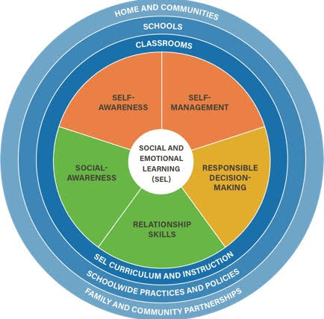
Social & Emotional Learning

Slide 6
Deonte Grimes, Program Director
Friendshouseministries.com

Slide 7
How Can Employers Help Reduce Recidivism, Aid Reentry and Recovery?
Train supervisors and team leaders on recovery so that they understand and recognize the signs of what’s going on
Employ Certified Peer Recovery Specialist
Recovery Meetings in the workplace.
Family Sustaining Wages
Utilize Government incentives for hiring reentry individuals
To have a sustainable workforce:
“to get what you need, you have to give them what they need”

Slide 8
Chad Byers, Community Outreach Specialist

Slide 9
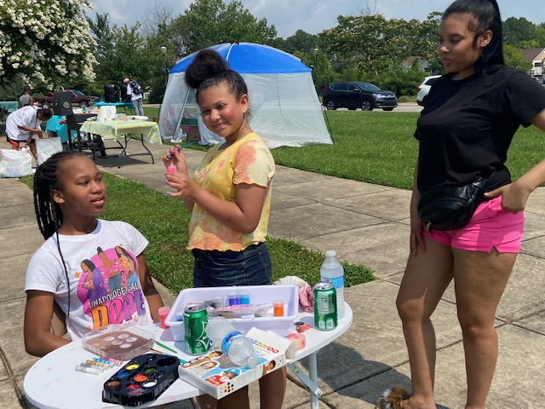
A Story of Reentry
Work Smart Live Well
Above the Rest (Painting Business)
Dad’s Making a Difference
The Community Specialist

Slide 10
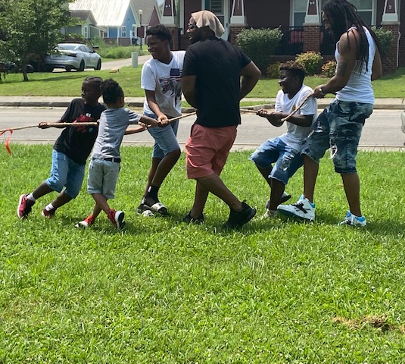
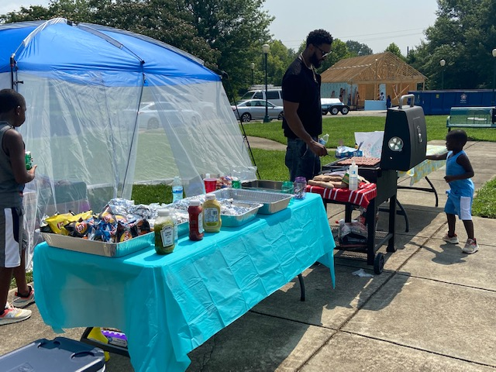
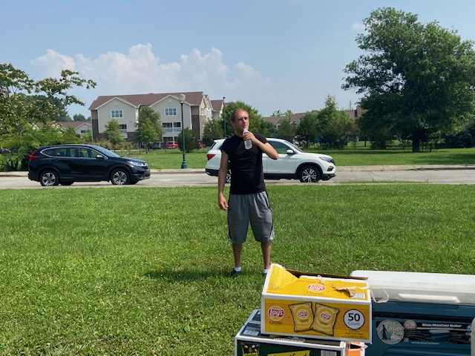
Community Outreach Activities
Bring Families Together
Start New Life for Others

Slide 11
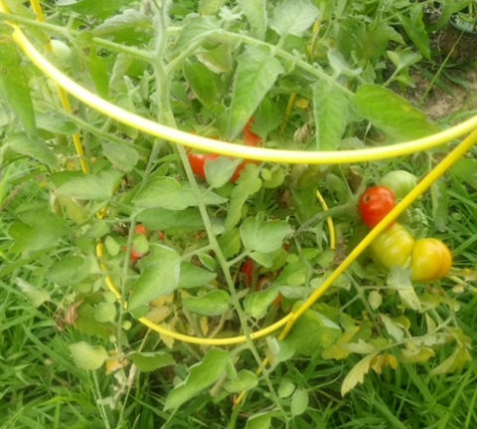
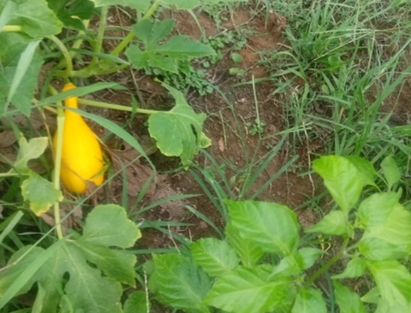
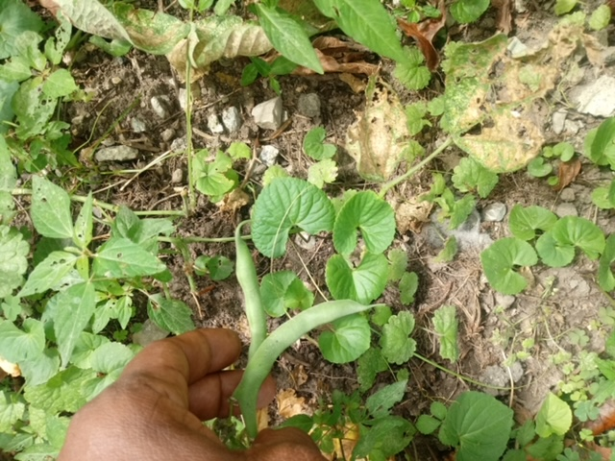
Temperance
How to nurture
Love
Responsibility
Follow through
Consistency
Longevity
How to work together as a team
Entrepreneurship
The Harvest
The Power of Community Gardens

Slide 12
INSPIRINGCHATTANOOGA.COM
Inspire, Network, Strategize, Prepare, Innovate, Relate, Empower
Deborah Gunn, CEO

Slide 13
Meeting People Where They Are: Community Based Job Skills Training

Slide 14
The 80/20 Rule Professional Development Workshop
WILLING TO GO THE EXTRA MILE
FLEXIBLE
SELF THINKER
POSITIVE ATTITUDE
DEPENDABLE
WILLINGNESS TO LISTEN
APPRECIATION
RESPECT FOR MANAGEMENT
TEAM PLAYER
YOU
RESPECT FOR CO-WORKERS
SELF MOTIVATED
TIME FOCUSED
HONESTY
SEEKS SOLUTIONS VS. COMPLAINING
GREAT WORKER
LEADERSHIP

Slide 15
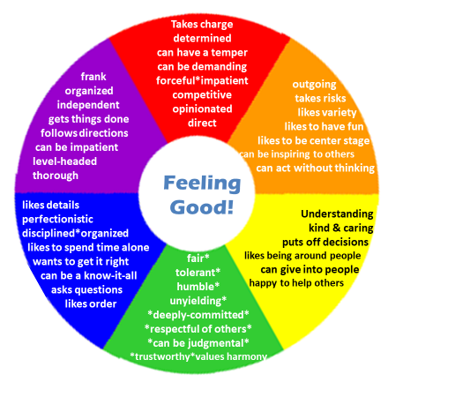
Discovering Your Strengths & Weaknesses
Generational Differences
Diversity, Equity and Inclusion

Slide 18
Co-Founders
Chad Byers
byersc1977@gmail.com
(423) 432-9367
Logan Taylor
ybnormal2016@gmail.com
(704) 993-7170
Home Base Network
Deborah Gunn
deborah@inspiringchattanooga.com
(423) 314-2532
Monty Reeves, Founder
Deonte Grimes, Program Director
deontegrimes43@gmail.com
(423) 355-6544

