Slide 1
Tennessee Pathways and Local Workforce Boards
August 19, 2021

Slide 2
Introductions
Tennessee Pathways
Pamela Sieffert, Program Director, District and Industry Engagement
Amy Profant, Regional Coordinator, Upper Cumberland
Tracy Whitehead, Regional Coordinator, Southern Middle
Upper Cumberland Local Workforce Development Board
Becky Hull, Executive Director
Caroline Timpson, Youth & Special Projects Coordinator
South Central Human Resource Agency
Jennifer Henry, One Stop Operator
Tennessee Department of Education
Pamela Thurman, CTE CORE Consultant, Southern Middle
Notes:
Introduction of presenting team and how we are all connected.

Slide 3
Tennessee Pathways Overview

Slide 4
Objectives
By the end of this session attendees will:
Understand the Tennessee Pathways initiative and how the Tennessee Pathways pillars and theory of action can be implemented to promote partnership, innovation, and investment in your region.
Learn about regional best practices and the design and operation of peer region partnerships.
Gain operational knowledge of regional partnership best practices to implement within your own partnerships.

Slide 5
Tennessee Pathways History
Notes:
Pam will cover a brief overview of Tennessee Pathways history post rebrand, with specific attention to the team across the state.

Slide 6
Notes:
Pam to provide overview of the three Tennessee Pathways pillars, with emphasis on cross sector alignment as being a key collaboration point for the audience.

Slide 7
The Tennessee Pathways Certification
The Tennessee Pathways Certification recognizes schools whose K-12 educational programs meet the three Tennessee Pathways levers for ensuring all students are college and career ready:
High-quality college and career advisement throughout K-12;
Rigorous early postsecondary and work-based learning opportunities in high school;
Seamless vertical alignment between K-12, postsecondary programs, and career opportunities as a result of effective partnerships among school districts, higher education institutions, employers and community organizations.
Notes:
Pam to lead- Quick overview of Certification
Pam will acknowledge that this may be new and foreign to the audience but discuss the importance of their understanding and how the certification undergirds the support we can offer districts, pathways, and partnerships

Slide 8
Our Theory of Action
If…
we set clear expectations for and definitions of high-quality career pathways;
we build the capacity of districts to build pathways and partnerships (e.g. college & industry);
we help districts improve practices without penalty;
Then…
we can measure pathway quality and consistency regionally and statewide;
we can elevate exemplary models and practices and scale those practices through technical assistance;
we can promote continual innovation and investment in career pathways.
Notes:
Pam to lead. Describe how these could easily be translated into “I believe” type of statements. Within the certification and outside of the application window we believe that if we hold our initiative to these expectations and goals, then we can achieve quality opportunities for students while building thriving communities in Tennessee. Point to how the audience, as partners can help us and our districts promote innovation and investment.

Slide 9
What Tennessee Pathways Offers
Technical Assistance
Postsecondary Policy
Pathway Alignment
Partnership Connector
Dual Enrollment Best Practices
Grant Writing
Student Advising Best Practices
Cross-Sector Collaboration
Identifying and overcoming barriers
Data sharing for informed practices
Student Advocacy
Notes:
Pam Discuss how these are the tangible strategies and expertise we offer as a team to achieve our theory of action.

Slide 10
Moving Forward with Partners
Notes:
Pam- Discuss how understanding TN Pathways Pillars, our theory of action, and tangible offerings moves us from the octopus to this circle, involved with so many partners.

Slide 11
Organizational Chart
Executive Branch (Governor)
TBR
Office of Academic Affairs
Tennessee Pathways Regional Coordinators
TDOE
Division of College, Career & Technical Education
State Government
State Agencies
Staff Level
Notes:
Pam- Review make- up of TN Pathways.

Slide 12
Tennessee Pathways Regional Coordinators
Northern Middle
Pathways Regional Coordinator:
Ellen Gomez, ellen.gomez@tbr.edu
Upper Cumberland
Pathways Regional Coordinator:
Amy Profant, amy.profant@tbr.edu
Northeast
Pathways Regional Coordinator:
Mary Beth Oxendine-Woodby, mary.oxendine-woodby@tbr.edu
Northwest
Pathways Regional Coordinator:
Justin Crice, justin.crice@tbr.edu
East
Pathways Regional Coordinator:
Danny Satterfield, danny.satterfield@tbr.edu
Greater Memphis
Pathways Regional Coordinator:
Kenderek Harris Kenderek.harris@tbr.edu
Southwest
Pathways Regional Coordinator:
Lori Burdine lori.burdine@tbr.edu
Southern Middle
Pathways Regional Coordinator:
Tracy Whitehead, tracy.whitehead@tbr.edu
Southeast
Pathways Regional Coordinator:
Cydnie Tate, cydnie.tate@tbr.edu
Notes:
Pam

Slide 13
Tennessee Pathways Certification Participation
Tennessee Pathways Data Dashboard
https://www.tbr.edu/tennessee-pathways
Notes:
Pam
Point out the Certification as the data source and only participating districts and their partners being included

Slide 14
Upper Cumberland

Slide 15
Upper Cumberland
Partnership Best Practices:
Connection: getting the right people in the right place
Youth Committee/Executive Committee Participation= TN Pathways Regional Coordinator acts as Chair of Youth Committee
Committee members include school counselors, CTE Directors, WBL coordinators, business/industry partners, non-profits
Collaboration: projects that benefit both in- and out-of-school youth
Youth services flyer
Virtual job fair
Resource dashboard
Youth Listening Tours
Communication: members report back to their district stakeholders

Slide 16
Youth Services Flyer Winner

Slide 17
Upper Cumberland
Labor Perspective:
Connection:
Middle TN Regional Partners
Upper Cumberland employers
American Job Center partners
Upper Cumberland Local Workforce Development Board
Business Services
Highlands Economic Partnership
Collaboration:
A focus on pathways in all programs
Adults
Dislocated Worker
Youth
Communication:
Middle TN Regional Plan
Upper Cumberland Local Plan
Board Reports
Pathways Coordinator

Slide 18
Southern Middle

Slide 19
Southern Middle
Partnership Best Practices:
Connection: the Why
WIOA In-School Youth program = assists districts with access and equity goals
Collaboration: the logistics
minimum 8-week (less than 40 hour per week) schedule
Communication: language barriers
WIOA eligibility can easily get confused with education’s Title 1

Slide 20
Southern Middle
District Engagement Projects:
Giles County Pilot
Lewis County Partnership
Coffee County Perkins Reserve Grant

Slide 21
Southern Middle
Background/Operations
South Central Human Resource Agency (SCHRA) as CSP for Adult, DW, and Youth
Career Advisors (CA’s) are in each of our 13 counties inside the American Job Centers
Students must meet Title I eligibility
Paid Work Experience is offered for ISY up to 400 hours, students are also eligible for incentives for Work Readiness Completion, Work Experience Completion, Grades, Attendance, and HS Completion. After graduation, their eligibility continues with Postsecondary assistance.
Connection/Collaboration/Communication:
Our Pathways Team, Tracy Whitehead and Pamela Thurman, were instrumental in connecting with local high schools Work Based Learning Teachers to offer services in the high school. Some schools won’t let just anyone in.
Held parent/student meetings at high schools, CA’s visited classrooms to present program, shared flyer with students with CA’s contact info. Worksites were already pre-determined in some cases where the student was working a non-paid WBL job. Worksites in the community were proud to host these students.

Slide 22
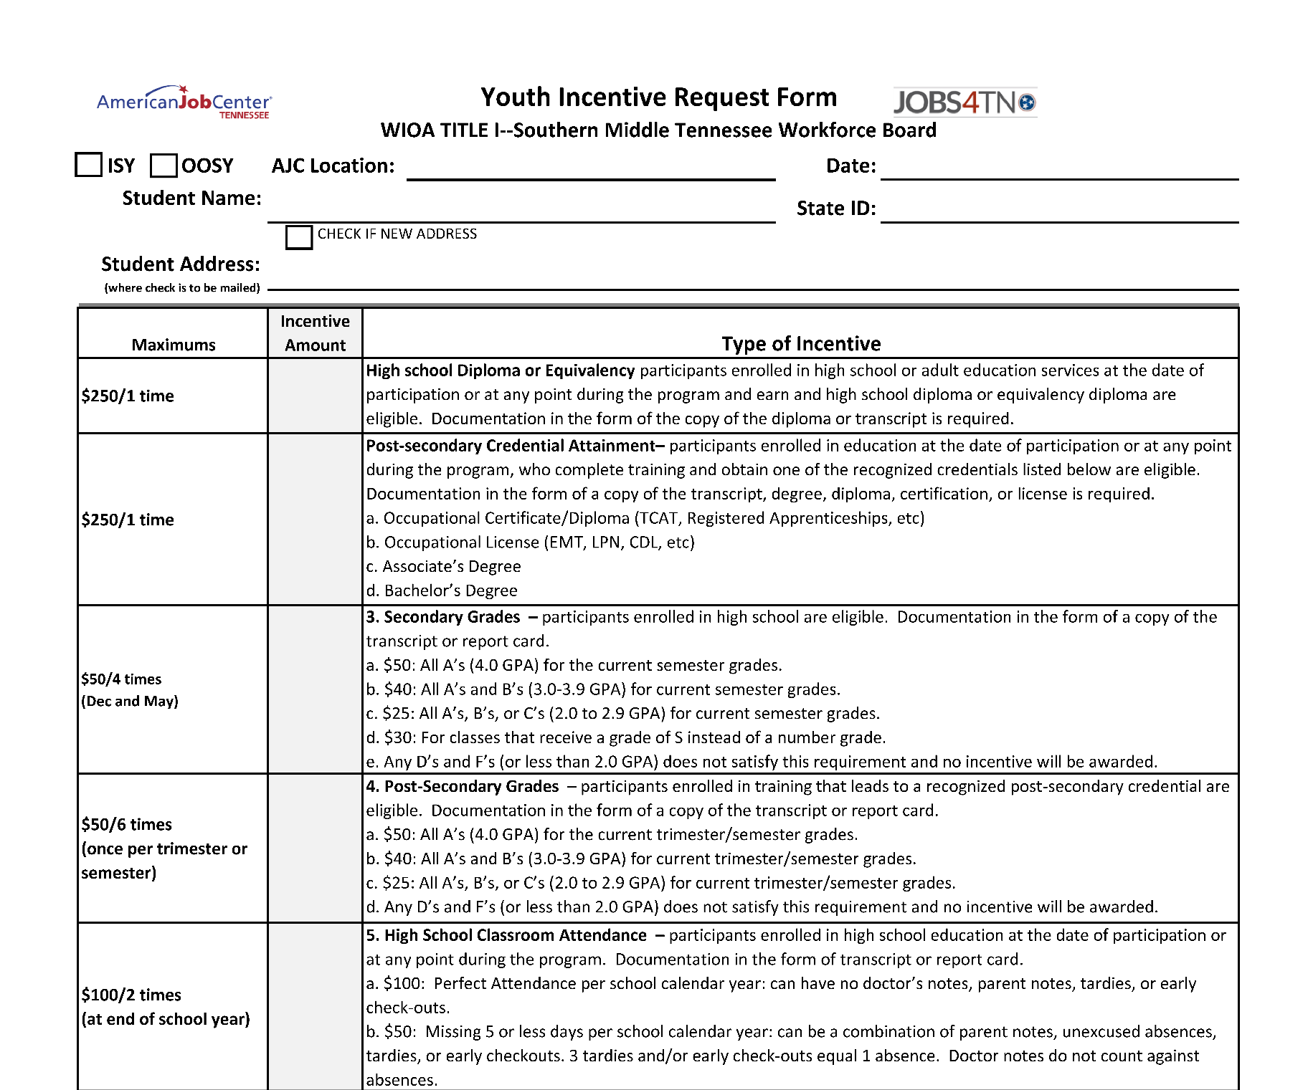
Youth Incentive Request Form

Slide 23
Southern Middle
Success Stories
Giles County Animal Shelter: after completing the 400 hours of WEX Katelynn was hired.
Johnson’s Food Town: after completing the 400 hours of WEX Peyton was hired.
Dezirae has learning disabilities and worked to save money to continue her education after graduating in May 2021. She begins the Industrial Maintenance program at TCAT on September 1st and will receive Title I assistance.
Quentin has intellectual disabilities his goal was to learn work readiness skills. After graduating in May 2020, he continued improving his work skills at McDonald’s, and currently works for Frito Lay.
Timothy rode his bike 7 miles to his WEX location, David Crocket State Park. He started his own business during the Covid shutdown to deliver food from restaurants and Walmart to local customers…on his bike. After moving to Texas for 6 months, he has returned opening his own business “Mystical Sloth”. He is doing well and still rides his bike!!
2021-22 Stats
Served over 70 participants
Expended over $70,000 total on wages alone

Slide 25
Contact Information
Pamela Sieffert
Amy Profant
Tracy Whitehead
Becky Hull
Caroline Timpson
Jennifer Henry
Pamela Thurman
Pamela.Sieffert@TBR.edu
Amy.Profant@TBR.edu
Tracy.Whitehead@TBR.edu
BHull@UCworkforce.org
CTimpson@UCworkforce.org
JHenry@schra.us
Pam.Thurman@TN.gov
Notes:
Introduction of presenting team and how we are all connected.

