Slide 1


2021 TOSHA
Employer Resources

Slide 2
Disclaimer
This presentation is intended as general information only and does not carry the force of legal opinion.
The Department of Labor is providing this information as a public service. This information and related materials are presented to give the public access to information on Department of Labor programs. You should be aware that, while we try to keep the information timely and accurate, there will often be a delay between official publications of the materials and the modification of these pages. Therefore, we make no express or implied guarantees. The Federal Register and the Code of Federal Regulations remain the official source for regulatory information published by the Department of Labor. We will make every effort to keep this information current and to correct errors brought to our attention.
Notes:
Please note that this presentation is intended as general information only and does not carry the force of legal opinion. Next slide.

Slide 3

Tennessee Occupational Safety and Health Administration (TOSHA)
OSHA’s Mission
With the Occupational Safety and Health Act of 1970, Congress created the Occupational Safety and Health Administration (OSHA) to ensure safe and healthful working conditions for workers by setting and enforcing standards and by providing training, outreach, education and assistance.
Act of Congress
OSH ACT
of 1970
Notes:
OSH ACT
Worker safety in the United States is enforced by OSHA, year 2020 marked 50th year of existence.
TOSH Act 1972 – TOSHA assumed responsibilities in 1972, Public Sector in 1974, and final approval in 1985
OSHA/TOSHA’s mission has always been focuses on worker safety and health. Our common goal is that every worker goes home safe and healthy at the end of each day.
Test Question:
22. OSHA must issue a citation within ___ of the occurrence of the violation: (TLO 5)
Three months
Six months
Twelve months
Five years
23. Citations are signed by the OSHA Area Director but they are not effective until they become a final order of: (TLO 5)
The Assistant Secretary for OSHA
The Occupational Safety and Health Review Commission
The Solicitor of Labor
The Secretary of Labor

Slide 4
Overview and History of TOSHA
TOSHA stands for the Tennessee Occupational Safety and Health Administration, an agency of the Department of Labor & Workforce Development
TOSHA’s responsibility is to improve worker safety and health protection (State Plan)
TOSH Act 1972 – TOSHA assumed responsibilities in 1972, Public Sector in1974, and final approval in 1985
TOSHA is audited by Federal OSHA – FAME, Strategic Plan, quarter reports – (timely public service reports to Commissioner & Governor)
Notes:
HOW OSHA IS ORGANIZED
OSHA also has 10 Regional Offices, which are located throughout the United States.
Each of these 10 regional geographic regions, which cover several states and contain multiple area offices.
Test Question:
22. OSHA must issue a citation within ___ of the occurrence of the violation: (TLO 5)
Three months
Six months
Twelve months
Five years
23. Citations are signed by the OSHA Area Director but they are not effective until they become a final order of: (TLO 5)
The Assistant Secretary for OSHA
The Occupational Safety and Health Review Commission
The Solicitor of Labor
The Secretary of Labor

Slide 5
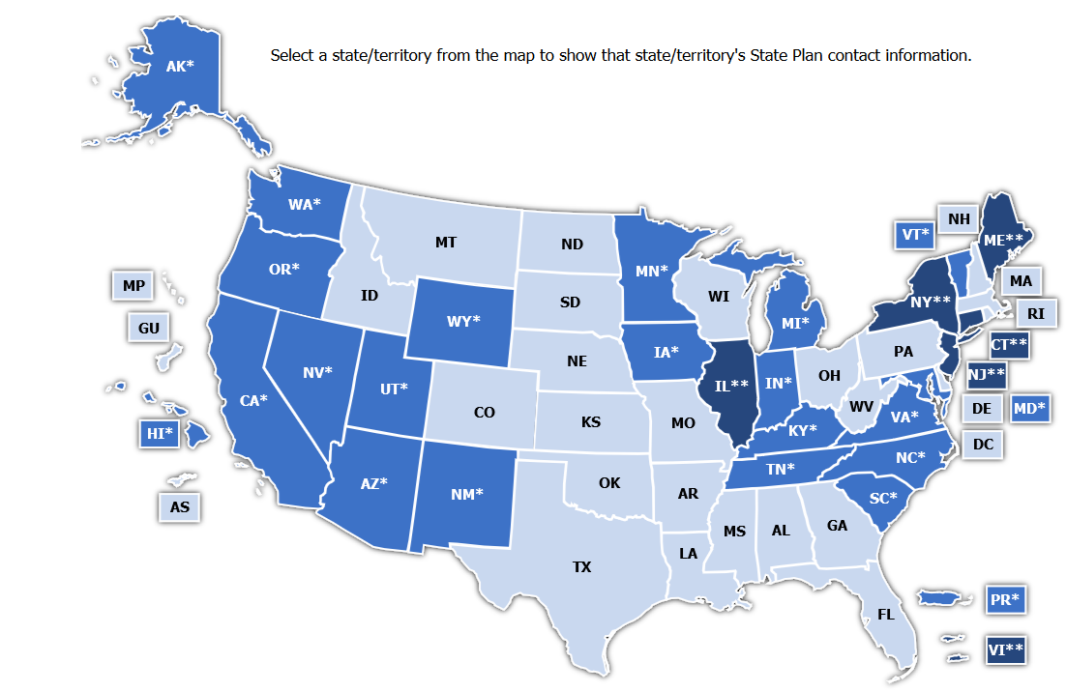

OSHA State Plans
Notes:
OSHA State Plans
*Blue = State Plans
**Dark Blue = State Plans cover state/local government employees only
Light Blue = Federal OSHA states
State Plans are OSHA-approved workplace safety and health programs operated by individual states or U.S. territories.
There are currently 22 State Plans covering both private sector and state and local government workers, and there are six State Plans covering only state and local government workers.
State Plans are monitored by OSHA and must be at least as effective as OSHA in protecting workers and in preventing work-related injuries, illnesses and deaths.
Test Question:
22. OSHA must issue a citation within ___ of the occurrence of the violation: (TLO 5)
Three months
Six months
Twelve months
Five years
23. Citations are signed by the OSHA Area Director but they are not effective until they become a final order of: (TLO 5)
The Assistant Secretary for OSHA
The Occupational Safety and Health Review Commission
The Solicitor of Labor
The Secretary of Labor

Slide 6
TOSHA’s Mission
The Mission of TOSHA is to assure safe and healthy working conditions for working Tennesseans.
Carrying out the Mission:
  Enforcing Safety and Health Standards
  Providing outreach training programs
  Resources and partnership for employers
OSHA Standards 29 CFR
General Industry* - 1910
Construction - 1926
Agriculture – 1928 - >10 EEs
*General Industry is the set that applies to the largest number of workers and worksites
What are Standards :
  Rules that employers must use to protect employees from hazards
  Designed to protect workers
*Where there are no specific standards, employers must comply with the General Duty Clause of the TOSHA Act.
Notes:
Carry out the Mission:
Enforcing safety and health standards (regulations) through worksite inspections – compliance & consultation
Providing outreach training programs to increase knowledge about occupational safety and health
What are Standards:
A standard (or regulation) is a regulatory requirement established and published by the agency to serve as criteria for measuring whether employers are in compliance with the OSH Act laws.
OSHA standards are published in Title 29 of the Code of Federal Regulations (CFR) and are divided into separate standards for General Industry, Construction, and Maritime.
Test Question:
22. OSHA must issue a citation within ___ of the occurrence of the violation: (TLO 5)
Three months
Six months
Twelve months
Five years
23. Citations are signed by the OSHA Area Director but they are not effective until they become a final order of: (TLO 5)
The Assistant Secretary for OSHA
The Occupational Safety and Health Review Commission
The Solicitor of Labor
The Secretary of Labor

Slide 7
Employer Resources – Outreach Training
Outreach Training Program’s purpose is to promote workplace safety and health and to make workers more knowledgeable about workplace hazards. The Program provides education on the recognition, avoidance, abatement, and prevention of workplace hazards.
TOSHA offers Outreach Training throughout the state in conjunction with our training partners. (Chamber of Commerce, Community Colleges, Membership Associations, etc.)
Standards based seminars (schedule posted on website)
Publish Newsletter (3 editions per year; Jan, May, Sept)
Notes:
Employers are responsible for providing additional training for their workers on the specific hazards of their job
Protecting workers means not only complying with regulations. Workers also have a legal right to raise safety and health concerns on the job without fear of retaliation.

Slide 8

TOSHA Consultation
The Onsite Consultation Program’s resources are available at no direct cost and include:
Primarily assists smaller and medium sized employers
Onsite and offsite surveys for hazard recognition and program review
Provide abatement assistance
Informal onsite training in hazard recognition
Help employers develop an effective safety and health program
Identify ways to reduce costs and injuries
Provide industrial hygiene sampling
TOSHA’s SHARP (Safety and Health Achievement and Recognition Program) award
Notes:
WORKER RIGHTS
Among other protections, workers have the right to —
report unsafe working conditions to their managers and to OSHA;
assist in an OSHA investigation; and
request Personal Protective Equipment (PPE) and training to make sure that they can do their jobs without exposure to hazards that can cause injury or illness.

Slide 9
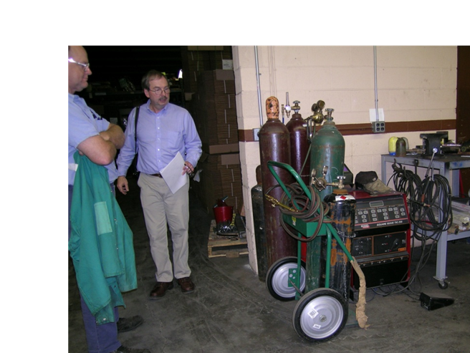
Key Features of Consultation
Why use TOSHA Consultation?
  No fees for services – taxpayer funded
  Does not issue citations or penalties
  Is confidential and separate from TOSHA Enforcement
  Provides written reports of findings
  Employer agrees to correct/abate hazards
  Identify injury/illness trends and reduce costs
Notes:
TN covers one statutes: TOSH Act; can’t discriminate against any protected activity in the act
FED OSHA cover 22 statutes: Commercial Motor Vehicle, Federal Railroad Safety Act, Safe Drinking Water Act, etc. Even in TN
WHISTLEBLOWER PROTECTIONS
It is against the law for employers to discipline or suspend their workers for reporting injuries or exercising other rights—and OSHA enforces this law.

Slide 10
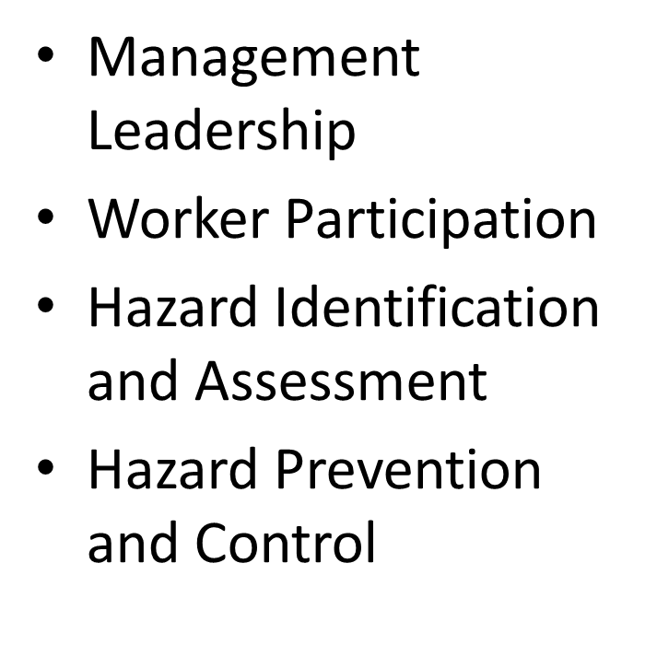
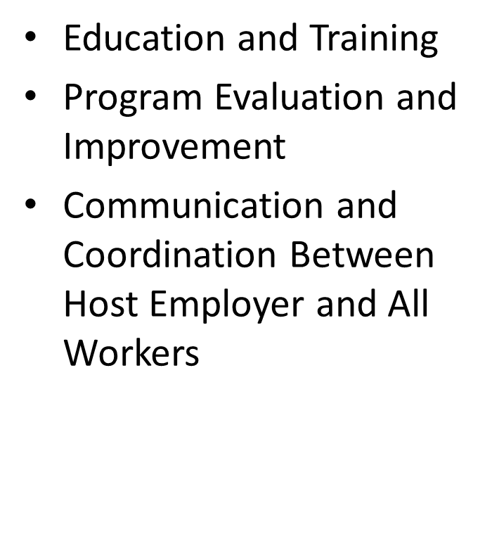
Overall Safety and Health Program
Notes:
Retaliation
occurs when an employer (through a manager, supervisor, or administrator) fires an employee or takes any other type of adverse action against an employee for engaging in protected activity
Reassignment to a less desirable position or actions affecting prospects for promotion (such as excluding an employee from training meetings)
Blacklisting (intentionally interfering with an employee’s ability to obtain future employment)
Participated in protected activity
Effect's ability to do their job

Slide 11
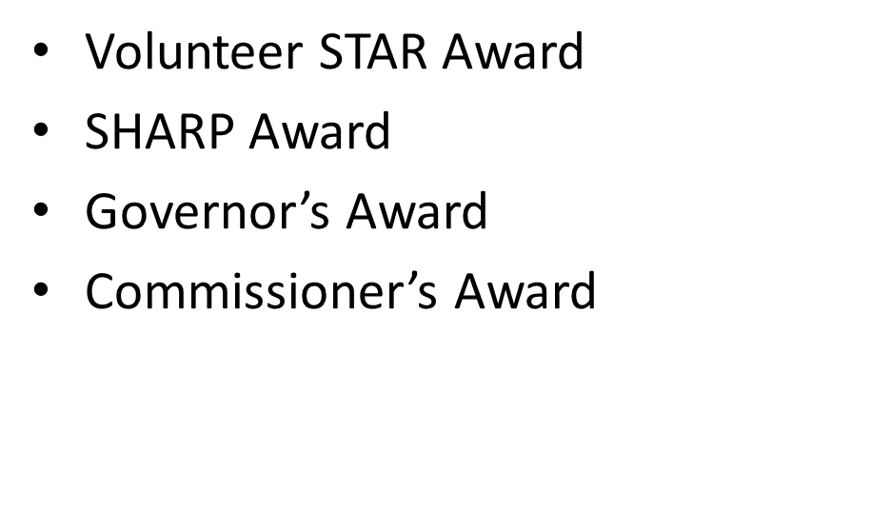


TOSHA Recognition Programs

Slide 12
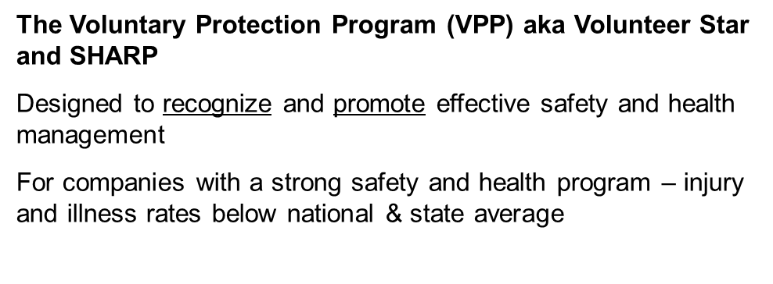
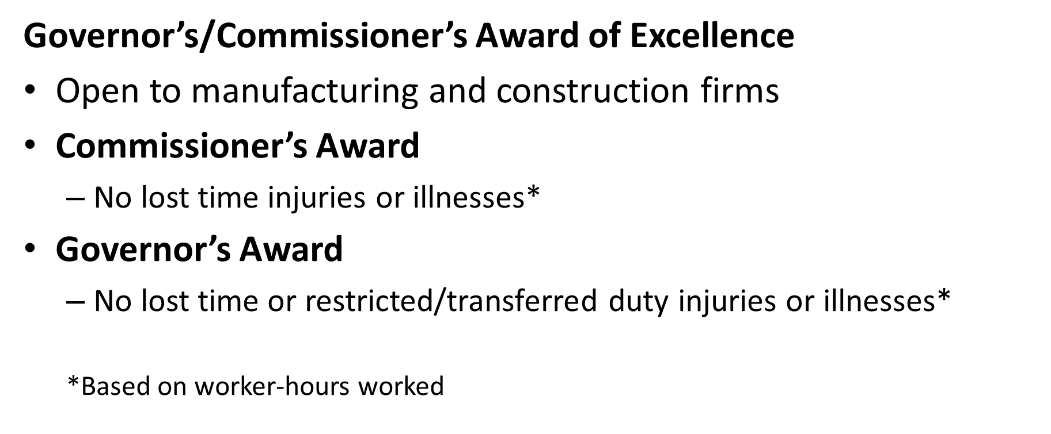
Recognition Programs

Slide 13
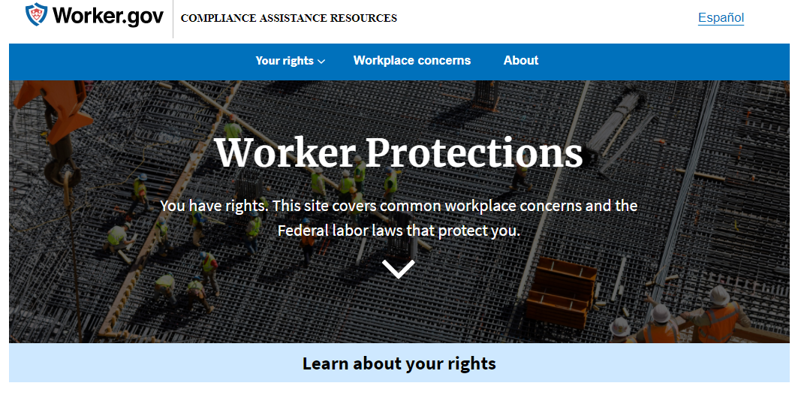
Online Resources
TN Occupational Safety and Health Administration
Occupational Safety and Health Administration
OSHA Regulations
Workers' Rights Booklet (English & Spanish)
The Whistleblower Protection Program
Coronavirus Disease (COVID-19)
Center for Disease Control and Prevention (CDC)
Worker.gov
Employer.gov
Notes:
OSHA also has a wide variety of web resources to help employers and workers understand their rights and responsibilities.
These include compliance assistance tools, training resources, information on cooperative resources, required forms, and ways to contact the agency with any questions or concerns.
In addition to resources available on our individual WHD and OSHA websites, DOL has created worker.gov and employer.gov which provide direct access to department-wide resources for the respective audiences in one place. Both pages are now available in both English and Spanish.
Worker.gov: This site covers common workplace concerns and the Federal labor laws that protect you. (The right to be paid properly, to a safe and healthy workplace, to be treated equally, to join with coworkers, to be treated fairly as a veteran or service member, and more).
Employer.gov: Resources for Employers. You may have questions about your role as an employer. This site provides answers to common questions about workers and business.

Slide 14
Online Resources
Subscribe to the TOSHA Newsletter
TN Workplace Required Posters
Employers are required by law to share information with their employees on employment laws and provide other work-related information. They should be posted in a prominent place where employees have access such as a break room or time-clock area.
TOSHA Consultative Services
Contact at (800) 325-9901
Email: Tosha.Consultation@tn.gov
TN Safety & Health Conference
CY 2022 Dates TBD
Opryland Hotel and Convention Center, Nashville, TN

Slide 15
Contact Us and Thank You
TOSHA
Visit www.tnosha.gov
Call our toll-free information and helpline
at (800) 249-8510
OSHA
Visit www.osha.gov
Call our toll-free information and helpline
at 1-800-321-6742 (1-800-321-OSHA)
Notes:
Though many of you are probably already in touch with your local contacts, I encourage you to contact us if you need any additional assistance.
At this point, we will begin to address some of the questions you all have submitted.

