Slide 1
Apprenticeships & Pre-Apprenticeships
Charlene Russell
Holly Free-Ollard
Jessica Barnett
Freda Herndon

Slide 2
What is An Apprenticeship?
Apprenticeship is a flexible and proven development strategy that can help grow talent at your company.
Notes:
Holly – Slide 3: Progress to Date (1 minute 30 seconds)
6991 Registered Apprentices and 622 completers as of July 22nd

Slide 3
What are the Components of Apprenticeship?
Employer Involvement
Structured
On-the-Job Learning (OJL)
Related Technical/ Training and Instruction (RTI)
Rewards for Skill Gains
National Occupational Credential
Five Components of Apprenticeship

Slide 4
On-the-Job Learning & Related Technical Instruction
On-The-Job Learning OJL | Related Technical Instruction (RTI) minimum | Approximate Time (Yrs)
2000 Hours | 144 Hours or More | = 1 Year
4000 Hours | 288 Hours or More | = 2 Years
6000 Hours | 432 Hours or More | = 3 Years
8000 Hours | 576 Hours or More | = 4 Years

Slide 5
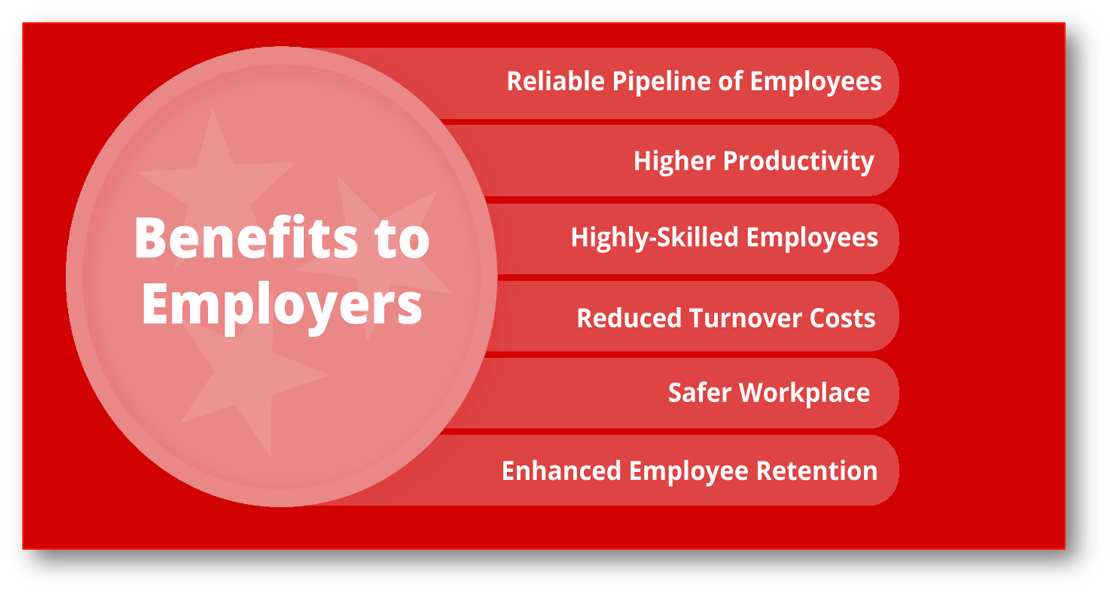
What are the Benefits?
Notes:
Matt – Slide 4: Progress to Date (1 minute)
Enrollment in WBL courses statewide has increased by 1,856, a 9.78% increase already
By the end of the 2020-21 school year, every student enrolled earned at least one WBL Credit
TDOE has awarded over 300 certificates for new WBL teachers in the 2020-21 school year, positioning schools to meet our goal of a 50% increase in enrollment by June 2023.

Slide 6
Three Responsibilities of RAPs
Sponsor
Registers apprentices in RAPIDS 2.0
Documents OJL & RTI hours
Employer
Hires apprentices
Assumes cost of training
Training Provider
Provides required RTI
Pays apprentices according to a structured wage progressions scale
Provides required OJL
An employer may assume all three responsibilities or partner with other organizations who may serve as the sponsor and/or training provider.

Slide 7
How Apprenticeship and Pre-Apprenticeship Work Together

Slide 8
WIOA Youth Program Serves
In-School Youth must be:
14 – 21 years of age
Attending secondary or post-secondary school
Low-income
Out-of-School Youth must be:
16 – 24 years of age
Not attending secondary or post- secondary school
(*OSY must also be low-income for these barriers)
And one or more of the following:
Basic skills deficient*
An English language learner*
An offender (any touch point with the justice system)
Homeless
Individual in foster care or aged out of foster care, or a runaway
Pregnant or parenting
Individual with a disability
A school dropout
Within age of compulsory school attendance, but has not attended for at least the most recent complete school year
Requires additional assistance to complete an educational program or to secure or hold employment*

Slide 9
WIOA Youth Program Offers
Tutoring
Alternative Secondary School services
Paid and unpaid work experience
Occupational Skills Training
Education offered concurrently with workforce preparation
Leadership development opportunities
Postsecondary preparation and transition activities
Adult mentoring
Supportive services
Comprehensive guidance and counseling
Financial literacy education
Entrepreneurial skills training
Services that provide labor market information
Follow-up services

Slide 10
Supportive Services
Enable youth to participate in WIOA activities
Wrap around services to assist with:
Transportation
Child care/dependent care
Housing
Needs-related payments
Educational testing
Reasonable accommodations for youth with disabilities
Legal aid services
Uniforms or other appropriate work attire
Books, fees, school supplies, etc.

Slide 11
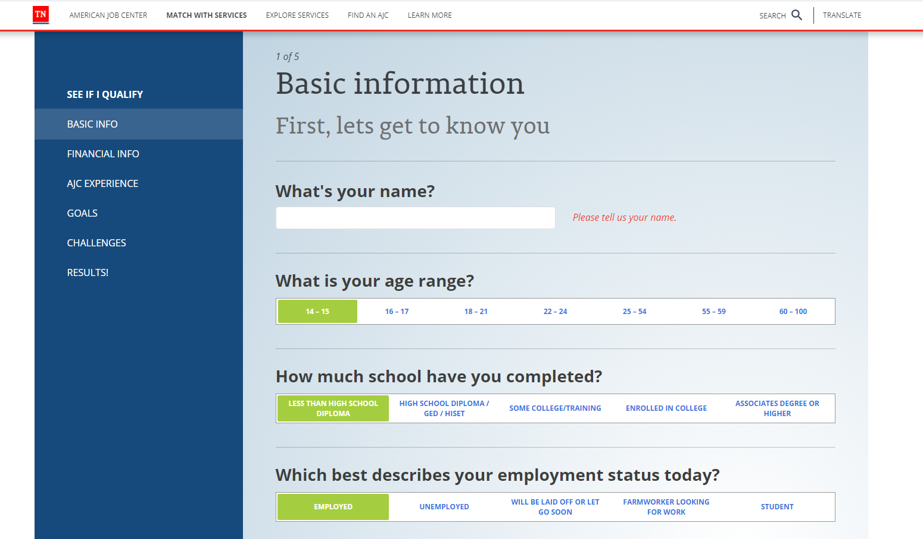
Virtual American Jobs Center
The Virtual American Job Center provides an online service match to determine service eligibility.
Access www.tnvirtualajc.com and then click “Match with Services.”
Notes:
Carla

Slide 12
Apprenticeship Funding Sources
Apprenticeship State Expansion Grant (ASE)
Grant funds provided for each workforce area. This funding stream does not require WIOA eligibility for apprentices. Amount is $593.75 per apprentice. Check with local workforce area for availability
Incumbent Worker Training Grant
IWT Grant funds can be allocated by the local board to support apprenticeships. The local board determines parameters, and limits. If using this funding stream, IWT guidelines apply. For example, at least 50% of the cohort must be incumbent workers with more than six months employment with the apprenticeship employer.
Other Grants
The local workforce board may apply for and receive additional grants to support apprenticeship training. The local board determines parameters limits.

Slide 13
Apprenticeship Applications and Contracts
EMPLOYER APPLICATION
The employer should complete the short “pre-application” on the JOBS4TN website to indicate they are applying for funding. https://www.tn.gov/workforce/employers/training-redirect/grants-for-training.html
Once board staff confirms the apprenticeship is federally registered, the local board employer application is emailed to employer.
After application is reviewed, a contract is written and signed by the employer and the board and outlines the financial agreement.
EMPLOYEE APPRENTICESHIP APPLICATION(S)
An Apprenticeship Signing Day can be planned to obtain complete paperwork and review documents for completeness.
Employee apprentices need to complete the following documents:
Local Board Apprentice Application
USDOL Apprenticeship application (to be shared with sponsor)
TDLWD Individual Apprenticeship Form

Slide 14
Employer, Training Provider, and Sponsor Information Needed
Documents Needed from Employer
Completed and Signed Employer Application
Information Needed from Training Provider
Program Costs (Tuition, Books, Supplies)
Information Needed from Sponsor
RAPIDS Number for Individual Apprentices
W-9 (For Accounting)
Completed and Signed Employee applications
Signed contract
Trainer Salary, Books and Supplies if using Internal Training Model
Program Start Date and Projected End Date
Copy of USDOL Apprenticeship Form

Slide 15
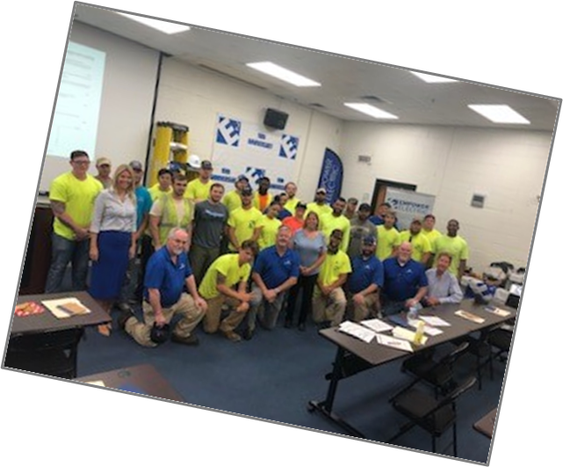
Local boards are key to providing support for Apprenticeships through employer engagement
Develop professional relationships with
strategic partners in Apprenticeship
Regional Apprenticeship Director
Employers
Training Providers
Counterparts in other Workforce Areas
Track data and report to Board.
Respond in a timely manner to apprenticeship inquiries.
Make the paperwork process as easy as possible for the employer and training provider.
Celebrate Signing Days and promote/market these events.
Develop forms and documents before needed. Adjust them as you learn about new requirements or processes from TDLWD. These are fluid documents.
Continue to learn about trends in apprenticeship development.
Learn how to complete the data entry at all levels, even if you will have assistance with this process.
Complete state apprenticeship reporting form quarterly.
Educate other board staff about the Apprenticeship process. Share your best practices.

Slide 16
What Do We Do?
Outreach – Outreach – Outreach
Consultation with employers on program design
Development of documentation / registration paperwork to hand off to US DOL
Work with US DOL on employer's behalf
Provide technical assistance to program sponsors/employers

Slide 17
ApprenticeshipTN Website:
www.ApprenticeshipTN.com
Find a program
Pre-Apprenticeship Policy location

Slide 18
Lynn Kirby
Apprenticeship Grants Programs Manager
Lynn.Kirby@tn.gov
o. (615)532-0148 c. (615)330-1631
Shalondria Shaw
West TN Regional Apprenticeship Director
Shalondria.Shaw@tn.gov
Charlene Sands Russell
Middle TN Regional Apprenticeship Director
Charlene. Russell@tn.gov
(931) 303-7638
Jessica Barnett
State Apprenticeship Assistant Director
Jessica.L.Barnett@tn.gov
(423) 408-0128
Holly Free-Ollard
State Apprenticeship Director/
East TN Regional Director
Holly.Free-Ollard@tn.gov
(865)973-8157

Slide 19
Questions

Slide 20
THANK YOU

