Slide 1
Virtual Access Points
Increasing Awareness of Virtual Pathways
Teresa Smith | 4-23-2021

Slide 2
Virtual Access Points
Purpose:
To bring awareness to each local workforce area regarding Virtual Access Points and start-to-finish virtual services for all WIOA partner participants
Start Date: Public Awareness Campaign Begins – September 2021

Slide 3
Virtual Access Points
Virtual Access Awareness Campaign
Public Service Announcements
social media, paper, radio, VAJC tagline, tn.gov/workforce
Calendar
LWDA Board Calendar
Calendar updated by local boards
Madison.Bumpus@tn.gov managing calendar
Shareable with state staff, required partners, and local boards
Notes:
Go through each objective

Slide 4
TN American Job Center Virtual Pathways
Virtual AJC Service Pathway via AE Locations
Virtual AE Service Pathway via AJC Locations
Virtual Voc Rehab Service Pathway via AJC and AE Locations
Voc Rehab Locations will be identified as part of Phase 2
Library Locations for AE, AJC, Voc Rehab Services Pathway are in Phase 2

Slide 5
TN Adult Education Virtual Pathway
All 95 counties have a virtual pathway available
From start to finish, a student can participate in our programs virtually
virtual enrollment and orientation
virtual pre-testing (TABE and CASAS)
virtual referrals/transitions co-enrollment/dual enrollment
virtual classroom
virtual post-testing (TABE and CASAS)
virtual OPT and virtual HiSET
This fully virtual student pathway is a permeant part of our service model

Slide 6
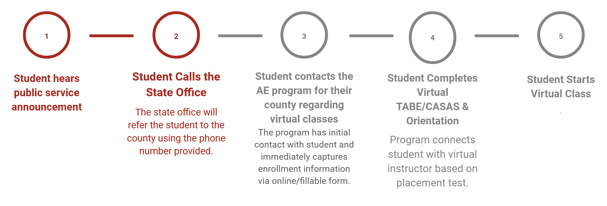
TN Adult Education Virtual Pathway
Virtual Pathway Student Process
Notes:
Go through each objective

Slide 7
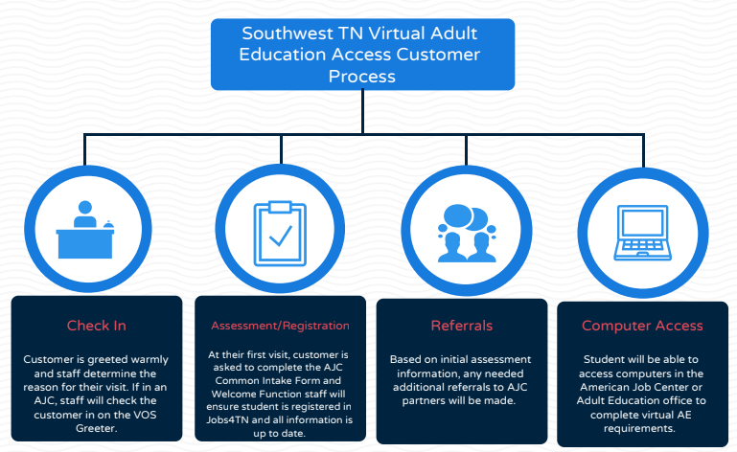

Slide 8
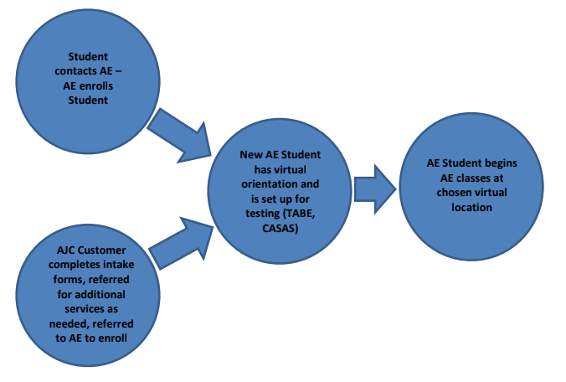

Slide 9
Action Steps
LWDA’s have identified locations for AE and AJC’s that are ready for September rollout & have identified those that will need additional TA
Determine how to show locations
interactive map
track & share identified locations with address & phone
Notes:
Go through each objective

Slide 10
Virtual Access Points
Phase 1: All American Job Center Locations
Adult Education Locations
Phase 2: Vocational Rehabilitation
Libraries
Probation & Parole
UT Extension Offices
Notes:
Go through each objective

Slide 11
MOU Statement
Example MOU Statement:
The LWDB, in collaboration with American Job Centers, Adult Education, and Vocational Rehabilitation, will be providing a process for virtual access for all participants to access services start-to-finish via virtual platforms.
Notes:
Go through each objective

Slide 12
Team Training Needed
WFS Regional Directors
OSO
Team Leads
Executive Directors
Case Managers
AE Program Directors
AE Instructors & Career Coaches
AE Student Coordinators
Notes:
Go through each objective

Slide 13
Plan Considerations
For the plan ------ Identify all AE, VR, and AJC locations
all computers or identified stations
reserved or at will
Consider High traffic areas-----how to---- think through the potential increase in usage
Process flow
Times when center is open and computers available
Notes:
Go through each objective

Slide 14
Notes:
Go through each objective

