Slide 1
TENNESSEE DEPARTMENT OF
HUMAN
SERVICES
TANF Opportunity
Act Overview
August 19, 2021 | 2021 Refocus TN Workforce Convening
Notes:
Title Page Template

Slide 2
OVERVIEW
The American Public Safety Net
The Flaws of Design and Operation
The Tennessee Vision
The TANF Opportunity Act
The Role of the TN Workforce System
DEPEDENCY

Slide 3
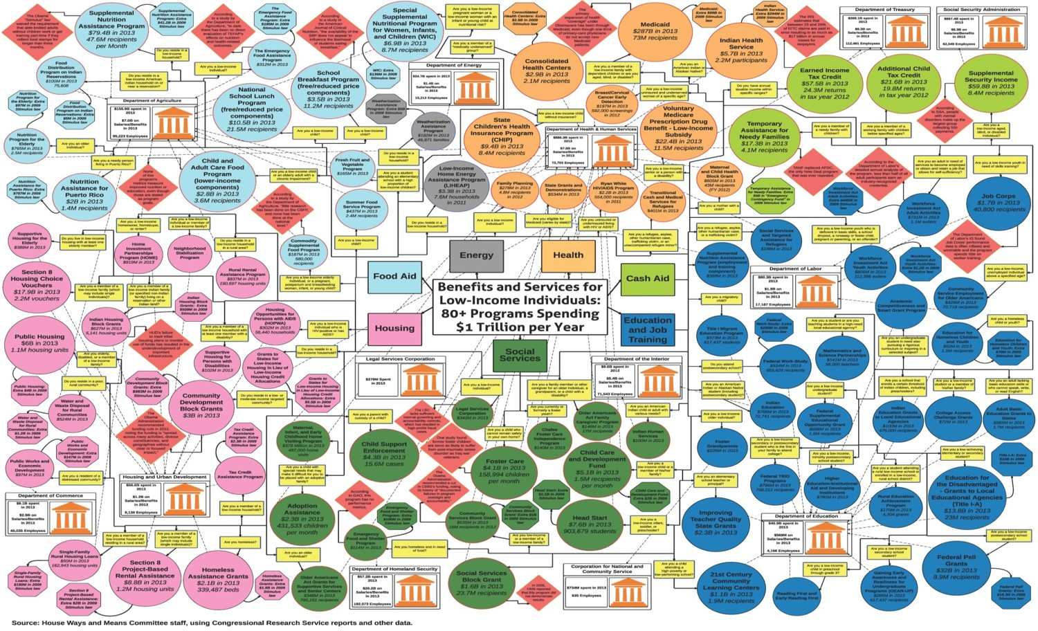
Federal Programs

Slide 4
The flaws of the Public Safety Net
Lack of a shared
Notes:
Blue Blank Template

Slide 5
The flaws of the Public Safety Net
Program-centric
Person-centric

Slide 6
The flaws of the Public Safety Net
Transactional
Relational
Notes:
Blue Blank Template

Slide 7
The flaws of the Public Safety Net
Cohesive & Coordinated
Siloed
Notes:
Blue Blank Template

Slide 8
The flaws of the Public Safety Net
Measuring Outputs
Outcomes
Notes:
Blue Blank Template

Slide 9
The flaws of the Public Safety Net
Government
Notes:
Blue Blank Template

Slide 10
Tennessee’s Vision for Redesigning the Safety Net
DEPENDENCY
The safety net should be a mile-marker in life’s journey, not a destination unto itself.
Our shared vision is to grow capacity to reduce dependency.
CAPACITY
Notes:
Blue Blank Template

Slide 11
Re-defining
Success
Most metrics for measuring poverty either capture a Snapshot or population-level data (poverty rate, unemployment, etc.)
We are developing a framework for moving through and out of poverty and beyond dependency
At beginning of the pilots, we will aggregate the cohort’s dependency
Notes:
Blue Blank Template

Slide 12
TANF
Temporary
Assistance
for Needy
Families
Goals: The purpose of TANF is to reduce intergenerational dependency on public benefits by increasing self-sufficiency, education, and economic mobility of families with children.
The four federal goals of TANF are to:
Provide assistance to needy families with children so that they can live in their own homes or the homes of relatives;
End dependence of needy parents on government benefits through work, job preparation, and marriage;
Reduce out of wedlock pregnancies; and
Encourage the formation and maintenance of two-parent families.

Slide 13
Community Grants
Community grants aim to make stronger partnerships within communities to serve low-income families.
Programs and services are aligned with the Department’s mission and meets one of the four TANF goals.
Partners are well established within the communities and offer a uniqueness to addressing their community’s specific needs.
Grants are reimbursable.
Notes:
Blue Blank Template

Slide 14
Program In Action
Notes:
Video needs to be embedded on this slide.

Slide 15
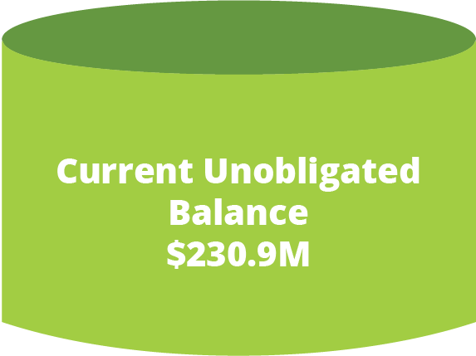
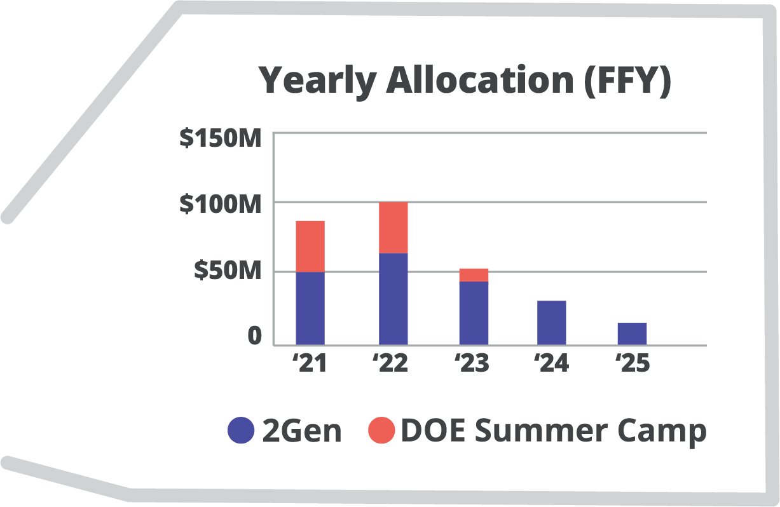
TANF
Reserve Obligations
Total Reserve
$710.4M
*The TANF Opportunity Act will obligate these funds
*
Current
Obligations
= $479.5M
As of December 2020
Notes:
Blue Blank Template

Slide 16
TANF
Opportunity
Act
Program
Partners
The procurement of third-party vendors to provide technical assistance, research and program evaluation, and other needed supportive services for the Tennessee Opportunity Act (TOA).
Advisory Board
The establishment and ongoing convening of the Families First Community Advisory Board.
Planning
Grants
The creation and administration of Planning Grants, which will prepare communities to submit proposals to be selected for the TN Opportunity Pilot Program.
Pilots
The creation, administration, and monitoring of the Tennessee Opportunity Pilot Program, which will include 6 pilots statewide to be selected by the Advisory Board and 1 pilot operated by TDHS.
Sector-Based Conversations
The convening of various stakeholders through Sector-Based Conversations to engage a broad range of partners to communicate the vision for using TOA as a catalyst to redesign the safety net and encourage partnership opportunities aligned with TOA.
Community
Grants
The administration of the Families First Community Grants program.

Slide 17
Advisory
Board
Must meet monthly until pilots are awarded
Upcoming Advisory Board Meetings
September 21, 2021
October 19, 2021
November 16, 2021
December 14, 2021
January 18, 2022
February 15, 2022
March 15, 2022
April 19, 2022
May 17, 2022

Slide 18
Planning Grants
$5M for up to 50 planning grants
Advisory Board can award up to $500,000 per grant no earlier than October 1, 2021
Application Period Fall 2021
Grants will assist community partners with technical assistance, visioning, program design, budgeting, and partnership development for the TN Opportunity Pilot Program proposals
Grantees will have three (3) months to complete proposals
Notes:
Embedded Video slide here

Slide 19
Planning Grantees: Eligibility
Grantees must be selected from each grand region and represent a mix of urban, rural, and suburban populations.
The following four types of entities are eligible to apply for pilot planning grants:
A political subdivision of this state;
A nonprofit corporation, created pursuant to title 48;
A development district, created pursuant to the Development District Act of 1965, compiled in title 13, chapter 14; and
A human resource agency, created pursuant to the Human Resource Agency Act of 1973, compiled in title 13, chapter 26.
Notes:
Embedded Video slide here

Slide 20
Process for Awarding Planning Grants
TDHS will notify the community of the upcoming application period
Interested partners will have thirty (30) days to submit applications
Applicants must meet the mandatory minimum requirements to be considered by the Advisory Board
TDHS will provide evaluation criteria for the Advisory Board selection process
Advisory Board will have four (4) weeks to review and select final grantees
TDHS will announce grantees
Notes:
Embedded Video slide here

Slide 21
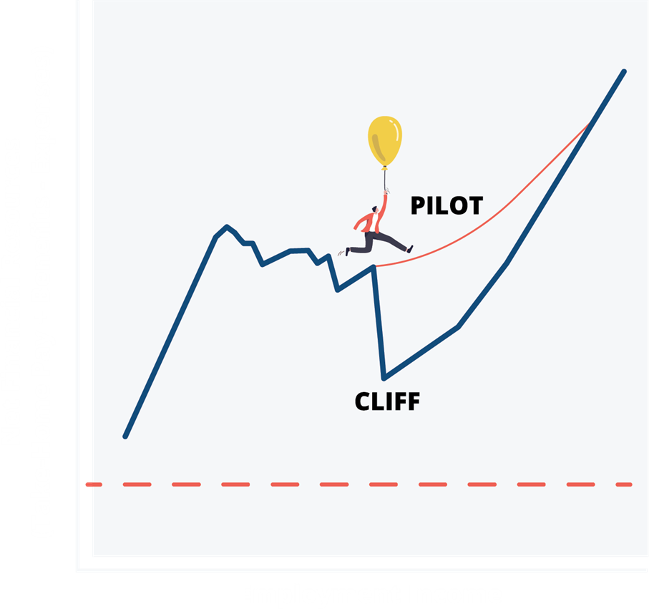
TN Opportunity
Pilots
$180M across 7 pilot programs (6 pilots to be selected by the TANF Advisory board, with 2 in each grand division; 1 pilot to be operated by TDHS)
Demonstrating effectiveness of growing capacity to reduce dependency
Encouraging collaboration and collective impact to provide comprehensive supports and wraparound services to families
Selected by May 1, 2022
$25M per pilot over 3 years
Notes:
Blue Blank Template

Slide 22
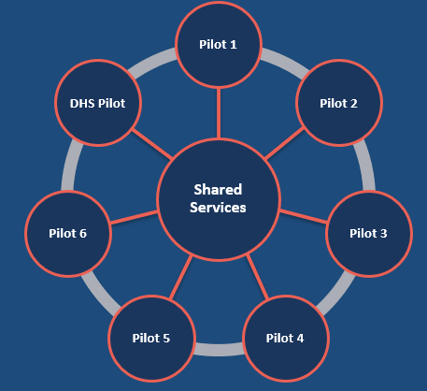
Training &
TA Partner
Technical assistance and support for TN Opportunity Pilots through suite of shared services
RFP to be issued Fall/Winter 2021
Notes:
Blue Blank Template

Slide 23
Program
Evaluation Partner
No earlier than October 1, 2021, the TANF Advisory Board must select a research partner or partners that will support the research and evaluation of the TN Opportunity Pilot Program
Must regularly gather and present research and data to pilot program leaders and Advisory Board to aid continuous improvement; must produce regular reports and final reports
TDHS to outline proposed scope and process for selecting partner
RFP to be issued Fall/Winter 2021
Notes:
CG: What photo should we use here?

Slide 24
Selected Tennessee
Faith Based Organizations
Sectors
Business
Philanthropic
State Agencies
CSBG Community Action Agencies & HRAs
Academic
Non-governmental Organizations

Slide 25
Notes:
Blue Blank Template

Slide 26
Notes:
Blue Blank Template

Slide 27
A WHOLE OF TENNESSEE APPROACH
TO GROWING CAPACITY & REDUCING DEPENDENCY

Slide 28
Next Steps and Key Dates
Planning Grant Application Period: September 1 – September 30, 2022
Planning Grant Application Review: Fall 2022
Planning Grant Contract Term (90 days): Winter 2021/2022
TN Opportunity Pilot Proposal Review: Spring 2022
TN Opportunity Pilots Implementation: Fall 2022 – Fall 2025
Research Partner Selected: Spring 2022
Notes:
Embedded Video slide here

Slide 29
The Role of
The Tennessee Workforce System
Notes:
Longer term success
Pathways from crisis into career pathways
Supportive services along the way
Benefits cliffs
Addressing workforce needs
Be at tables/ apply for funding/ large tables/ collective impact

Slide 30
Reminders and Important Info
Next Advisory Board Meeting: September 21st, 2021
TDHS will continue to post updated information online about the TANF Opportunity Act:
https://www.tn.gov/humanservices/tanf-opportunity-act.html
You can sign up online to join the TANF Opportunity Act contact list and receive the latest updates.
Notes:
Embedded Video slide here

Slide 31
Question
&
Answer

