Slide 1
2021 Refocus TN Workforce Convening
Optimizing Partnerships
Thursday, August 19th 1pm - 2pm
Notes:
(Selina)

Slide 2
Optimizing Partnerships
As part of the Vocational Rehabilitation Program, the community Tennessee Rehabilitation Centers (CTRCs) are modernizing and revolutionizing by providing person-centered community-based employment services to individuals with disabilities. The session will focus on three pilots developed by the CTRCs to cultivate and maintain collaborative partnerships in the local community to foster and advance this service delivery model.
Notes:
(Selina)

Slide 3
Outline of Today’s Presentation
Introduction of Panel Presenters
Brief overview of Vocational Rehabilitation (VR) the community Tennessee Rehabilitation Centers (CTRCs) and Pre-Employment Transition Services (Pre-ETS)
Presentation of pilots: Maury County, Bedford County, Greene County
Questions and Comments
Notes:
(Selina)

Slide 4
What is Vocational Rehabilitation?
Vocational Rehabilitation provides services for individuals with a disability to assist them in preparation and placement for competitive integrated employment
VR is an eligibility program
Individuals referred to VR must be determined eligible to receive services.
Individuals must have a qualifying disability which causes a substantial impediment to employment.
Services are required to prepare for, secure, retain, advance in or regain employment.
Notes:
(Selina)

Slide 5
What is Pre-ETS?
The Workforce Innovation and Opportunity Act provides students with opportunities for job exploration counseling, work-based learning experiences, counseling on postsecondary education, workplace readiness training, and instruction in self-advocacy. These five services are Pre-Employment Transition Services (Pre-ETS.) These services help students with disabilities ages 14-22 progress from secondary education into higher education or employment and to meet their goals for life after high school.
Notes:
(Selina)

Slide 6
The Community TRCs
Community TRCs are building the road to
Independence: community-based partnerships that increase independence and community participation
Success: job retention and job loss services that benefit both the individual and the employer
Employment: career assessment and readiness services that support individuals in identifying a career path and preparing for work
Notes:
(Selina)
Once center-based traditional vocational rehabilitation services like vocational evaluation, career assessment, and vocational adjustment training have been transformed into community-based vocational rehabilitation services that provide a broad array of services to support individuals on their employment path. Under the new service delivery framework – Road to Independence, Success, and Employment (RISE) – the centers have become community-based vocational rehabilitation services provided in the local community with the support of the local community. Under this framework all communities have access to core vocational rehabilitation services that prepare and support individuals in going to work. And, in addition to these core services, the model offers the opportunity to customize community-based vocational rehabilitation services to the unique needs and circumstances of the community.

Slide 7
RISE Pilots
Pilot #1 Maury County
Focus on rising juniors and rising seniors
Provide work-based learning experiences, specifically summer work
Pilot #2 Bedford County
Focus on at risk youth
Provide community experiences like business tours, exploration and job shadowing
Provide career readiness training
Pilot #3 Greene County
Provide nationally recognized training based on local labor market
Provide job-driven customized employment
Notes:
(Selina)

Slide 8
Pilot #1 – Maury County
GOAL: Develop a competitive integrated work-based learning summer work experience for incoming juniors or seniors with disabilities to promote employment and/or postsecondary educational attainment.
Background of how the pilot came to be
Pilot in development
Pilot in action
Partner collaboration
Results of the pilot
Future plans for the pilot

Slide 9
Pilot Background
Survey of Pre-ETS services currently being delivered to TN students
It was observed that students statewide lacked work based learning (wbl) services
In Maury County there was a significant lack of wbl services being offered to students enrolled in Pre-ETS
Discussions with partners in Maury County helped highlight a gap that the TRC Columbia was well equipped to fill.

Slide 10
Pilot Background
Requirements
Pre-ETS students
Ability and drive to work semi-independently

Slide 11
Pilot Development
The VR Summer Work Experience is a service that is provided in collaboration Pre-Employment Transition Services (Pre-ETS’s), Vocational Rehabilitation (VR), Community Tennessee Rehabilitation Center’s (CTRC) and Department of Labor (DOL)
Participants must be students who are entering their final year of high school and have no prior successful formal work experience in a competitive integrated setting.
The VR Summer Work Experience will consist of one six-week, work-based learning experience during the summer. All six weeks must be completed within an eight-week window of time.
Total weekly hours will be 20 hours per participant. Preceding the work-based learning experience the student will undergo an intensive job readiness course facilitated by the CTRC Rehabilitation Assistant.

Slide 12
Pilot Development
Discussions, Collaborations, and Planning
Maury County VR Team Members
Pre-ETS Staff
Vocational Rehabilitation (VR) Counselor / Field Staff
Business Employment Consultant
Discussions with WIOA Title 1 Career Advisor and Director of American Job Center (OSO)
Department of Labor
Discussions with Maury County Schools
Maury County Chamber of Commerce
CTRC Advisory Board (consists of community members and business partners)

Slide 13
Pilot in Action
Work Based Learning Site
City of Columbia
Recreation Aide
Building and Grounds Maintenance
Building Maintenance Custodial Worker
Operation Worker

Slide 14
Plan in Action
Enroll in the WIOA Title 1 Services
Presentations were done at local schools to establish interest in work opportunities
Meet with Title 1 Career Advisor to enroll in services
Job Readiness Course
The course was adapted from the current Employee Development course offered at the CTRC Columbia to cover the key job readiness components for the DOL/WIOA. Participants received a $250 incentive bonus upon completion of course.
Time To Work!
Students participated in a competitive interview process with City Of Columbia supervisors where they learned of the summer work opportunities.

Slide 15
Partner Collaboration
External Partners
Maury County Schools
American Job Center / South Central Human Resource Agency / WIOA Title 1 Career Advisor and AJC Director
DOL Regional Director
City of Columbia
Internal Partners
Pre-Employment Transition Services (Pre-ETS)
Vocational Rehabilitation Services (VRCM)
Business Services Unit

Slide 16
Pilot Results
2 Participants in Community-Based Training/Internship Sites Paid through WIOA Youth Program
1 Participant has been offered a position once finished with the WIOA paid internship
Increased Knowledge of Community Services, Locations, Opportunities, and Career Requirements
Participants had the opportunity to learn the benefit of work and earning wages

Slide 17
Success Story
https://youtu.be/LxFANQag1us

Slide 18
Future Plans for Pilot
Replication and Individualization by other CTRCs
Incorporating throughout the year
Enhanced community knowledge of the VR Program

Slide 19
Pilot #2 – Bedford County
GOAL: Develop and implement a community-based pilot to serve youth ages 14 – 22, who are at risk to become employed or enrolled in an educational program.
Background of how the pilot came to be
Pilot in development
Pilot in action
Partner Collaboration
Results
Future plans

Slide 20
Pilot Background
Independent Living and Community Involvement Survey of Bedford County citizens
Bedford County Schools and Bedford County/Shelbyville Chamber of Commerce Assisted
390 Responses Indicating Several Areas of Need
Responses from VR Colleagues and External Partners Indicating Need
Statewide Consumer Needs Assessment Results
SILC Quarterly Report July 2020-September 2020
348 Consumers Completed Unmet Needs Survey
63% (220) Needed Independent Living Daily Activities
Notes:
***Selina insert VR info here***

Slide 21
Pilot Background
Requirements
At Risk Youth
Eligible for Pre-ETS services, VR services, or both
Ages 16-22

Slide 22
Pilot Development
At Risk Youth
“An at-risk youth is a child who is less likely to transition successfully into adulthood. Success can include academic success and job readiness, as well as the ability to be financially independent. It also can refer to the ability to become a positive member of society by avoiding a life of crime.”*
*Smith, R. (2016, July 15). What Is At-Risk Youth? - Definition & Statistics. Retrieved from https://study.com/academy/lesson/what-is-at-risk-youth-definition-statistics.html.

Slide 23
Pilot Development
Discussions, Collaborations, and Planning
CTRC Shelbyville Team Members
Other CTRC Managers
Pre-ETS Staff
Vocational Rehabilitation (VR) Counselor / Field Staff
Business Employment Consultant
Community Rehabilitation Provider
Discussions with WIOA Title 1 Career Advisor
Discussions with Bedford County Schools

Slide 24
Pilot in Action
Community Tours
Musgrave Pencil Company, Bedford County Courthouse, Bedford County Fee Offices, Judicial Complex including Sherriff’s Department, American Job Center, Truth & Nails Vocational Training Center, Goodwill, Ms. Menza’s Daycare/Kiddie Kingdom, Shelbyville Recreation Center, Shelbyville Times Gazette, TCAT Shelbyville, and Community Clinic of Shelbyville and Bedford County

Slide 25
Plan in Action
Guest Speakers
Shelbyville Police and K9 unit, TRC Smyrna, WIOA Title 1 Career Advisor, Emergency Management Services (EMS), Shelbyville Fire Department Training Officer and Fire Marshall, Business Employment Consultant and UT CLEE Business Coordinator, Silver Bullet Ranch, and Shelbyville Fire Department Firemen with Truck
Independent Living and Career Readiness Training
Community Development Center Trained One Hour Per Day
CTRC Shelbyville Provided the Rest
Job Shadowing and/or Community-Based Training Opportunities Upon Completion
CTRC Shelbyville and WIOA Youth Program when eligible

Slide 26
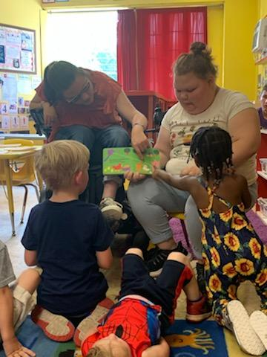
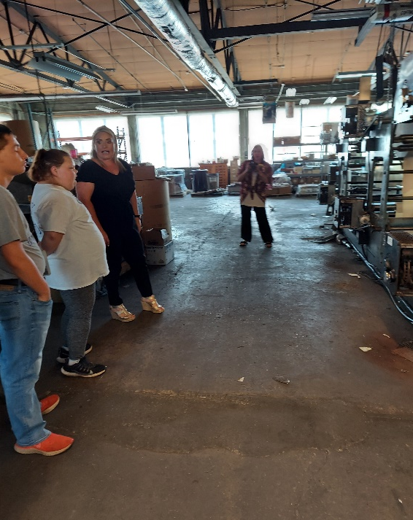
Community Involvement

Slide 27
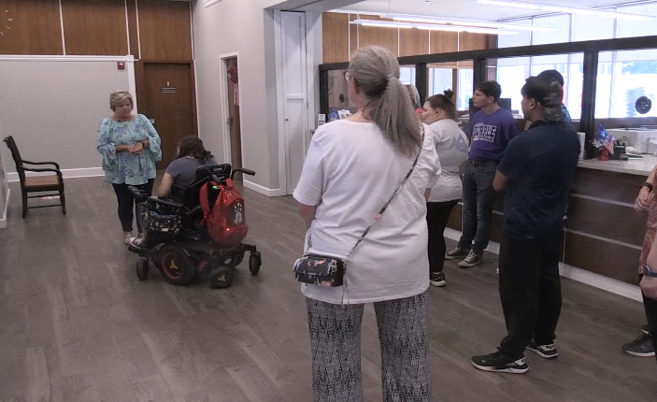
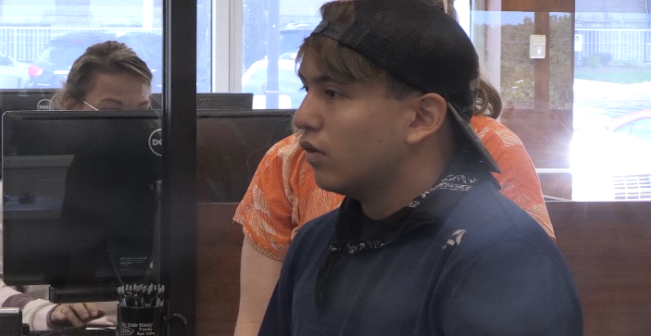
Bedford County Offices and Careers

Slide 28
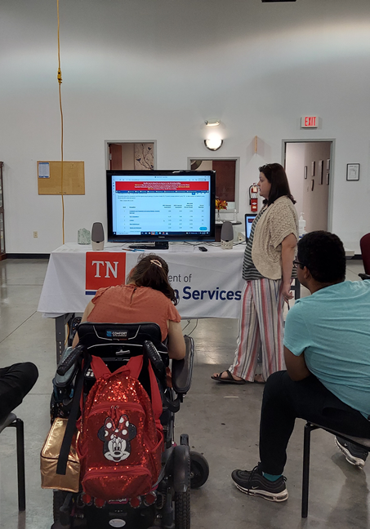
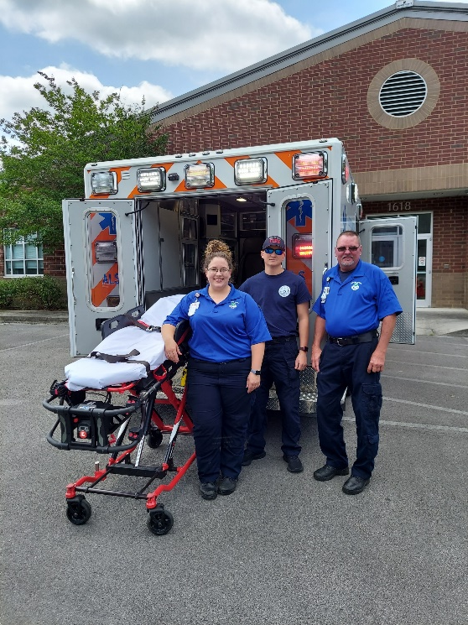
Community Positions and the Training Required

Slide 29
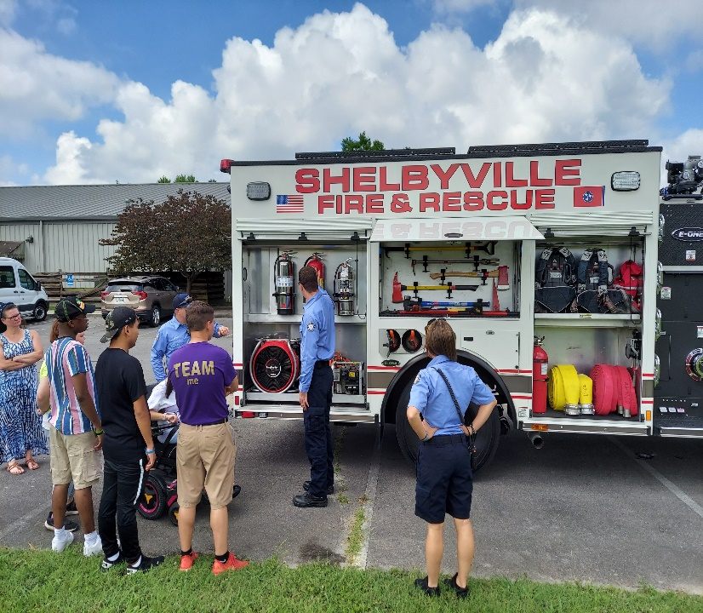
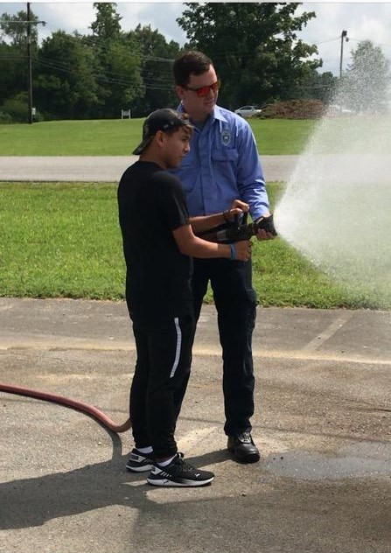
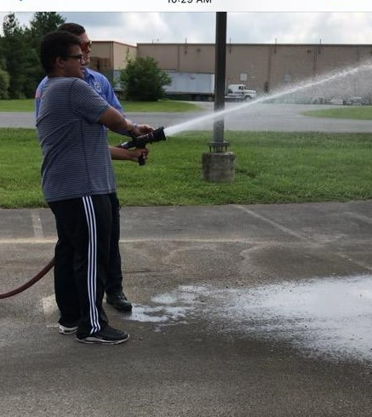
Learning Fun

Slide 30
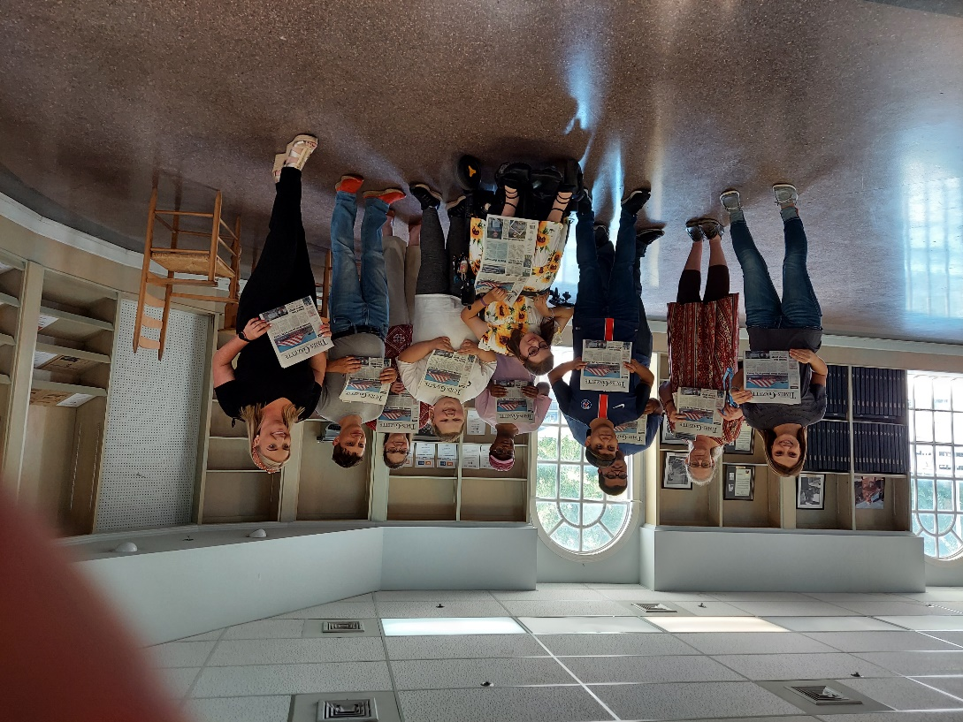
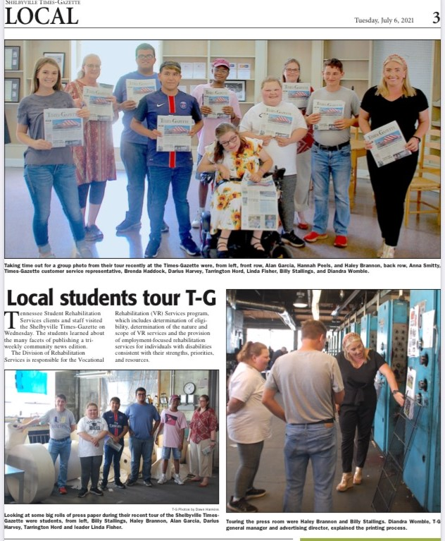
Fame!

Slide 31
Partner Collaboration
Bedford County Schools
Pre-Employment Transition Services (Pre-ETS)
Vocational Rehabilitation Services (VRCM, FS1, & Regional)
American Job Center / South Central Human Resource Agency / WIOA Title 1 Career Advisor
Community Development Center (Community Rehabilitation Provider)
Tennessee Rehabilitation Center (TRC) Smyrna
Business Services Unit

Slide 32
Result of Pilot
3 Participants in Community-Based Training/Internship Sites Paid through WIOA Youth Program
1 Participant with a Community-Based Training/Internship Site Interview 8/06/21.
Increased Knowledge of Community Services, Locations, Opportunities, and Career Requirements

Slide 33
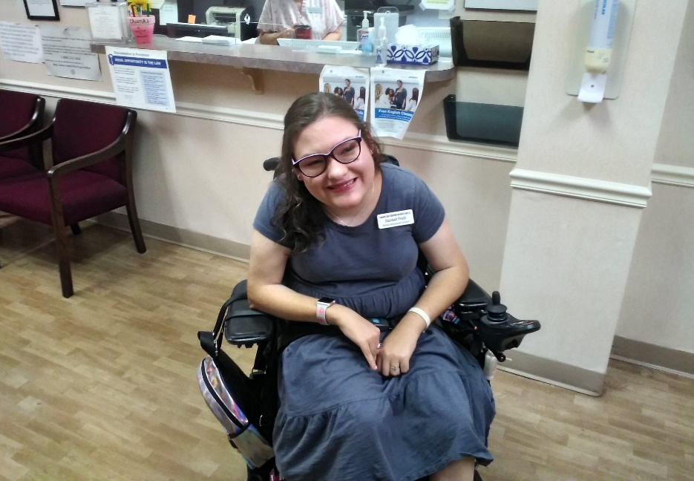
Happy Participants

Slide 34
Future Plans for Pilot
Replication and Individualization by Other CTRCs
Incorporating Throughout the Year
Enhanced Community Knowledge of Our Program
Enhanced Community Knowledge Accessibility Needs

Slide 35
Pilot #3 – Greene County
GOAL: Operate a job-driven model and strengthen collaboration, communication, and integration of employers, community partners and individuals with disabilities in the local workforce.
The Greeneville-TRC researched the employment opportunities in Greene County
Met with the VR Business Employment Consultant
Met with the Greene County Partnership/Chamber of Commerce
Spoke with AJC Career Specialist

Slide 36
Pilot #3 – Greene County
Pilot in Development
Contacted other State VR Programs to gather information about their customized employment programs
Researched Models that were successful
Reached out to employers to assess needs in Greene Co.
Reached out to Advisory Board for support and information

Slide 37
Pilot #3 – Greene County
Partner Collaboration
Reached out to Lowes in Greene County and met with Store Manager and Scheduling Coordinator
Received Job Descriptions
Continued meetings with Scheduling Coordinator
Completed environment survey
Reached out to General Morgan Inn and met with HR Director
Received Job Descriptions
Completed environment survey
Leadership met with the HR Director and Toured Hotel
Reached out to Ingles in Greeneville and met with Store Manager
Received job descriptions and available positions
Completed environment survey

Slide 38
Pilot #3 – Greene County
Reached out to Food City
Met with Store Manager and HR Director
Completed environment survey
Donaldson Inc. reached out to the Greeneville TRC
Met with BEC, Leadership, Counselor
Met with Plant Manager
Received Job Descriptions
Completed a tour of the plant and completed environment survey
Professional Vending Services reached out to the Greeneville TRC
Met with Owner to discuss needs
Completed a tour of the business and completed environment survey

Slide 39
Pilot #3 – Greene County
Pilot in Action
Customer Service and Manufacturing was the area of greatest opportunity in Greene County/Greeneville
Partnership with Walters State Community College Workforce Training to provide our customers with Nationally Recognized Certificate of Training
Customer Service Professional Level 1 (16 hours)
Customer Service Professional Level 2 (16 hours)
Identifying customers for preparation for employment by the Vocational Rehabilitation Counselor
Results of the Pilot
Future Plans for the Pilot: State-Wide Implementation

Slide 40
Questions and Comments
Notes:
Slide for video link(s)

