Slide 1
Addressing Child Care Needs for the Tennessee Workforce
Gwen Laaser, Director, Child Care Services
Michelle Joyner, Policy & Research Coordinator
August 19, 2021
Notes:
Good morning. We appreciate this opportunity to speak to you regarding Child Care and how we can build collaborative partnerships to address the needs for building child care capacity. My name is Gwen Laaser and I serve as the Director over our Child Care Services Division. Our team will introduce themselves as we move through this brief presentation. The Department of Human Services is continually evaluating the needs of families as well as those of the licensed child care agencies in order to provide supports and resources that met these needs. As we move from COVID Response to COVID Recovery we are building community centered partnerships to remain responsive to the impact on child care across the state.

Slide 2
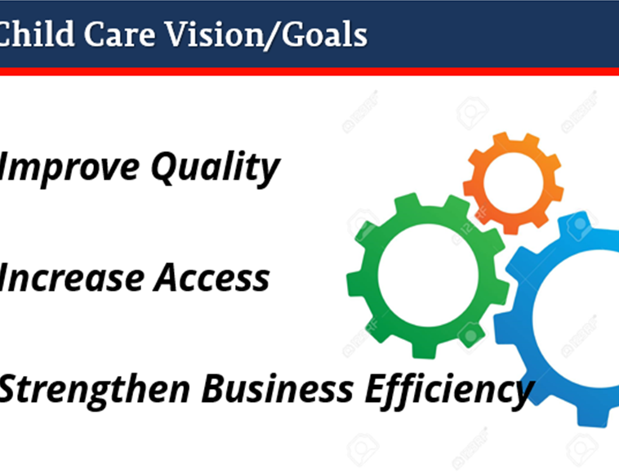
Child Care Services
Child Care Certificate Program (Child Care Payment Assistance)
Child & Adult Care Licensing Program
Program Reliability & Compliance
Quality Initiatives
Quality Rating & Improvement System

Slide 3
Transforming the Child Care Industry!
Notes:
We are not just transforming DHS- We are transforming the childcare industry!

Slide 4
Transforming
Child Care Workforce
Babysitters to Professionals
DHS Staff
Enforcers to Partners
Report Card Process
Quality Rating to Quality Improvement
Administrative Tasks
Cumbersome to Empowering
Capacity
Child Care Obstructer to Child Care Creator
Payment Assistance
Access to Care becomes Access to Quality
Isolated Interaction becomes Continuity of Care
Notes:
We are in a time of tremendous momentum for the child care industry. Understanding of the importance of quality early education continues to grow. More and more, there is demand for the sustainability and growth of the child care sector. In a growing economy or in a pandemic- access to quality child care is critical. We are committed to leading the transformation of child care, ensuring that all Tennesseans can access and afford quality child care in their communities.

Slide 5
New Pre-Licensure Support Unit
DHS’ new Pre-Licensure Unit will help streamline processes and increase support for child care providers
Support new agencies throughout the child care licensing process
Deliver training that equips agencies with the tools needed to serve families and run successful businesses
Provide guidance that ensures compliance with licensure rules and regulations
Grow child care capacity across the state, particularly in rural areas
Build partnerships with community and business leaders to assess child care needs and explore solutions and necessary supports
Establish local contacts, facilitate effective and impactful connections
Recruit prospective providers to increase the number of child care slots available in rural areas of the state

Slide 6
Growing Capacity: Establishment Grants
DHS is launching a Child Care Establishment Grant program to support new providers and expand the state’s network of child care facilities
Aligns with other efforts to grow the number of child care slots available to families
Administered by Childcare Tennessee, an initiative of the Community Foundation of Tennessee
Agencies seeking licensure can
Apply for up to $1,000 in establishment funds per slot of licensed capacity to be created
Use funding to purchase items like furniture, supplies, materials, and curriculum
Support provided through federal American Rescue Plan Act (ARPA) Child Care Stabilization Funds (which provide resources to carry out activities that increase the supply of child care)

Slide 7
Growing Capacity: DECD Grant Funding
A new partnership between DHS, DECD, and local development districts will also expand the state’s network of child care facilities
Provides assistance to center-based and home-based child care facilities
Launches a pilot program to develop employer-based child care opportunities
Supports capital expenses
New construction
Renovation
Expansion of existing child care spaces
Partners are encouraged to braid DECD funding with DHS Establishment Grants when possible

Slide 8
Developing Employer-Based Child Care
A web of DHS resources and supports can be tailored to fit the diverse needs of employers interested in establishing child care services for employees
Pre-Licensure Unit support
Funding to assist with start-up costs
Furniture, equipment, supplies, materials, curriculum
Smart Steps tuition reimbursement
Support for employers and employees seeking child care payment assistance
Quality program supports
WAGE$ salary supplement for educators; bulk purchasing agreements; shared services and business tools; coaching and technical assistance
Employee recruitment and support
DHS program teams can identify candidates for employment, helping employers fill talent pipelines

Slide 9
Addressing Community Needs
DHS continually evaluates the needs of both families and licensed child care agencies in order to provide supports and resources that support individual communities across the state
In the shift from COVID Response to COVID Recovery, we have a unique opportunity to stabilize and strengthen the child care industry
We are building community-centered partnerships that will help us be even more responsive stakeholder needs
DHS continues to implement modernization efforts that strengthen business efficiencies to improve the customer journey
Ongoing communication and engagement activities with both providers and community partners will ensure that stakeholder voices are heard and help shape the future state of child care in Tennessee
Notes:
As we shift from COVID Response to COVID Recovery, we are building community-centered partnerships that will help be even more responsive to the impact on child care across the state.

Slide 10
Questions?
Notes:
Questions?

