Slide 1
Merit’s Workforce Development Solutions
2021 Refocus TN Workforce Convening

Slide 2
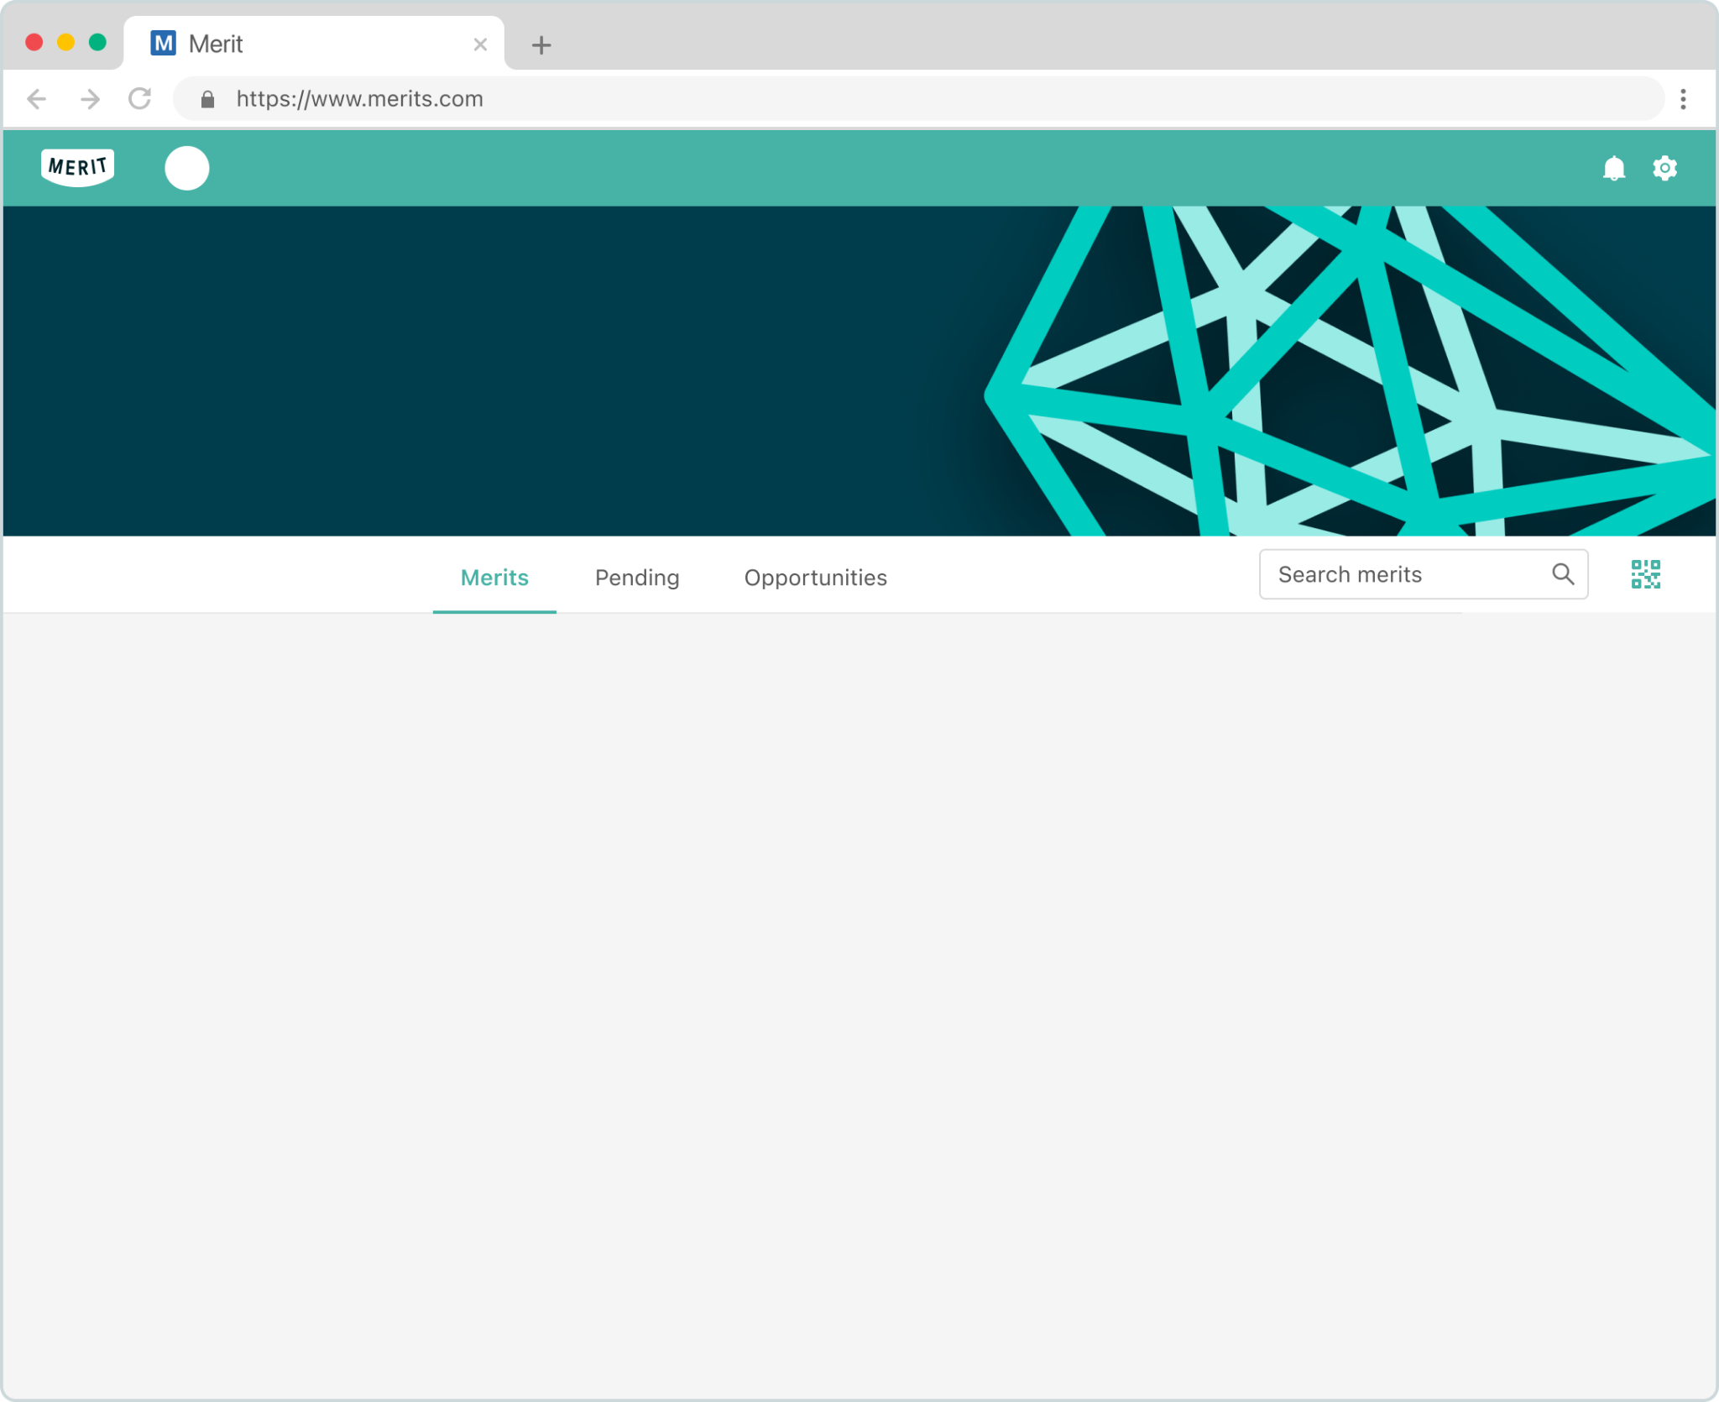
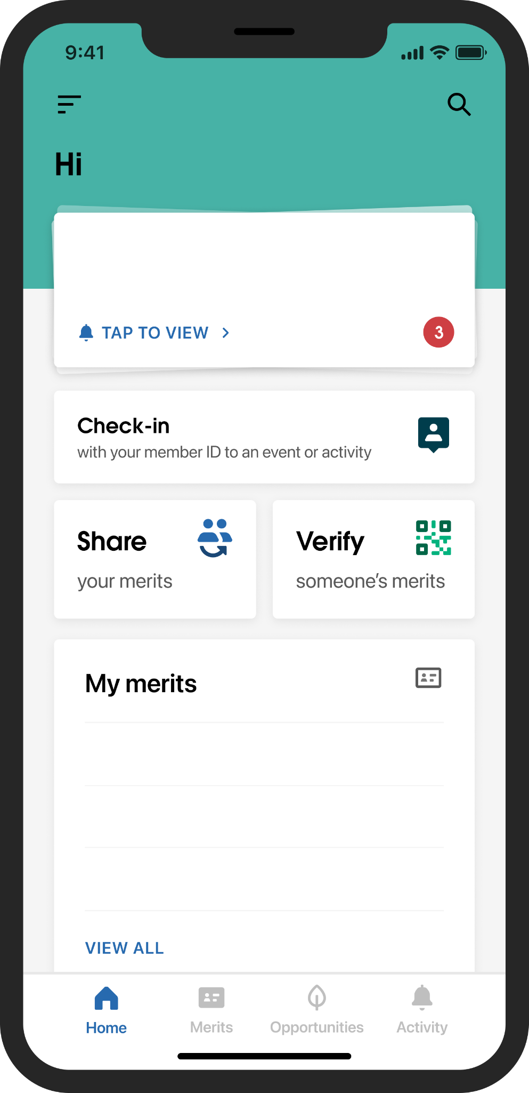
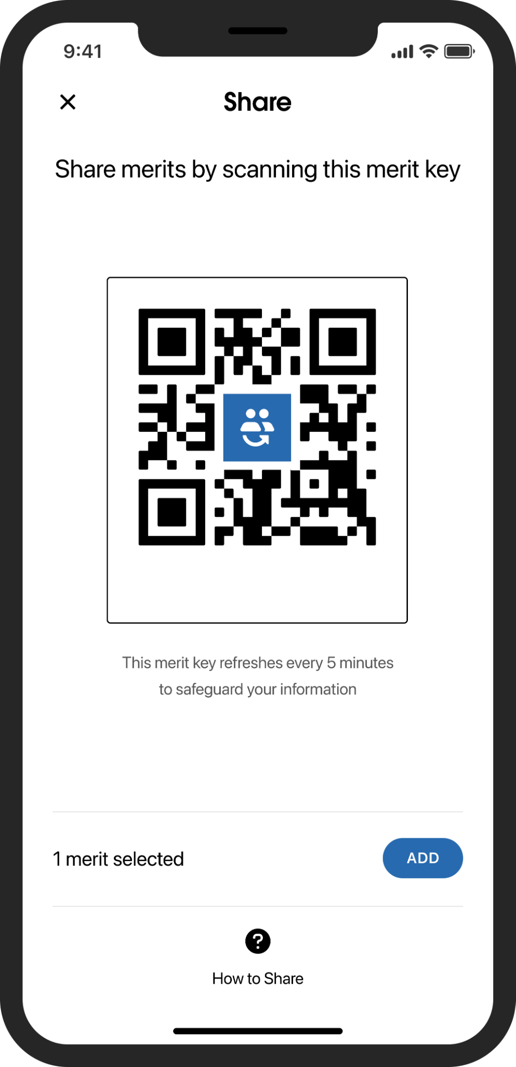
Merit is the only platform for Verified Identity
Kristen Chung
Merit enables organizations to easily issue verified credentials, licenses, and records to people.
Individuals benefit by having all of their credentials and records in one secure place, and in their control.
Industry partners benefit by having a common, trusted, and secure standard to check credentials and compare qualifications.
FEDM Verified Professional
COVID-19 Testing Record
Access Receipt
Kristen
Merit title that is really long
Merit title that is really long
You received a IT Help Desk Administrator merit from TN...
Vaccination Site Access
Merit title that is really long
Kristen Chung
TechConnect Program Participant
TechConnect Program Graduate
IBM Customer Engagement Specialist

Slide 3
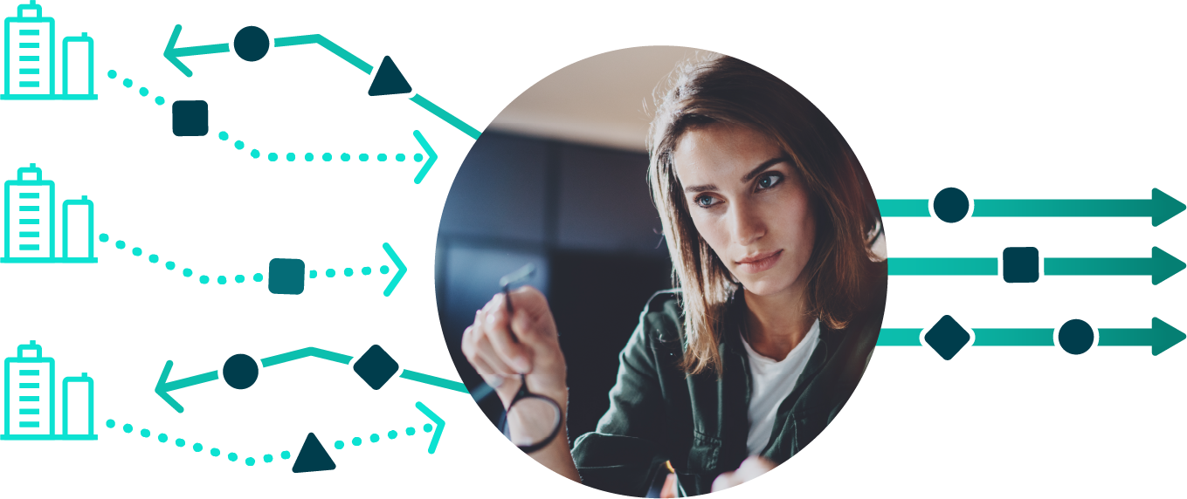
The verification process
HOW IT WORKS
1. A trusted organization sends an inactive merit to the individual.
3. After the individual accepts, the merit is activated. There is no limit on the number of merits sent or accepted.
Kristen
You received a IT Help Desk Administrator merit from TN...
Portfolio of verified merits
VERIFIED
Individuals can use verified merits
Merges identity and capabilities for individuals
Streamlines verification process and accountability
NOT-ACCEPTED
VERIFIED
TechConnect Program Participant
TechConnect Program Graduate
IBM Customer Engagement Specialist
2. Issuing organizations benefit from data cleaning and reciprocity.
4. Merit recipients can selectively share verified data as needed.

Slide 4
Merit Protects Data
MERIT OVERVIEW
Security
All individual, organizational, and business data is safeguarded by market-leading SOC 2, HIPAA, & FERPA-compliant security solutions in a layered security approach.
Control
We provide individuals the ability to own, control, and unlock value from their achievements and personal information, on their own terms.
Privacy
We give individuals complete transparency and control on how their data is being shared. Data is never shared without their explicit permission.

Slide 5
HOW IT WORKS
Platform capabilities
How Merit can improve workforce development systems

Slide 6
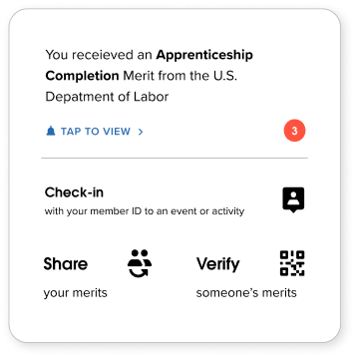
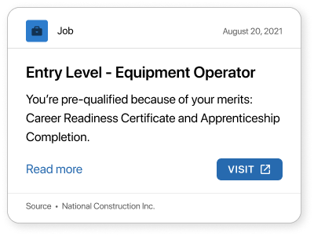
Verified identity delivers new capabilities and benefits to everyone - agencies, individuals, and employers
Agencies
Individuals
Employers
MUTUAL BENEFIT
Automatically match recipients to tailored opportunities
Bridge gaps in legacy systems
Drive data accuracy
Issue policy updates
Control privacy
Autonomy over data
Receive targeted opportunities
Have a common standard for verification and evaluating qualifications

Slide 7
OVERVIEW
Merit delivers the verified identity ecosystem to drive success
An interoperable verified credentialing system for issuing, verifying, and tracking credentials.
Interoperable credentials: Merits, representing licenses and other credentials, work across programs and even states to increase usability.
Immediate verification: Validated credentials are pre-verified and ready for use for access to training programs, employment, and childcare.
Opportunities: Target job, training, and childcare opportunities to eligible constituents based on their credentials.
Better tracking: Dashboards and analytics delivers transparency to the Department of Labor around program performance.
Bridged technology siloes: Merit works with any legacy systems and existing technologies across agencies and states.

Slide 8
Merit platform capabilities
OVERVIEW
Verified identity is more than just the digitization of paper
Digital credentials
Verified identity capabilities
Although better than paper certificates or badges, digital credentials aren’t verified or interoperable.
Organizations, verifiers, and individuals still have to contend with data gaps, legacy systems, and unique needs.
A verified identity ecosystem, that connects many organizations, can help bridge those gaps and give continuity and accountability.
Trust scoring
Privacy management
Analytics
Notifications
(tasks/renewals)
Opportunities
Policies
Reciprocity
Prerequisite/Pathways
Workflows (fields/actions)

Slide 9
Empowerment and employment through interoperability
SOLUTION
Increase the power of licenses across state lines
Connects agencies in Merit’s interoperable verified credentials ecosystem and lays the foundation for interstate reciprocity.
Connects disparate data sources and technology without the burden of replacing legacy systems
Verified credentials and skills for federal agencies, as well as women across the country – everywhere they go.
Future-proofs government technology and delivers immediate transparency across agencies.

Slide 10
Custom Reports and Surveys

Slide 11
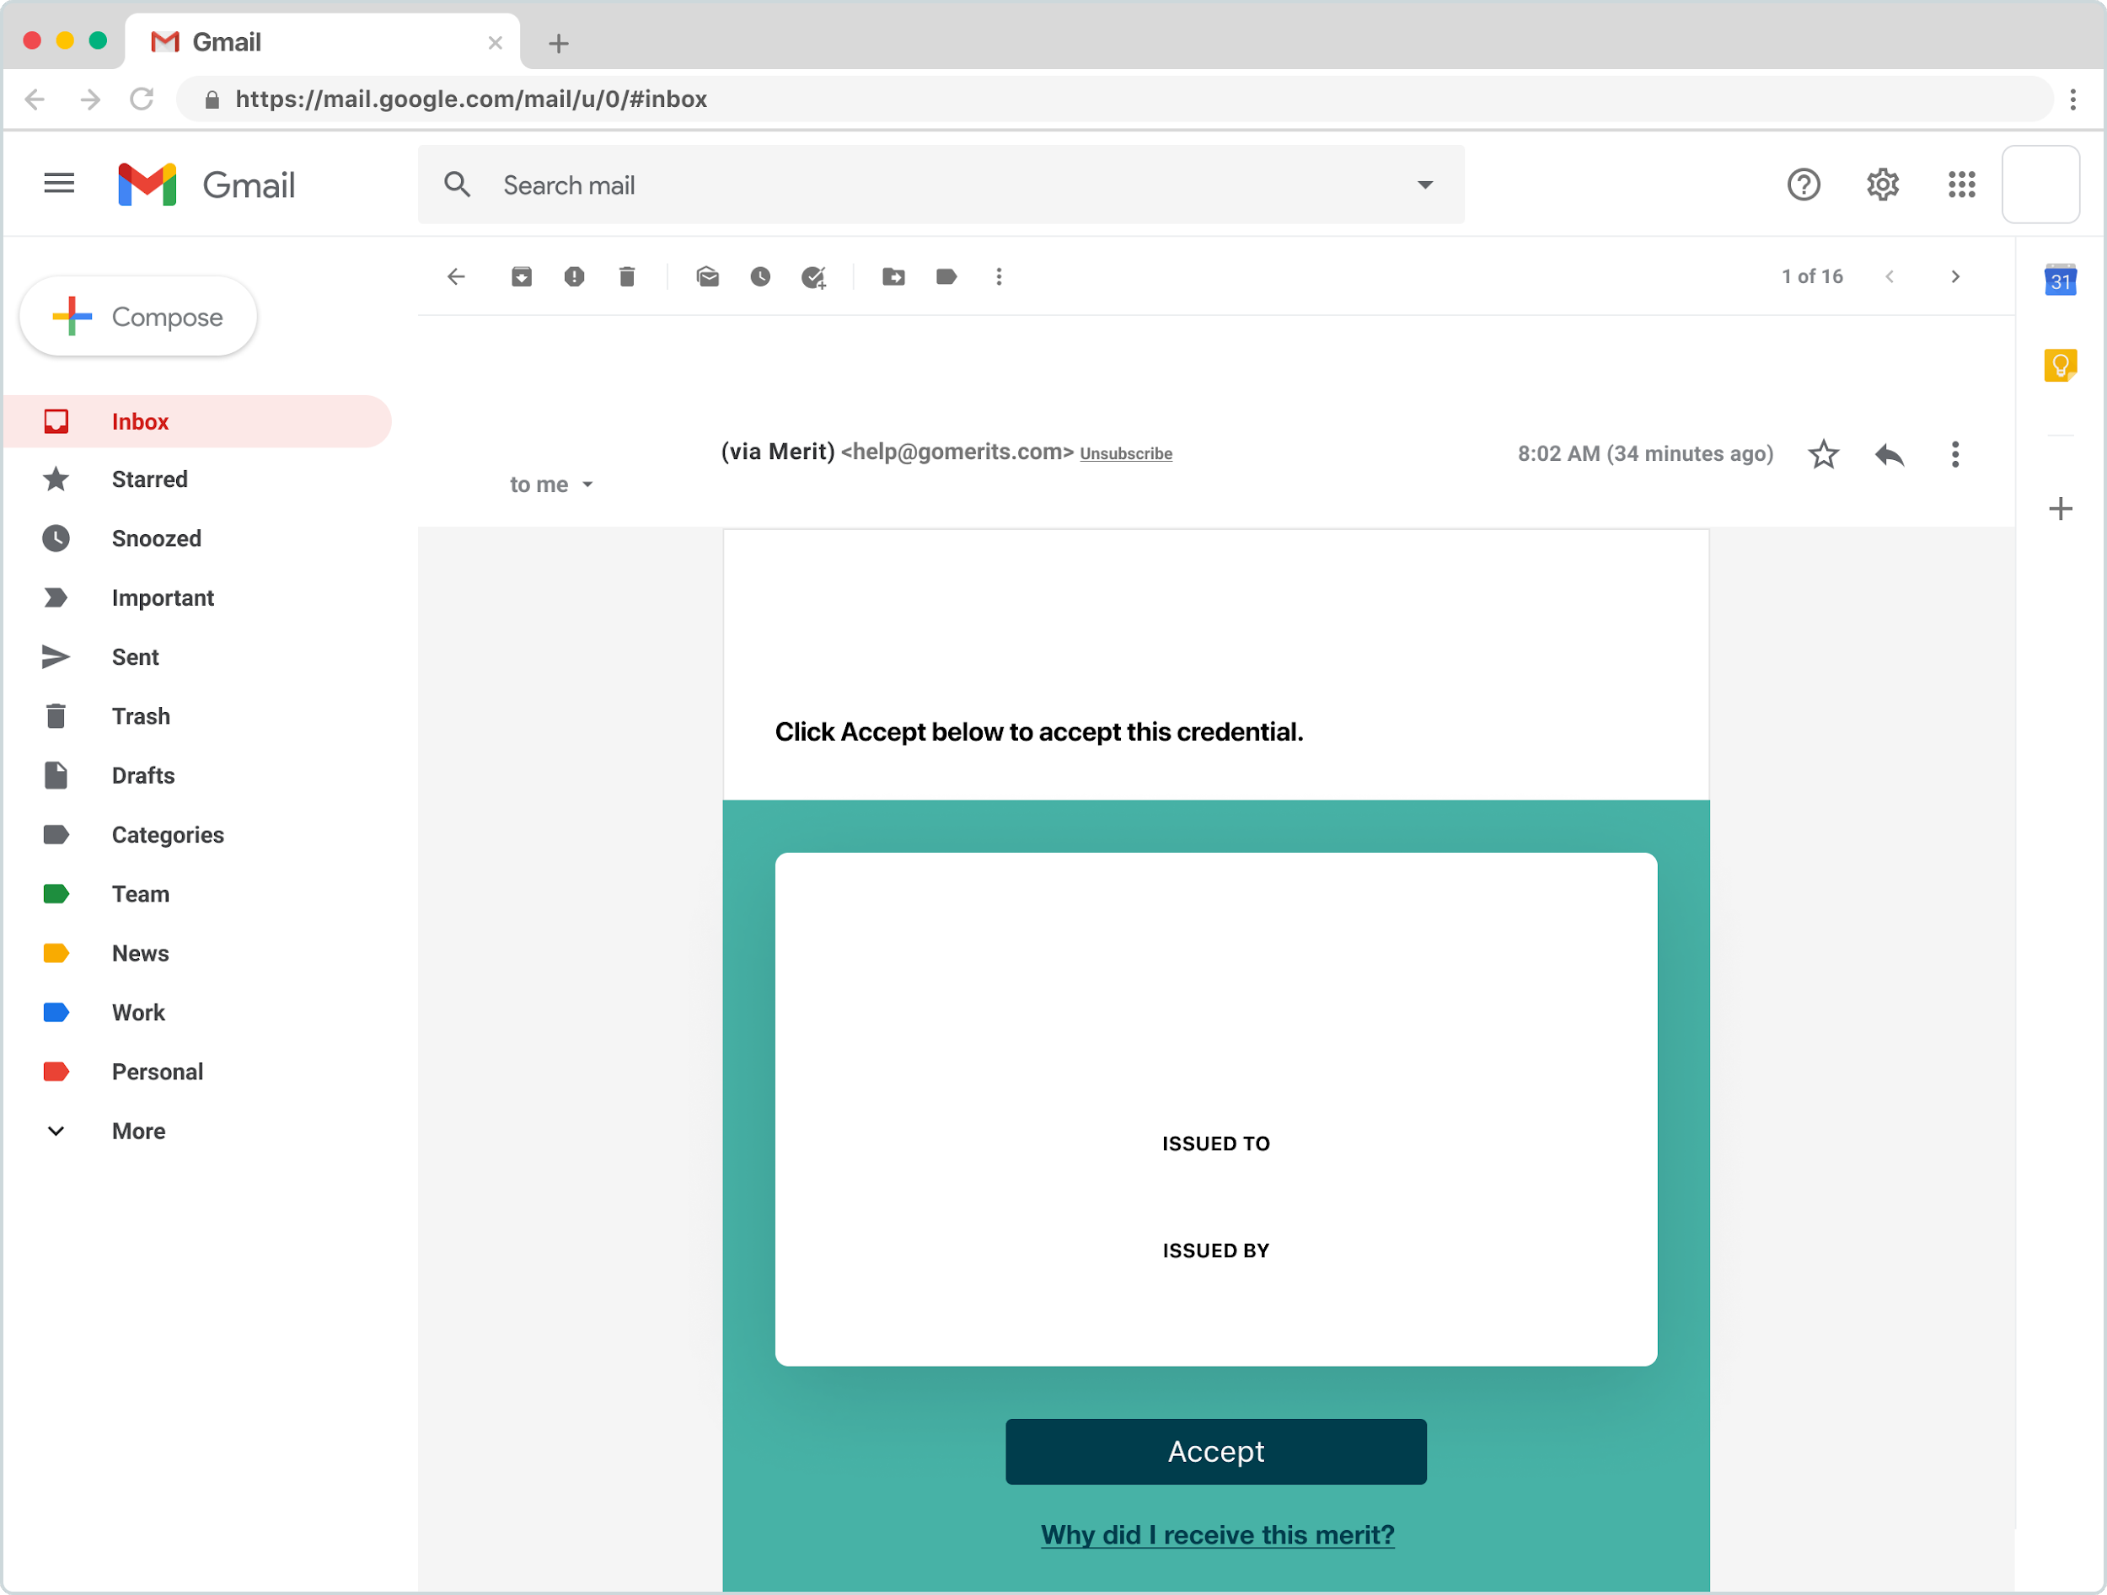
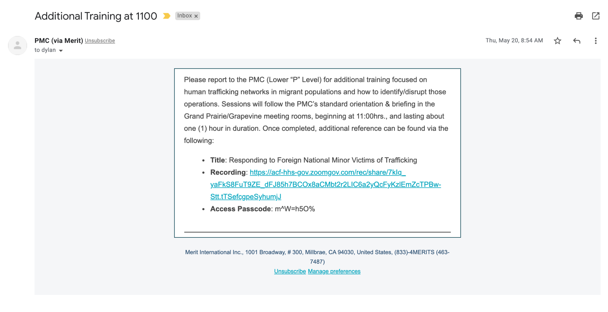
Custom communications and lists
Lists can efficiently be generated to assist with targeted email or phone communication to personnel.
Lists can be generated by any activity or merit issued. For example, based on Site Access, Declared Vaccination Status, or because someone is currently scanned in to a site at a particular time.
Assistance with assembling lists and directly issuing communication is available upon request.
Marc, FL Division of Emergency Management has sent you an official digital record
FL Division of ...
Congrats, Marc! You have received a new merit from FL Division of Emergency Management
FDEM Verified Professional
Marc Douglas
FL Division of Emergency Management

Slide 12
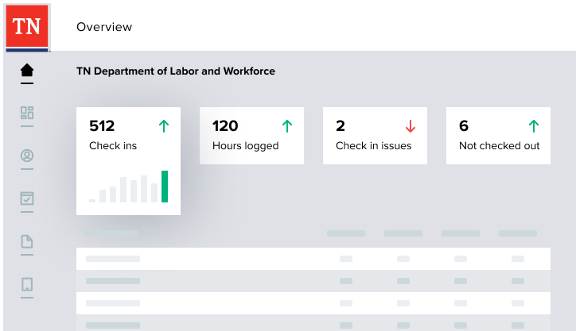
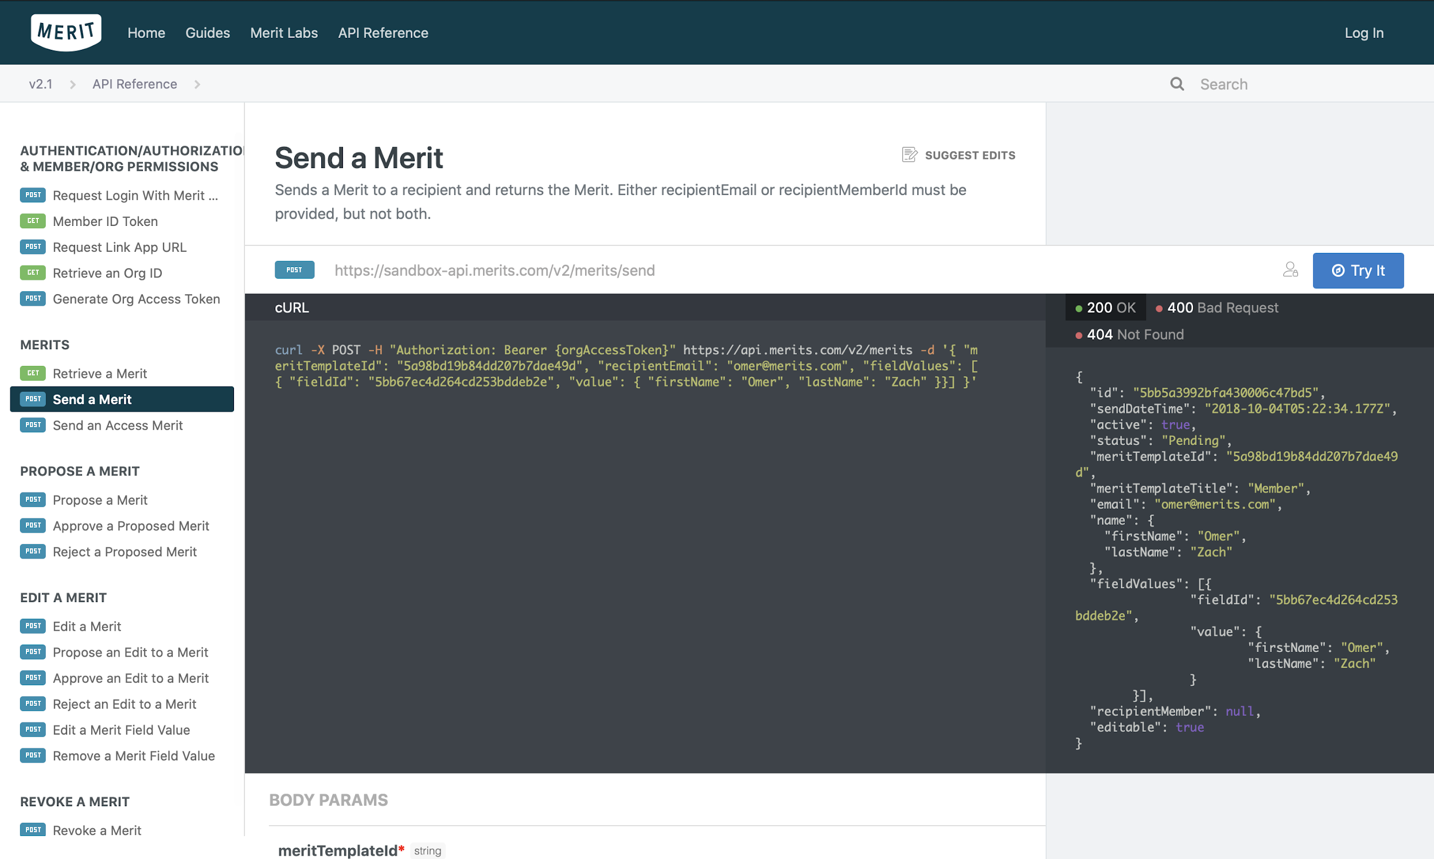
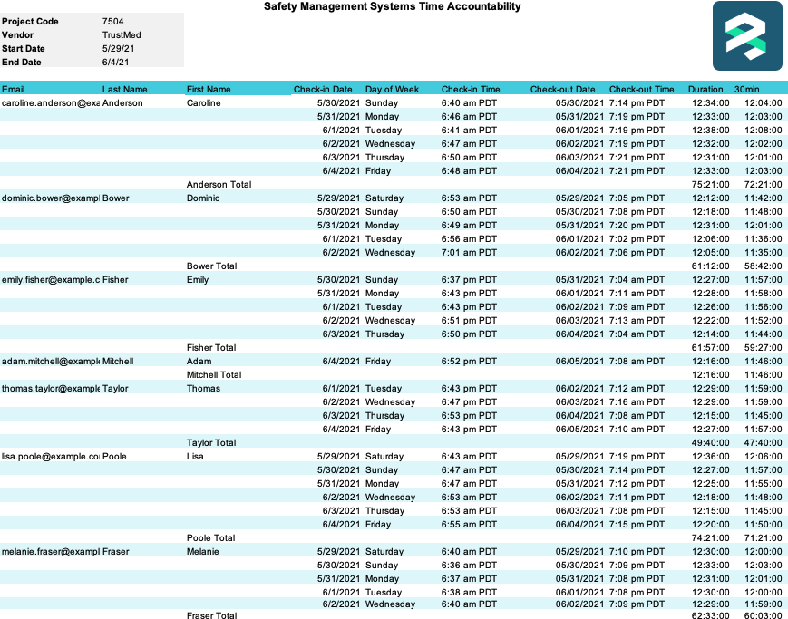
Accountability data accessible in custom, real-time dashboards
Permissioned leadership will automatically receive the data in real-time. Data can be exported at any time for analysis or migration. Merit’s API-based platform makes it easy to integrate with other systems, like HR, payroll, fraud, compliance, or reporting.
Merit can build custom reports for you, including branded, exportable PDF invoices for payroll delivered on your schedule.
All data can be filtered and aggregated by:
Activity
Location
Check in/out times
Individuals
Duration

Slide 13
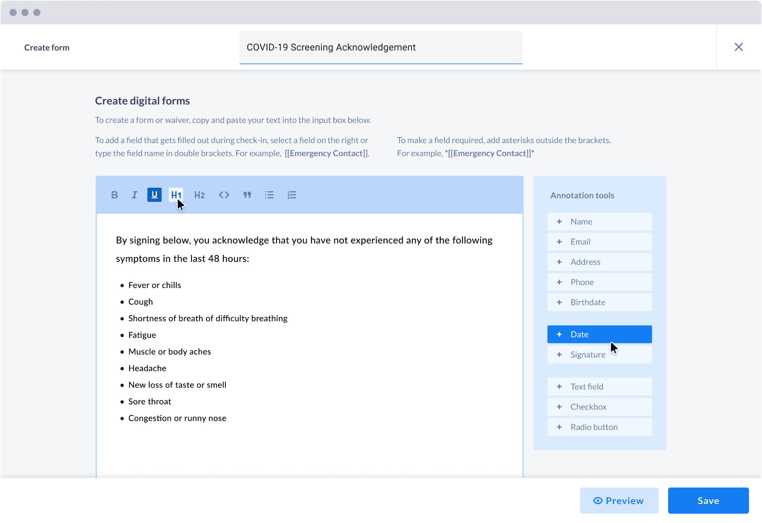
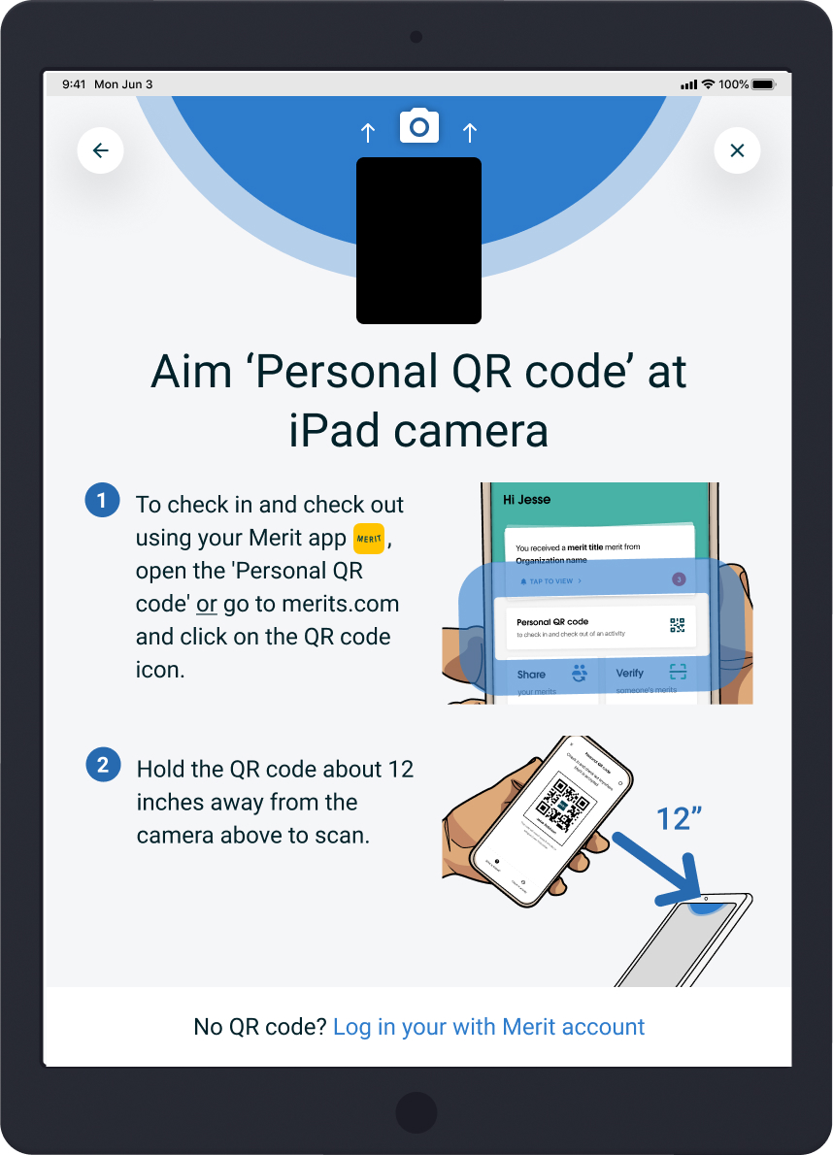
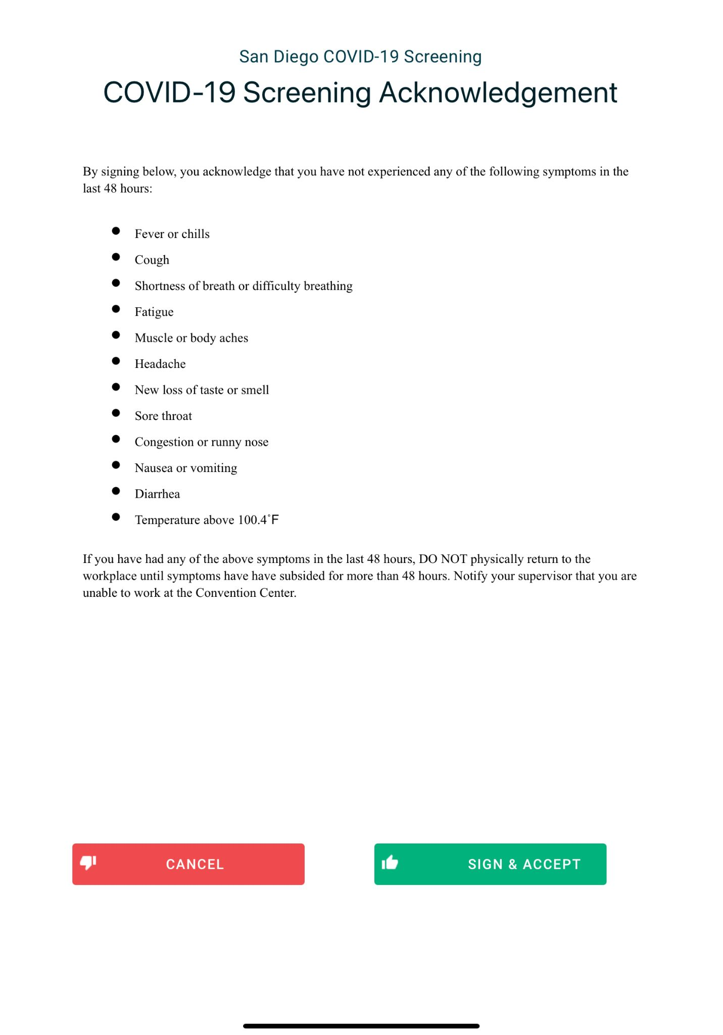
Customizable forms & surveys
From releases, to waivers, Merit allows you to build customizable forms directly into your personnel’s check-in process, ensuring you get the information you need every time. Individuals sign on the scanners and get a digital receipt.
Example:
A COVID-19 screening acknowledgement form that must signed to ensure that individuals verify that they do not have symptoms. In addition, unvaccinated individuals can be asked a series of additional questions, such as if they would like to sign up for a vaccination.

Slide 14
Implementation, Training, & Support

Slide 15
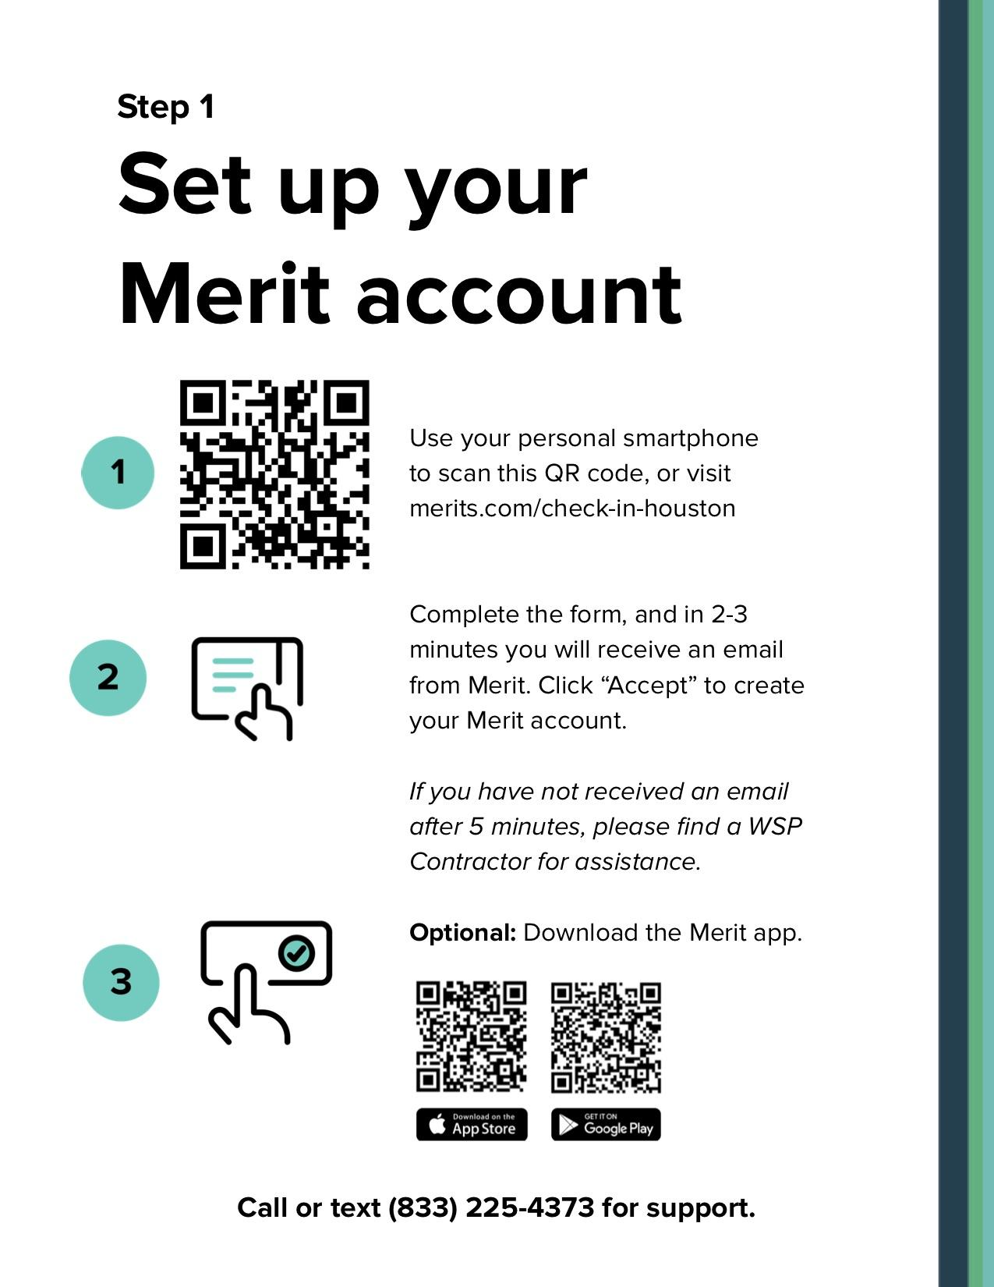
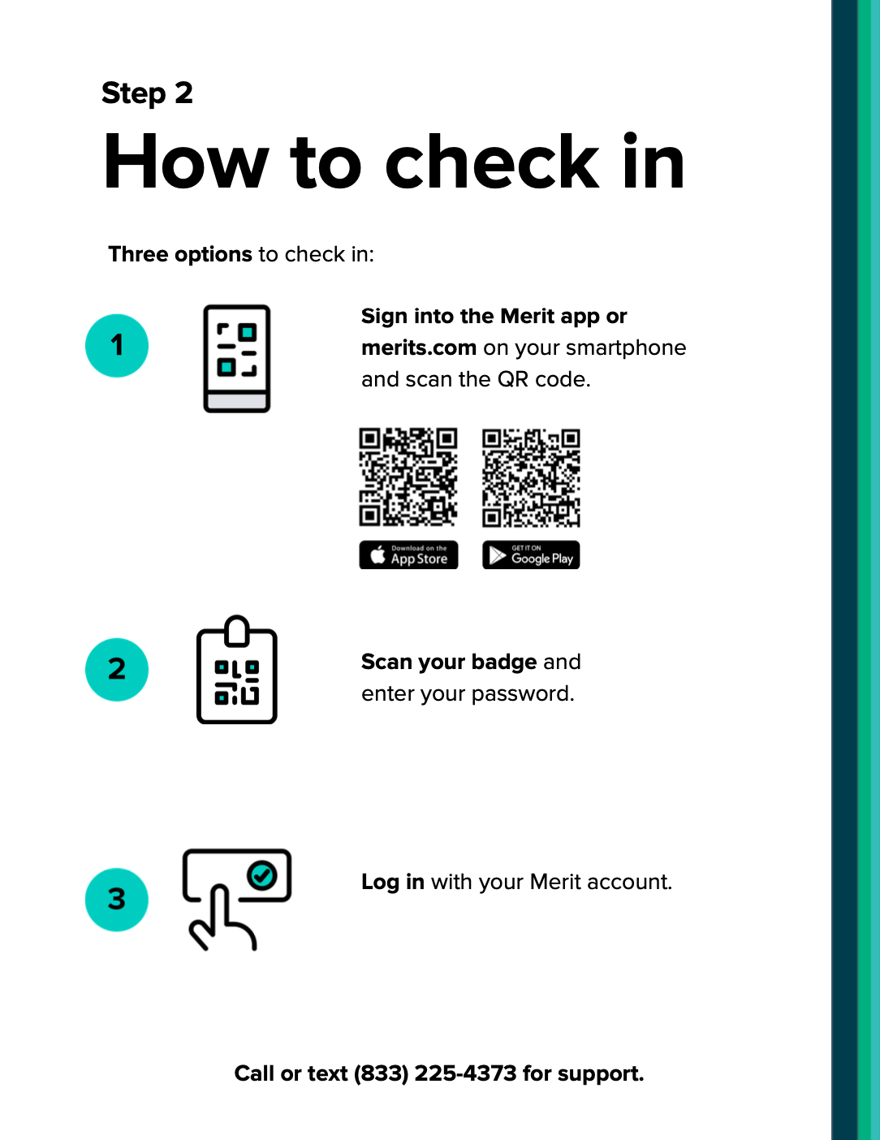
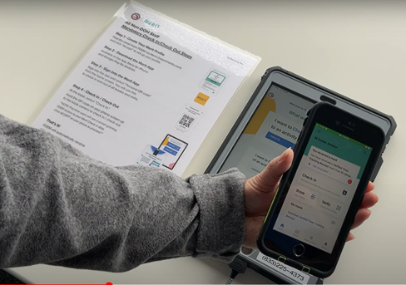
Software with a Service
We ensure that everything — from logistics and onboarding, and integrations, to informative marketing plans and helpful customer support — works for you and those you serve.
Merit’s kiosk kits ship directly to the site, and are easy to transport, set up, and break down.
Set-up in 48 hours or less
Dedicated onsite or remote Merit team members to train staff
24/7 phone & text support line
Kiosk(s) sent to each location with tablets, cases, stands, and locks
Custom-built multilingual signage, instructions, reference guides, video, email campaigns, etc.

Slide 16
Onsite Support
Merit provides all necessary onsite support for operational excellence.
Trained Expert Assistance Merit personnel is tasked with making sure you get full value from your implementation and all use cases Merit can support.
24/7 Support On-site technical support at all hours.
Enforced Site Accountability Merit personnel will ensure all scanners are used properly and enforce compliance with verification results.
1:1 Onboarding Merit staff can aid in the continual onboarding of new personnel, from badging to time-tracking to COVID-19 safety.

Slide 17
Recap & Overview
Human coordination solutions through digital Verified Identity

Slide 18
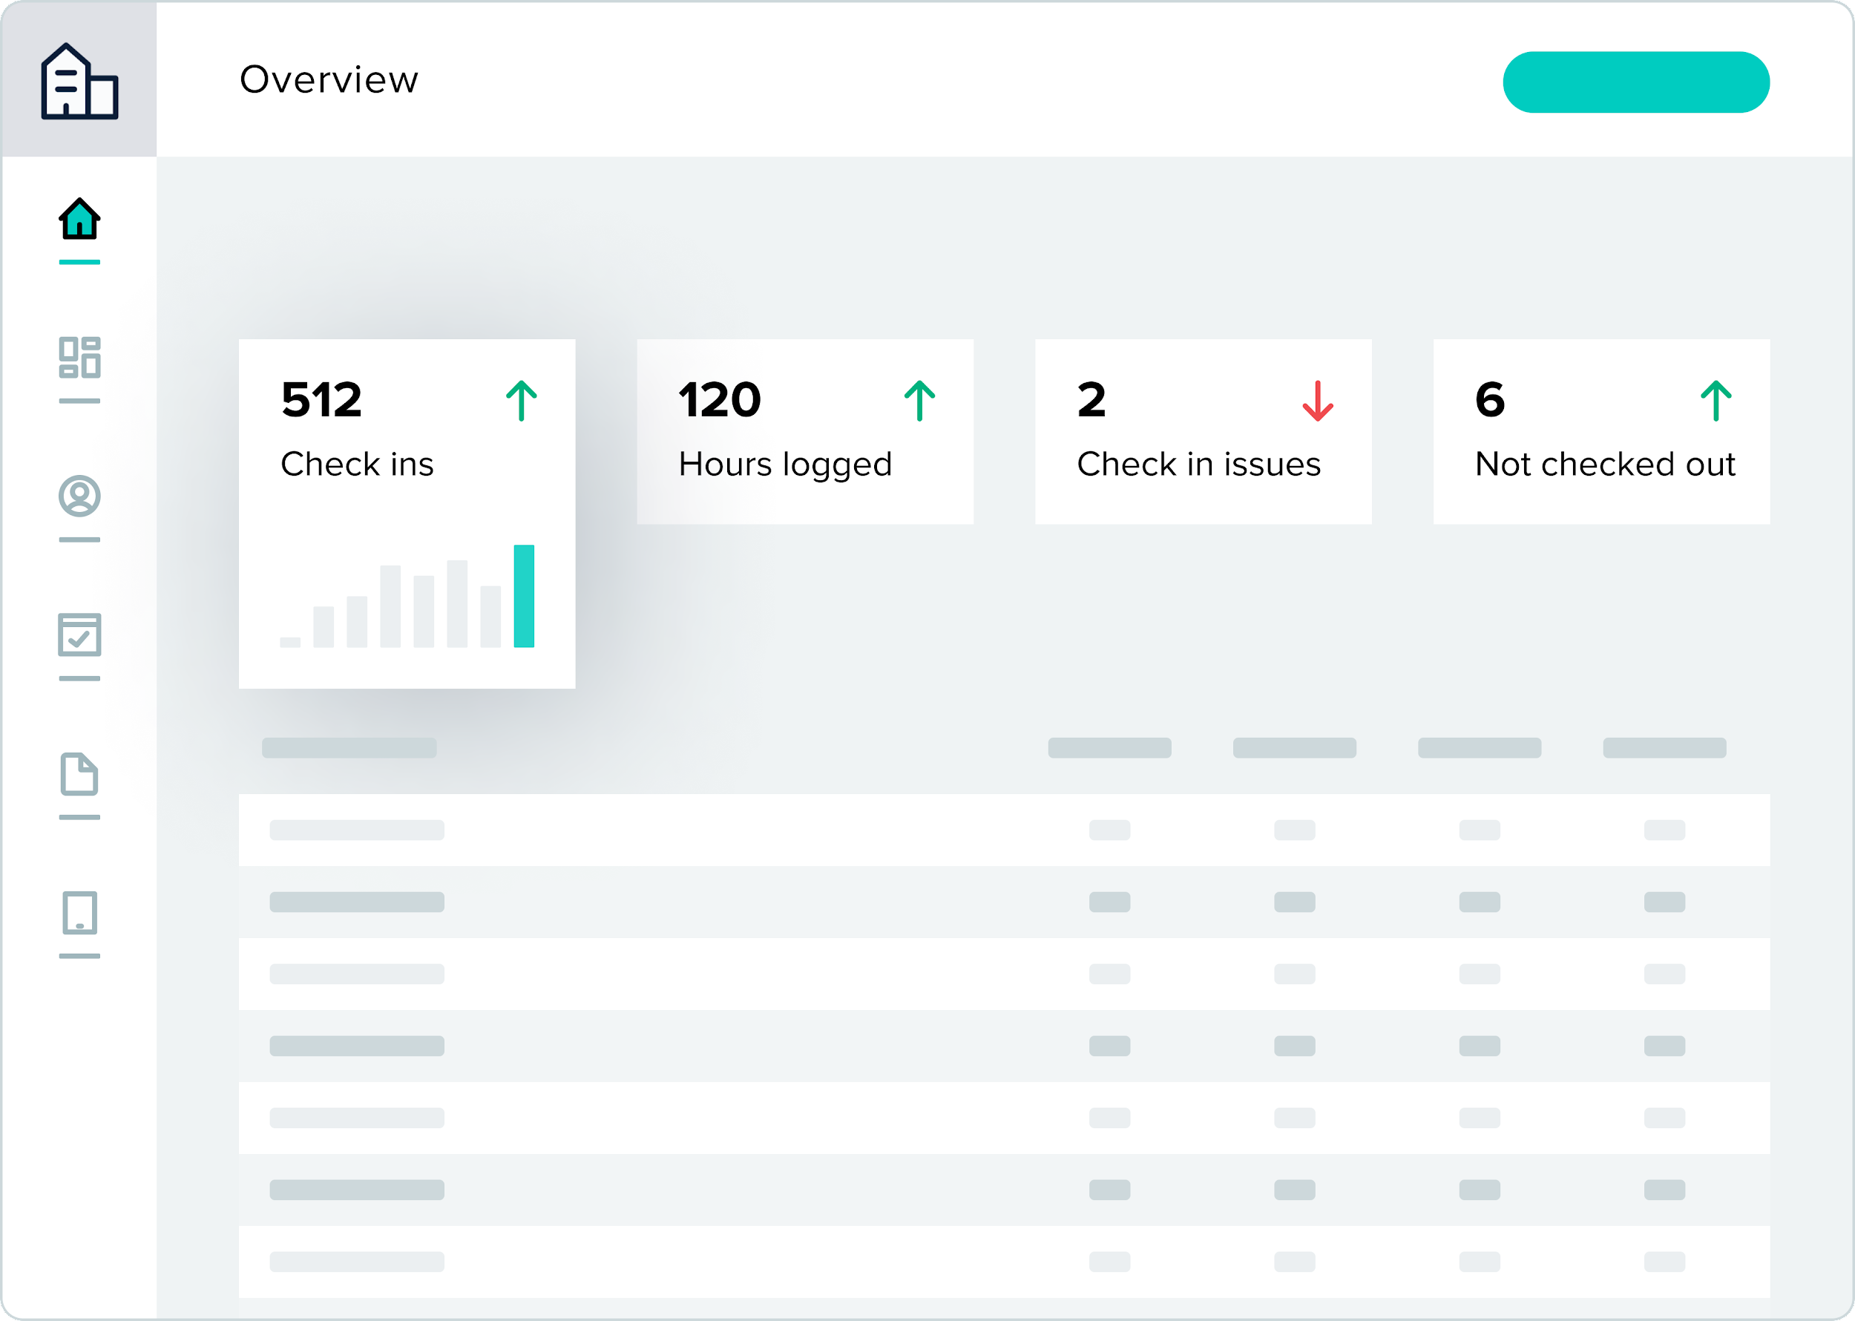
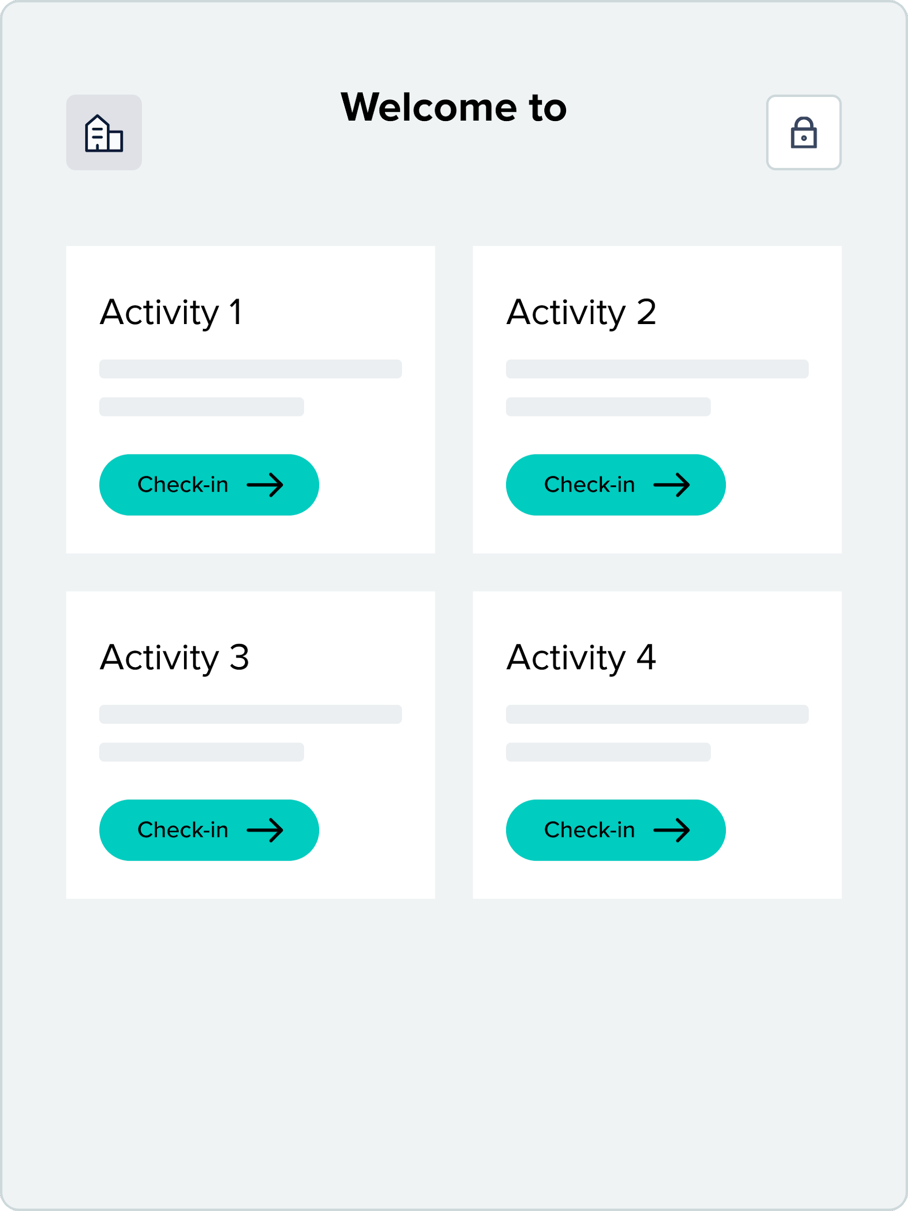
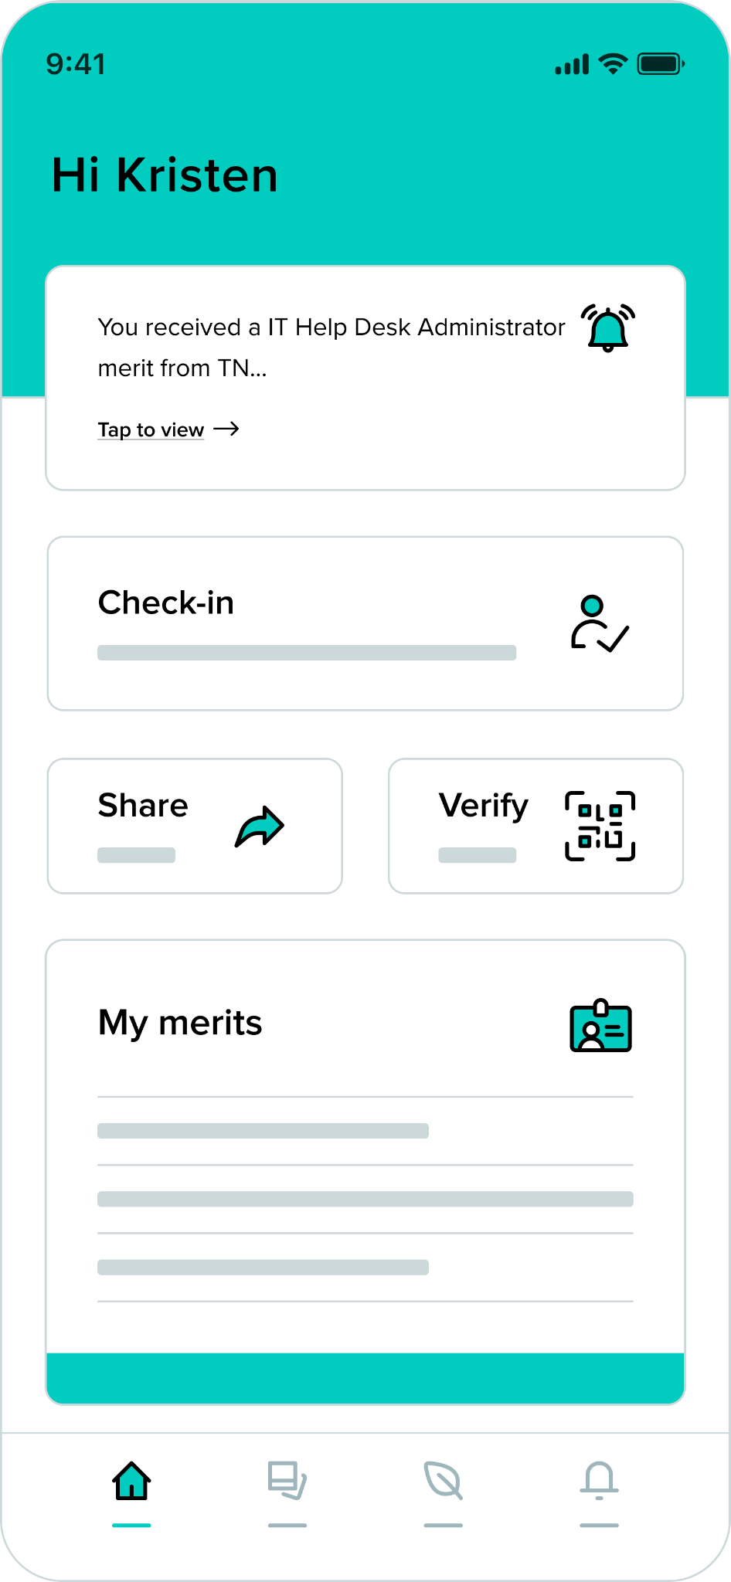
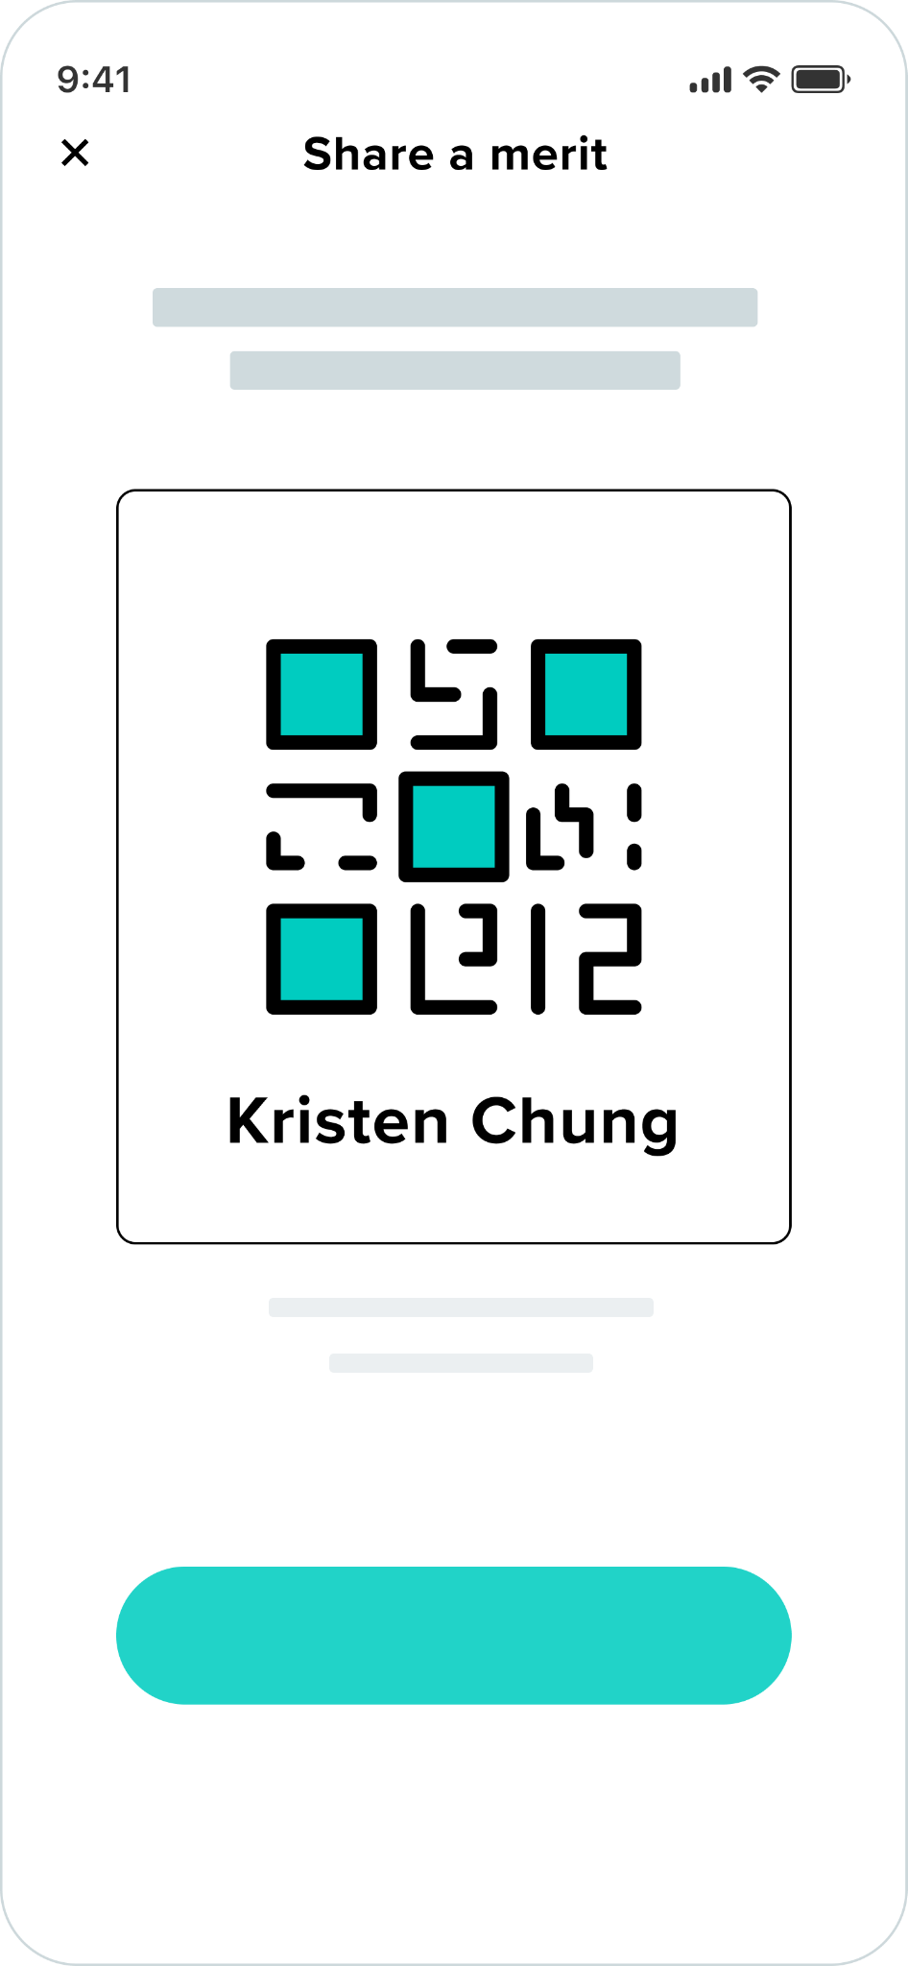
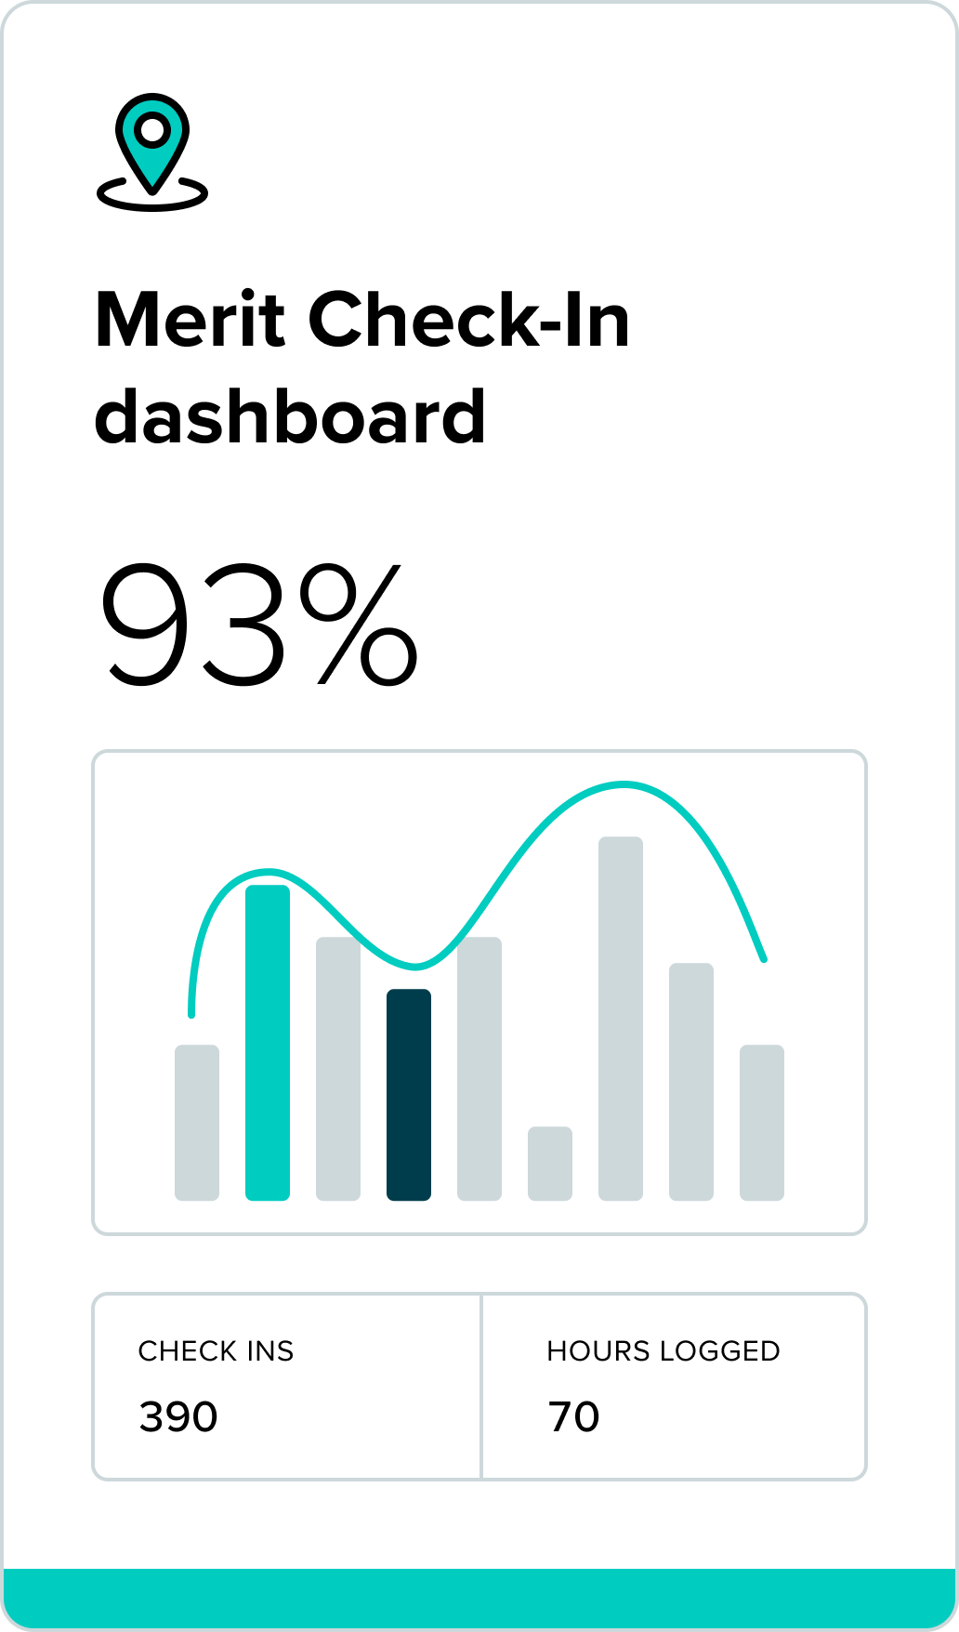
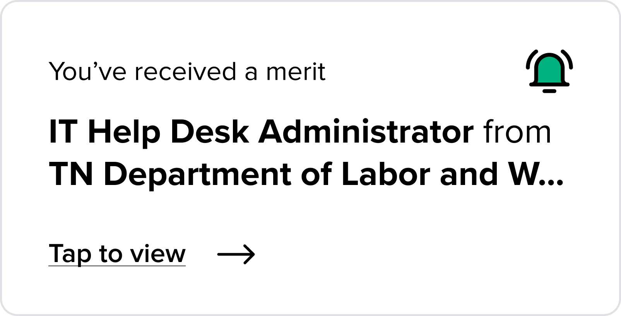
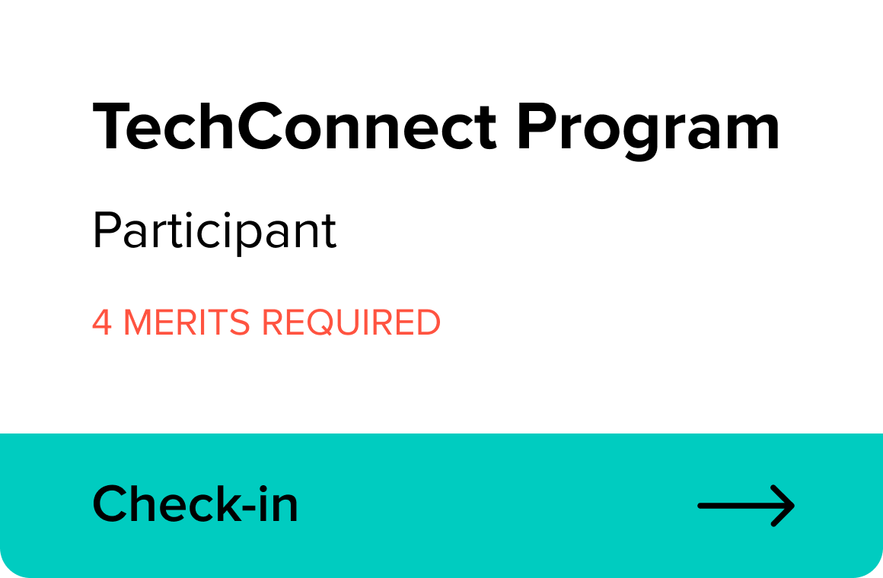
Merit is the all-in-one solution to track hours, training, experience, and credentialing.
Organization name
Organization name
Track reimbursable hours
Activity name
Activity name
Track compliance
Track Deployment Experience
Activity name
Activity name
Aggregated capability assessments
Digitize credentials and qualifications
Unify volunteers, medical personnel, electricians, and first-responders

Slide 19
Thank you
Taimarie Adams – taimarie@merits.com
Trevor Cornwell – trevor@merits.com

