Slide 1
JOBS4TN Version 18.0
System Efficiencies and Individuals
Sharyn Pelych l April 2018

Slide 2
System Efficiencies—Alerts/Preferences
Log in as Staff; My Staff Workspace; My Staff Resources; My Alerts; Modify My Alert Subscriptions.
Log in as Staff; My Staff Workspace; My Staff Resources; My Preferences; To configure what menu groupings appear, the order in which they display and if they are expanded or collapsed, click here.
And:
Log in as Staff; My Staff Workspace; My Staff Account.

Slide 3
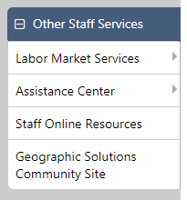
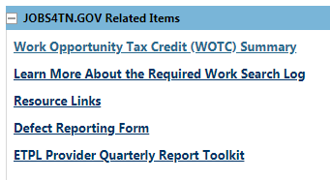
Other Staff Services: Easy Access
Click on the Assistance Center link (not on the flyouts).
Notes:
WOTC segue for LVERs; DRF for field staff.

Slide 4
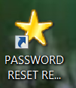
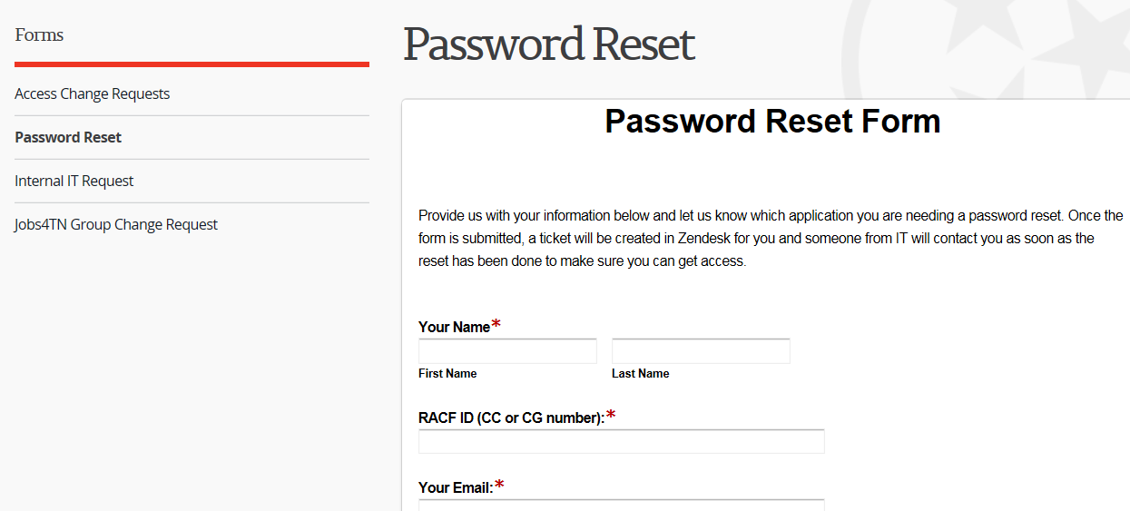
Desktop ICON
Notes:
Currently, only Labor Staff have this functionality; Our IT group can provide this functionality to our other field agencies if you want it. Click the Desktop icon; Formstack access is in Access Change Requests;

Slide 5
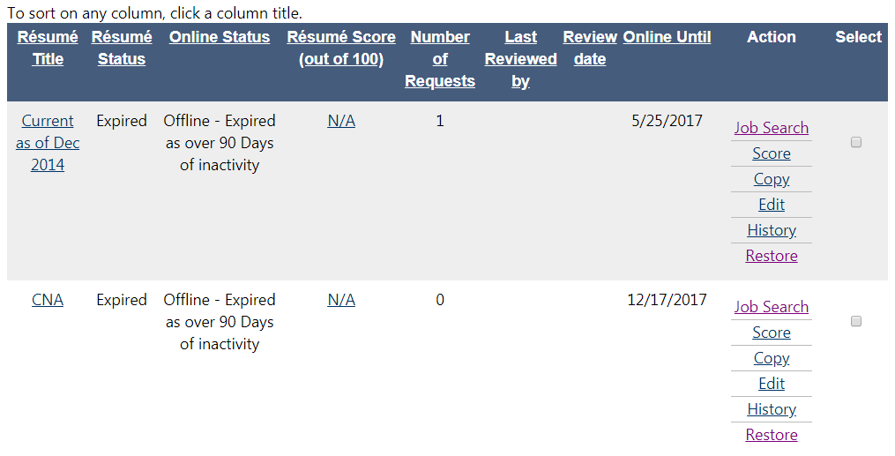
Accessing the Resume Scoring Tool
Notes:
Locate individual record. Click on Resumes. View all resumes.

Slide 6
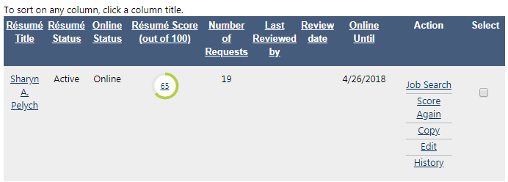
New Tool – Resume Scoring Tool
Click on the Score.

Slide 7
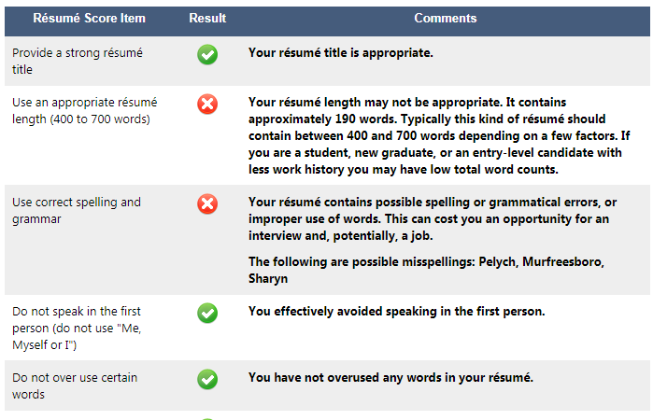
Resume Scoring Results
Notes:
This is a very abbreviated view of the information that is reviewed and scored. There are a total of 18 results that are scored.

Slide 8
New Tool – Cost of Living Calculator
Expand the +.
Notes:
Open a job order. Scroll down to the ‘How to apply for this job’ link. Expand the plus for ‘Show Additional Job Information’.

Slide 9
Access to Cost of Living Calculator
Notes:
This will pull out additional information for the job order. Scroll down to ‘Location/Work Site Information. View cost of living information.

Slide 10
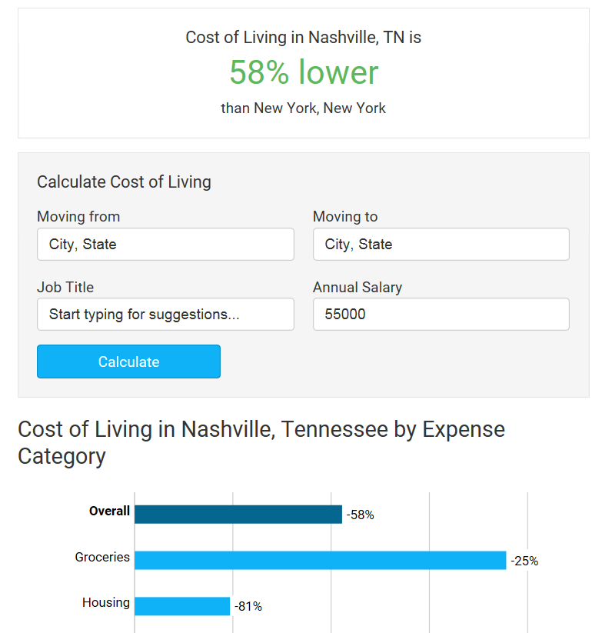
Calaculator Results
Notes:
This is just the beginning of the Calculator results. There is additional information and functionality available that will open in another window.

Slide 11
Case Notes: Good, Bad, & Ugly
Notes:
Ugly. Need to be more professional. Use Spell Check on case notes.

Slide 12
Good, Bad, or Ugly?
Notes:
Good case note. Good details.

Slide 13
Good, Bad, or Ugly?
Notes:
Bad. No details: Which hospital is the client working at? Who did the Staff person talk to in HR? What’s next?

Slide 14
Good, Bad, or Ugly…..or something else?
Notes:
Good case note. But this is a training opportunity for the Site Lead. Does anyone see what the training opportunity is?

Slide 15
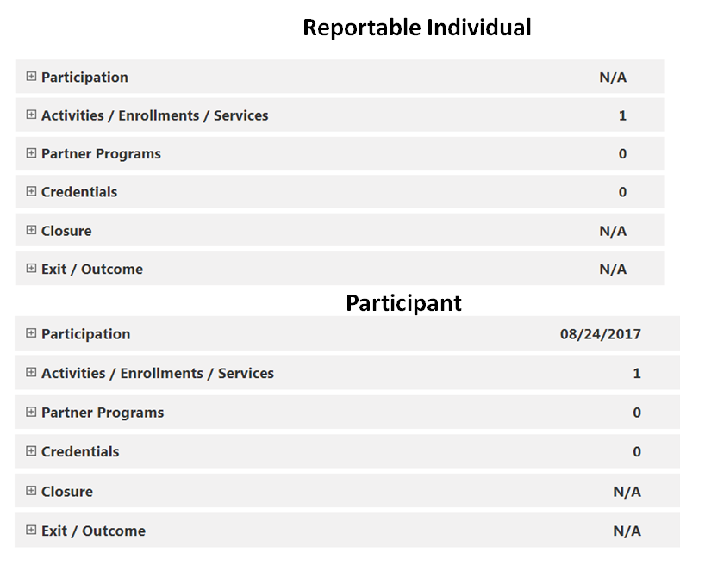
Reportable versus Participant
Notes:
What is the obvious difference? What should we look for when staff are unable to record certain activities?

Slide 16
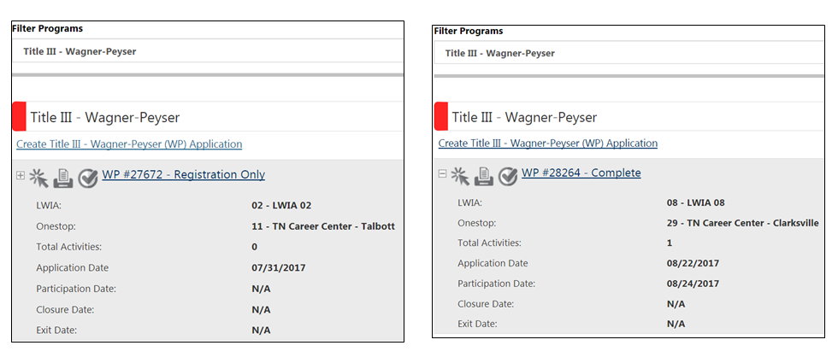
WP Registration Only v. Participation
Notes:
Incomplete applications need to be made Complete. How is that done? Bouncing around the application tabs will cause required information to be missed. The application will appear to be Complete but it will return to Incomplete status overnight. There are noo more shortcuts.

Slide 17
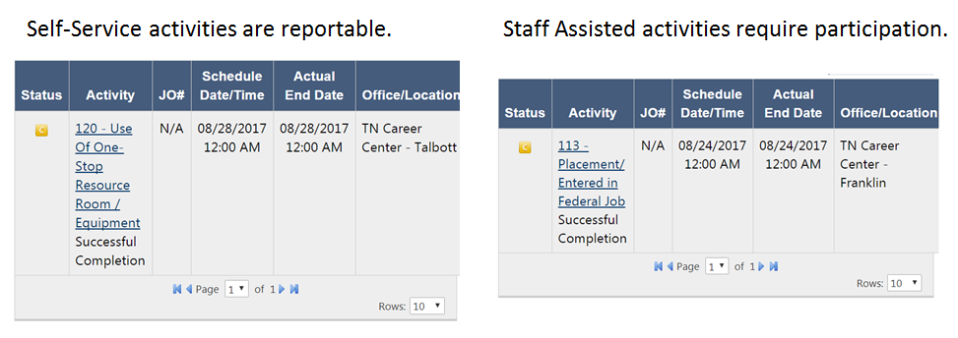
What is the difference between a Self-service and Staff Assisted-service?
Notes:
Hold up the Services spreadsheet. This should be printed, on the desk of, and in use by every case manager in the office.

Slide 18
Questions

Slide 19
Thank You!

