Slide 1
Using Work Based Learning to Employ Dislocated Workers
Justin Williams and Jamie Franklin

Slide 2
Defining Dislocated Workers
Anyone laid off through no fault of their own.
Including those affected by reduction in force, mass layoff, or closure
Self-employed, but now unemployed because of natural disaster
Displaced Homemaker
Exiting military service member (veteran)
Or qualifying spouse of military service member

Slide 3
Defining Work-Based Learning
Work-based learning (WBL) is a proactive approach to bridging the gap between workers and high-demand, high-skill careers. It is an arrangement that includes a paid work component and an educational or instructional element, wherein an individual obtains relevant knowledge and skills.
This can include:
Apprenticeships
Internships
On-the-Job Training

Slide 4
Apprenticeship
WHAT IS REGISTERED APPRENTICESHIP?
Registered Apprenticeships (RA) are innovative work-based career programs that include postsecondary earn-and-learn models meeting national standards for registration, provide on-the-job training and job-related technical instruction with incremental wage increases, and are conducted under the direction of a mentor.

Slide 5
On-the-Job Training (OJT)
WHAT IS On-the-Job Training?
On-the-Job Training is used when an employer identifies the need to fill vacant positions and is willing to hire people who need additional training.
OJTs can pay 50% of the trainee’s wages during a specific time frame
OJTs can be used in conjunction with an apprenticeship program
Participants must be new hires to the company

Slide 6
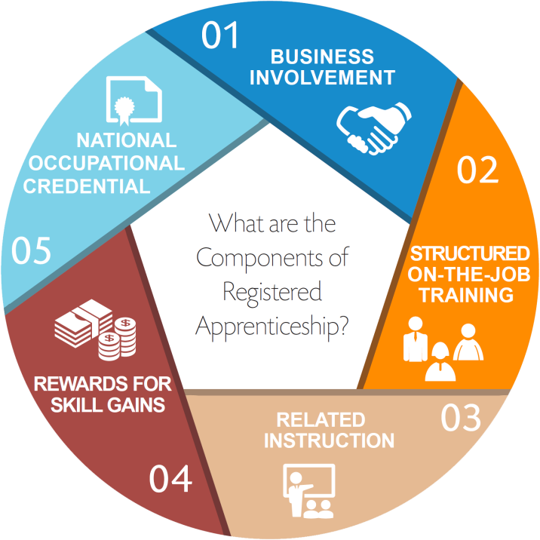
Components of Apprenticeship

Slide 7
Apprenticeship
Apprenticeship Myths
Apprenticeships are only for trades people
People are better off going to college
Apprenticeships are only for people who did not do well in college
There is no support from Businesses
Apprenticeships do not lead to full time work
Notes:
Average wage after completion: $70,000

Slide 8
Apprenticeship
Return on Investment
The return on investment for a registered apprenticeship program is: $1.46 for every $1 invested in an apprentice.
89% three-year retention rate. Moreover, 94% of apprentices retain employment after conclusion of the apprenticeship program.
A 2012 Mathematica evaluation of 10 States found that
for every $1 invested in Apprenticeship, return on
investment was $27.

Slide 9
Where Do Dislocated Workers fit in?
Dislocated Workers are a perfect fit for these WBL because:
They tend to already have soft skills
They may already have some of the skills needed in the new job, putting them ahead of a typical new hire
They should qualify for Title I Dislocated Worker funding, therefore allowing the LWDA to cover some of the training costs and/or salary
They could qualify for supportive/wrap-around services, ensuring that they get to work successfully and reduce absenteeism

Slide 10
Best Practices
Work with businesses within the industry sectors as defined by local plan
Go to where the businesses are…Chamber of Commerce, SCHRM, etc.
Case Managers should be aware of all open contracts with the LWDA to include Apprenticeships that are seeking new hires
Talk with businesses who are in a hiring cycle and provide information on the benefits and availability of OJTs and Apprenticeships
Talk with other LWDAs in your region who are utilizing OJTs and Apprenticeships

Slide 11
Questions?
Tennessee Department of Labor
& Workforce Development
Attn: Workforce Services (4-B)
220 French Landing Drive
Nashville, TN 37243

