Slide 1

Janet Shouse
Disability Employment Specialist
TennesseeWorks, Vanderbilt Kennedy Center
April 3, 2018

Slide 2

The Business Case
for Hiring People
with Disabilities
and How You Can Make This Work

Slide 3

TennesseeWorks Partnership
GOALS:
Increase employers’ awareness of hiring people with disabilities
Address key concerns and needs of employers
Partners are more than 45
state departments
and advocacy organizations committed to employment efforts
and resources
Notes:
TennesseeWorks is, again, a partnership that is implementing policy and systems changes to make competitive employment the first desired option and choice for every Tennessean. We are a group of 40 state departments and advocacy organizations that are committed to employment efforts to share resources.

Slide 4

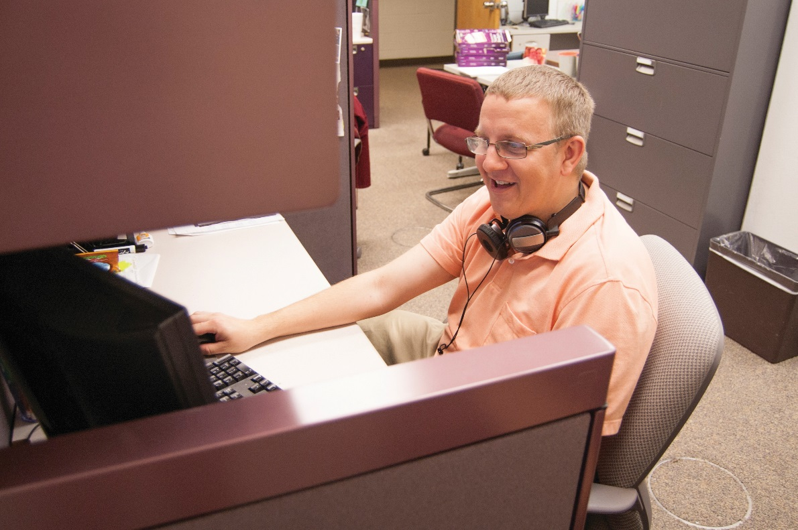
Today I will share …..
  Why hiring
  people with
  disabilities
  makes good
  business sense
  Examples of
  companies that have benefited
  Where you can find help to do it easily and well

Slide 5

New Realities in the Workforce
  Many of the nation’s leading companies have recognized the “Business Case” for hiring job seekers with disabilities and have established disability recruitment initiatives.

Slide 6
The Business Case for Hiring
Job Seekers with Disabilities
Employees with Disabilities
Employers
Customers
Equal or better reliability and retention rates Equal or better safety records, job performance ratings, job assignment flexibility
Require equal amounts of supervision
Reduced costs due to less turnover and retraining
Improved morale and productivity throughout the company
Employees with disabilities help
companies fine-tune their products to
meet the needs of people with
disabilities
87% prefer businesses that employ people with disabilities
92% will return to support such businesses
People with disabilities are 1/5 of U.S. population

Slide 7
The Business Case for Employing
Job Seekers with Disabilities
Labor Market Projections
Acquired Disabilities
Incentives
Labor shortages are here
Non-traditional sources of labor include people with disabilities
Accommodate and retain experienced and knowledgeable employees who acquire disabilities, which is often less costly than hiring and training new workers
Benefit from state and federal incentive programs, such as the Work Opportunity Tax Credit
Comply with the Office of Federal Contract Compliance regulations
Improve diversity

Slide 8
The Bottom Line …..
  Hiring people with disabilities makes good business sense
  Allows people to become taxpayers
  It’s the right thing to do!

Slide 9
Companies that are Leading the Way
Those with disability employment initiatives include:
Pepsico Best Buy
Manpower Motorola
Walgreens AT&T
Lockheed Martin Walmart
Microsoft Sears/K-Mart
American Airlines Lowes
Banana Republic SunTrust
IBM Booz Allen
Hamilton

Slide 10

Companies that are Leading the Way

Slide 11

Walgreens Executive Explains How That Company Made the Decision to Focus on Hiring People with Disabilities
I will insert the video of Randy Lewis here

Slide 12



Models in Tennessee
AT&T in Memphis
Walgreens REDI sites in retail stores throughout the state
Tennessee Rehabilitation Center at Smyrna has a “mock” Walgreens store and
is adding a CVS pharmacy tech program
Notes:
We have, in Tennessee, as many places around the country, tried to learn from the Walgreen experience and our attempting replications of Walgreens here. We have a replication of the distribution center initiative at the AT&T plant in Memphis. Also, Randy mentioned that as a result of the company’s success in its distribution centers , it has established the Retail Employees with Disabilities Initiative (REDI) in its retail stores nationwide. We have REDI sites Walgreens stores throughout the state of Tennessee and at each site Walgreens has a partnership with a local disability employment agency. Additionally, the Tennessee Rehabilitation center, which is operated by VR in Smyrna, has a mock Walgreens store, which starts people learning the skills that it takes to become a REDI intern.

Slide 13

Project Search
Cincinnati Children’s Hospital began to train job seekers with disabilities to meet a business need for qualified, reliable support staff in its Emergency Department.
Replicated in more than 300 licensed sites in the U.S., the U.K. and Australia.
Tennessee sites:
  Sheraton Hotel, Memphis
  West Tennessee Healthcare, Jackson
  Montgomery County Government Offices, Clarksville
  Vanderbilt Children's Hospital, Nashville
  Amerigroup, Nashville
  Embassy Suites, Murfreesboro
  East Tennessee Children’s Hospital, Knoxville
  University of Tennessee Medical Center, Knoxville
  Maryville College, Maryville, TN

Slide 14
Project Search
Transition-to-Work Program is a unique, business-led, 10-month employment preparation program that takes place entirely at the workplace.
Total workplace immersion facilitates a seamless combination of classroom instruction, career exploration, and hands-on training through worksite rotations.
The program culminates in individualized job development.
Students complete a resume that has each intern’s rotations and skills learned during the program.
Graduates get a Project SEARCH certificate of completion.
              Some programs are linked
              with school districts,
              some focus on individuals
              who are out of school.

Slide 15
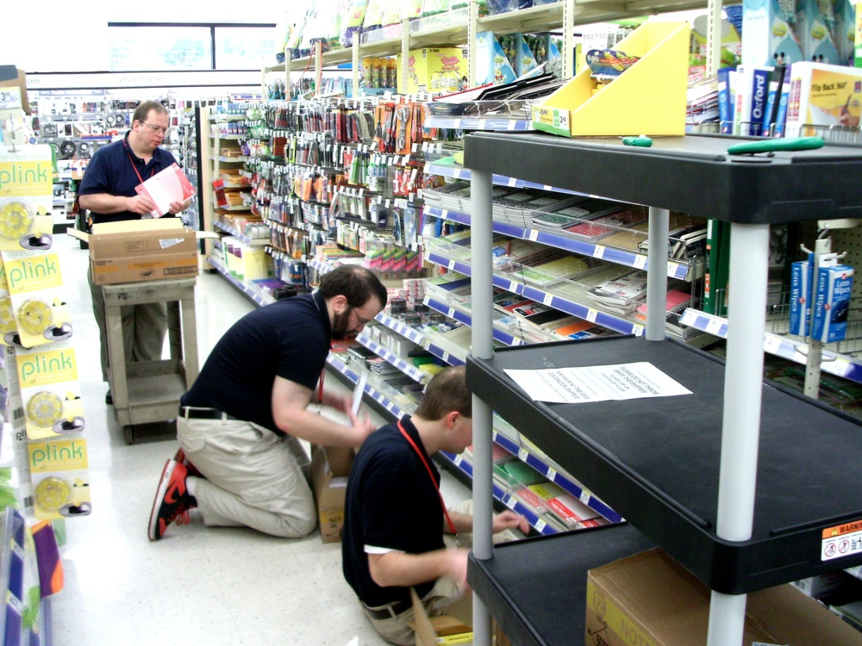
The Message from Walgreens and Project SEARCH
When we teach the way people learn, people can learn to do all kinds of work successfully…
and it’s great for business!
Notes:
The message from the Walgreens and Project SEARCH models is “when we teach the way people learn, people can learn to do all kinds of work”. The kind of work you saw in both the Project SEARCH and Walgreens videos show that the vision is boundless in terms of the possibilities for the kind of work that people with disabilities can do. And its great for business. Project SEARCH wouldn’t be replicated in 300 different sites unless they were showing business success at each site.

Slide 16

We Can Help You Do This
National Research Tells US that YOU:
Need a single point of contact to coordinate hiring and training
Need supports for recruitment, training and job retention to your industry standards
Need Just-in-Time technical assistance on workforce and disability-specific issues.
TennesseeWorks Partnership agencies are ready to help
Notes:
The message from the Walgreens and Project SEARCH models is “when we teach the way people learn, people can learn to do all kinds of work”. The kind of work you saw in both the Project SEARCH and Walgreens videos show that the vision is boundless in terms of the possibilities for the kind of work that people with disabilities can do. And its great for business. Project SEARCH wouldn’t be replicated in 300 different sites unless they were showing business success at each site.

Slide 17
The TennesseeWorks Partnership
Department of Labor and Workforce Development
Department of Intellectual and Developmental Disabilities
Department of Education
Council on Developmental Disabilities
Department of Human Services/Division of Rehabilitation Services
Department of Mental Health and Substance Abuse Services
Department of Economic and Community Development
TennCare
Vanderbilt Kennedy Center
UT Boling Center for Developmental Disabilities
Numerous disability-related advocacy organizations
Numerous community provider agencies supporting
people with disabilities

Slide 18

To Find Employees with Disabilities
UT Center
for Literacy, Education & Employment
  Join a local/regional employment group
VR Business Employment Consultants
  Be or get a business mentor to successfully employ persons with disabilities
American Job Centers
  Any size business can hire!
Notes:
To access job seekers with disabilities, Tennessee businesses small or large, can do it in what ever way feels comfortable. We are prepared to support you. Any organization who is looking to fill a job, or two jobs or four jobs a year, we want to work with you and provide you with the supports to be able to do that.
NEW:
You can contact any of these 3 entities- whoever you are most familiar with, or with whom you have developed relationships.
They’ll serve as that local point of contact and work with the other two to help you mobilize the resources to get your needs met.
You may already be familiar with listing your jobs with the American Job Centers– they can help. You may want more support, so you can connect with a VR Business Employment Consultant. They can help you become or find a mentor in your business sector who can talk about how to’s.
The Regional Corporate Connections representatives are involved with local employment groups; these can be a great place to learn more and make connections at your pace.
There is no wrong place of entry.
I want to leave you with one final point of inspiration in terms of meeting people who are potential job seekers out there to meet your workforce needs using this video.

Slide 19
Hiring and Retaining Workers
with Disabilities
Vocational Rehabilitation (VR) program can help:
Locate a talent pool of skilled candidates
Retain a valued employee whose job is affected by illness, injury or disability
Access no-cost resources to save your company time and money
Find ways to make your business accessible to customers and employees with disabilities
Link your company to multi-state resources
To find a local contact, call (615) 313-4891

Slide 20
Additional Services from VR
Job Site review --to become acquainted with the specifications of your vacancies and your screening preferences for the best match
Pre-screening before referral -- a customized review of each job candidate to determine if they can meet the demands of your job
No-obligation, no-cost “tryout” -- the U.S. Department of Labor has created pre-hire work options for selected candidates from the VR program
In the pre-hire trial period -- VR will work with you to make sure the candidate can do the job and, if necessary, consider any accommodations that might be helpful
Job Site training -- an option to provide wage reimbursement to cover your costs for training a VR referral that is hired…OR access to a VR-provided “job coach” to ensure one-on-one
coaching for a new hire
Post-hire follow-up

Slide 21
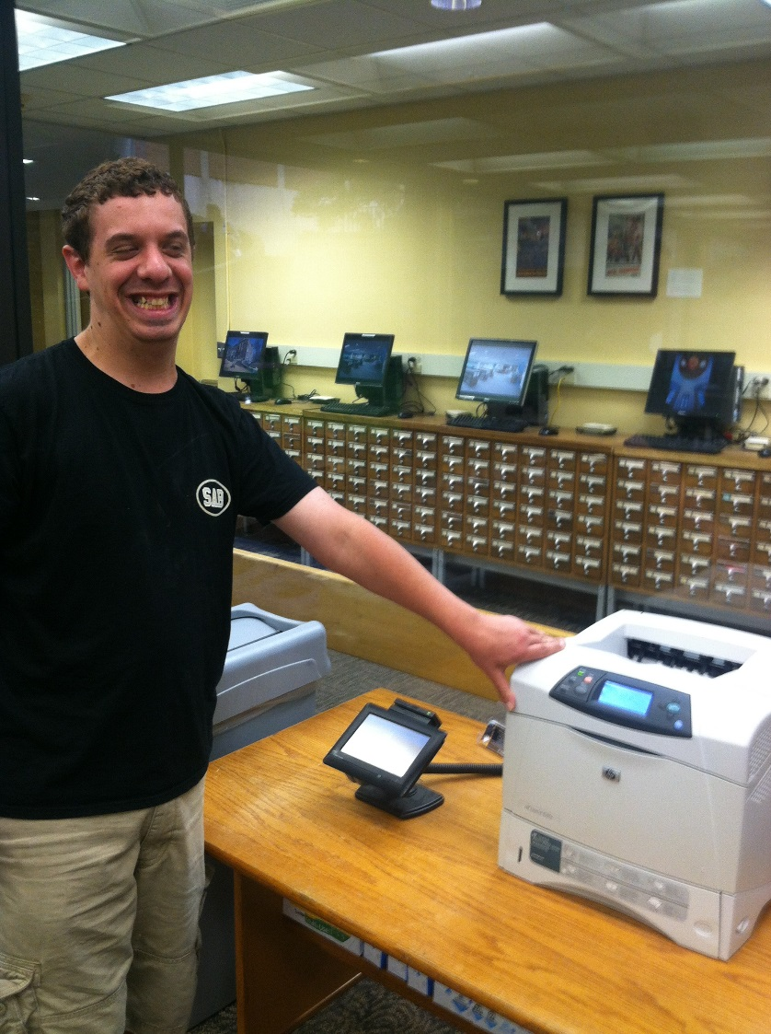
Employment and Community First CHOICES
Gov. Bill Haslam designated Tennessee an Employment First state in 2013.
Employment First means employment in integrated, competitive jobs is the first and preferred options for individuals with disabilities receiving state services.
TennCare works with the three managed care organizations to provide services under the ECF CHOICES program, which
include many employment services.

Slide 22
Employment and Community First CHOICES
Young people with intellectual or developmental disabilities who are exiting high school are a priority category.
The three MCOs—BlueCare, Amerigroup and United Healthcare—contract with community provider agencies for employment services for their members.
These provider agencies would be happy to work with employers in hiring job seekers in ECF CHOICES.
Agencies can provide ongoing job support for these individuals.
I hope to have a list to share.

Slide 23
Department of Intellectual and Developmental Disabilities
With the Employment First directive, efforts are now focused on employment for people supported by the DIDD waivers.
Right now, only 16% of individuals in these waiver programs are employed.
Community provider agencies also offer employment support for people in these waiver programs.
For additional information, contact Jeremy Norden-Paul, State Director of Employment and Day Services for DIDD. Call 615-210-4830 or email Jeremy.Norden-Paul@tn.gov

Slide 24
Department of Mental Health
and Substance Abuse Services
Individual Placement and Support (IPS) is an evidence-based model of supported employment for people with serious mental illness that assists individuals in obtaining employment and provides supports to assist in maintaining the job.
Work is the best treatment we have for serious mental illness (i.e., people with schizophrenia spectrum disorder, bipolar, or depression).
Two-thirds of people with serious mental illness want to work but only 15% are employed.
They see work as an essential part of recovery.
Working can both be a way out of poverty and prevent entry into the disability system.
Competitive employment has a positive impact on self-esteem, life satisfaction, and reducing symptoms.
For information on IPS, contact Sejal West, Director of Wellness
and Employment at TDMHSAS, at sejal.west@tn.gov.
Luciano, Bond, & Drake, 2014

Slide 25
Individual Placement and Support
Contact a Community Mental Health Center to connect with IPS:
Frontier Health/Victory Center (Northeast Tennessee) 423-975-6000
www.frontierhealth.org/services-vocational-recovery.php
Peninsula (East Tennessee) 865-374-7134
www.frontierhealth.org/services-vocational-recovery.php
Helen Ross McNabb (Knox County) 865-544-3841
www.mcnabbcenter.org/IPS
Ridgeview (East Tennessee) 865-481-6170
www.ridgevw.com/index.html
AIM Center (Hamilton County) 423-702-8015
www.aimcenterinc.org/services/employment
Park Center (Davidson County) 615-650-2900
www.parkcenternashville.org/programs/employment-solutions-partnership
Pathways (West Tennessee) 731-541-4545
www.wth.org/locations/pathways/pathways-behavioral-health-services/services-and-programs
Lowenstein House (Shelby County) 901-274-5486
www.lowensteinhouse.com/home.html

Slide 26
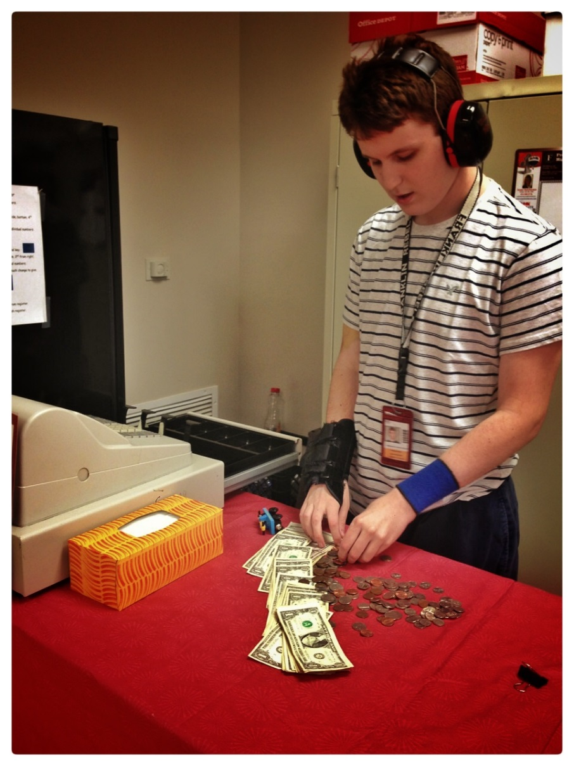
Department of Education
Occupational Diploma
For students with disabilities who have Individual Education Programs (IEPs)
Has a stronger focus on vocational/career outcomes
Student must meet requirements of Mastery of the Skills, Knowledge and Experience Mastery Assessment (SKEMA)
Student must complete of two years of paid or non-paid work experience as defined in the IEP
SKEMA was created with input from businesses and employers
SKEMA has 4 “Required” skills, 10 “Critical” skills, 18 “Preferred” skills and 17 “Enhancing” skills

Slide 27
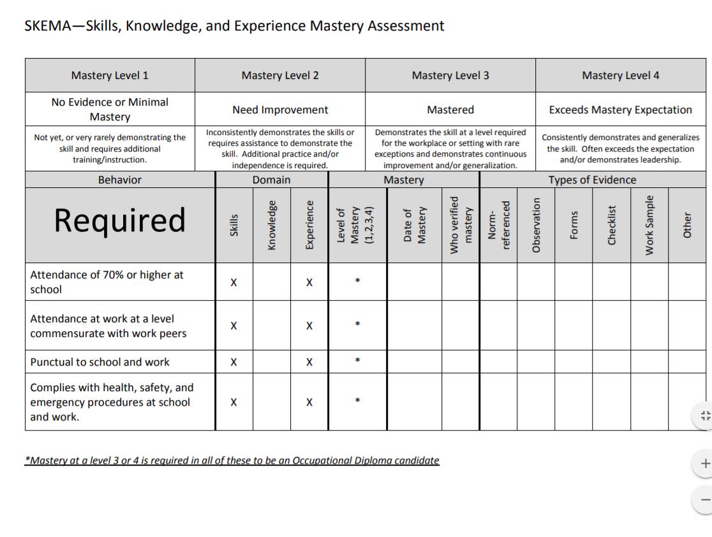

Slide 28
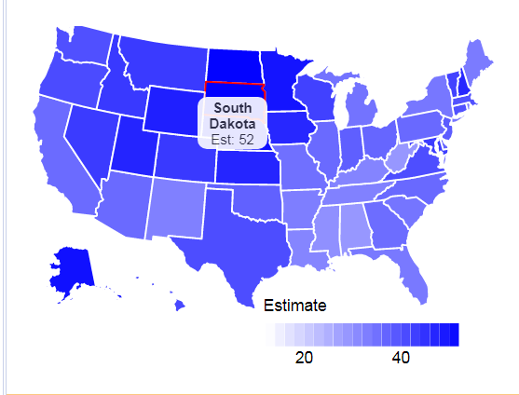
Employment Rate Estimates for People with All Disabilities
South Dakota,
at 52, ranks No.1
Tennessee, at 31.4, ranks No. 45
Alabama and West Virginia, at 27.9, are tied at the bottom
of the 50 states
The percentage of non-institutionalized persons, male or female, with a disability, ages 21-64, all races, in the United States who were employed in 2016. From the American Community Survey, www.disabilitystatistics.org

Slide 29
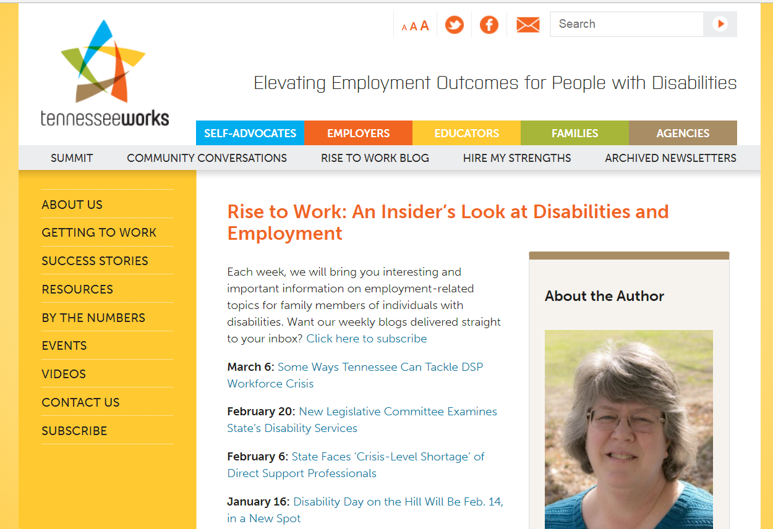
Now for a Shameless Plug
www.tennesseeworks.org/blog/

Slide 30
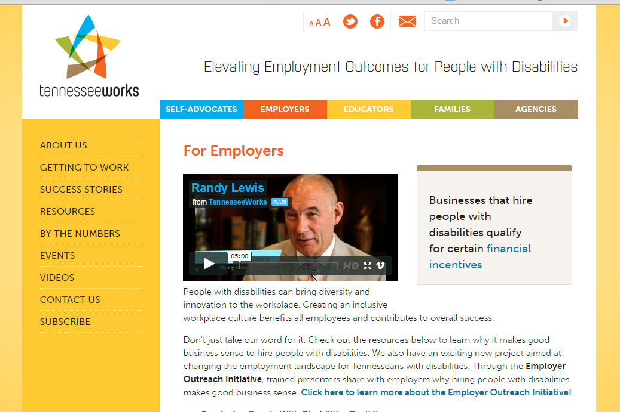
Visit www.TennesseeWorks.org
Like us on FaceBook!
Watch Success Stories
Check out events
Get the newsletter!!
Notes:
We’d like you to get involved, and we have some websites that have information on disability employment generally, and on disability employment initiatives here in Tennessee and what’s going on. We also have developing regional and local disability employment collaborations that we hope you’ll get involved in. And we hope that you’ll become a mentor to successfully employed people with disabilities.

Slide 31
Job Accommodation Network-Ask Jan
Practical Solutions – Workplace Success
JAN is the leading source of free, expert, and confidential guidance on workplace accommodations and disability employment issues.
JAN consultants offer one-on-one guidance on workplace accommodations, the Americans with Disabilities Act (ADA) and related legislation, and self-employment and entrepreneurship options for people with disabilities.
Assistance is available over the phone and online.
Private employers of all sizes, government agencies, employee representatives, and service providers, as well as people with disabilities and their families.
https://askjan.org/
JAN is one of several services provided by the U.S. Department of Labor's Office of Disability Employment Policy. www.dol.gov/odep/index.htm

Slide 32

My Thanks
Michael Needel, Director of Business Services, Workforce Development
Robin Wright, Trade Adjustment Coordinator
Jamie Franklin, Trade Adjustment Specialist
And my many colleagues in the TennesseeWorks Partnership

Slide 33
Questions?

Slide 34


Contact
Janet Shouse
615-875-8833
Janet.shouse@vanderbilt.edu
For information on
TennesseeWorks
and additional resources,
contact:
(615) 322-4999
tennesseeworks@vanderbilt.edu
www.tennesseeworks.org
Notes:
These are the contact information for PRESENTER, in case you want to contact me, I’d be happy to send you information on anything that’s been covered here on behalf of TennesseeWorks. I also have the name of the Corporate Connections person who would be your contact if you want to pursue specific disability employment objectives. I thank you so much for your time today, and we look forward to working with you and all of the Tennessee employers to make it possible to meet your workforce needs through people with disabilities. Thank you.

