Slide 1
WIOA Systems Performance Data

Slide 2
Two Main Goals
To Promote Greater Accountability in Grants Systems Data Management
To Promote Greater Consistency in the Recording and Tracking of Grants Systems Data

Slide 3
GOAL 1: Accountability is defined as…
Probity and legal accountability-raising and spending funds according to law and regulations.
Process accountability-using adequate management processes, organization structure and internal controls.
Performance accountability- achieving desired outputs (activities, services, methods, approaches) with efficiency.
Program accountability-effectively achieving desired program outcomes (results, impact, accomplishments).
Policy accountability-implementing appropriate policies, adjusting if they prove ineffective or if priorities change.

Slide 4
GOAL 1: Accountability is Shared…
Responsible to policy goals set by elected officials;
Fulfilling program objectives in the most cost-efficient manner;
Complying with applicable policies and procedures;
Providing timely and accurate reports;
Exercising good stewardship is responsibility of every stakeholder here and to promote long-term sustainability to the benefit of those were serve.

Slide 5
GOAL 2: Recording and Tracking…
Fragmentation:
Collections and management of data is spread across multiple silos (local structures)
Lack of policies and processes
Untimely / Inaccurate recording

Slide 6
GOAL 2: Why is it important…?
Funding is dependent on it
Management decisions are made on this data
Federal Government relies on this data to update congress
Remain relevant as a workforce system
Tell success of what we are doing in Tennessee
Transparent
Fiscally responsible

Slide 7
Charge….
Change the game by:
Fully leveraging government's vast information resources to enable evidence-based policy development, decision-making, and public accountability and transparency.
Learn how to turn data into powerful insights to manage programs and operations and enhance the citizen experience.

Slide 8
Themes of WIOA
Integrated Service Delivery
Integrated Data Systems
Performance measurement

Slide 9
WIOA Vision
Across the system, continuous improvement is supported through evaluation, accountability, identification of best practices, and data driven decision making

Slide 10
Primary Indicators of Performance for all Programs
Employment Rate 2nd Quarter after Exit
(Education/Employment for youth)
Employment Rate 4th Quarter after Exit
(Education/Employment for youth)
Median Earnings in the 2nd Quarter after Exit
Credential Attainment Rate
of those who received training or education, excluding OJT or Customized Training
Measurable Skills Gains
Effectiveness in Serving Employers

Slide 11
Employment Rate 2nd Quarter After Exit
Employment Rate 2nd Quarter after Exit is the percentage of participants who are in unsubsidized employment during the second quarter after exit from the program.
Methodology
The number of participants who exited during the reporting period who are found to be employed, either through direct Unemployment Insurance wage record match, Federal or military employment records, or supplemental wage information, in the second quarter after the exit quarter divided by the number of participants who exited during the reporting period.

Slide 12
Employment Rate 4th Quarter After Exit
The Employment Rate 4th Quarter after Exit is the percentage of participants who are in unsubsidized employment during the fourth quarter after exit from the program
Methodology
The number of participants who exited during the reporting period who are found to be employed, either through direct Unemployment Insurance wage record match, Federal or military employment records, or supplemental wage information, in the fourth quarter after the exit quarter divided by the number of participants who exited during the reporting period.

Slide 13
Median Earnings 2nd Quarter After Exit
Median earnings are the number of program participants who are in unsubsidized employment during the second quarter after exit from the program, as established through:
Direct Unemployment Insurance wage record match
Federal or military employment records
Supplemental wage information.
Using the collected quarterly wage information as a set, arranged the set from lowest to the highest. Find the central value.

Slide 14
Measurable Skill Gains
The Measurable Skills Gains Indicator
Is used to measure the interim education or training progress of enrolled participants within a reporting period
Not an exit-based measure
Examples of Documented Progress
Achievement of at least one educational functional level of a participant receiving instruction below the 9th grade level
A secondary diploma or its equivalent
Secondary or post-secondary transcript or report card that shows the student is meeting TN’s academic standards
Satisfactory or better progress report towards established milestones
Completion of an On-the-Job Training
Completion of a One Year Apprenticeship
Successful passage of an exam that is required for a particular occupation
Progress in attaining technical or occupational skills training
Knowledge-based exams

Slide 15
Effectiveness in Serving Employers
Retention with the same employer in the 2nd and 4th quarters after exit
The percentage of participants who exit and are employed with the same employer in the second and fourth quarter after exit
Repeat Business Customer Rate
The percentage of employers who receives core program services more than once within the last three reporting periods
Employer Penetration Rate
The percentage of employers that are using core program services out of all the employers in the state

Slide 16
Reporting Layouts
Title 1& 3 -DOL only PIRL- Participant Individual Reporting Layout (PIRL) ETA 9172
Current MIS reporting system for Wagner Peyser and Title 1 Adult, Dislocated Worker and Youth is the Jobs4TN System.
Title 2 -NRS Reporting Tables
Current reporting system for Adult Education was Ecmats and is now Jobs4tn
Title 4 -RSA 911
Current reporting system for Vocational Rehabilitation is TRIMS.
ETA 9170 – Joint PIRL – Combines elements from each of the above reports to produce a combined performance report for the state workforce system.

Slide 17
Table 1. State Program Score and State Indicator Scores

Slide 18
Workforce Services Reports
Information now gives us the ability to further analyze and make comparisons
Grants4tn- Fiscal Reports- Program and Administration dollars tracked
Jobs4tn- Program per participant dollars and enrollments
Jobs4TN- Reports- Greeter- How many people walked into a brick and mortor AJC and the reason for their visit
Labor Market Information- Gives potential that could be served in areas

Slide 19
Dashboard

Slide 20
Path to run reports are on back of dashboard

Slide 21
Dashboard Alignment with Fiscal Policies

Slide 22
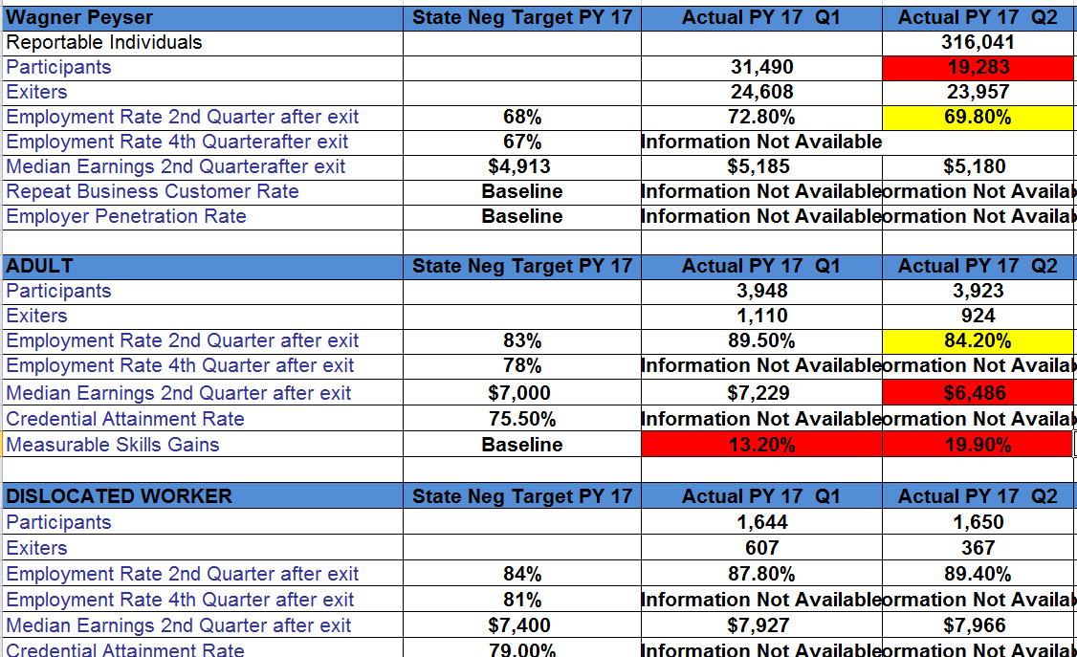
Performance outcomes per program

Slide 23
Reports on hard to serve in Jobs4tn
Login as staff
Detailed Reports
Case Load –WIOA
Targeted Population Summary
Run Report
Export to Excel

Slide 24
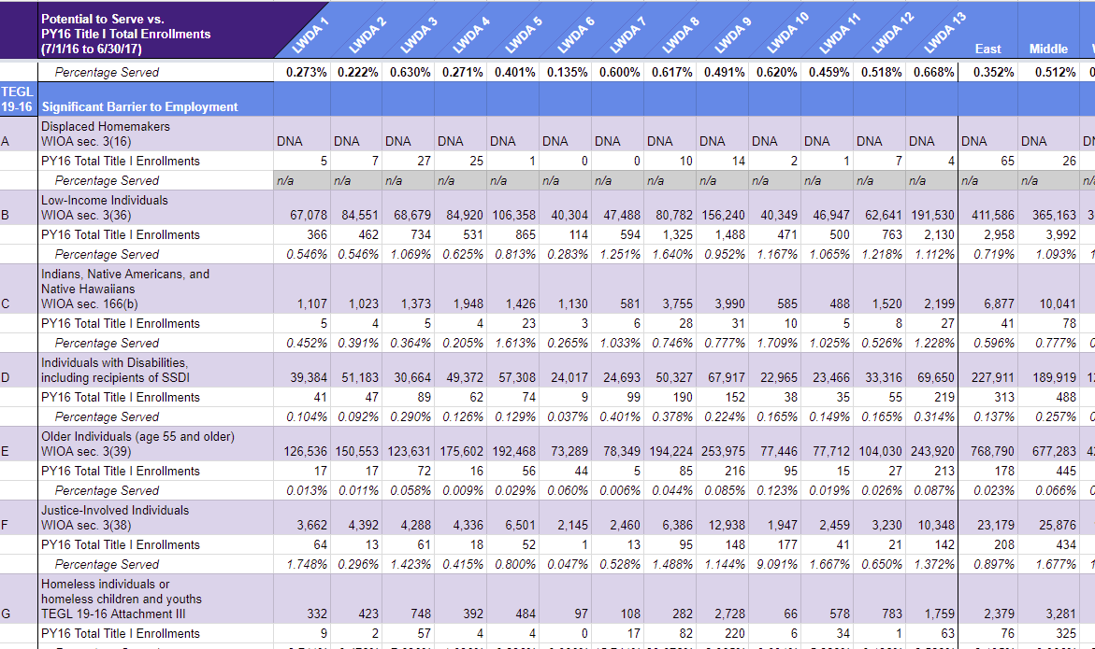

Slide 25
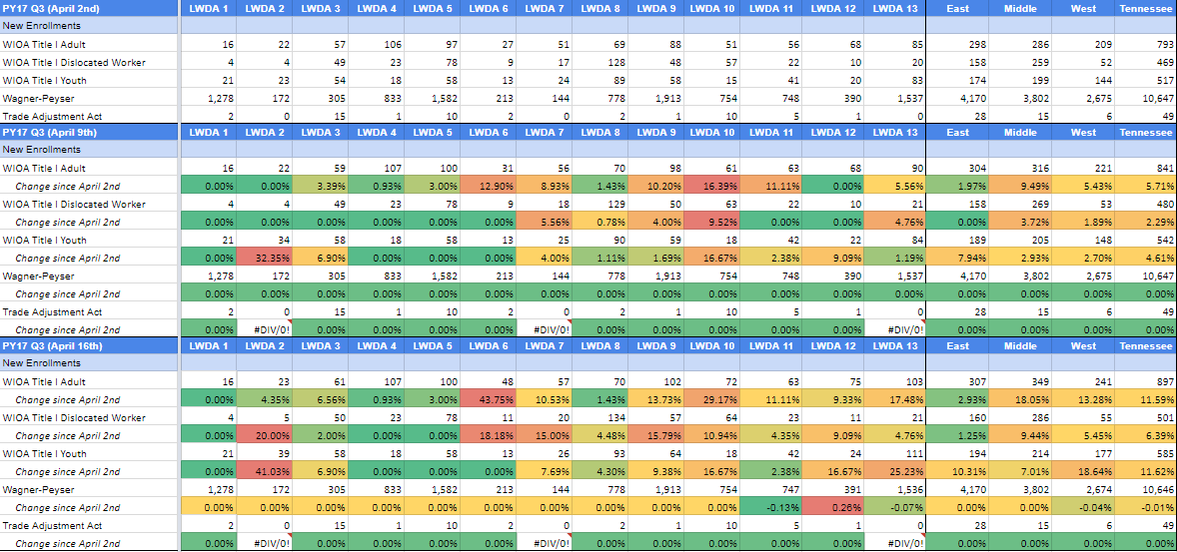
We are looking at how long it took to update data in the system.

Slide 26
Question?

