Slide 1
RE-EMPLOYMENT SERVICES AND ELIGIBILITY ASSESSMENTS (RESEA) UNEMPLOYMENT ELIGIBILITY
TN DISLOCATED WORKERS CONFERENCE
GAYLORD OPRYLAND RESORT AND CONVENTION CENTER
NASHVILLE, TN
JULY 22 – 24, 2019

Slide 2
UNEMPLOYMENT INSURUANCE CONTACTS
Jeremy Colbert, Director UI Claim Center (housed in Chattanooga, TN) – jeremy.colbert@tn.gov
Elizabeth Jolly, Assistant Director UI Claim Center (housed in Knoxville, TN) – elizabeth.jolly@tn.gov – RESEA DECISIONS
Tiffany Kerstetter, Assistant Director UI Claim Center (housed in Central Office, Nashville, TN) – tiffany.m.kerstetter@tn.gov – TRA/RTAA/Federal/CWC

Slide 3
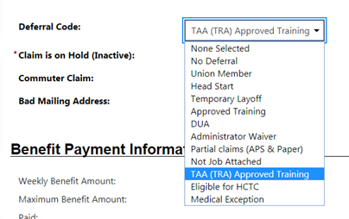
CHANGES TO WEEKLY CERTIFICATIONS SINCE GUS IMPLEMENTATION
No more random Eligibility Reviews every so many weeks
Now built into the question every week based on their Deferral Code:

Slide 4
WHAT DOES THIS MEAN FOR UNEMPLOLYMENT AND RESEA
Catch the issues sooner, hopefully the week it becomes an issue
Reduces Improper Payments
Reduces Overpayments
Cuts down on Misinformation or Miscommunication
Allows us to make the claimant aware of how their Unemployment is affected or IF it is even affected
Allows AJC staff more time to focus on Reemployment – Unemployment is for the Claim Center Staff to worry about

Slide 5
Weekly Certification for Unemployment

Slide 6
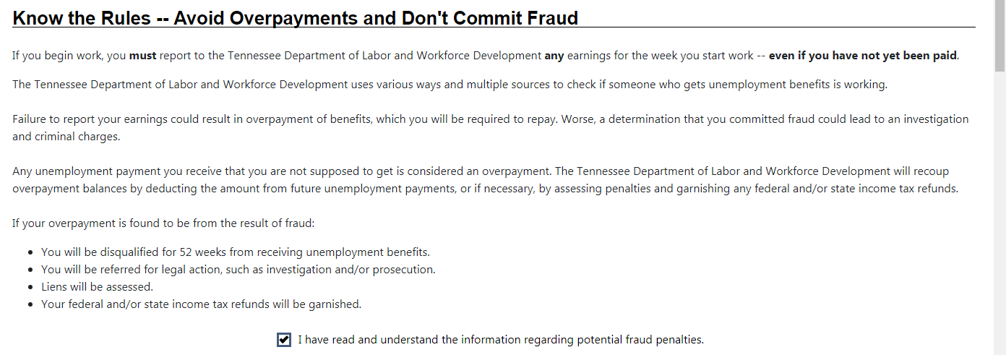
Weekly Certification for Unemployment

Slide 7
Weekly Certification for Unemployment

Slide 8
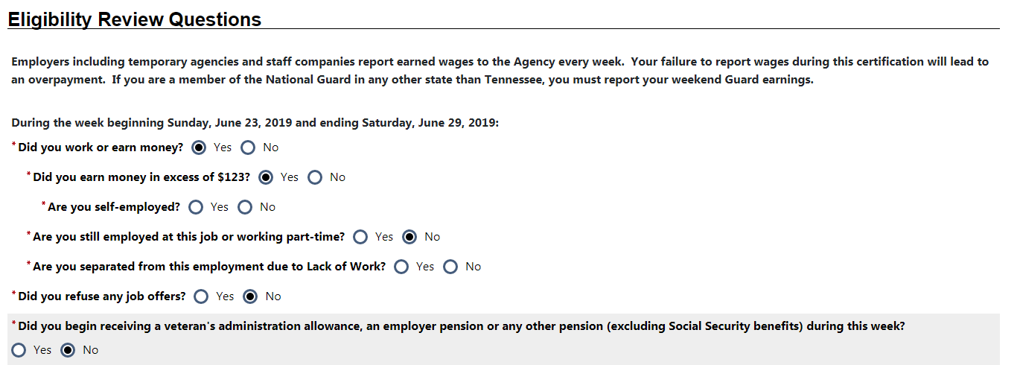
Weekly Certification for Unemployment
Number 1 on the RESEA Eligibility Review Corresponds to THESE Certification Questions asked weekly

Slide 9
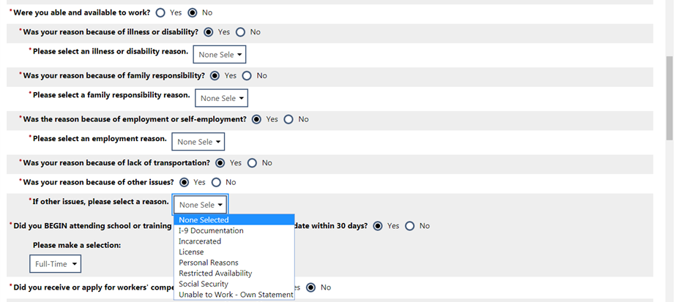
Weekly Certification for Unemployment
Number 3 and 4 on the RESEA Eligibility Review Corresponds to THESE Certification Questions asked weekly

Slide 10
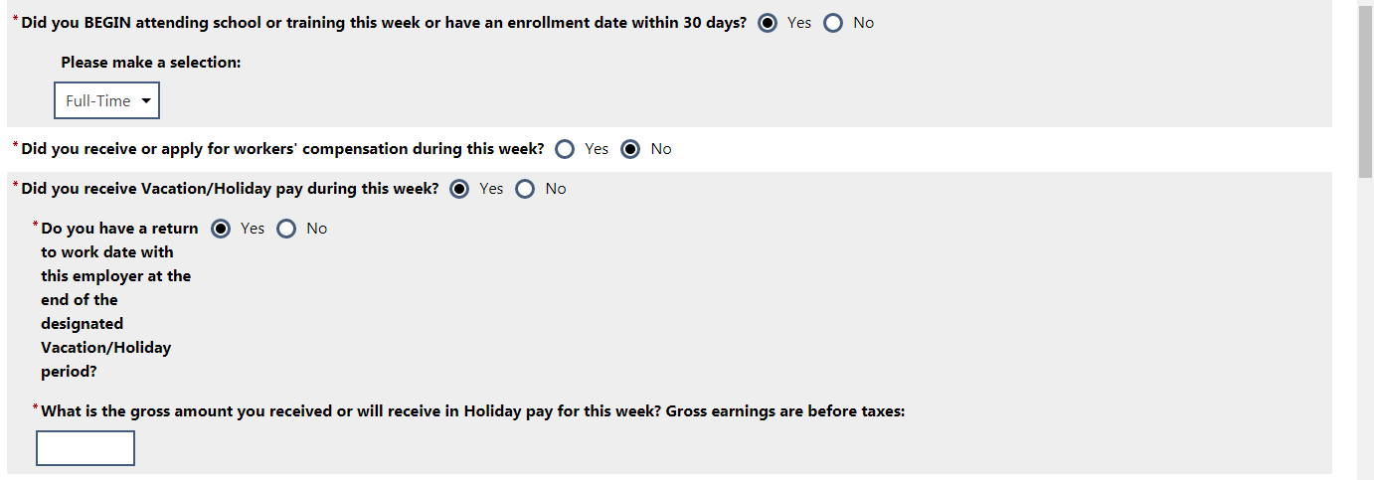
Weekly Certification for Unemployment
Number 2 on the RESEA Eligibility Review Corresponds to THIS Certification Question asked weekly

Slide 11
HOW TO HANDLE ISSUES THAT COULD AFFECT UNEMPLOYMENT
As you go through the RESEA Eligibility Review with the claimant, if they answer YES to any of the questions:
I have provided some questions in each section that might help you and them better understand what constitutes a YES question
Explain to them any of these issues that have not already been reported to unemployment could lead to a potential overpayment of benefits – Unemployment will deal with that further if it does become an issue
Upload the claimant’s statements and any supporting documentation they may provide into VOS.
Send an email to RESA.info@tn.gov stating you have uploaded into VOS

Slide 12
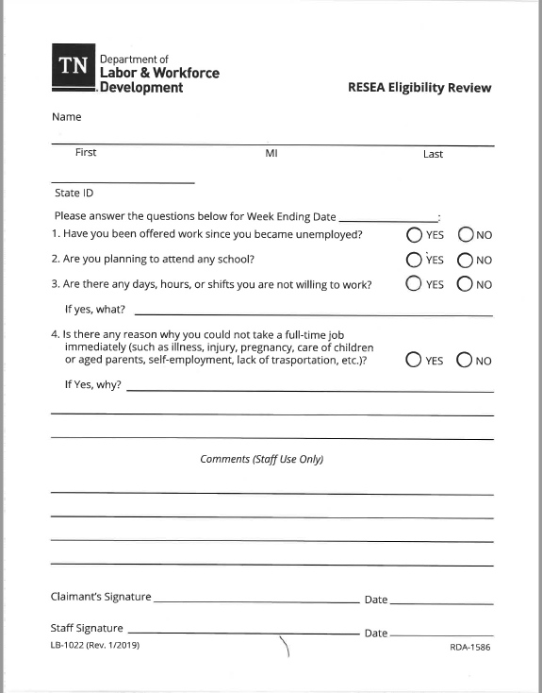

Slide 13
1. Have you been offered work since you became unemployed?
✓YES
Make sure they understand what the question is asking if a position has been offered to them by an employer after they filed their unemployment claim.
If they understand, then make sure the correct answer is yes.
If they still answer yes, then you will need to determine if they refused that job or have a pending offer. Inform them that refusal of work may affect their unemployment eligibility.

Slide 14
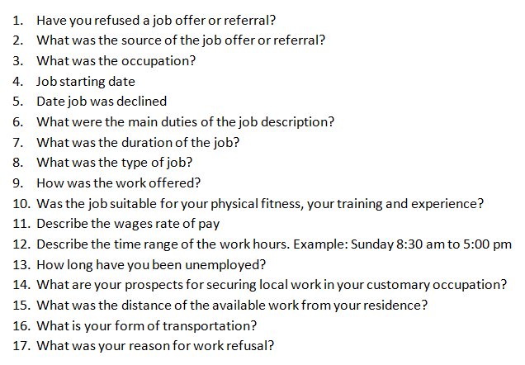
1. Have you been offered work since you became unemployed?
Refusal of Job Offer or Referral

Slide 15
2. Are you now attending or planning to attend any school?
✓YES
Make sure they understand the question is asking if they are currently enrolled in school or within 30 days of beginning training (if NO, they will report it at that point in time on their certification).
If they understand, then make sure the correct answer is yes.
If they still answer yes, then please get a statement

Slide 16
2. Are you now attending or planning to attend any school?
This question exempts the claimant from RESA if:
Full-time TAA Approved training with enrollment date 30 days or less
Currently enrolled in school:
Claimant is exempt if they are full-time (determined by training institution) and documentation has been gathered.
Enrollment date is within 30 days
Claimant is exempt if they are full-time (determined by training institution) and documentation has been gathered.
This question does not exempt the claimant from RESA if:
Enrollment date is greater than 30 days

Slide 17
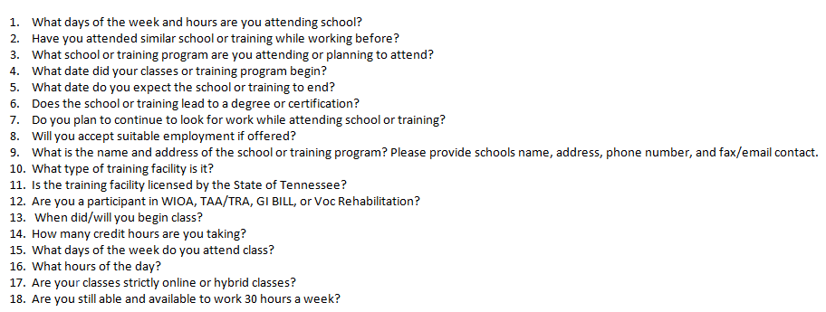
2. Are you now attending or planning to attend any school?
If claimant states that are attending training Full Time and are not Able and Available for Full Time employment

Slide 18
3. Are there any days, hours, or shifts you are not willing to work?
✓YES
Make sure they understand that the question is asking if there are any times in which they are not able or available to work .
If they understand, then make sure the correct answer is yes.
If yes, then a claimant statement will need to be filled out. Also, make sure they understand that not being able and available may affect their unemployment eligibility. Include why they are not A&A.

Slide 19
3. Are there any days, hours, or shifts you are not willing to work?
If claimant states that are unable to work certain days, hours or shifts

Slide 20
4. Is there any reason why you could not take a full-time job immediately?
✓YES
Make sure they understand that the question is asking them if there is something preventing them from taking a full-time job at this time (I have provided some questions that might help you and them better understand what constitutes a YES question)
If they understand, then make sure the correct answer is yes.
If yes, then a claimant statement will need be filled out. Also, make sure they understand that not being able and available may affect their unemployment eligibility.

Slide 21
4. Is there any reason why you could not take a full-time job immediately?
If claimant states that are unable to take a full time job immediately
Medical issue
If the reason for not being able to take a full-time job is due to a medical reason, someone from the UI Claim Center will contact them to discuss their claim further.

