Slide 1
Rapid Response Team
Beth Keylon, Rapid Response Coordinator
Charlotte Burger, Career Specialist, TAA
Leslie Travis, Adult Education Director
Casey Eschette, Career Service Manager, Title I
Notes:
Introduction of the Team

Slide 2
Information Discussed
The Information Packets contains information about:
The American Job Center Locations
Assessing your skills and interests
Career pathways and Training
Resume & Interview Workshops
One Day Hiring Events and Job Fair
In-House Partner Services
Registering on Jobs4TN.gov
Tips for Job Searching
Appling for Hot Jobs
Labor Market Info
Unemployment Insurance process
Applying for Benefits
Weekly Certifications
Notes:
Folders, begin with handouts on the left side.

Slide 3
Team Partners
American Job Center
5 Job Centers cover 10 counties
Visit the nearest AJC office, regardless of address for services
www.secareercenter.org - Review calendar of events
Department of Labor & Workforce Development
Department of Human Services
Adult Education
SNAP – Supplemental Nutrition Assistance Program
Vocational Rehabilitation
Veterans Services
SETHRA
Notes:
HANDOUT - Reference the American Job Center flyer with all the locations listed.
Remind them to review the website for Calendar of Events and activities in AJCs

Slide 4
American Job Centers
There are 75 American Job Centers across the state of Tennessee. Visit http://www.tn.gov/workforce/topic/find-local-help to find an American Job Center near you.
American Job Centers Services:
Computer workstations with internet access
Access to employers
Skills training
Veterans’ Programs
Computer Workshops
Comprehensive Offices
Chattanooga—Eastgate Town Center
Athens—410 N. Congress Parkway
Affiliate Offices
Cleveland, Dayton and Jasper
You may have seen one of the Department of Labor and Workforce Development’s mobile units. The Career Coaches take job placement activities and technology on the road to provide employment services anywhere they are needed in Tennessee, offering the same services that are available in the American Job Centers found across the state. www.getonthecoach.tn.gov
Notes:
HANDOUT - Reference the AJC Customer Service Flow chart, Steps 1 – 2 – 3

Slide 5
American Job Centers
Computer Workstations Career Centers and Affiliate Offices offer computers with Internet access
Chattanooga and Athens—Computer Basics Classes at no cost to you (Microsoft Office)
Assistance with résumé, www.jobs4TN.gov assistance, online application assistance
If you visit the Career Center, please fill out the Employee Needs Survey
and bring with you so we can review your information with you.
Access to Employers Career Center staff can refer you to www.jobs4tn.gov for job searches with employers who have open positions.
Hiring events and job fairs for specific employers may also take place at the Career Center.
Market-Responsive Skills Training
Local Workforce Investment Area (LWIA 5) partners with training providers for individual skills upgrade or post-secondary degrees that are in demand
Veterans’ Programs
Career Centers have veterans’ representatives who team with branches of the military.
Notes:
HANDOUT - Reference the Needs Survey, complete and take to the AJC and ask for assistance.

Slide 6
Supportive Services /Resources
Paying for College & Education Assistance
Tennessee Student Assistance Corporation
TN Promise
TN Reconnect
FASFA
WIOA Funding of last resort, last dollar in
Other Resources
Refugee Services
Assistance for Homelessness
Veterans Assistance
Tennessee Low Income Energy Assistance (LIHEAP) Agencies
Public Transportation
Notes:
FASFA PHAMPLET - This information should be explained by Title I representative regarding training and other supportive services available through the WIOA program and TN Reconnect.

Slide 7
Supportive Services /Resources
Food and Nutrition
WIC stands for Women, Infants, and Children and is also called the Special Supplemental Nutrition Program. WIC is a federal program designed to provide supplemental food to low-income pregnant, postpartum and breastfeeding women, infants and children until the age of five. The program provides a combination of nutrition education, supplemental foods, breastfeeding promotion and support, and referrals for health care. For more information, visit: http://tn.gov/health/topic/wic; (800) 342-5942.
The Supplemental Nutrition Assistance Program (SNAP, formerly known as Food Stamps) provides nutritional assistance benefits to children and families, the elderly, the disabled, unemployed and working families. For more information, visit: http://www.tn.gov/humanservices/topic/supplemental-nutrition-assistance-program-snap; (615) 313-4700 or (866) 311-4287.
Tennessee's School Nutrition Program is responsible for providing nutritious meals and snacks for students in public and private schools, as well as residential and child care institutions. School Nutrition administers the USDA's National School Lunch Program, School Breakfast Program and Afterschool Snack Program across the state. For more information, visit: http://www.tn.gov/education/topic/school-nutrition; (800) 354-3663. To apply for this program, visit: http://www.fns.usda.gov/school-meals/applying-free-and-reduced-price-school-meals.
Notes:
Remind them many other services from our Partners are available.

Slide 8
Health Insurance Marketplace
You may be eligible to apply for insurance before open enrollment if you experience a qualifying life event:
Not being able to enroll due to complex situation
Change in marital status
Change in the number of dependents
Change in employment status or income
Release from incarceration
Apply online at www.healthcare.gov
Or by phone – 1-800-318-2596
Notes:
HANDOUT – Healthcare Insurance Marketplace.
TN SHIP handout – assist older employee nearing age 62 with filing for Medicare.

Slide 9
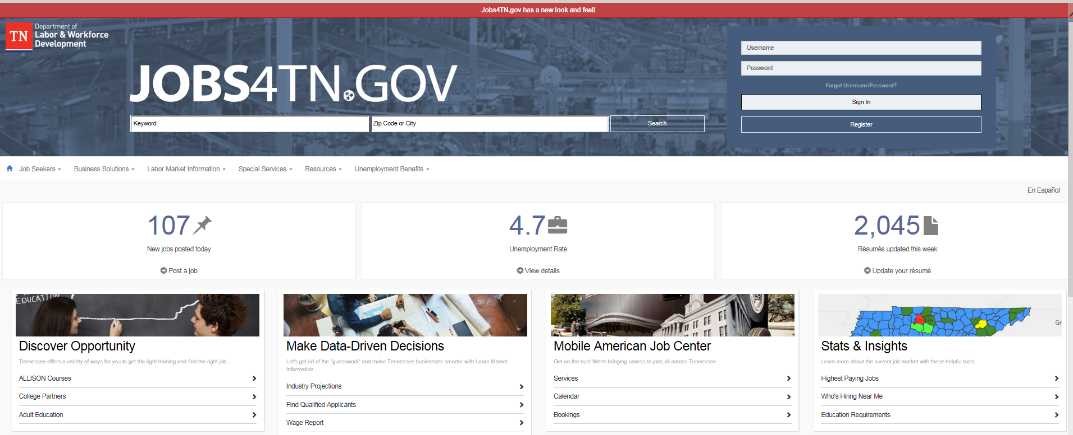
Registration Instructions for Employees
Option 1, under the “USERNAME” section, select “NOT REGISTERED”.
If you are already registered in the system, it will instruct you on retrieving your password.
Make sure you update any changed contact information
Option 2, select “INDIVIDUAL” to create your account.
All questions with a red * must be completed.
Notes:
HANDOUT – Jobs4TN.gov – MUST register to job search and apply for benefits.

Slide 10
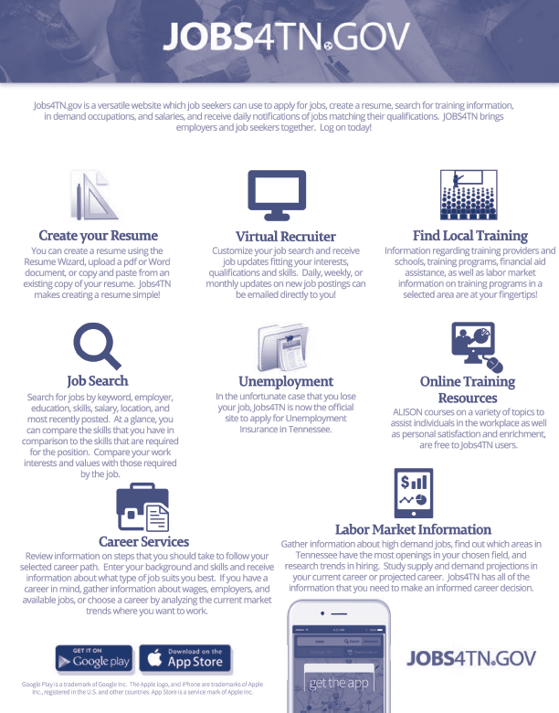
Notes:
Tools on Jobs4TN to assist with getting back into the workforce.

Slide 11
Who – What – How – When For Applying
https://www.tn.gov/workforce/unemployment/apply-for-benefits.html
Notes:
STATE WEBSITE - Visit the link in yellow to see the following slides.

Slide 12
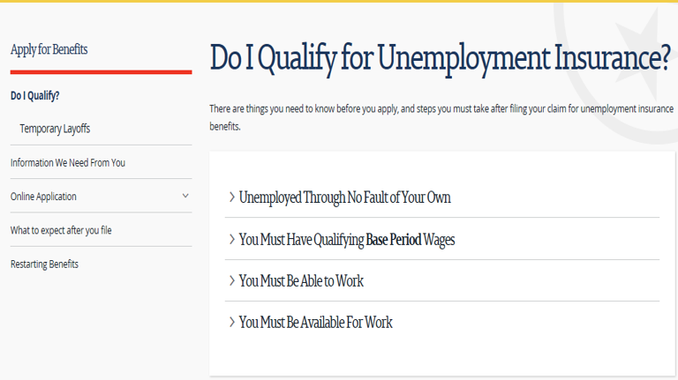
Who Qualifies For Benefits

Slide 13
What Information You Need
Have the following Information Needed when you file:
Social Security Number
Driver’s license number
Home address
Telephone number (cell or home)
Bank Account Information (Direct Deposit)
E-mail account – you must have an email account
DD214 if you have served in the military in the past 18 months
Separating employer’s name (Separation Notice)
Company address
Company telephone number
Last day worked
Reason for separation
Previous 18 months of employment (BASE PERIOD WAGES)
TDLWD may contact you by mail/phone or email to verify the information submitted. You may be requested to submit additional documentation so a determination may be made on your claim. Please make sure that ALL information is accurate and timely to expedite a decision on your claim.
Notes:
HANDOUT – reference list in file – MUST have email address.

Slide 14
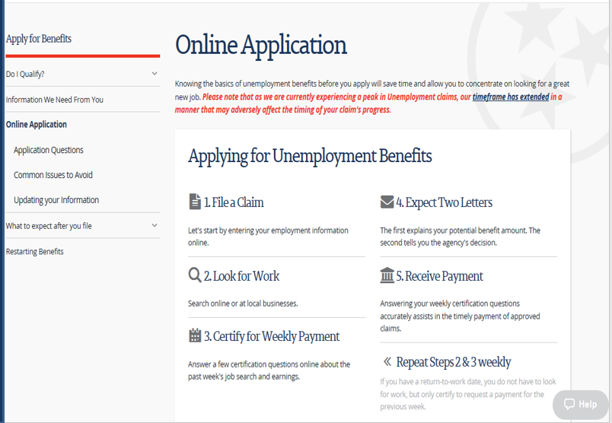
How to Apply for Benefits

Slide 15
UI Claim Filing Assistance
Notes:
HANDOUT – UI Team will be at the AJC office to assist with filing.

Slide 16
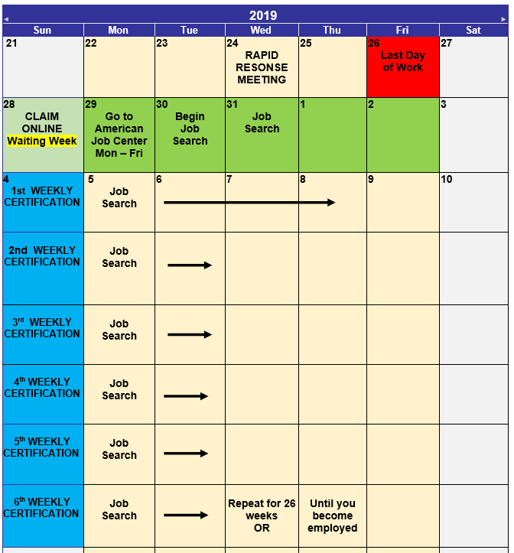
When to File the Claim
Your benefit year is 52 consecutive weeks beginning Sunday of the week in which you file your claim.
TN: Maximum
MBA - $7,150
WBA - $275
26 weeks
Notes:
Dates the UI TEAM will be at the office to assist.

Slide 17
Reportable Income
Vacation pay or holiday pay is reportable but not deducted if you are permanently separated.
Drawing from a pension or 401K, to which you contribute is not reportable.
A pension which was 100% funded by the company is considered reportable.
Severance benefits or wages–in-lieu of notice are considered reportable if equivalent to regular wages and assigned to weeks beyond the date of separation.
You cannot remove yourself from the job market unless enrolled in an approved training program.
Unemployment Insurance is taxable income. You can have 10% deducted from your weekly benefit or wait until you file your yearly taxes.
You can receive Social Security retirement and Unemployment Insurance benefits at the same time.

Slide 18
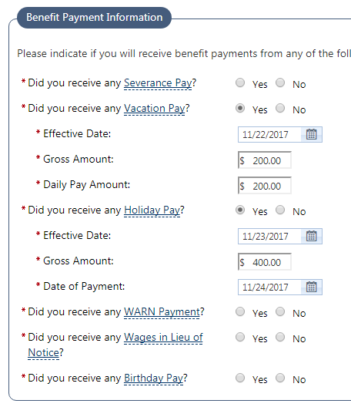
Reporting Severance Pay
Yes – Severance Pay
Claimant
Report in the work history portion of the claim filing process
Send your severance agreement to nashville.claims@tn.gov
Or upload to your application at the AJC office.

Slide 19
Holiday/Vacation Pay
Holiday/Vacation Pay
Required to be reported
Permanent Layoff
No Return to Work Date)
Holiday/Vacation pay is not deductible
Temporary Layoff
(Definite Return to Work Date)
Holiday/Vacation pay is potentially deductible

Slide 20
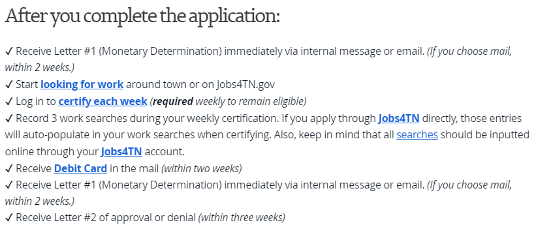
After you Apply

Slide 21
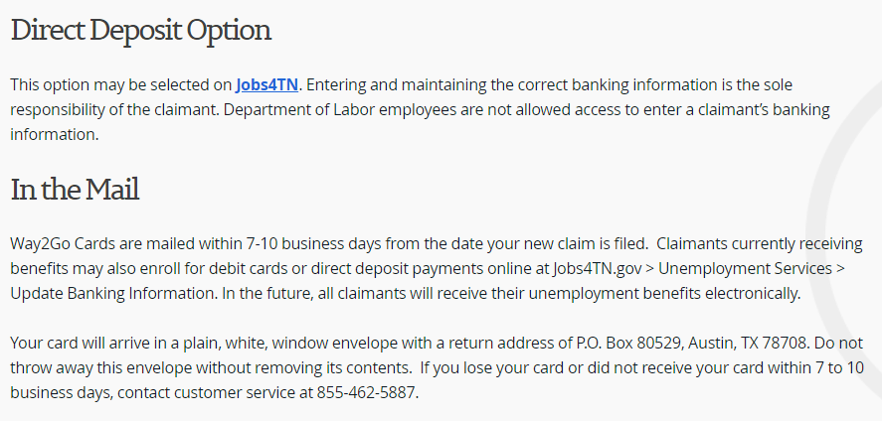
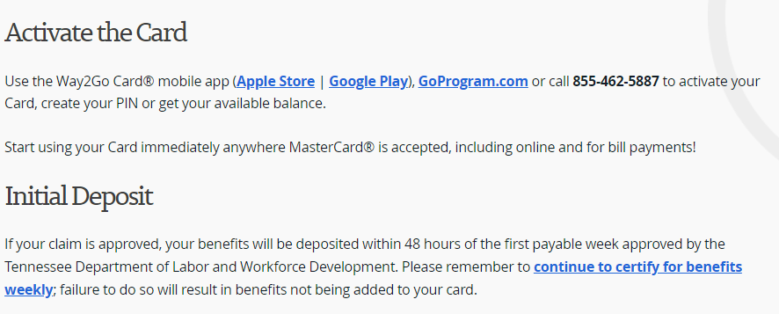
Way2Go Debit Card
Notes:
MUST contact Master Card for assistance, not the AJC staff

Slide 22
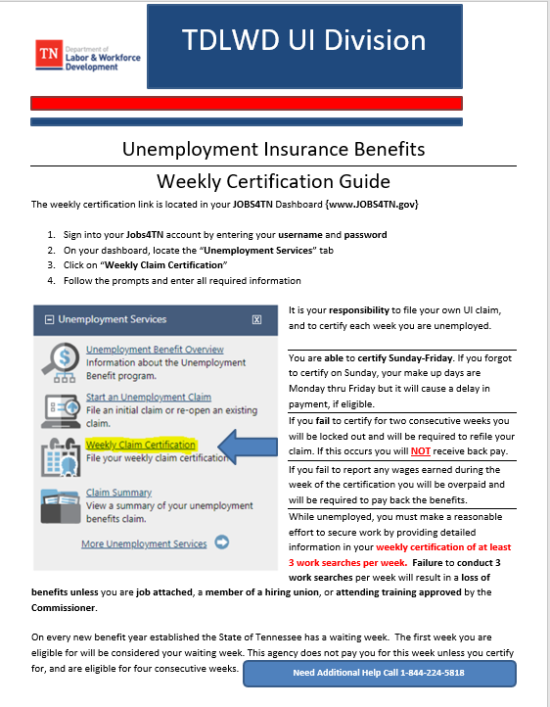
Weekly Certification Process
Notes:
HANDOUT – steps for completing weekly certifications

Slide 23
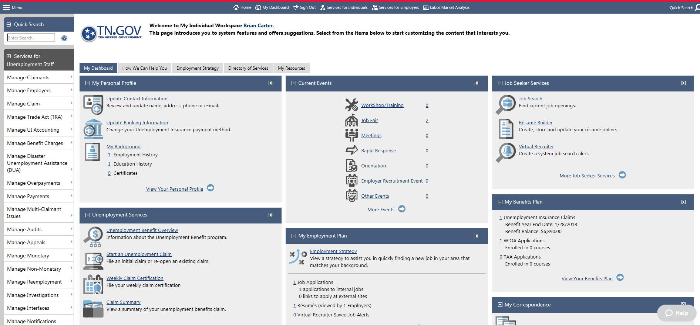
Jobs4TN Dashboard

Slide 24
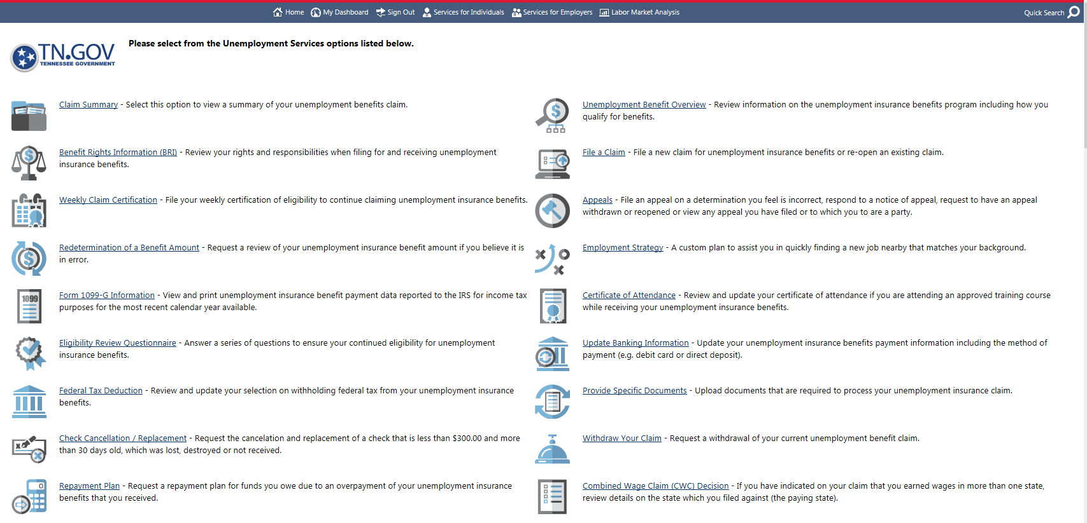
Unemployment Services

Slide 25
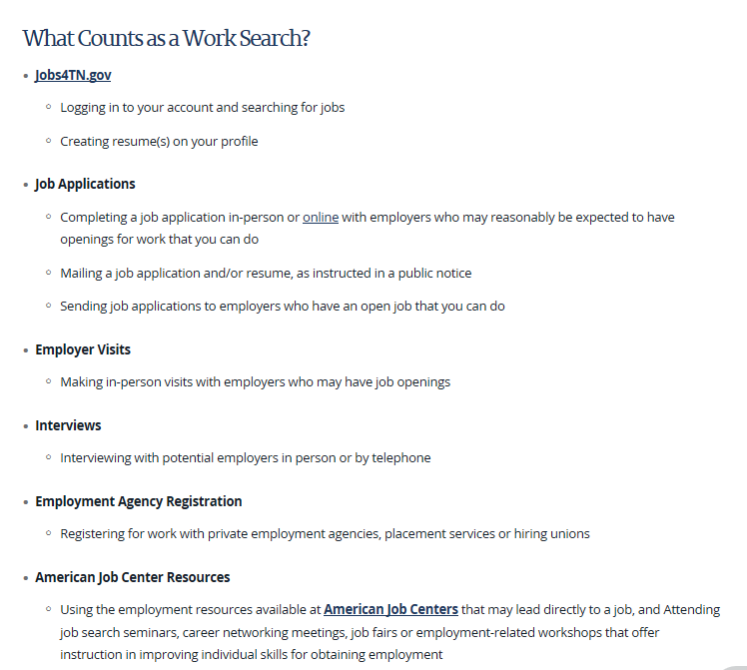
MUST Look for Work
Notes:
MUST job search, 3 per week, ask about Travel Assistance

Slide 26
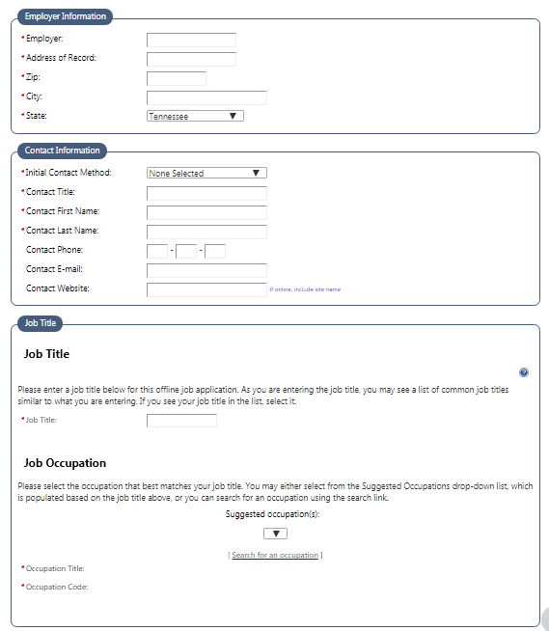
Entering Job Searches Online
Notes:
KEYING in job search activities

Slide 27
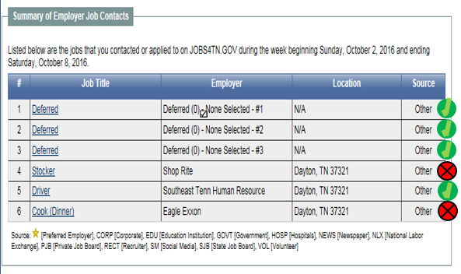
Employer Contacts
Notes:
APPROVED – job searches

Slide 28
Unemployment Insurance Issues
If you have issues with your claim or weekly certification, please visit the webpage below and submit a request to be contacted:
https://lwdsupport.tn.gov/hc/en-us/requests/new?ticket_form_id=135978
*ONLY SUBMIT ONE REQUEST
Submitting multiple requests may slow down your response time.
Customer Service: (844) 224-5818

Slide 29
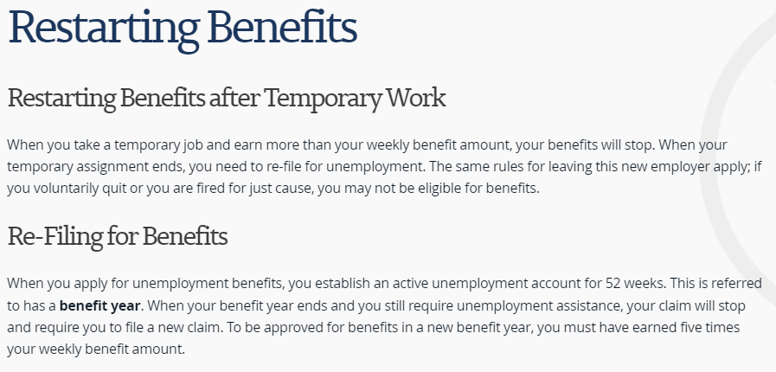
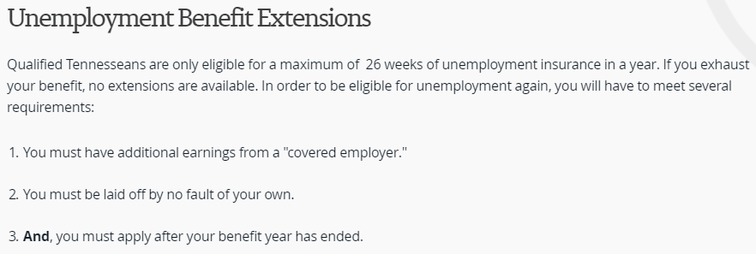
Unemployment Insurance

Slide 30
QUESTIONS
https://www.tn.gov/workforce/unemployment/apply-for-benefits.html

