Slide 1
RAPID RESPONSE BEST PRACTICES
Presenter
Beth Keylon
LWDA5 – Special Projects Coordinator

Slide 2
Rapid Response Coordinators
Who has conducted a meeting?
When, where, how many employees affected?
Not all are the same, right?
How do you get started?
Try to relate, make it about them
Here to offer help and hope
Thanks the employer for inviting you
Thank the employees at the END for attending
How do you handle the tough questions?
If you don't know, don’t guess, tell them you will get back to them
If you do know, and it is personal, ask to talk after the meeting
What do you do if they get upset?
Keep your cool, let them know it is okay

Slide 3
Types of Notification
Employer contacts Rapid Response Coordinator
Employer contacts DWU Team in Nashville
Employee visits an AJC office
AJC staff collect information and send to RR Coordinator to make contact with employer
Announcement made via the media outlets
Newspaper, Radio, or TV
Employer submits Announcement Letter to the State
50 or more employees affected
Receive WARN Letter
State will issue the WARN Notice

Slide 4
Contact with Employer
Contact employer immediately upon receiving Notification
Mostly via phone and email
Use the Rapid Response Checklist to stay on track
Layoff Communication Sheet and WARN Notice Form
Collect as much information as possible
If less than 50 employees and they may not submit a letter or want to do the online application
Use these forms to collect information then email to the DWU Team
Rapid Response Event flyer
Create and send for the employer to post about the RR meeting
Mass Layoff Spreadsheet & Instructions
Remind them not to change the formatting
Must send to DWU prior to layoffs occurring
Severance Spreadsheet & instructions
Send only if employees will be receiving severance
Make sure they send spreadsheet to Sharon Coleman

Slide 5
Contact with Employer *Extra Services if time permits
Job Fairs
Offer to conduct or assist with event – most employers do their own
Provide employer contacts
Connect with AJC staff
Special Partner Services
Find out if employees need GED
If anyone has a disability
Provide partner contacts
Additional Workshops
Resume Writing & Interviewing
Depending on the time, go onsite and let AJC staff present a workshop
Training Opportunities
Use Needs Survey to pole the employees to see if they are interested in training
Reach out to Training providers to purchase classes

Slide 6
Create the WARN Visit

Slide 7
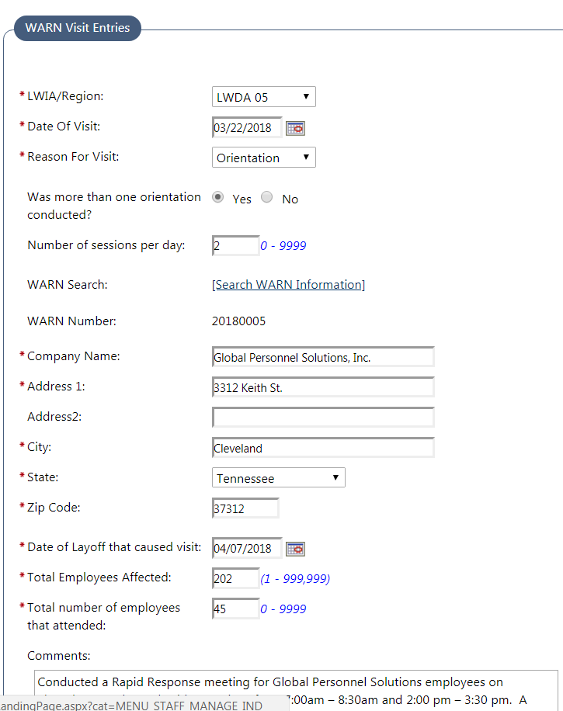
Planning vs. Orientation
Planning Visit
May have multiple planning meetings
Zero sessions
Zero employees attended
Detailed notes
Orientation Visit
The Rapid Response meetings
Indicate the number of sessions and total employees that attended the session(s)
May have multiple Orientation visits

Slide 8
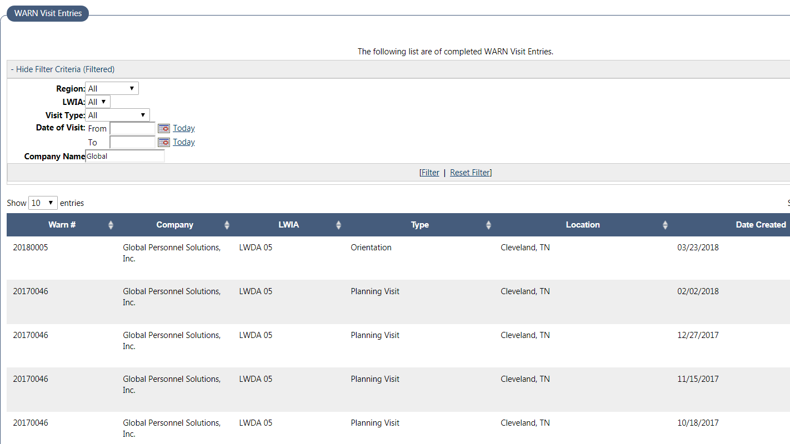
Multiple WARN Visit Entries

Slide 9
Employer Activity

Slide 10
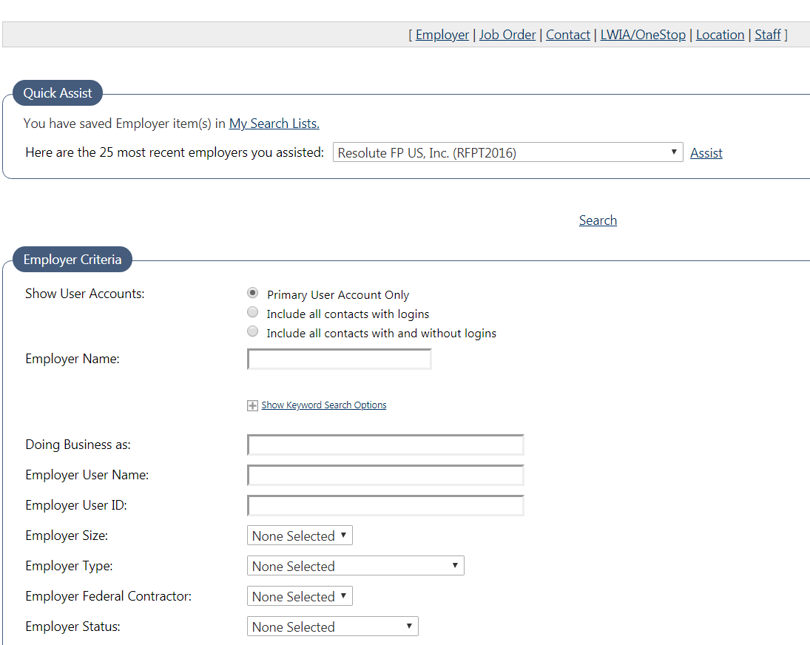
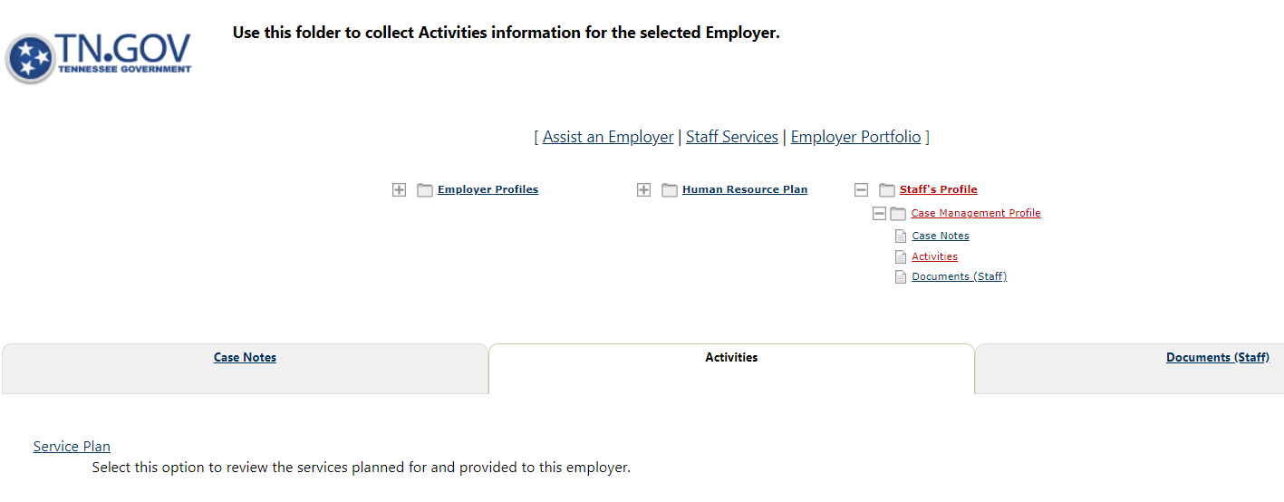
Assist Employer – Service Plan

Slide 11
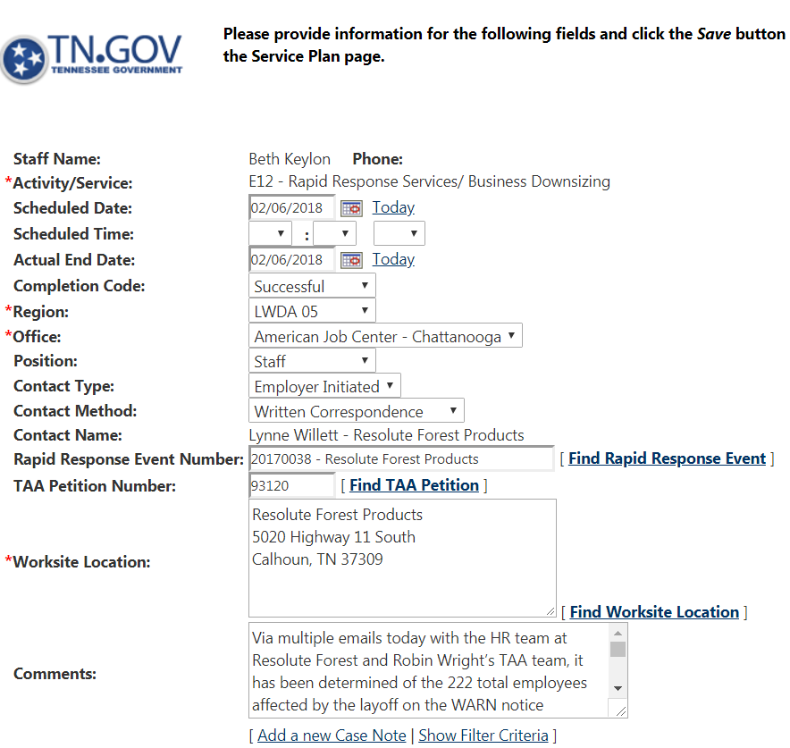
Adding Employer Activities/Services

Slide 12
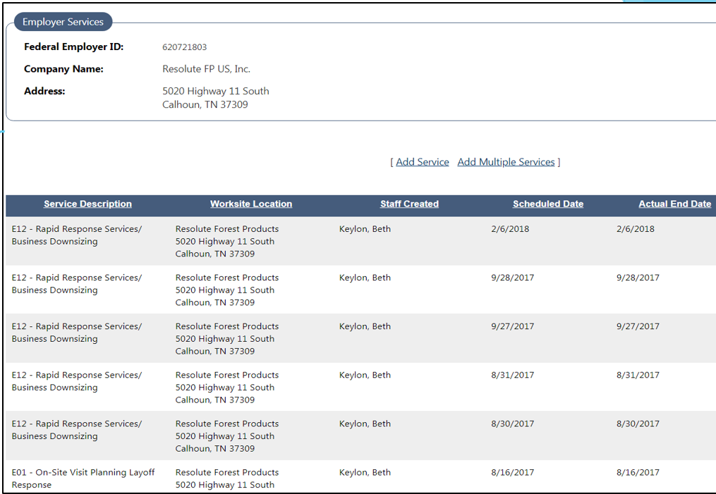
Multiple Employer Activities/ Services

Slide 13
Rapid Response PowerPoint & Packets
Left side – AJC Services
Career Center locations
Visit any center in the area of choice
Partner agencies co-located in facilities
Veterans Services, SNAP, AE, etc.
Services Flow Chart
Advice they can do a lot of self-service activities or ask for assistance
Point out step 3 and talk about WIOA training assistance
If TAA approved, extra slides are at the end for the TAA rep to explain services
Needs Survey
Ask them to complete and take to the AJC staff services
Rapid Response logo – identifies they attending the meeting
Guide to Healthcare
Advice they can visit site for insurance coverage
Also can meet with local ACA navigator
Jobs4TN Flyer & Registration card
Explain the importance and how to register on Jobs4TN
Let them know this is how co-workers and the RR team know they have attended an RR meeting

Slide 14
Rapid Response PowerPoint & Packets
Right side – UI Process
What Information applicant needs to file a claim
Printed list from State site
Severance and Holiday pay questions
Brief explanation of how this effects UI benefits
Help button on screens
Weekly Certification
Explain the process & questions
When, why, how and what happens if they don’t
Required Job Searches
Remind them of the 3 Job Search requirements
Work Search log
Provide paper log and explain the importance of keeping up with searches for the following week

Slide 15
Rapid Response PowerPoint & Packets
Extra Booklets and Handouts in the Meeting
ToolKits
Surviving a Layoff Booklet
Job Hunting Handbook
FAFSA Pamphlets
TN Reconnect pamphlets
Adult Ed flyer – when needed
TAA Contact Sheet – has TAA reps contact info

Slide 16
Follow-up with Employers
Multiple Meetings
Don’t expect them to always call you
Plan, coordinate, schedule execute
Mass Layoff Spreadsheet
Make sure they sent it to DWU
Issues or problems
Ask if any employees have contacted them
Make sure things are going smooth

Slide 17
Communication
Keep AJC Staff, TAA Rep and Partners Informed
Invite Partners and AJC staff when requested by employers
Most employers only allot a small amount of time to conduct meetings
Goal is to provide information about partners and instruct the employees to the AJC for the Services
Send frequent emails to One Stop and AJC Leads about meetings
Make sure they know when employees will be coming to the AJC
Sign In Sheets
Provide copies to AJC Leads and TAA reps so staff can contact employees and offer services

Slide 18
Technical Assistance
Rapid Response
https://www.tn.gov/workforce/employers/staffing-redirect/layoffs---unemployment/rapid-response.html
WARN Technical Assistance Guide
https://www.tn.gov/content/dam/tn/workforce/documents/employers/et_WARN_guide.pdf
Online WARN Notice
https://stateoftennessee.formstack.com/forms/warn_notice_information
Dislocated Worker Unit Manual & Rapid Response Guide
https://www.tn.gov/content/dam/tn/workforce/documents/ProgramManagement/Dislocated_Worker_3B.pdf

