Slide 1
Getting to know your LWDA
The Statewide Workforce Development’s Dashboard and selected canned reports in Jobs4TN
Benjamin Passino l April 2018

Slide 2
What is the Dashboard for the Statewide Workforce Development Board?
The Dashboard
Consistently provides board members with key measures they need in order to further a data driven approach
Started in May of 2017 and is quarterly
Founded by the desire of our board to compare fiscal and programmatic metrics.
It is able to do so by using unified:
Definitions
Date ranges
Current quarter
Pervious quarter
Same quarter of the previous year
Reporting paths

Slide 3
Fall 2017- PY17 Q2 (10/01/2017 to 12/31/2017)

Slide 4
Future of the Dashboard
The dashboard continues to improve by incorporating measures that are
Accessible
Timely
Accurate
Workforce Services is currently working with WIRED to make a digital version of the dashboard
The goal is to have all live and transparent data

Slide 5
Taking a closer look at enrollment

Slide 6
New and Total Enrollments across Tennessee

Slide 7
Geographical Areas
Currently, the SWDB’s Dashboard tracks measures across 17 geographical areas.
Tennessee as an aggregate
3 Grand Regions
13 Local Workforce Development Areas

Slide 8
Unified Definitions
As with each measure on the dashboard, enrollments are defined as:
A new enrollment occurs when a participant begins a new period of participation between the specified time period.
-This is type of enrollment may be a better measure of activity.
Total enrollments is a count of all enrolled individuals within the specified time period, included those that are carried in.
-This type of enrollment measure may be a better metric to use when comparing with fiscal data as all active participants can continue to draw down funds.

Slide 9
Unified Date Ranges
Each measure has a unified set of date ranges.
Current Quarter
(PY17 Q2: Oct. 1, 2017 to Dec. 31, 2017)
-most recent data available
Same Quarter Previous Year
(PY16 Q2: Oct. 1, 2016 to Dec. 31, 2016)
-seasonally comparative to most recent quarter
Latest Full Program Year
(PY16: July 1, 2016 to June 30, 2017)
-provides historical context

Slide 10
Reporting Path

Slide 11
Reporting Path- example WIOA Title I Adult New Enrollments

Slide 12
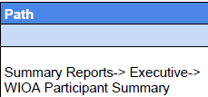
Pull up VOS (Jobs4TN.gov)
Sign in.

Slide 13
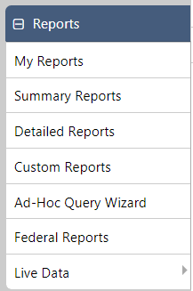
Reports
On the opening page (My Dashboard), you should see a series of menus on the left. Look for Reports.

Slide 14
WIOA Participant Summary

Slide 15
Reporting Path- example WIOA Title I Adult New Enrollments

Slide 16
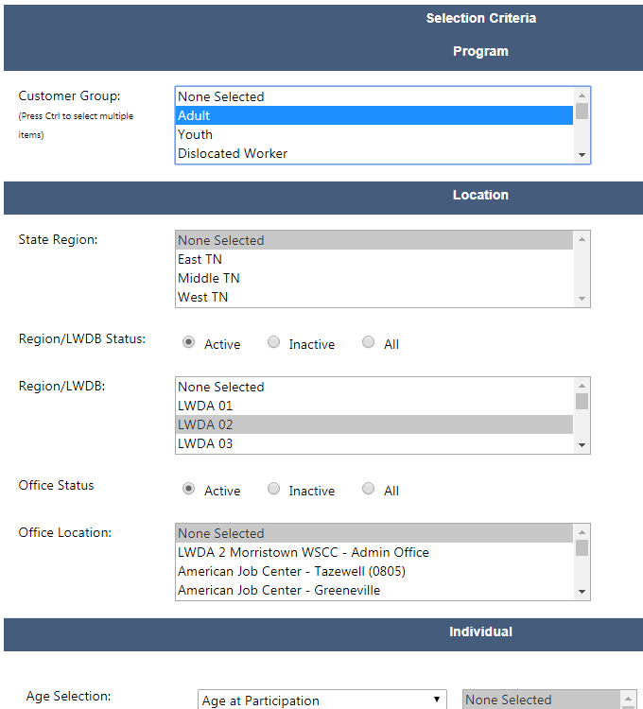

Slide 17
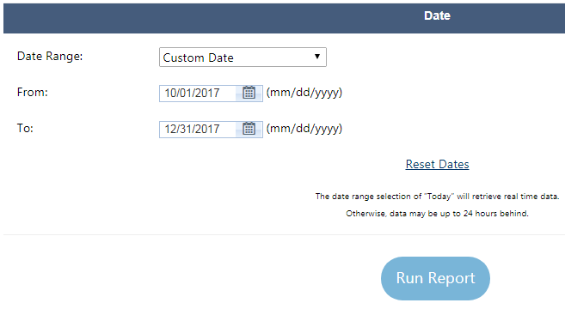
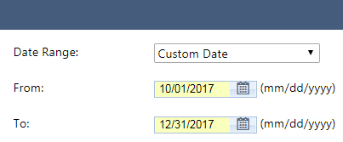

Slide 18
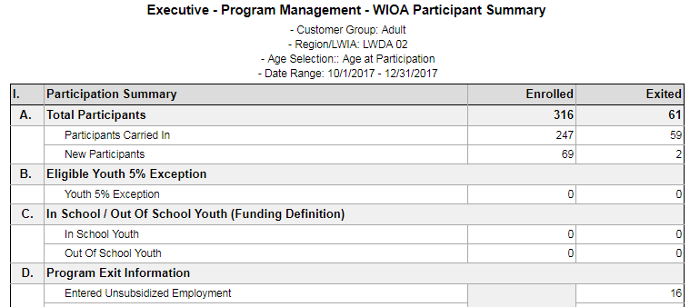
New Enrollment Count
Note: Total Enrollments, would be 316.

Slide 19
What can you do with this data?

Slide 20
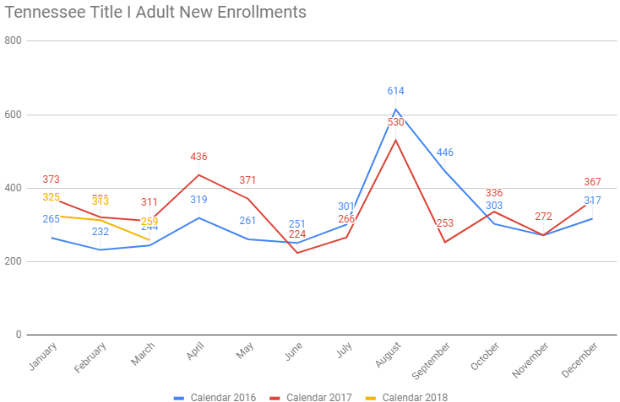
Tennessee Title I Adult New Enrollment

Slide 21
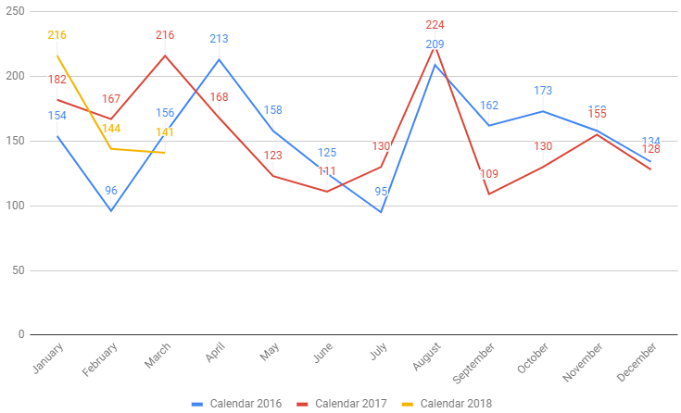
Tennessee Title I Dislocated Workers New Enrollment

Slide 22
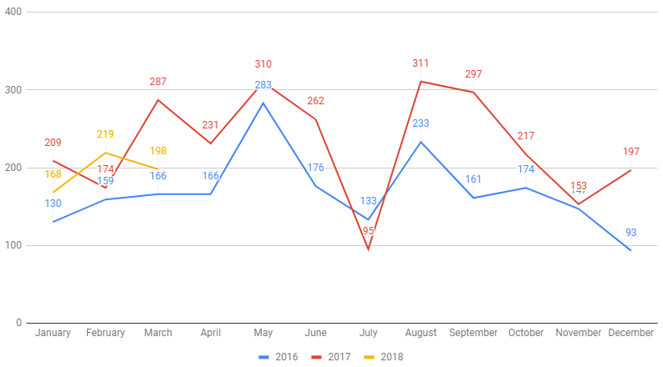
Tennessee Title I Youth New Enrollment

Slide 23
Thank you!

