Slide 1
Future of the Labor Market
Presented by
Workforce Insights, Research and Reporting Engine Division/WIR²ED
July 23, 2019
Workforce Learning and Development

Slide 2
Future of the Labor Market
AGENDA
Labor Market Trends
Current Resources Available
Future Resources Available
Workforce Learning and Development

Slide 3
Labor Market Trends

Slide 4
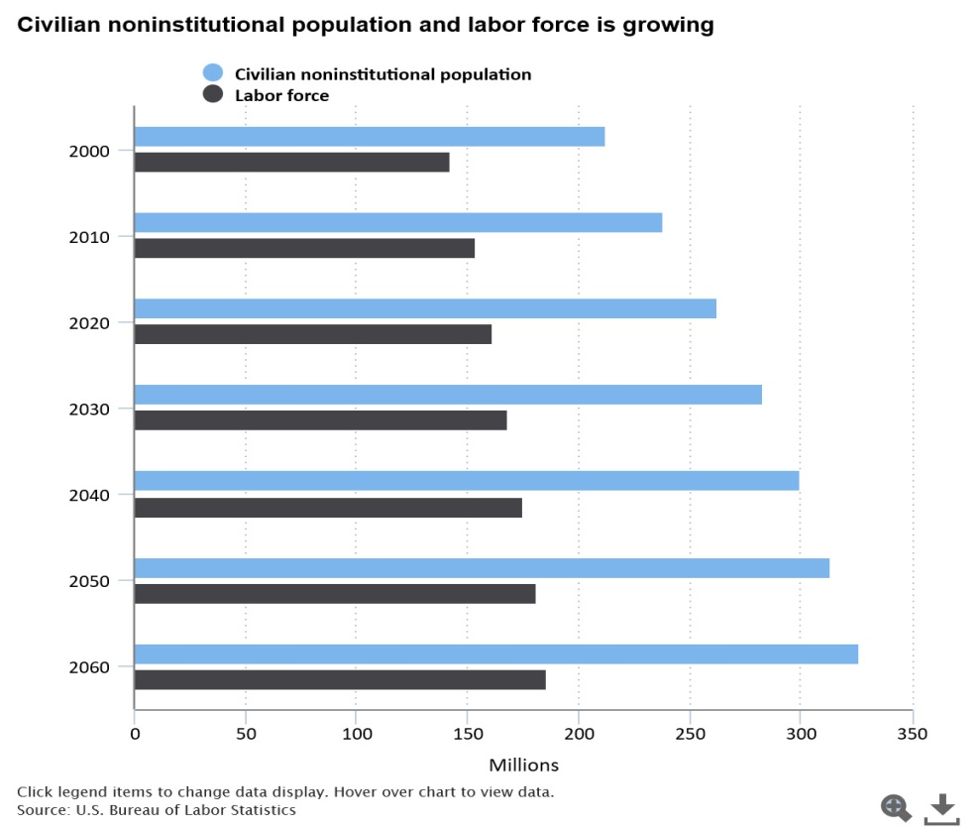
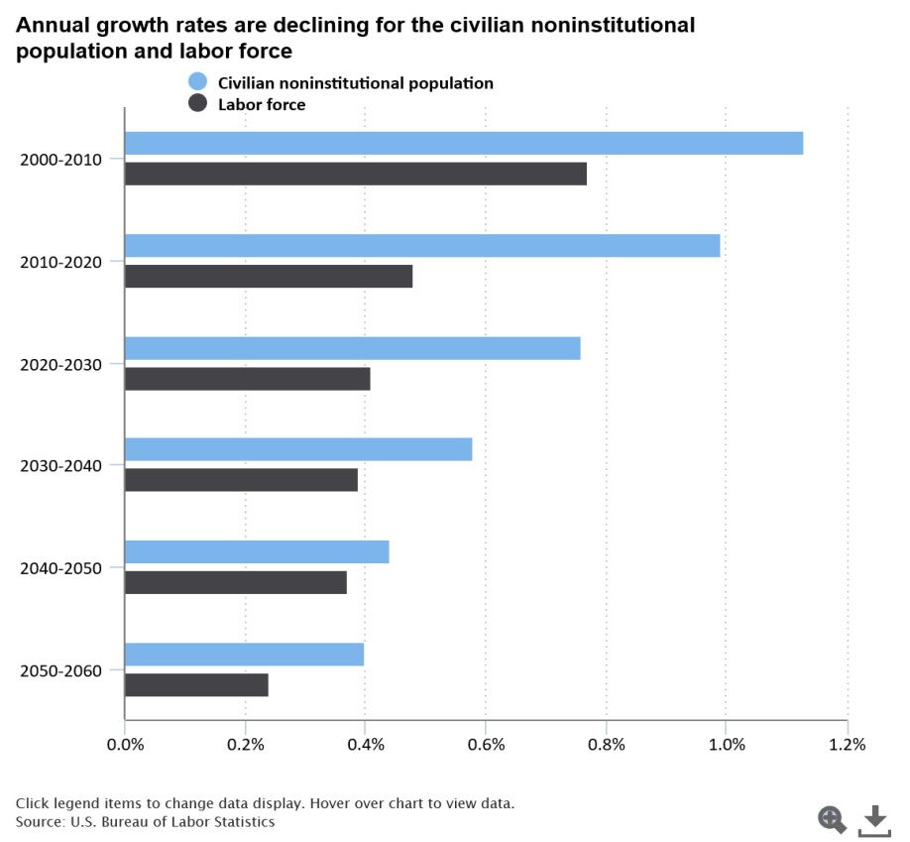
Future of the U.S. Labor Force to 2060
Growth of the labor force is directly related to the growth of the population and changes in the labor force participation rate.
Significant part of the changes in labor force growth results from changes in the population
The labor force participation rate has declined substantially since its peak in 2000
Demographic Reason
Economic Reason
Source: Bureau of Labor Statistics : A look at the future of the U.S. Labor force to 2060
Notes:
In the next 50 years, demographic changes will significantly alter the U.S. population and labor force. These changes include an aging and more diverse population that will continue growing, but at a slower rate. These changes will impact the growth of the U.S. economy and its ability to create goods and services.
The growth of the labor force is directly related to the growth of the population and changes in the labor force participation rate. A significant part of the changes in labor force growth results from changes in the population.
As per US Bureau of Labor Statistics:
The civilian noninstitutional population is projected to grow from 251 million in 2015 to 326 million in 2060, an increase of 75 million people.
The labor force is projected to increase from 157 million in 2015 to 186 million in 2060, an increase of 29 million.
Changes in population growth and labor force participation rates over the next several decades will impact the growth of the labor force.
Even though the size of the population will grow, its annual growth rate is projected to slow down in the coming decades. The decline in the growth rate of the U.S. population is due to a variety of factors, such as the aging of the baby boomers, declining fertility rates, and a lessening of the growth in immigration.
Growth is expected to get progressively slower for both the population and the labor force over the projected time frame to 2060, much slower than in earlier decades.

Slide 5
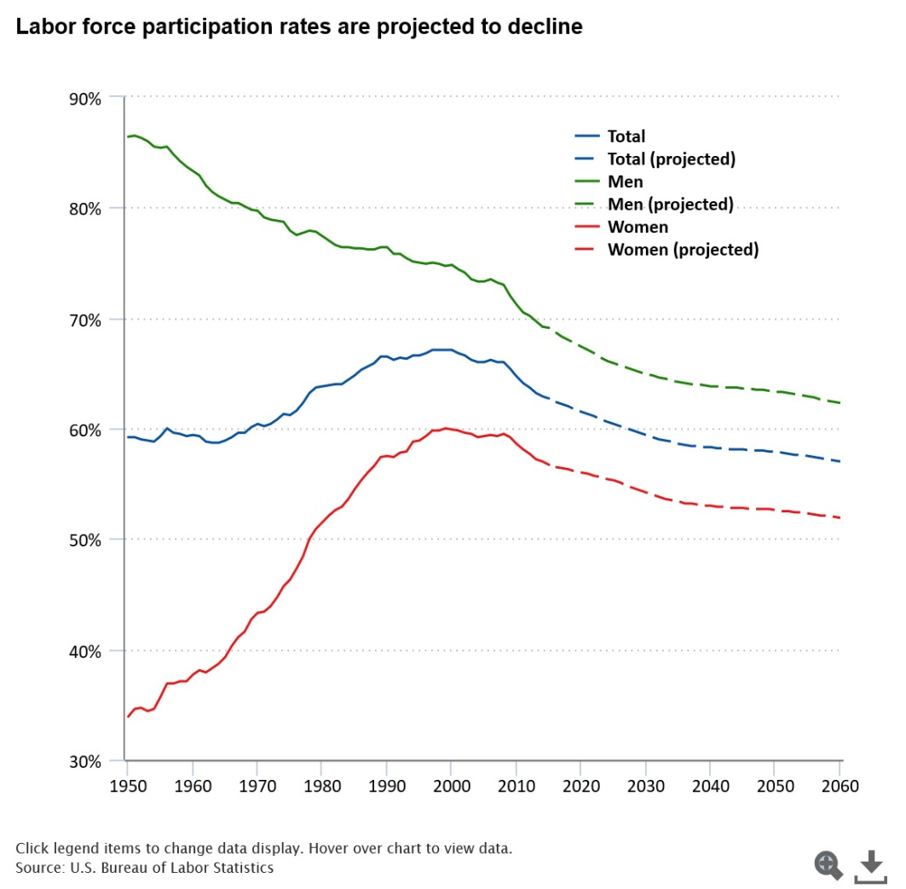
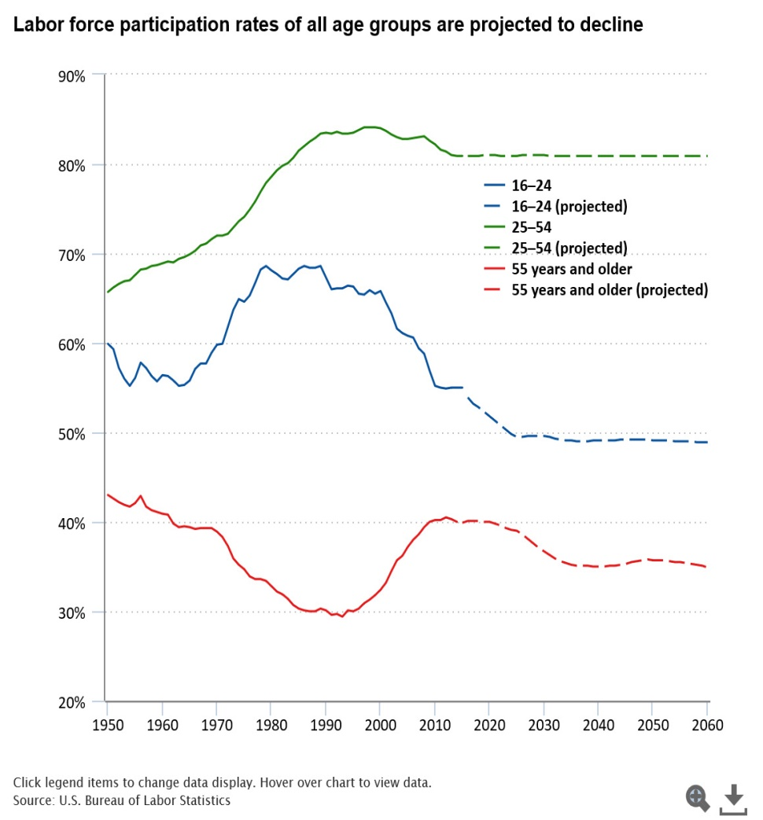
Future of the U.S. Labor Force to 2060 continue…
Labor force participation rates are projected to decline
Notes:
The labor force participation rate has declined substantially since its peak in 2000, for both demographic and economic reasons.
Labor force participation rates by sex
From the early 1950s until its peak over 1997–2000, the overall labor force participation rate increased. From 2000 to 2010, the overall participation rate fell by 2.4 percentage points. In the 5 years between 2010–2015, the overall participation rate fell by another 2.0 percentage points, much sharper than the previous 10 years.
BLS is projecting a continuous decline in the overall participation rates until 2060.
BLS is projecting a further decline in the participation rates of men.
The BLS is also projecting a further decline in women’s participation rates.
Labor force participation rates by age
The labor force participation rate of teenagers (16 to 19 years old) and young adults (20 to 24 years old) has been on a decline for several decades. It is projected that the decline will continue in the future. The labor force participation rate of the prime age group, 25 to 54 years old, has been declining since the end of the 1990s and is projected to decline slightly in the future. The labor force participation rate of those age 55 years and older had been on the rise since 1996, but has slightly declined since a peak in 2012. BLS projects that a decline will continue in the future.
The baby boomers' exit from the prime-age labor force and their movement into older age groups will lower the overall labor force participation rate.

Slide 6
Labor Force Participation Rate
Labor Force Participation Rate (LFPR) : US vs TN - May, 2009 and May, 2019
Both the U.S. and the Tennessee rates have trended down over time, but the gap between the rates is narrowing.
Tennessee’s 61.8 percent rate is just 1.0 point below the national rate of 62.8.
Notes:
Both the U.S. and the Tennessee rates have trended down over time, but the gap between the rates is narrowing.
Tennessee’s 61.8 percent rate is just 1.0 point below the national rate of 62.8.

Slide 7
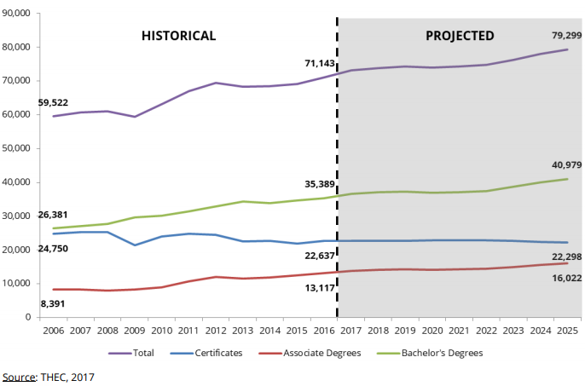
Labor Market in TN – Academic Supply Projections (2016-2025)
Projected to award 79,299 degrees.
11.5 % increase in statewide degree production compared to 2016.
Credential production is expected to increase across all sectors, except at proprietary institutions; a 6.1% decrease is projected.
More associate and bachelor’s degree will be awarded. Most substantial growth (22.1%) will be in associate degrees.
Notes:
Projected to award 79,299 degrees in 2025.
11.5 % increase in statewide degree production compared to 2016.
Credential production is expected to increase across all sectors, except at proprietary institutions; a 6.1% decrease is projected from 2016 to 2025
More associate and bachelor’s degree will be awarded. Most substantial growth (22.1%) will be in associate degrees from 2016 to 2025.
Higher education institutions will award more postsecondary credentials by academic year 2025.
* Tennessee is projected to award 79,299 degrees in 2025, compared to 71,143 in 2016, which represents an 11.5 percent increase in statewide degree production
Total credential production in Tennessee is expected to increase across all sectors, except at proprietary institutions; a 6.1 percent decrease in this sector is projected from 2016 to 2025.
Postsecondary credentials are projected through academic year 2025, based on historical data for 2006 through 2016.
The institutions included in these projections are public, private, and proprietary institutions in Tennessee that award postsecondary certificates, associate degrees, or bachelor’s degrees.
For public and proprietary institutions, THEC used historical data from its student information system, its Division of Postsecondary State Authorization, and the Integrated Postsecondary Education Data System (IPEDS). 3 For private institutions, THEC used historical data from the Tennessee Independent Colleges and Universities Association (TICUA) and IPEDS. The projections include certificates of less than two years in length, associate degrees, and bachelor’s degrees

Slide 8
Occupational Demand Projections (2016-2026)
High Demand Occupations with the Greatest # of Annual Openings
Title | Annual Openings
General and Operations Managers | 4,740
Registered Nurses | 4,315
First-Line Supervisors of Production and Operating Workers | 1,805
Secondary School Teachers, Except Special and Career/Technical Education | 1,495
Computer User Support Specialists | 1,160
Occupation Groups with High Employer Demand across the state
Occupation Group | High Demand Occupations
Information Technology | Computer User Support Specialists
 | Software Developers, Applications
 | Computer Systems Analysts
 | Network and Computer Systems Administrators
 | Software Developers, Systems Software
Production | First-Line Supervisors of Production and Operating Workers
 | First-Line Supervisors of Mechanics, Installers, and Repairers
 | Maintenance Workers, Machinery
Healthcare | Registered Nurses
 | Medical and Clinical Laboratory Technicians
 | Physical Therapy Assistants
Engineering and Engineering Related | Civil Engineers
Business and Financial Operations | General and Operations Managers
 | Medical and Health Services Managers
 | Chief Executives
Notes:
There is high demand for individuals trained in a variety of occupations across the state.
The occupations with the greatest number of projected annual openings include General and Operations Managers, Registered Nurses, First-Line Supervisors of Production and Operating Workers, and Secondary School Teachers (except Special and Career/Technical Education).
Occupations with the greatest number of projected annual openings require all levels of education and training, from a high school diploma (or equivalent) through a graduate degree.
Conversely, a number of career paths are oversupplied; more Tennesseans are trained in the following occupations than there are jobs available: Drafting and Design Technology, Postsecondary Teachers (Teacher Education), Power Structural and Technical Systems Pathway, and Support Services (Instructional Coordinators).
• Occupational demand varies slightly by region but is largely aligned with statewide workforce needs.
Regional projections indicate that the following six occupation groups are in high demand: Information Technology, Production, Healthcare, Engineering and Engineering-Related, Business and Financial Operations, and Transportation and Material Moving.

Slide 9
Demand for STEM Occupations in TN
Science, Technology, Engineering and Mathematics
Categories of STEM occupations:
Management; Architecture and Engineering; Computer and Mathematical; Education, Training, and Library; Life, Physical, and Social Science; Sales and Related
138,100 STEM employees in 2016.
Will increase to 167,950 STEM employees in 2026.
New STEM jobs are expected to grow by 21.6 % from 2016 to 2026, while the growth rate for all jobs is expected to be 11.4%.
Majority STEM jobs will be in the ‘Computer and Mathematical’ and ‘Architecture and Engineering’ categories.
Three computer occupations are in the top 5 STEM occupations expected to have the most openings through 2026.
Median salary in STEM occupations, $70,849, is more than twice the median salary for all occupations ($34,895).
Top knowledge categories include technical and interpersonal or soft skills:
Computers and Electronics, Engineering and Technology, Customer and Personal service, Mathematics, and English language.
Notes:
Will have significant growth in STEM occupations
STEM occupations are projected to grow nearly twice as rapidly as all occupations.
Majority STEM jobs. more than half (53.8 percent) will be in the computer and mathematical occupational group.
Three computer occupations- computer user support specialists, applications software developers, and computer systems analysts- are in the top five STEM occupations expected to have the most job openings through 2026. Three other computer occupations are in the top 10. All require at least some college education, with most requiring a bachelor’s degree.
Top knowledge categories by number of STEM job openings include both technical and interpersonal or soft skills: computers and electronics, engineering and technology, customer and personal service, mathematics, and English language.
Why are many STEM jobs going unfilled? A recent survey showed that young men and women are not planning on entering these fields at the rates needed to meet the demand.
From 2017 to 2018, Junior Achievement found a significant drop in teenaged boys who want a STEM career, down from 36 percent to 24 percent. And the low level of interest among teenaged girls remained unchanged at 11 percent year-over-year.
However, growing educational programs have increased student and parent engagement in STEM through educational awareness at earlier ages, mentoring, internships, apprenticeships, and including emphasis on how STEM jobs and careers help others.
https://www.govtech.com/education/K-12/New-Research-Shows-Declining-Interest-in-STEM.html.

Slide 10
Industry Trends for TN
In the Long Term (2016-2026)
Total employment is expected to increase to 3,531,210 or an average 1.1% per year
By 2026, the largest industries are expected to be:
Health Care and Social Assistance (479,780 employees)
Manufacturing (348,445)
Accommodation and Food Services (311,185 employees)
Administrative and Support and Waste Management and Remediation Services (274,450 employees)
Educational Services (272,190 employees)
In the Short Term (2018-2020)
Expected to be slightly faster, at 1. 6 percent
Manufacturing is expected to grow about twice as fast as in the long term
Food Services, Health care and Social Assistance, Professional and Technical services, and Construction industries are expected to be in the top five for new jobs creation
Notes:
Industry Trends for Tennessee in the Long Term (2016-2026) and Short Term (2018-2020).
Total employment for Tennessee in 2016-26 is expected to increase from 3,175,455 to 3,531,210, or on average 1.1 percent per year, slightly slower than the 1.3 percent increase previously projected for 2014 to 2024.
In the short term, however, industry growth is expected to be slightly faster, at 1. 6 percent. Manufacturing is expected to grow about twice as fast as in the long term, creating more than 4600 new jobs between 2018 and 2020. Other industries expected to be in the top five for new jobs created through 2020 include food services, health care and social assistance, professional and technical services, and construction. In addition to the above occupations, civil engineers are expected to be in demand.

Slide 11
Industries (detailed) in TN
Industries in TN through 2026 are expected to be:
Fastest Growing Industries (annually)
Electronic Shopping and Mail Order Houses (NAICS 4541) | 7.30%
Continuing Care Retirement Communities and Assisted Living Facilities for the Elderly (NAICS 6233) | 4.09%
Residential Intellectually and Developmentally Disabled, Mental Health, and Substance Abuse Facilities (NAICS 6232) | 4.07%
Business Support Services (NAICS 5614) | 3.84%
Medical Equipment and Supplies Manufacturing (NAICS 3391) | 3.67%
Fastest Declining Industries (annually) (with greater than 300 employment)
Pulp, Paper, and Paperboard Mills (NAICS 3221) | -7.35%
Specialty Food Stores (NAICS 4452) | -6.12%
Furniture Stores (NAICS 4421) | -4.06%
Fabric Mills (NAICS 3132) | -4.00%
Apparel Knitting Mills (NAICS 3151) | -3.95%

Slide 12
TN Local Workforce Development Area (LWDA) - Growth Projections
On the basis of Base and Projected employment for each of the 9 LWDAs from 2016-2026:
Expected to add the most new jobs
Northern Middle (187,140)
East Tennessee (63,270)
Greater Memphis (51,210)
Expected to grow the most rapidly
Northern Middle(1.72% annually)
Southern Middle (1.56% annually)
Southeast (1.23% annually)
Notes:
Northwest, Northern Middle, Upper Cumberland, Northeast, East, Southeast, Southern Middle, Southwest, Greater Memphis – 9 LWDAs
Northern Middle : Wilson, Rutherford, Davidson, Williamson, Dickson, Humphrey, Robertson, Sumner, Trousdale, Houston, Stewart, Montgomery and Cheatham (13 Counties)
Southern Middle: Coffee, Franklin, Maury, Lincoln, Bedford, Giles, Lawrence, Wayne, Perry, Hickman, Lewis, Marshall, Moore (13 Counties)
Southeast: Grundy, Bledsoe, Marion, Hamilton, Bradley, Polk, McMinn, Sequatchie, Rhea, Meigs (10 Counties)

Slide 13
Most Rapidly Growing Industries to 2026 in 3 LWDAs
The most rapidly growing industries with greater than 1,000 employment in three LWDAs:
Northern Middle | Southern Middle | Southeast
Electronic Shopping and Mail Order Houses | Motor Vehicle Parts Manufacturing | Couriers and Express Delivery Services
Business Support Services | Offices of Physicians | Foundries
Continuing Care Retirement Communities and Assisted Living Facilities for the Elderly | Nursing Care Facilities | Specialized Freight Trucking
Management of Companies and Enterprises | Restaurants and Other Eating Places | Warehousing and Storage
Sporting Goods, Hobby, and Musical Instrument Stores | Colleges, Universities, and Professional Schools | Home Health Care Services
Notes:
The most rapidly growing industries with greater than 1,000 employment in 3 LWDAs (excluding private household and agricultural workers, whose data not collected regularly, and confidential industries)
Northern Middle LWDA,
Electronic Shopping and Mail Order Houses (NAICS 4541)- 16.5 percent annually
Business Support Services (NAICS 5614) – 10 percent annually
Continuing Care Retirement Communities and Assisted Living Facilities for the Elderly (NAICS 6233)- 4.98 percent annually
Management of Companies and Enterprises (NAICS 5511)- 4.96 percent annually
Sporting Goods, Hobby, and Musical Instrument Stores (NAICS 4511)
Southern Middle LWDA:
Motor Vehicle Parts Manufacturing (NAICS 3363)- 4.35 percent annually
Offices of Physicians (NAICS 6211)- 2,83 percent annually
Nursing Care Facilities (NAICS6231)- 2.21 percent annually
Restaurants and Other Eating Places (NAICS 7225)- 1.99 percent annually
Colleges, Universities, and Professional Schools (NAICS 6113)- 1.71 percent annually
Southeast LWDA:
Couriers and Express Delivery Services (NAICS 4921)-5.4 percent annually
Foundries (NAICS 3315)- 4.3 percent annually
Specialized Freight Trucking (NAICS 4842)- 3.93 percent annually
Warehousing and Storage (NAICS 4931) -3.88 percent annually
Home Health Care Services (NAICS 6216) – 3.65 percent annually

Slide 14
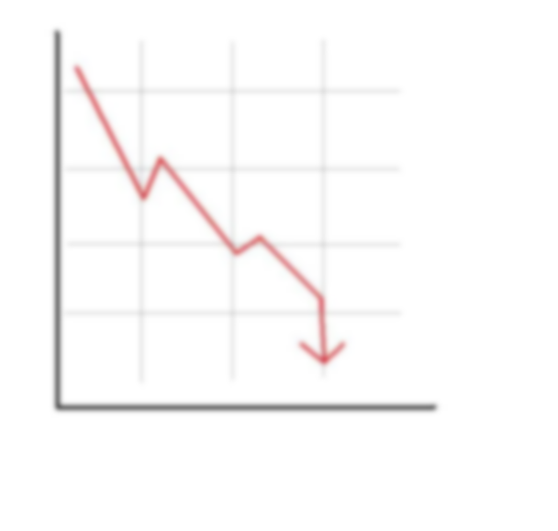
Declining Industries in a Booming Region Northern Middle
Declining industries in :
Manufacturing:
Architectural and structural metals manufacturing -5%
Printing and related support activities -2.3%
Glass and glass produce manufacturing -2.1%
Tobacco -1.4%
Retail Trade:
Office supplies, stationery, and gift stores -6.1%
Florists -4.8%
Specialty food stores -4.2%
Furniture stores -3.6%
Jewelry, luggage, and leather goods -3.1%
Bookstores and music stores -3.0%
Information:
Newspaper, periodical, book, and directory publishing -2.0%
Wired Telecommunication Carriers -1.9%
Transportation:
Taxi and Limousine Service -5.6%
Rail Transportation -1.9%
Notes:
Northern Middle is the fastest growing LWDA in Tennessee. However, it does have industries projected to decline. Some of the major industry categories include manufacturing, wholesale and retail trade, information , and transportation.
Declining industries in Manufacturing:
Tobacco -1.4 percent
Architectural and structural metals manufacturing -5
Printing and related support activities -2.3
Glass and glass produce manufacturing -2.1
Declining industries in Retail Trade:
Office supplies, stationery, and gift stores -6.1
Florists -4.8
Specialty food stores -4.2
Furniture stores -3.6
Jewelry, luggage, and leather goods -3.1
Bookstores and music stores -3.0
Declining industries in Information:
5111 Newspaper, periodical, book, and directory publishing -2.0
5171 Wired Telecommunication Carriers -1.9
Declining industries in Transportation
4853 Taxi and Limousine Service -5.6
4821 Rail Transportation -1.9

Slide 15
Gig Economy
There is no official definition of the ‘gig economy’. According to one definition, it is
"a labor market characterised by the prevalence of short-term contracts or freelance work, as opposed to permanent jobs".
Definitions are based on :
Work Arrangement: Contract or relationship between workers and the individual or company who pays them.
Legal classification: the difference between employees and independent contractors. Receives 1099 forms when they perform services for a company without being a direct employee.
Nature of work: on what people actually do on a day-to-day basis.
Growth of the gig economy is a global trend and this trend does not show signs of slowing.
Parts of the Gig Economy : Technology Platform Companies (Uber, Lyft, Airbnb, Etsy, etc.), Gig Workers (Dog walkers, Baby sitters, etc.) and Consumers.
Under the broadest measure of contingency, there were 5.9 million contingent workers;
Gig workers who did not expect their jobs to last accounted for 3.8% of total employment as reported by BLS in May 2017 data.
Source: Bureau of Labor Statistics Contingent and Alternative Employment Arrangements Summary
Notes:
Contingent workers are those who do not have an implicit or explicit contract for ongoing employment. Persons who do not expect to continue in their jobs for personal reasons such as retirement or returning to school are not considered contingent workers, provided that they would have the option of continuing in the job were it not for these personal reasons.
One of the main differences between a gig and traditional work arrangement is that a gig is a temporary work engagement, and the worker is paid only for that specific job.
Under the broadest measure of contingency, there were 5.9 million contingent workers; these workers who did not expect their jobs to last accounted for 3.8 percent of total employment.
Part of the Gig Economy : Technology Platform Companies like Uber,Lyft, Airbnb, Etsy, TaskRabbit etc, Gig Workers (Dog walkers, Baby sitters, etc.) and Consumers.
Gig workers are spread among diverse occupation groups and are not easily identified in surveys of employment and earnings. But they are similar in the way they earn money.
Gig workers may be included in counts of workers who are part-time, self-employed, or hold multiple jobs. But these counts also include workers who are not part of the gig workforce.

Slide 16
Workers in Gig Economy
Source: www.gigeconomydata.org
Notes:
-More than a quarter of workers participate in the gig economy in some capacity.
-More than one in ten workers rely on gig work for their primary income.
-About one percent of workers regularly use online platforms to connect with work opportunities.

Slide 17
Current Resources Available

Slide 18
Jobs4TN.gov
Notes:
This is the main portal for Job Seekers and staff working with Job Seekers.
This is used by WFS staff and Job Seekers
Job Seekers can look for jobs, post resumes
WFS Staff use this site to provide services for federal programs
UI Claimants file claims in this site and UI staff process the claims.
Employers also use this site to post jobs and search for potential candidates.
Another tool in this site is all the Labor Market information just described.
There are many areas that can be explored in the LMI section.
An Example is Staffing Patterns for projected growth in occupations or industries.

Slide 19
Staffing Patterns in TN in 2016-2026
Notes:
Staffing Patterns> Tennessee = Finance and Insurance
Staffing Patterns represent the distribution of employment for an occupation among industries. What is the estimated employment for this occupation now and in 10 years.
This list is for staffing patterns for this industry over a 10 year projection period (2016- 2026).
For each occupation you can view, Estimated Employment, and Projected Employment.
Also you can view the Percentage of Total Employment and Projected Employment
Click on any of the Occupation Profile link in Action column (Accountants and Auditors) - you can then drill into specific information on the occupation.

Slide 20
Real-Time Occupational Supply and Demand
Notes:
Accountant
Summary | Description | Jobs | Candidates | Supply and Demand | Employers
Skills | Education and Work Experience |Employment and Wages |Nature of the Work | Job Requirements |Other
On this view you will see a variety of occupation information, such as Description, Supply and Demand Data, Skills, Job Requirements, potential candidates in TN- County, etc.
This gives you an overview of each occupation you can also drill into see Top Employers Posting Jobs with Job Opening Counts and the Job Title for that Employer.

Slide 21
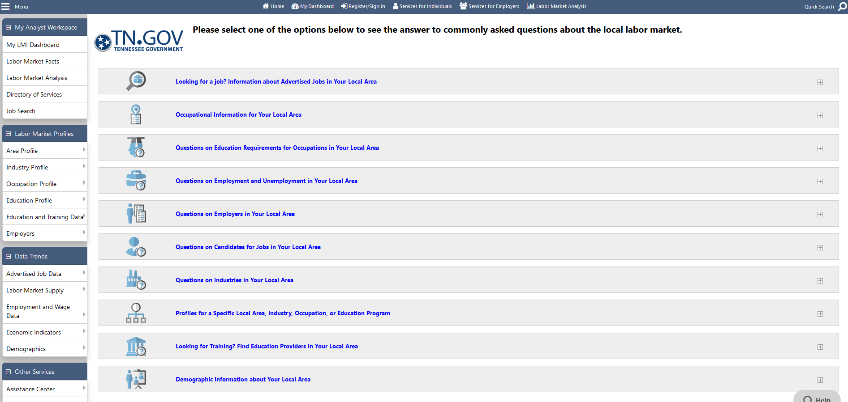
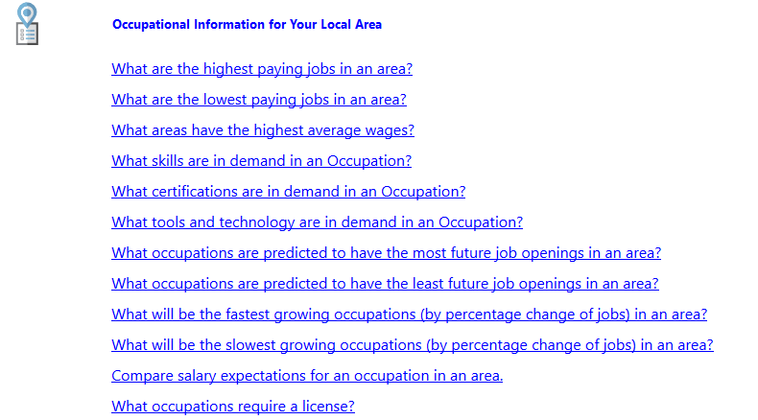
Labor Market Information For Your Local Area
Notes:
www.Jobs4tn.gov has an extensive information which provides insight into the US, TN, and local labor markets that includes bright outlook occupations.
This list gives a broad overview of area of interest in the Labor Market area. Each of these items are expandable to specific information.
Under The Occupational Information for your Local Area, I have expanded this section.
Here you can look for highest paying jobs, fastest growing jobs, etc.
For example, let’s look at : What occupations are predicated to have the most future jobs openings in an area. We can select an area of the state. (Northern Middle).

Slide 22
Labor Market Information For Your Local Area
Notes:
This view shows the Occupations for a 10 Year period of Estimated Employment. We can drill down to view specific information about that Occupation
Combined Food Preparation and Serving Workers is expected to be the fastest growing jobs in TN.
You can view the current estimated employment and to projected employment in 10years. You can also view Annual openings in this occupation.
Bright Outlook Jobs are jobs that are expected to grow rapidly in the next several years.
The Yellow is Nationally and Red is Statewide for Tennessee.
Every Bright Outlook occupation matches at least one of the following criteria:
Projected to grow faster than average (employment increase of 10% or more)
Projected to have 100,000 or more job openings over the period 2016-2026

Slide 23
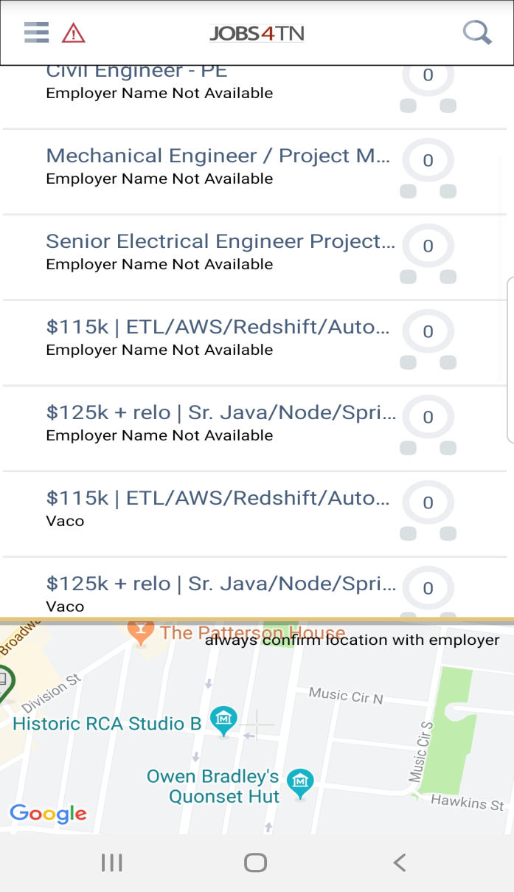
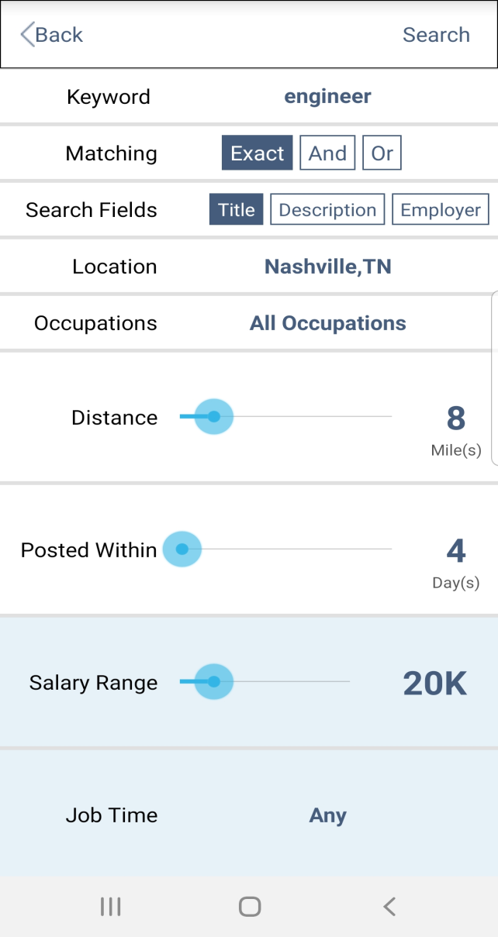
Jobs4TN on Mobile App Stores
Notes:
Jobs4TN Mobile App: Allows to do Job Searches
For many people, they do not have computers at their home or perhaps they want to check frequently on jobs openings in an area.
Jobs4tn has a mobile application that is available on any mobile platform.
Job Seekers can sign in if they have an account or continue as a guest.
In this view I have selected engineers. Made some selections for salary, location within miles, etc.
You can select their search parameters and then view the results.
The results on top of screen are the jobs available in jobs4tn – you can drill into these jobs to view specifics, at bottom of the screen you see a map of where these jobs are located.

Slide 24
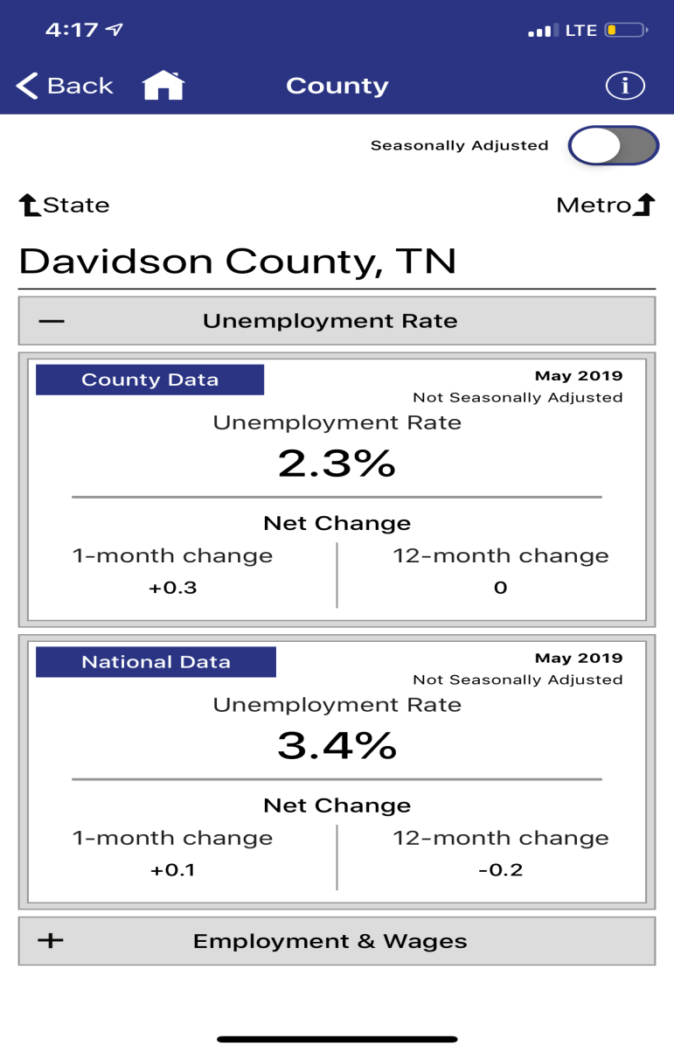
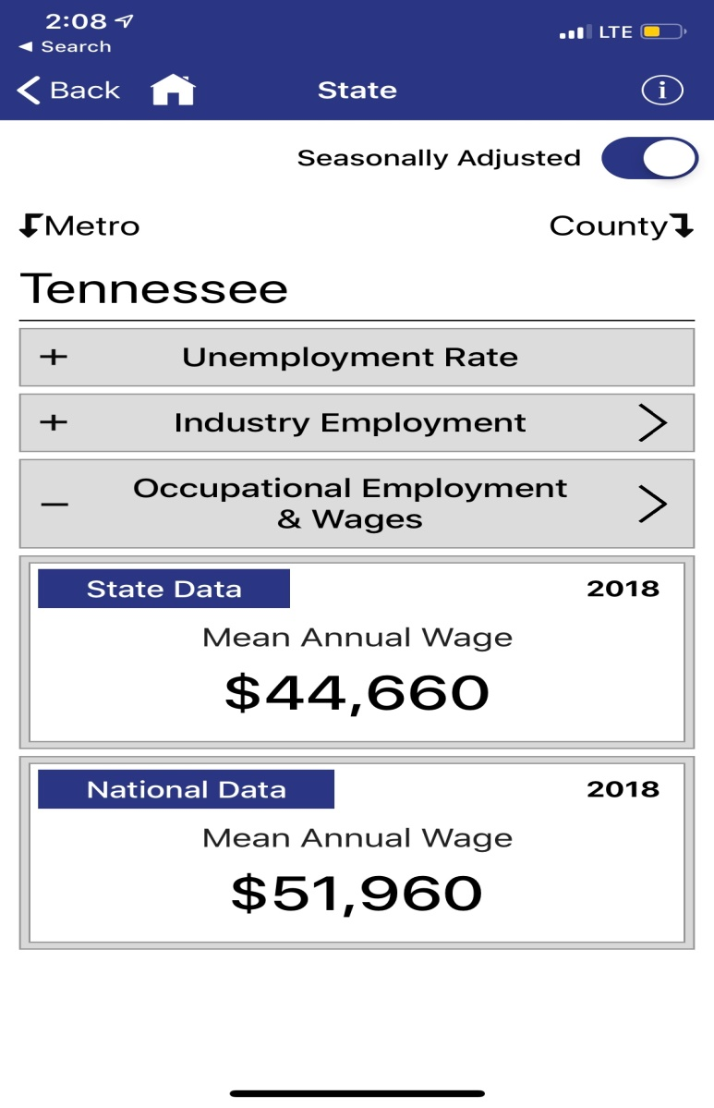
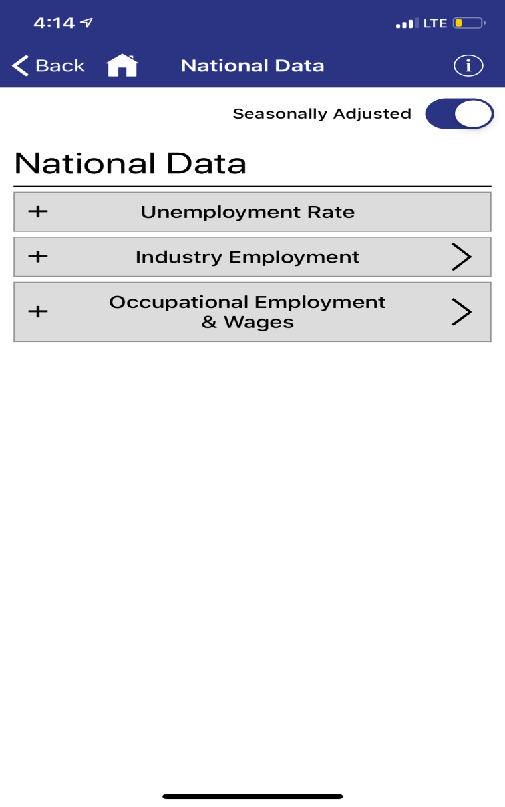
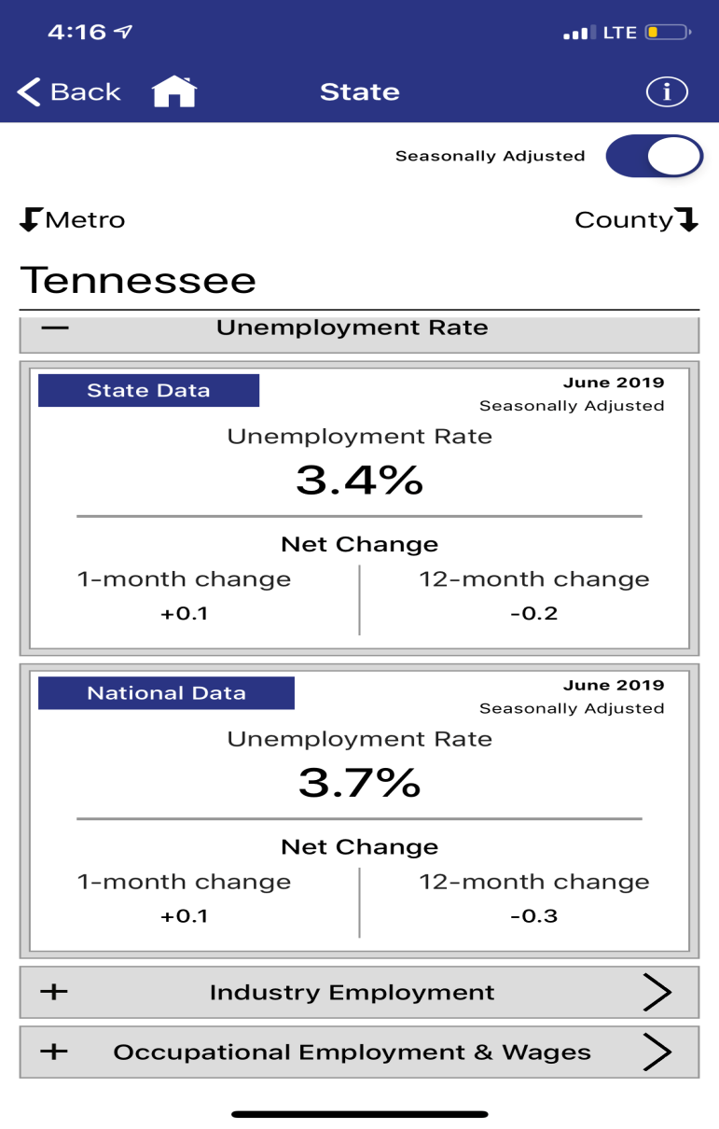
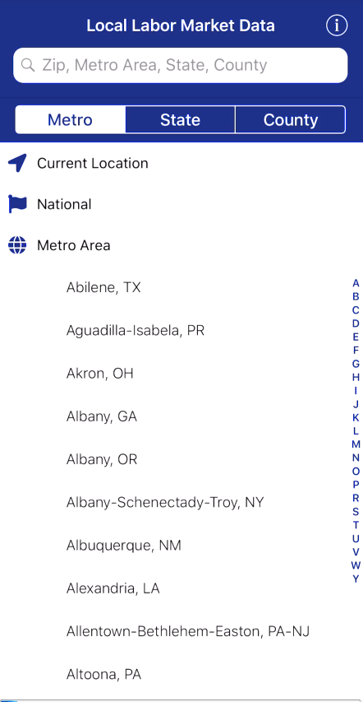
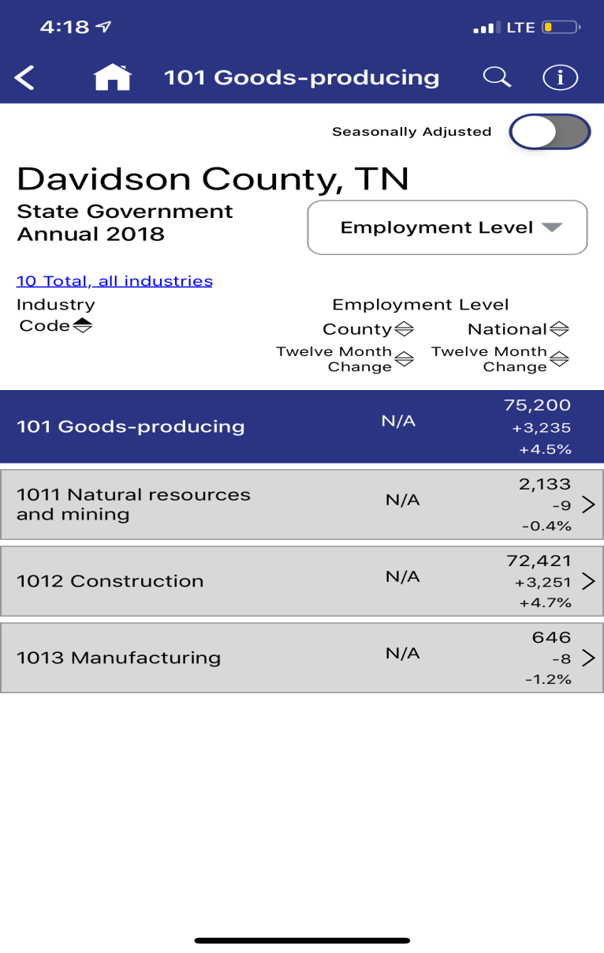
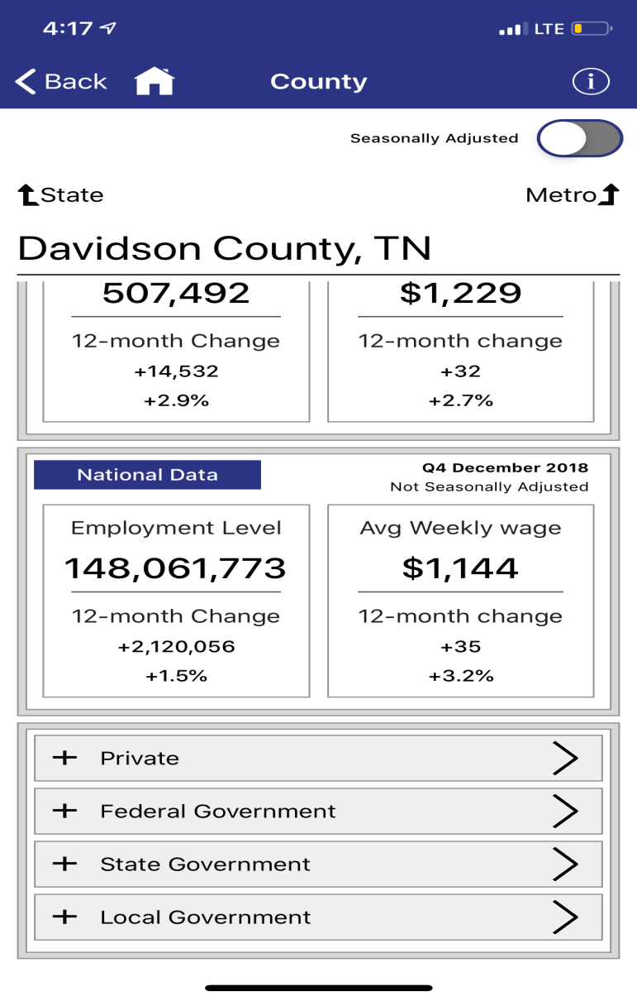
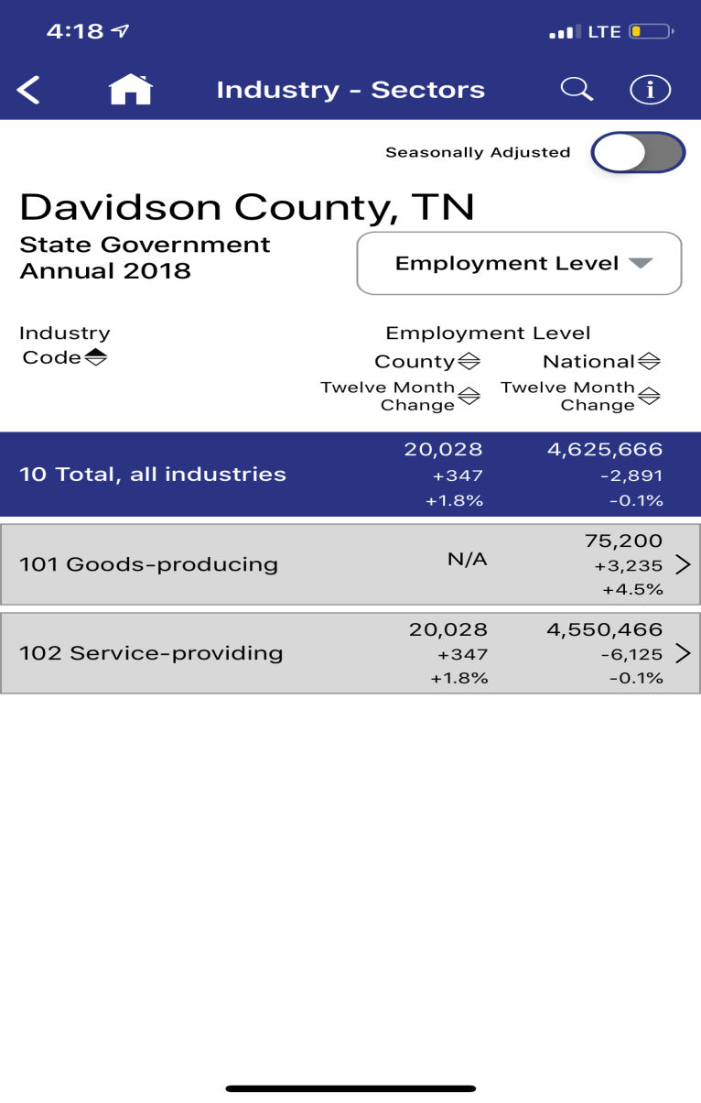
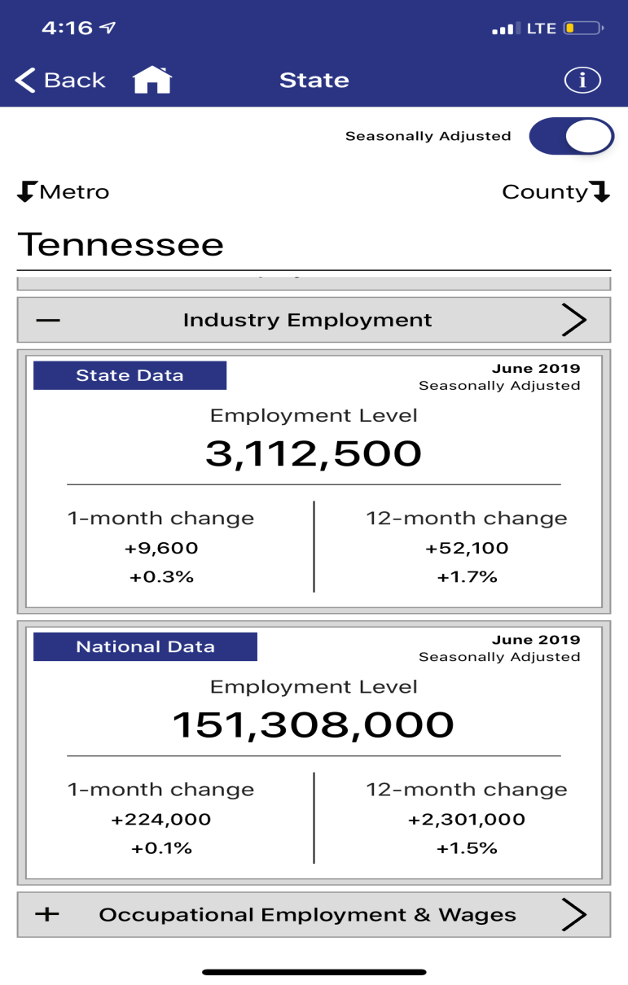
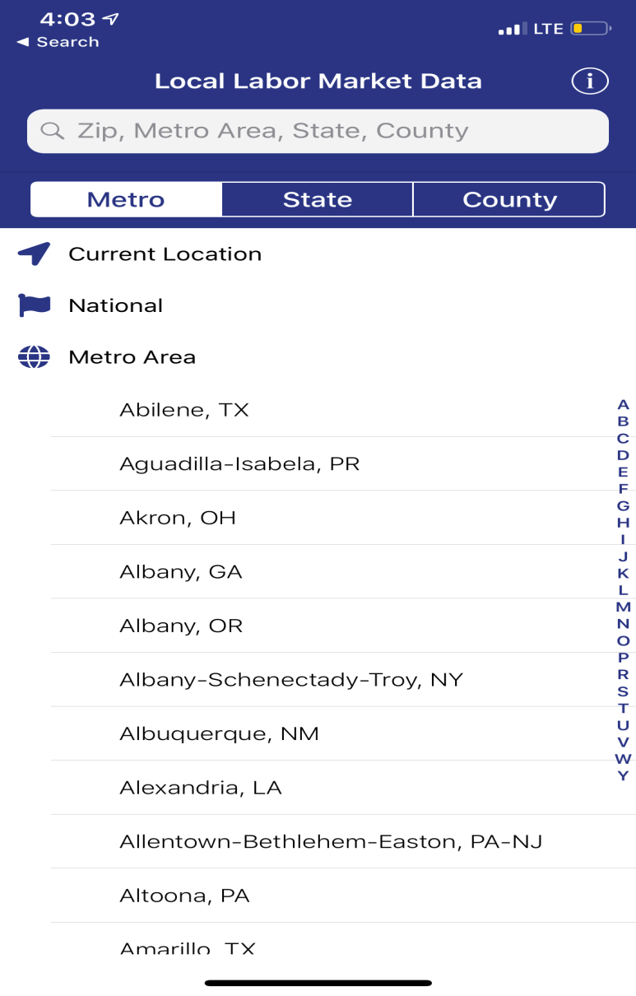
Bureau of Labor Statistics on Mobile
BLS Local Data
Available on App Store
Notes:
* Provides quick statistics on Unemployment, Industry Employment and Occupational Employment & Wages for National, States & their Counties.
Shows the trends between National/State/Metro Areas/Counties data.
Also provides the information of net change from last month and last year.
For Counties, it also shows Employment and Wages data for Private and Federal/State/Local Government
Drill down or search to find employment levels and wages for detailed occupations and industries in all states, metro areas and counties. Find the largest or highest paying occupations and industries, and compare local industry growth with national trends. Seasonally adjusted data is now presented by default when available.
Slide:
National
Tennessee (Unemployment Rate /Industry Sector/ Occupational Employment and Wages)
County (Davidson) :
Unemployment Rate /Employment & Wages: Compare with National data.
Employment & Wages (Private/Federal Government /State Government/Local Government) sector data.
State Government: Employment Level/Avg. Weekly Wage Level
Drill down more on Industry level (Upto 6 NAICS code)

Slide 25
Future Resources Available

Slide 26
Scenarios

Slide 27
Additional resources available on https://www.tn.gov/workforce

Slide 28
Contact us:
wired.info@tn.gov
615-741-2284

