Slide 1
Determining Federal Performance Indicators using VOS
How to check quarterly federal performance outcomes.
Jennifer Snow l April 2018

Slide 2
Pulling Predictive Reports in VOS

Slide 3
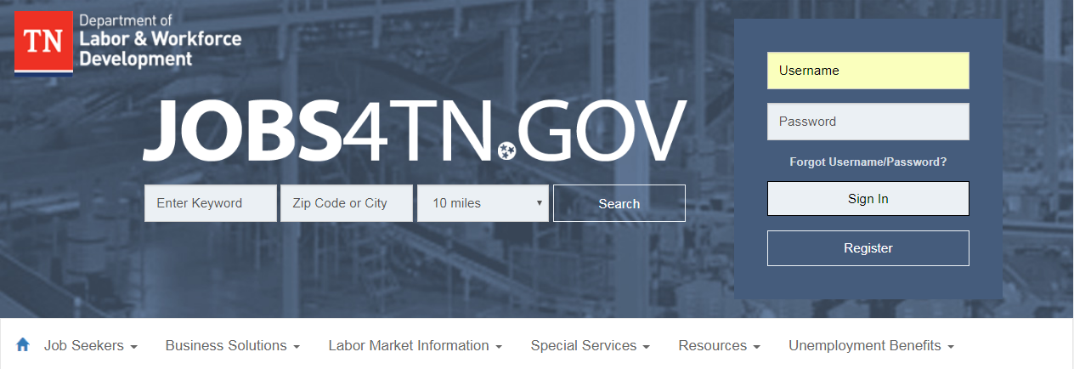
How to pull federal performance outcomes
First, log in to Jobs4TN.gov

Slide 4
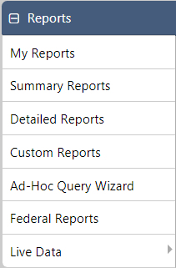
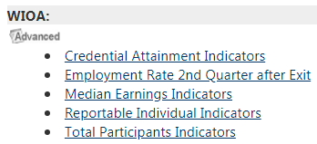
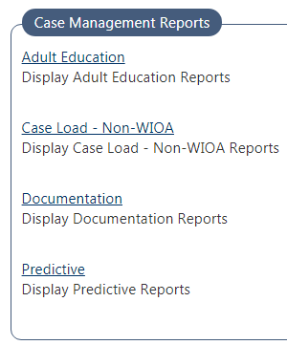
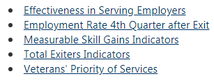
Reporting Path for Calculating Outcome Rates
Reports -> Detailed Reports -> Predictive
These reports can be used to see federal performance indicators.

Slide 5
Example: Employment Rate 2nd Quarter after Exit
As an example, we will use the “Employment Rate 2nd Quarter after Exit” report.

Slide 6
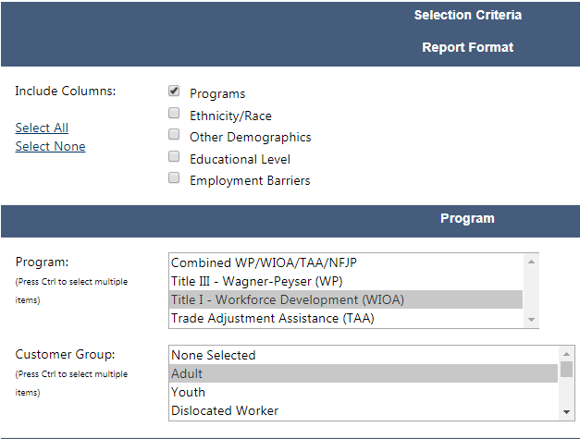
Choosing the program
Check the “Programs” box.
Select the desired program and customer group.

Slide 7
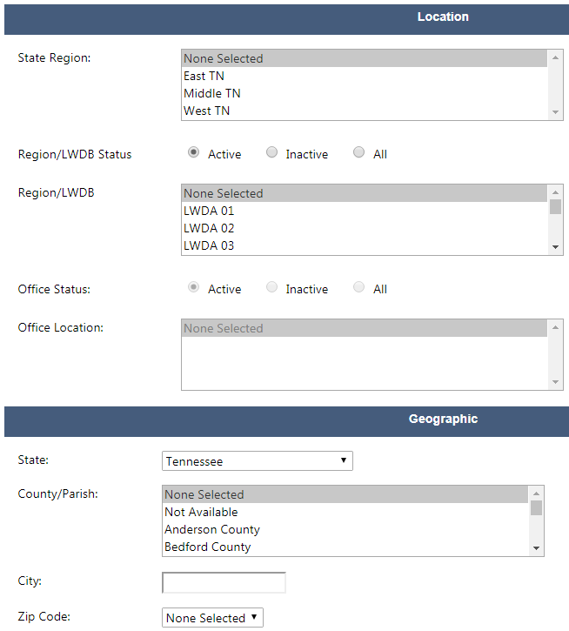
Choosing the Location/Geographic Area
Select the desired Grand Region, LWDA or State. For this example, we will choose Tennessee.

Slide 8
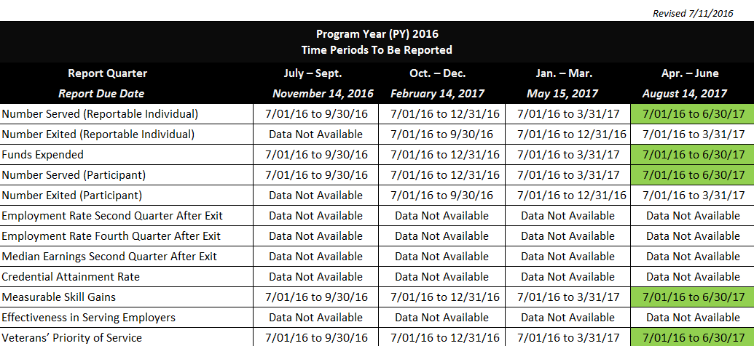
Determining the Date: PY16 Quarterly Cohorts for WIOA Performance Measures

Slide 9
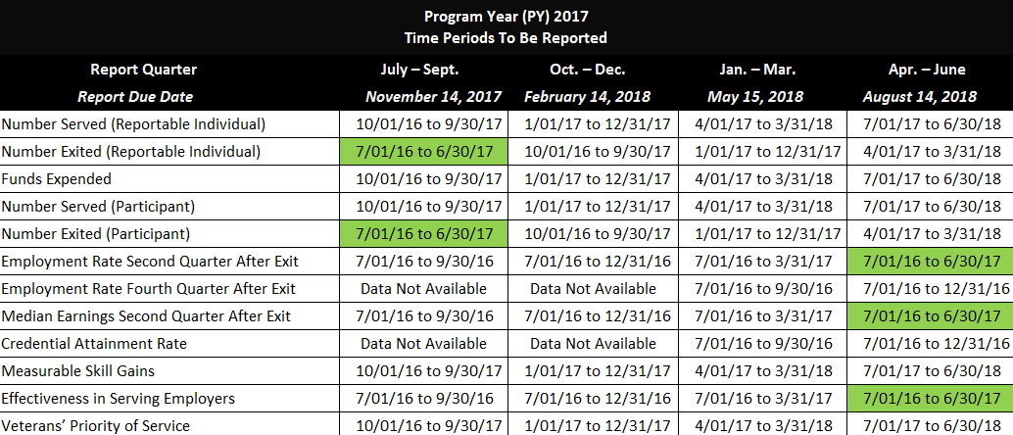
PY17 Quarterly Cohorts for WIOA Performance Measures

Slide 10
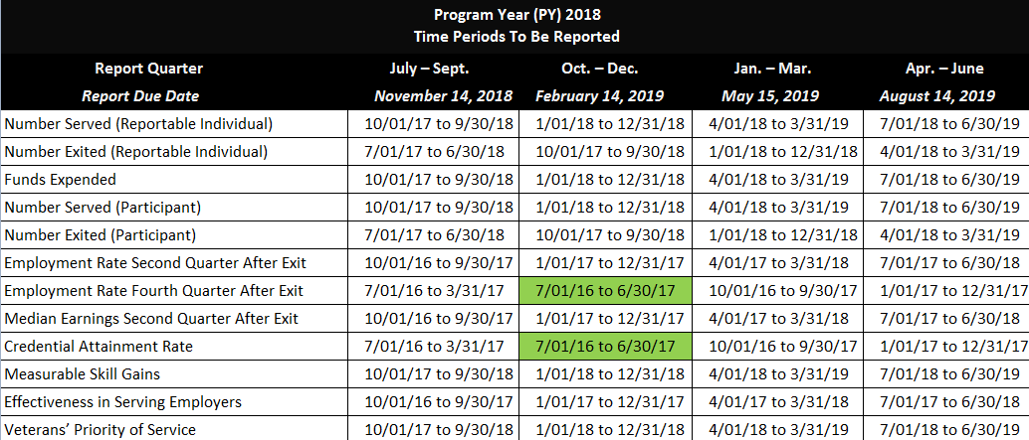
PY18 Quarterly Cohorts for WIOA Performance Measures

Slide 11
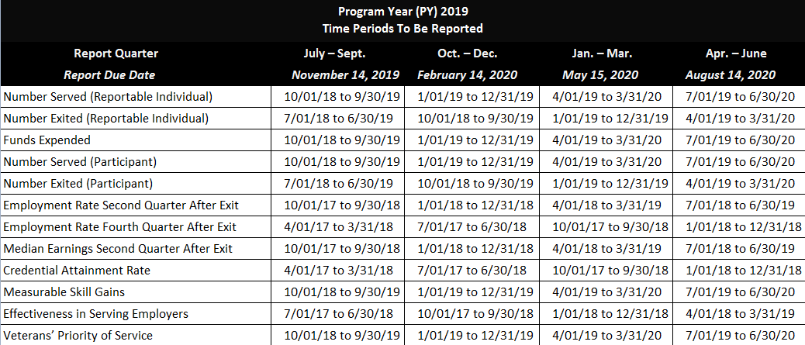
PY19 Quarterly Cohorts for WIOA Performance Measures

Slide 12
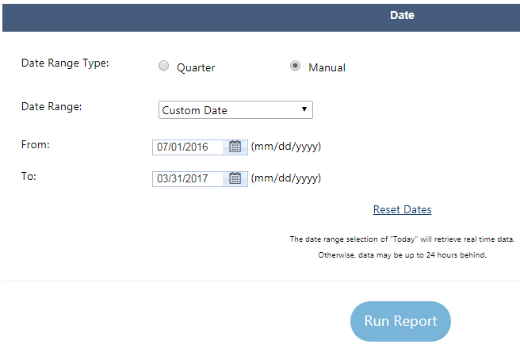
Choose the date
Check Manual.
Choose the desired date range using Custom Date.

Slide 13
Applying Predictive Reports from VOS

Slide 14
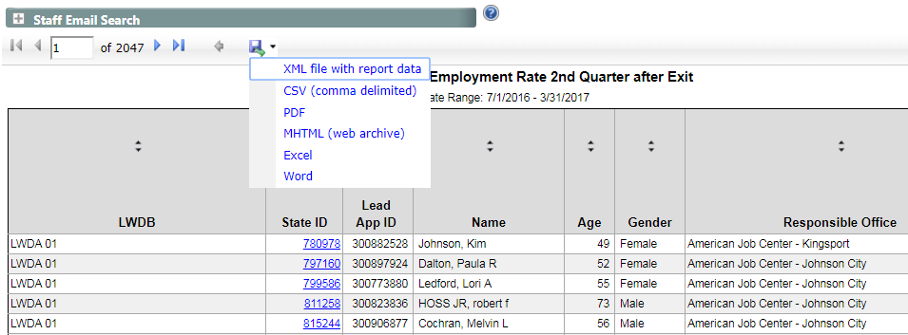
Exporting a predictive report into Excel
Click the “Save As icon.”
Choose Excel.

Slide 15
Recall the definition of the chosen performance indicator
Employment Rate 2nd Quarter after Exit is the percentage of participants who are in unsubsidized employment during the second quarter after exit from the program.
In order to determine our example federal performance indicator of the Employment Rate 2nd Quarter after Exit the following elements are needed:
The Numerator (# employed 2nd Q after exit)
The Denominator (total # of exited)

Slide 16
Start editing
Click Enable Editing.

Slide 17
Columns to Know

Slide 18
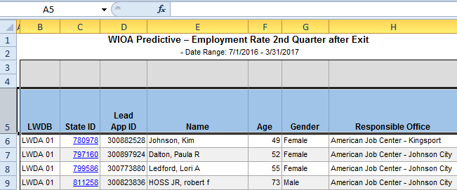
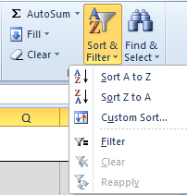
How to apply a filter
Select the header row.
Apply a filter.

Slide 19
Ensuring cleanliness of data
The highlighted rows should be reviewed.
Ensure all information was properly entered into VOS.

Slide 20
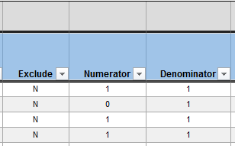
Eliminating those excluded from performance
Filter Exclude column to show only “N”s.

Slide 21
Determining the Denominator
Filter Denominator column for “1”s.
Take the sum, this will be the denominator.

Slide 22
Filter Numerator Column to only show 1’s then SUM that column
Filter Numerator Column to only show 1’s.
Take the SUM that column.

Slide 23
Performing the calculation
Dividing the this Numerator by the Denominator will yield the Employment Rate 2nd Quarter After Exit.

Slide 24
Revealing Negative Outcomes within the Measure

Slide 25
Determining the negative hits for a performance measure
In order to determine the “negative hits” for this measure, simply filter the numerator by “0”s.

Slide 26
Passing on this information to local staff
Filter rows to only show rows with those:
That have not been excluded from performance.
Numerators of 0’s.
Denominators of 1s.
The result will be a comprehensive list that can be passed along to staff. They should verify all data was entered properly for those participants and enter supplemental wage data if applicable.

Slide 27
Thank you!

