Slide 1
WIOA Systems Training April 18, 2018

Slide 2
Pre-Application Site

Slide 3
Pre-Application Site

Slide 4
Pre-Application Site

Slide 5
FY2018 CBG
The CBG for FY2018 was extremely successful. There were:
363 Pre-applications from employers
176 signed contracts broken down as follows:
96 IWT
62 OJT
18 Apprenticeship
4,225 individuals to be trained
$2,406,000 million dollars in funding requests

Slide 6
Question?

Slide 7
How to enter Incumbent Worker, Apprenticeship and On-the-Job Training into Jobs4tn

Slide 8
Understand What Funds are Paying for the Training
If Consolidated Business Grants are used to pay for activities then that means the funds are coming from statewide funds.
Statewide CBG funds can pay for Apprenticeship Training, On-the-Job Training, or Incumbent Worker Training
Locals also may use up to 20% of Adult and Dislocated Worker formula funds to provide Incumbent Worker Training
Local formula funds may also be used to fund Apprenticeship and On-the-Job training and both will be in local performance
Incumbent Worker Trainings will not be counted in your local performance measures per TEGL 10-16. If the participant receives any local funded activities, then they will be calculated in performance.

Slide 9
Using the Contract Section Under the Provider
Pros
Only one invoice and one payment made for all the participants that got trained. You still need to record the activities on each participant that got trained but would not record the fiscal amounts. IWT would be a good example of where this could be used.
Cons
The financial payments made will not show up in your fund management reports if you use the contract.

Slide 10
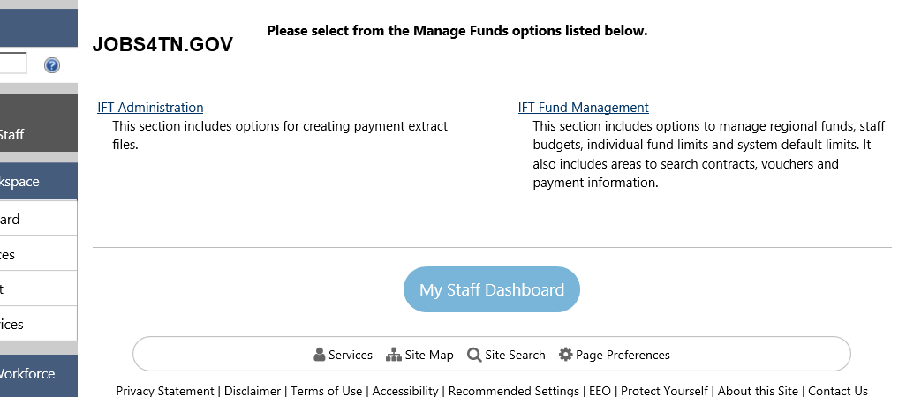
Setting Up the Fund Stream

Slide 11
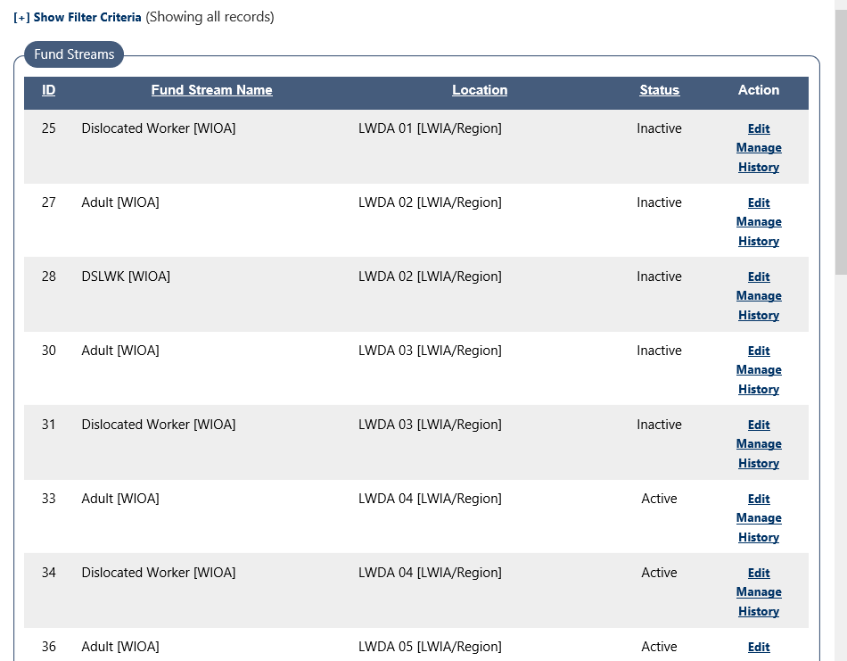

Slide 12
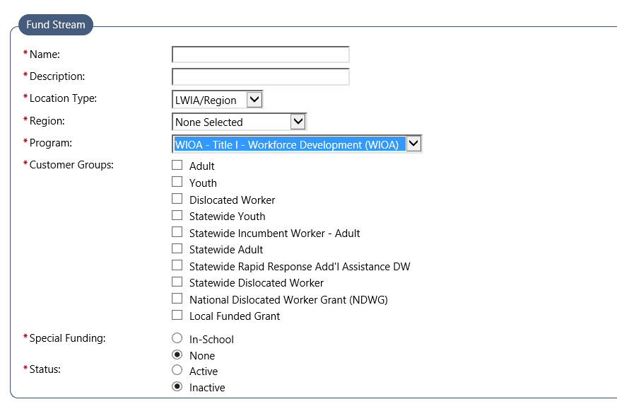
Ensure all Customer Groups That Need to be Served by the Grant are Checked

Slide 13
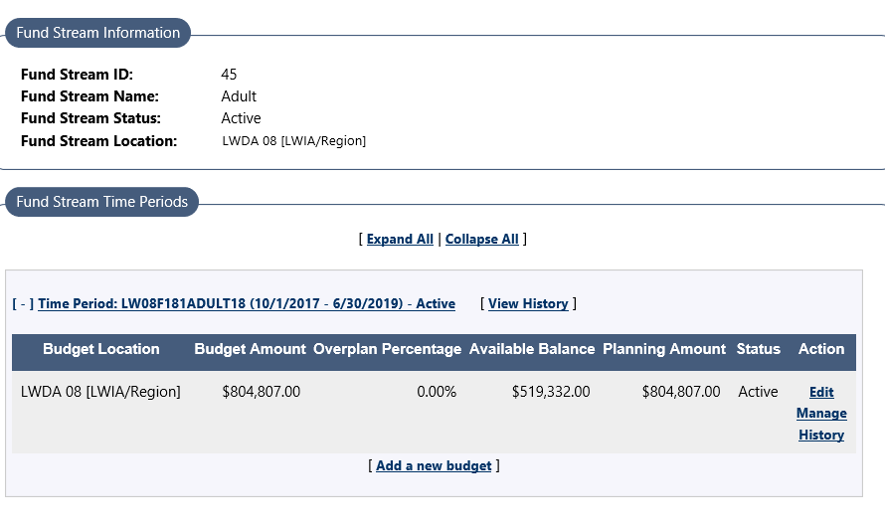
Ensure That Your Time Period is Correct

Slide 14
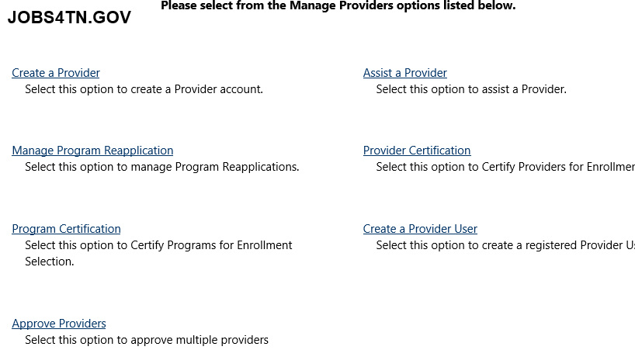
Create the Provider
Now that we have set up the fund stream we will be going to the assist a provider tab. We will create a provider which will be the company that will be doing the training. Under this provider we will also have to create the training program so that we can give the service to each of the individuals under their WIOA application.

Slide 15
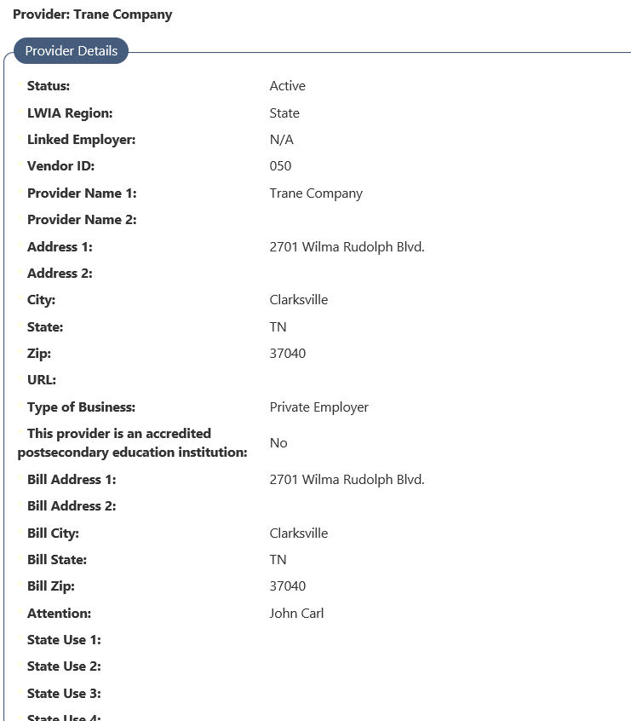
Input the provider details on the general tab under Add a New Provider

Slide 16
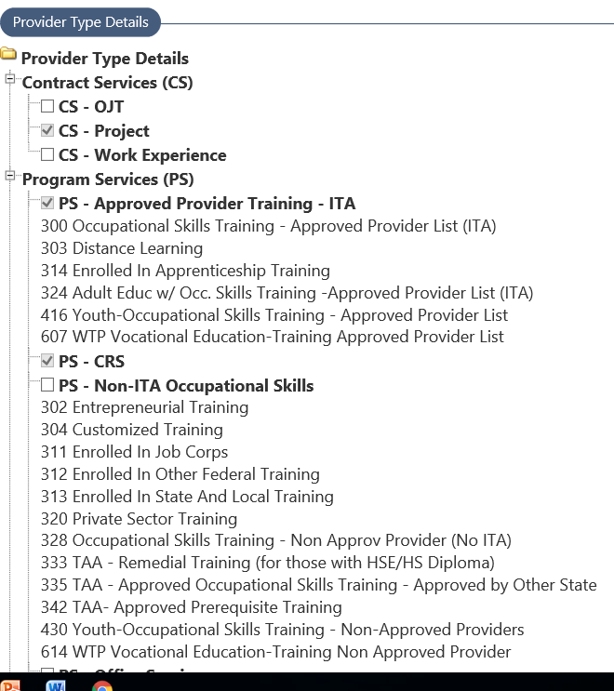
Provider Type Details
Make sure you have CS-Project turned on if you wish to use the contract section
Make sure you turn on any training activities that the provider needs to be able to provide-
325- Employed Worker Skills upgrading (IWT)
314- Enrolled in Apprenticeship training
301- On-the-Job Training

Slide 17
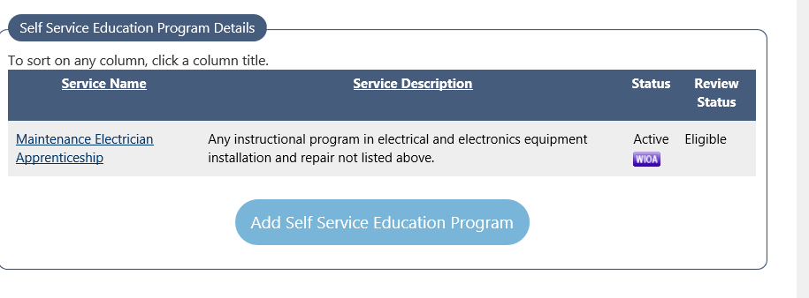
Create the Training Program

Slide 18
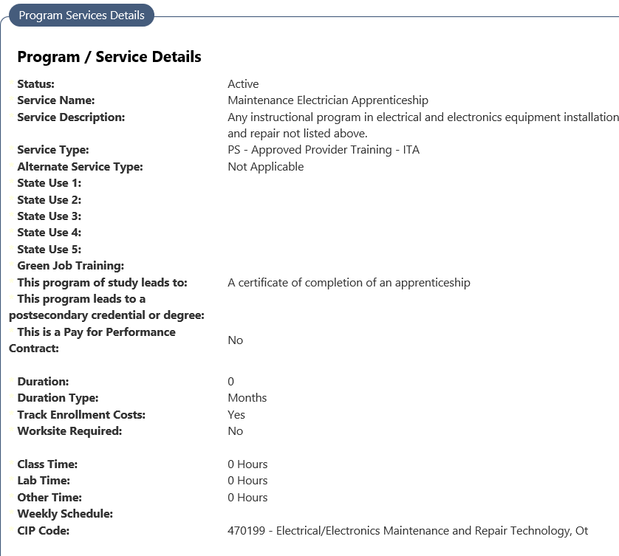
Fill Out All the Information On the Training Program

Slide 19
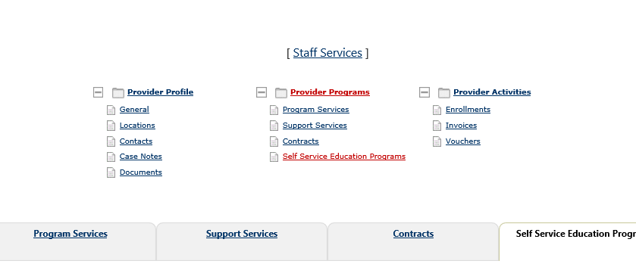
Add a new Project Contract
The contract section should be used when you are going to invoice and pay the provider in a lump sum for the training as opposed to recording cost on all students. An example of this would be Incumbent worker training contracts.

Slide 20
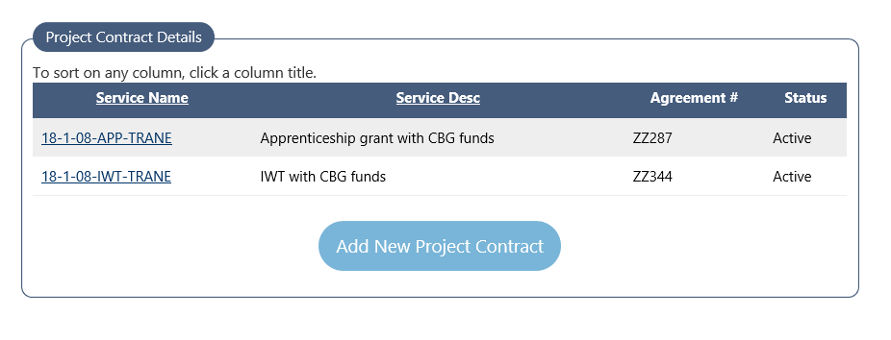

Slide 21
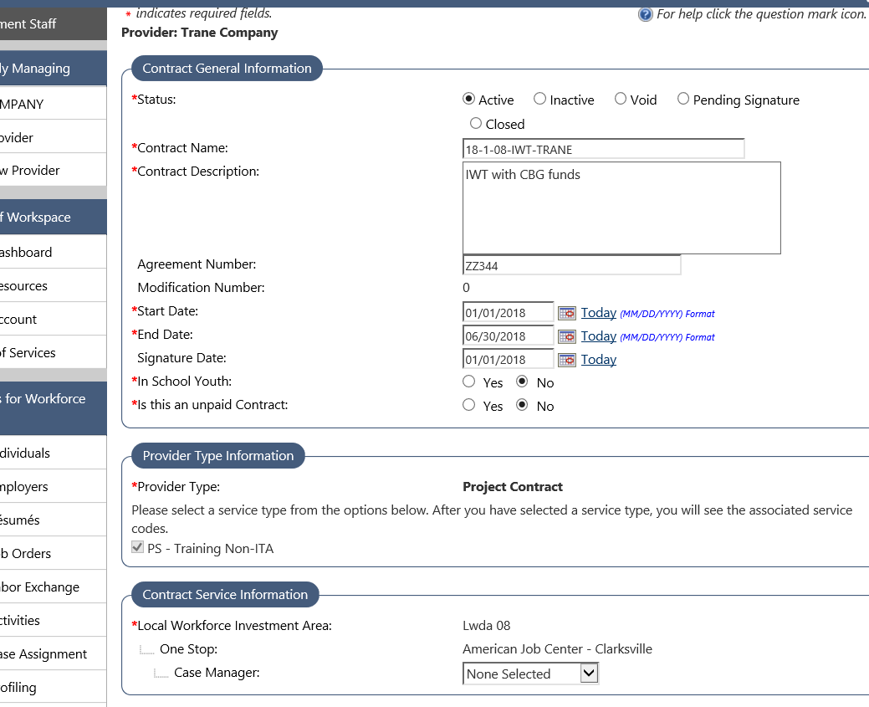

Slide 22
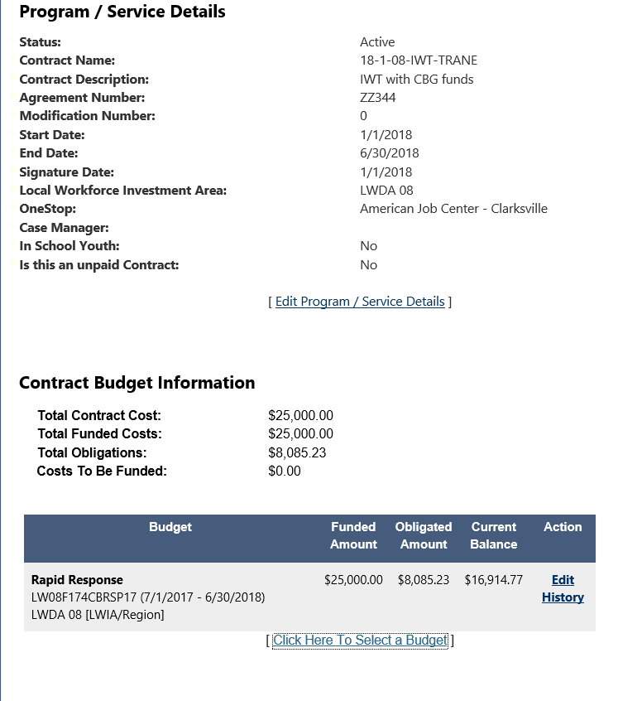
Select the Budget for the Contract

Slide 23
Assist an Individual to Add the Activity to Their Record

Slide 24
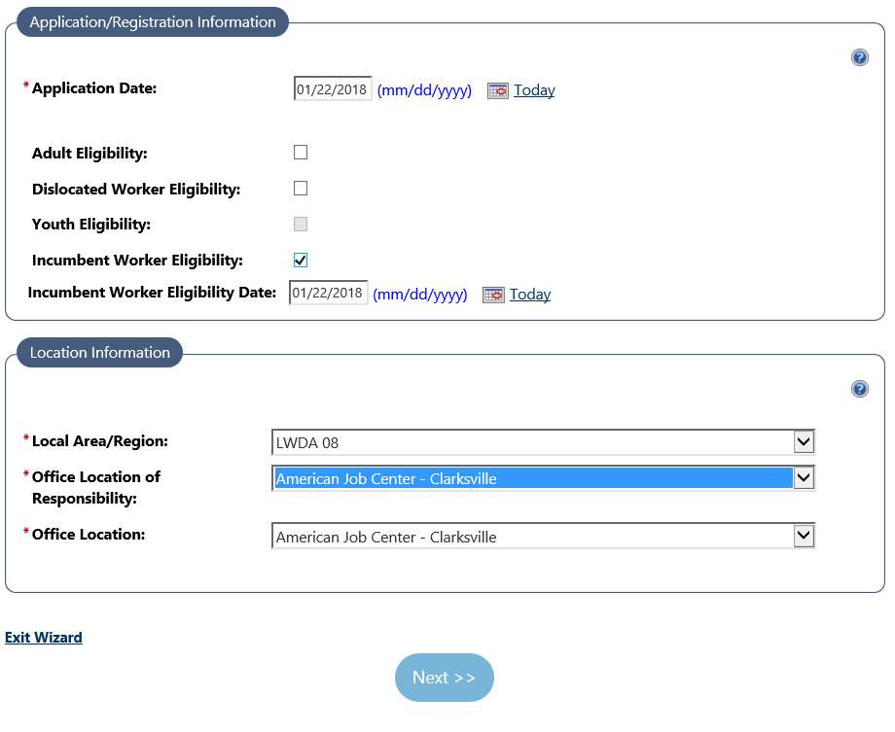
Example 1 In this Example, LWDA is using 20% formula funds

Slide 25
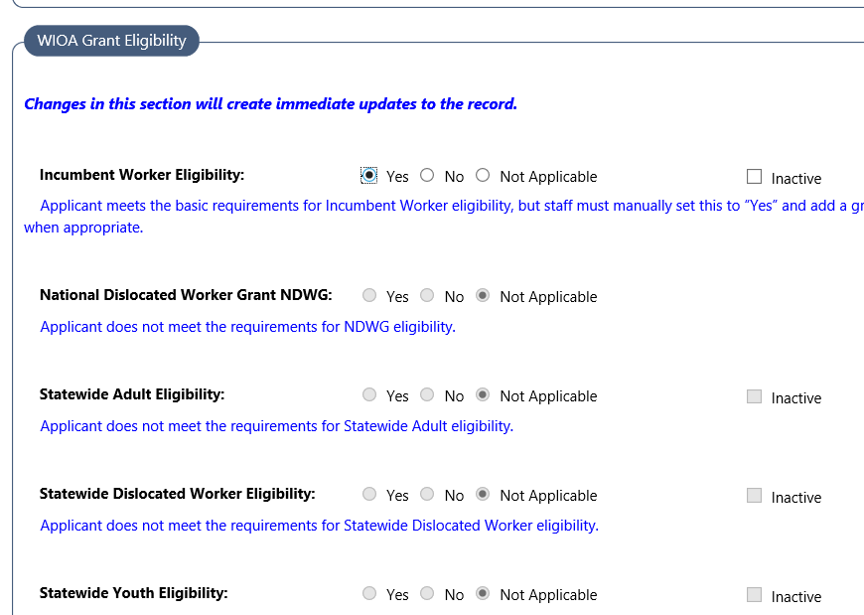

Slide 26
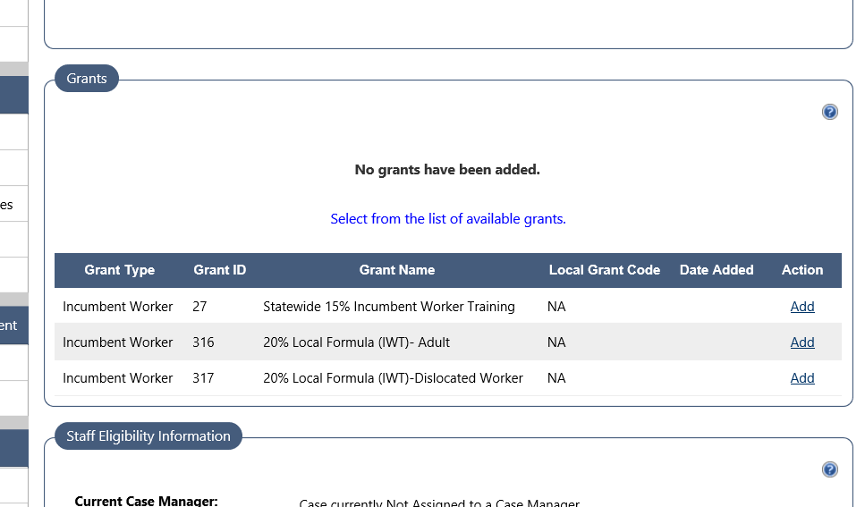

Slide 27
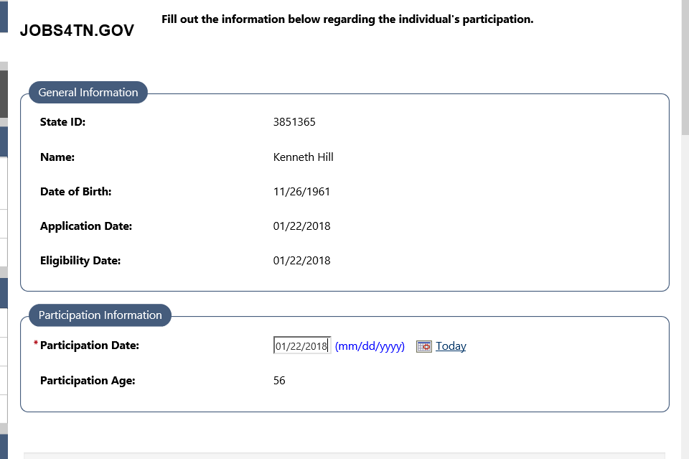

Slide 28
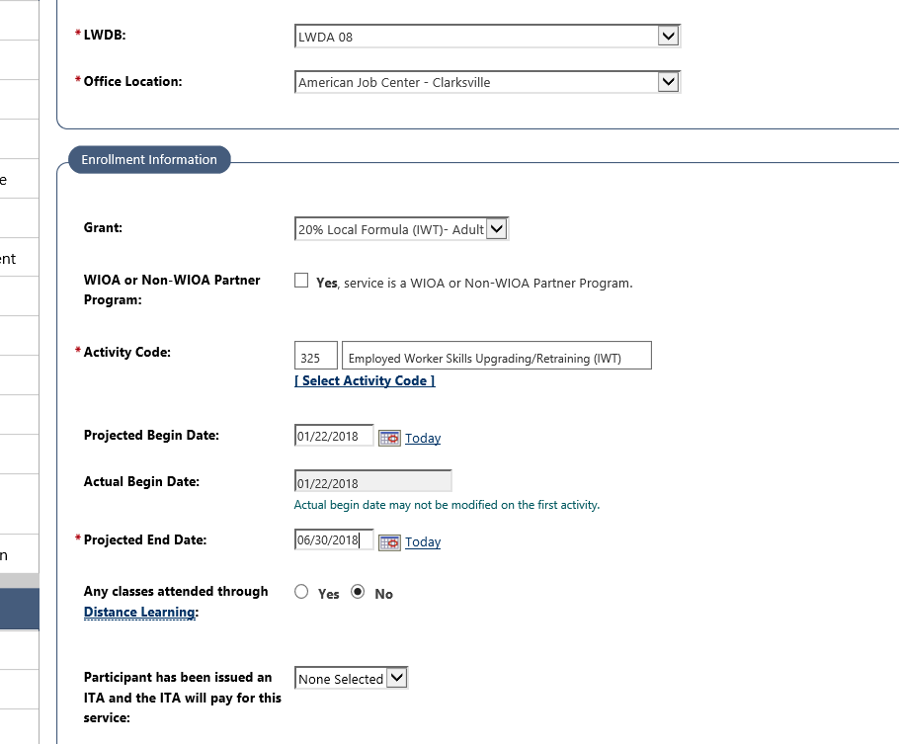

Slide 29
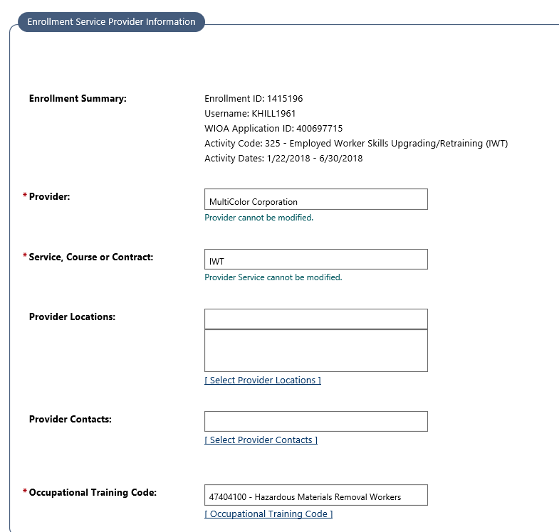

Slide 30
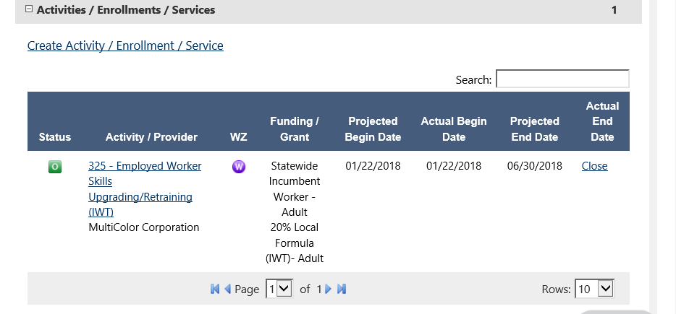

Slide 31
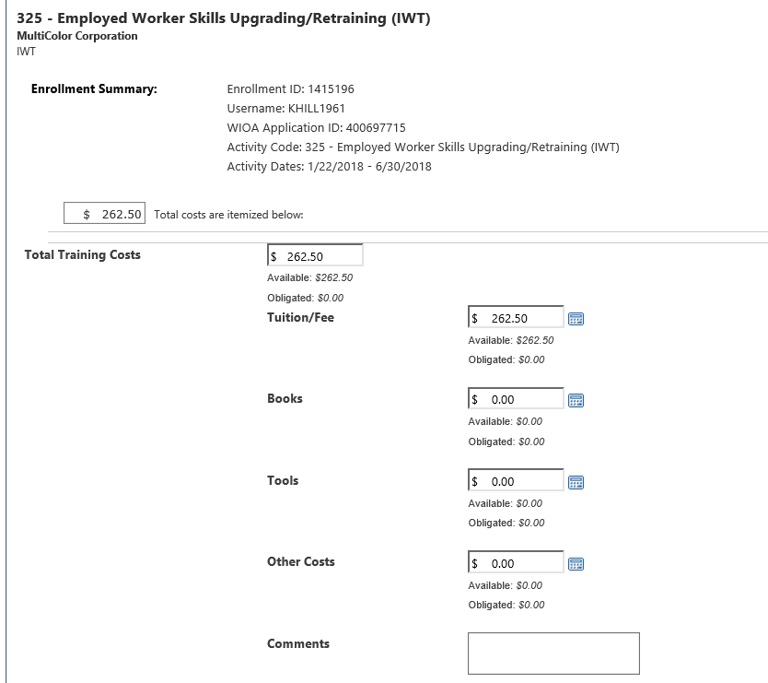

Slide 32
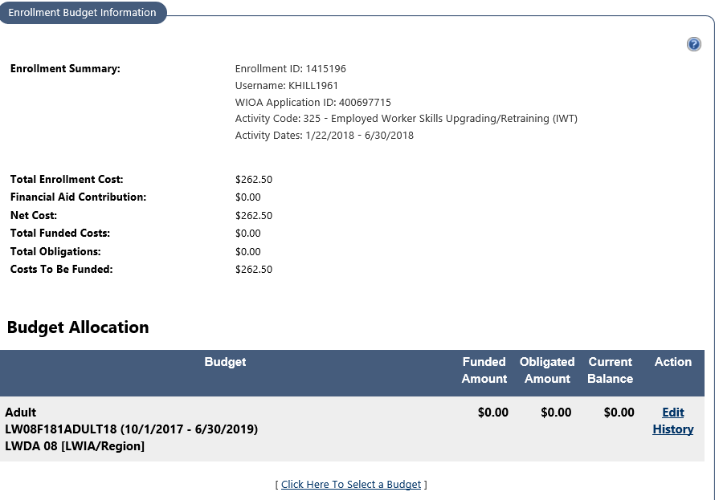

Slide 33
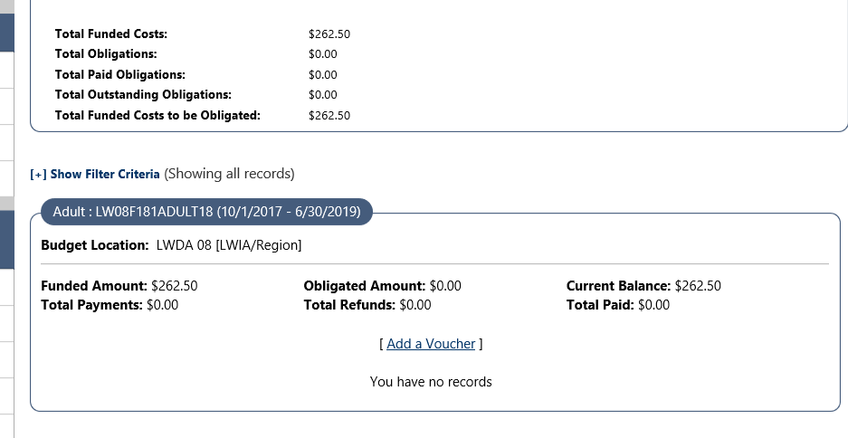

Slide 34
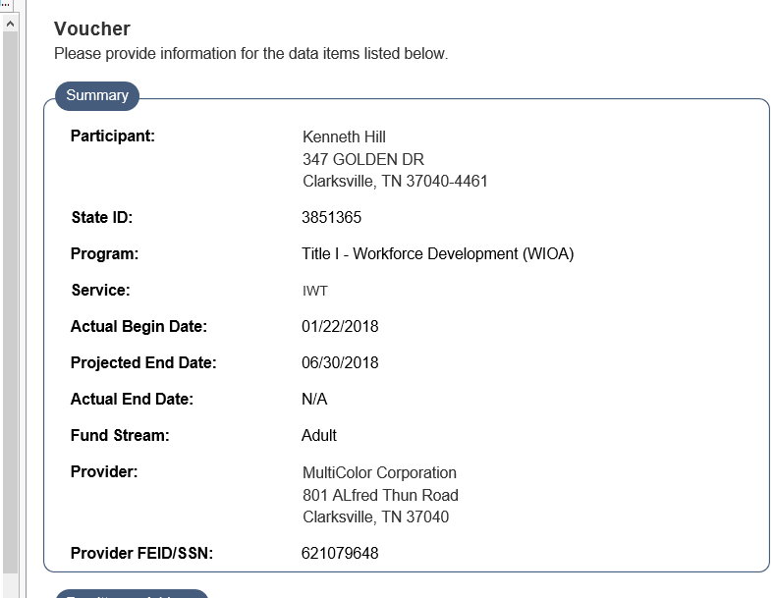
Voucher

Slide 35
Voucher

Slide 36
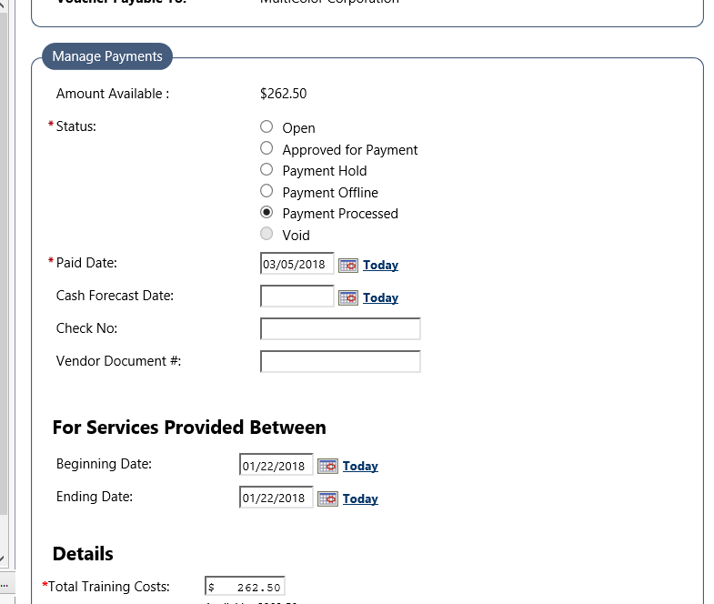
Payment

Slide 37
Payment

Slide 38
Example 2 Individual Paid With Statewide 15% CBG- IWT

Slide 39
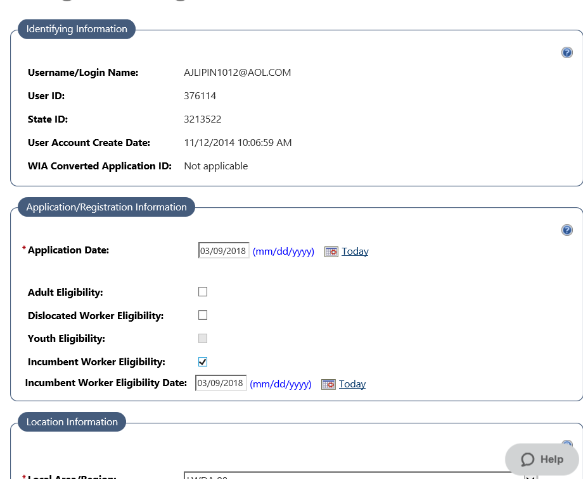

Slide 40
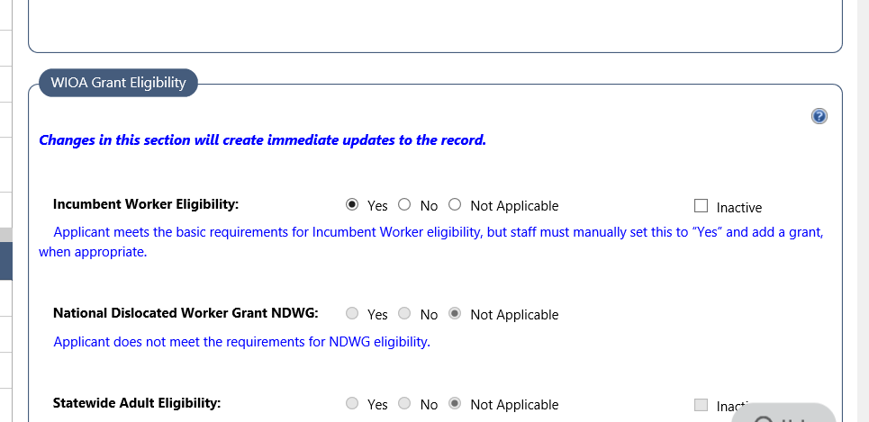

Slide 41
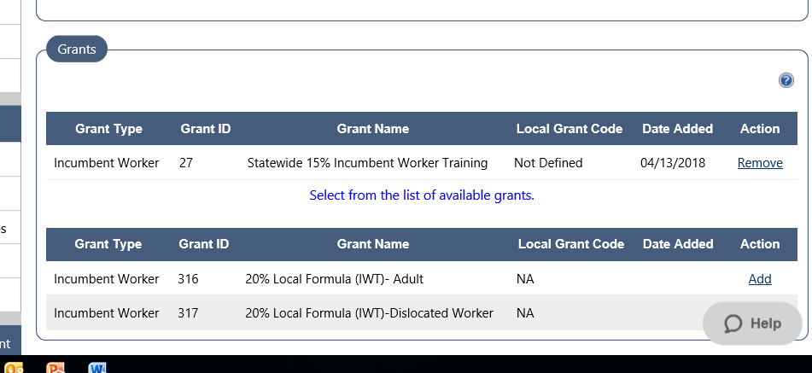

Slide 42
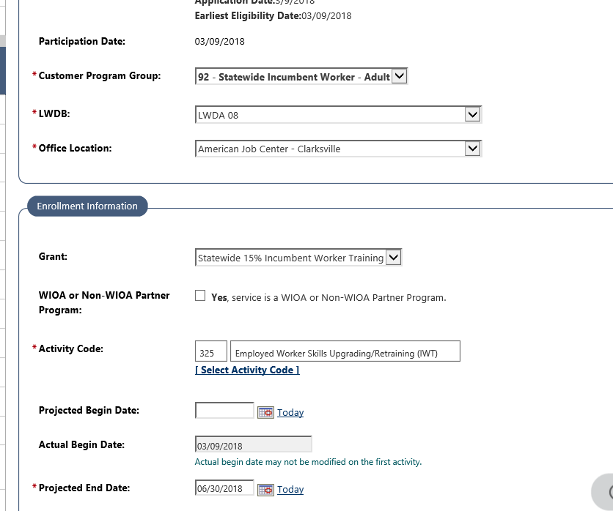

Slide 43
Questions?

