Slide 1
Business Services
Professional Development
April 2018

Slide 2
Business Services
Business Services Team Purpose
Engage Employers
Establish Relationships
Provide Analysis
Provide Solutions/Options

Slide 3
Business Services
Business Services Team Structure
OSO
Team Lead
Anyone Who Visits Employers
Functional Alignment

Slide 4
Business Services
Talking With Businesses
How Do You see Yourself?
Are You:
“From The Government And Here to Help”
Or Are You:
A “Business Professional” Who Can Provide Meaningful Assistance.

Slide 5
Business Services
Transformational vs. Transactional Relationship
Transactional – Want something in return from employer
Transformational – Develop a relationship with a business. Gain an understanding of their needs and position yourself to provide assistance when needed.

Slide 6
Business Services
What to do first?
Why are businesses in business?
You have to establish credibility.
Speak the language of business.
EBITDA?

Slide 7
Business Services
EBITDA - Earnings Before Interest, Taxes, Depreciation and Amortization.
EBITDA is calculated by taking net income and adding interest, taxes, depreciation and amortization expenses back to it.
EBITDA is used to analyze a company's operating profitability before non-operating expenses (such as interest and "other" non-core expenses) and non-cash charges (depreciation and amortization).

Slide 8
Business Services
Another business example
High turn-over rate…What could be the cause?
Low Pay
No Benefits
Use of Staffing Company
Work Culture

Slide 9
Business Services
Small Business
For a small business you can talk about saving money by having them allow you to be their staffing company.
Review resumes
Pre-screen applicants
Ensure qualified candidates
Assist with lower tax liability
Assist with lower workers compensation (Drug Free TN)

Slide 10
Business Services
Large Business
For a large business you can discuss saving them 10% on their recruiting costs.
Review resumes
Pre-screen applicants
Ensure qualified candidates
Assist with lower tax liability
Assist with lower workers compensation (Drug Free TN)

Slide 11
Business Services
After you sell the services…
Now you have to deliver!

Slide 12
Business Services

Slide 13
Business Services
Record All Activities In Jobs4TN
When you conduct a visit or provide assistance to an employer, you must annotate what you did by using the appropriate E-Codes in the system.
Write thorough case notes.

Slide 14
Business Services
Question?
What Are The Three Business Services Performance Measures As Set By US DOL?

Slide 15
Business Services
WIOA Sec. 116(b)(2)(A)(i)(VI) Requires The Departments To Establish A Primary Indicator Of Performance For Effectiveness In Serving Employers.
Retention
Repeat Business Customers
Employer Penetration Rate

Slide 16
Business Services
Performance Measures
The two performance measures TN has chosen are:
Penetration Rate
Repeat Customers

Slide 17
Business Services
Employer Penetration
The number of establishments that received a service or are continuing to receive a service or other assistance during the reporting period divided by the total number of establishments located within Tennessee during the final month or quarter of the reporting period.
You Must Get Out Of The Office!

Slide 18
Business Services
Repeat Business Customers
A unique count of employers who use WIOA core programs more than once.
Follow-up with Businesses to Maintain The Relationship.
Case manage an employer just like you would a client.

Slide 19
Business Services
Penetration Rate
The penetration rate will take care of itself if you are serving the businesses in your area.
Repeat business will occur because you have established a relationship with the employer and they can trust that you will assist them when needed.

Slide 20
Business Services
“You can judge a professional by the books that they read”
Don Brown, Mentor

Slide 21
Business Services
Business Professional
As a business professional, what do you read to stay current with the business community?
Industry Newsletters:
Supply Chain Dive
Jobs For The Future
3. Tech Republic

Slide 22
Business Services
The Future of Business
Be able to talk about the future of business
Automation
Technology
The Internet of Things (IoT)

Slide 23
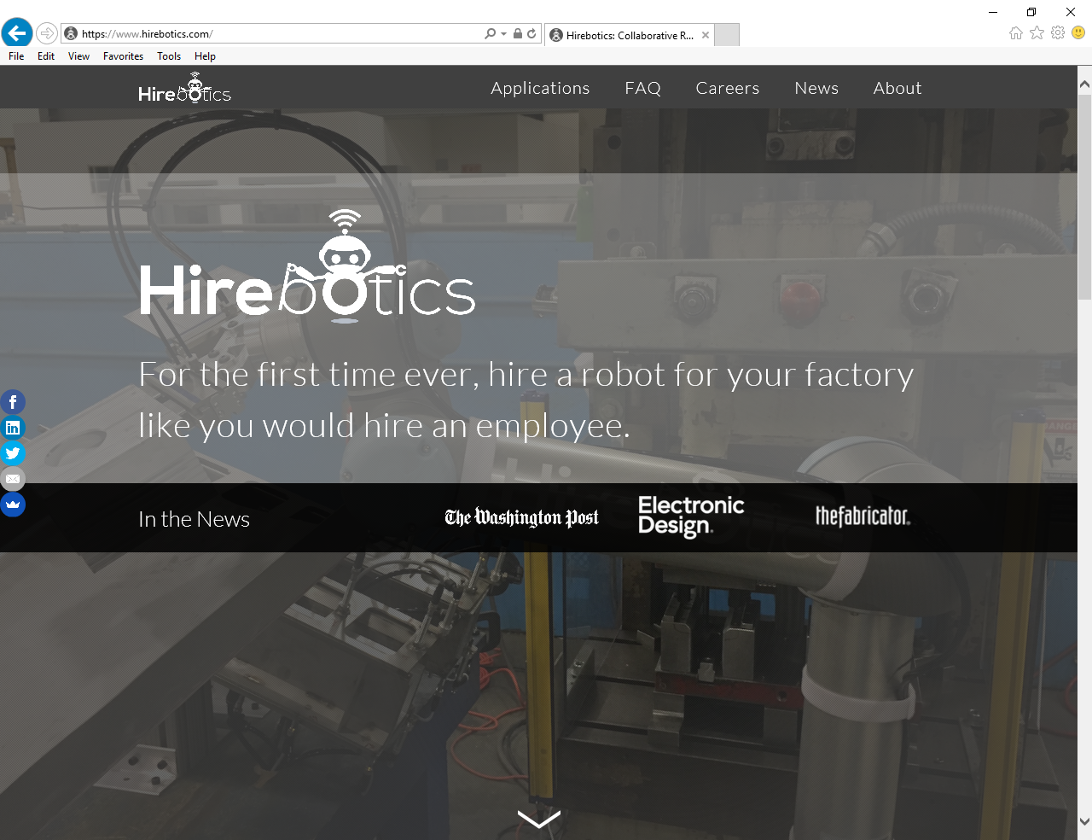
Business Services

Slide 24
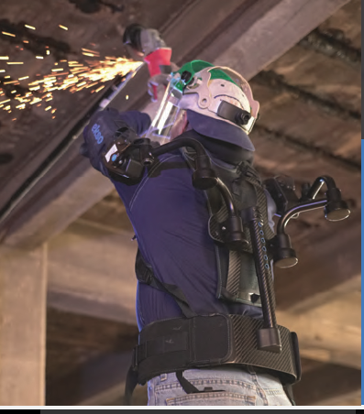
Business Services

Slide 25

Business Services

Slide 26
Business Services
Summary –
Transformational vs. Transactional

Slide 27
Business Services
Be knowledgeable of the business services that the AJC can provide.
IWT
OJT
Apprenticeship
TAA
WARN
Rapid Response
WOTC
Federal Bonding

Slide 28
Business Services
Questions?

