Slide 1

Globally Harmonized Hazard Commmunication and the Tennessee Right-To-Know Law
29 CFR 1910.1200
29 CFR 1926.59
TDL Rule 0800-1-9

Slide 2
TOSHA believes the information in this presentation to be accurate and delivers this presentation as a community service. As such, it is an academic presentation which cannot apply to every specific fact or situation; nor is it a substitute for any provisions of 29 CFR Part 1910 and/or Part 1926 of the Occupational Safety and Health Standards as adopted by the Tennessee Department of Labor and Workforce Development or of the Occupational Safety and Health Rules of the Tennessee Department of Labor and Workforce Development.

Slide 3

Bernardino Ramazzini
De Morbis Artificum, 1713
“Various and manifold is the harvest of diseases reaped by certain workers from the crafts and trades that they pursue; all the profit that they get is fatal injury to their health.”

Slide 4


Basic Nature of Chemicals
Everything is (a) chemical
Every chemical can be “hazardous”
“Hazardous” means there is scientific evidence that the chemical causes harmful effects during normal use
Harmful effects range from irritation to cancer

Slide 5

Paracelsus, 1493-1541
“All substances are poisons, there is none which is not a poison. The right dose differentiates the poison from the remedy.”

Slide 6


Hazardous Chemicals
Hazardous chemicals are of great value
Most can be used safely
OSHA does not ban chemicals
OSHA helps you work with chemicals safely

Slide 7


Basic Principle of Chemical Safety
What you don’t breathe won’t hurt you
What you don’t contact won’t hurt you

Slide 8
What Hazardous Chemicals Do You Use?

Slide 9
Examples of Hazardous Chemicals
Solvents--xylene, toluene, acetone
Corrosives--acids (HCl), bases (KOH)
Dusts--wood, metal
Mists--acid
Fumes--welding
Compressed gases--oxygen, acetylene, argon
Flammables--gasoline

Slide 10

Why a Hazard Communication Standard?
Employees have a need to know the hazards and identities of chemicals they are exposed to while working
Employees have a right to know the hazards and identities of chemicals they are exposed to while working
Employees need to know how to protect themselves from adverse effects of chemicals

Slide 11

History of Hazard Communication
Became law in 1985
Updated in 1994
Globally Harmonized in 2012

Slide 12
Time Line of GHS
    September 30, 2009 published the proposed rule in the Federal Register
    OSHA submitted the final rule to OMB on October 25, 2011.
      OMB finished the review on February 21st
    Final rule available on March 20th
    The Federal Register publication was on March 26th, 2012
NPRM
OMB
Final
Rule

Slide 13
Globally Harmonized System for Classification and Labeling of Chemicals
Based on United Nations initiative to develop global standards for classification and communication of chemical hazards
  Adopted originally in 2002
  Revision 1 in 2005
  Revision 2 in 2007
  Revision 3 in 2009* this is the one US adopted
  Revision 4 2011
Unified hazard communication for workers, consumers, transport workers, and emergency responders
Provides the underlying infrastructure for establishment of national, comprehensive chemical safety programs

Slide 14

What Have Other Countries Done?
Examples where GHS legislation or standards have been passed include:
  –New Zealand (2001)
  –Japan (2006)
  –Korea (2008)
  –Taiwan (2008)
  –EU (2008)
  –Indonesia (2009)
  –SOLAS (International Convention for the Safety of Life at Sea) (2009)
  –USA (2012)
Draft regulations on GHS published:
  Malaysia
  Philippines

Slide 15

  http://www.unece.org/trans/danger/publi/ghs/ghs_welcome_e.html
The Purple Book

Slide 16
Transition to GHS Format and Content
Classification | Reclassify Physical, Health and Environmental standards to new GHS standard
Labeling | Apply new hazard symbols to reclassifications
MSDS to SDS | Mandatory 16-section format with new required data elements and expanded information

Slide 17
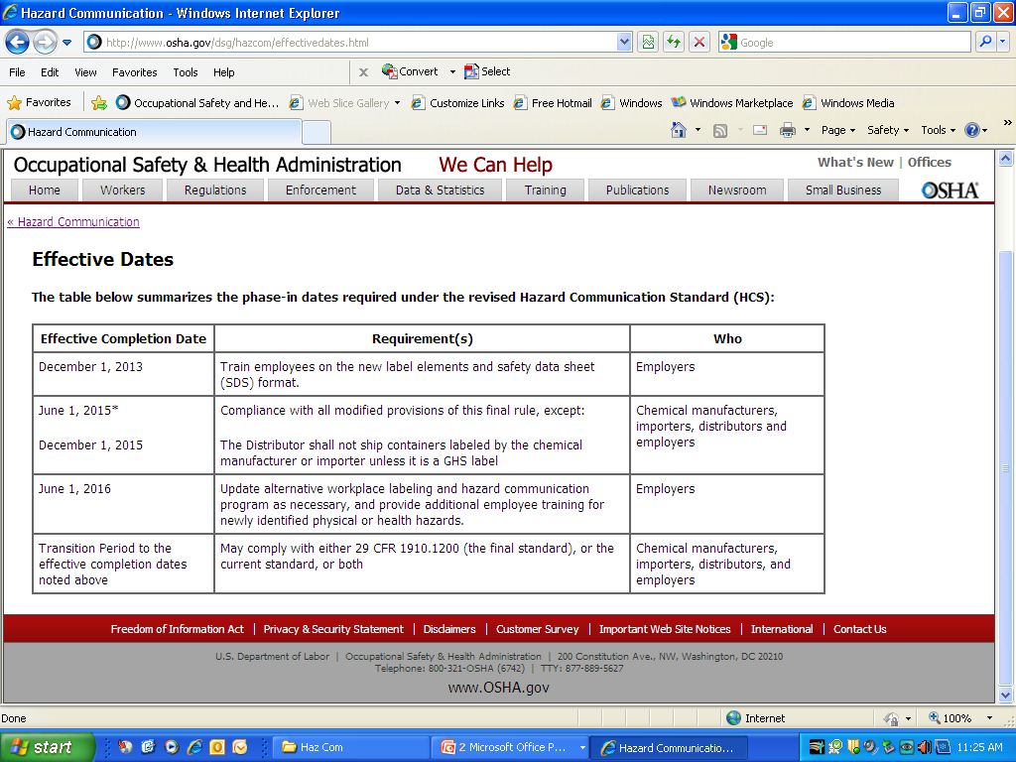
Compliance Dates

Slide 18
Why GHS?

Slide 19
OSHA Says GHS Will….
Help improve information received from other countries by standardizing the label and SDS information
Ensure symbols and hazard statements are familiar and understood by all workers
Ensure that chemicals crossing borders have consistent information
Enhance both employee and employer understanding of hazards
Allow everyone to access information on hazards of chemicals more effectively and efficiently

Slide 20

What are the Changes?

Slide 21
Purpose of Hazard Communication
Section (a)
States purpose is to harmonize with international requirements
Changes term evaluation of chemicals to classification

Slide 22

Scope and Application
Section (b)
Only terminology changes
  Material safety data sheets to safety data sheets
  Assess hazards to classify hazards
  Removes Appendix E
Still applies to all chemicals known to be present in the workplace in such a manner that employees may be exposed under normal conditions or in a foreseeable emergency
Exemptions retained, laboratory and warehouse coverage remains unchanged

Slide 23
Labeling Exemptions (b)(5)
Pesticides
Toxic Substances Control Act (TSCA regulated chemicals
Food, food additives, color additives, drugs, cosmetics, medical/vetinary devices, alcoholic beverages
Consumer products when labeled in accordance with the Consumer Product Safety Commission
Seeds treated with pesticides if labeled under US Department of Agriculture (USDA)

Slide 24
Full Exemptions (b)(6)
Hazardous waste
Hazardous substances at a CERCLA remediation site
Tobacco
Wood and wood products which will not be processed and only present a fire hazard
Articles
Food and alcoholic beverages sold, used or prepared in retail establishments or intended for personal consumption

Slide 25
Full Exemptions (b)(6)
Drugs in solid final form for direct administration to patient or packaged for sale, or for consumption by employees
Cosmetics packaged for sale or for use by employees
Consumer products if used only in consumer fashion
Nuisance particles
Radiation (ionizing and non-ionizing)
Biological hazards

Slide 26
Definitions
Section (c)
Added definitions for
  Classification
  Hazard category
  Hazard class
  Hazard not otherwise classified
  Hazard statement
  Label elements
  Pictogram
  Precautionary statement
  Product identifier
  Pyrophoric gas
  Safety data sheet
  Signal word
  Simple asphyxiant
  Substance

Slide 27
Definitions
Section (c)
Deleted definitions for
  Combustible liquid
  Compressed gas
  Explosive
  Flammable
  Flashpoint
  Hazard warning
  Identity
  Material safety data sheet
  Organic peroxide
  Oxidizer
  Pyrophoric
  Unstable (reactive)
  Water-reactive

Slide 28
Definitions
Section (c)
Revised definitions for
  Chemical
  Chemical name
  Hazardous chemical
  Health hazard
  Label
  Mixture
  Physical hazard
  Trade Secret

Slide 29
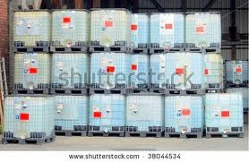
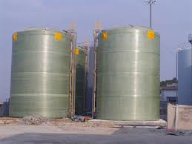

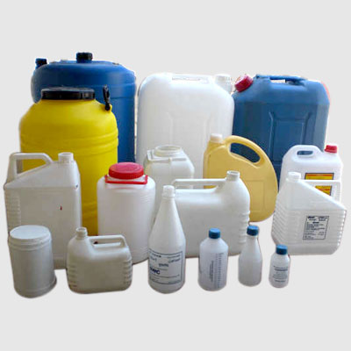
Definition of a “Chemical”
Any substance or mixture of substances
  Can be any of the following, for example:
    Xylene
    Carbon monoxide
    Silica
    Sand
    Bleach
    AbsorbAll
    Metalic 400

Slide 30
Hazard Classification
Section (d)
Hazard classification approach is different from performance-oriented approach
Includes general provisions for hazard classification of chemicals and mixtures of chemicals
Adds appendices A and B to address criteria for hazard classification
States that the person classifying the chemical should use available data and no additional testing is required

Slide 31
Written Hazard Communication Program Section (e)
Only terminology changes
Remember the list of hazardous chemicals must be part of the written program
Based on new criteria, the list may change

Slide 32
Labels
Section (f)
Extensively re-written
Detailed and specific provisions for labeling
Appendix C for specific information to be provided for each hazard class and category

Slide 33
Safety Data Sheet
Section (g)
Requires a 16-section format
Same as ANSI Z400.1 and Z129.1
Specific order
Appendix D details information to be included under each heading

Slide 34
Employee Information and Training Section (h)
Only change is addition of training on
  New labels
  New safety data sheet format

Slide 35
Trade Sectret
Section (i)
No substantive changes

Slide 36
What is a Hazardous Chemical Under GHS?
Hazard Classification

Slide 37
Hazardous Chemical
A chemical is defined as hazardous when it is classified as one of the following
  Health hazard
  Physical hazard
  Simple asphyxiant
  Combustible dust
  Pyrophoric gas
  Hazard not otherwise classified

Slide 38
Previous Definition
Under the earlier HCS, the concept of a “floor” of hazardous chemicals applied.
Chemical was determined to be hazardous if:
  There was an expanded standard for it in 29 CFR Part 1910, subpart Z,
  There was an OSHA PEL
  There was an ACGIH TLV
Chemical was determined to be carcinogenic if it was listed as such in:
  NTP Annual Report on Carcinogens
  IARC Monographs
  Carcinogen standards in 29 CFR part 1910, subpart Z

Slide 39

No “Floor”
Under HazCom 2012, no floor of chemicals exists.
  Follow GHS classification system as described in Appendices A and B

Slide 40

Mixtures
Mixture rules vary for the different hazard classes
There is no more 1 % rule

Slide 41
How to Classify Substances and Mixtures
Identify relevant data
Review the data to ascertain the hazards
Classify by comparison with the agreed criteria in Appendices A and B
  OSHA is not allowed to classify substances and mixtures for manufacturers, importers, or distributors.

Slide 42
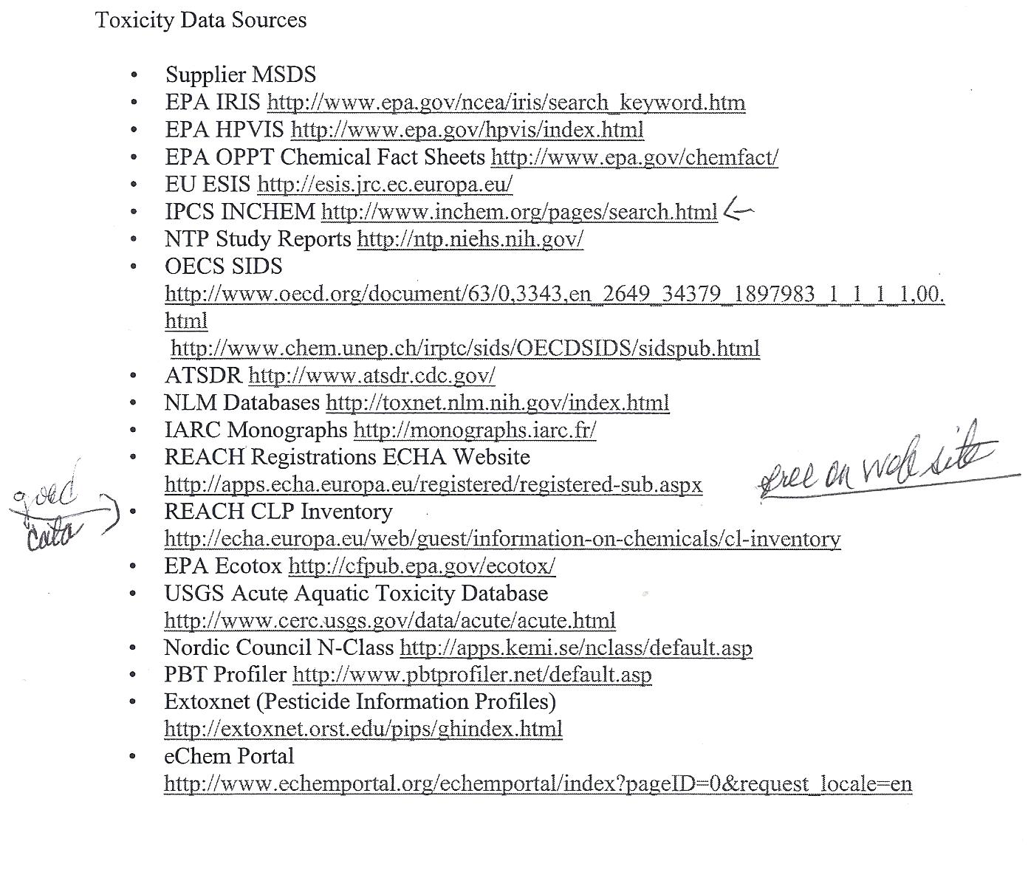
OK, Then Where Do I Find the Information

Slide 43
Health Hazard Classification
A chemical is classified as a health hazard if it poses one of the following effects
  Acute oral toxicity (any route)
  Skin corrosion or irritation
  Serious eye damage or eye irritation
  Respiratory or skin sensitization
  Germ cell mutagenicity
  Carcinogenicity
  Reproductive toxicity
  Specific target organ toxicity
  Aspiration hazard

Slide 44
Physical Hazard Classification
A chemical that poses one of the following hazardous effects
  Explosive
  Flammable
  Oxidizer
  Self-reactive
  Pyrophoric
  Self-heating
  Organic peroxide
  Corrosive to metal
  Gas under pressure
  In contact with water emits flammable gas

Slide 45
Simple Asphyxiant Classification
A chemical is classified as such if it displaces oxygen in the ambient atmosphere and can cause oxygen deprivation leading to unconsciousness and death
  For example,
    Nitrogen
    Carbon dioxide
    Hydrogen
    Methane

Slide 46
Combustible Dust
NFPA 654 (2006) and NEP Definitions
  Combustible Dust A combustible particulate solid that presents a fire or deflagration hazard when suspended in air or some other oxidizing medium over a range of concentrations, regardless of particle size or shape
  Combustible Particulate Solid Any combustible solid material, composed of distinct particles or pieces, regardless of size, shape or chemical composition
NFPA 69 (2002), and 499 (2004) Definitions
  Combustible Dust. Any finely divided solid material 420 microns* or less in diameter (i.e., material passing through a U.S. No 40 Standard Sieve) that presents a fire or explosion hazard when dispersed

Slide 47
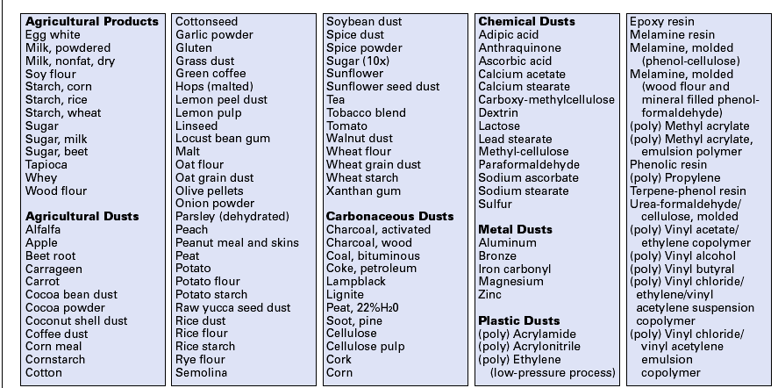
Combustible Dusts

Slide 48

Common NFPA Standards for Dust
NFPA 654- Prevention of Fires and Explosions for Mfg./Process/Handling
NFPA 664- Prevention of Fires and Explosions in Wood Processing/Working
NFPA 484- Standard for Combustible Metals
NFPA 499- Classification of Combustible Dusts and of Hazardous Locations for Electrical Installations in Chemical Process Areas
NFPA 61- Prevention of Fires and Explosions in Ag/Food

Slide 49

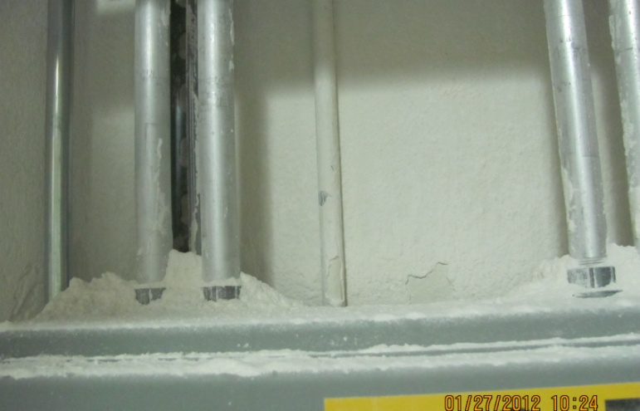
Combustible Dust
GHS does not include combustible dust hazard classification
There is no internationally accepted classification criteria for combustible dusts
Combustible dusts does not equal a flammable solid but a flammable solid may present a combustible dust hazard

Slide 50
Pyrophoric Gas Classification
A chemical in a gaseous state that will ignite spontaneously in air at a temperature of 130 degrees F
  For example,
    Arsine
    Silane
    Metal carbonyls (dicobalt octacarbonyl, nickel carbonyl)
    Diborane

Slide 51
Hazard Not Otherwise Classified Classification
A chemical is classified as such when there is an adverse physical or health effect identified through evaluation of scientific evidence that does not meet the specified criteria for the physical and health hazard classes
Not required on the label, but should be on the MSDS
Does not apply to adverse physical and health hazards under a GHS category that was not adopted by OSHA, such as acute toxicity Category 5

Slide 52
Labeling Requirements

Slide 53
Incoming Containers
The requirement to have labels in unchanged
The label content has changed—refer to Appendix C once the chemical has been classified
The chemical manufacturer, distributor, or importer must label a container with
  Product identifier
  Signal word
  Hazard statement(s)
  Pictogram
  Precautionary statement(s)
  Name, address, telephone number of manufacturer, distributor or importer
  Manufacturers, importers, will not ship containers without GHS labels after June 1, 2015
  Distributors after December 1, 2015

Slide 54
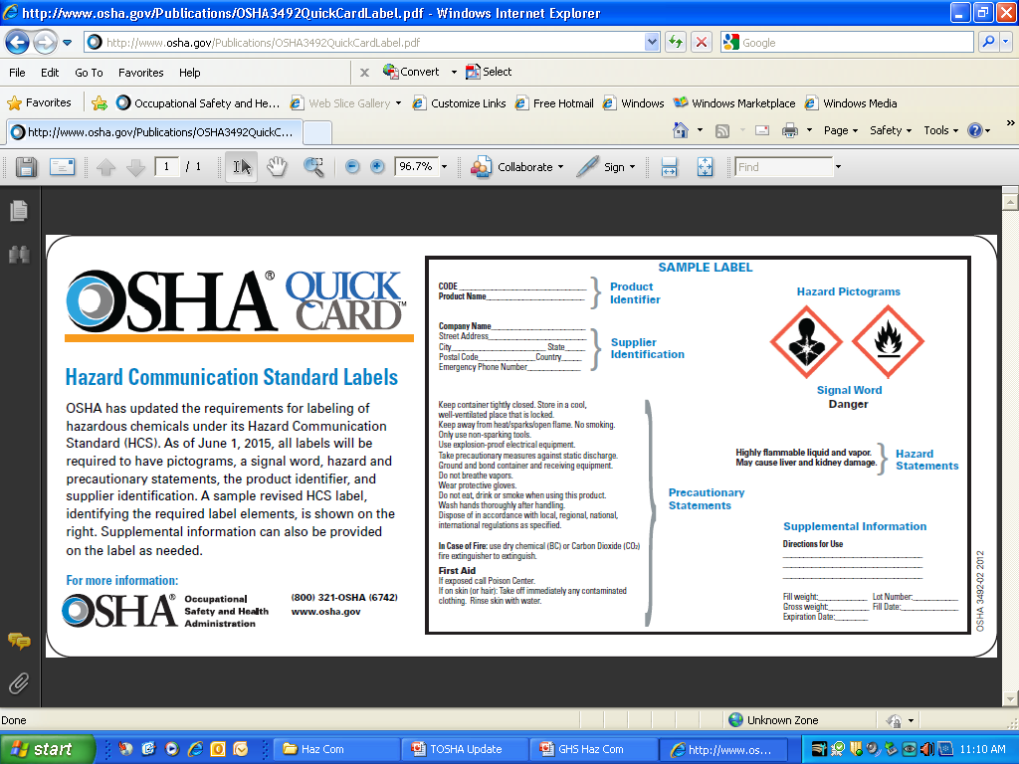
Labels

Slide 55
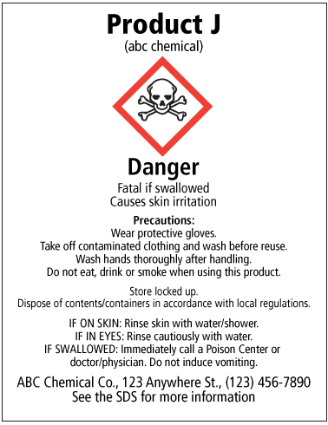
Product Identifier
The name used for a hazardous chemical on the label and in the SDS
Provides a unique means by which the user can identify the chemical
Shall permit cross-references among the list of hazardous chemicals, the label and the SDS

Slide 56
Signal Word
Used to indicate the relative level of severity of hazard and alert the reader to a potential hazard
One, but not both, of the following
  Danger—more severe hazard
  Warning—less severe hazard

Slide 57
Hazard Statement
Assigned to a hazard class and hazard category and describes the nature of the hazard
Examples
  Fatal if swallowed
  May cause damage to kidneys through prolonged or repeated exposure
  May cause or intensify fire
  Extremely flammable liquid or vapor
  Heating may cause an explosion
See Appendix C

Slide 58
Hazard Statement

Slide 59
Precautionary Statements
A phrase that describes recommended measures that should be taken to minimize or prevent adverse effects resulting from exposure or improper storage or handling
Prevention
Response
Storage
Disposal
They can be combined or consolidated to save space on the label

Slide 60
Precautionary Statement

Slide 61
Pictograms
Nine are designated by GHS
Eight are adopted by OSHA
No duplicates or blank diamonds allowed on the label
Correct name for the diamond is “squares-on-point”

Slide 62
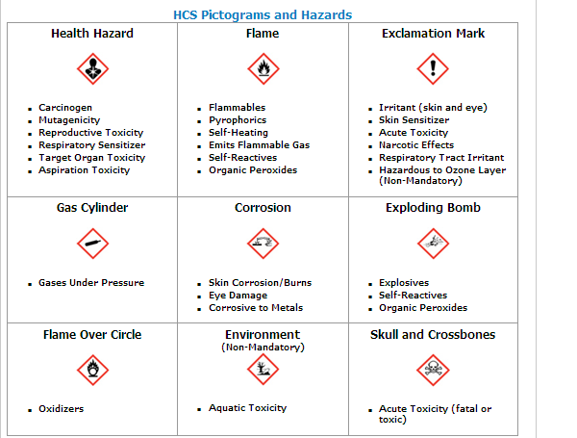
Pictogram

Slide 63

Pictogram
Red frame
Black hazard symbol
White background

Slide 64

Health Hazard
Carcinogen
Mutagenicity
Reproductive Toxicity
Respiratory Sensitizer
Target Organ Toxicity
Aspiration Toxicity

Slide 65

Skull and Crossbones
Acute Toxicity

Slide 66

Flame
Flammables
Pyrophorics
Self-Heating
Emits Flammable Gas
Self Reactives
Organic Peroxides

Slide 67

Flame Over Circle
Oxidizers

Slide 68

Corrosion
Skin Corrosion/Burns
Eye Damage
Corrosive to Metals

Slide 69

Gas Cylinder
Gases Under Pressure

Slide 70

Exploding Bomb
Explosives
Self-Reactives
Organic Peroxides

Slide 71

Exclamation Mark
Irritant (skin and eye)
Skin Sensitizer
Acute Toxicity-low
Narcotic Effects
Respiratory Tract Irritant
Hazardous to Ozone Layer (-non-mandatory)
(Low degree health hazard)

Slide 72

Environmental
(non-mandatory)
Aquatic Toxicity
OSHA Does Not Enforce This One

Slide 73
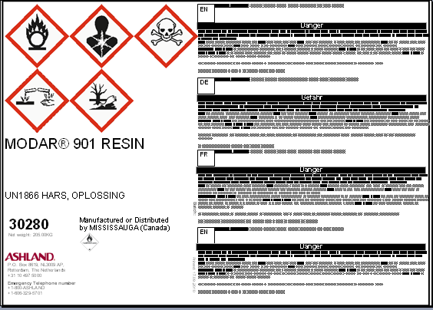
Pictograms
May see labels with many languages and pictograms

Slide 74
Workplace Labels
(Transfer containers)
The employer shall ensure that each container is labeled with either
  Product identifier
  Signal word
  Hazard statement(s)
  Pictogram
Or
  Product identifier and
  Adequate information about the hazards
  Employers must comply by June 1, 2016

Slide 75
Transfer Container Labeling Exemption Continues
Portable containers
  Identity and hazard information (or product identifier, signal word, hazard statement, signal word, pictogram) must be transferred unless the portable container is:
    Under the control at all times of the employee making the transfer from the labeled container and
    Contents used up in one shift
Employers must comply by June 1, 2016

Slide 76
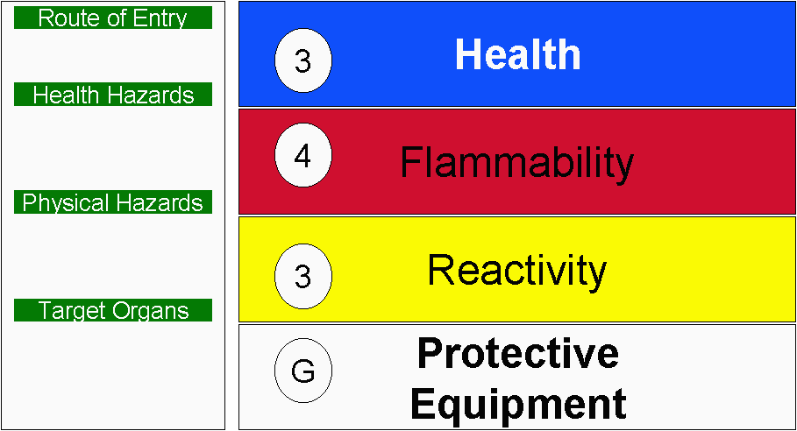
Alternative
Labeling
Permitted when employer's overall program proven effective
Must ensure employees fully aware of hazards/use and understanding of labeling system
Employer bears burden of establishing that employee awareness equals or exceeds conventional labeling system

Slide 77
Workplace Labeling
Can HMIS or NFPA system be used?
While, the hazard category does not appear on the label, consider
GHS
Category Hazard
1 highest
2 high
3 medium
4 low
HMIS/NFPA
Category Hazard
1 slight
2 moderate
3 serious
4 severe
NFPA categories were intended for emergency response, not workplace hazards; only considers acute effects, does not consider chronic effects

Slide 78


DOT
If a pictogram required by DOT appears on a shipped container, the pictogram required in Appendix C for the same hazard shall not appear.

Slide 79

Solid Materials
Solid metal, wood, plastic items not exempted as articles
Label may be transmitted to the customer at initial shipment, with SDS
Not required with subsequent shipments unless label changes

Slide 80
Appendix C
Proscribed Labeling

Slide 81
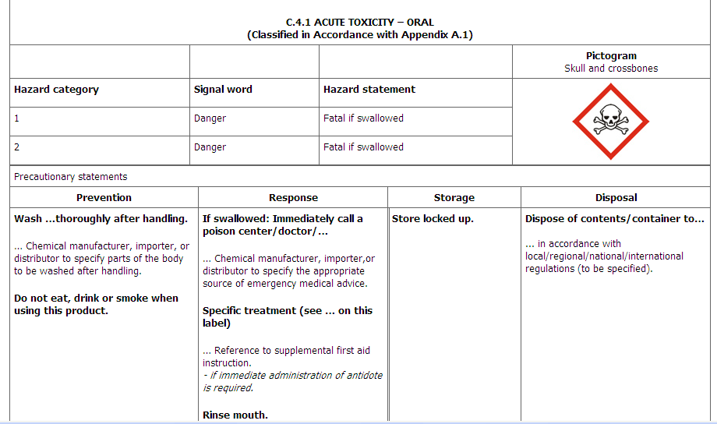

Slide 82
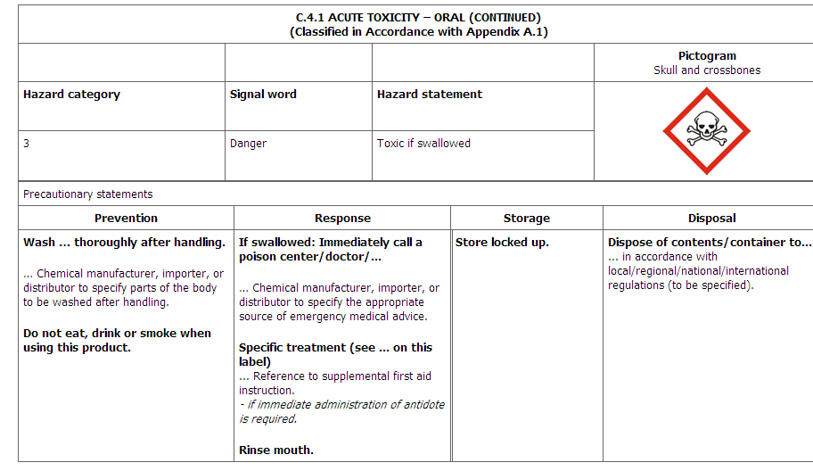

Slide 83
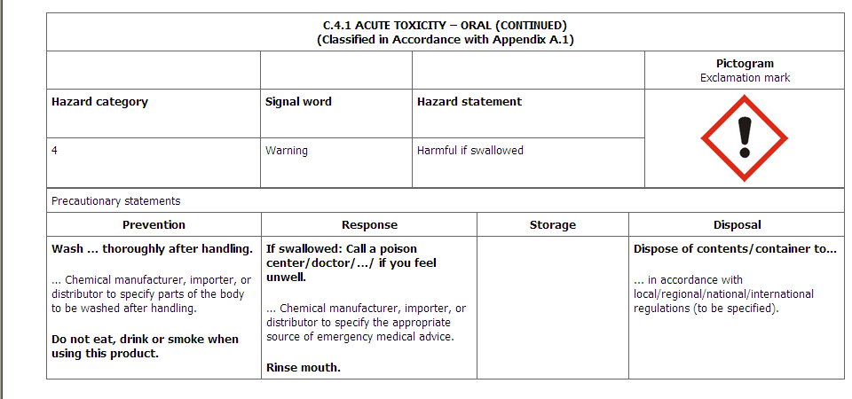

Slide 84
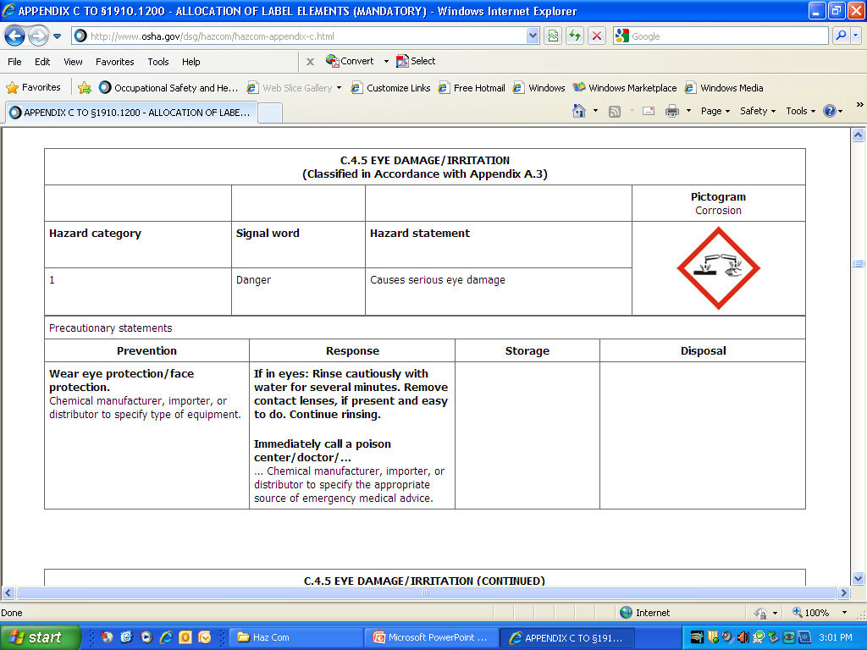

Slide 85
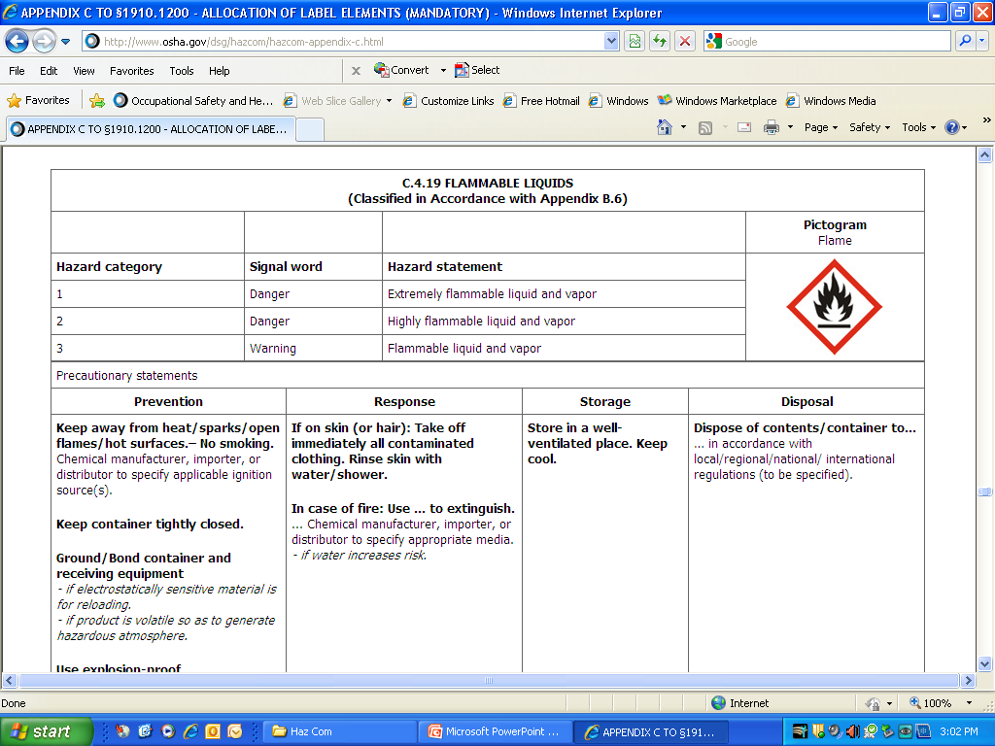

Slide 86
Labeling Effective Dates
Chemical manufacturers, importers, and employers
  Will not ship containers without GHS labeling/SDS by June 1, 2015
Employers
  By June 1, 2016
    Update alternative workplace labeling and hazard communication program as necessary, and provide additional employee training for newly identified physical or health hazards.

Slide 87
SDS
Safety Data Sheets
Appendix D

Slide 88
Safety Data Sheet Info
In English
New 16-section format
Sections must be in order as dictated in Appendix D
Appendix D details the information to be included under each heading
Same as ANSI Z400.1
Compliance date for chemical manufactures, imports and distributors —June 1, 2015

Slide 89
Safety Data Sheet Sections
Section 1, Identification;
Section 2, Hazard(s) identification;
Section 3, Composition/information on ingredients;
(Section 4, First-aid measures;
Section 5, Fire-fighting measures;
Section 6, Accidental release measures;
Section 7, Handling and storage;
(Section 8, Exposure controls/personal protection;
Section 9, Physical and chemical properties;
Section 10, Stability and reactivity;
Section 11, Toxicological information.
Note 1 to paragraph (g)(2): To be consistent with the GHS, an SDS must also include the following headings in this order:
Section 12, Ecological information;
Section 13, Disposal considerations;
(Section 14, Transport information; and
Section 15, Regulatory information.
Note 2 to paragraph (g)(2): OSHA will not be enforcing information requirements in sections 12 through 15, as these areas are not under its jurisdiction.
Section 16, Other information, including date of preparation or last revision.

Slide 90
16 Sections
1. Identification
2. Hazard identification
  Classification—class & category
  Labeling
    Signal word, symbol, hazard statements, precautionary statements
    Symbol name can be used instead of graphic
    Hazards Not Otherwise Identified Information
    Unknown acute toxicity statement

Slide 91
16 Sections
3. Composition information on ingredients
  Substances
    Name
    CAS number/other identifier
    Impurities and additives that contributes to the hazard
  Mixtures
    Name
    Exact percentage or concentration range of all ingredients classified as health hazard and
      Present at their cut-off concentration limit or
      Present below their cut-off concentration limit but present a health hazard

Slide 92
16 Sections
4. First-Aid Measures
  Includes main symptoms of exposure and necessity for immediate or special treatment
5. Firefighting Measures
Extinguishing media, ppe
6. Accidental release measures
  Personal precautions and methods for containment/cleanup
7. Handling and storage including incompatibility
8. Exposure controls/personal protection
  Including PELS, TLVs, and other occupational exposure limits recommended

Slide 93
16 Sections
9. Physical and chemical properties
  a-r data elements specified
10. Stability and reactivity
11.Toxicological information
  Description of health effects by likely route of exposure
  Symptoms
  Numerical measures of toxicity, LD50, etc.
  Whether the chemical is listed as a carcinogen by NTP, IARC or OSHA

Slide 94
16 Sections
12. Ecological information
13. Disposal considerations
14. Transportation information
15. Regulatory information
16. Other information
The date of SDS preparation or last revision
Information in these sections will not be enforced by OSHA

Slide 95
Training

Slide 96
By December 1, 2013
Employers must train employees on the new label elements and safety data sheet (SDS) format.
This is the first compliance date for the revisions
Training compliant with all aspects of GHS by June 1, 2016
  Alternative workplace labeling
  Revision of written program
  Training on newly identified hazards focusing on the physical, health, simple asphyxiant, combustible dust, and pyrophoric gas hazards

Slide 97
Seven Basic Questions
What are the requirement of the hazard communication standard?
What hazardous chemicals are you exposed to (or may be exposed to in an emergency)?
Where are these chemicals present?
What are the short and long term effects?
How can you detect if you are overexposed?
How can you protect yourself?
Where are the MSDS and written program?

Slide 98

Plus Two More for GHS
What information must be on the label on containers of hazardous chemicals?
What do the pictograms indicate? See Appendix F

Slide 99
Tennessee Right-to-Know Law
Extra Provisions
Employee also includes volunteer firefighters
MSDS must be made accessible to students in laboratories
Must train even if employees are illiterate
Measure effectiveness by verbal recall
Evaluate training through employee interviews

Slide 100
Tennessee RTK-Training
Must provide annual training
Must maintain records of training
  Identification of those trained
  Date of the training
  Brief description (e.g., symptoms of CO poisoning, H₂SO₄ emergency procedures, etc.)

Slide 101
Tennessee RTK-Recordkeeping
Maintain training records for period of employment + 5 years
  Identity of the employee trained
  Date(s) of training
  Brief description of the training
Maintain MSDS for as long as the chemical is used or stored
Maintain chemical list for 30 years

Slide 102

Effects on Other Standards

Slide 103
Substance Specific Standards
Change workplace signs to make statements consistent with GHS
Revised standards to reference HCS for labels, SDS and training, and identified hazards to address
Cadmium, formaldehyde, methylene chloride, hexavalent chromium, etc.,

Slide 104

Laboratory Standard, 1910.1450
Updated definitions to maintain compatility with GHS
  Hazardous chemical
  Health hazard
  Mutagen
  Physical hazard
  Reproductive toxin

Slide 105
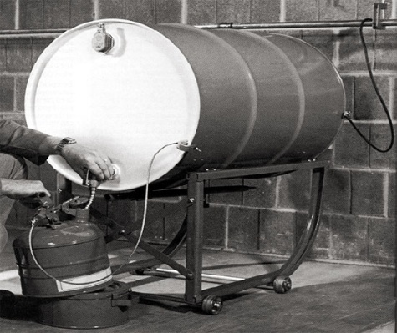
Safety Standards
Process Safety Management, 1910.119
  Added GHS reference for flammable gas and specific flashpoint criteria for flammable liquids
Flammable Liquids—1910.106
  Removed reference to combustible liquids
  Refer to HCS for hazard criteria for aerosols
  Change flammable liquid definition to conform
  Change in text to refer to FL category 1-4, adding flashpoint criteria where needed

Slide 106
Flammable Liquids
GHS FL Category | Flashpoint Deg F | Boiling Point Deg F | Old OSHA Class | Flashpoint Deg F | Boiling Point Deg F
1 | <73.4 | ≤95 | 1A | <73 | <100
2 | <73.4 | >95 | 1B | <73 | ≥100
3 | ≥73.4 and ≤140 |  | 1C II | ≥73 and <100 ≥100 and <140
4 | >140 and ≤199.4 |  | IIIA | ≥140 and <200
None |  |  | IIIB | >200

Slide 107

Other Safety Standards
1910.107 Spray Finishing (added definition)
1910.120 Hazwoper (definition of health hazard)
1910.123, 124, 125 Dipping and Coating (removed definition of combustible liquid, revised flashpoint and flammable liquid definitions, changed references)
1910.252 Welding and Brazing (added hazard communication requirements)

Slide 108


Slide 109
Resources
www.osha.gov www.state.tn.us/labor-wfd
www.cdc.gov
www.cdc.gov/niosh
Memphis Office 901-543-7259
Jackson Office 731-423-5641
Nashville Office 615-741-2793
1-800-249-8510
Knoxville Office 865-594-6180
Kingsport Office 423-224-2042
Chattanooga 423-634-6424
Consultative Services 1-800-325-9901

