Slide 1
Understanding Mental Health Diagnosis & Causation in Workers’ Compensation
Presenter: Les Kertay, Ph.D., Owner & President, Dr. Les Kertay & Associates, LLC

Slide 2

Understanding Mental Health Diagnosis & Causation in Workers’ Compensation
22nd Tennessee Workers’ Compensation Educational Conference
June 2019
Les Kertay, Ph.D.
Licensed Psychologist, Health Services Provider

Slide 3
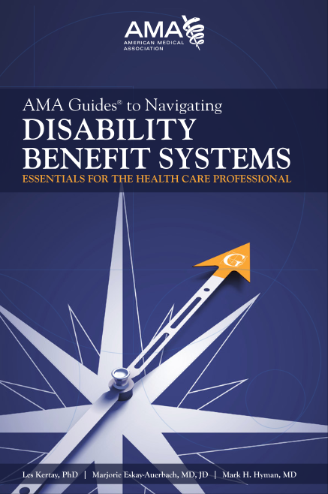
Disclosures & Disclaimers
Les Kertay, Ph.D., ABPP, FAACP, FIAIME
Disclosures:
  Employed as a medical director for
  a large disability insurance carrier
  Industry consultant
  Adjunct professor, UT Chattanooga
  AMA Guides to Navigating Disability
  Benefit Systems
  No commercial endorsements or conflicts relevant to this presentation
Disclaimer
  The opinions and ideas expressed in this presentation are those of the author, based on his training and experience, and not intended to represent the opinions of employers or other entitites

Slide 4
Agenda
Understanding mental health in the workers’ compensation context
Barriers, symptoms, and diagnoses
The special case of PTSD
Causation issues in mental health conditions

Slide 5
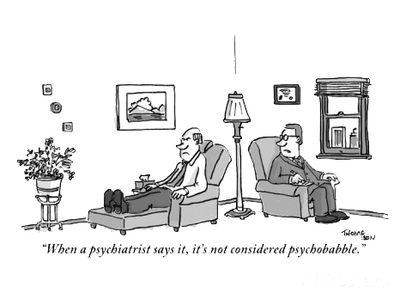

Slide 6
Understanding Mental Health in the WC Context
22nd Tennessee Workers’ Compensation Educational Conference

Slide 7


Slide 8

Biopsychosocial Model
Biological
Psychological
Social
Neurophysiology
Physiological dysfunction
Illness behavior, beliefs,
Coping, emotions, distress
Culture, interactions

Slide 9

Unemployment Associated With:
Heart Disease
Cancer
Suicide
Accidental Trauma
Divorce
Spouse Abuse
Child Abuse
DEATH

Slide 10
Conditions contributing to DALYs

Slide 11
Life impact of unemployment
Group | Life expectancy high unemployment | Life expectancy low unemployment | Difference | Increased % of life disabled
AA men | 68.4 | 71.4 | 3 (-4.2%) | 23.9%
AA women | 73.7 | 77.1 | 3.4 (-4.4%) | 21.0%
White men | 73.7 | 76.9 | 3.2 (-4.2%) | 21.3%
White women | 77.5 | 80.6 | 3.1 (-3.8%) | 21.1%
Average DALYs = 11.4 (would rank #5)
At age 40
Laditka JN, Laditka SB. Unemployment, disability, and life expectance in the United States: A life course study. Disabil Health J., 2016 Jan; 9(1):46-53.

Slide 12
Conditions contributing to DALYs
Worklessness

Slide 13
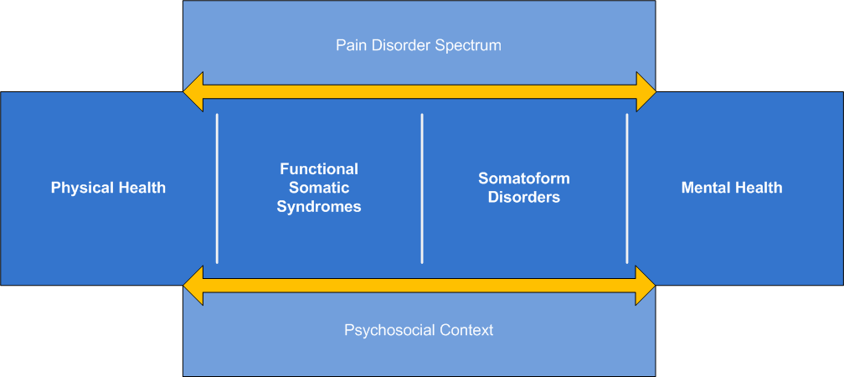
Chronic pain continuum

Slide 14
Mental Health Diagnosis
22nd Tennessee Workers’ Compensation Educational Conference

Slide 15
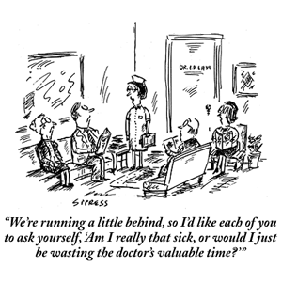
A critical distinction
Stress
Psychosocial barriers to recovery and RTW
Psychological symptoms
Psychiatric diagnoses

Slide 16
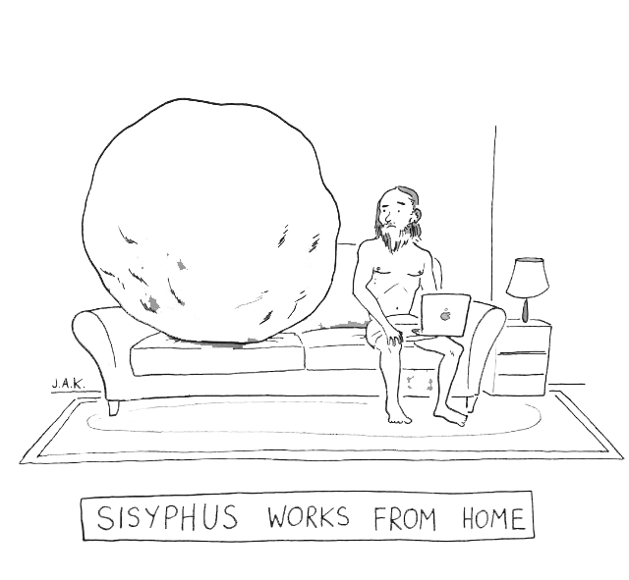
Stress

Slide 17
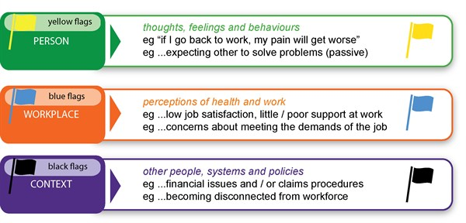
Psychosocial barriers
NOT a diagnosis
NOT a symptom
External or internal
DOES impact outcome
Treatment is not indicated
Interventions focus on RTW, addressing barriers, motivation
Kendall N, et al. Tackling musculoskeletal problems: A guide for clinic and workplace, 2009. Norwich, UK: TSO (The Stationery Office).

Slide 18


Slide 19
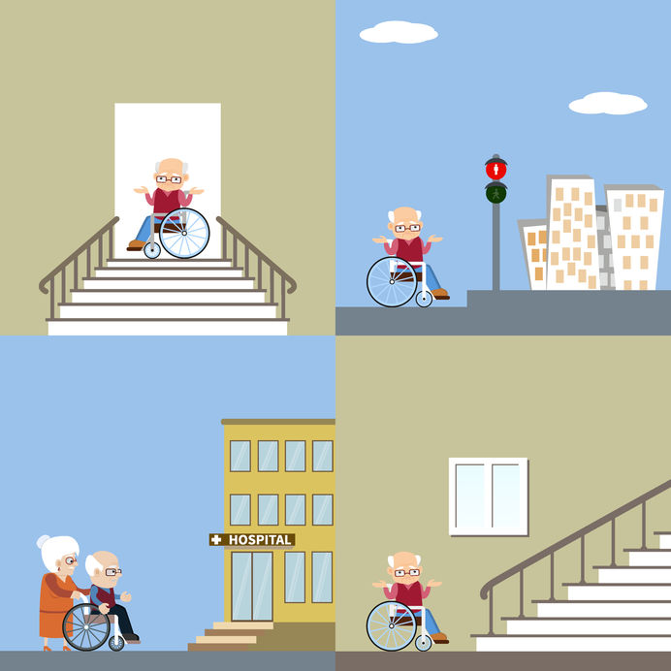

Slide 20

Psychological symptoms
Best understood on a spectrum
Anxiety, depression, and agitation are non-specific, common human experiences
At extremes they may interfere with function
NOT a diagnosis
Treatment may or may not be helpful
Long term treatment is NOT indicated

Slide 21

Psychiatric diagnoses
To warrant a psychiatric diagnosis, at a minimum there must be:
A standardized system of evaluation
A standardized set of set of diagnostic criteria
Interfere with function
No other, more plausible explanation
Keep in mind:
Not just a bad day
Can lead to substantial impairment
Typically responds to treatment

Slide 22
Meets diagnostic criteria
Symptoms exist on a spectrum
Diagnostic criteria do not

Slide 23

Standardized method
How was the diagnosis determined?
Symptoms only?
Behavioral observations?
Collateral data?
Structured interview?

Slide 24
Must impair function
Involves distress or functional impairment
From a work-relevance standpoint, distress is not enough
Can’t do what, because of what, and so what?
e.g., APA, Diagnostic & statistical manual of mental disorders, 5th edition. Washington, DC: American Psychiatric Press, 2013.

Slide 25
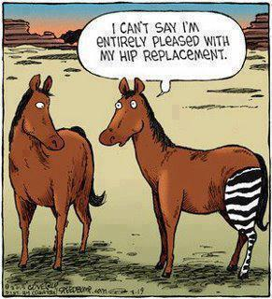
Don’t think zebras
Understand base rates and classification statistics
Given two plausible diagnoses, the simpler is probably correct

Slide 26
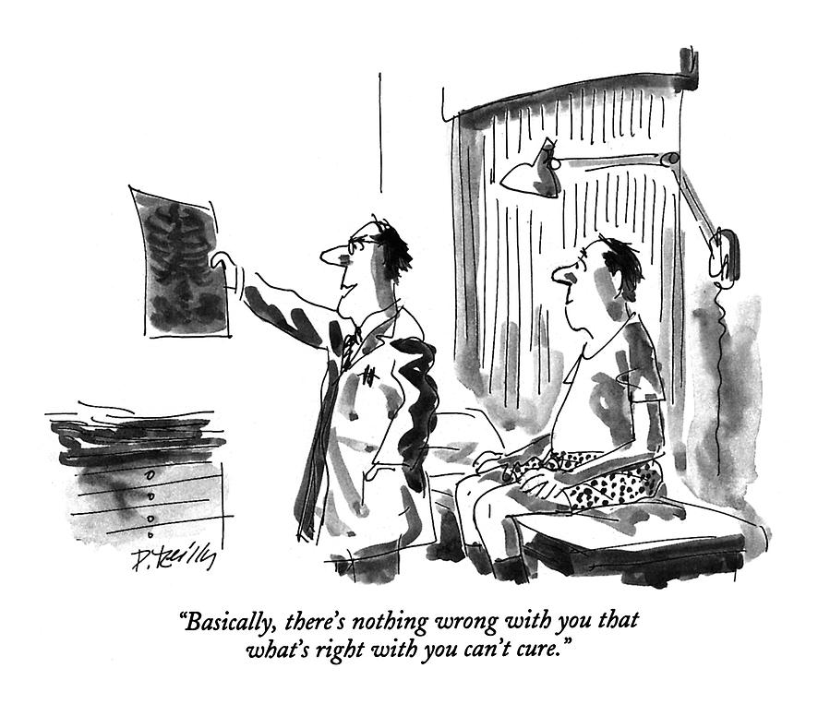
Often the most plausible diagnosis
Low base rate
External incentives
Workplace stress
Terrible boss
Poor job performance
Non-credible history
Non-credible presentation

Slide 27
Understanding symptom validity
22nd Tennessee Workers’ Compensation Educational Conference

Slide 28
What’s the most likely outcome of a work-related illness or injury?

Slide 29
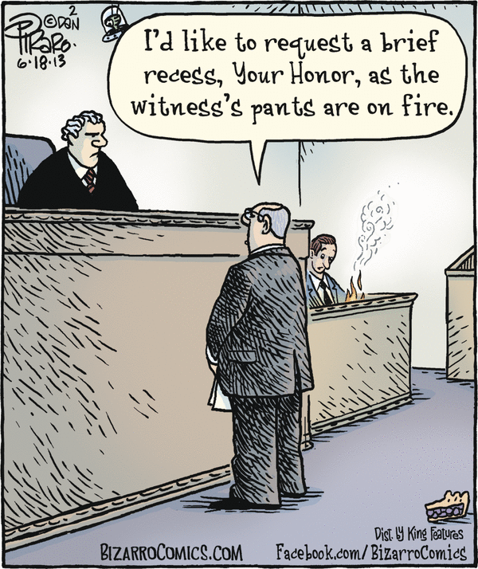
Understand symptom validity
Why assess?
Base rates
It’s not just about lying

Slide 30

Why assess validity?
Forgetting
Fabricating
Telescoping
Barsky, A. Forgetting, fabricating, and telescoping: The instability of the medical history. Arch Int Med, 162(13), 982-984, 2002.

Slide 31
Common Causes:
Personality Characteristics
Negative affectivity
State-Dependent Recall
Emotional state at the time of recall
Illness Beliefs
Perceived state of health and causes of their symptoms
Information-Specific Characteristics
The characteristic of Information being recalled affects reliability and stability
Barsky, A. Forgetting, fabricating, and telescoping: The instability of the medical history. Arch Int Med, 162(13), 982-984, 2002.
Notes:
An individual answers the same question differently on different occasions
Personality Characteristics
Negative affectivity: associated with the over reporting of past illnesses, symptoms, and medical care use. It encompasses low morale, poor self esteem, hypersensitivity, and unpleasant emotions such as guilt, anger, fear, and depression
State-Dependent Recall:
Emotional state at time of recall: the current state of one’s physical health affects recall of previous health events and symptoms because people alter their reports of the past to reflect their current state. For example, past pain is reported as more severe than when it was being experienced.
Illness Beliefs:
Patient’s memory of past illness’ and symptoms are affected by the understanding of, or opinions of those events. Patients injury/illness may result in an underestimation of symptoms in the period before the patient believed S/he became ill, and overestimate the symptoms after that time. An example I can give is a patient I saw who was diagnosed with a concussion, but was presented to the patient as a mild traumatic brain injury. The patient focused on ‘Brain Injury’ and although presented meticulous notes on her history, but attributed all her current symptoms to the brain injury, that included physical, cognitive and emotional distress.
Information-Specific Characteristics:
The more remote in time the symptom or episode, the more unreliable and unstable is an individual’s recall. Three events can occur:
Forgetfulness: Patients are less reliable when recalling information that is personally threatening or socially undesirable.
Recomposition: Patients will combine multiple, separate incidences or episodes into one.
Fabrication: falsely remembering events that did not occur. This is less frequent than the latter.

Slide 32

Example: Motor Vehicle Collisions
E. Carragee MD, Stanford Spine Clinics
Retrospective chart review comparing recorded History with actual Medical Records
  The Spine J 2008; 8: 311-19
  Random audit of 100 records from a pool of 422
Prospective Study Comparing Scripted History after Crash with actual Medical Records
  335 records from a pool of 702 patients
  The Spine J 2009; 9: 4-12

Slide 33
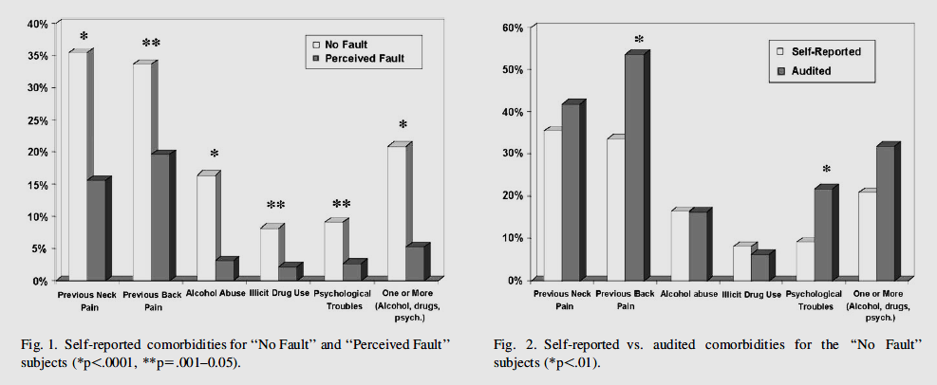
TSJ 2009; 9: 4-12
NO Fault means
the driver caused, or
the car/weather
Caused the crash.
Perceived fault means
The OTHER vehicle
Driver CAUSED the
Crash, and there is
Someone to sue.

Slide 34
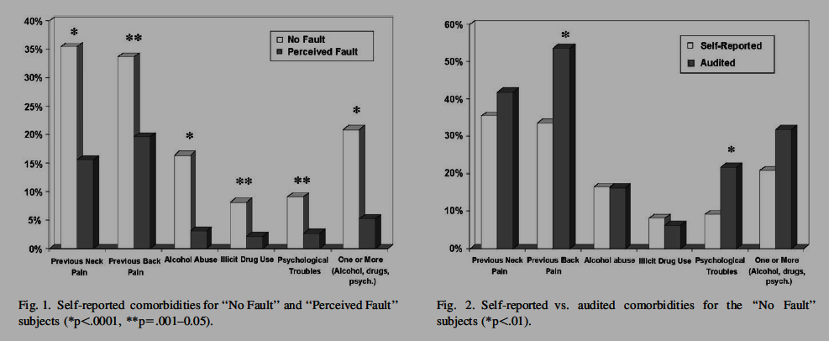
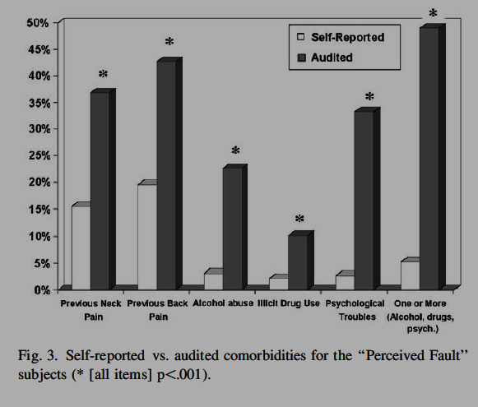
TSJ 2009; 9: 4-12
All subjects ACCURATELY reported their Past History of Diabetes and Hypertension

Slide 35
Mittenberg W, Patton C, Canyock EM, Condit DC. Base rates of malingering and symptom exaggeration. J Clin Exp Neuropsychol, 24(8), 1094-1102, 2002.
Cases | Reported | Adjusted
Personal Injury | 28.7% | 30.4%
Disability or Worker’s Compensation | 30.1% | 32.7%
Criminal | 19.2% | 22.8%
Medical / Psychiatric | 8.1% | 8.1%

Slide 36
Cases | Reported | Adjusted
Mild TBI | 38.5% | 41.2%
Fibromyalgia / Chronic Pain | 34.7% | 38.6%
Pain / Somatoform | 31.4% | 33.5%
Neurotoxic | 26.5% | 29.5%
Mittenberg W, Patton C, Canyock EM, Condit DC. Base rates of malingering and symptom exaggeration. J Clin Exp Neuropsychol, 24(8), 1094-1102, 2002.

Slide 37

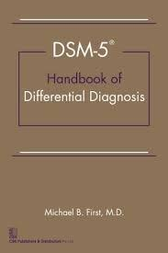
Evaluating effort is central to diagnosis
https://dsm.psychiatryonline.org/doi/book/
10.1176/appi.books.9781585629992
DSM-5 Handbook of Differential Diagnosis
  Edited by Michael B. First MD, November 2013
The process of DSM-5 differential diagnosis can be broken down into six basic steps:
1) ruling out Malingering and Factitious Disorder,
2) ruling out a substance etiology,
3) ruling out an etiological medical condition,
4) determining the specific primary disorder(s),
5) differentiating Adjustment Disorder from the residual Other Specified and Unspecified conditions, and
6) establishing the boundary with no mental disorder. A thorough review of this chapter provides a useful framework for understanding and applying the decision trees presented in the next chapter.

Slide 38
Malingering makes accurate diagnosis impossible
DSM-5 Handbook of Differential Diagnosis
  Edited by Michael B. First MD, November 2013
Step 1: Rule Out Malingering and Factitious Disorder
The first step is to rule out Malingering and Factitious Disorder because if the patient is not being honest regarding the nature or severity of his or her symptoms, all bets are off regarding the clinician’s ability to arrive at an accurate psychiatric diagnosis. Most psychiatric work depends on a good-faith collaborative effort between the clinician and the patient to uncover the nature and cause of the presenting symptoms. There are times, however, when everything may not be as it seems. Some patients may elect to deceive the clinician by producing or feigning the presenting symptoms.

Slide 39
No, not everyone is making it up
DSM-5 Handbook of Differential Diagnosis
  Edited by Michael B. First MD, November 2013
The intent is certainly not to advocate that every patient should be treated as a hostile witness and that every clinician should become a cynical district attorney.
However, the clinician’s index of suspicion should be raised
  1) when there are clear external incentives to the patient’s being diagnosed with a psychiatric condition (e.g., disability determinations, forensic evaluations in criminal or civil cases, prison settings),
  2) when the patient presents with a cluster of psychiatric symptoms that conforms more to a lay perception of mental illness rather than to a recognized clinical entity,
  3) when the nature of the symptoms shifts radically from one clinical encounter to another,
  4) when the patient has a presentation that mimics that of a role model (e.g., another patient on the unit, a mentally ill close family member), and
  5) when the patient is characteristically manipulative or suggestible.
  Finally, it is useful for clinicians to become mindful of tendencies they might have toward being either excessively skeptical or excessively gullible.

Slide 40
PTSD: A Case in point
22nd Tennessee Workers’ Compensation Educational Conference

Slide 41

Diagnoses are not benign
Rheumatologists do NOT diagnose
  Rheumatoid Arthritis, and Lupus, and Mixed Connective Tissue Disease, and Systemic Sclerosis, and Polymyalgia Rheumatica.
  They pick the ONE disease that best encapsulates the findings of overlapping diagnostic possibilities.
Common to see Mental Health Professionals diagnose in a single person [symptoms overlap categories]
  PTSD
  MDD
  GAD
  Panic Disorder
  NO evidence that evaluation for personality disorders occurred
    Multiple studies document high prevalence of personality disorders in chronic pain patients
      Dersh J, et al. Spine 2006; 31 (10): 1156-62

Slide 42
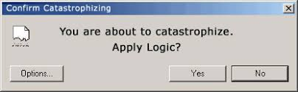
Injured by Mental Disorder Diagnoses
In Workers’ Comp, Employer/Insurer, and Plaintiff Attorney get medical records
Lawyers want to verify accuracy of medical records, so many have patient review the records for accuracy.
Joe: “I am ruint, I tore my disc”
  Or “I have a bulged disc”
Frank: “ I am ruint, I have 4 PERMANENT mental illnesses…. I can never work again.”
Diagnoses sound PERMANENT to lawyers and to the internet searching patient.
Catastrophizing

Slide 43
PTSD Criterion A
Exposure to actual or threatened death, serious injury, or sexual violence in one (or more) of the following ways:
  Direct experience
  Witnessing, in person, as occurring to others
  Learning that the event occurred to a close family member or close friend; event must have been violent or accidental
  Experiencing repeated or extreme exposure to aversive details (e.g., first responders); not electronic only
APA. Diagnostic & statistical manual of mental disorders, 5th edition. Washington, DC: American Psychiatric Publishing, 2013.

Slide 44
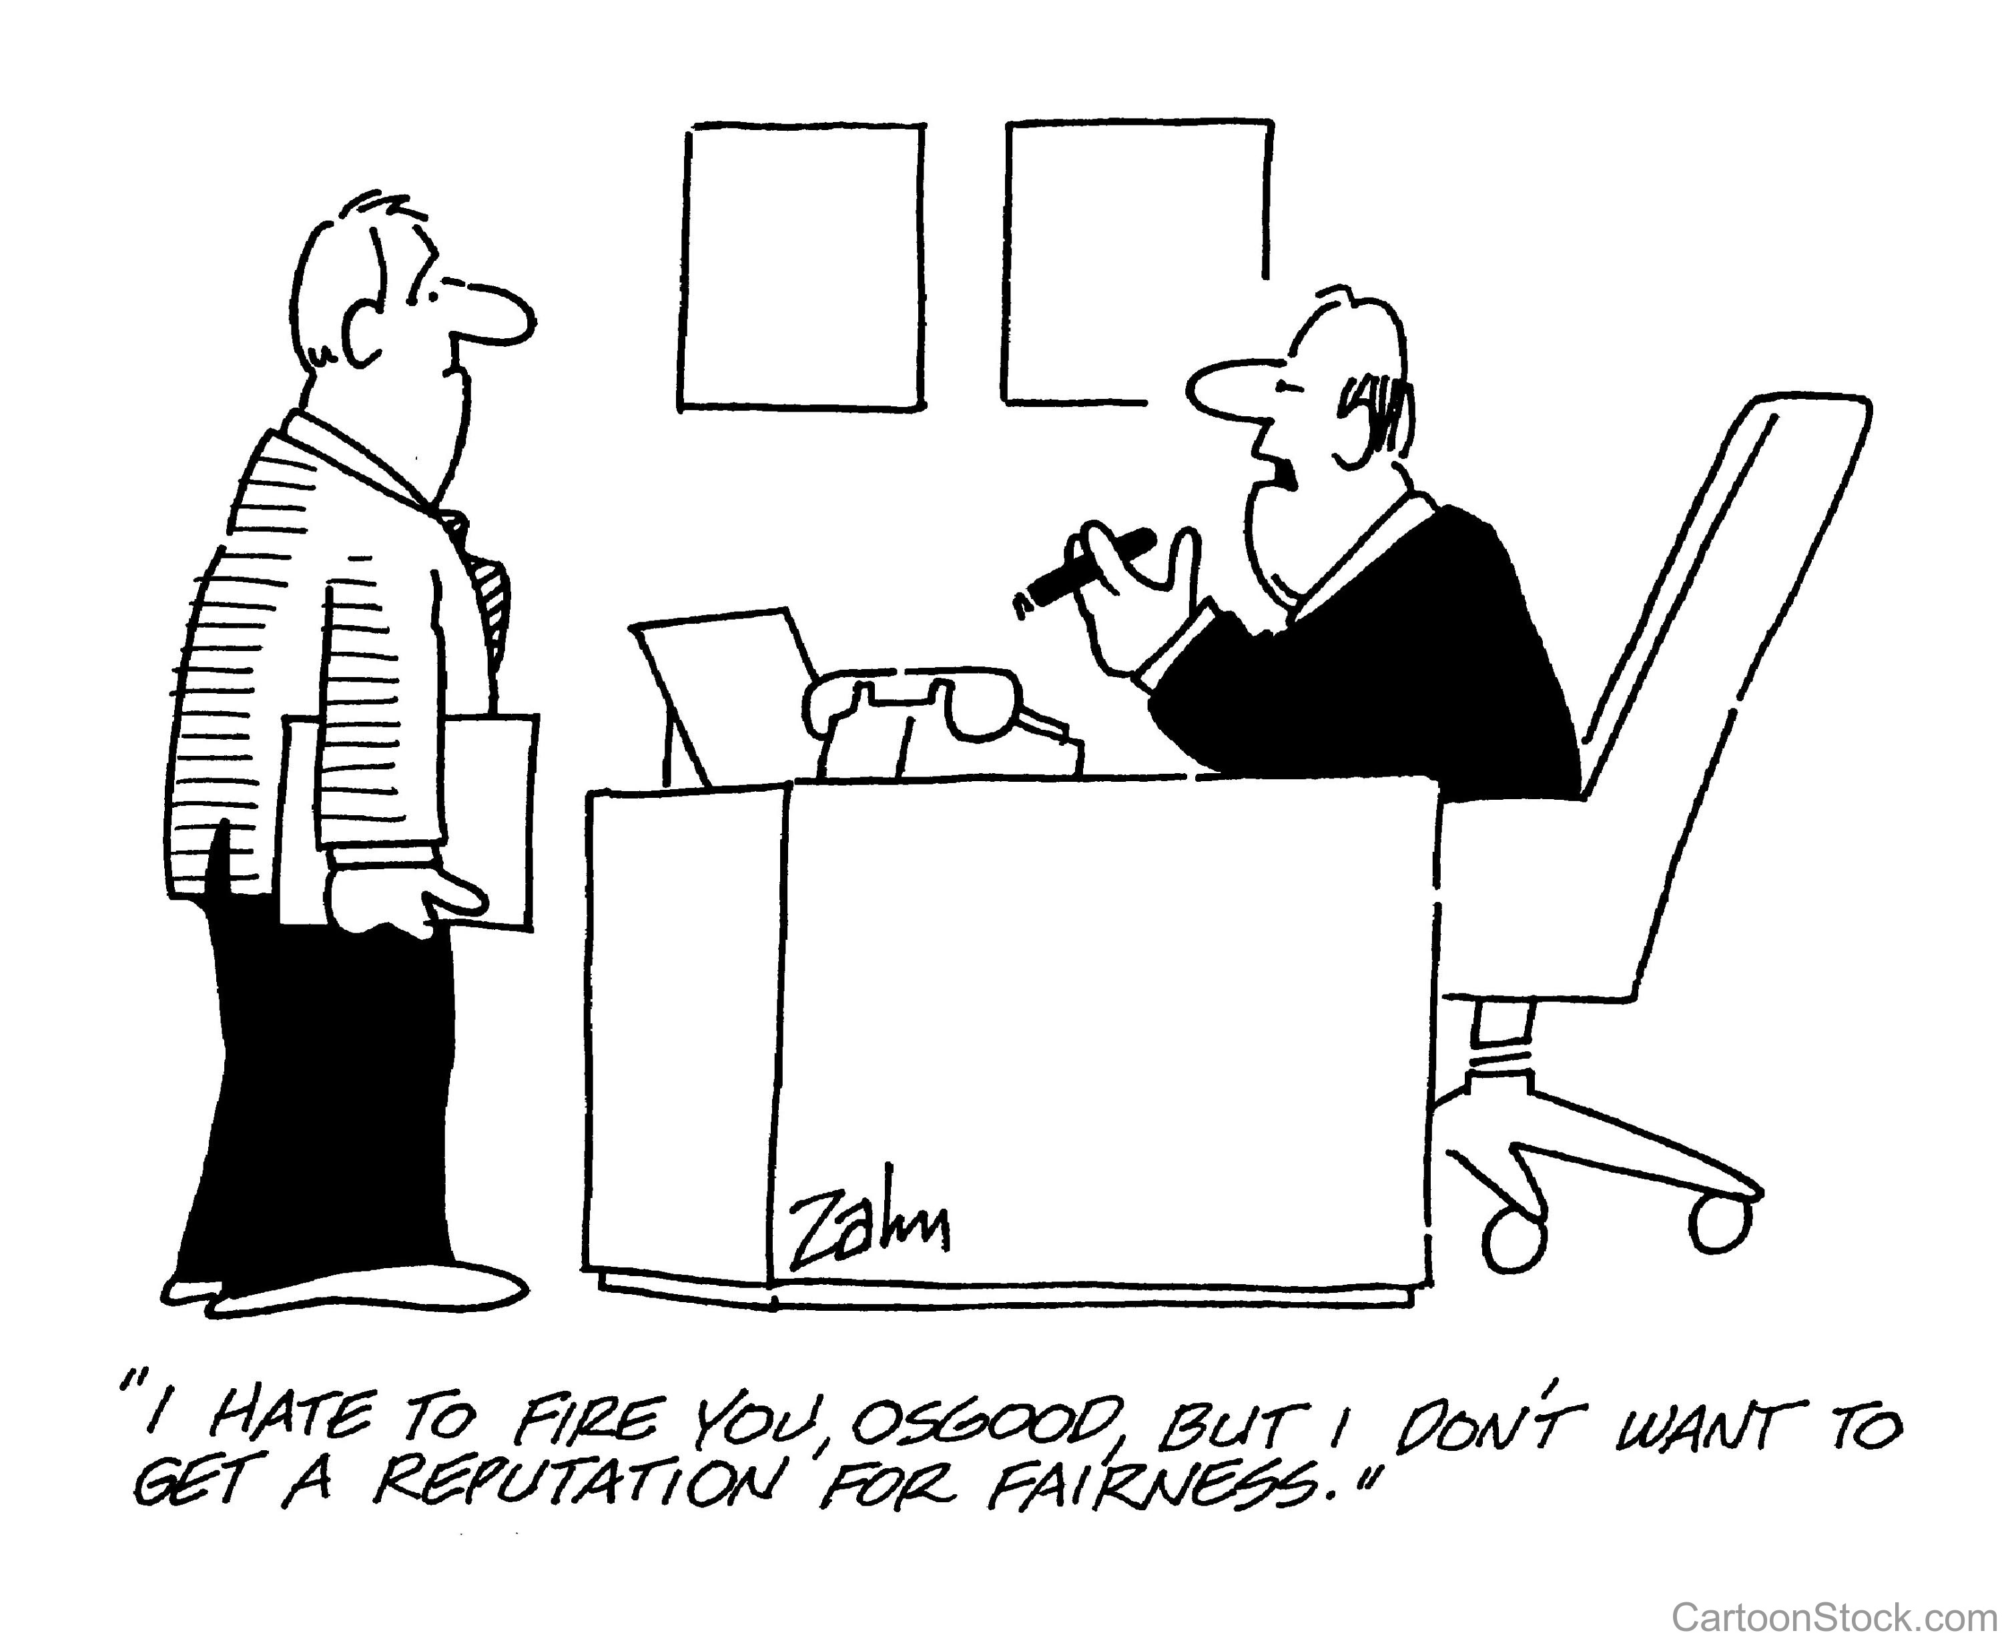
What Criterion A is NOT

Slide 45

Criterion A has changed over time
Exposure to actual or threatened death, serious injury, or threatened loss of bodily integrity and …
DSM-III: “outside normal experience”
DSM-IV: “response involved intense fear, helplessness, or horror”
DSM-5: includes experiencing, witnessing, or learning that the traumatic event occurred to a close family member

Slide 46
ICD criteria have changed
ICD-10: must have been exposed to a stressful event or situation of exceptionally threatening or catastrophic nature, which would be likely to cause pervasive distress in almost anyone.
ICD-11: changes the other criteria in such a way that substantially fewer will qualify

Slide 47
Criterion A exposure
Kilpatrick DG, et al. National estimates of exposure to traumatic events and PTSD prevalence using DSM-IV and DSM-5 Criteria. J Trauma Stress, 26(5), 537-547, 2013.
National sample, 2953 adults
89.7% exposure using DSM-5 criteria, multiple exposures the norm; Work exposure 11.5%
Lifetime 8.3%, 12-month 4.7%, slightly lower than DSM-IV
Lifetime male 5.7%, female 12.8%

Slide 48
PTSD incidence civilian
Lifetime 8.3%, 12-month 4.7%, slightly lower than DSM-IV
Lifetime male 5.7%, female 12.8%
Increased with multiple exposures
  Kilpatrick DG, et al. National estimates of exposure to traumatic events and PTSD prevalence using DSM-IV and DSM-5 Criteria. J Trauma Stress, 26(5), 537-547, 2013.
Lifetime 6.8%, 12-month 3.5%
Lifetime male 3.5%, female 9.7%
  Kessler RC, et al. Lifetime prevalence and age-of-onset distributions of DSM-IV disorders in the National Comorbidity Survey Replication. Arch Gen Psychi, 62(6), 593-602, 2005.

Slide 49
PTSD incidence military
Vietnam veterans
Lifetime 30.9% men, 26.9% women
Current 15.2% men, 8.1% women
  Kulka RA et al. Trauma and the Vietnam War generation: Report of findings from the National Vietnam Veterans Readjustment Study. New York: Brunner/Mazel, 1990.
Gulf War veterans
Current 12.1% (combined)
  Kang HK, et al. Post-traumatic stress disorder and chronic fatigue-like illness among Gulf War veterans: A population based survey of 30,000 veterans. J Epidemiology, 157(2), 141-148, 2003
Iraq 1 and 2 veterans
Current 13.8% (combined)
  Tanielian T et al. Invisible wounds of war: Psychological and cognitive injuries, their consequences, and services to assist recovery. Santa Monica, CA: Rand Corporation, 2008.

Slide 50
So what is the most common response to exposure to a criterion A event?

Slide 51
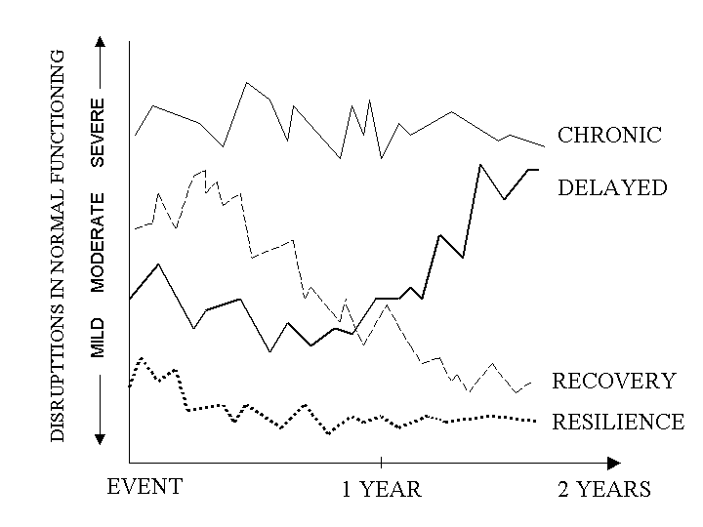
Bonanno GA. Loss, trauma, and human resilience: Have we underestimated the human capacity to thrive after extremely aversive events? American Psycholgogist, 59(1), 20-28, 2004.

Slide 52

The rest of the diagnosis
Criterion B: Presence of one or more intrusion symptoms
Criterion C: Persistent avoidance of associated stimuli, beginning after the event
Criterion D: Negative alterations in cognitions and mood (two or more)
Criterion E: Marked alterations in arousal and reactivity (two or more)
Criterion F: Duration more than 1 month
Criterion G: Significant distress or impairment
Criterion H: Not attributable to physiological effects of substance, or another medical condition

Slide 53

Differential diagnosis
Adjustment disorders
Other post-traumatic disorders
Acute stress disorder
Anxiety disorders and OCD
Major depressive disorder
Personality disorders
Dissociative disorders
Conversion disorder
Psychotic disorders
Traumatic brain injury [?]

Slide 54
Adjustment Disorder
Fits What’s Actually Happening in Many Workers’ Comp Patients
The DSM-5 defines adjustment disorder as “the presence of emotional or behavioral symptoms in response to an identifiable stressor(s) occurring within 3 months of the onset of the stressor(s)” (American Psychiatric Association, 2013).
In addition to exposure to one or more stressors, other DSM-5 criteria for adjustment disorder must be present.
One or both of these criteria exist:
  Distress that is out of proportion with expected reactions to the stressor
  Symptoms must be clinically significant—they cause marked distress and impairment in functioning
Further, these criteria must be present:
  Distress and impairment are related to the stressor and are not an escalation of existing mental health disorders
  The reaction is not part of normal bereavement
  Once the stressor is removed or the person has begun to adjust and cope, the symptoms must subside within six months.

Slide 55
Evaluating Work ability
22nd Tennessee Workers’ Compensation Educational Conference

Slide 56
Risk, Capacity, & Tolerance
Adapted From: Talmage, J.B., Melhorn, J.M., & Hyman, M.H. (eds.) AMA guides to the evaluation of work ability and return to work. Chicago: AMA Press.

Slide 57

What is the risk?

Slide 58
Considerations in Return to Work Decisions: Tolerance
Psychophysiologic concept
Ability to tolerate sustained work at a given level. Not scientifically measurable
Generally less than capacity
Symptoms like pain and/or fatigue limit performance, thus “not very scientific”
Influenced by Rewards available and Personality
May or May Not be similar to “current ability”

Slide 59
The R-C-T Inversion
Health Professional
Patient/Employee
Tolerance
Capacity
Risk
Risk
Capacity
Tolerance

Slide 60
Causation
22nd Tennessee Workers’ Compensation Educational Conference

Slide 61
Causation
In General Medicine
In Mental Health
Cases with major violence that is severe enough to frequently injure NORMAL people.
  e.g. 30 foot fall, fracture
Cases with EITHER minor violence that would not typically injure normal people, OR cases with no incident, but alleged cumulative trauma.
  Analyze by epidemiologic data (PUBLISHED STUDIES)
Cases with severe acute incident
  PTSD criterion A
  Adjustment Disorder
Cases with NO single inciting incident, but stress accumulating over time.
  Alleged cause for GAD, phobias, MDD, etc.

Slide 62
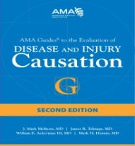
Hypothesis
Testing
Methodology
REVIEW
Hypothesis
GENERATING
Methodology
Non-epidemiologic
publications

Slide 63
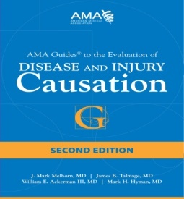
Prospective Cohort Study
Prospective investigation of the factors that might cause a disorder in which a cohort of individuals who do not have evidence of an outcome of interest but who are exposed to the putative cause are compared with a concurrent cohort who are also free of the outcome but not exposed to the putative cause. Both cohorts are then followed to compare the incidence of the outcome of interest.
Best study design if subjects can NOT be randomized.
  Suspected toxins (smoking or asbestos)
  Caused by work?
REVIEW
63

Slide 64
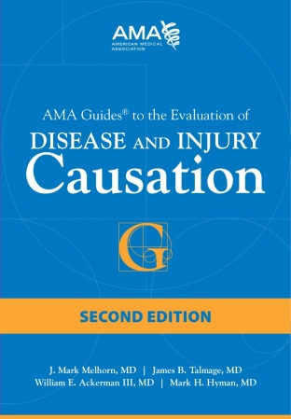
Chapter 16:
Mental Illness
Step 1: Definitively establish a diagnosis
Step 2: Apply relevant findings from epidemiology
Step 3: Obtain and assess the evidence of exposure
Step 4: Consider other relevant factors
Step 5: Scrutinize the validity of the evidence
The question: Is there evidence that adult life experience causes psychiatric impairment?
Barth RJ, et al. Mental Illness. In: Melhorn JM, et al. AMA guides to the evaluation
of disease and injury causation, 2nd edition. Chicago: AMA, 2014.

Slide 65
Out of 5,000 plus hits
None met minimum criteria for inclusion

Slide 67
Holmes & Rahi Stressful Life Events
Common Workers’ Comp case would have 177 points
5000 medical patients used to develop the scoring system ranking 43 life events:
  <150 = Low Stress,
    < 30% of psychosomatic illness in the NEAR FUTURE
  150-300 = Moderate Stress
    50% chance of psychosomatic illness
  > 300 = High Stress
    80% chance of psychosomatic illness.
https://www.acc.com/aboutacc/newsroom/pressreleases/upload/srrs.pdf
The social readjustment rating scale, Holmes, T. H. and Rahe, R. H. 1967, Journal of Psychosomatic research, 11(2), 213-21.

Slide 68
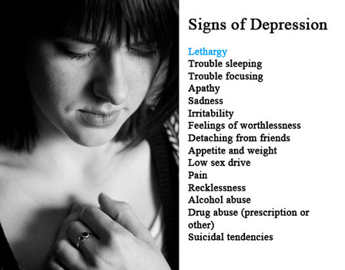
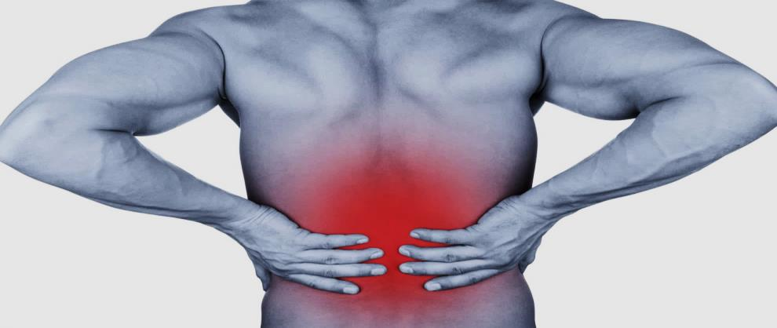

MDD and LBP
Which Came First?

Slide 69

Hooten WM.
Mayo Clinic Proceedings 2016; 91 (7): 955-70
Chronic pain and mental health disorders are common in the general population;
  the prevalence of chronic pain ranges from 2% to 40%,
  the prevalence of mental health disorders range from 17% to 29%.
Concomitant with the high prevalence of both conditions, epidemiological and functional imaging studies suggest that a bidirectional relationship exists between chronic pain and mental health disorders.

Slide 70
Hooten WM.
Mayo Clinic Proceedings 2016; 91 (7): 955-70
Individuals with Neck Pain or LBP (either “mild” or “disabling”) are 2.0, 2.5, or 6 times more likely to have a future episode of “depression” at 6 & 12 months.
Pain free Individuals with depressive symptoms were 3 or 4 times more likely to develop Neck Pain or LBP at 6 & 12 months than individuals without “depression”.

Slide 71
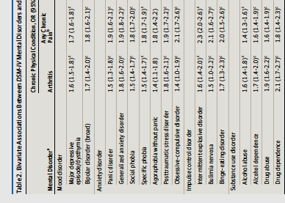
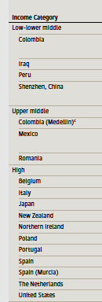
Psych Before Pain
JAMA Psychiatry. 2016 Feb;73(2):150-8. doi: 10.1001/jamapsychiatry.2015.2688.
Association of Mental Disorders With Subsequent Chronic Physical Conditions: World Mental Health Surveys From 17 Countries
ALSO Found
INCREASED
RATE OF:
Heart Disease
Stroke
Hypertension
Diabetes
Asthma
Chronic Lung
Disease
Peptic Ulcer
Cancer

Slide 72
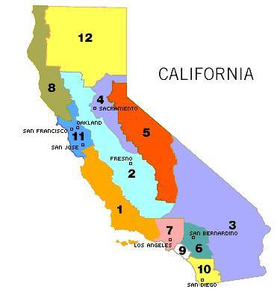
Living in California is Painful
Ohayon MM, Schatzberg AF. J Psychiatr Res. 2010 May;44(7):454-61. doi: 10.1016/j.jpsychires.2009.10.013.
A random sample of 3243 adult subjects, representative of California inhabitants
The point prevalence of Chronic Painful Physical Conditions (CPPC) was 49%
  (95% confidence interval: 47.0 – 51.0%).
Back area pain was the most frequent;
1-month prevalence of MDD was at 6.3%
  (95% CI: 5.5– 7.2%);
66.3% of MDD subjects reported at least one CPPC.
Being confined to bed, taking sick leave and interference of pain with daily functioning were twice as frequent among MDD subjects with CPPC than in non-MDD subjects with CPPC

Slide 73
Recap
22nd Tennessee Workers’ Compensation Educational Conference

Slide 74
Correlation is NOT causation
Joe drops a pencil at work and bends down to pick it up,
Joe feels his back “snap”
Did the pencil cause Joe’s back pain?
Did work cause Joes’ back pain?
Is Joe injured?

Slide 75
Remember
Do NOT confuse Sad Social Circumstances with Major Mental Illness. [Is it Adjustment Disorder?]
“Depression” is NORMAL during grief.
“Depression” is NORMAL with Sad Social Circumstances.
Epidemiologic studies UNFORTUNATELY confuse Sad Circumstances with Major Mental Illness.
CBT, etc, may help, but Medications probably don’t help social circumstances.

Slide 76
Remember
History of Pre-Injury Function and Mental Symptoms BEFORE the Work Injury MAY NOT be Accurate.
Symptom Validity Testing MAY detect exaggeration of current symptoms.
[Not pre-injury status]
Collateral Sources MAY be Necessary to Accurately Assess Pre-Injury Function and Symptoms.
PCP records
Interview with family
Input from Employer

Slide 77
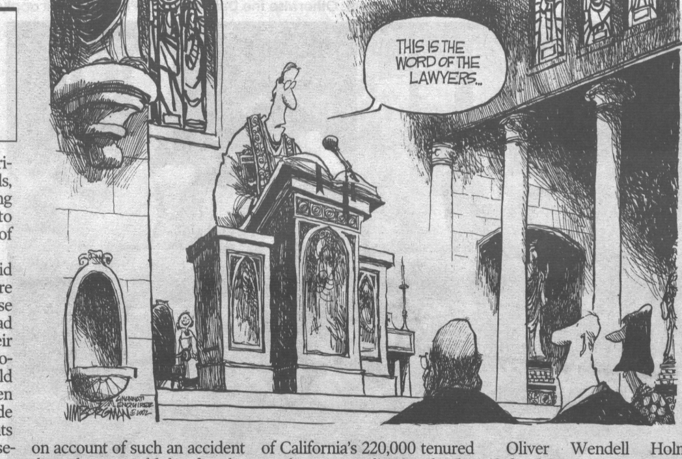
REMEMBER: LAW TRUMPS MEDICINE
77

Slide 78

Remember
Stress is ubiquitous
Psychosocial barriers to RTW to work are real, and need to be heard, but they typically are NOT amenable to treatment, and do not require it
Psychological symptoms are common, may or may not benefit from psychotherapy, and may need to be addressed to resolve a claim – but they are NOT caused by life events
Psychiatric conditions require a clear diagnosis, usually respond to treatment, but are they caused by life events?

Slide 79
