Slide 1
Handling Claims with Self-Represented Employees
Presenter: James (JV) Thompson, Member, Rainey, Kizer, Reviere, & Bell, P.L.C.

Slide 2

Handling Claims with
Self-Represented Claimants
Presented by
James V. Thompson
June 2019

Slide 3
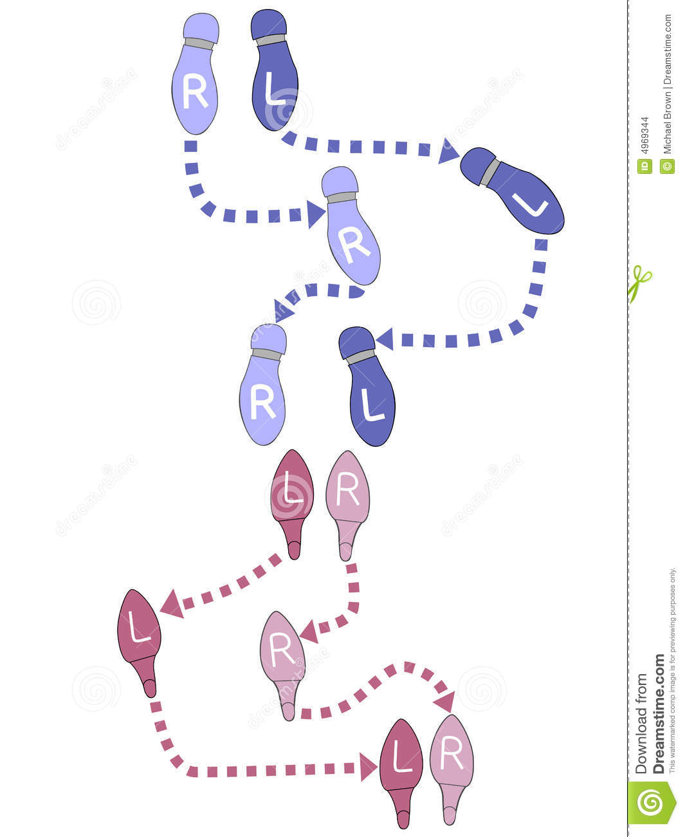
Understanding the Movements
What’s Required?
What’s Prohibited?
What are the
Players’ Roles?
How do we Bridge
the In-Between?

Slide 4
What’s Required
For any documents filed with the Bureau, must serve a copy of same on all parties/counsel.

Slide 5
What’s Required –
Initial Investigation
Within 2 business days of notice of injury:
  Send Notice of Reported Injury
  Send Beginner’s Guide to TN Workers’ Comp.
  Make written/verbal contact with Employee
  Provide Claims Rep’s name and contact info

Slide 6
What’s Required –
Initial Investigation
Within 2 business days of assignment to different claims rep:
  Make written/verbal contact with Employee
  Provide new Claims Rep’s name and contact info
Within 3 business days of request for medical care:
  Send panel of physicians

Slide 7
What’s Required –
Initial Investigation
Within 15 calendar days of notice:
  Decision on compensability
If denied, within 5 business days of determination, send:
  Notice of Denial
If accepted, within 5 business days of first benefits payment, send:
  First Report of Payment of Compensation

Slide 8
What’s Required –
Initial Investigation
If change in/termination of benefit payments, within 5 business days, send:
  Notice of Change/Termination of Compensation
If later controverting liability, within 15 calendar days of due date of first omitted payment, send:
  Notice of Controversy

Slide 9
What’s Required –
Initial Investigation
Within 30 calendar days of Claims Rep’s receipt:
  Send PPI rating and MMI date
  Send all other info needed to settle a claim
  Send a written settlement offer

Slide 10
What’s Required -
Case Management
Within 7 calendar days of notice of catastrophic injury, assign a case manager (if management is provided)
Within 14 calendar days after assignment (catastrophic/non-catastrophic injuries):
  At least 1 face-to-face meeting with Employee
Within 14 calendar days of notice of a significant decline in Employee’s medical condition,
  Another face-to-face meeting with Employee

Slide 11
What’s Required -
Mediation
Promptly after a PBD is filed:
  Provide copies of any medical records related to the injury in a party’s possession
Within 14 calendar days of receipt:
  Provide additional medical records received during a claim
Within 15 business days after a DCN is filed (or 7 business days of mediator’s request):
  Provide a wage statement

Slide 12
What’s Required -
Litigation
When filing Dispositive Motions:
  Send the motion
  Send the rule or statute on which the motion is based
  Indicate any response requirement or deadline
When filing Pre-hearing Briefs:
  Send the brief
  Send any case or statute cited in the brief
When submitting Orders, Joint Motions:
  Obtain the self-represented party’s actual signature
  No signing “by permission”

Slide 13
What’s Prohibited
May not knowingly, willfully, or intentionally allow a compensable claim to be paid by health insurance or other accident insurance.

Slide 14
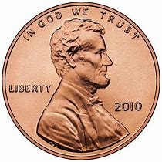

What’s Prohibited
Do Not Mislead
  Be Honest
  Be accurate

Slide 15
Explaining Roles of the Various Players
What is Employee’s expected role?
  Maintain point of contact
  Cooperate with medical investigation
  Accept the appropriate medical treatment

Slide 16
Explaining Roles of the Various Players
What is Employer’s expected role?
  Receive information on claim from Employee
  Report claim to Claims Rep
  Provide payroll information
  Cooperate with efforts to investigate
  Cooperate with efforts to rehabilitate Employee

Slide 17
Explaining Roles of the Various Players
What is Employer’s role after reporting claim?
  Is Employer conducting/leading investigation (versus Claims Rep)?
  Is Employer letting claim color its ongoing work relationship with Employee?
  What’s an “adjuster decision” versus an “employer decision”?
  What aspects of Employee’s work factor into claim investigations and decisions?

Slide 18
Explaining Roles of the Various Players
What is Claims Rep’s role?
  Provide the required information
  Investigate the claim fairly and completely
  Provide the lawfully appropriate treatment and benefits

Slide 19
Explaining Roles of the Various Players
What is Case Manager’s role?
  Advocate for Employee, versus Employer, versus doctor?
  Presenting doctor with facts bearing on treatment
  Assist Employee in understanding treatment scheduling
    (but not necessarily in understanding treatment reasoning?)
Notes:
(Reg. 0800-02-07-.04

Slide 20
Explaining Roles of the Various Players
“Thou shalt’s” for case managers:
  Develop treatment plan for appropriate medical services
  Monitor the treatment rendered and the medical progress
  Assess whether alternate medical care services are appropriate and delivered in a cost-effective manner
  Ensure the Employee is following the prescribed medical care plan
  Formulate a plan for Employee’s return to work
Notes:
(Reg. 0800-02-07-.04

Slide 21
Explaining Roles of the Various Players
“Thou shalt not’s” for Case Managers:
  Prepare physician’s panel or influence the employee’s physician choice
  Determine work relatedness
  Question the physician or employee on compensability
  Conduct or assist any party in claims negotiation, investigation, or any other non-rehabilitative activity
Notes:
(Reg. 0800-02-07-.04

Slide 22
Explaining Roles of the Various Players
“Thou shalt not’s” for case managers:
  Advise the Employee as to any legal matter
  (Settlement options, monetary recovery, claims evaluation, or applicability of workers’ comp act)
  Accept any compensation or reward from anyone based on settlement results
  Discuss with the Employee or physician what the impairment rating should be
  Reschedule medical appointments without first discussing the scheduling change with the Employee
Notes:
(Reg. 0800-02-07-.04

Slide 23
Explaining Roles of the Various Players
“Thou shalt not’s” for case managers:
  Refuse to provide case management reports to parties to the claim
  Assist in recording the Employee’s activity to help disprove the claim
  Deny or authorize treatment for purpose of guaranteeing prepayment or precertification
Notes:
(Reg. 0800-02-07-.04

Slide 24
Explaining Roles of the Various Players
What is the Mediator’s role?
  Help the parties identify the disputed issues
  Help the parties understand strengths/weaknesses of their positions
  Help the parties be aware of applicable law
  Help the parties reach mutual agreement on any/all of the issues
Notes:
(Reg. 0800-02-05-.01
“Workers’ Compensation Specialist” or “Specialist” means a department employee who has the following authority, including but not limited to: a) providing information regarding workers’ compensation for employees, employers and medical providers; b) investigating and analyzing issues related to workers’ compensation claims; c) issuing Orders Granting or Denying Benefits; d) conducting Benefit Review Conferences to resolve disputed issues; e) reviewing settlements for approval; f) and performing other duties to achieve the purposes of the Act.
0800-02-21-.11 ALTERNATIVE DISPUTE RESOLUTION PROCEEDINGS.
(1) Once a case has been assigned to a mediator, the mediator shall conduct alternative dispute resolution proceedings in any manner that is practical for the effective resolution of the issues in dispute, including allowing for telephonic, electronic, or in-person interactions.
(2) The parties shall cooperate with the mediator and provide any information necessary for the resolution of the dispute. If the mediator determines that a party is not cooperating or is not negotiating in good faith, then the mediator shall refer the party for a penalty as provided by T.C.A. § 50-6-118. When a party is referred by the mediator for the assessment of civil penalty pursuant to this section, the referral shall be assigned to another employee of the Bureau who shall consider the referral and make a decision of whether assessment of a penalty is appropriate.
(3) If the parties are able to reach a resolution of all disputed issues, the mediator shall reduce the terms of the resolution to a settlement agreement and file the agreement with the clerk. The clerk shall place the case on the docket and assign the case to a workers’ compensation judge for a settlement approval hearing.
(4) If the parties are unable to reach a resolution of all disputed issues, the mediator shall issue a dispute certification notice to the parties. The mediator shall note any issues that the parties have agreed upon in the notice as well as the remaining issues that are still in dispute including all defenses to the claim that were raised during the mediation.

Slide 25
Explaining Roles of the Various Players
What is the Ombudsman’s role?
  Explain basic legal principles
  Explain elements of claim and standard of proof
  Explain procedures
    What to expect, how to file, how to admit evidence
  Explain methodology of calculating comp rate, PPD
  Address legal questions from mediators
  Provide applicable general rules, statutes, cases
  Refer to forms, templates, legal info sources
  Explain strengths/weaknesses of case
Notes:
0800-02-21-.04 OMBUDSMAN.
(1) The workers’ compensation ombudsman program provides assistance to employees, employers or any other party or participant in a workers’ compensation claim who is not represented by legal counsel. The ombudsman can provide information on workers’ compensation law and rules; inform participants of their rights and obligations under the law; assist participants in completing forms; obtaining medical records and scheduling appointments; and perform any other duties as required by the administrator.
(2) Any party who is not represented by counsel may request the services of a workers’ compensation ombudsman by contacting the Bureau.
(3) An ombudsman shall have authority including, but not limited to:
(a) Meeting with and providing information to unrepresented parties about their rights and responsibilities under the law;
(b) Investigating claims and attempting to resolve disputes without resort to alternative dispute resolution and court proceedings;
(c) Communicating with all parties and providers in the claim;
(d) Assisting the parties in the completion of forms; and
(e) Facilitating the exchange of medical records.
(4) An ombudsman cannot provide legal advice.
(5) An ombudsman cannot be called to testify in any proceeding and no statement or representation made to an ombudsman shall be considered by a workers’ compensation judge for any purpose.
(6) Any unrepresented person or entity seeking the services of an ombudsman shall contact the Bureau and the Bureau shall assign an ombudsman to assist the person or entity so long as the Bureau determines that the person or entity is qualified to receive the services of the be provided by the ombudsman, pursuant to T.C.A. § 50-6-216(a).
(7) If a person or entity receiving the services of an ombudsman obtains legal counsel in the case or dispute for which the services of an ombudsman were sought, the person or entity shall immediately notify the Bureau of the representation and shall discontinue use of the services provided by an ombudsman.

Slide 26
Explaining Roles of the Various Players
What is the Ombudsman’s role?
  Attempt to resolve disputes without ADR or litigation
  Communicate with all parties
  Assist parties in scheduling
  Facilitate in exchange of medical records
Notes:
0800-02-21-.04 OMBUDSMAN.
(1) The workers’ compensation ombudsman program provides assistance to employees, employers or any other party or participant in a workers’ compensation claim who is not represented by legal counsel. The ombudsman can provide information on workers’ compensation law and rules; inform participants of their rights and obligations under the law; assist participants in completing forms; obtaining medical records and scheduling appointments; and perform any other duties as required by the administrator.
(2) Any party who is not represented by counsel may request the services of a workers’ compensation ombudsman by contacting the Bureau.
(3) An ombudsman shall have authority including, but not limited to:
(a) Meeting with and providing information to unrepresented parties about their rights and responsibilities under the law;
(b) Investigating claims and attempting to resolve disputes without resort to alternative dispute resolution and court proceedings;
(c) Communicating with all parties and providers in the claim;
(d) Assisting the parties in the completion of forms; and
(e) Facilitating the exchange of medical records.
(4) An ombudsman cannot provide legal advice.
(5) An ombudsman cannot be called to testify in any proceeding and no statement or representation made to an ombudsman shall be considered by a workers’ compensation judge for any purpose.
(6) Any unrepresented person or entity seeking the services of an ombudsman shall contact the Bureau and the Bureau shall assign an ombudsman to assist the person or entity so long as the Bureau determines that the person or entity is qualified to receive the services of the be provided by the ombudsman, pursuant to T.C.A. § 50-6-216(a).
(7) If a person or entity receiving the services of an ombudsman obtains legal counsel in the case or dispute for which the services of an ombudsman were sought, the person or entity shall immediately notify the Bureau of the representation and shall discontinue use of the services provided by an ombudsman.

Slide 27
Explaining Roles of the Various Players
What is not the ombudsman’s role?
  Not provide UNLIMITED legal advice
  Not testify in any proceeding
  Not make any litigation appearances
  Not draft or critique documents
  Not communicate with opposing party or Court
  Not advise on value of the claim
  Not advise on issues to raise on appeal
Notes:
Ethics Opinion 2017-F-162
ombudsman attorneys may, in their professional discretion, do the following:
Explain basic legal principles, such as causation, notice, statute of limitations, etc.
Explain procedures, such as what a party can expect in an expedited hearing or the procedure for appealing an adverse decision (i.e. how long to file the notice of appeal, how to obtain a transcript, etc.)
Explain the standard of proof required to prevail (preponderance of the evidence)
Explain the elements of the employee’s cause of action (i.e. “primarily arising out of” and “in the course and scope” of employment)
Explain any affirmative defenses raised by the employer, what the employer must show to establish the defense and what information the employee may need to provide when faced with such a defense
Explain what medical proof may be needed and suggest avenues to obtain that information
While refraining from advising a party or potential party regarding whether they should settle their claim; explain the methodology for calculating a compensation rate and an award of permanent disability benefits
Address legal questions from other ombudsman and/or mediators
Refer parties or potential parties to forms, templates, examples of motions, and other sources of information, such as UT-Trace (for trial court/appeals board opinions), Medical Impairment Registry, Medical Fee Schedule, etc.
Stress the importance of submitting relevant documents and other information to the courts
Provide contact information, such as for the clerks of the trial court, appeals board, or Supreme Court
Provide applicable rules, statutes, and case law as they apply to general principles of workers’ compensation
Evaluate the claim and explain the strengths and weaknesses of the case to the pro se litigant
Generally explain the purpose of a deposition, routine deposition questions, the proper method of asking questions and introducing documents, and common objections.
Explain what constitutes admissible evidence and process for admitting evidence during and hearing or trial.
May NOT:
Court appearances with or on behalf of any person or entity
Settlement conference appearances with or on behalf of any person or entity
Deposition appearances with or on behalf of any person or entity
Filing documents in the trial court or on appeal for or on behalf of any party or their representatives
Drafting documents or correspondence, including emails, for or on behalf of any party or potential party
Review or critique written materials or oral presentations prior to the submission for mediation or court proceedings
Perform legal research on the behalf of the pro se litigant
Communicating, orally or in writing, with the opposing party or their representatives, including legal counsel
Communicating, orally or in writing, with health care providers or any other person or entity, including insurance companies and their representatives, about the claim or potential claim
Communicating orally or in writing, with any judge of the Court of Workers’ Compensation Claims or Appeals Board for or on behalf of a party or potential party
Testify or otherwise disclose confidential information
Make attorney referrals
Advise a party or potential party regarding the value of the claim
Advise a party regarding what issues to raise on appeal.

Slide 28
Explaining Roles of the Various Players
What is the trial court’s role?
  Jones v. Dollar General, et al., No. 2017-07-0074( TN WC App. Bd. 9/22/17):
    Cannot offer legal advice to a party in case being adjudicated before them
    Caution against asking questions of witnesses
    Should not conduct Employee’s direct and redirect examinations
    Should not assist a party in satisfying the elements of claim or meeting his/her burden of proof
Notes:
BUT – employer/appellant failed to detail, brief, argue, cite authority or explain how trial court was incorrect; appeals board declined to speculate on employer’s argument or search record to support conclusory claims of error – that would disadvantage the opponent

Slide 29
How Do We Handle the In-Between?
Providing Connections
  Provide all reasonable contact points for Claims Reps/counsel
    Name, company name
    Phone, fax, email
  Obtain all possible contact points from Employee
    Name, address, phone(s), email of Employee
    Name, address, phone(s), email of Employee’s family member/alternate contact

Slide 30
How Do We Handle the In-Between?
Providing Documents
  Provide by both email and regular mail
  Address Employee’s lack of ability to print documents
  Engage Employer to follow up with Employee
  Ensure Employee’s understanding of where and when to send documents

Slide 31
How Do We Handle the In-Between?
Providing Communication
  Engage Employee to explain his or her side of the story
    Employee feels acknowledged and heard
    Claims Rep builds trust and credibility with Employee
    Claims Rep has opportunity to investigate more fully outside of litigation
    Claims Rep can help frame and manage Employee’s expectations of claim process
Notes:
Need to get all

Slide 32
How Do We Handle the In-Between?
Providing Communication
  Engage Employer to assist with claim process
    Employer can better document claim details
    Employer can provide any “back story” on the claim or Employee/Claimant
    Claims Rep has more evidentiary support for claims decisions
    Claims Rep has a better understanding of Employee’s background
    Employer may be a more trusted or credible information source
Notes:
Need to get all

Slide 33
How Do We Handle the In-Between?
Providing Communication
  Engage medical providers to explain their treatment plan and medical opinions
    Equip Case Managers to present all pertinent facts to doctor for treatment
    Use communications with authorized panel doctors to support claims decision-making
    Use communications from authorized panel doctors to explain process to Employees
Notes:
Need to get all

Slide 34
How Do We Handle the In-Between?
Providing Context
  Explain the need for information requests
    Sending interrogatories right off the bat with no explanation → seems suspicious to wary Employees
  Refer Employees to the Ombudsman General Line for more explanation
Notes:
Need to get all

Slide 35
How Do We Handle the In-Between?
Providing Context
  Use Mediators to help bridge gaps in understanding
    Multiple discussions leading up to initial mediation
    Ability to give neutral comments on the “why” of parties’ positions and decisions
    Ability to play “devil’s advocate” on potential arguments
    Potential for postponements if further investigation warrants
Notes:
Need to get all

Slide 36
How Do We Handle the In-Between?
Providing Context
  Use Ombudsman to help bridge gaps in understanding
    Usually involved after the initial mediation
    Ability to frame Employee’s options on claim
      Including disputed-basis settlement options
    Helpful to get mediators back involved as an intermediary between Ombudsman/Employee and Claims Rep/Defense Counsel
Notes:
Need to get all

Slide 37
How Do We Handle the In-Between?
Learning from Experience
  What has worked in previous claims?
  What has not worked in previous claims?
  How has Employer learned to approach claimant?
  What concerns are you hearing from self-represented claimants?
  Where have parties felt “burned” or ignored in the past?
  What is the main claimant’s main concern?
Notes:
Need to get all

Slide 38
Questions and Feedback
  Thanks for your attendance and feedback.
  If you have any questions or comments, please feel free to contact me:
  J.V. Thompson
  jthompson@raineykizer.com
  731.423.2414 x2260

Slide 39
Memphis ▪ Jackson ▪ Nashville ▪ Chattanooga
Go-To Law Firm ® by Fortune 500 General Counsel
Health and Wellness Award by the Chamber of Commerce 2012
Voted Best Law Firm by Readers’ Choice Awards 2007
Cornerstone Award Recipient by the Chamber of Commerce 2006
Small Business of the Year Award by the Chamber of Commerce 1996
Business and Finance
Employment and Civil Rights
Estate Planning, Wills, and Trusts
Healthcare
Mediation
Litigation
Professional Malpractice Defense
Tort and Insurance Defense
www.RaineyKizer.com

