Slide 1
Ethical Practices for Caring for Workers
Presenter: Kate Payne, JD, RN, NC-BC

Slide 2
Ethical Practice In Caring For Workers
BWC Educational Conference
June 12-14, 2019
Murfressboro, TN

Slide 3
Objectives
Define and describe ethics in the care of patients and workers as patients.
Identify principles of medical ethics and how they apply in occupational health.
Compare and contrast ethical obligations in clinical care with those in occupational health.
Formulate an approach for dealing with ethical dilemmas with working patients.

Slide 5
Sociology of Workers Comp
Deeply rooted distrust
Of workers
Of employers
Of carriers
Of providers
Abuse of system
By injured workers
By malingering workers
By employers
By carriers
By providers
Fear of consequences of filing a claim
Emphasis on “moral hazard”

Slide 6
Sociology of injured workers
Filing claim may bring stigmatization
Esp. if injury is not obvious
Esp. if embarrassing to employer
Esp. if highly visible to other workers
Prolonged disability or prolonged rehabilitation
Wearing on family
Coworkers often turn unsympathetic, even hostile
Neighbors, friends get tired, even suspicious of abuse
Injured worker gets depressed
Depressed people are difficult to be around
Intimations of fraud, exaggeration, abuse
Involutional cycle

Slide 7
What is Ethics?
It can be about resolving dilemmas,
It can be about individual actions,
It is also about what kind of persons we are becoming – our character and how our choices shape us.
Ethics is ultimately about human flourishing, about living well, about achieving good through means that are consistent with real human values and needs.

Slide 8
What is Organizational Ethics?
It can be about compliance,
It can be about due diligence,
It can be about resolving value conflicts,
Organizational ethics is primarily about integrity, about making decisions that are consistent with the moral identity and values of the organization, so that the organization, its workers and the communities it serves can truly flourish.

Slide 9
Role of Ethics Mechanisms
Improve and enhance the quality of care
Care of employees
Education
Committee, staff, community
Administrative
Policy development and review
Oversight and comment on operations with ethical impact
Consultation and case review
Conflict resolution
Inform other institutional efforts
Regulatory compliance
Notes:
1st is overall
2,3,4 are traditional ethics committee /consultation roles
5 is more modern, next generation but not quite

Slide 10
Ethical Standards
Utilitarian
Most good, least harm or best balance of good over harm
Rights
Humans are ends not means and have moral rights
Justice
Treat all human being equally, or if unequal then fairly
Common Good
Relationships are the basis for ethics
Virtue
Consistent with ideal virtues that provide for the full development of humanity

Slide 11
What is medical ethics*?
Standards of behavior informing us how human beings ought to act related to the care of patients
Many influences:
Standards
Approaches
Principles
*see also: Clinical ethics, biomedical ethics, healthcare ethics

Slide 12
Ethical Approaches: Lenses
Principle-based: What are the principles/rules?
Virtue-based: What would a virtuous doctor do?
Feminist Ethics: What societal roles contribute?
Care ethics: How does care affect relationships?
Communitarian: What is the community standard?
Case-Based: Are there previous similar cases?
Ethical Decision Making in Obstetrics and gynecology. ACOG. 2007.
Notes:
These standards have been used to develop various approaches to ethics.

Slide 13
Principled Decision Making adapted from Robert Orr, MD
FAITH BASED
Respect for life
Truth telling
Non-exploitation
Advocacy
Benefit/burden
Free will
Obedience
Stewardship
Faith
Sovereignty
Dominion
God’s purpose
SECULAR
Medical
Indications
Patient
Preferences
Diagnosis
Prognosis
Treatment options
Values
Goals
Wishes
Non-Maleficence
Autonomy
Fidelity
Contextual
Features
Quality of Life
Social
Cultural
Legal
Financial
Physical
Psychological
Social
Spiritual
Mercy
Grace
Hope
Scripture
Eternity
Ritual
Social justice
Sanctity of life
Compassion
Service
Meritorious suffering
Redemptive suffering
Contentment
Justice
Beneficence
Notes:
Principles and agreement 658-659

Slide 14
The Ethics Iceberg
Decisions and actions
Systems and processes
Environment and culture
Notes:
Responsive
Crisis management
Consultations
Routine
Policy work
Patterns/Trends
Strategic
Operations
What is really going on?

Slide 15
Decision Making Process
Ethical Decision Making in Obstetrics and gynecology. ACOG. 2007
1. Identify the ethical question(s)
Use action oriented questions: “Should we….” or “How should we…”Ask “how” questions to explore strategies
2. Identify the decision makers
Assess the patient’s decision making capacity
Identify / designate a surrogate
3. Collect data, establish facts
Be objective
Use consultants
4. Identify all medically appropriate options
Use consultants
Identify options raised by the patient or others concerned
Identify the feasibility and barriers to identified options

Slide 16
5. Evaluate feasible options following values and principles
The patient’s values are generally a the most important concern
Consider professional ethical guidelines and relevant laws
Eliminate options that are morally unacceptable to all
Re-examine remaining options; combine if possible
6. Identify ethical tensions/conflicts and set priorities
Weigh the relative importance of the principles in context
Examine past cases for relevant similarities/ differences
7. Select the options than can be best justified
Seek a rational (and explainable) solution
Re-evaluate the effects of the decision after acting
Identify unanticipated consequences

Slide 17
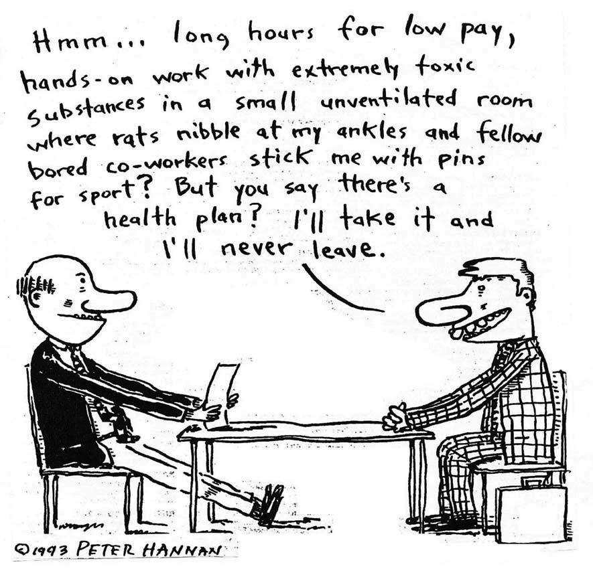

Slide 18
Underlying Values
Board Certified Case Managers (CCMs)
Believe that case management is a means for improving client health, wellness and autonomy through advocacy, communication, education, identification of service resources, and service facilitation.
Recognize the dignity, worth and rights of all people
Understand and commit to quality outcomes for clients, appropriate use of resources, and the empowerment of clients in a manner that is supportive and objective
Embrace the underlying premise that when the individual(s) reaches the optimum level of wellness and functional capability, everyone benefits; the individual(s) served, their support systems, the health care delivery systems and the various reimbursement systems
Understand that case management ins guided by the ethical principles of autonomy, beneficence, nonmaleficence, justice and fidelity

Slide 19
CCM Principles
Board Certified Case managers (CCMs):
will place the public interest above their own at all times.
will respect the rights and inherent dignity of all of their clients.
will always maintain objectivity in their relationships with clients
will act with integrity and fidelity with clients and others.
will maintain their competency at a level that ensures their clients will receive the highest quality of service.
will honor the integrity of the CCM designation and adhere to the requirements for its use.
will obey all laws and regulations.
will help maintain the integrity of the Code, by responding to requests for public comments to review and revise the code, thus helping ensure its consistently with current practice.

Slide 20
CCM Rules of Conduct
Board-Certified Case managers (CCMs):
will not intentionally falsify an application or other documents.
will not be convicted of a felony.
will not violate the code of ethics governing the profession upon which the individual’s eligibility for the CCM designation is based.
will not lose the primary professional credential upon which eligibility for the CCM designation is based.
will not violate or breach the Standards for Professional Conduct.
will not violate the rules and regulations governing the taking of the certification examination and maintenance of CCM Certification.

Slide 21
American Nurses Association (ANA) Code of Ethics
Applies to all nurses in all healthcare settings
Ethical principles agreed upon by members of the nursing profession
Sets standards of conduct and behaviors for all nurses
http://www.nursingworld.org/Mobile/Code-of-Ethics
Notes:
Weather you are and ANA member or have ever seen the code it applies to all of us and is used as a way to describe what a reasonable nrse would to

Slide 22
About Patients
Respect for Others: Unrestricted compassion and respect for the inherent dignity, worth, and uniqueness of every individual
Commitment to the Patient: Primary commitment is to the patient--individual, family, group, or community
Advocacy for the Patient: Promotes, advocates for, and protects the rights health, safety, of the patient
Notes:
There are nine total statements that speak about what we owe to patients 1-3
To ourselves and our practice 4-

Slide 23
About Us, Our Practice
Accountability and Responsibility for Practice: Authority, accountability and responsibility for nursing practice consistent with the obligation to provide optimum patient care
Duty Self and Duty to Others: Same duties to self as to others, including the responsibility to promote health can safety, preserve wholeness, integrity, maintain competence, continue personal and professional growth
Contribution to Healthcare Environments: Individually or collectively establishes, maintains, and improves health care environments and conditions of employment
Advancement of the Profession: Advances the profession through research, scholarly inquiry, professional standards, knowledge development, and health policy

Slide 24
Broader Society
Promotion of Community and World Health: Collaborates with other health professionals and the public to protect human rights and reduce health disparities
Promotion of the Nursing Profession: The profession must articulate its values, maintain integrity, and integrate social justice principles

Slide 26
CDMS

Slide 27
Preamble
The fundamental spirit of caring and respect with which the Code is written is based upon five principles of ethical behavior. These include autonomy, beneficence, nonmaleficence, justice, and fidelity, as defined below:
Autonomy: To honor the right to make individual decisions.
Beneficence: To do good to others.
Nonmaleficence: To do no harm to others.
Justice: To act or treat justly or fairly.
Fidelity: To adhere to fact or detail.

Slide 28
A code of professional conduct cannot guarantee ethical behavior. Moreover, a code of professional conduct cannot resolve all ethical issues or disputes or capture the richness of complexity involved in providing professional input within a moral community. Rather, a code of conduct sets forth values, ethical principles, and ethical standards to which professionals aspire and by which their actions can be judged. Disability management specialists’ ethical behavior should result from their personal commitment to engage in ethical practice. The Code reflects the commitment of all disability managers to uphold the profession’s values and to act ethically. Principles and rules of conduct must be applied by individuals of integrity who discern moral questions and, in good faith, seek to make reliable ethical judgments.

Slide 29
CDMS Principles
Certified Disability Management Specialists shall:
endeavor to place the public interest above their own at all times.
shall respect the integrity and protect the welfare of those persons or groups with whom they are working.
shall always maintain objectivity in their relationships with clients.
shall act with integrity in dealing with other professionals.
shall keep their technical competency at a level that ensures their clients will receive the benefit of the highest quality of service the profession can offer.
shall honor the integrity and respect the limitations placed on the use of the CDMS credential.
shall obey all laws and regulations, avoiding any conduct or activity that could harm others.
shall help maintain the integrity of the CDMS Code of Professional Conduct.

Slide 31
CRC Values and Principles
Respecting human rights and dignity;
Ensuring the integrity of all professional relationships;
Acting to alleviate personal distress and suffering;
Enhancing the quality of professional knowledge and its application to increase professional and
Personal effectiveness;
Promoting empowerment through self-advocacy and self-determination;
Appreciating the diversity of human experience and appreciating culture;
Emphasizing client strengths versus deficits;
Serving individuals holistically; and
Advocating for the fair and adequate provision of services.

Slide 32
These values inform principles. They represent one important way of expressing a general ethical commitment that becomes more precisely defined and action-oriented when expressed as a principle. The fundamental spirit of caring and respect with which the Code is written is based upon six principles of ethical behavior:
Autonomy: To respect the rights of clients to be self-governing within their social and cultural framework.
Beneficence: To do good to others; to promote the well-being of clients.
Fidelity: To be faithful; to keep promises and honor the trust placed in rehabilitation counselors.
Justice: To be fair in the treatment of all clients; to provide appropriate services to all. Nonmaleficence: To do no harm to others.
Veracity: To be honest.
Notes:
Out of these come enforceable standards

Slide 33
Enforceable Standards
Counseling Realtionship
A.1. Welfare of those Served
A.2. Respecting Diversity
A.3. Client Rights
A.4. Avoiding Value Imposition
A.5. Rules and Relationships with Clients
A.6. Multiple Clients
A.7. Group Work
A.8. Termination and Referral
A.9. End of Life Care for Terminally Ill Clients

Slide 34
Standards continued
Section B: Confidentially, Privileged Communication, and Privacy
Section C: Advocacy and Accessibility
Section D: Professional Responsibility
Section E: Relationships with Other Professionals and Employers
Section F: Forensic Services
Section G: Assessment and Evaluation
Section H: Supervision, Training, and Teaching
Section I: Research and Publication
Section J: Technology, Social Media, and Distance Counseling
Section K: Business Practices
Section L: Resolving Ethical Issues

Slide 35
Decision Making Process
Ethical Decision Making in Obstetrics and gynecology. ACOG. 2007
1. Identify the ethical question(s)
Use action oriented questions: “Should we….” or “How should we…”Ask “how” questions to explore strategies
2. Identify the decision makers
Assess the patient’s decision making capacity
Identify / designate a surrogate
3. Collect data, establish facts
Be objective
Use consultants
4. Identify all medically appropriate options
Use consultants
Identify options raised by the patient or others concerned
Identify the feasibility and barriers to identified options

Slide 36
5. Evaluate feasible options following values and principles
The patient’s values are generally a the most important concern
Consider professional ethical guidelines and relevant laws
Eliminate options that are morally unacceptable to all
Re-examine remaining options; combine if possible
6. Identify ethical tensions/conflicts and set priorities
Weigh the relative importance of the principles in context
Examine past cases for relevant similarities/ differences
7. Select the options than can be best justified
Seek a rational (and explainable) solution
8. Re-evaluate the effects of the decision after acting
Identify unanticipated consequences

Slide 37
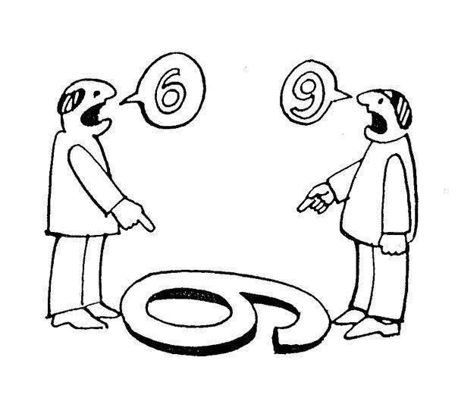
Notes:
What to do about it? Get some perspective: Self, others, etc

Slide 38

What is conflict?
An unavoidable aspect of group life
Any situation in which people have incompatible interests, goals, principles or feelings.
Unmet expectations
A process that begins when one party perceives that another party has negatively affected, or is about to negatively affect something that the first party cares about.
Things we care about
Ideas, Perspectives, Priorities, Preferences, Beliefs, Values, Goals, People, Organizational Structures

Slide 39
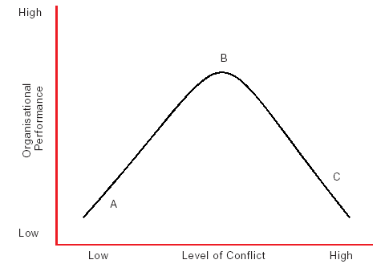
Passionate
Power Play
Polite
Notes:
Stats on cost

Slide 40
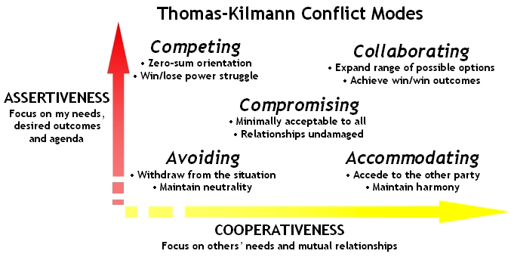
Notes:
Avoid ostrich
Compete shark
Accommodate teddy bear
Compromise rat
Collaborate dog

Slide 41

Hot Buttons What irritates you the most?
Unreliable people
Unappreciative people
Micro-managers
Abrasive people
Hostile people
Overly-Analytical people
Aloof people
Self-centered people
Untrustworthy people
Notes:
Do you know what yours are.
Online assessments also help ID these for you

Slide 42
Causes of Conflict in Health Care:
Fundamentally competing care-related ideologies and priorities
Factors emerging from the organizational and regulatory structure
The mental and emotional status of the patients and their families

Slide 43


Brain Power
The Rational brain
Allows objectivity
Makes sense of any risk
The Emotional brain
Quickly processes incoming information
Filters for potential threat
Triggers fight or flight
“I can’t believe she
voted for that person!”

Slide 44

Amygdala Hijacks
Stimulus
Result: rational mind is swamped by the emotional mind.
Understanding
Notes:
Tying to become as least threating as possible
Brain is contantly bathed in emotions

Slide 45
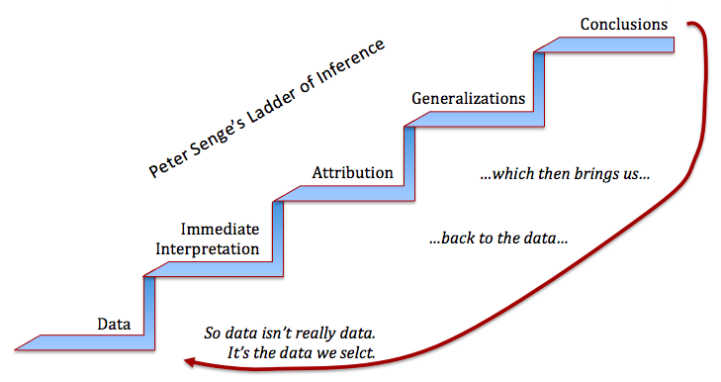
Notes:
The 5th Discipline

Slide 46

SCARF
Status
Connection
Autonomy
Relationships
Fairness
Notes:
Recognizing this dichotomy (between primal and social needs) can assist mediators in helping people to transition from “protect” mode (among the primary needs) to “connect” mode (among the social needs).
In chemical terms, it’s about moving from adrenalin (tied to fight/flight) to oxytocin production, which triggers a more relaxed, supported, state – a “humanized” state.

Slide 47
To Do
Remember the common goal
Accountability
Infrastructure
Communication is primary
Meet face to face
Conversation
Get real data
Ask another question
Plan in advance if you can
Civility
Maintain respect
Use “I” versus “You” language
Forgiveness & understanding
Find the workable solution
Personal
Professional
Organizational

Slide 48
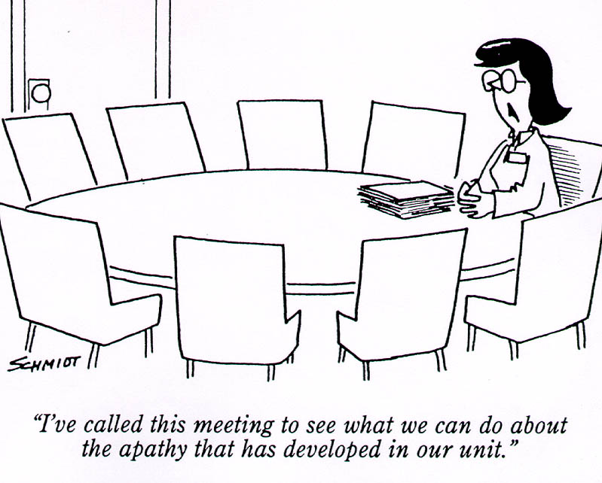

Slide 49
BO/CF/STS/MD/MI
All share issues with empathy and engagement
Burnout (BO)
More related to mismatch between person and job
Organizational characteristics
Compassion fatigue (CF)
Psychological/emotional consequences
Change in beliefs and expectations
Secondary Traumatic Stress/Vicarious traumatization (STS/VT)
Personally traumatized
Anxiety, confusion, apathy, sadness
Moral Distress (MD)
Injury to integrity
Moral Injury
Injury to conscience that produces profound emotional guilt and shame
Some betrayal, anger
Moral disorientation

Slide 50
Crescendo Effect
Moral
Distress
Moral distress crescendo
Moral residue
Baseline
Time

Slide 51
Cost control,
safety, infection control,
facility, others
Organizational awareness, performance improvement, information management
Customer service, patient rights, communication, and teamwork
Professionalism/self-development/respect and rational decision making
Accountability, self-control, and resilience
Self esteem/self confidence
Decker, Hospital Topics, 1999
Notes:
Decker JP. The hidden competencies of healthcare: why self-esteem, accountability, and professionalism may affect hospital customer satisfaction scores. Hospital Topics, 1999;77(1):14-26

Slide 52
Contact
Kate Payne, JD, RN, NC-BC
Associate Professor of Nursing
Center for Biomedical Ethics and Society
Vanderbilt University Medical Center
2525 West End, Suite 400
Nashville, TN 37203
phone: 615-936-2609
kate.payne@vumc.org

Slide 53
