Slide 1
Accident Prevention with the International Paper LIFE Program & Intervention with Employee Advocacy
Presenter: Darin Hampton, Regional Recovery Coordinator, International Paper

Slide 2
Accident Prevention with the Internatonal Paper LIFE Program &
Intervention with Employee Advocacy
Darin Hampton

Slide 3
Safety @ International Paper
Strong Safety Culture
Good at the Basics
Focused on Right Things – for the Right Reasons!
Loaded Safety Tool Box
Targeted Goals

Slide 4
REACTIVE APPROACH
What is our injury count so far this year?
How does the count compare to last year?
How are we compared to other similar sites?
Safety management is not counting injuries.
It’s about driving action to prevent injuries.
PROACTIVE APPROACH
Have we implemented corrective actions from the latest LIFE Lesson that relate to our site?
What is our status on closing out corrective action related to our recent safety audit?
How do we prevent it

Slide 5
Safety
PRODUCTION
Speed
Quality
Quantity
SAFETY
Notes:
A significant shift in safety culture is always challenging, but can be especially so when safety is perceived to be in great condition, as evidenced by a low TIR, and the manufacturing culture is perceived to be in conflict with safety. A balanced approach is required and at IP, we are spending as much time working on “soft” issues such as safety culture and leadership, as we are on “hard” projects like machine guarding and electrical safety.

Slide 6
TRANSLATE VALUES INTO ACTIONS
VALUES
ACTIONS

Slide 7
VALUE
ACTIONS
Safety is a foundation of efficient production
Question the need to work on energized equipment
Lead a project to install interlocked safety switches for operator tasks
Recognize that your employee is performing frequent work at height on a ladder
Install a fixed work platform with guardrails
My actions impact others
Confirm that all machine guards are reattached after maintenance work
Pick up trash or debris when you see it on the floor to prevent slips & falls
Be your “Brother’s Keeper”
Notes:
Examples of ways you can convert your core values into actions. Start with the basics, then take it to the next level.

Slide 8
How do we get there?
Identify & Eliminate Hazards
Individual Accountability
Look Out for Others
Intervene When Needed
“Management is doing things right;
leadership is doing the right things.”
-Peter Drucker

Slide 9

International Paper launched the LIFE initiative, a multi-year effort to identify and mitigate the potential hazards and risks that lead to serious injuries and fatalities.

Slide 10

5 LIFE Focus Areas and
A Contractor Safety Emphasis
Machine Safeguarding
Motorized Equipment
Falls
Driver Safety
Harmful Substances or Environments
Contractors
10
Notes:
Our LIFE program consists of 6 Focus areas to address our highest-risk exposures.
Machine Safeguarding – Represents 39% our serious injuries & fatalities in 2014. This includes machine guarding, ZES and IES/MSK (Machine Safeguard Key).
Motorized Equipment – most of these incidents involve clamp trucks or forklifts.
Falls – This includes both falls from height and slips & trips from the same level.
Exposure to Harmful Substances/Environments – Electricity, hazardous chemicals, burns from hot liquids and solids and confined space hazards.
Driver Safety – On-the-Road vehicles such as xpedx (divested in 2015) trucks, recycle trucks, and our sales fleet vehicles. Driver Safety impacts every IP employee, no matter what his or her job is. This is also something employees can take home and share with their family. Staring in 2013 for example driving a company car while using a mobile device or cell phone will be prohibited as it has been shown to be distracting to drivers and has been a major contributing cause of accidents.
Contractor Safety Emphasis Area – starting in 2012 we began to address the unique hazards to our contractors who work at our IP facilities. A major hazard to our contractors is falls from heights during maintenance and construction work. Contractor safety covers all 5 focus areas as well and is depicted on this slide to reflect this.

Slide 11
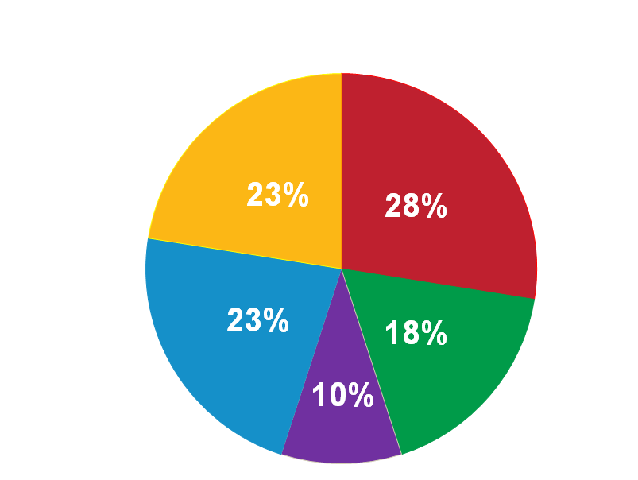
Severity/Data Analysis
Machine Safeguarding
Motorized Equipment
Harmful Substances or Environments
Driver Safety
Falls

Slide 12
What is a LIFE Incident?
A Fatality or Amputation
OR
An injury that results in :
Organ Damage Concussion or Other Brain Trauma Bone Fracture | Crushing Injury Degloving Serious 2nd or 3rd Degree Burn
Notes:
LIFE incidents are primarily acute injuries represent the most serious types injuries that occur at International Paper. After studying our first year results we may adjust the criteria to be sure we include all serious injuries while excluding minor injuries that are not life-changing.
Example: Employee’s hand caught in machine – sustained several fractures to hand. Not a LIFE incident because employee returned to work on restricted duty in less than 14 days.
Example: Employee fractured pinky finger and was out of work for 20 days due to local regulations at non-US location. LIFE incident.
Lessons Learned: Sites worked to avoid lost workdays, we missed vision loss and lacerations, most LIFE incidents fit the definition clearly – but those in a gray area need a clearly defined process to determine if they are a LIFE event

Slide 13

Our Goal is to be a Zero-Injury Workplace
Prevent ALL fatalities
Eliminate life-changing injuries
Every employee goes home safely to their family every day

Slide 14
LIFE Strategy
Communicate Effectively
Engage Stakeholders
Make Safety a Core Value
Learn from Past Mistakes
Benchmark Best Practices

Slide 15
LIFE Strategy
Focus on Training & Education
Change the way we measure safety performance
Be Global
Use ME* tools, Project Teams & be Data Driven
*Manufacturing Excellence

Slide 16
Global Performance Standards
Safety Leadership
Benchmarking
Site-Specific LIFE Project Plans
Hazard Recognition
Safety Culture
Communication
Performance Indicators
Contractor Safety
Notes:
Along with the 5 focus areas, we have many supporting projects to emphasize safety as a core value, develop safety leaders and engage employees at every level.

Slide 17

Machine Guarding
Inspections
Guarding specifications
Global Lockout Implementation
Equipment Upgrades

Slide 18

Motorized Equipment
Traffic Flow Risk Assessment (TRFA)
Pedestrian Segregation
Operator training
Dock Safety
Notes:
W

Slide 19

Driver Safety
Performance Standard
Cell Phone Ban
Distracted Driving Training
Awareness Campaign

Slide 20

Falls
Truck Tarping
Roof Access Permit
Fall Hazard Risk Assessment

Slide 21

HARMFUL SUBSTANCES & ENVIRONMENTS
Electrical Safety
Ash Hopper Safety
Confined Space

Slide 22
Contractor Safety
Added Focus

Slide 23
EMPLOYEE FOCUS – WHY?
Maintains the core value of care and compassionate for our employees
Minimize the impact an on-the-job injury or illness might have on an Employee and his/her family
Actively engage employees in their medical care and recovery
Will produce enhanced results and reduce costs

Slide 24
Employee Engagement
Begins BEFORE an accident happens
Ongoing general education and communications to work population
  New employees
  Annual training
  Bulletin Boards
  Pamphlets
No secrets, no games approach
Injury reporting expectations
Employee rights and responsibilities

Slide 25
Roles and Responsibilities of the Injured Employee
Report any injury or illness immediately
Obtain medical attention/treatment when necessary
Ask questions and talk to the treating doctor to understand their injury, treatment plan, medical restrictions, and medications
Advise doctor International Paper has a Return-to-Work program
Discuss incident with Claim Administrator and Employee Advocate

Slide 26
Roles and Responsibilities of the Injured Employee
Provide a return to work form to International Paper following each doctor appointment
Comply with any medical restrictions at work and at home
Communicate status after each doctor visit to your Supervisor, HR, or EHS representative

Slide 27
Roles and Responsibilities of the Injured Employee
Provide an accurate/updated home address and phone number
Provide Cell phone number, personal email for communications
Use personal e-mail and web access to claim file info
Complete WC Employee Survey

Slide 28
Employee Resources
The Employee Advocate
Claims Specialist
Local Human Resources
Employee Assistance Program
Environment Health and Safety Representative
The State Division of Workers’ Compensation
State Workers’ Compensation Ombudsman
PUSH Technology (Available through Claim Administrator - allows electronic access to claim info, and communications via personal email address and/or cell phone number, including texting)

Slide 29
Roles and Responsibilities: Employee Advocate
Contacts each injured employee who files a work comp claim
Explain roles and responsibilities and who will contact them
Help employee understand the claims process
Help minimize the impact of an on-the-job injury
Address any questions or concerns the employee might have
Assist with barriers to recovery and return to work

Slide 30
Roles and Responsibilities: Employee Advocate
Remind employee of compliance with restrictions
Discuss any medication issues or concerns
Make appropriate resources available to employee and family members
Assist with communications
Remind employee of their responsibilities in their own recovery
Be available throughout recovery and return to work

Slide 31
Rules of Engagement For Management
Treat them like an Employee – Not a Claimant
Motivate recovery and Return to Work
Be Empathic – Care and compassion
Be Random
Encourage Others

Slide 32
Rules of Engagement For Management
Help Maintain Connection with Co-Workers
Discuss upcoming Events at Work
Does not Stop at Return to Work
If Litigated Avoid Discussing Injury – But Engage

Slide 33
Rules of Engagement for Management
Call
  Different Times of Day
  Leave Messages
  Talk to Family Members
  Ask questions & Share Info & Activities
Home Visits- with permission and agreement
Site visits – Within Restrictions & Medications

Slide 34
Questions and Answers
Q. Do I have a right to know medical information?
A. Yes, but only with regard to the job injury and work status. Not any personal or non-related medical info.
Q. How often should I contact employee?
A. No set schedule. Try contacting them like you would a close friend that is ill. More than just initially right after the injury.

Slide 35
Questions and Answers
Q. Should I encourage others to contact the injured worker?
A. Yes. It is always good to hear from co-workers and friends. But give them some guidelines such as being sensitive to medical issues and keeping things positive.
Q. Should I invite them to visit the Facility?
A. Maybe. Depending on restrictions and activities at the facility. Face to Face is good!

Slide 36
Questions and Answers
Q. What if the employee is represented by an attorney?
A. They are still your employee and can be treated as such. We can engage with them, but don’t talk about the contested issues, such as extent of injury or denial of certain medical treatment. Focus on personnel issues and recovery. Care and compassion.

Slide 37

It’s about your health and well-being …
it’s about our teammates…
it’s about friends…
It’s about family…
…and our ability to go home safely to them

Slide 38


Slide 39
Questions ???

