Slide 1
Legislative Update
Troy Haley, Esq. & Ch. Clark Boyd
2019

Slide 2
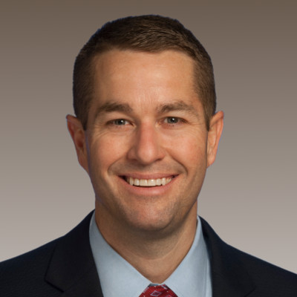
Ch. Clark Boyd (R) Lebanon-District 46
(Cannon, part of Wilson and Dekalb Counties) Chair: House Consumer/Human Resources Committee
Member, House Commerce Committee
Member, House Calendar and Rules Committee
Member, House Utilities Subcommittee

Slide 3

The 111th General Assembly
The 2019 session of the 111th General Assembly convened on January 8, 2019, at 12:00 noon (1st year of two-year session).

Slide 4
Before Legislative Session…

Slide 5
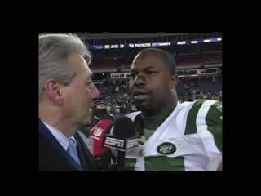

Slide 6


Slide 7
During Legislative Session

Slide 8


Slide 9
After Legislative Session…

Slide 10


Slide 11
QUIZ

Slide 12
Quiz
The first person to yell the answer… WINS!
Ready…

Slide 13
Who is Chair of House Consumer and Human Resources Committee?

Slide 14
Who is Chair of House Consumer and Human Resources Committee?
Answer:
Ch. Clark Boyd!

Slide 15
How many subcommittees are there under House Consumer/HR Committee?

Slide 16
How many subcommittees are there under House Consumer/HR Committee?
Answer:
Two:
Employee Affairs Subcommittee
Consumer Subcommittee

Slide 17
Bills That Became Law

Slide 18
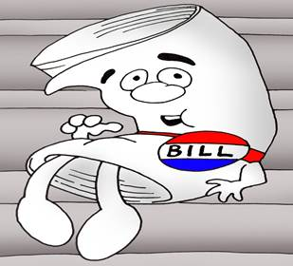
SB 466-Roberts HB 539-Howell (PC337)
SUMMARY:
Requires consideration of the 20-factor test in IRS Revenue Ruling 87-41 to determine whether an employer-employee relationship exists in certain employment arrangements.

Slide 19
SB 466-Roberts HB 539-Howell (PC337)
The final amended version of this bill (Amendment #6048 by Boyd) removes references to the workers’ compensation law, retaining the present 7- factor test specified under the Workers' Compensation Law for determining whether a person is an employee or contractor for workers’ compensation purposes.

Slide 20
SB 466-Roberts HB 539-Howell (PC337)
New 20-factor test applies to:
wage regulations
TOSHA
unemployment insurance
drug-free workplace
NOT WORKERS’ COMP

Slide 21
SB 466-Roberts HB 539-Howell (PC337)
Governor Lee signed Public Chapter 337 into law on May 10, 2019
becomes effective January 1, 2020

Slide 22
OTHER WORKERS’ COMPENSATION LEGISLATION THAT BECAME LAW- 2019

Slide 23
SB1442 by Bailey HB0316 by Hicks
Creates a presumption that certain conditions or impairments of full-time firefighters caused by certain cancers occurred in the course of employment unless the contrary is shown by competent medical evidence.
Gov. Lee signed P.C. 490 into law on May 24, 2019 and it becomes effective July 1, 2019.

Slide 24
Firefighter cancer presumption:
Must:
Be a full-time paid firefighter
Have pre-employment and annual cancer screenings
Have at least 5 years of service as firefighter
Must have been exposed to heat, smoke, chemicals, etc.

Slide 25
SB0312 by Watson HB0389 by Helton
Prohibits a medical review officer from considering prescriptions issued more than six months prior to a positive confirmed drug result for purposes of determining a valid prescription and immunity from actions authorized for employers to take against employees and job applicants following such a result.
Governor Lee signed Public Chapter 373 into law on May 10, 2019, and it became effective upon signing.

Slide 26
SB1259 by Gresham HB0740 by White
Work-based learning: Requires local school system to provide student accident insurance for volunteer interns.
Governor Lee signed Public Chapter 468 into law on May 24, 2019 and it becomes effective on July 1, 2019.

Slide 27
SB0663 by Watson HB0756 by Marsh
Removes safety improvement(s) required by a motor carrier from being considered when evaluating a person's status as an employee or independent contractor.
Governor Lee signed Public Chapter 97 into law on March 28, 2019, and it became effective upon signing.

Slide 28
The 2019 session of the 111th General Assembly adjourned on May 2, 2019, and will reconvene January 14, 2020, at 12:00 noon.

Slide 29
Bills Deferred to January 2020:
SB0029 by Haile/HB0384 by Weaver
Extends compensation for death of emergency responders to emergency medical technicians and paramedics.

Slide 30
Bills Deferred to January 2020:
SB0200 by Briggs/HB0780 by Ramsey
Creates a presumption that a firefighter or EMT diagnosed with post-traumatic stress disorder (PTSD) sustained the injury in the line of duty for purposes of workers' compensation.

Slide 31

Bills Deferred to January 2020:
SB0572 by Dickerson/HB1011 by Terry
"Tennessee Agricultural Medicine Act”
Status: Action “rolled” to January 2020.
Note: This was the main piece of medical cannabis legislation in 2019. Several bills were combined by various sponsors. None of the medical cannabis bills moved beyond the committee process to a floor vote.

Slide 32
Bills Deferred to January 2020:
SB1169 by Swann/HB0753 by Smith
Telehealth: Provides that a health insurance entity must provide coverage under a health insurance policy or contract for covered healthcare services delivered through facility-based telehealth or provider-based telehealth without any distinction or consideration of the geographic location.

Slide 33
Questions??

Slide 34


See you back next year!!!

Slide 35
Thank you!

