Slide 1
Stay-At-Work
Return-to-Work
Keys to Reducing Workers’ Compensation Injury Costs
Presenters: Dan Headrick, PT, CEAS III, ASTYM, BS, Star Physical Therapy
Brian Holmes, TN Bureau of Workers’ Compensation

Slide 2
Stay-at-Work
Return-to-Work
Keys to reducing workers’ compensation injury costs.
Presenters: Dan Headrick, PT, CEAS III, ASTYM, BS Star Physical Therapy
Brian Holmes, TN Bureau of Workers’ Compensation
TN Workers Compensation Conference June 2019

Slide 3
Ellsberg Paradox
Stick with known situation, even if its bad for you.
Can’t embrace change
Aim low and settle for mediocre results
Other people’s expectations are not high enough

Slide 4
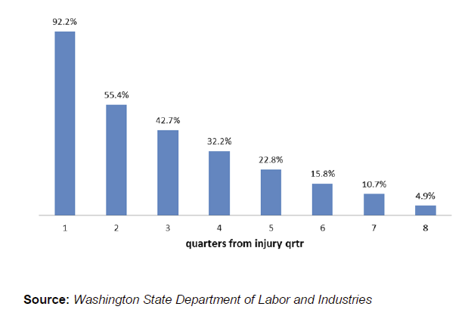
Probability of Return to Work, if not returned in previous quarter.

Slide 5
Statistics
As a result of changes to Social Security enacted in 1983, benefits are now expected to be payable in full on a timely basis until 2037, when the trust fund reserves are projected to become exhausted.¹ At the point where the reserves are used up, continuing taxes are expected to be enough to pay 76 percent of scheduled benefits. Thus, the Congress will need to make changes to the scheduled benefits and revenue sources for the program in the future.
The Social Security Board of Trustees project that changes equivalent to an immediate
reduction in benefits of about 13 percent, or an immediate
increase in the combined payroll tax rate from 12.4 percent to 14.4 percent, or some combination of these changes, would be sufficient to allow full payment of the scheduled benefits for the next 75 years.
Goss, Stephen C., “The Future Financial Status of the Social Security Program” Social Security Bulletin, Vol 70, No. 3, 2010

Slide 6
Statistics
2016
$301,039,000 SSDI paid to Tennesseans
$1,140.86 average per month per disabled worker
31.7% because of a musculoskeletal injury.
Social Security Administration

Slide 7

Statistics
2016
$301,039,000 SSDI paid to Tennesseans
301 times what Dr. Evil wanted
in exchange for not blowing up the world

Slide 8
Statistics
2016
$301,039,000 SSDI paid to Tennesseans
$1,140.86 average per month per disabled worker
31.7% because of a musculoskeletal injury.
Social Security Administration

Slide 9

Statistics
$1,140.86 average per month per disabled worker
Minimum wage
$7.25 x 40 hours x 4.3 weeks = $1247 per month

Slide 10
Statistics
2016
$301,039,000 SSDI paid to Tennesseans
$1,140.86 average per month per disabled worker
31.7% are disabled because of a musculoskeletal injury.
Social Security Administration

Slide 11
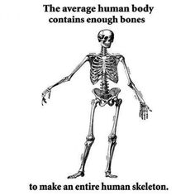
Statistics
2015-2017 Tennessee
                282,691 First Reports of Injury,
                98,764 musculoskeletal injuries
                35%
                12 per every 1,000 employees
TN Bureau of Workers’ Compensation

Slide 12
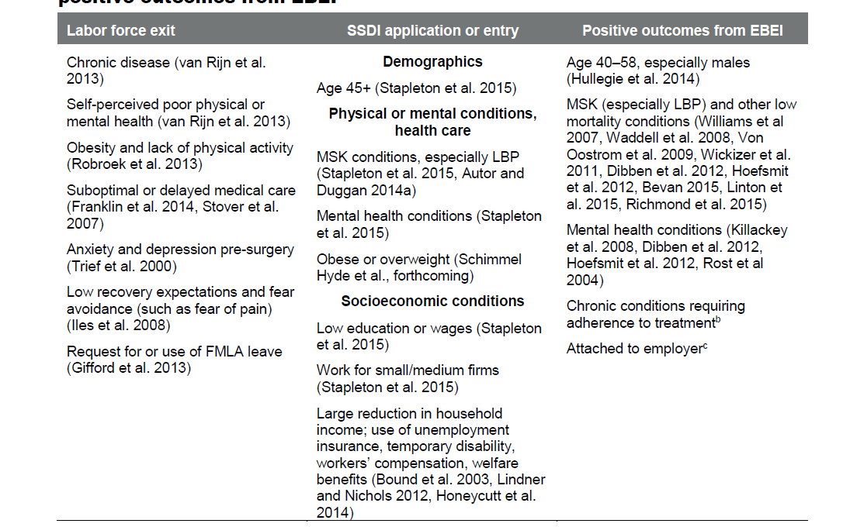
Mathematica “Targeting Early Interventions to Workers Who Need Help To Stay in the Labor Force.” October 2015

Slide 13

Statistics
People who work are….
Happier, with a better quality of life
Socially Engaged
Less likely to use pain relieving drugs
Less likely to utilize lifetime medical benefits
“its what the experts say”

Slide 14

Statistics
Workers’ Compensation Research Institute
  Compared Workers’ Compensation Outcomes across 15 states
    2017 survey of 1600 permanent partial disability benefit recipients from 2011-2014

Slide 15
Statistics
Of the injured workers with more than 7 days lost time:
  15% reported they did not have substantial work* because of the work injury within the last 3 years.
  18% reported they did not have substantial work within the same year.
  Median reported substantial return to work at 11 weeks post-injury
    8% reported earning a lot less after their work injury
    * substantial work is a work period for 30 consecutive days.

Slide 16

What am I supposed to do now?

Slide 17
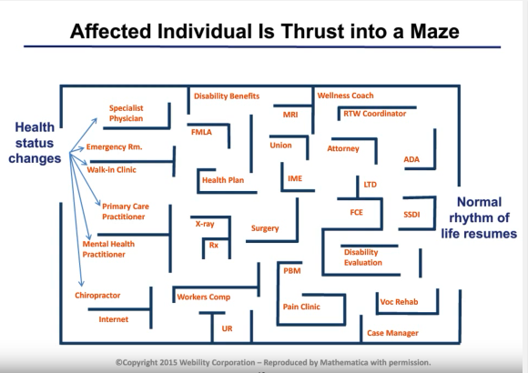

Slide 18


Avoid the Cliff

Slide 19

Post-Claim Cost Reduction Strategies
Stay At Work and Return To Work Programs

Slide 20
Objectives
1) Identify the difference between a job description and job demands analysis
2) Identify applications of job demands analysis for post claim cases
3) Identify the difference between job demands analysis and ergonomic analysis
4) Site the role of job demands analysis and transitional work programs
5) Identify the monetary value of injured stay at work employees

Slide 21



Dan Headrick PT, CEAS III, ASTYM, BS
Physical Therapist since 1992
Level I, and III Certified Ergonomic Assessment Specialist
Married for 27 years to college sweetheart
Two fantastic adulting children... and one cute rescue
Sunday school teacher, youth volunteer, lay speaker
Basketball nut-especially UT Vols and WSU Shockers
Love to fish
Taught Functional Capacity Evaluation courses at TSU and to CM
Presenter at BAMA , MSWCA, State Of Tennessee Worker’s Comp Physician Conference, Tennessee Health and Safety Conference, and State Of Tennessee State Worker’s Comp Conference
SHRM certified CEU provider for 2018-2020
JDAs at over 17 industries
Joshua 1:9 "Be Strong and courageous. Do not be afraid or discouraged, for the Lord your God will be with you wherever you go."

Slide 22


What do you think?
What are your frustrations with worker’s comp?
What are your frustrations with return to work decisions?
What kind of JDAs do you have?
What kind of injury prevention program do you have?
What is the monetary value of stay at work versus off work?

Slide 23


Best Practices
Post-Claim
Pre-Claim
FFD/FCE
JDA/EA
RW/SW
JC/WC
POETS
JDA/EA
MI
HC
Job Analysis
Job Analysis

Slide 24
Best Practices
Post-Claim
Job Demands Analysis (JDA)
Ergonomic Analysis (EA)
Fitness For Duty (FFD). Functional Capacity Evaluations (FCE)
Return To Work, Stay At Work (RW/SW)
Job Coaching (JC)/Work Conditioning (WC)
FFD/FCE
JDA/EA
RW/SW
JC/WC
Job Analysis

Slide 25

Job Analysis
Job Demands Analysis
Ergonomic Analysis

Slide 26

What HR says to me when I ask for a Job Demands Analysis
Degrees-not angular
Values
Drugs
Is this ADA, Worker’s Comp, or EEOC?
Work well with others
Is that PT really EEOC in disguise?
Our insurance company takes care of all of that!
  Any insurance company only makes money if claims are generated
  Any employer loses money when claims are generated
Physical Demands
  Yes! We have one line that says “must be able to lift 50lbs”.
  Yes, we have a Job Demands Analysis
  Ours are out of date
  We have one for the whole company
Job Description?
What is a Job Demands Analysis?

Slide 27
Job Description Versus Job Demands Analysis
Job Description
Job Demands Analysis
Human Resources Type
Education
Experience
Computer Skill
Technical Skill
Certification Requirements
Getting Along Well With Others
ODAA
Tells Little To Nothing Of Physical Requirements Of Job Tasks
Physical Demands Of The Job
Dictionary Of Occupational Titles Physical Demand Levels
Defined Frequencies And Duration Of Tasks
Defined Essential and Marginal Physical Functions And Job Functions
Allows For POETS, FFD, and Modification
Does not replace HR job description
Cornerstone for compliant RTW decisions by employer

Slide 28


Job Demands Analysis (JDA)
Cornerstone for RTW, Stay At Work (Post-Claim), and Safe Placement Decisions (Pre-Claim)
Narrative of job tasks and essential/marginal functions
  Interview of incumbents and supervisors
Physical tasks associated with the essential and marginal functions of the job
Production Demands
Categorization of the job tasks according to Dictionary Of Occupational Titles, and/or other defined references
Easy To Read?

Slide 29
Dictionary Of Occupational Titles (DOT), FCE Processes-Blankenship, Matheson
Material Handling (MH)
 | Sedentary | Light | Light/Medium | Medium | Med./Heavy | Heavy | Very heavy
Occasional (1-33% of day, <32 reps/day) | 10lbs | 20lbs | 35lbs | 50lbs | 75lbs | 100lbs | >100lbs
Frequent (34-66% of day, 33-200 reps/day) | Neg. | 10lbs | 15lbs | 20lbs | 35lbs | 50lbs | >50lbs
Constant (67-100% of the day, >200 reps/day) | Neg. | 5lbs | 7lbs | 10lbs | 15lbs | 20lbs | >20lbs
Non-Material Handling (NMH)
Occasional = 1-33% of day, 1-100 reps | Frequent = 34-66% of day, 101-800 reps | Constant = 67-100% of day, >800 reps

Slide 30


EEOC Considerations-Employer/Evaluator Level
EEOC-Equality and Discrimination Enforcement
Health Professional -Essential Functions and Safety
Whether the reason the position exists is to perform that function
The number of other employees available to perform the function or among whom the performance of the function can be distributed
The degree of expertise or skill required to perform the function
The actual work experience of present or past employees in the job
The time spent performing a function
The consequences of not requiring that an employee to
perform a function
The terms of a collective bargaining agreement
EQUALITY, Fair Treatment, Discrimination
  To ensure that a test or selection procedure remains predictive of success in a job, employers should keep abreast of changes in job requirements and should update the test specifications or selection procedures accordingly.
Are the job’s physical demands of the essential and marginal functions safe for the physical demand level of the client?
Medical safety not EEOC concern
RTW or Pre-employment setting medical safety is the only concern

Slide 31
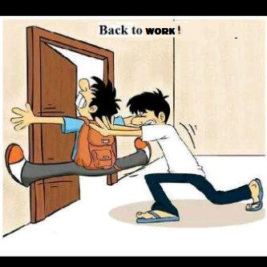
RW/SW Accommodative Process-4 Steps
Compliant-Employee Involvement
Non-Compliant
RW at same position
Modified duty in same position, with gradual written plan of RW to full duty
Temporary work in different position, with determination of RW ability to previous position
Re-assignment to another position, following documented proof of inability to perform same position
  ADA/EEOC regs state that an injured employee needs to be an Active participant in their stay at work and return to work process
  EEOC’s biggest concern is employees who could work essential functions are not being allowed, and with a medical injury, this could be discrimination under ADA
  To prove direct threat to employee and others BOTH the physical ability of the injured employee AND physical demands of the job are hallmarks of a compliant decision
100% RW or Fired
The Uniform Guidelines on Employee Selection Procedures states that a thorough job analysis is needed for supporting a selection procedure (see: 60-3.9 - No assumption of validity. Section B.)

Slide 32

Consequences of RW decisions without Accommodative Process
The EEOC recently filed a lawsuit against American Airlines and Envoy Air, its largest regional affiliate, alleging that the airlines had engaged in discrimination in violation of the Americans with Disabilities Act (“ADA”)- they illegally prohibited disabled employees from returning to work or transferring into other positions.
  100% Return To Work Without Restriction policy ignored the reasonable accommodation process within ADA
  Settled for 9.8 million dollars
The EEOC reported in a press release that Interstate Distributor Company, a trucking firm, agreed to pay $4.85 million to settle a lawsuit alleging pattern and practice violations of the Americans with Disabilities Act. The lawsuit, filed by the EEOC in a federal court in Colorado, claims Interstate maintained a “no restrictions” leave policy in which employees on leave were automatically terminated after exhausting 12 weeks of leave unless they were able to return to full-duty work without limitation. The lawsuit and sizeable settlement raises concerns for employers regarding potential liability arising from personnel policies. The EEOC’s position regarding leave policies is nothing new. The federal agency has long-held the position that employers must make an individualized determination for each employee that has exhausted a leave of absence as to whether the employee can return to work with or without reasonable accommodation for a disability
Without a JDA, how can INDIVIDUAL employment decisions be made-return to work or screening?
  Policies are a part of the defense but not all
  Accommodation process matters, and JDA is a part of that process

Slide 33

JDAs can relieve pressure
Healthcare Provider Role
Accommodation Process
Order/perform the JDA
Interpret restrictions as they relate to essential functions from JDA
Simulate work tasks clinically-work conditioning according to JDA
Over-see and teach during transitional work process
  Job Coaching of problematic job functions
  Reporting back to CM and MD
  Communicating with Safety
Which essential functions are an issue?
Which marginal functions are an issue?
If restrictions are permanent, can tasks be moved to another position without undue harm to business or other employees?
Can a transitional work program (graded exposure) improve an employee’s work tolerance?
With employee, gives some autonomy back to the employee, and is a cornerstone from the EEOC and ADA perspective

Slide 34

Bad JDA-Too Little
Physical Demands: operator must lift and carry up to 50 lbs
Physical Demands: operator must be able to meet the essential functions of the job
Physical Demands: employee must be able to lift 40lbs occasionally (and no definition of what occasionally means)

Slide 35
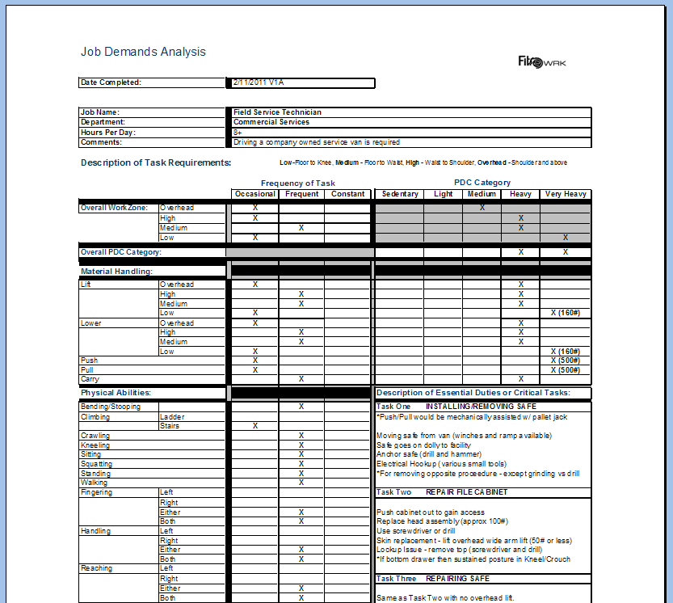
Bad Job Demands Analysis-Too Much

Slide 36
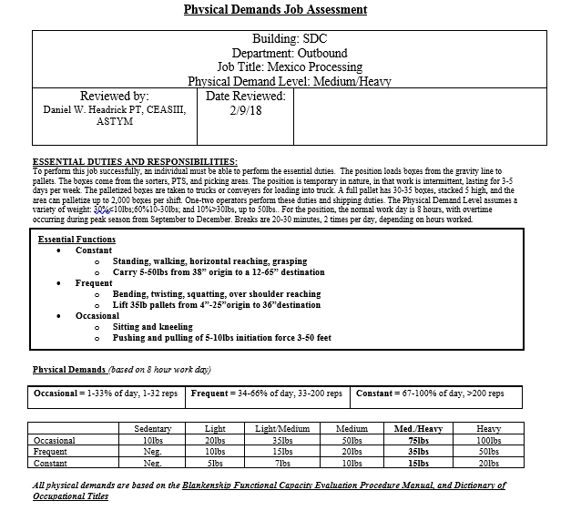
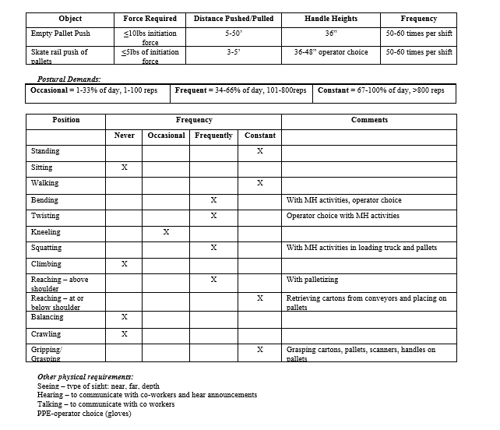
Good Job Demands Analysis

Slide 37
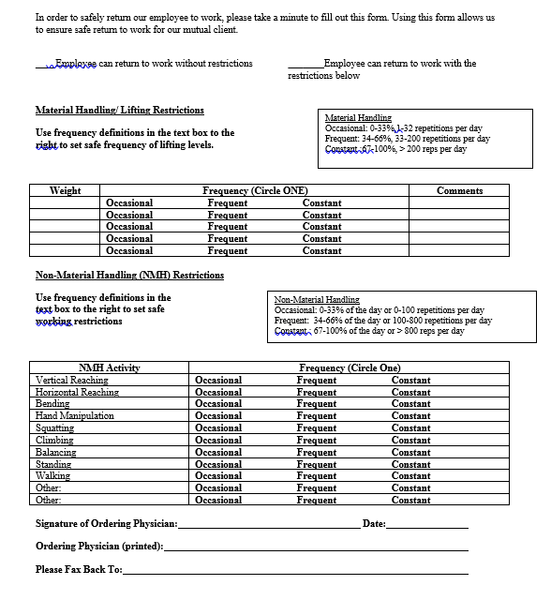
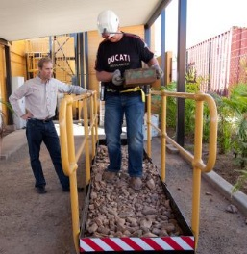

Application Of JDAs-A Bridge Between Health Care and the Workplace
JDAs as a part of a comprehensive program, have Predictive Value- Franche et al, a systemic review of literature related to workplace-based return to work interventions, concluded that there is strong evidence that work disability is reduced by work accommodation offers and contact between health care provider and the workplace

Slide 38


When and How To Get A Job Demands Analysis
When
How
Contact an ergonomically trained PT, OT, ATC, EP, PTA to do the JDA
Schedule a walk through
Review proposal and start
Post-Claim-at the beginning of the case to use at later stages of recovery process
  Do it with or without MD order
Pre Claim-as a part of a Injury Prevention Program
  No MD order needed

Slide 39
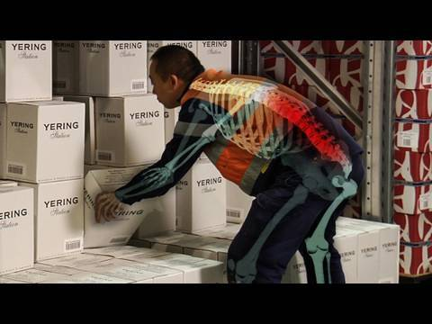
Ergonomic Analysis
Job or task specific rating of injury possibility
Rapid Entire Body Assessment (REBA)
Rapid Upper Limb Assessment (RULA)
NIOSH Lifting Index
WISHA Lifting Calculator
Index Score -Risk of Injury
Higher Scores Are Away from COG and Power Zones

Slide 40
EA Versus JDA
Ergonomic Analysis
Job Demands Analysis
Standardized public risk assessment tool
Used for risk mitigation
  NIOSH lifting scores of 2.0 or above have a higher incidence of LBP according to Waters et al
  1,728 nurses were followed and engineering controls were implemented to help with patient handling injuries. Overall, the eight facilities experienced decreases of 32% in all injuries, 62% in all lost work days, 6% in all restricted work days, and 55% in total workers’ compensation costs.
Index scored injury risk based upon body position, weight lifted, frequency of tasks, and couplings
  REBA, RULA, NIOSH Lifting Equation, WISHA Lifting Calculator
Gives a Physical Demand Level of The Job
Rates physical demands for work tasks-reaching, lifting, climbing, etc
Used for safe, compliant job placement following injury or in applicant stage

Slide 41
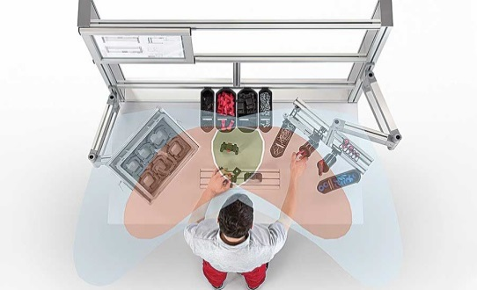

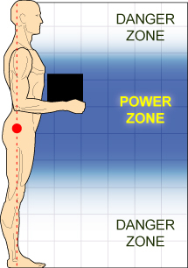
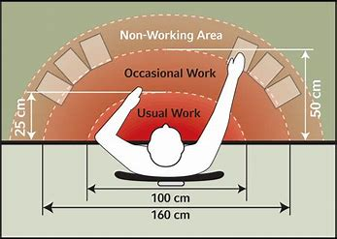
Ergonomic Job Design
Low Risk of Injury-$$$
Moderate Risk of Injury-Waste
High Risk of Injury-Waste

Slide 42
Work Conditioning and Transitional Work
WC
Transitional Work
Clinical Based
Fear Avoidance Assessment
Catastrophization Assessment
ROM, MMT, Posture, Functional Ability
Material Handling Ability
Non-Material Handling Ability
Weekly Assessments
Program that includes process based and work task based work task circuits
5 days/week, 4 hours per day
On-site at work
Based on JDA and MD restrictions
Identifies tasks that need to be transferred or modified
Job Coaching with employee on work technique
Written reports to MD, CM regarding tolerance
Work Conditioning may a part of this process
Goal is return to full job duties with time frame determined by ATP upon recommendation from PT/ATC/PTA
Why not let MD write work restrictions and go on?

Slide 43
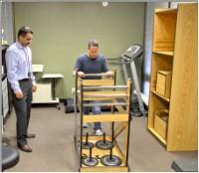

Functional Capacity Evaluation Versus Medical Evaluation for RW
Predictive Value FCE
Predictive Value Medical Assessment Only
Alberta WCB, 2 year historic cohort study
Isernhagen Work Systems FCE
246 exams, 226 with 1 year follow up data
4% passed all evaluation tasks (none re-injured)
  11 of 246 patients
Better performance on FCE correlated with INCREASED chance of re-injury with RTW
Overall low predictive value of re-injury
154 Chronic Pain Cases, comparing physician medical evaluation to predict sitting and standing tolerances to a capacity test
Expert physician prediction showed poor correlation (under rating the patient’s ability) to covertly observed sitting and standing tolerances, raising doubt about the validity of using physician evaluation to establish work restrictions in patients with chronic back pain
ADA and EEOC Compliance QUESTIONABLE with this method because Job Ability and Physical Demands of the Job have not been assessed

Slide 44
Non-Injured Work Capacity Tests Versus Injured Work Capacity Tests
Importance of Effort and “Want To”
Pre-Employment Work Capacity Tests
This paper summarizes a series of studies on the effectiveness of ergonomically based functional screening tests for post offer pre-placement of applicants for physically demanding jobs, and their relationship to reducing worker compensation injuries.
A meta-analysis “indicated that new-hires who passed the battery had a 47% lower worker compensation injury rate and 21% higher retention.”
Of the 175 pre/post-implementation studies indicated “a 41% reduction in worker compensation injuries associated with implementation of ergonomically based physical ability tests.”
WCT/FCEs are predictive of retention and less incidence of injury
Injured population at times does not want to return to work
  Poor co-worker and supervisor relationships
  Fear/Catastrophization
  Financial Incentive
1,440 Chronic Pain Disabled Patients, On Disability
Signed up for Functional Restoration Program, and allowed to quit if they wanted
1,137 completed the program
Completions-90% went back to work; and 81% were still at work a year later
WCT/FCE have their deficiencies, but the tests along with JDAs are a requirement in some form with the accommodations and selection process

Slide 45

Can We Afford Not To Bridge The Gap?

Slide 46
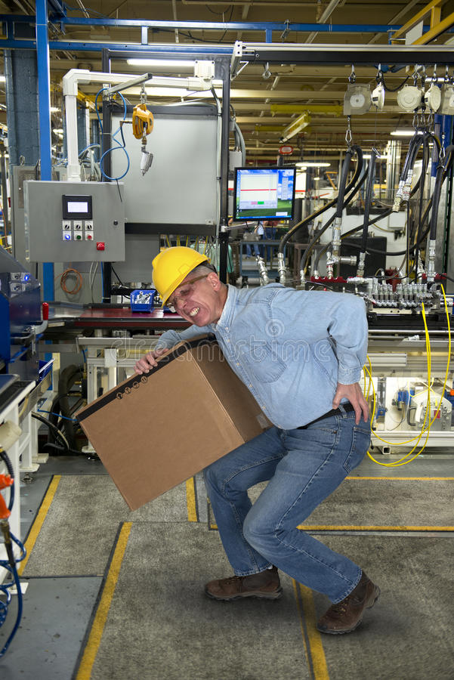
Bridging The Gap-Value of Stay At Work
Low Back Sprain, No Surgery (off work)
Direct Medical Costs | $7,217.00
Indemnity Costs | $8,115.00
Administrative Expense | $1,158.00
Total Cost | $16,490
Low Back Sprain, No Surgery (at work)
Direct Medical Costs | $2,856.00
Indemnity Costs | $0.00
Administrative Costs | $239.00
Total Cost | $3,095
Source: Office Of Disability Guidelines, review of 5 million work injury claims

Slide 47
Best Practices
Post-Claim
Pre-Claim
FFD/FCE
JDA/EA
RW/SW
JC/WC
POETS
JDA/EA
MI
HC
Job Analysis
Job Analysis

Slide 48

References
https://www.eeoc.gov//facts/ada17.html
http://www.franczek.com/frontcenter-EEOC_Settlement_ADA.html
https://www.mcmahonberger.com/eeoc-settles-disability-discrimination-lawsuit-over-100-return-to-work-leave-policy/
https://blogs.cdc.gov/niosh-science-blog/2008/09/22/lifting/
Guide to the Evaluation of Functional Ability-How to Request, Interpret, and Apply Functional Capacity Evaluations-Elizabeth Genovese, MD; Jill S. Galper, PT
Source: National Council on Compensation Insurance (2018). Average total incurred costs per claim by part of body, nature of injury, and cause of injury - Using the WCSP Data as of the 2nd report for accident years 2015-2016 and states where NCCI provides ratemaking services, excluding Texas.
ODG by MCG - https://www.youtube.com/watch?v=CyiuuhtlnJM&t=1s
Waters TR, et al Applications for the revised NIOSH lifting equation. DHHS (NIOSH) Pub.No.94-10. US Department of Health and Human Services, Centers for Disease Control and Prevention, NIOSH. Cincinnati, OH, 1994
Employers Must Begin Interactive Process for Return to Work Sooner Than Thought (12/4/2014). EEOC's Aaron Konopasky, JD and Jennifer Christian, MD Provide Guidance on When Employers Must Start Discussion Regarding Return to Work Accommodations
Sitting and standing tolerance in patients with chronic back pain: comparison between physician prediction and covert observation - Presented as a poster at the American Academy of Physical Medicine and Rehabilitation’s annual assembly, November 2002, Orlando, FL. Jason P Brokaw MD; William C Walker MD, David X Cifu MD, ^{and} Marie Gardner PhD
The Prognostic Value of Functional Capacity Evaluation in Patients with Chronic Low Back Pain, Part 2 Spine 2004; 29(8): 920-924 Gross, Battie, & Cassidy
FAILURE TO COMPLETE A FUNCTIONAL RESTORATION PROGRAM 5 FOR CHRONIC MUSCULOSKELETAL DISORDERS: A PROSPECTIVE ONE-YEAR OUTCOME STUDY Timothy Proctor, Ph.D.; Tom Mayer, MD; Brian Theodore, PHD Candidate, Robert J Gatchel Ph.D.
A study of the effectiveness of ergonomically-based functional screening tests and their relationship to reducing worker compensation injuries , Anderson and Briggs

Slide 49


Questions
Dan Headrick PT, CEAS III, ASTYM, BS
Physical Therapist, Level I and III Certified Ergonomic Assessment Specialist, ASTYM Certified
Industrial Specialist, STAR Physical Therapy
CP (615) 476-0037
E-mail Dan.Headrick@STARpt.com
Twitter:@DanHeadrickPT
Twitter:@starpt4u
Joshua 1:9 "Be Strong and courageous. Do not be afraid or discouraged, for the Lord your God will be with you wherever you go."

Slide 50

Connect permanently disabled injured workers with public institutions and monetary resources to acquire the knowledge, skills and abilities they need to return to meaningful employment.

Slide 51
Finding employment for people who lose their job because of their work injury.
1. Get a new job.
2. Obtain new skills to start a new career.

Slide 52

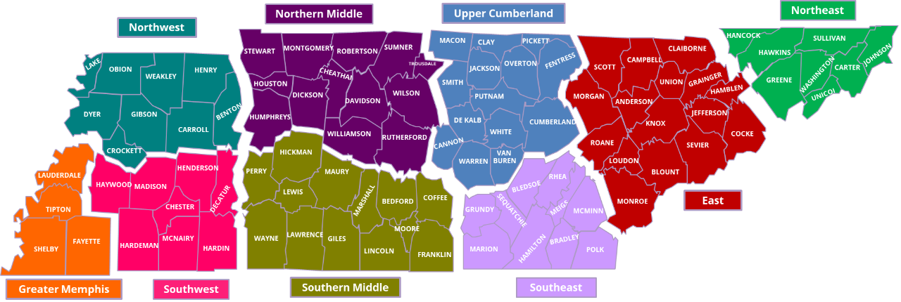

Slide 53
Free Access to computers, phones and fax machines
On-Site recruiting events
Resume writing workshops
Interviewing skills
Job Search
Training
Certifications
Career Coaches

Slide 54
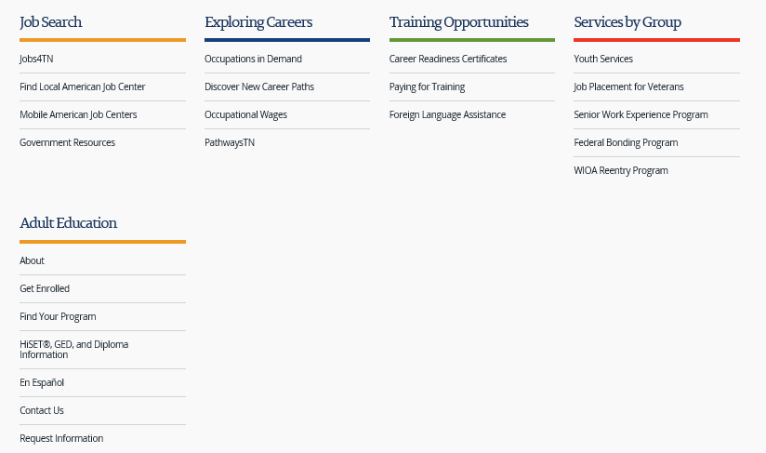
Jobs & Education

Slide 55
Jobs & Education

Slide 56

Job Search

Slide 57
Jobs & Education

Slide 58
Jobs & Education

Slide 59
Exploring Careers

Slide 60
Jobs & Education

Slide 61
Career Readiness Certificates
Reading for Information
Applied Mathematics
Locating Information

Slide 62
Career Readiness Certificates
Helps get past baseline applicant screening

Slide 63
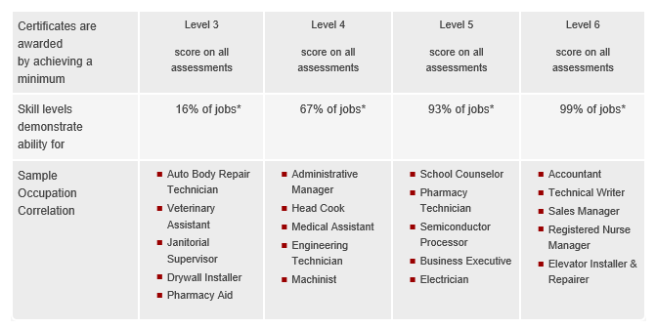
Career Readiness Certificates
Oklahoma Workforce Development

Slide 64
Career Readiness Certificates
Myworkkeys.com

Slide 65
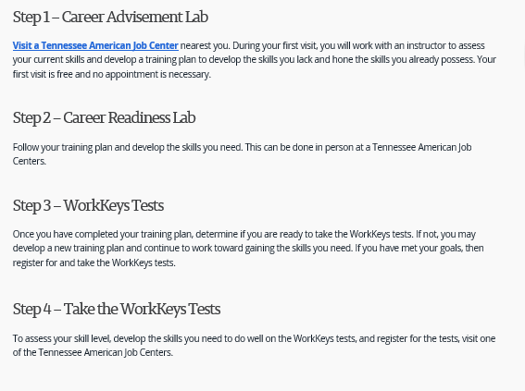
Career Readiness Certificates

Slide 66

Paying for Training
American Job Center Scholarships
  Workforce Investment Opportunities Act
SNAP Employment and Training
TN Student Assistance Corporation
  Hope, TN Promise, TN Reconnect
Registered Apprenticeships

Slide 67
Return to Work Assistance applies to all workplace injuries
Pre-MMI
Post-MMI

Slide 68
Scholarship applies to those who qualify
Injured after July 1, 2018
Permanent Impairment
Receive Resulting Award
Apply within 90 of receipt of payment

Slide 69
Fund Allocation Committee selection criteria
Likelihood of successful matriculation
Data from Jobs4TN and American Job Centers
In-Demand Careers

Slide 70
TN School of Choice
TN College of Applied Technology
TN Community College
TN University

Slide 71
Continued Services
Annual Enrollment
Up to $20,000.00
Follow-up 1 year after employment

Slide 72
Need Your Help
Communication
Enrollment
Encouragement

Slide 73
2019

