Slide 1
2018 Workers’ Compensation Benchmarking Study
Presenter: Anne Kirby, RN,, Chief Compliance Officer & VP of Care Management, Rising Medical Solutions

Slide 2
2018 WORK COMP BENCHMARKING STUDY
Advancing Medical Performance Management

Slide 3

ANNE KIRBY
Chief Compliance Officer & Vice President of Care Management
Rising Medical Solutions
Study Publisher Since 2013 Program Inception

Slide 4
Research Program Overview – Work Comp Benchmarking Study
IMPROVEMENT
POTENTIAL
COMPARE
BEST PRACTICES
LEADING
CLAIMS ORGANIZATION
Largest
Focuses
Validates
Provides
Advocates
survey of claims execs in the industry, 1800+ participants
on operational challenges, solutions & emerging trends
claims differentiators of higher performing orgs vs. lower performers
operations assessment tool for claims leadership
for claims management advancement in the industry

Slide 5
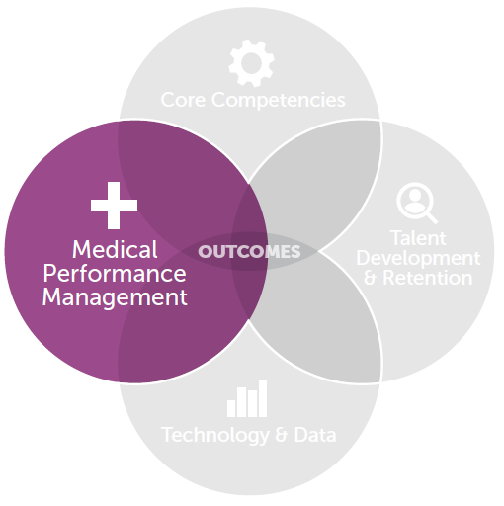

2018 Study Focus & Differences
Published in Dec 2018
Focused solely on Medical Performance Management
Utilized qualitative, focus group research with 40 claims & medical executives

Slide 6
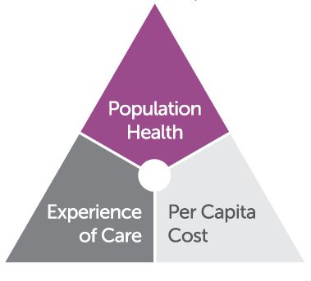
Solutions to the Medical Severity Dilemma
Institute for Health Improvement (IHI) Triple Aim

Slide 7
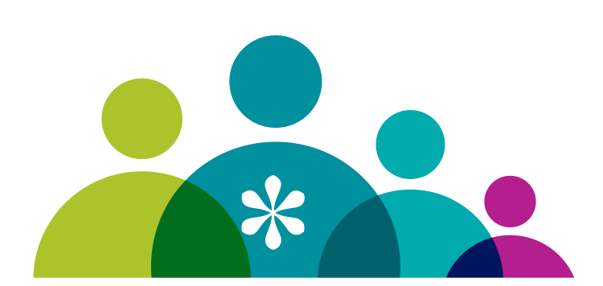
Incorporating Patient-Centered Outcomes
One large employer’s mission is for employees to be healthier post-injury than they were pre-injury.
Total Worker Health | Quality of Life | Functional Outcomes

Slide 8

Integrate Mental Health Programs into Med Mgmt Programs
Addressing a psychological component in a claim shouldn’t hold a negative stigma.
We don’t worry about if a psychological issues is compensable or not. If psychological treatment will get you better, we’ll get you better.

Slide 9

Reducing Frictional Delays in Claims Practices

Slide 10

Utilizing Universal Provider Scorecards

Slide 11

Employee Self-Reporting of Claims

Slide 12

Leveraging Data & Advanced Technology

Slide 13
Using Diverse Tools to Improve Stakeholder Communication

Slide 14
Advance a Culture of Advocacy Throughout Med Mgmt Programs

Slide 15

Key Take Aways
Not your mother’s medical management
Align & improve claim outcomes w/ Triple Aim principles
Integrate biopsychosocial & mental health resources
Enhance worker education & engagement
Measure what you say is important
EVOLVE
ALIGN
INTEGRATE
ENGAGE
MEASURE
Claims execs are shedding the confines of traditional thinking to offset continued growth of medical costs
Study confirms industry’s expansion into total worker health
Incorporate employee wellness
Enhance employer education around employee advocacy & communication
Integrate benefits delivery programs
Focus on outcomes management & best practices
Emphasize patient functional outcomes -- ranked as # 1 criterion for a good claims outcome in 2017 study
Leverage EAP programs, cognitive behavioral health, & mindfulness solutions as part of an integrated medical management strategy
Educate claims & medical management professionals about mental health conditions & solutions, as well as known & unconscious bias toward mental health issues
Arm workers to be educated health consumers
Educate them on role of evidence-based medicine & the critical function of stay-at-work / return-to-work in their recovery
Leverage telehealth, telephonic case management and/or technology solutions focused on consumer health education
Change success metrics from “volume” to value”
To truly drive program results focused on quality & outcomes, we must stop measuring success based on volume discounts & percentage of savings metrics
Patient-centered metrics must be incorporated, including satisfaction, improvements in function & productivity, & reduced total cost of risk

Slide 16
Q&A
Questions?

Slide 17
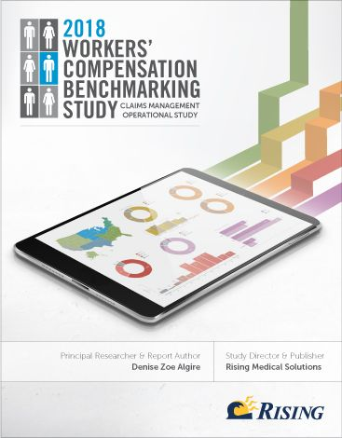
Closing
Copy Requests
2019 Study Focus
Surveying Frontline Staff for First Time Ever
Will compare frontline perspectives to the views of 1,800 past claims execs
Will validate operational alignment & highlight opportunities to advance the entire industry

Slide 18
Thank You
ANNE KIRBY
Chief Compliance Officer & Vice President of Care Management
Rising Medical Solutions
e: Anne.Kirby@RisingMS.com
t: 312.224.5937

