Slide 1
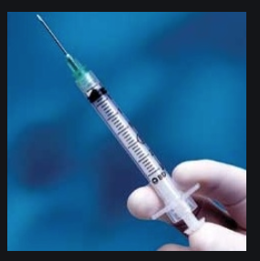
IPARDE Booster Shot
Susan Ragsdale, Managing Partner, Author,
Write Creations Group, Inc.
Terry Silver, Associate Professor, The University of Tennessee at Martin

Slide 2
1–2–3 Newbie Entrance
1: What is one impression you have about IPARDE?
2: What are two questions you have about IPARDE?
3: What are three words to describe previous IPARDE experiences?

Slide 3
IPARDE Word Sort Relay Race

Slide 4
Investigation: Analyzing community needs; assess participants interests/skills & talents
Preparation: Collaborating with community partners to create a service-learning plan that addresses identified needs and skills
Action: Engage in meaningful and creative activities that enhances learning and provides guided practice in social responsibility
Reflection: Communicate feelings, experiences and learning
Demonstration: Showcase service-learning experience
Evaluation: Assessing learning; identifying successes and areas of improvement

Slide 5
Investigation: Exploding the Issue
Notes:
Ask what they think a penny has on front side, then back side

Slide 6
Planning

Slide 7
Action Phase A–Z Round Robin
Notes:
Ask what they think a penny has on front side, then back side

Slide 8
Reflective Activities
Pre/During/Post Reflection 3, 2, 1
3 Words to Describe this IPARDE Experience
2 Things You are Still Curious About
1 Impression You have Now that You Did Not Have Before Workshop

Slide 9
Demonstration

Slide 10
Evaluation

Slide 11
3–2–1 Exit
3: What are three things you learned
2: What are two things you are still curious about or want to learn more?
1: What is one impression you have now that you didn’t have before?

Slide 12
Stay Connected
Website: www.WriteCreationsGroup.com
Facebook & Instagram: @WriteCreationsGroup
Twitter: @Write_Creations
Newsletter: sign up at www.WriteCreationsGroup.com
Contact: 615.262.9676/team@WriteCreationsGroup.com
YouTube: Ragsdale & Saylor https://www.youtube.com/channel/UCuBiIot9a7CJQT_wq0S5-Hg?view_as=subscriber

Slide 13
Great Group Reflections
60 Compelling Challenges to
Prompt Self-Discovery &
Critical Thinking

