Slide 1
Service Learning and Community Engagement:
A Solution for Meeting Community Needs
Department of Social Work
Ariana Postlethwait, MSW, Ph.D.
Carmelita l. Dotson, MSSW, LAPSW
Sasha fallon, MSW, LCSW, LAPSW
Penelope Storm, BSW Candidate

Slide 2
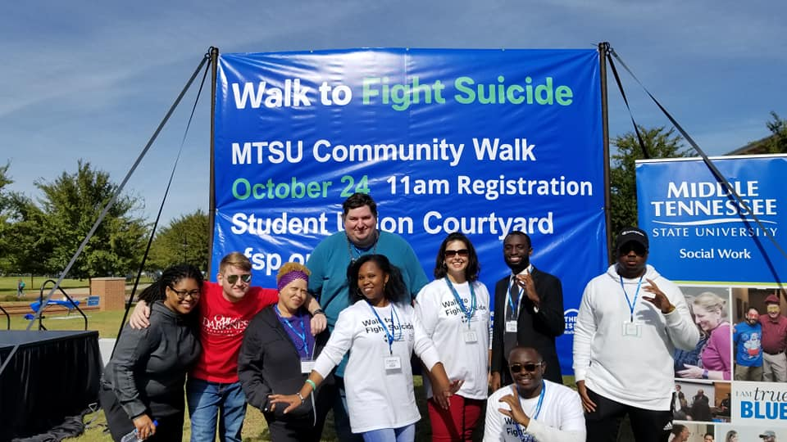
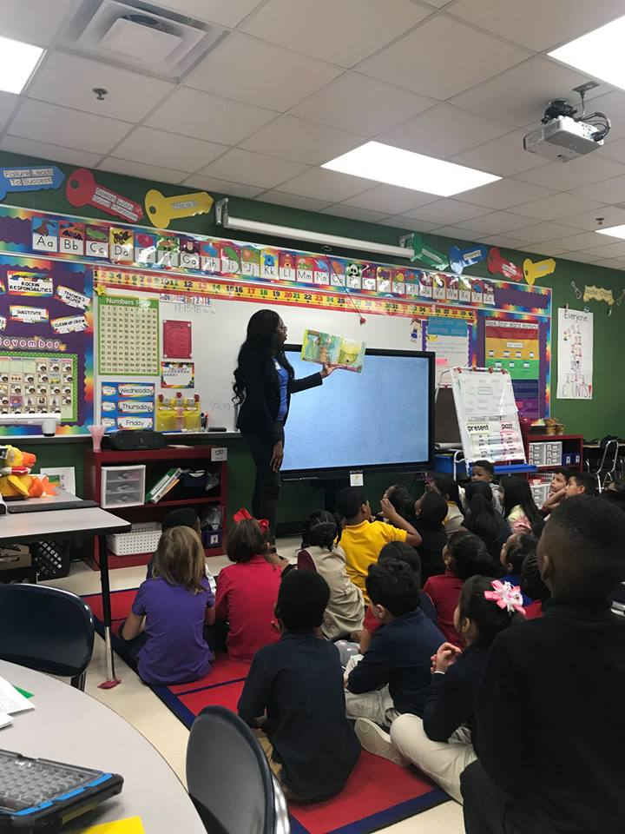
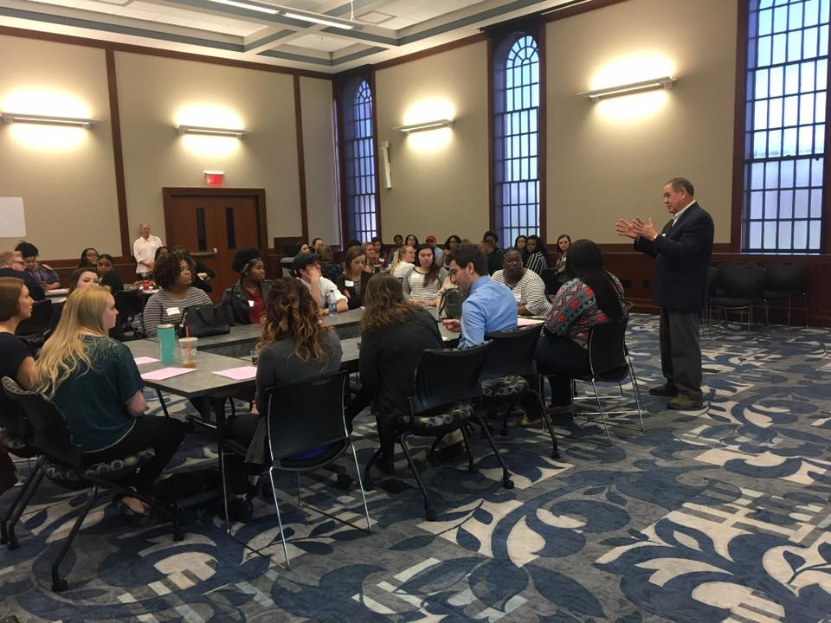
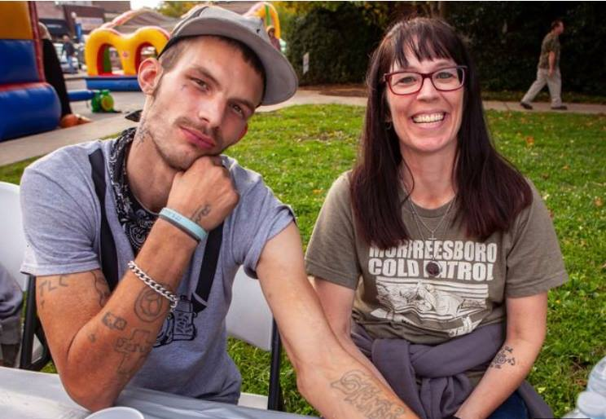
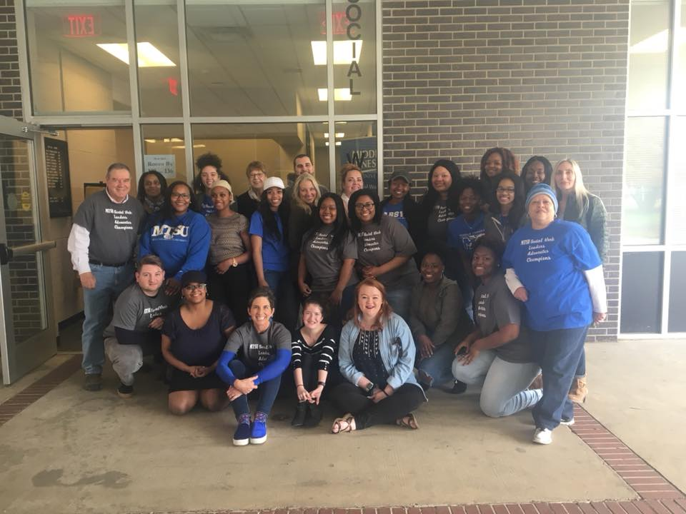
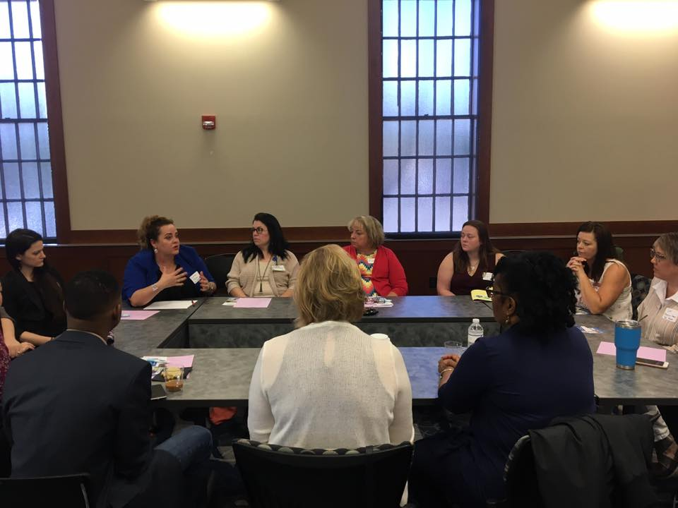
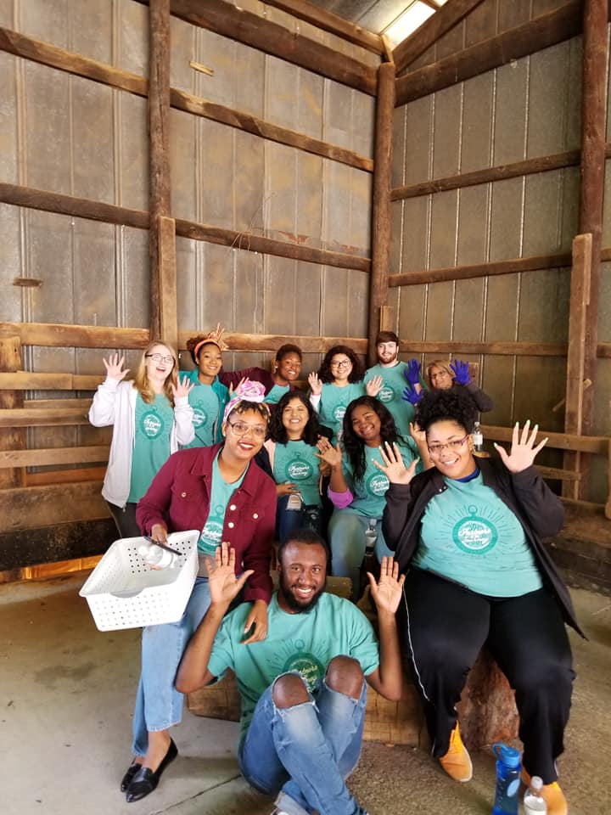
Welcome and Introduction

Slide 3

Agencies where students complete a social work internship

Slide 4
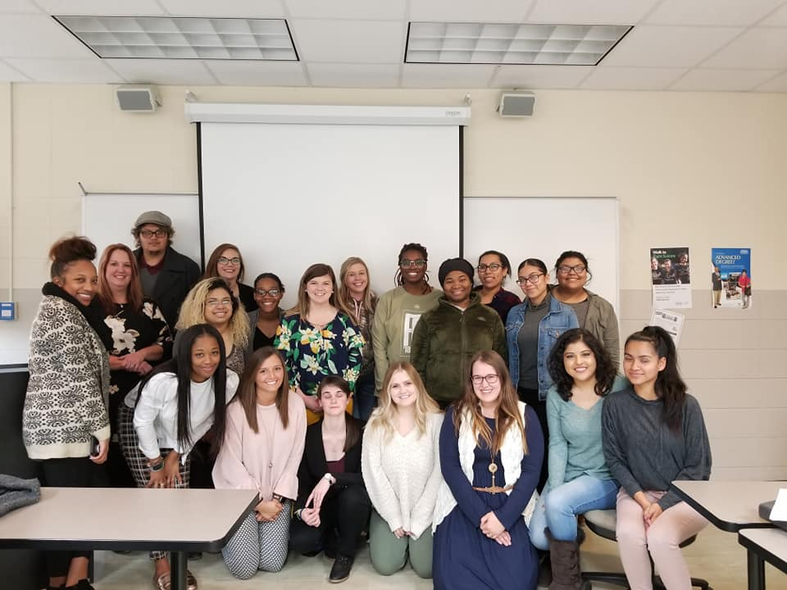
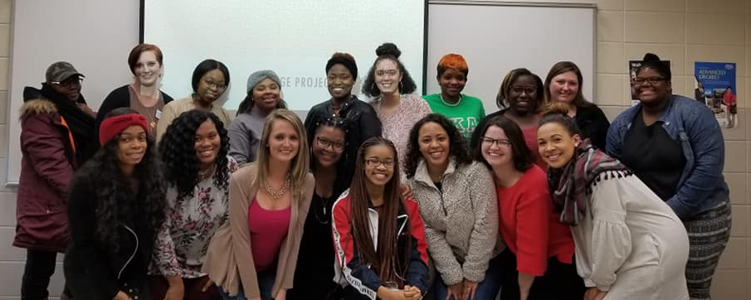
Social Work
Change
Projects

Slide 5
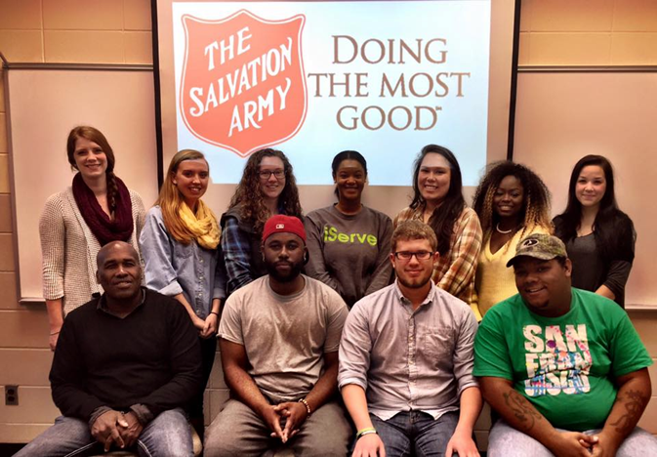
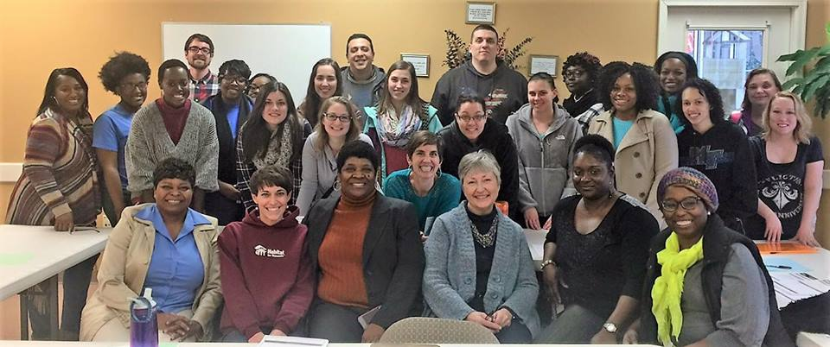

Data Analysis Projects

Slide 6
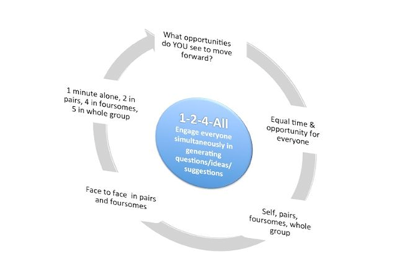
Liberating Structures (1-2-4-All exercise)

Slide 7

Access packet of resources at
https://drive.google.com/open?id=1hYIBshL07G-zX2S1hMARGqSM6tK9jUj2

