Slide 1
AmeriCorps & Disaster Services
Michael Rojas
9/11 Day of Service

Slide 2


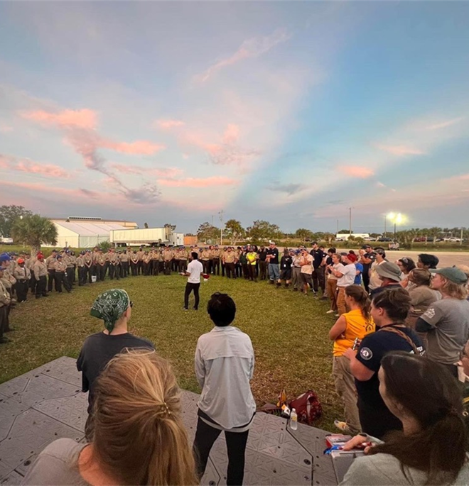
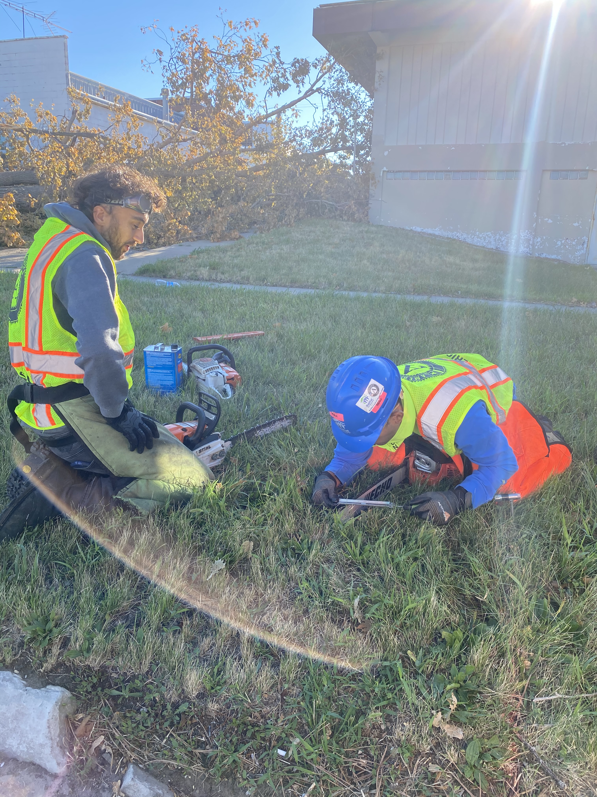
MICHAEL ROJAS
Habitat for Humanity of Iowa Mobile Response Team: AmeriCorps Member
2018 Marshalltown Tornado: Recovery Efforts
2019 Southwest Iowa Floods: Response
Habitat for Humanity of Iowa: County Coordinator
2020 COVID-19 Pandemic: Response - Liaison
Food Insecurity; Food Banks
2020 Derecho: Response
Incident Commander FEMA MA
Volunteer Iowa: Disaster Program Officer
2021 Nevada: GOTV – Liaison
2021 Hurricane Ida – New Jersey – Incident Commander
2022 Iowa Tornado March Response – Emergency Management Support & Coordination
2022 Missouri Flooding – Incident Commander
2022 Florida Hurricane Ian – Incident Commander
Governor`s Initiative

Slide 3
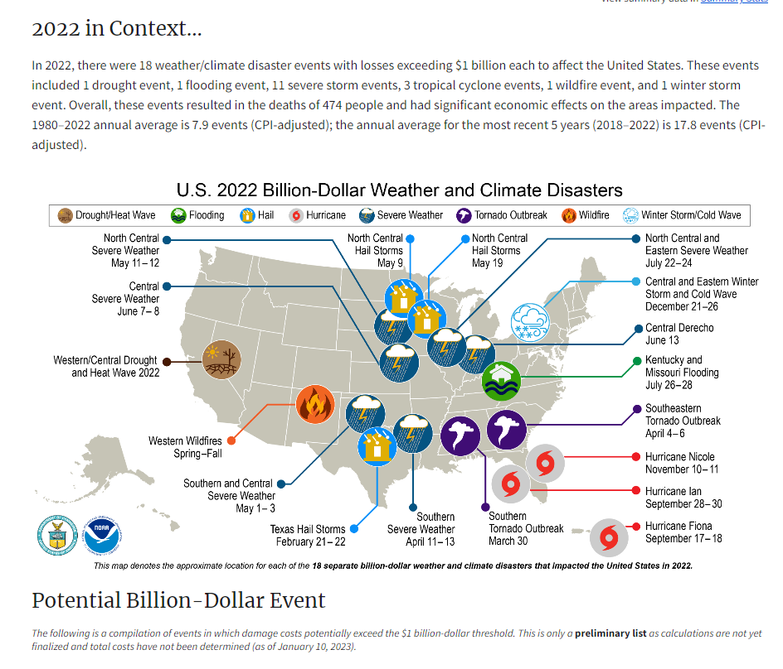
Breaking Records

Slide 4

4673DR-FL-CNCS-03: Initial Incident Command Structure
DSU FEMA MA Operations Manager
Me
AmeriCorps Disaster Cadre
A-DRT Incident Commander
Planning
VAL Support LNO
Logistics
Safety
Training
Operations
Strike Team 1
Strike Team 2
Strike Team 3
Strike Team 4

Slide 5
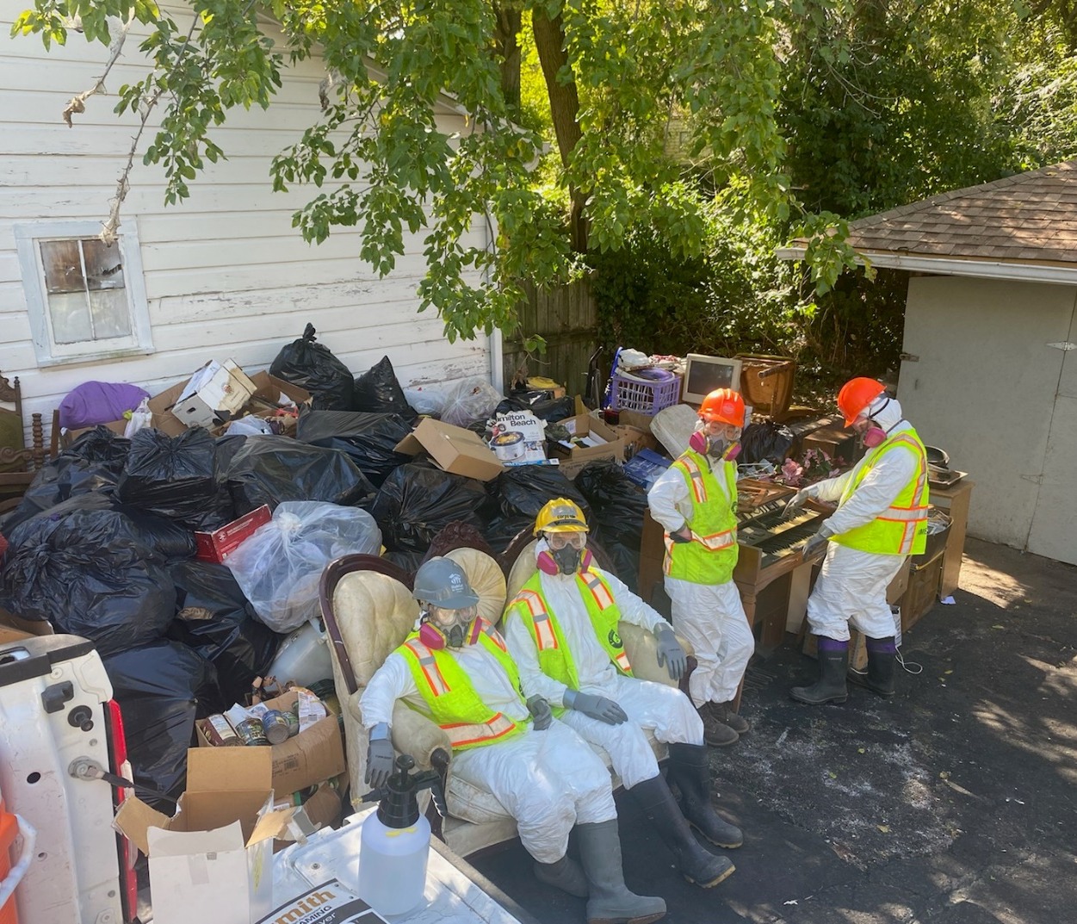
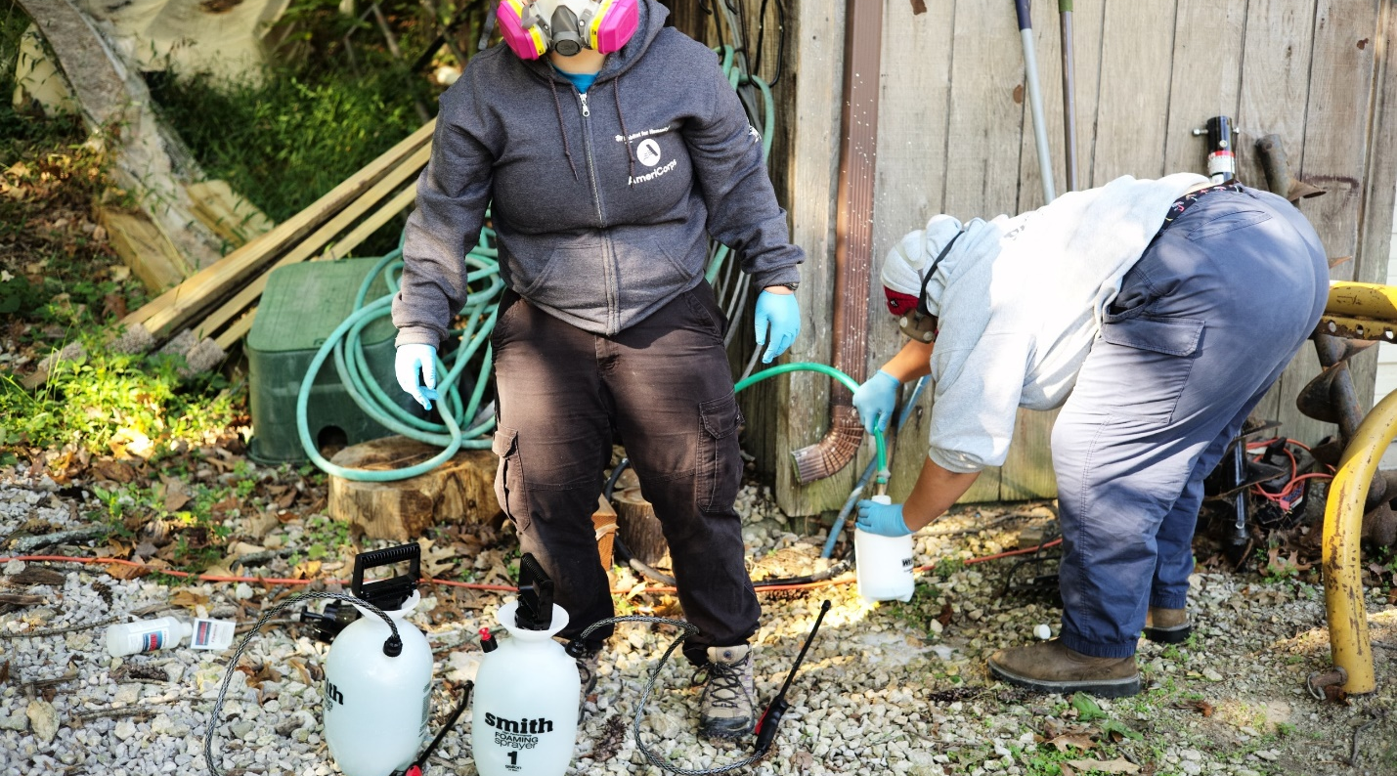
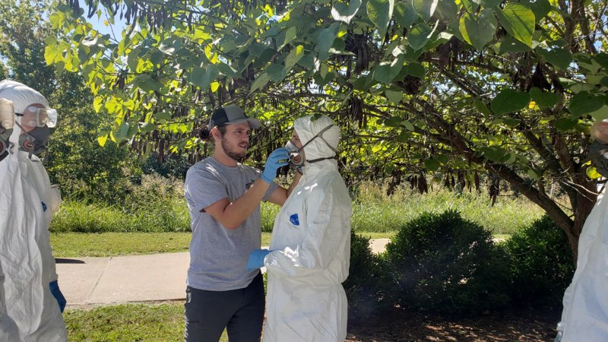
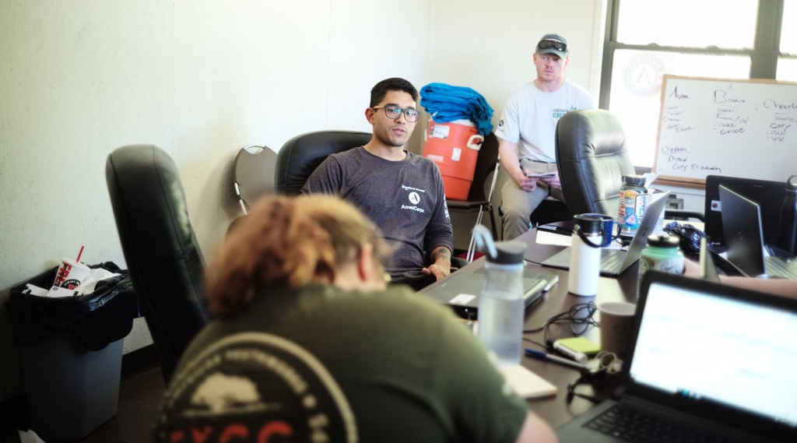

Slide 6
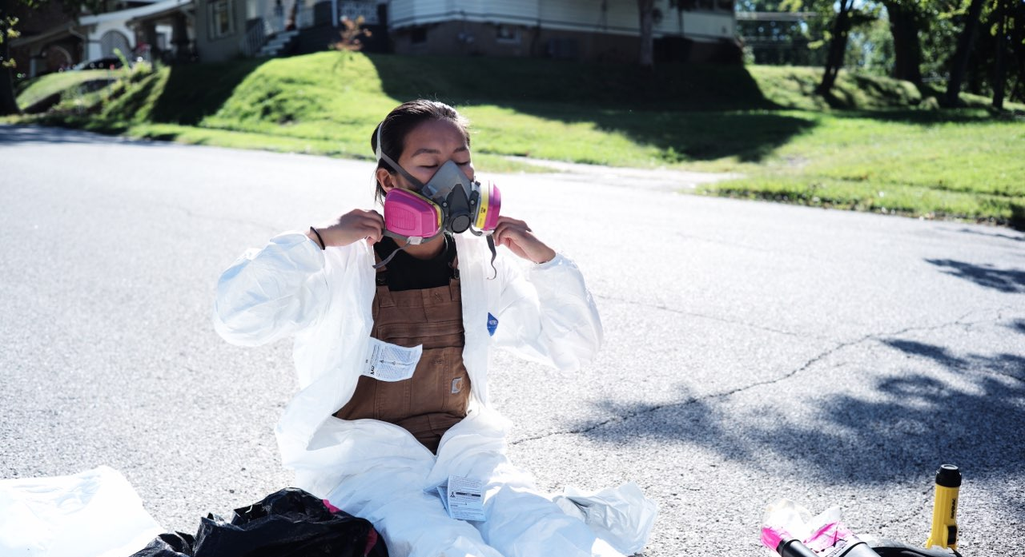

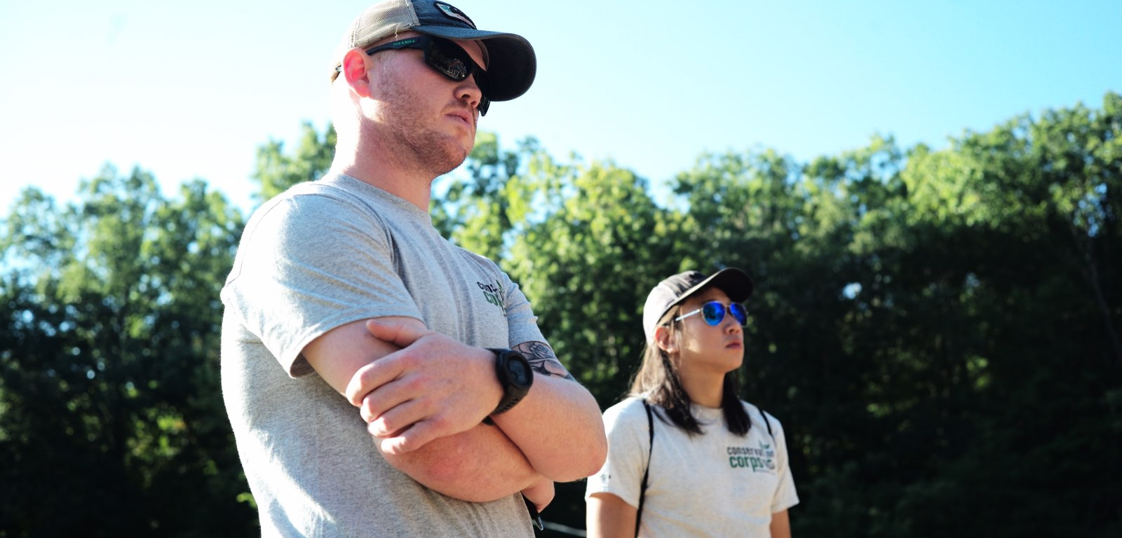
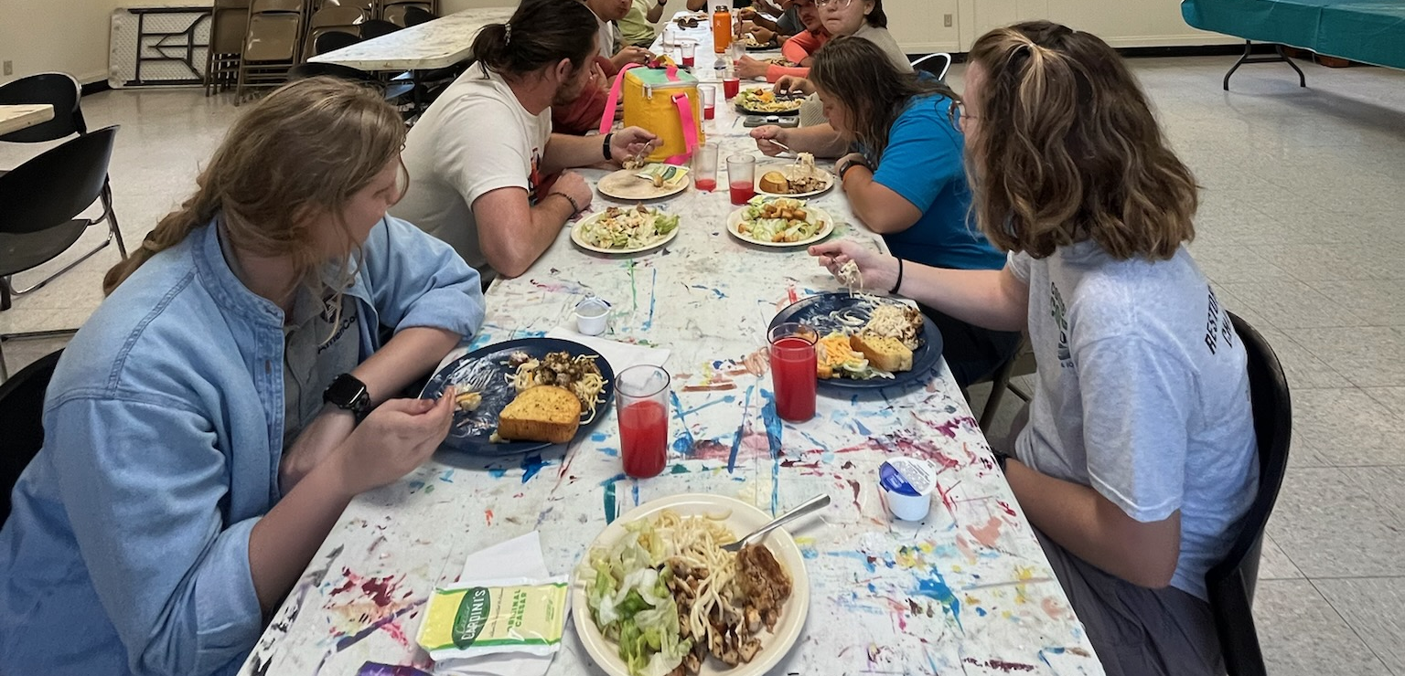

Slide 7
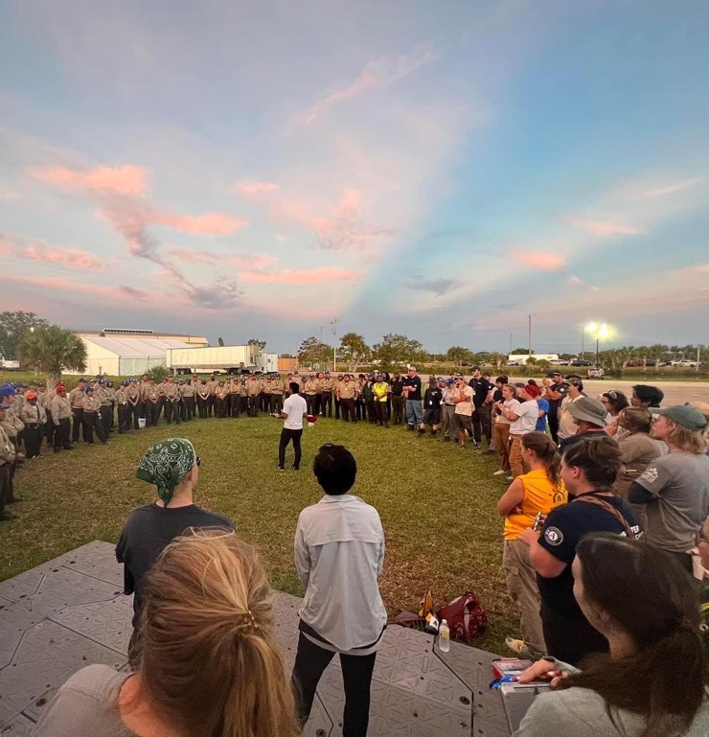
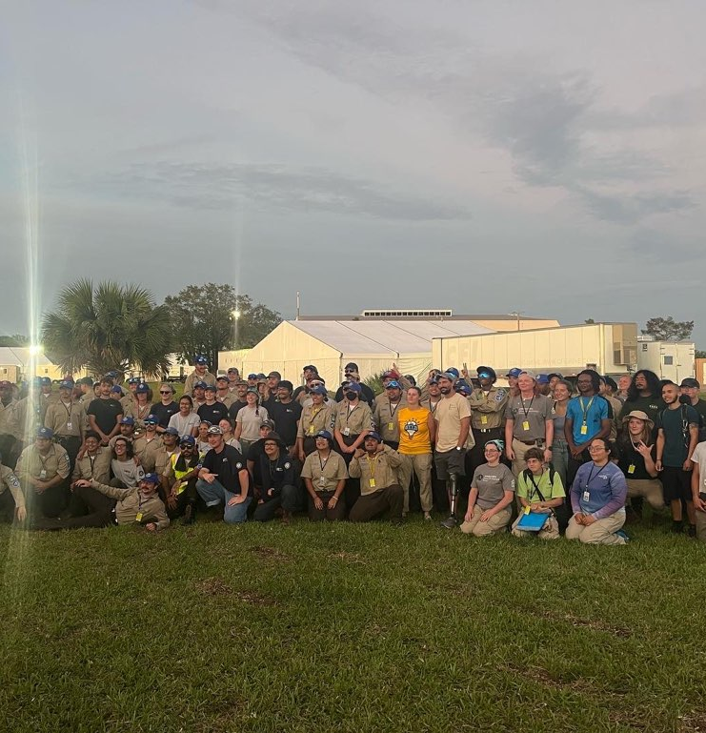

Slide 8
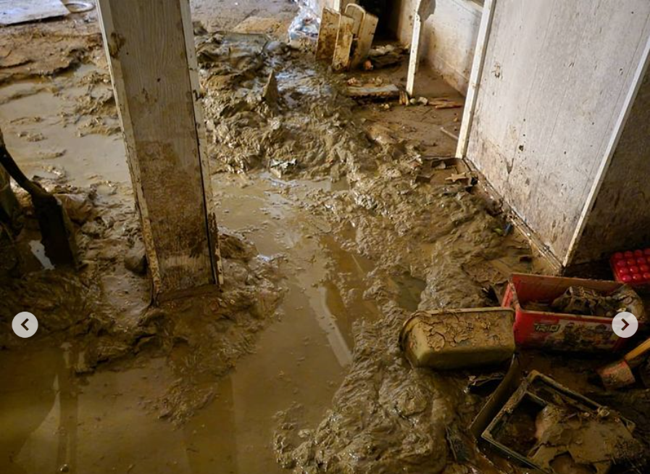
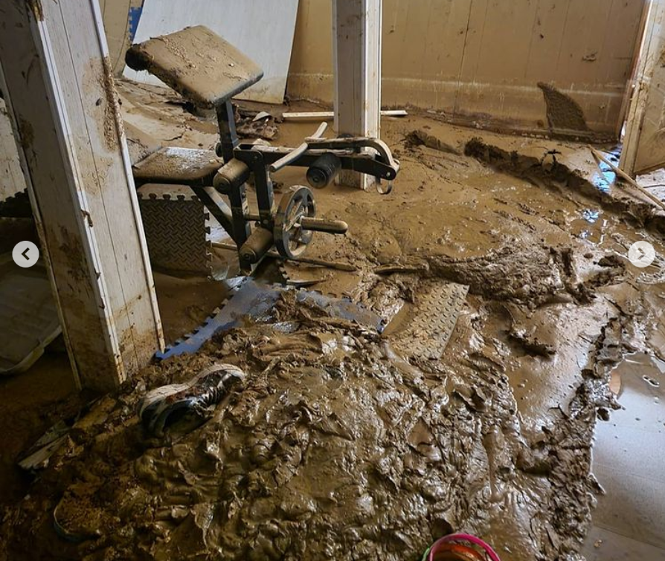
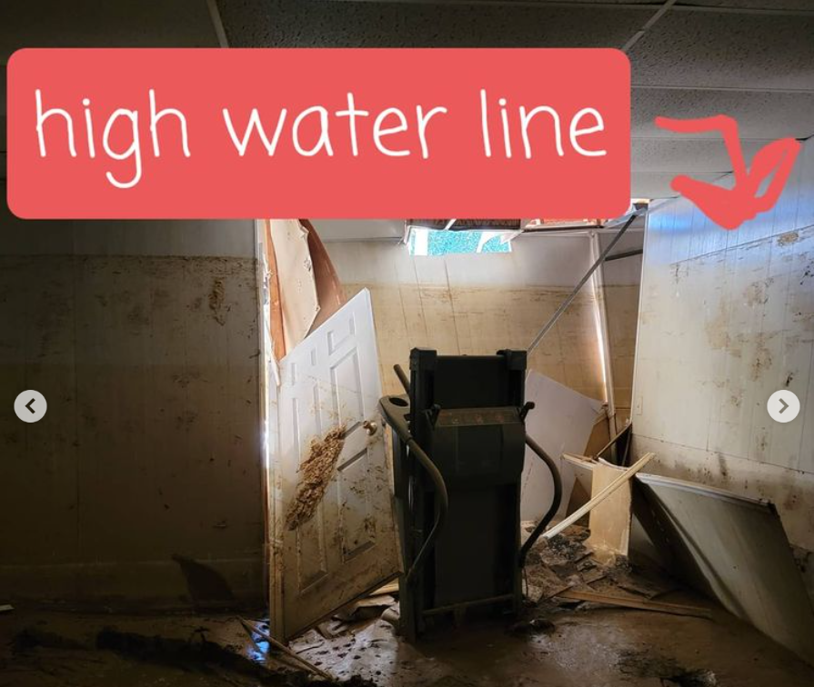
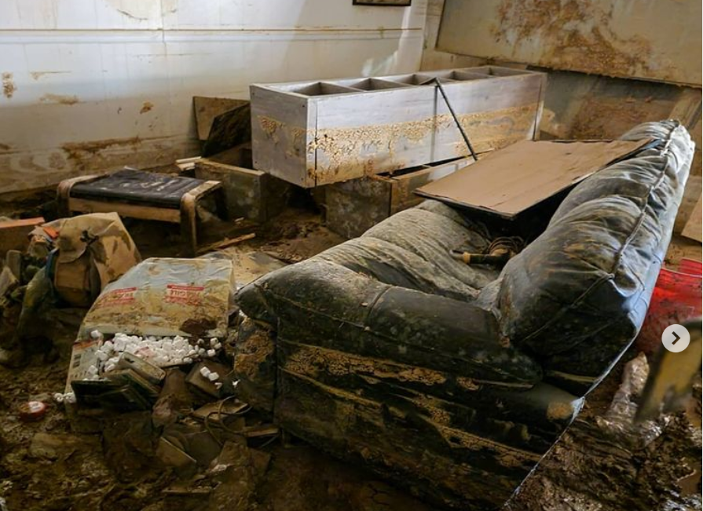
Before AmeriCorps Disaster Response Teams (A-DRT)
Hurricane Ida 2021

Slide 9
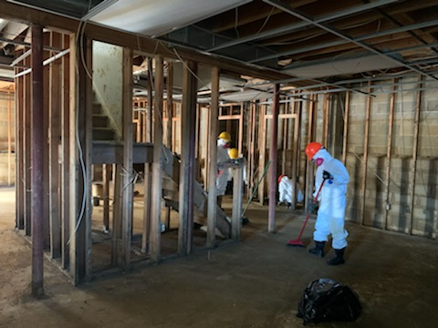
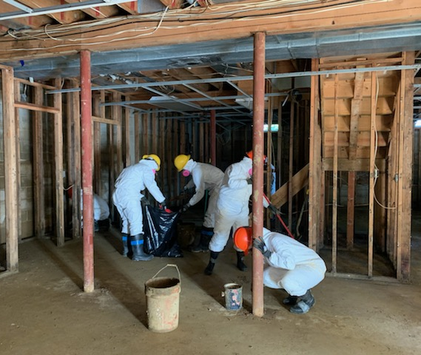
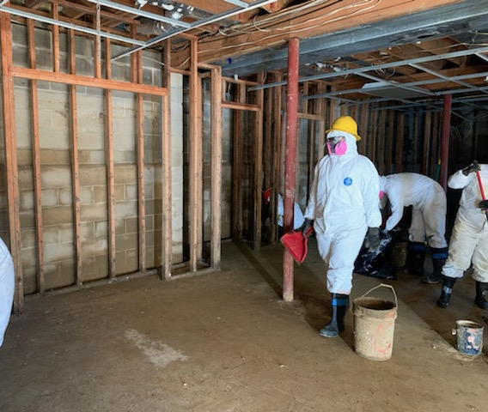
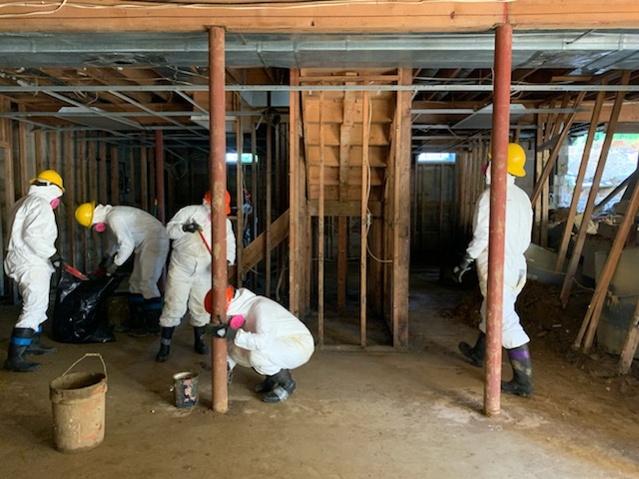
After AmeriCorps Disaster Response Teams (A-DRT)
Hurricane Ida 2021​
Notes:
Jumped in with a volunteer day with the NJ State police

Slide 10
Disaster Services Unit 101

Slide 11

AmeriCorps Disaster Services Unit
Maintain agency’s role as a leader in disaster services among federal partners
Increase capacity of communities to prepare for, mitigate, respond to, and recovery from disasters through agency programs
Committed to assist communities build disaster resilience
NOT a first responder agency
Supporting agency in the National Response Framework and National Disaster Recovery Framework

Slide 12
AmeriCorps Disaster Resources
A-DRT
AmeriCorps State and National
AmeriCorps NCCC
State Service Commissions
FEMA Corps
AmeriCorps Cadre
AmeriCorps Seniors
AmeriCorps VISTA

Slide 13
History of National Service in Disaster
1995 | OK City Bombing
2001 | September 11 Attacks
2005 | Hurricanes Katrina and Rita
2008 | Hurricanes Gustav and Ike; IA Floods
2009 | WV and KY Floods
2010 | Deepwater Horizon Oil Spill; MS Tornadoes; TN Floods
2011 | Joplin Tornado; AL Tornado Super Swarm
2012 | Hurricane Sandy
2013 | West, Texas Explosion; OK Tornadoes; Yukon River Flooding
2014 | Detroit Flood; Oso, WA Mudslide
2015 | Typhoon Soudelor (Saipan); TX and SC Floods; Western Wildfires
2016 | MO, TX, WV, LA Floods; Hurricane Matthew
2017 | Hurricanes Harvey, Irma, and Maria
2018 | TX Floods; Hurricanes Florence and Michael
2019 | Midwest Floods
2020 | Coronavirus Pandemic; Hurricanes Laura and Sally; Iowa Derecho
2021 | COVID-19 Vaccine Missions; Hurricane Ida
2022 | Hurricane Ian; NM Severe Weather
2023 | Typhoon Mawar; HI Wildfires

Slide 14



DSU Functions
Coordinates Disaster Services Strategy
Response Operational Command and Coordination
Technical Assistance and Training

Slide 15


Thank you!

Slide 16

Contact Info and
Additional Resources
Want More?
DSU can provide in depth trainings,
just email us to request
Contact Info: DSU@cns.gov
Additional Resources:
DSU SharePoint Site
DSU External Website
2021 Disaster Framework
At A Glance: National Service Assets sheet

