Slide 1



2026 AmeriCorps State Grant Information Session
Volunteer Tennessee
Notes:
Thank you for joining today's information session. Please introduce yourself in the chat and include your name, organization name, and number of years you have received VT AmeriCorps funding. If you have never had an AmeriCorps program funded by VT, just put 0.
While you introduce yourselves, I’ll go ahead and introduce myself and the team here at VT.
The purpose of this webinar is to review Volunteer Tennessee’s Notice of Funding Opportunity (NOFO) and Application Instructions. If you have not done so already, you may want to download the NOFO from Volunteer Tennessee’s website since we will reference it throughout the webinar. The intended audience is new and recompeting applicants for AmeriCorps funding.

Slide 2



Agenda Overview
National Service Overview
Volunteer Tennessee Overview
Is AmeriCorps Right for Your Agency?
2026 AmeriCorps State NOFO Application Process
Notes:
Today's session will introduce you to national service and Volunteer Tennessee. It will also help you determine if applying to FY26 NOFO to host an AmeriCorps program is a good fit for your agency, and how to apply.

Slide 3

House Keeping
Please put all questions in the chat and/or
Ask questions during designated Q&A times
Session is being recorded
Please stay muted except during Q+A
Notes:
Because there is a lot of information to cover today, when you have questions, please share them in the chat or wait until designated Q&A times so that we can keep the flow of this session moving.

Slide 4
National Service
Individuals, programs, agencies, and organizations involved in federal government sponsored community service and volunteerism
History
1933: President Franklin D. Roosevelt established the Civilian Conservation Corps (CCC)
1964: President Lyndon B. Johnson created VISTA to combat poverty
1992: National Civilian Community Corps (NCCC) is created as part of the 1993 Defense Authorization Act
1993: President Bill Clinton signs the National and Community Service Trust Act on September 21, creating AmeriCorps and the Corporation for National and Community Service
Notes:
AmeriCorps, like the Peace Corps, falls under the umbrella of National Service. Existing national service programs, which had been developed under several different administrations, were rolled into the AmeriCorps agency upon its creation in 1993.

Slide 5
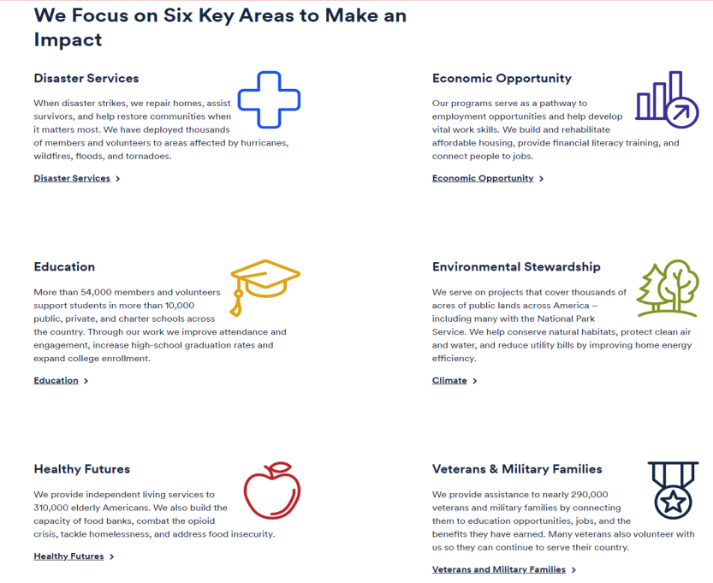
Notes:
The purpose of AmeriCorps funding is to provide resources to organizations proposing to engage AmeriCorps members in evidence-based or evidence-informed interventions to strengthen communities. AmeriCorps has identified six focus areas for national service: Disaster Services, Economic Opportunity, Education, Environmental Stewardship, Healthy Futures, and Veterans and Military Families.

Slide 6


AmeriCorps Programs
www.americorps.gov
AmeriCorps State and National
AmeriCorps VISTA
AmeriCorps NCCC
Foster Grandparents
Senior Companions
RSVP
Notes:
To make a difference in these focus areas, the AmeriCorps agency provides Americans with opportunities to serve by administering a number of programs. There are many different kinds of AmeriCorps programs, each with their own funding opportunity. This session focuses on AmeriCorps State grants. AmeriCorps State and National programs recruit, train, and place AmeriCorps members to meet critical community needs.
But this is just one type of AmeriCorps program. AmeriCorps VISTA provides full-time members to nonprofit, faith-based and other community organizations, and public agencies to create and expand programs that bring low-income individuals and communities out of poverty. Finally, AmeriCorps National Civilian Community Corps (or NCCC), is a full-time, team-based, residential program for men and women ages 18-24. Its mission is to strengthen communities and develop leaders through direct, team-based national and community service.
Senior Corps connects persons age 55 and up with the people and organizations that need them most and also consists of three programs. Foster Grandparents serve as role models, mentors, and friends to young people. Senior Companions provide help and support that allow help other adults remain independent in their homes instead of having to move to more costly institutional care. RSVP allows volunteers to use the skills and talents they’ve learned over the years, or develop new ones while serving in a variety of volunteer activities within their community.

Slide 7
Major Players
AmeriCorps agency
Regional Offices
State and territorial service commissions
What They Oversee
AmeriCorps agency: National Direct Grantees
Regional Offices: AmeriCorps NCCC, VISTA, and Seniors
State and territorial service commissions: State Subgrantees
Notes:
State Service Commissions provide AmeriCorps funding to AmeriCorps state programs through annual grant competitions. We work closely with the regional office and the AmeriCorps agency. State Service Commissions are also charged with encouraging volunteering in their states and often administer special volunteer initiatives. If you are interested in another type of AmeriCorps grant, you should refer to the program specific NOFO on the AmeriCorps.gov webpage or visit Volunteer Tennessee’s website for more information on how to get involved.

Slide 8
MISSION
To encourage volunteerism and community service.
VISION
The State of Tennessee is the national leader in the promotion of volunteerism, community service initiatives and partnerships in which its citizens of all ages and backgrounds engage in services addressing the educational, public safety, environmental and other human needs of the state and nation.
Notes:
Established in 1994, Volunteer Tennessee is the Governor’s Commission on Volunteering and Community Service. We are located in Nashville and oversee AmeriCorps State in Tennessee by directly managing grants that support single state programs and consulting with national programs that propose to operate in Tennessee.

Slide 9
Volunteer Tennessee Initiatives
www.volunteertennessee.net
AmeriCorps State
Volunteer Center and Youth Civic Engagement Grants
Tennessee Conference on Volunteerism and Service-Learning
Governor’s Volunteer Stars Awards
Tennessee Serves Volunteer Portal
Corporate Social Purpose Network
Community Emergency Response Teams Training
Notes:
Volunteer Tennessee currently oversees a portfolio of 16 AmeriCorps State programs and manages a Volunteer Center grant and Youth Civic Engagement grant. In addition to managing these grant programs, we provide training and professional development at our Tennessee Conference on Volunteerism and Service Learning which is coming up on Monday, March 9th. We also recognize outstanding volunteers, businesses, and nonprofits at the GVSA, coming up on March 8th. Finally, the Tennessee Serves portal connects volunteers to volunteer opportunities.
Please visit www.volunteertennessee.net to learn more about Volunteer Tennessee and its programs.

Slide 10

Examples from our Portfolio: CAC AmeriCorps
Knoxville Knox County Community Action Committee's AmeriCorps Program
Focus Area: Environmental Stewardship
Notes:
Let’s look at some examples of AmeriCorps programs currently in our portfolio:
The Knoxville Knox County Community Action Committee AmeriCorps Program addresses environmental and social needs in Knox, Blount, Anderson, and Sevier Counties by placing members at partner organizations to provide environmental education, improve public lands, and engage in capacity building activities. While members primarily serve at their assigned host site, the cohort model also convenes members for trainings and group service projects, encouraging members to build meaningful relationships with their community and each other.

Slide 11
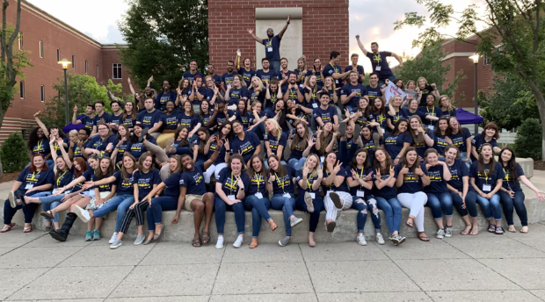
Examples from our Portfolio: Teach For America
Nashville-Chattanooga and Memphis
Professional Corps – training teachers in classrooms
Focus Area: Education
Notes:
Teach For America–Memphis equips members with the skills they need to lead the classroom during their two-year commitment with TFA-M and lead their community post-service.
As a professional corps, TFA members earn a salary from their employer (the school where they teach) instead of a living allowance. They are otherwise eligible for the same benefits previously described.
As a professional corps, TFA must show in their application that the community where it will place AmeriCorps
members has a shortage of teachers.

Slide 12
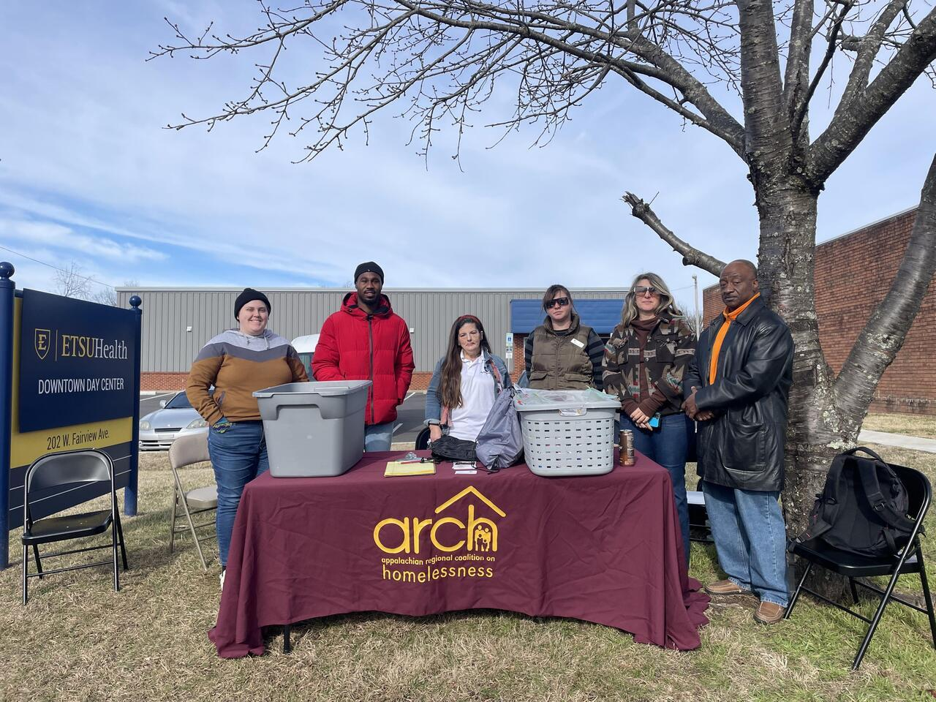
Examples from our Portfolio: Housing First
Chattanooga, Morristown, and Paris
Member provide frontline service to clients and assist with them obtaining informational and material resources, supportive services—and ultimately—safe, stable housing.
Focus Area: Economic Opportunity + Healthy Future
Notes:
An initiative of Appalachian Regional Coalition on Homelessness, the Housing First Service Corps (HFSC) places AmeriCorps
members with agencies and nonprofits that provide frontline service to clients and assist with them obtaining informational
and material resources, supportive services—and ultimately—safe, stable housing. Members serve as Coordinated Entry
Intake Specialists and Communications Coordinators at sites across Northeast Tennessee, in Chattanooga, Morristown, and
Paris, TN.

Slide 13
Benefits of an AmeriCorps
State Program
Agency Benefits
  Increased capacity for direct service
  Increase agency visibility
  AmeriCorps Member to Agency Staff/Host Site Staff Pipeline
AmeriCorps Member Benefits
  Living Allowance
  Education Award Equal to Pell Grant
  Health Care (for eligible members)
  Child Care (for eligible members)
  Student loan deferment
  Student loan forbearance
Notes:
In addition to benefiting the communities they serve, AmeriCorps programs benefit the managing agency and the members enrolled. Subgrantee agencies may enjoy increased capacity, increased visibility, and long term, an increase in strong staff members at your agency or within your field. Members, in turn, earn a living allowance throughout their term of service and and education award upon completion of their term of service. Full time members or member serving in a full time capacity are eligible for health care and child care. All members are entitled to request student loan deferment and forbearance.

Slide 14
Investment of an AmeriCorps State Program
Agency Investments
  Dedicated Program Director
  Fiscal staff
  24% minimum cash and/or in-kind match (Cost Reimbursement Grant)
Volunteer Tennessee Investments
  Federal funding
  Programmatic and fiscal systems support
  Local & national training opportunities for subgrantee staff
  Program Monitoring
  Guidance and daily support
Notes:
Host agencies must also invest in the AmeriCorps program. While the program provides some funding, the grant will not be enough to cover all of the costs involved in running a program. The host agency will need to secure additional cash and in-kind resources through fundraising and matching efforts. Your agency, as a subgrantee, will need to invest considerable time and resources into the application and management of this grant.
It is required that your application describe the roles, responsibilities, and structure of the staff that will implement and provide oversight of the program. Typical implementation and oversight activities include grant compliance, member recruitment, member training, member supervision, invoice submission, and monitoring.
Most programs have dedicated program director and designate responsible fiscal staff within their organization. A separation of duties is found to be beneficial. Certain types of grants, and we'll get into types of grants in a moment, must also meet a cash/in kind match (unless a match waiver is submitted and approved.)
Volunteer Tennessee supports programs by providing funding, support, training, and monitoring.

Slide 15


Who is eligible to apply for AmeriCorps State grant?
Government agencies
501(c)3 Nonprofits
Notes:
Most non-profit organizations, higher education institutions, local governments, among others are eligible to apply for AmeriCorps grants, so long as they meet the other eligibility requirements as described in the NOFO.

Slide 16
Is AmeriCorps Right for My Agency?
  Refer to the “Is My Organization Ready?” checklist on the Volunteer Tennessee Funding Opportunities webpage
Key Requirements:
Staff capacity to manage program
Strong fiscal systems
Ability to comply with federal funding requirement
Notes:
How will you know if your program is ready to host an AmeriCorps program? Minimally, the organization will need to be a 501(c)3 or government agency, have staff capacity to administer the grant, maintain strong fiscal systems, and possess the ability to comply with federal requirements. We recommend that you continue investigating organizational readiness by referring to the Is My organization ready checklist on the VT Funding Opportunities webpage.

Slide 17
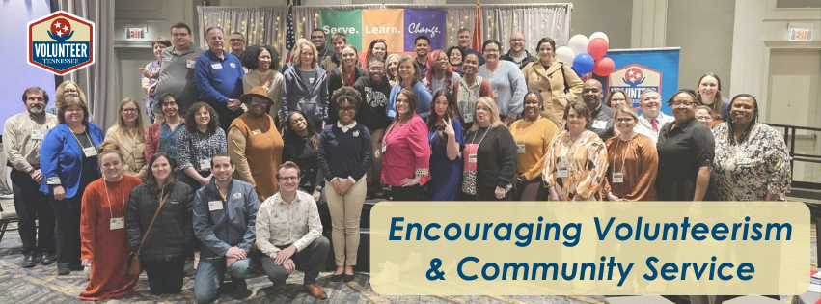
Let’s Check-In

Slide 18
2026 AmeriCorps State NOFO Application Process
Volunteer Tennessee’s website is
www.volunteertennessee.net
The Notice of Funding Opportunity, Application Instructions, Mandatory Supplemental Information, and other related information and resources can be found on the Funding Opportunities page
Notes:
The Notice of Funding Opportunity or the NOFO is the reason we're all here and it can be found on the funding opportunities page on our website.
AmeriCorps typically structures grant funding over a three-year period. While the project is approved for three years, funding is awarded annually based on performance, compliance, and budget, requiring grantees to submit applications for years two and three. This NOFO is for new applicants looking to begin a three-year grant cycle, recompeting applicants looking to begin another three year grant cycle, and continuation applicants going into their second or third year of funding.

Slide 19
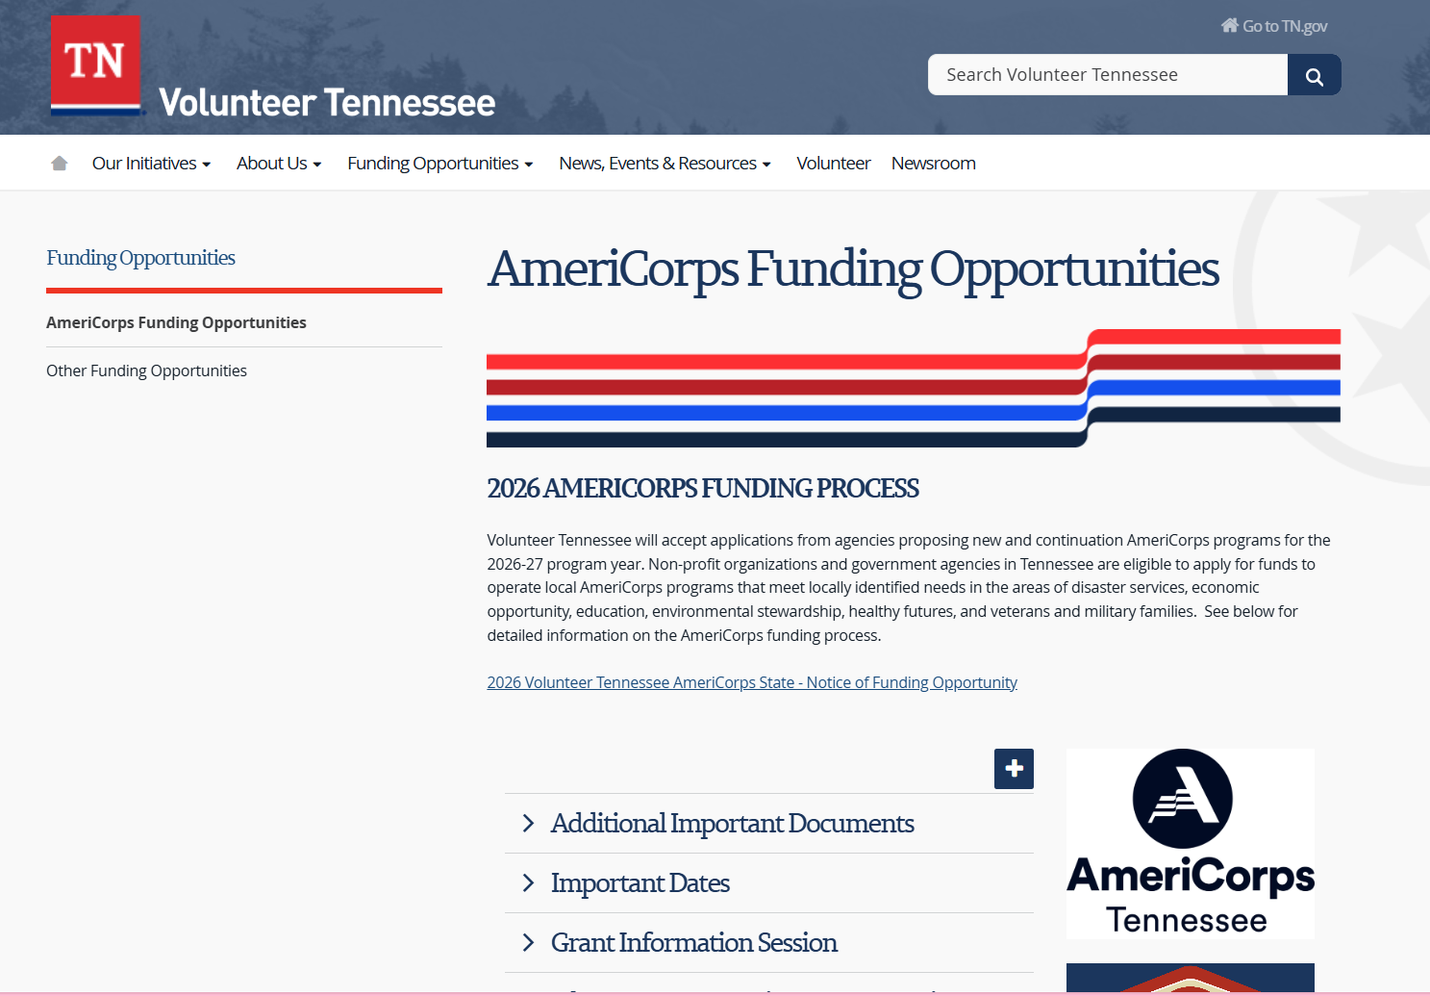
2026 AmeriCorps State NOFO Application Process
Notes:
On this page, in addition to the the Notice of Funding Opportunity and the important additional documents, you’ll also find resources like the logic model worksheet, sample cost reimbursement budget, and an important dates section. This page is designed to make it as easy as possible to navigate the process, so make sure to bookmark it and use it throughout your application journey.
The recording of this session will eventually be posted in the grant information section.
If you were interested in NCCC or National Direct grants, you can also find more information on this page.

Slide 20
2026 AmeriCorps State NOFO Application Process
Additional Important Documents:
Attachment A: Mandatory Supplemental Information
Attachment B: Application Instructions
Attachment C: Performance Measures
Attachment D: 2026 Applicant-Determined Performance Measure Supplement
Attachment E: eGrants Indirect Cost Rate User Instructions
Operational and Financial Management Survey (OFMS)
Notes:
Alright, now let’s dive into the additional documents required for your State and National AmeriCorps grant application. Additional documents must be uploaded to the Volunteer Tennessee AmeriCorps Funding Applicant Additional Documents + Information form.
First, we have the Mandatory Supplemental Information. This document is essential because it provides clarity on terms and definitions used in the Notice of Funding Opportunity (NOFO). It’s important to read through this carefully, as it will help you align your program with the funding priorities and performance measures AmeriCorps is looking for. Make sure to refer back to it as you complete your application.
Next up is the Application Instructions. This is your go-to guide for navigating the entire application process. It provides detailed steps for each section of your grant submission, including formatting guidelines and tips for writing a strong narrative. Following these instructions will ensure your application is complete and in compliance with AmeriCorps standards.
The third document is Performance Measures. This is crucial because your program’s success will largely be evaluated based on these measures. The document provides guidance on selecting performance measures that align with AmeriCorps’ focus areas and outlines how to report on the outcomes of your service activities. It’s important to choose measures that are meaningful and directly tied to the impact your program will have. There is an additional document for applicant determined performance measures.
Then theres eGrants Indirect Cost Rate User Instructions. This document is for those of you who are applying for an indirect cost rate or already have one approved. It walks you through how to claim and document those costs in your budget submission. Make sure you understand how indirect costs fit into your budget so you can allocate resources efficiently.
Finally, the Operational and Financial Management Survey is a mandatory form for all new and recompeting applicants.
So, these documents—Mandatory Supplemental Information, Application Instructions, Performance Measures, and the eGrants Indirect Cost Rate User Instructions—are all critical for ensuring your application is complete and competitive. Be sure to download and review each of these before you submit, and don’t hesitate to reach out if you have questions or need further clarification.

Slide 21

Types of Awards
Formula
  All new applicants;
  Including applicants who have previously been awarded an AmeriCorps planning grant
Competitive
  Programs which have received AmeriCorps formula funding previously;
  Programs that are instructed to apply as competitive by Volunteer Tennessee
Notes:
Now let’s talk about who should apply under formula versus competitive.
Formula applicants will compete with other applicants in the state of Tennessee. Competitive applicants will compete with applicants from across the country.
Formula applies to all new applicants, including those of you who have been awarded an AmeriCorps planning grant in the past. Formula is your pathway for securing funding, and we recommend focusing your efforts here if you’re new to AmeriCorps.
On the other hand, competitive funding is for programs that have already received AmeriCorps formula funding in previous years or for programs that have been specifically instructed by Volunteer Tennessee to apply as competitive. If you’ve received this instruction from us, you’re ready to move into the competitive pool.
So, for the majority of you, the focus will be on formula, but for those moving to the competitive level, we’ll be guiding you through that process.

Slide 22
Types of Awards
Cost Reimbursement
  Traditional Grant
  Match requirement
  Requires a detailed budget submission
Fixed-Amount
  Drawdown based on enrollment and member hours
  Does not require a detailed budget
  No match requirement
Notes:
Let’s break down the differences between Cost Reimbursement and Fixed-Amount grants.
First, for Cost Reimbursement:
• This is a more traditional grant with a match requirement, meaning your organization will need to provide a certain percentage of funds.
• You’ll also be required to submit a detailed budget, mapping out how every dollar will be spent.
Now, for Fixed-Amount:
• The main difference is how you draw down funds: based on enrollment and member hours, instead of needing to submit a detailed budget.
• Another key point—there’s no match requirement here, which can ease the financial burden for your organization.
Each of these options has its advantages depending on your program’s capacity and funding needs. New applicants may only apply for cost reimbursement grants.

Slide 23
Important Dates: Formula
2/20/2026 Applicants intending to apply for a new or re-competing Formula program are REQUIRED to complete a Notice of Intent form by 3:00 p.m. CT on February 20th, 2026.
3/18/26 Formula applications due to Volunteer Tennessee by 3:00 p.m. CT. Pre-Award Risk Assessment information due from new AmeriCorps Formula Applicants. Verification of SAM/CCR registration due from AmeriCorps Formula Applicants
6/22/26 Inform applicants of Formula funding decision and provide Application Feedback to funded programs

Slide 24
Important Dates: Competitive
2/25/26 1st Draft Competitive (new, re-competing, and continuation) and EAP (new) Grants applications due to Volunteer Tennessee by 3:00 p.m. CT.
3/18/26 Competitive applications due to Volunteer Tennessee by 3:00 p.m. CT.
Only grantees with preapproval from Volunteer Tennessee staff should apply Competitive.

Slide 25
Application Contents
Standard Form 424 Face Sheet: Automatically generated when applicants complete the data elements.
Narrative Sections:
  Executive Summary;
  Program Design;
  Organizational Capability;
  Cost-Effectiveness & Budget Adequacy; and
  Evaluation Plan Summary.
Performance Measures
Logic Model
Standard Form 424A Budget
Continuation Changes
Clarification
Authorization, Assurances, and Certifications
Additional Documents, as required
Notes:
Now let’s break down the key components of the State and National AmeriCorps grant application. First up is the Standard Form 424 Face Sheet, which is automatically generated when you complete the data elements in the application and counts towards your narrative page limit.
Next, we have the Narrative Sections where you’ll dive deeper into the details of your program. These sections include:
• The Executive Summary, which gives an overview of your proposed program.
• Program Design, where you outline the structure and goals of your program.
• Organizational Capability, where you demonstrate your organization’s ability to successfully run the program.
• Cost-Effectiveness & Budget Adequacy, ensuring that your program’s budget aligns with its needs and objectives.
• And lastly, your Evaluation Plan Summary, where you describe how you’ll measure the success of your program.
You’ll also need to submit Performance Measures and a Logic Model that clearly show how your program will deliver impact.
After that, you’ll complete the Standard Form 424A Budget, where you detail your financial plan.
For continuation applicants, there’s a section for Continuation Changes, and all applicants might need to respond to Clarification questions during the review process.
Finally, you’ll submit the Authorization, Assurances, and Certifications, as well as any Additional Documents required by AmeriCorps.
Each of these components plays a critical role in helping AmeriCorps evaluate your program and its potential for success, so be sure to put thoughtful detail into each section.
The application narrative and budget will be submitted online via the eGrants system. In some instances, applicants may need to provide additional documentation, such as evidence documents, which should be uploaded to the Volunteer Tennessee AmeriCorps Funding Applicant Additional Documents + Information form. Such documents are due at the same deadline as the application. Please do not submit additional documentation not specified in the NOFO, as they will not be reviewed or returned.

Slide 26
The Application Review
Categories/Subcategories | Percentage
Executive Summary | 0
Program Design | 50
Community and Logic Model | 20
Evidence Tier | 12
Evidence Quality | 8
Notice Priority | 4
Member Experience | 6
Organizational Capability | 25
Organizational Background and Staffing | 15
Member Supervision | 10
Cost-Effectiveness and Budget Adequacy | 25
Member Recruitment | 8
Member Retention | 9
Data Collection | 8
Notes:
All applications will be reviewed according to the criteria found on Pages 20-24 in the NOFO. So lets break down this rubric.
First, you will notice that the executive summary is a required part of the application, but it is not scored.
Next, you'll see that out of 100 possible points, 50 points can be scored in the program design section, 25 points can be scored in the organizational capability section, and 25 points can be scored in the cost effectiveness and budget adequacy section.
Each of these sections are broken into subsections. If you do not address a subsection or section, you cannot earn the points associated with it, so it is important that your application address each category and subcategory is the fullest extent.
When you go to enter your narrative into eGrants, you will see that the application is organized into several narrative fields: Executive Summary, Program Design, Organizational Capability, Cost Effectiveness and Budget Adequacy, and Evaluation Plan. We recommend that you additionally label each subcategory to ensure the application is clearly organized for reviewers.
The narrative has an 11 page limit. The face sheet counts as one of these 11 pages.
The logic model has an 8 page limit.
We encourage programs to print our their application prior to submission to ensure compliance with the limit. Any content exceeding the 11 pages will not be read or scored.
In addition to ensuring that you address each category and subcategory and follow guidance related to page limits, it is also necessary that applicants demonstrate that they meet the thresholds for grant type and strategic considerations for the program being proposed. More information on threshold issues can be found on page 10 of the NOFO.

Slide 27

AmeriCorps Funding Priorities
Serve Communities
Benefit AmeriCorps Members
Use Evidence
Faith-Based
Notes:
This year, the funding priorities section section is worth four points. In previous years, it was worth 0 points.

Slide 28

2026 Serve Communities Priorities

Slide 29
VT Funding Priorities
TN Distressed Counties
Prisoner Mentorship
Capacity for Volunteer Success
Disadvantaged and underrepresented youth
Applications aligned with one or more Volunteer Tennessee state priorities may receive additional consideration.

Slide 30
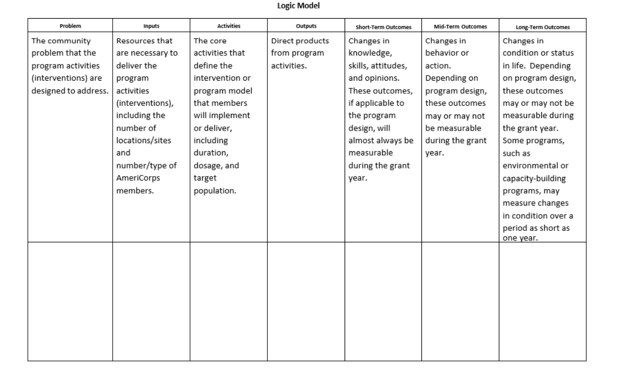
Logic Model
Notes:
The applicant must describe in the Logic Model inputs, activities, ouputs, and outcomes.
➢ The inputs or resources that are necessary to deliver the intervention, including but not limited to:
o Locations or sites in which members will provide services.
o Setting and community condition where the intervention is delivered.
o Number of AmeriCorps members who will deliver the intervention.
o Characteristics of AmeriCorps members, including specific knowledge, skills, and abilities required to implement the intervention.
➢ The core activities that members will deliver as part of the intervention including:
o Length of each activity (e.g., the total number of weeks, sessions, or months of the intervention).
o Dosage of each activity (e.g., the number of hours per session or sessions per week).
Target population for the intervention (e.g., disconnected youth, third graders at a certain reading proficiency level).
➢ The measurable outputs that result from delivering the intervention (i.e., number of beneficiaries served, types and number of activities conducted). If applicable, identify which National Performance Measures will be used as output indicators.
➢ Outcomes that result from the intervention, including meaningful changes in knowledge/skill, attitude, behavior, or condition. If applicable, identify
Remember:
Reference performance measures by number and title
Applicants are not required to measure all components of their Logic Model
Applicants with multiple interventions should include the required information for each intervention in the logic model

Slide 31
Performance Measures
Reviewed as part of the Logic Model and Evidence Base
✔ At least ONE aligned performance measure required
✔ Must correspond to primary intervention
✔ May be National OR Applicant-Determined
❌ Output-only does NOT satisfy requirement
✔ Quality over quantity!
Notes:
Now let’s talk about performance measures—these are crucial for demonstrating the impact of your AmeriCorps program.
First, it’s mandatory that all applicants submit at least one aligned performance measure, which includes both an output and an outcome. This ensures that your program is tracking not only what it’s doing but the change it’s making.
The performance measures you choose should directly align with your proposed primary intervention—in other words, the core activity or strategy you’ll use to address a community need. For example, if your program is focused on education, your performance measures should reflect improvements in student outcomes.
You can use either a National Performance Measure, which AmeriCorps provides as a guideline, or you can create an applicant-determined measure tailored to your specific program.
One important thing to keep in mind—quality over quantity. It’s better to focus on one or a few high-quality, meaningful measures rather than trying to report on too many things. The goal here is to have clear, impactful data that shows the true difference your program is making in the community.
Best practice: Make sure your performance measures are realistic and achievable, and be prepared to track and report data consistently throughout the program year.

Slide 32
🚨 Common Application Pitfalls
🔄 Misalignment
Narrative, budget, and performance measures don’t match.
📊 Performance Measure Mistakes
No aligned measure (output + outcome)
Unrealistic targets
💰 Budget Errors
Incorrect match
Indirect cost entered incorrectly
Costs not tied to program design
📁 Missing Requirements
OFMS incomplete
Attachments missing
Wrong Prime ID selected
⏳ Last-Minute Submission
Validation errors unresolved
SAM expired
Technical issues at deadline
📈 Overpromising
Targets too high
Capacity not demonstrated
Member supervision unclear
Notes:
Lateness! On page 13, there are instructions for if your application is late.

Slide 33
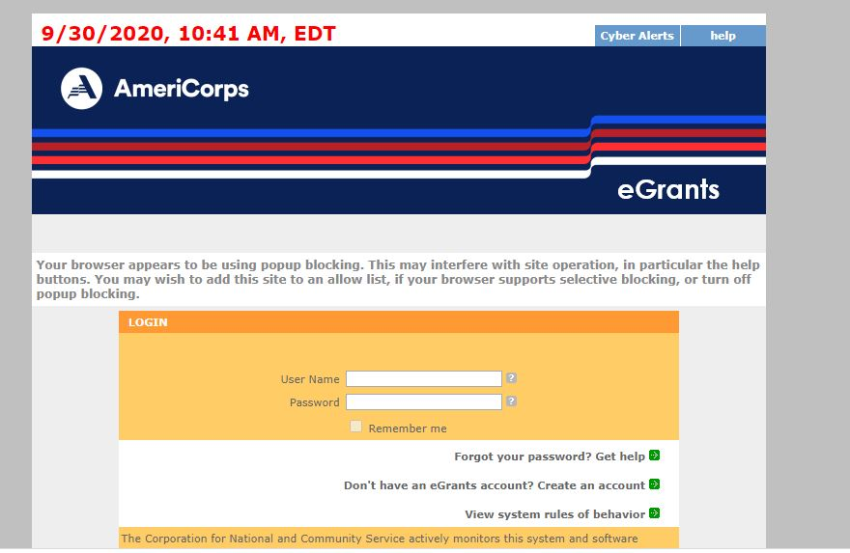
Application & Submission Information: eGrants
Notes:
Once you have prepared your narratives, you are ready to start entering the application in eGrants as described in the application instructions. The eGrants application consists of several areas, the first of which is Applicant Info. In this section, you will enter several pieces of general information about your organization. Application Info is more specific information about the program being proposed. Next, you will insert the Narratives and Logic Model that you have previously saved in a word processing document. As previously noted, all applications must contain at least one aligned performance measure. Applicants may select from a National Performance Measure or choose an applicant-determined measure. In the eGrants system, you will note whether certain documents have been submitted. All applicants will enter budget information in eGrants, but note that the budget for cost-reimbursement grant applicants will contain significantly more detail than the budget for fixed-amount grant applicants.
Once you have entered all required information in eGrants, you will proceed to the Review, Authorize and Submit page where you will review the application for completeness; have the appropriate certifying official to click the radio buttons to authorize submission and agree to the assurances and certifications; verify that the application narratives, budget and performance measures are validated without error; and click to submit the application to Volunteer Tennessee.

Slide 34
Application & Submission Information
Step 1: At the bottom of the home page, click on Start a New Grant Application
Step 2: Select AmeriCorps for your program area
Step 3: Select the following NOFA: [NOFA: FY 2026 AmeriCorps State and Territory Commission Fixed and EAP (New and Cont)]
Step 4: The next page will prompt you to select the state in which you are applying, select Tennessee

Slide 35
Application & Submission Information Contd.
Step 5: Select the appropriate Prime Application ID:
  Formula Cost Reimbursement: 25AC279083
  Formula Fixed: 26ES280622
  Competitive Cost-Reimbursement: 26AC280627
  Competitive Fixed-Amount: 26ES280624
Step 6: When choosing a Program Name, choose the title that you will consistently use to refer to your AmeriCorps program.
Notes:
For example, the Appalachian Regional Coalition on Homelessness names their program Housing First.

Slide 36
Additional Information
Submitted applications will be assessed against the criteria contained in the NOFO and funding decisions will be based on the criteria described in the Application Review Information section of the NOFO.
Selected applicants will be required to comply with several Volunteer Tennessee and federal requirements, including adhering to Uniform Administrative Requirements, Cost Principles and Audit Requirements for Federal Grants, complying with National Service Criminal History Check Requirements, and reporting, each of which will be described in the NOFO.
The remaining pages of the NOFO will contain resources that applicants may find helpful as they navigate the application process.
Notes:
When you submit your application, it will be assessed based on the criteria outlined in the Notice of Funding Opportunity (NOFO). These criteria are critical for determining which programs will be selected for funding, and they’re detailed in the Application Review Information section of the NOFO.
Once an applicant is selected, there are several requirements you’ll need to comply with—both at the state level with Volunteer Tennessee and at the federal level. These include:
• Adhering to the Uniform Administrative Requirements and Cost Principles for managing federal grants.
• Following the National Service Criminal History Check Requirements, which are mandatory for all AmeriCorps programs.
• Submitting regular reports to ensure your program’s compliance and performance are on track.
The remaining pages of the NOFO are packed with resources that will be helpful as you navigate the application process. These include details on compliance, timelines, and other important tools to support your application

Slide 37
Other Ways to Get Involved
Partner with current national service programs
Employers of National Service
Tennessee Conference on Volunteerism and Service-Learning
Governor’s Volunteer Stars Awards
Get involved in national days of service
  Martin Luther King (MLK) Day
  Make A Difference Day
  9/11 Day of Service and Remembrance
Notes:
Even if your organization is not ready to host an AmeriCorps program, there are other ways to be involved with this national movement. You might partner with a current AmeriCorps program to become a service location for one or more members, tap into the unique skills of AmeriCorps alumni by becoming an Employer of National Service, or participate in days of service such as Martin Luther King Day or the September 11 Day of Service and Remembrance.

Slide 38

Important Websites
Please visit www.americorps.gov for information related to AmeriCorps.
Please visit www.volunteertennessee.net for the Tennessee AmeriCorps State Notice of Funding Opportunity.
Please visit Egrants.cns.gov to start an eGrants account.

Slide 39
Q&A

Slide 40
Thank You for Joining Today!
Contact Information:
Latiyfa Fields, National Service Programs Director
Latiyfa.Fields@tn.gov
615-253-2805
Lizzy Lemieux, AmeriCorps Program Manager
Elizabeth.Lemieux@tn.gov
615-360-4243

