Slide 1
Annual Accreditation
2021 Training
10/13/2021

Slide 2
Mission, Vision, Values
Mission: Our mission is to serve veterans of all eras through passionate advocacy, informative outreach, and an honorable final resting place.
Vision: To make Tennessee the national leader in serving veterans and their families.
Values: (T.R.A.C.E)
Trust: Maintain the trust and confidence of all with whom I engage. Protect and cherish that trust with those Veterans and their families we support.
Respect: There is no higher calling or more noble mission than to serve the Veterans and their families who sacrificed so much for the freedoms we enjoy. Treat all of them, partner agencies, stakeholders, and my fellow TDVS teammates with dignity and respect.
Advocacy: Be truly Veteran-centric by identifying, fully considering, and appropriately advancing the interests of Veterans and other beneficiaries.
Commitment: Work diligently to serve Veterans and other beneficiaries. Be driven by an earnest belief in TDVS's mission. Fulfill my individual, leader, and collective organizational responsibilities.
Excellence: Adhere to the highest professional standards. Strive for the highest quality and seek continuous improvement. Be thoughtful and decisive in leadership, accountable for my actions, willing to admit mistakes, and rigorous in correcting them.

Slide 3
Functional Alignment
Commissioner
Deputy Commissioner
Assistant Commissioner Benefits
Assistant Commissioner Appeals
Assistant Commissioner Cemeteries

Slide 4
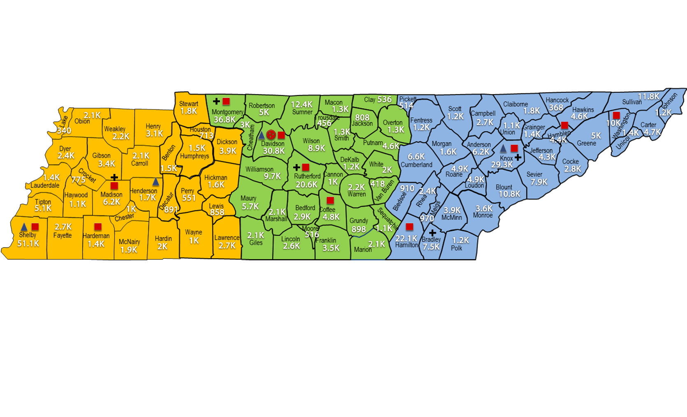
Partnerships

Slide 6
THANK YOU

