Slide 1
Peer-to-Peer Learning
Customer Service Academy

Slide 2
Your Turn (Again) – Session Goals
Teach & Learn From Each Other
Foster Collaboration
Share Knowledge and Experience

Slide 3
Your Turn (Again)
Excellent Customer Service Example(s)
I Can Do Better Customer Service Example(s)
Client Engagement Tools – Can They Help?
Notes:
Get Participants To Share Their Experiences Provided Customer Service – 2 to 3 Participant Experiences Per Topic – Approx. 10 Min. of Discussion Per Vignette
Start w/ Excellent – What Does Excellent Customer Service Look Like
Describe the Scenario, Describe Employee Actions, Describe Customers Response
Does Anyone See Any of the Principles Discussed In this Course
Ex. Emotional Intelligence / Good Communication / Deescalation
Any Comments – Other Participants
Hadn’t Thought of Doing That
I Can Incorporate Into My Work
I Take It a Step Further…
Move To I Can Do Better – WILL BE MORE DIFFICULT TO ENCOURAGE DISCUSSION – Share Time Didn’t Hit the Mark
Describe the Scenario, Describe Employee Actions, Describe Customers Response – where you surprised by the customer’s response?
Any Relation To Principles Discussed In this Course
Any Comments – Other Participants
Here’s How You Might Have Handled That
I’ve Had That Same Experience

Slide 4
Why Use Tools?
Consistent Customer Experience
Collect Necessary Information
Manage, Organize and Respond to Customers

Slide 5
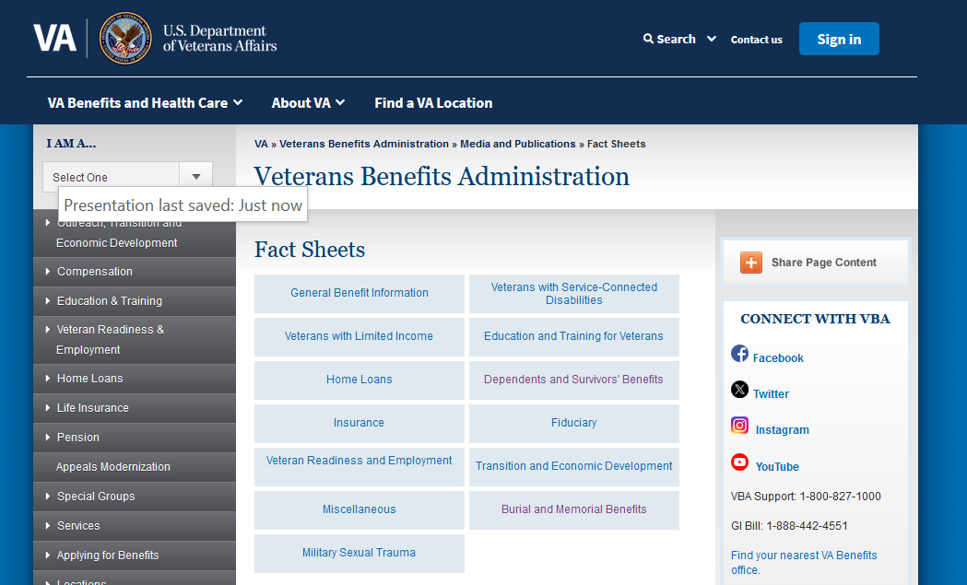
Client Engagement Tools - VA
Veterans Benefits Administration Fact Sheets

Slide 6
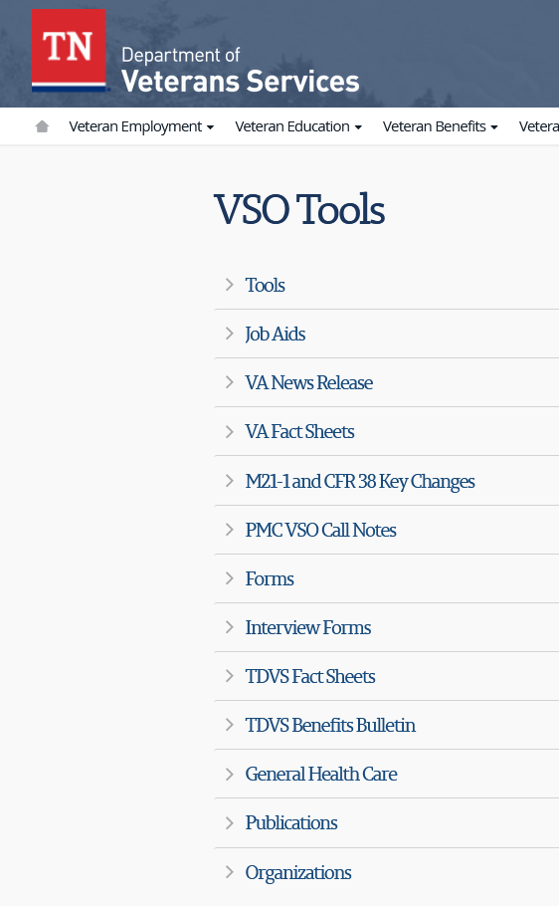
Client Engagement Tools - TDVS
TDVS Knowledge Library
Checks Lists, Fact Sheets, Etc.

Slide 7
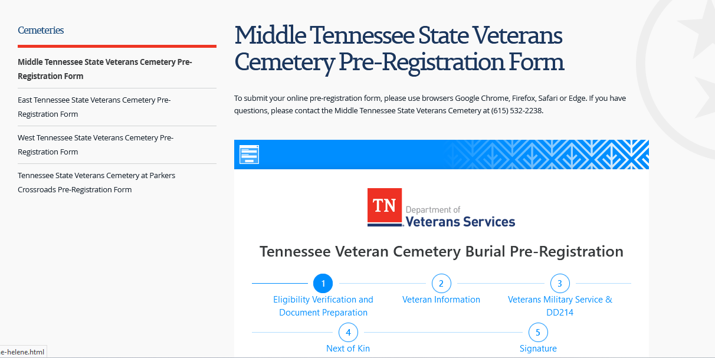
System Tools
TVB
Communications & Notes
Work Requests
TDVS Burial Pre-Registration

Slide 8
Questions

