Slide 1
Tennessee Fire Adapted Communities Program Awards

Slide 2
2021 Wildfire Community Preparedness Day
Wildfire Community Preparedness Day is a national campaign that encourages people and organizations everywhere to come together on a single day to take action to raise awareness and reduce wildfire risks.
Held in the United States and Canada on the first Saturday in May.
Given that in-person gatherings are limited or on-hold in many places, this year’s Prep Day was focused on what residents can do on and around their home to help protect against the threat of wildfires.

Slide 3
2021 Wildfire Community Preparedness Day
Project funding awards
Thanks to the generous support from State Farm, 150 communities received project funding awards to support activities aimed at reducing potential loss of life, property and natural resources to wildfire.

Slide 4
2021 Wildfire Community Preparedness Day
Project funding awards – Tennessee Recipients
Mark Bernard, Top of the World Community
Michael Dew, Fawn Hollow Community
Bryan Kerns, Dobbins/Bennett High School, Kingsport
Julia Lowe, East Gatlinburg Community
Weston Hofacker, Stonegate Community

Slide 5
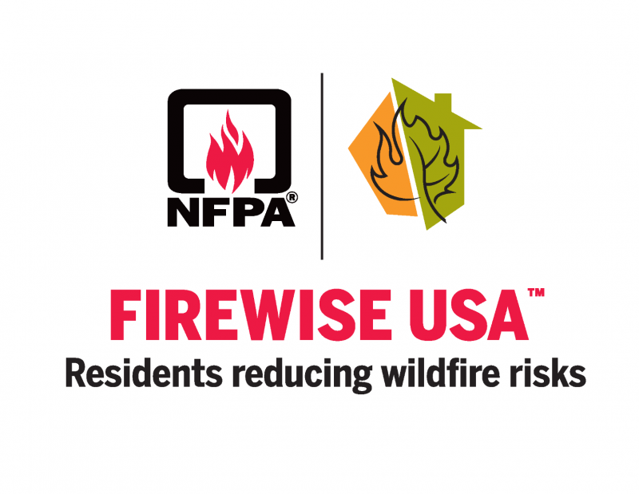
Firewise USA Communities Recognition
Cumberland Lakes Community – 15 years

Slide 6
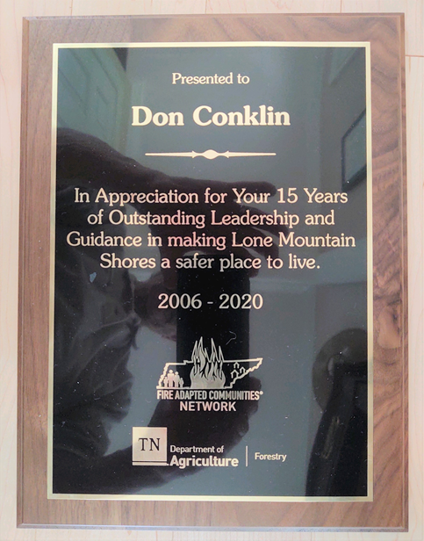
Firewise USA Community Leader Recognition
Don Conklin
Lone Mountain Shores

Slide 7
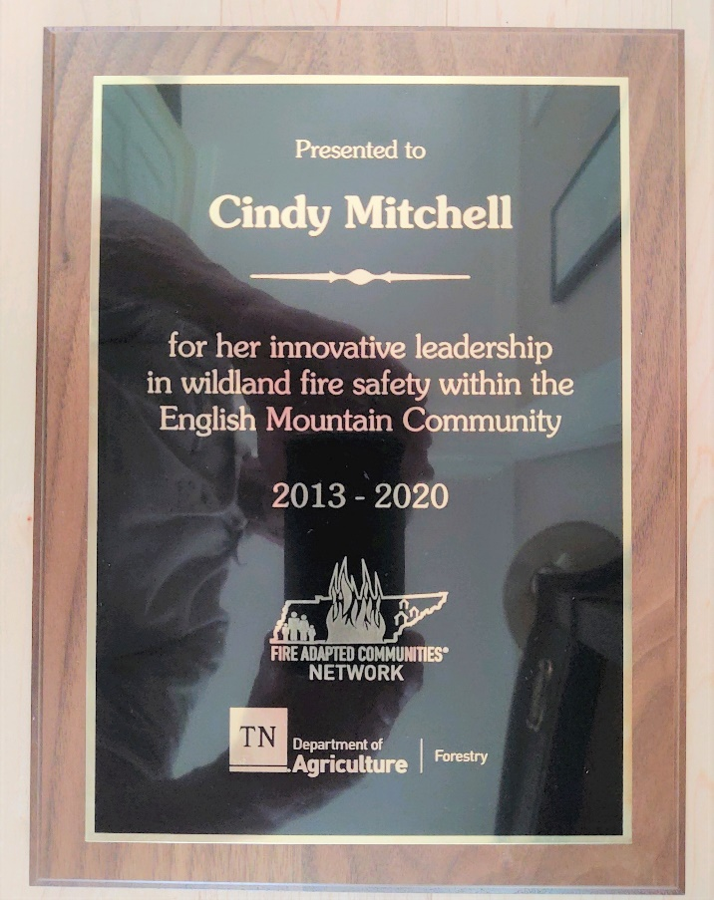
Firewise USA Community Leader Recognition
Cindy Mitchell
English Mountain Community

