Slide 1

2025 TBR Annual Veteran Service Survey
April 23, 2026
Dr. Regina Watkins, Director of Veteran Enrollment and Benefits, Service Center TN Board of Regents

Slide 2
2025 Annual Veterans Services Survey
Fall 2025
October 1 – Survey Opened for Student Reponses
QuestionPro, Flyer, URL Link, Email Template, QR Code
November 15 – Original Closing Date for Responses
December 1 – Extended Closing Date for Increased Responses
We wanted above the national average for responses – 30%.
Provided responses to date and percentage of total Military-affiliated population.

Slide 3
Veteran Services Survey Responses
23 Tennessee Colleges of Applied Technology - 58.47%
13 Tennessee Community Colleges – 19.94%
Total – 27.97%

Slide 4
Increase Response Rates
Goal for 2026 – Increase Response Rate ≥ 35%
Slate Email / Text Messaging – Best Response Rate
Email from SCO – More personal
Reminders from Instructors
Post QR code in break areas, Doors, Waiting areas
QR code on card

Slide 5
Survey Results
752 Total Responses
650 Completed Responses
TCAT
327 Total
284 Completed
CC
425 Total
366 Completed

Slide 6
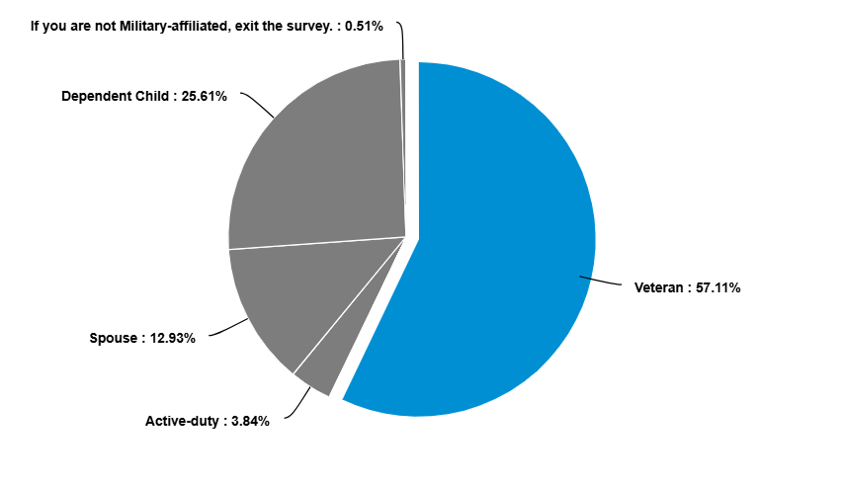
Military-affiliated Status​
Veteran – 57.11%
Dependent Child – 25.61%
Spouse – 12.93%
Active Duty – 3.84%

Slide 7
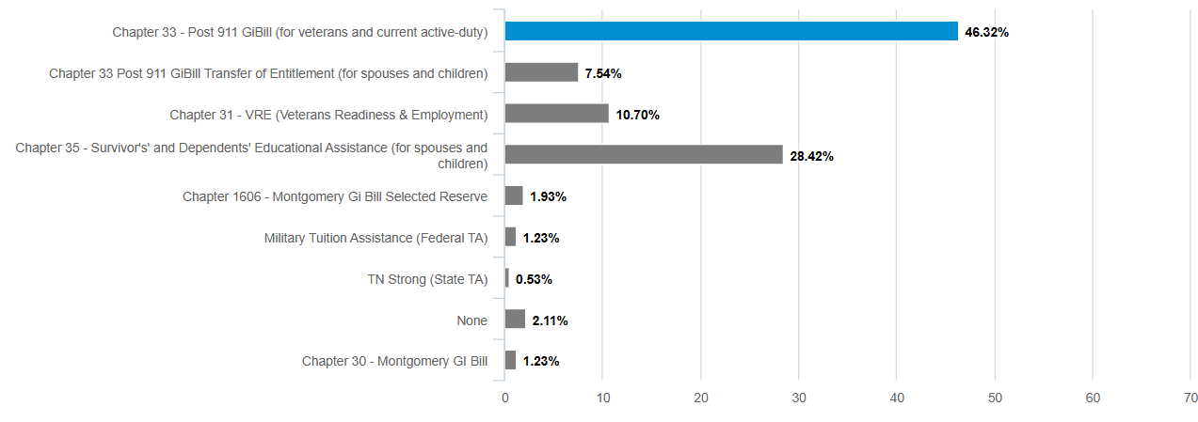
Veterans Education Benefits, TA, or VR & E​

Slide 8
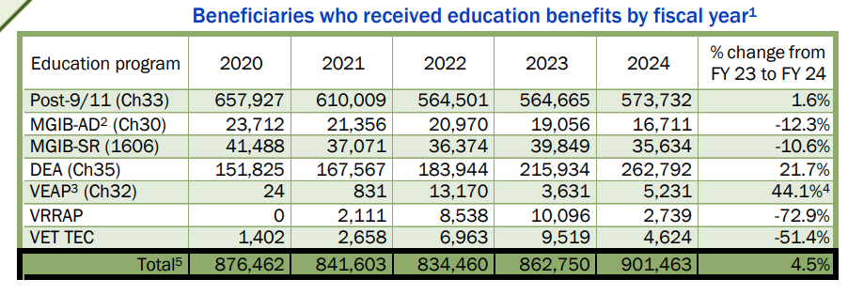
National Trends​​
Veteran Education Benefits

Slide 9
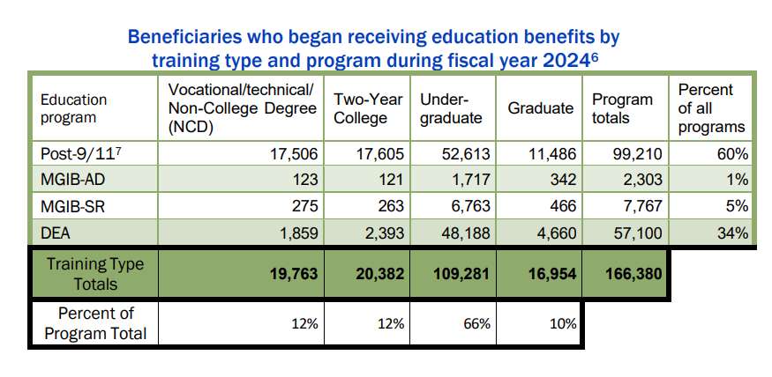
Veteran Education Benefits

Slide 10
An increase in the use of Chapter 35 (Survivors' and Dependents' Educational Assistance - DEA) and Chapter 33 Transfer of Entitlement (TOE) benefits is expected in 2026, driven by higher monthly stipends, expanded eligibility rules, and new legal interpretations allowing for longer periods of combined benefit usage.

Slide 11
Key Trends and Factors Driving Increased Usage (2025-2026)
Expansion of Combined Benefits (Rudisill Decision): Recent court rulings (Rudisill v. McDonough and Perkins v. Collins) allow veterans and dependents to potentially access up to 48 months of education benefits, combining Montgomery GI Bill and Post-9/11 GI Bill (Chapter 33) usage.
81-Month Combined Limit: The VA has expanded the aggregate limit for beneficiaries using Chapter 35 in combination with other programs (like Fry Scholarship or Chapter 33) to 81 months.
Significant Increase in Chapter 35 Rates: Effective Oct. 1, 2025, through Sept. 30, 2026, the monthly rate for full-time Chapter 35 (DEA) benefits is set at $1,574.00, representing a substantial increase for dependents.
Age and Eligibility Changes (Chapter 35): For dependents who turned 18 or completed high school on or after August 1, 2023, there is no longer an upper age limit to use Chapter 35 benefits, allowing for delayed education enrollment.
Chapter 33 TOE Flexibility: Servicemembers can still transfer up to 36 months of benefits, and children can use these while the veteran is still on active duty, with the VA now providing an automated process for maximizing these benefits.

Slide 12
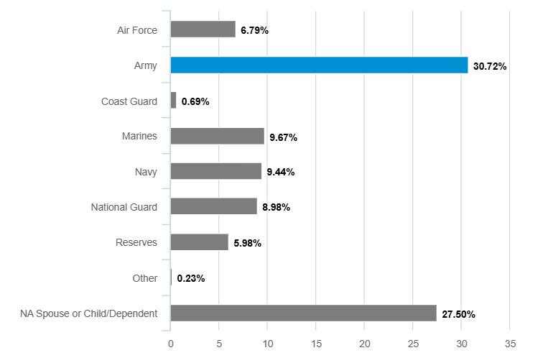
Branch of Service
Army – 30.72%​
​Spouse /Dependent Child – 27.5%​
​Marines – 9.67%​
Navy – 9.44%
National Guard – 8.98%
Air Force – 6.79%
Reserves – 5.98%
Coast Guard – 0.69%
​Other – 0.23%​

Slide 13
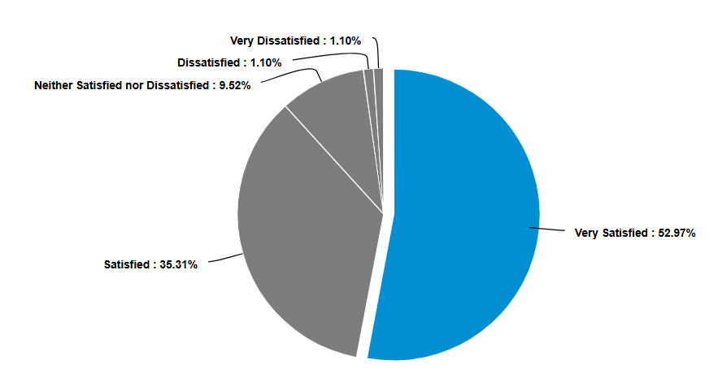
Admission Process Rating​
Very Satisfied – 52.97% Satisfied – 35.31% Neither/Nor – 9.52%

Slide 14
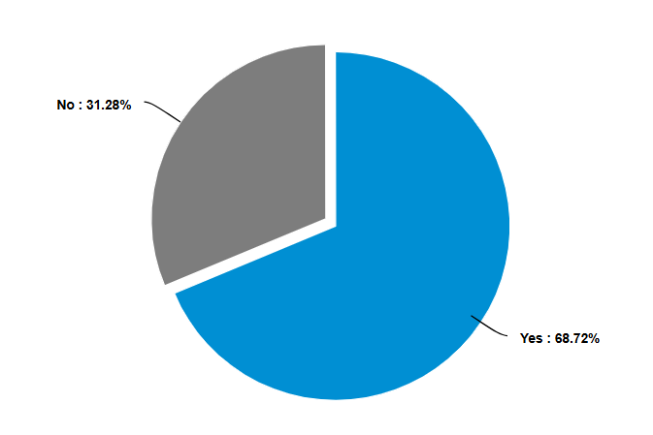
Orientation – VETS Campus Criteria
Yes – 68.72% No – 31.28%

Slide 15
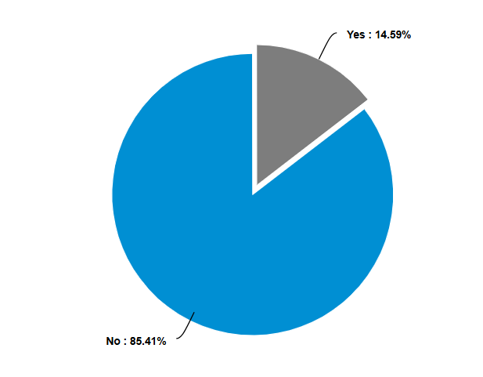
VA-Specific Orientation

Slide 16
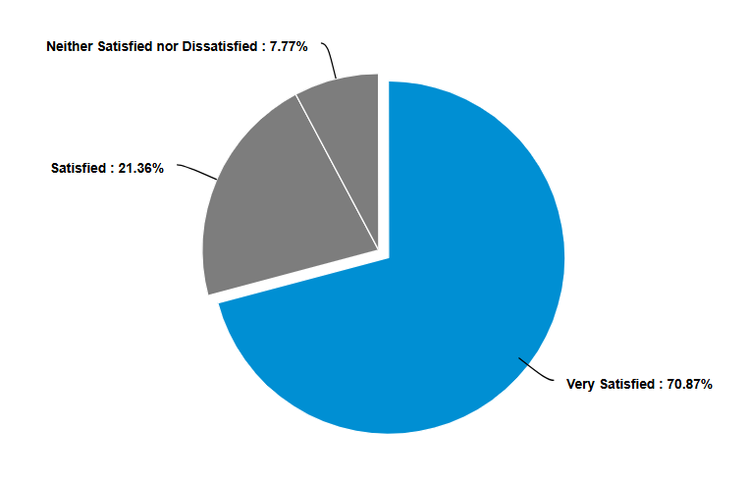
Orientation Rating
Very Satisfied – 70.87% Satisfied – 21.36% Neither/Nor – 7.77%

Slide 17
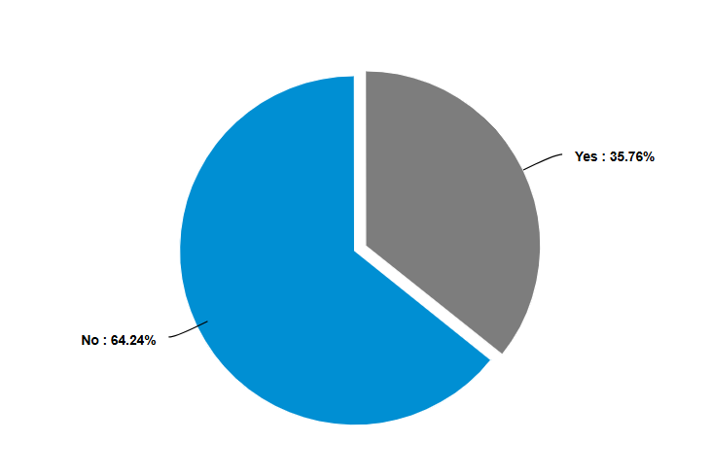
Military Transcripts Submitted –
PLA VETS Campus Criteria
No – 64.24% Yes – 36.76% ​

Slide 18
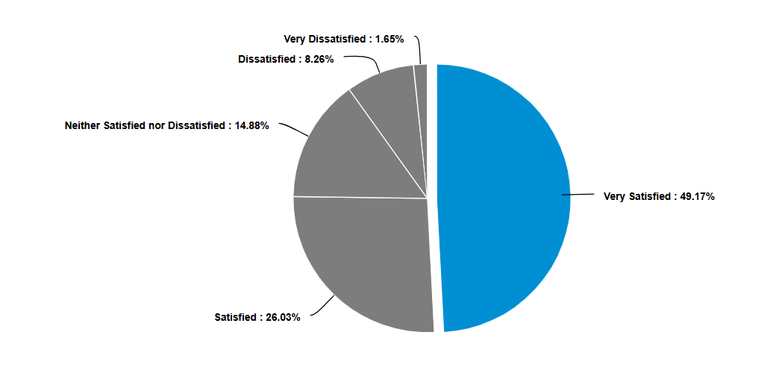
Rating of PLA Credit Rating
Very Satisfied – 49.17%​​
​Satisfied – 26.03%​​
​Neither/Nor – 14.88%​​
Dissatisfied – 8.26%​
Very Dissatisfied – 1.65%​
*Those that answered Yes to submitting PLA

Slide 19
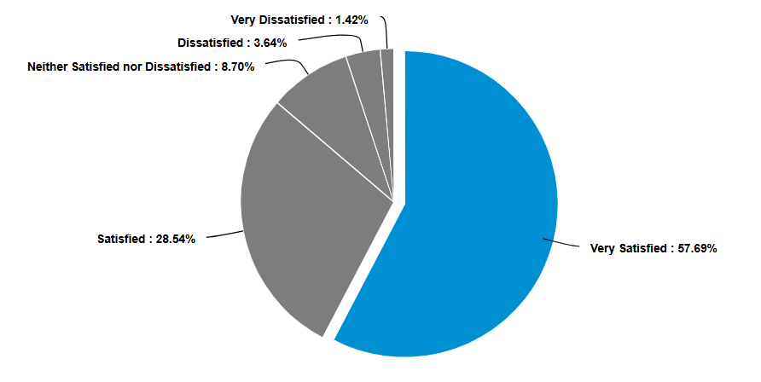
Veterans Education Benefits Process Rating

Slide 20
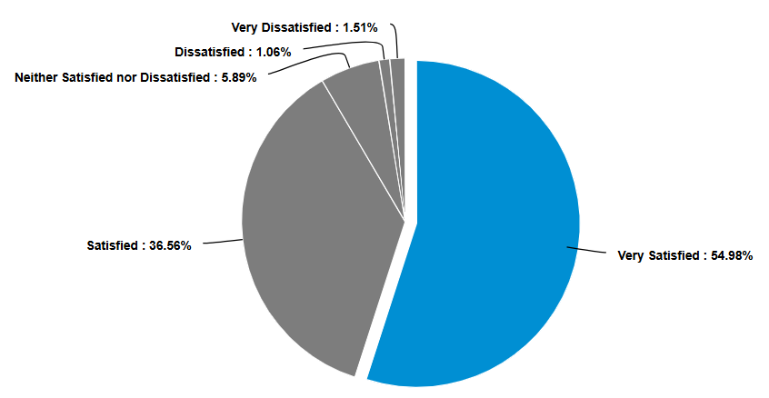
Programs Meet Educational Goals

Slide 21
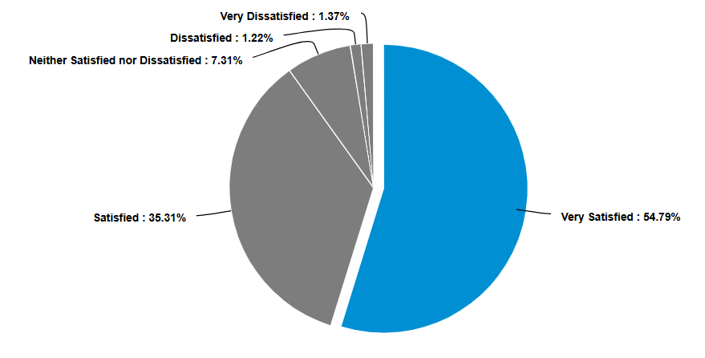
Programs Meet Career Goals

Slide 22
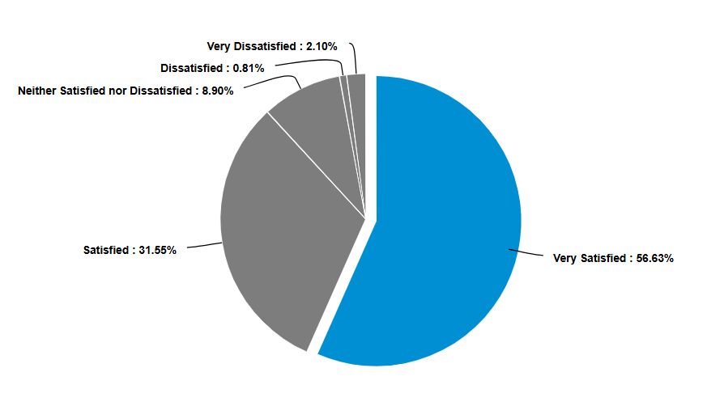
Good Value for Using VA / TA Benefits

Slide 23
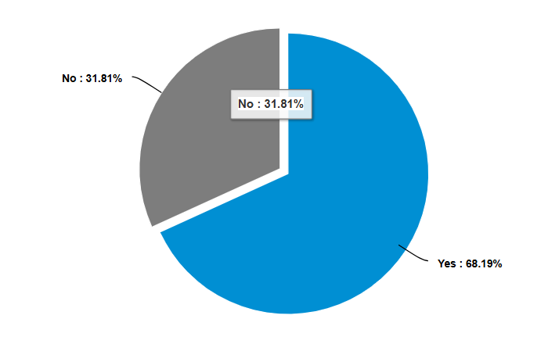
Familiar with Referral to Mental Health & Wellness Services
Yes – 68.19% No – 31.81% ​​

Slide 24
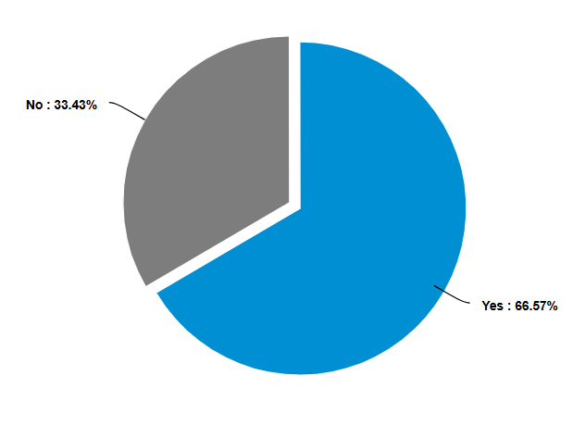
Familiar with Transfer of Credit or Pathways
Yes – 66.57% No – 33.43% ​​

Slide 25
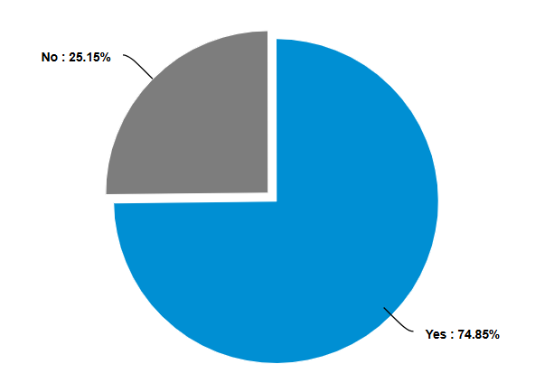
Engaged with an Academic Advisor
Yes – 74.89% No – 25.15% ​​

Slide 26
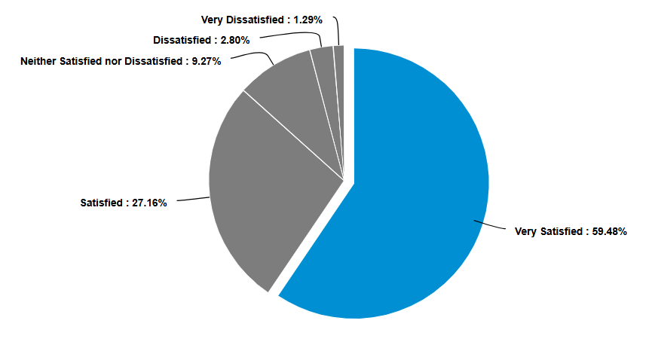
Overall Academic Advisor Rating
​​

Slide 27
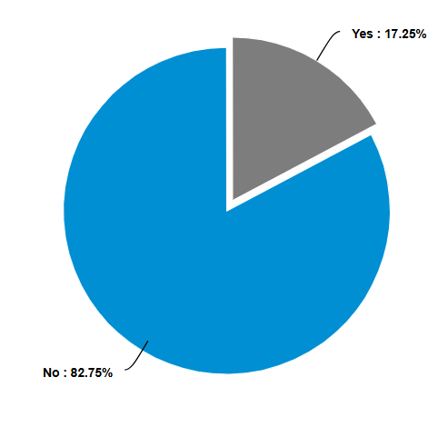
Engaged with a Veteran Peer Mentor
​​
VETS Campus Criteria
No – 82.75%
Yes – 17.25% ​​​

Slide 28
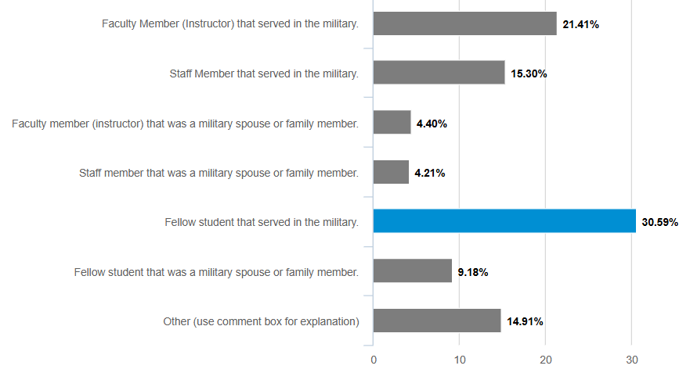
If not Veteran Peer Mentor, then Who?
​​

Slide 29
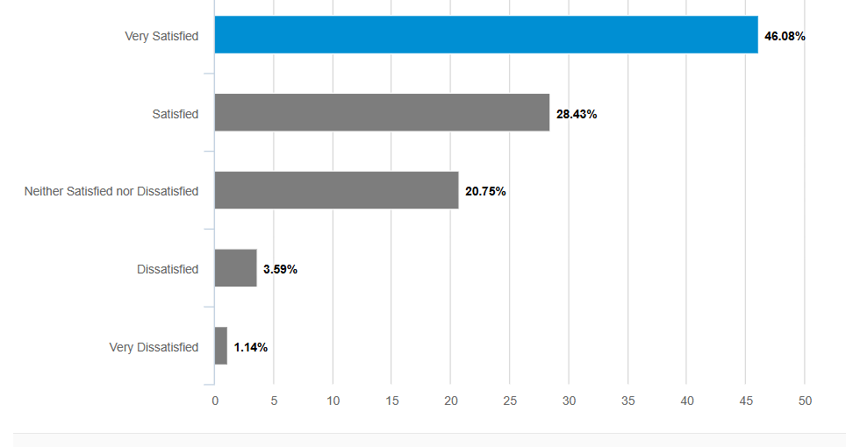
College Familiar with Military Culture
VETS Campus Criteria ​​​
​​

Slide 30
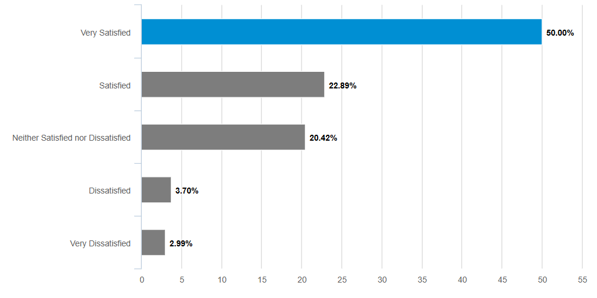
Military-Affiliated Break/Study Area
​​

Slide 31
Student Comments
I really enjoy all of the open spaces available in the Thigpen library. The access myself and other students have to quiet study spaces upstairs, and interactive spaces downstairs make working on homework and projects almost pleasant
I believe TCAT Morristown is superb and outgoing towards their community of veterans
Make it more known because I knew nothing about any of these things.
Good college would definitely recommend to other veterans and civilians
Veteran's services at this school have been exceptional. Non-veteran related services have been a disappointment overall.
I have only had experience with the College through EMT and AEMT program, but the Director, Coordinator and Instructors have been great!
Very satisfied with my College and VA that has helped me through this difficult process
I feel that this is a very good school with good military help and many people come in from the military. I hear a lot of people that were in the military say good things about it aswell.
It is very difficult going from Active almost immediately into this sort of setting for a lot of us. Most of my teachers have been accommodating but some have been very little on reciprocating the feeling of what it is we go through to all of the sudden changing our entire lifestyle.

Slide 32
Annual Veteran Services Survey
Conduct a Survey Every Year
Compare Year-to-Year Results
Use Data to Assess Services
Use Date to Address VETS and VETS BRAVO Criteria
Programming to Meet VETS and VETS BRAVO Criteria
Learn from Student Data and Comments
Realize You Can't Satisfy Every Student
Ask for Assistance
Train Staff and Faculty

Slide 33

Discussion

