Slide 1


Understanding CPL for Faculty
Terence Nelson, Executive Director of Pathways and Partnership
Calvin Klein Gloria, Director of Military CPL Pathways

Slide 2
What is CPL/PLA?
Credit for Prior Learning (CPL), or Prior Learning Assessment (PLA), as it is alternately known, is college credit awarded for validated skills and knowledge gained outside of coursework at a regionally accredited institution of higher education. We drove change through statewide policy guiding local district/college policy over 10 yrs ago.
California Title 5 §55050 subsection (a) identifies five types of CPL but is not limited to the following:
  Military Training
  Industry Certifications and Licenses
  Standardized Exams (AP, IB, CLEP, etc.)
  Portfolio Review
  Credit by Exam (Including High School Articulation)
  Other

Slide 3
History of CPL/PLA in California
2009-2012 Spotty Professional Development and Adoption
2012 Initial Legislation pushing Public IHLs beyond Status Quo
2013-14 CCCCO Creates CPL Workgroup
2015-17 Further Legislation with Faculty/ASCCC as Driving Force
Multiple Larger Scale Statewide CPL Grants including MAP
2019-2024 MAP Initiative Grows Statewide
2025-2026 Direct Funding to CACC campuses for CPL

Slide 4
CPL/PLA Articulation Decision Making, Governance, and the Role of Faculty
AB 1725 (Legislated Participatory Governance and Roles)
ASCCC and Local Curriculum Ownership
Internal College/District Level Decision Making Processes
Transferability and Portability
From Unique Articulations to a System of a Repository of Pathways

Slide 5
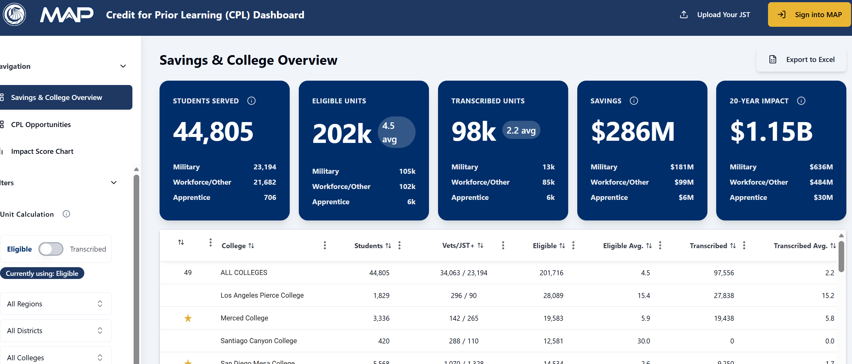
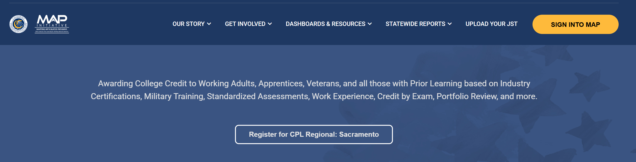
MAP Initiative and Progress

Slide 6
Policies & Compliance
Key State & Federal Regulations for California Community Colleges:
U.S. Department of Veterans Affairs:
  Title 38 Code of Federal Regulations
  School Certifying Official (SCO) Handbook
    Specifically addresses prior credit evaluation for veteran students
  VA Compliance Survey requirements
California Code of Regulations:
    Title 5, Section 55050, subsections (a), (d), (j), and (k)
      Governs credit by examination and prior learning assessment
California Community Colleges Chancellor's Office (CCCCO):
  Veterans Resource Center Minimum Standards
    Outlines requirements for serving veteran students in California community colleges

Slide 7
American Council on Education (ACE)
Who is ACE?
The American Council on Education (ACE) is responsible for evaluating military training and education.
Provides college credit recommendations based on military coursework and occupational experience.
How ACE Determines Credit:
College and University SMEs reviews military courses and occupations based on curriculum, learning outcomes, and assessment methods.
Assigns credit equivalencies.
Specifies recommended credit hours, course level (V, L, U, G), and subject area by consensus.
Why ACE Matters:
Helps colleges standardize the evaluation of JST credits.
Enables service members to earn transferable academic credit.
ACE recommendations do not guarantee credit—each institution makes the final decision.
Notes:
ACE serves as the bridge between military training and college credit by evaluating military courses and occupations.
The evaluation process is rigorous—ACE ensures that military training meets academic standards before making credit recommendations.
Despite these recommendations, colleges have the final say in accepting JST credits, which is why it’s important for students to understand their school’s policies.

Slide 8
American Council on Education (ACE)
Qualifications: Faculty members who are interested in becoming ACE reviewers typically have substantial experience in their academic field, hold advanced degrees, and have demonstrated expertise in curriculum development, teaching, or educational program assessment.
  Faculty must be currently teaching at an accredited college or university.
  Evaluators from various educational institutions: 4-Year Public and Private Universities, as well as 2-Year Public and Private Colleges.
  The reviews are founded on alignment with academic disciplines, ensuring expertise in the specific subject matter.
  A minimum of five years' experience is required for eligibility.
Faculty Consensus: All credit recommendations undergo a rigorous review by faculty evaluators. Their evaluations must attain 100% consensus, highlighting a thorough and comprehensive assessment process that values collective agreement among experts in the field.
Notes:
ACE serves as the bridge between military training and college credit by evaluating military courses and occupations.
The evaluation process is rigorous—ACE ensures that military training meets academic standards before making credit recommendations.
Despite these recommendations, colleges have the final say in accepting JST credits, which is why it’s important for students to understand their school’s policies.

Slide 9
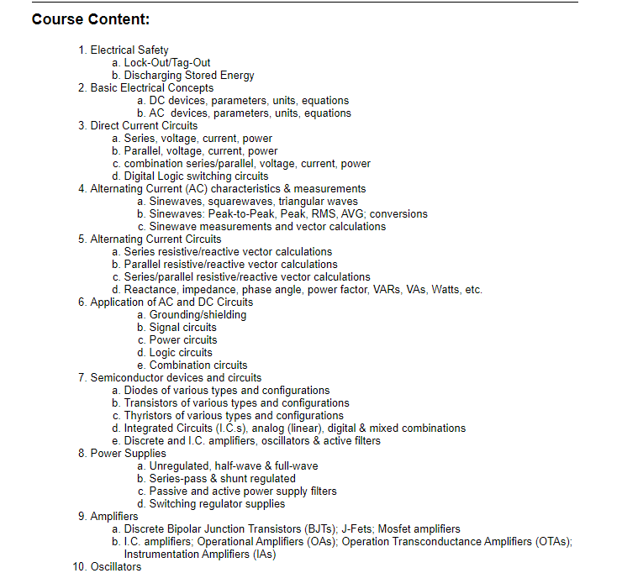
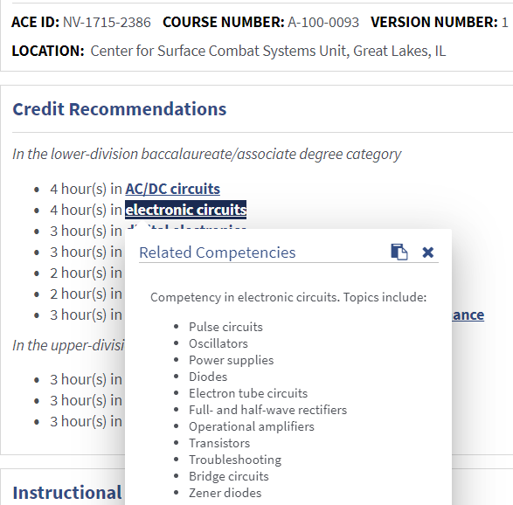
American Council on Education (ACE)
Notes:
ACE serves as the bridge between military training and college credit by evaluating military courses and occupations.
The evaluation process is rigorous—ACE ensures that military training meets academic standards before making credit recommendations.
Despite these recommendations, colleges have the final say in accepting JST credits, which is why it’s important for students to understand their school’s policies.

Slide 10
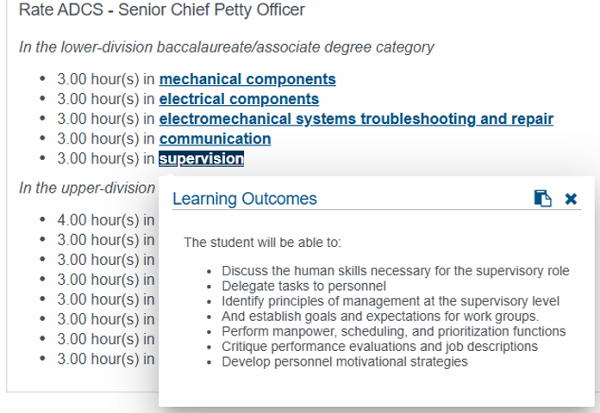

Slide 11
Veterans Sprint
Focuses on creating pathways for our 30,000+ enrolled student veterans to translate their military occupation experience and coursework into academic credits, supporting their transition to civilian life and higher education.
Goal 1: Upload all enrolled military student JSTs to the MAP platform.
Goal 2: Award appropriate course credit for military service (replacing CSU GE Area E, which is not a CalGETC requirement).
Goal 3: Offer additional CPL through JST Credit Recommendation (CRs) review.

Slide 12
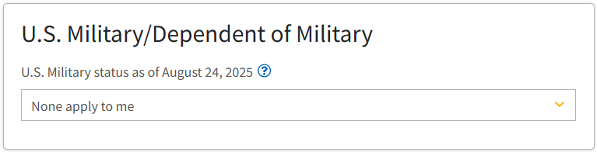
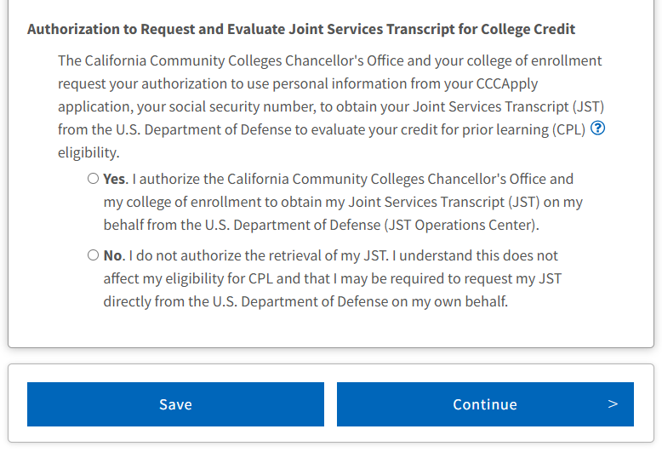
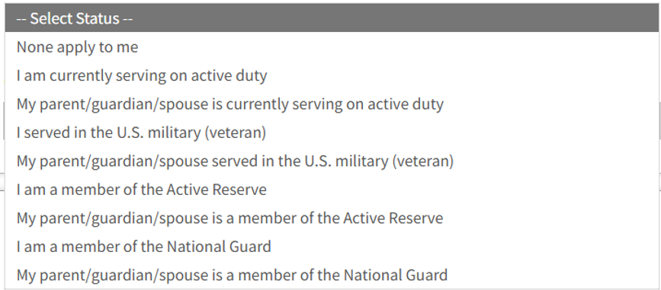

Student Authorization – CCCApply
Notes:
ACE serves as the bridge between military training and college credit by evaluating military courses and occupations.
The evaluation process is rigorous—ACE ensures that military training meets academic standards before making credit recommendations.
Despite these recommendations, colleges have the final say in accepting JST credits, which is why it’s important for students to understand their school’s policies.

Slide 13
Bulk JST Ordering
Bulk ordering for Joint Services Transcripts (JST) is a process used by educational institutions to efficiently request multiple military transcripts for their service members at a time.
Benefits:
  Removes barriers for your service members
  Saves time compared to individual requests
  Useful for colleges with a high veteran population
  Can streamline admissions and credit transfer processes
Point of Contact:
  Admissions & Records
  Veterans Resource Center
  Counseling Department

Slide 14
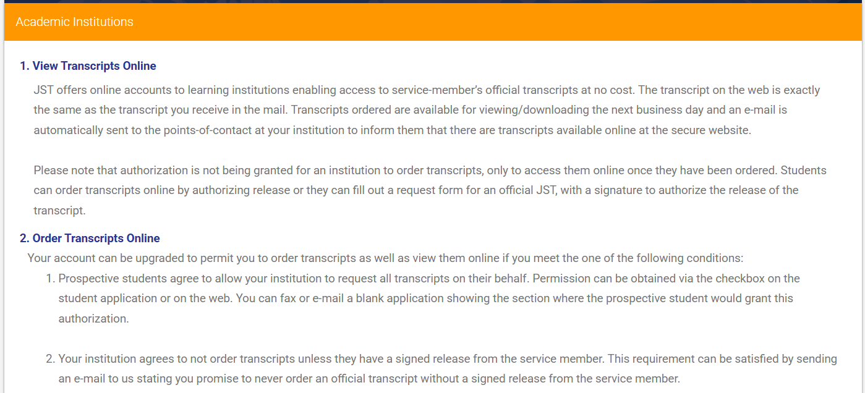
JST Student Authorization Update

Slide 15
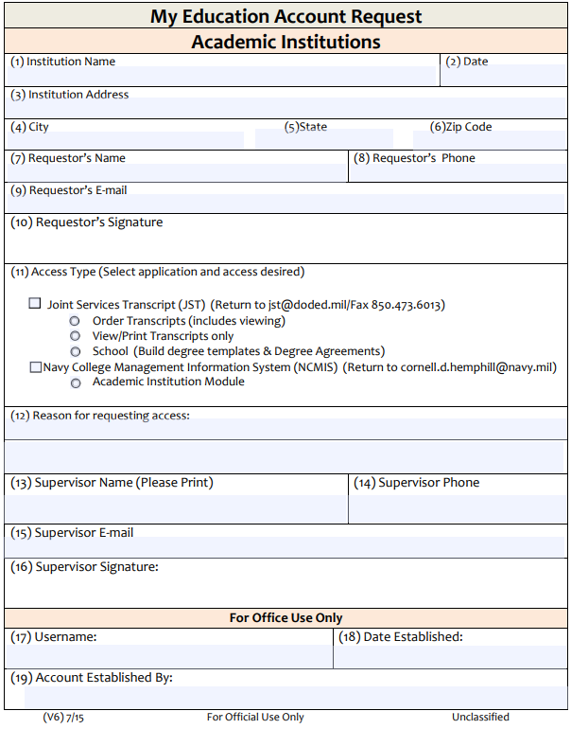
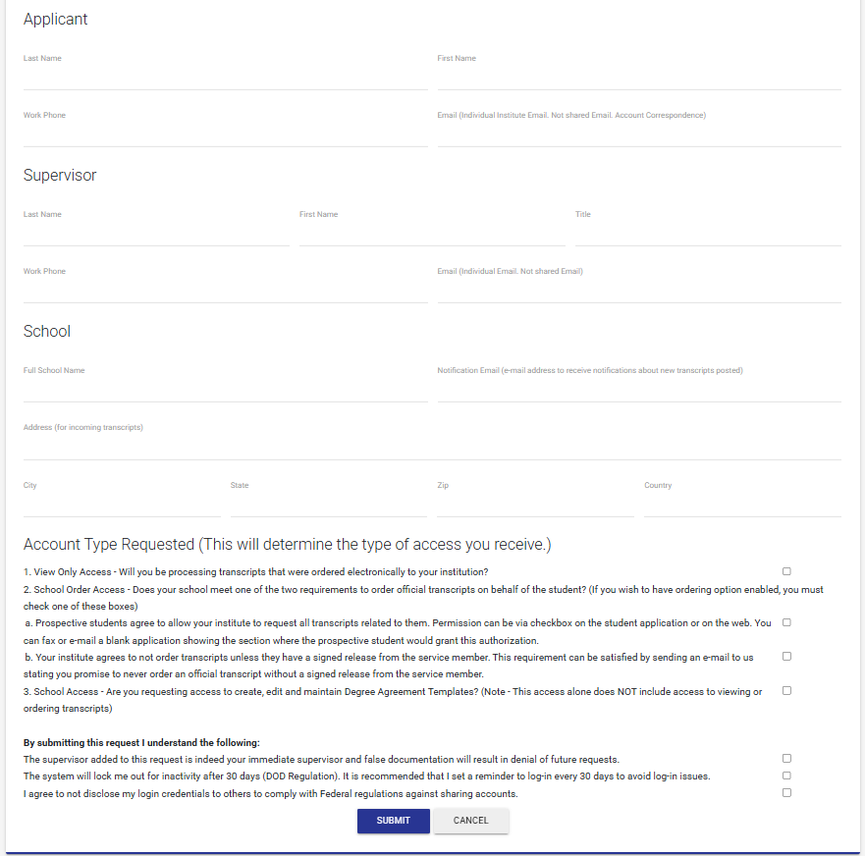

JST Student Authorization Update
OLD FORM
NEW FORM

Slide 16
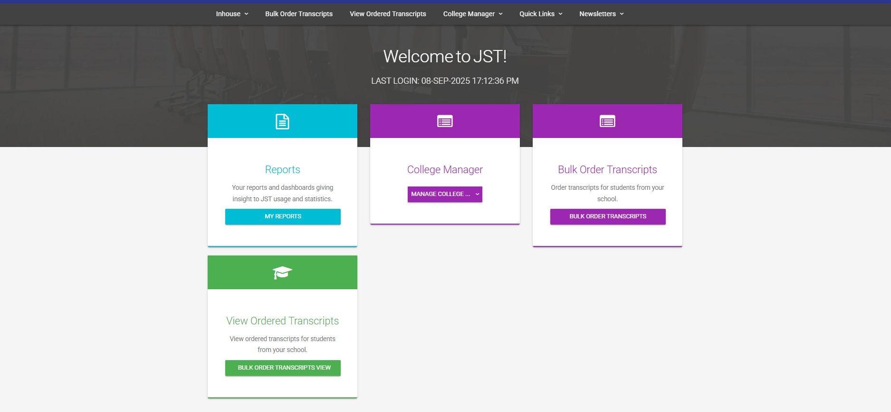

Slide 17
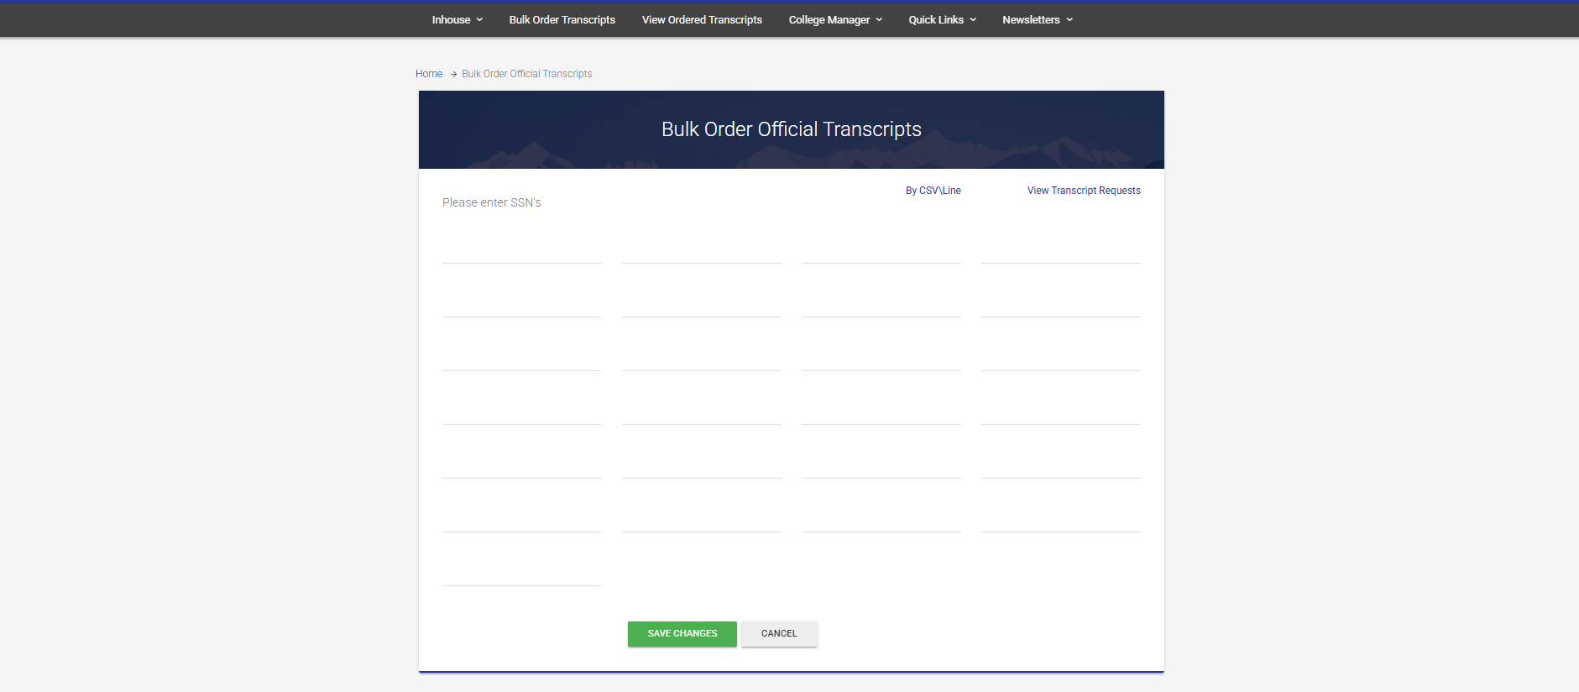
111111111
111111118
111111124
111111130
111111112
111111119
111111125
111111131
111111113
111111120
111111126
111111132
111111114
111111121
111111127
111111133
111111115
111111122
111111128
111111134
111111116
111111123
111111129
111111135
111111117

Slide 19
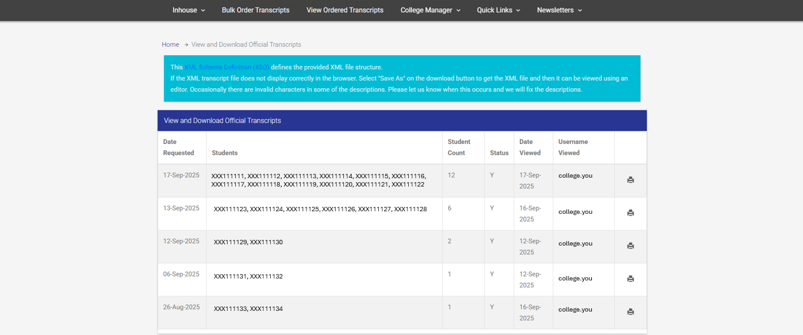
JSTs will be available in 1-2 days.
Save as PDF and save to a secure folder.
Will stay in queue for 30 days.

Slide 20
Joint Services Transcript
A Joint Services Transcript (JST) is an official academically accepted and approved document provided by the Department of Defense (DOD) that has been approved by the American Council on Education (ACE) to validate a service members military course completions, military occupations, college level test scores and other learning experiences.
ACE ID: All courses and occupations reviewed by ACE have a corresponding ACE identification number (ACE ID).
Credit Recommendations (CR): Credit recommendations listed on a JST are based on each service member’s learning through military experience, academic exam scores, and academic courses completed while in the military. These credit recommendations have been evaluated by the American Council on Education (ACE) and designated in semester hours.
Semester Hours (SH): ACE uses "Credits", "Hours", or "Semester Hours (SH)" interchangeably which refers to semester units using Carnegie Lecture Hours Equivalent (e.g., 3SH is 3 credits).
ACE CR Levels: V – Vocational, L – Lower, U – Upper, G – Graduate

Slide 21
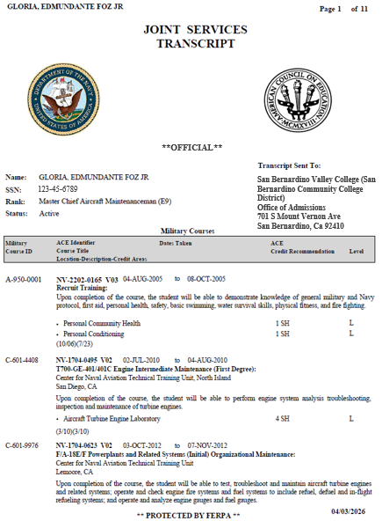
1
2
Branch of Service
ACE Seal
3
4
Service Member Information
College Recipient
5
Military Courses
6
ACE Exhibit Information (Courses)
7
Credit Recommendations
8
10
ACE Credit Recommendation Value
1st: ACE faculty review date
2nd: Administrative adjustments to course data
9
Level of Credit

Slide 22
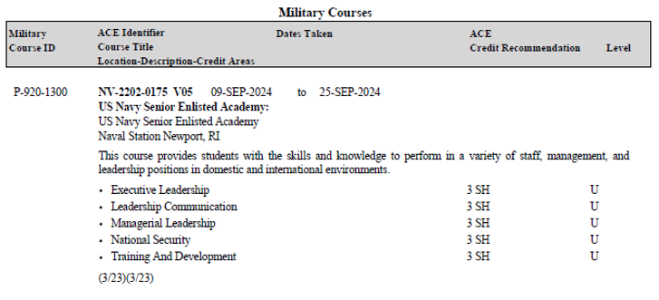
1
Military Courses
2
ACE Exhibit Information (Experience)
3
Credit Recommendations

Slide 23
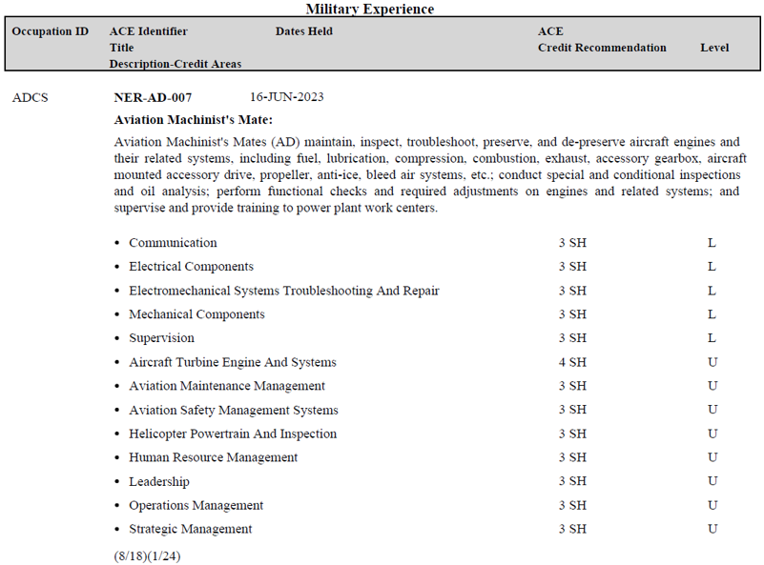
1
Military Experience
2
ACE Exhibit Information (Experience)
3
Credit Recommendations

Slide 24
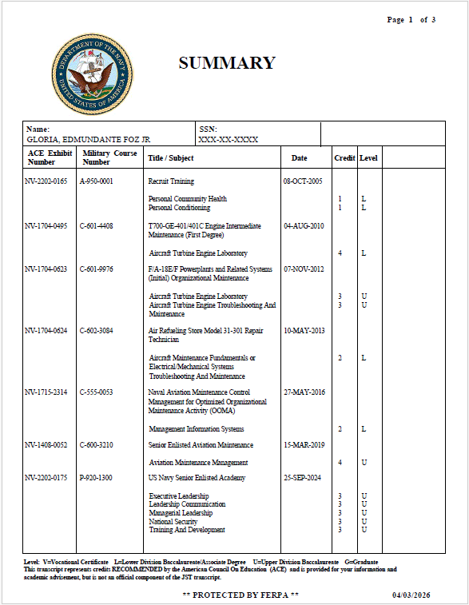
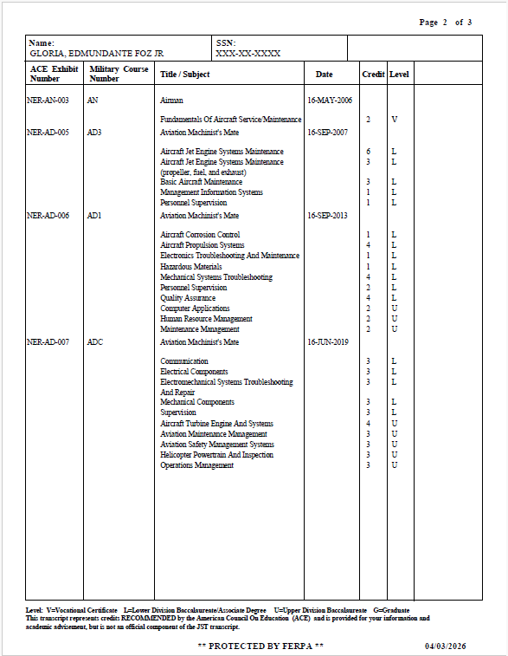
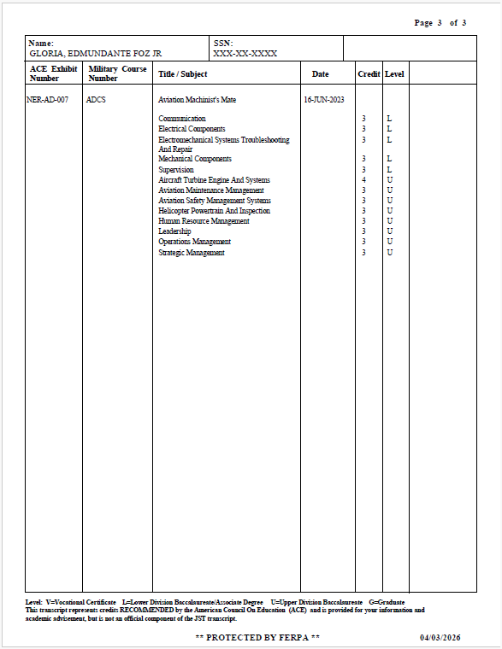
JST Summary Page

Slide 25
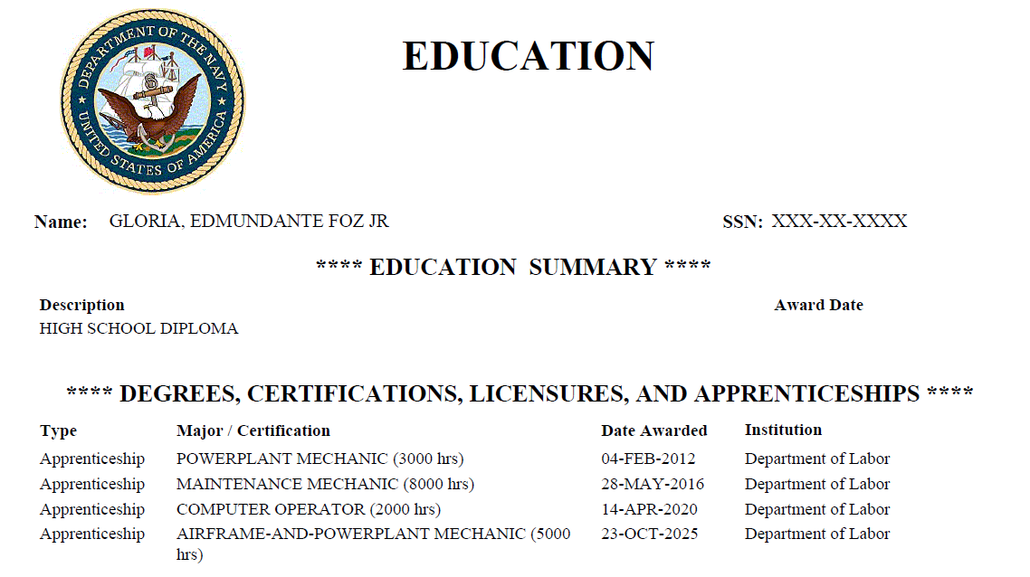

Slide 26
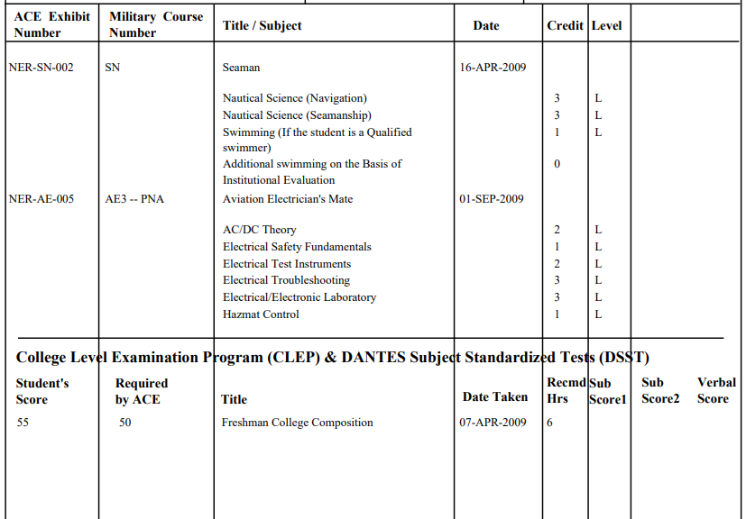
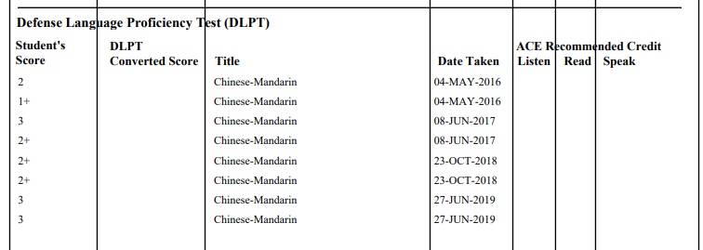
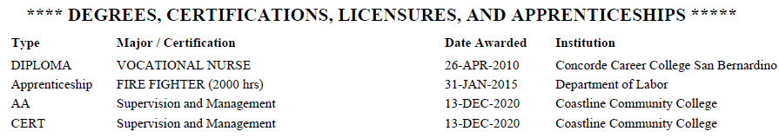

Slide 27
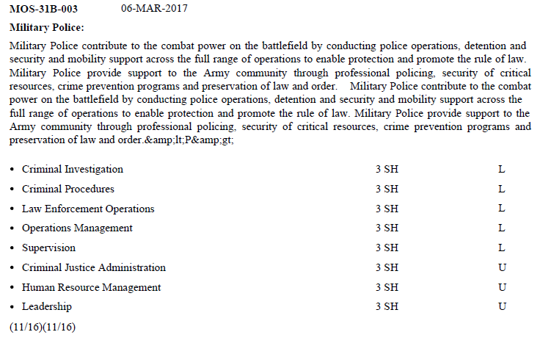
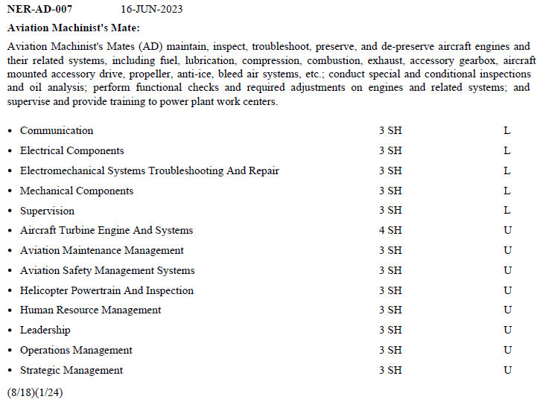
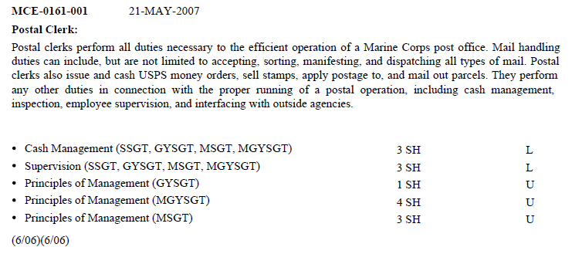
Reviewing Credit Recommendations over ACE ID (MOS/RATE – Occupation) is recommended as it provides a clearer, standardized framework that acknowledges and values the diverse experiences and training of service members.

Slide 28
ACE ID vs Credit Recommendations
Why does the MAP Initiative encourage the use of Credit Recommendations over ACE IDs to create articulations with college courses?
Prioritizing military ACE-IDs over credit recommendations risk creating inequities.
ACE-IDs can be less recognized and understood by faculty potentially complicating the CPL process.
Credit Recommendations provide a clearer, standardized framework that acknowledges and values the diverse experiences and training of our service members.
To truly support our students, we should focus on approaches that ensure equitable access to educational opportunities, recognizing the skills they've gained through their military service.
Notes:
ACE serves as the bridge between military training and college credit by evaluating military courses and occupations.
The evaluation process is rigorous—ACE ensures that military training meets academic standards before making credit recommendations.
Despite these recommendations, colleges have the final say in accepting JST credits, which is why it’s important for students to understand their school’s policies.

Slide 29
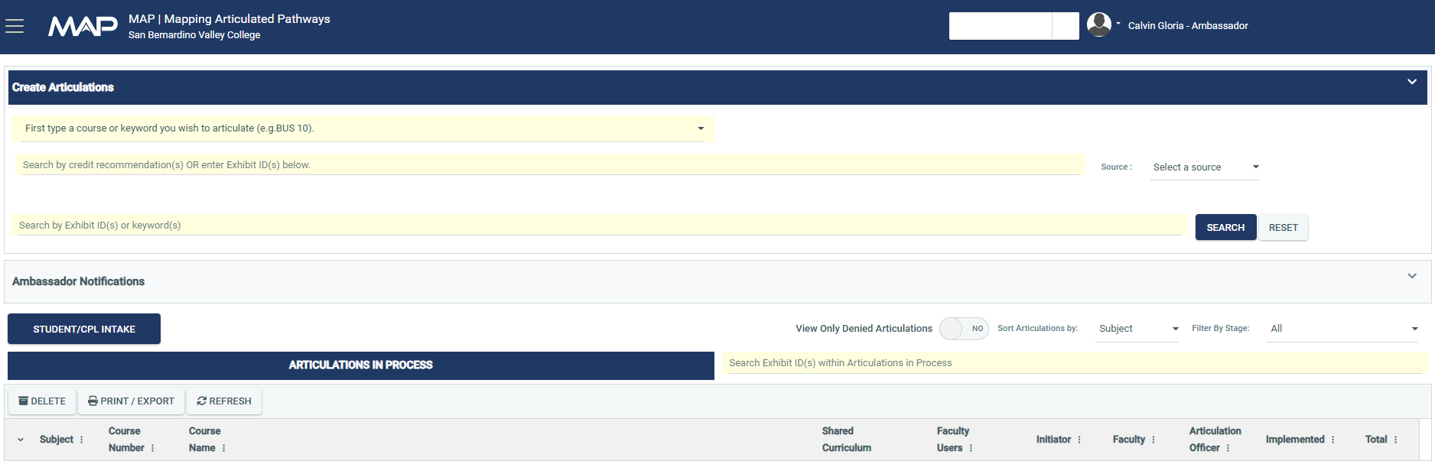

Select Student/CPL Intake
Notes:
ACE serves as the bridge between military training and college credit by evaluating military courses and occupations.
The evaluation process is rigorous—ACE ensures that military training meets academic standards before making credit recommendations.
Despite these recommendations, colleges have the final say in accepting JST credits, which is why it’s important for students to understand their school’s policies.

Slide 30
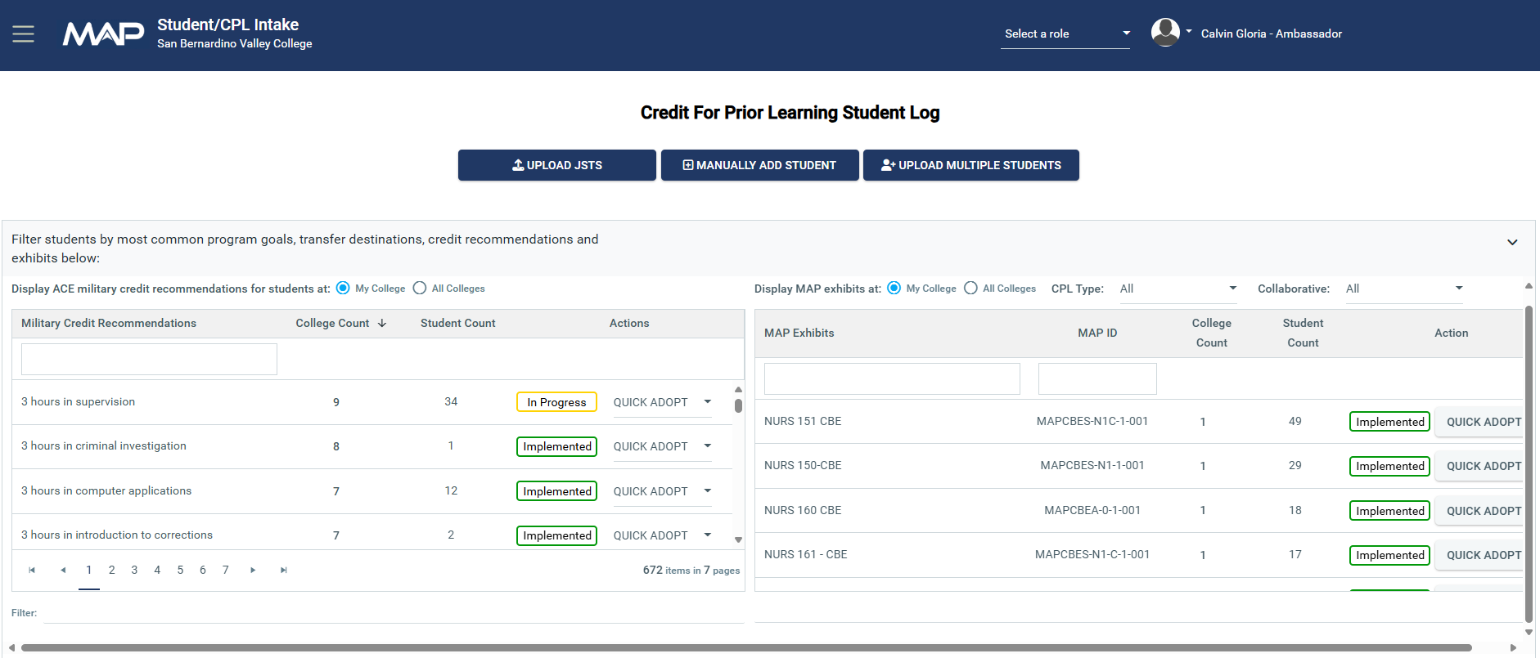
Notes:
ACE serves as the bridge between military training and college credit by evaluating military courses and occupations.
The evaluation process is rigorous—ACE ensures that military training meets academic standards before making credit recommendations.
Despite these recommendations, colleges have the final say in accepting JST credits, which is why it’s important for students to understand their school’s policies.

Slide 31
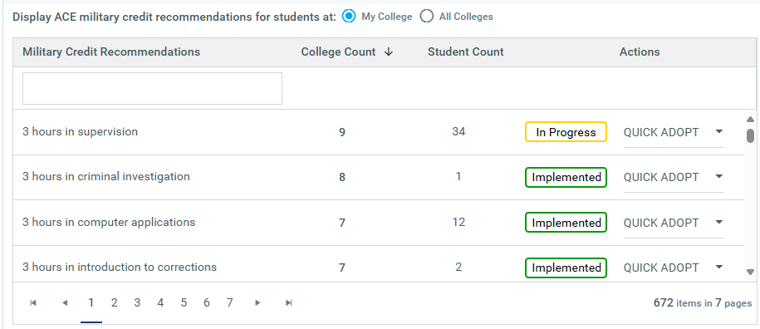
Notes:
ACE serves as the bridge between military training and college credit by evaluating military courses and occupations.
The evaluation process is rigorous—ACE ensures that military training meets academic standards before making credit recommendations.
Despite these recommendations, colleges have the final say in accepting JST credits, which is why it’s important for students to understand their school’s policies.

Slide 32
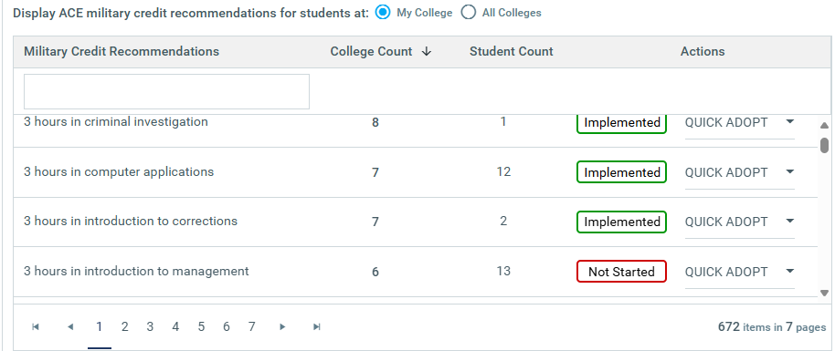
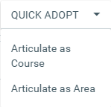
Notes:
ACE serves as the bridge between military training and college credit by evaluating military courses and occupations.
The evaluation process is rigorous—ACE ensures that military training meets academic standards before making credit recommendations.
Despite these recommendations, colleges have the final say in accepting JST credits, which is why it’s important for students to understand their school’s policies.

Slide 33
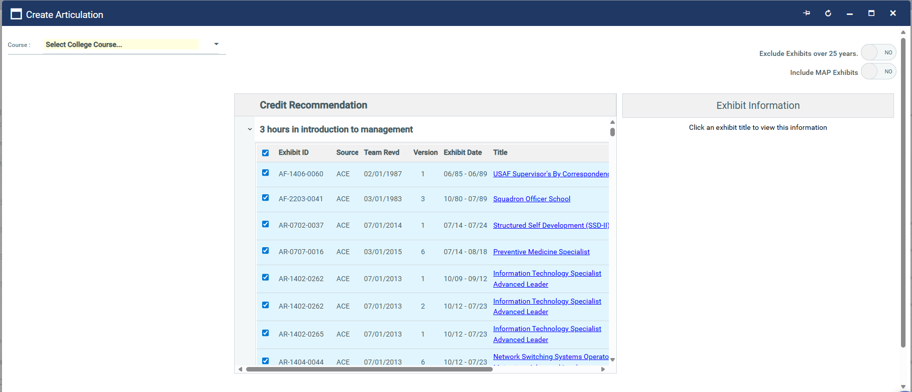
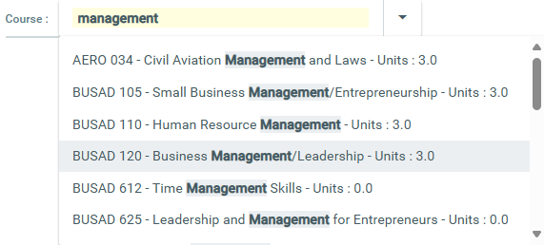
Notes:
ACE serves as the bridge between military training and college credit by evaluating military courses and occupations.
The evaluation process is rigorous—ACE ensures that military training meets academic standards before making credit recommendations.
Despite these recommendations, colleges have the final say in accepting JST credits, which is why it’s important for students to understand their school’s policies.

Slide 34
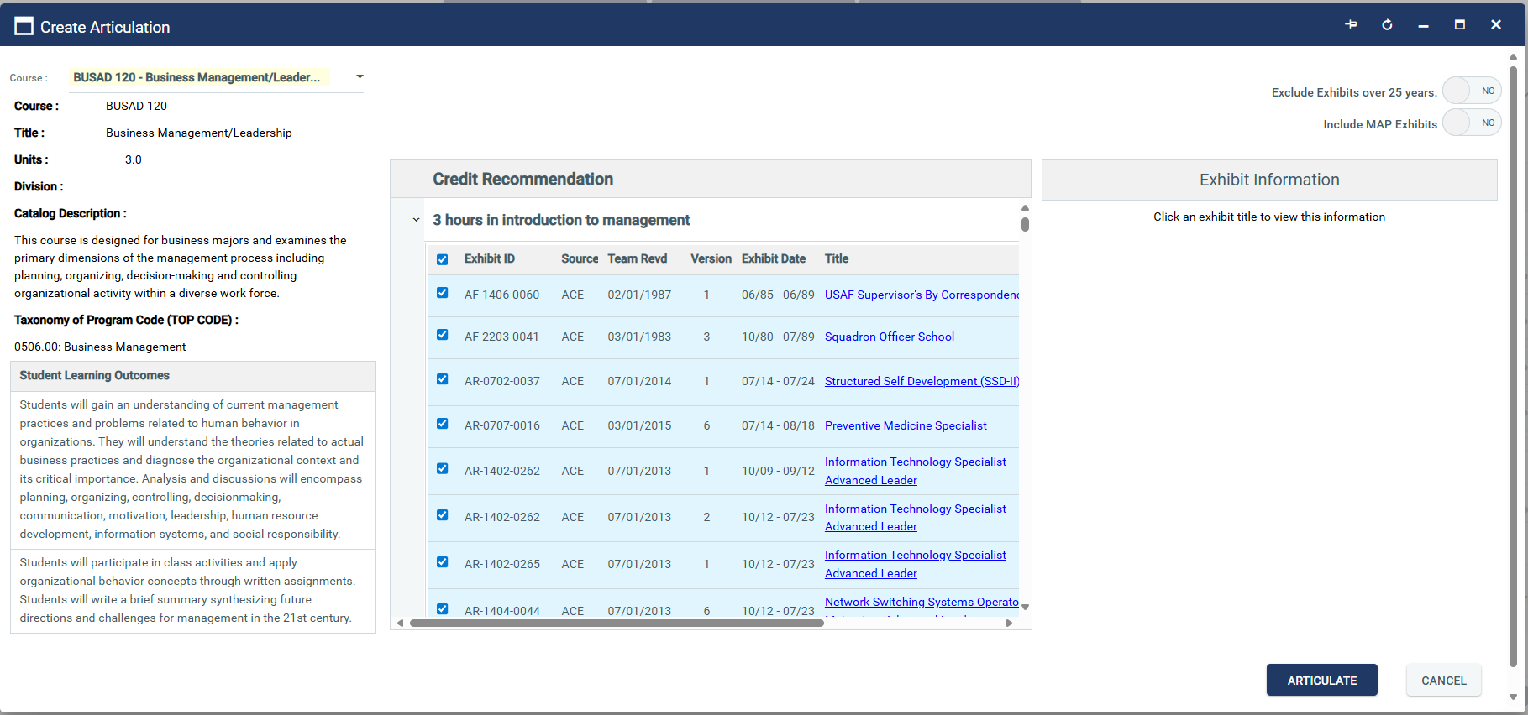
Notes:
ACE serves as the bridge between military training and college credit by evaluating military courses and occupations.
The evaluation process is rigorous—ACE ensures that military training meets academic standards before making credit recommendations.
Despite these recommendations, colleges have the final say in accepting JST credits, which is why it’s important for students to understand their school’s policies.

Slide 35
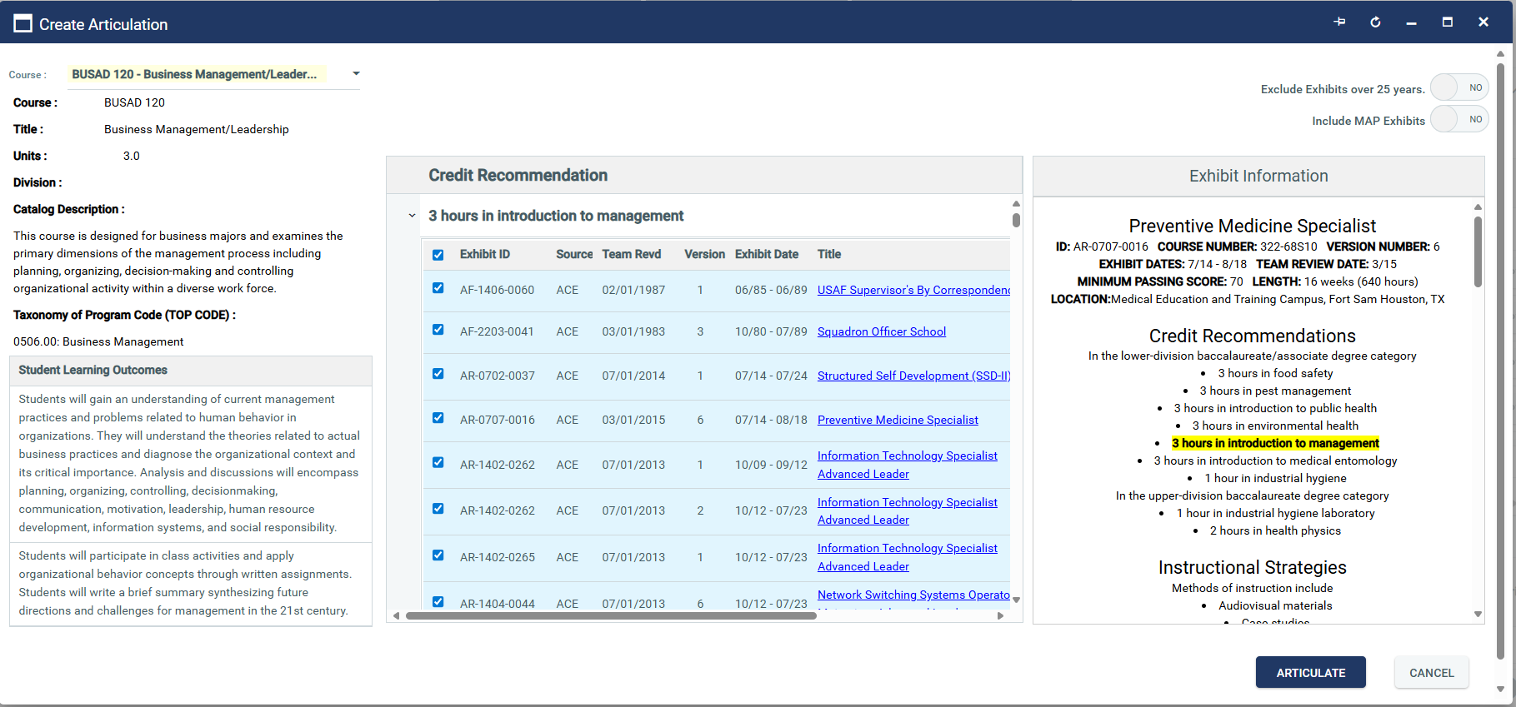
Notes:
ACE serves as the bridge between military training and college credit by evaluating military courses and occupations.
The evaluation process is rigorous—ACE ensures that military training meets academic standards before making credit recommendations.
Despite these recommendations, colleges have the final say in accepting JST credits, which is why it’s important for students to understand their school’s policies.

Slide 36
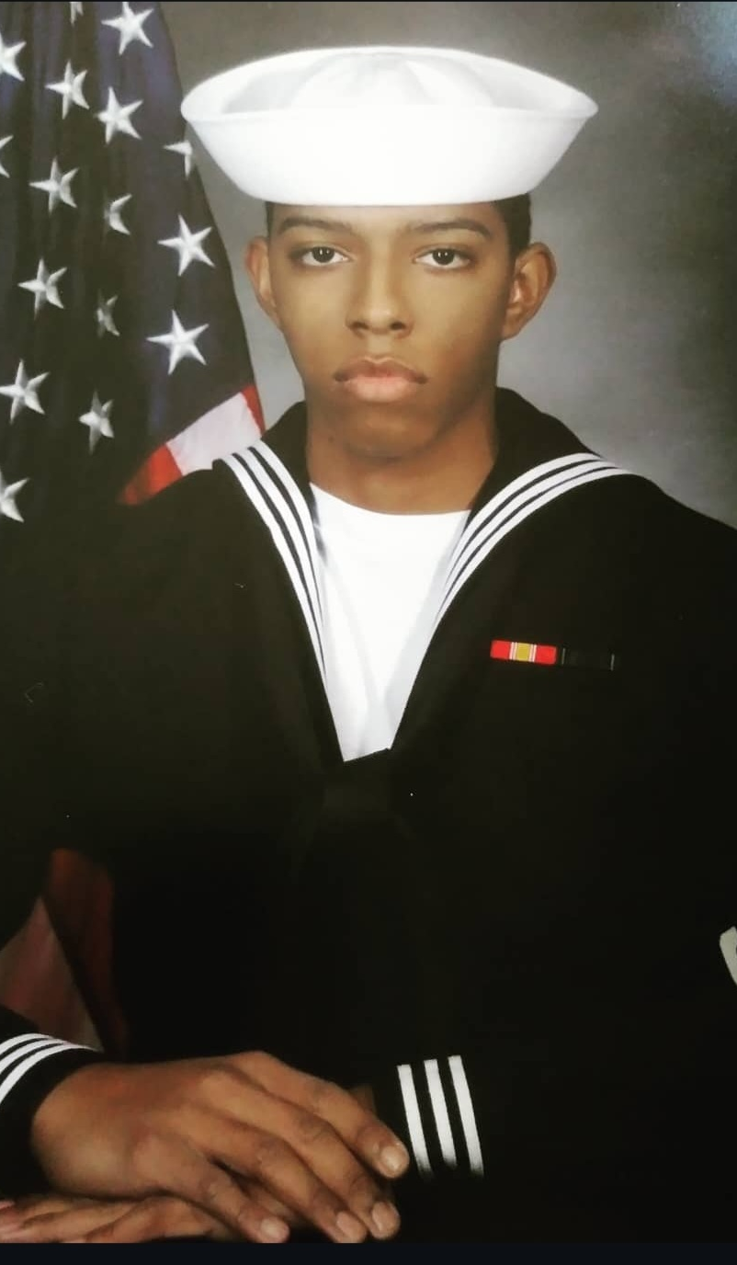
Matthew McKenzie
Navy Petty Officer 2nd Class - Information Systems Tech (E5)
Matthew began at San Bernardino Valley College in Spring 2025 and is pursuing an AS degree in Information Systems and Technology and later transfer to CSU San Bernardino for his BS in Information Systems and Technology. He is interested in Cyber Security or National Security concentrations. Based on a review of his JST, SBVC faculty approved the following 9 units of credit:
CIT 101 - Introduction to Computer Literacy (3 Units)
CIT 160 - Introduction to Information Systems Security (3 Units)
CIT 232 - Computer Network Fundamentals (3 Units)
CIT 101,160, 232 are major requirements and also major prep classes for the CSUSB degree.
A semester of study and benefits saved with CPL, Matthew expects to graduate and transfer by Fall 2026.

Slide 37

David Balderas
Eight-year Army veteran David Balderas, MOS 91B10 Wheeled Vehicle Mechanic, enrolled at San Bernardino Valley College in Summer 2024 and met with CPL Counselor Ryan Hogan to upload his JST to MAP and develop his CPL options and Education Plan. He was offered and accepted 13 units toward an AS Auto Technician:
3 units in BUSAD 120 - Business Management/Leadership
1 unit in Kinesiology 231 - First Aid and CPR
3 units in Kinesiology 138A - Beginning Physical Fitness
3 units in AUTO 050 - Automotive Brakes
3 units in AUTO 052 - Automotive Suspension
3 units in CSU GE Area-E
David is Transferring soon to a CSU!

Slide 38



Questions?
map.rccd.edu
THANK YOU

