Slide 1
Supporting the whole Military Community:
The growth and support of Military Dependents on campus
April 23, 2026
Rayna M. Vest
Middle Tennessee State University

Slide 2
Session Outcomes:
Be presented with trends in the presence and engagement of Dependents on campus
Be challenged to consider the growing number of military Dependents on campus, the unique needs of those students, and identify gaps in coverage.
Walk away with ideas for boosting Dependent engagement and develop ideas for supporting their needs.

Slide 3

The Daniels Center
Opened in 2015
Serves almost 1,300 Military-Connected students, as well as MTSU faculty and staff, and the community
Our team includes:
Director and Administrator
School Certifying Officials
Two Veterans Service Officers
VR&E counselor
VA clinical social worker
Career search and readiness personnel
Graduate Assistants
Student Workers

Slide 4
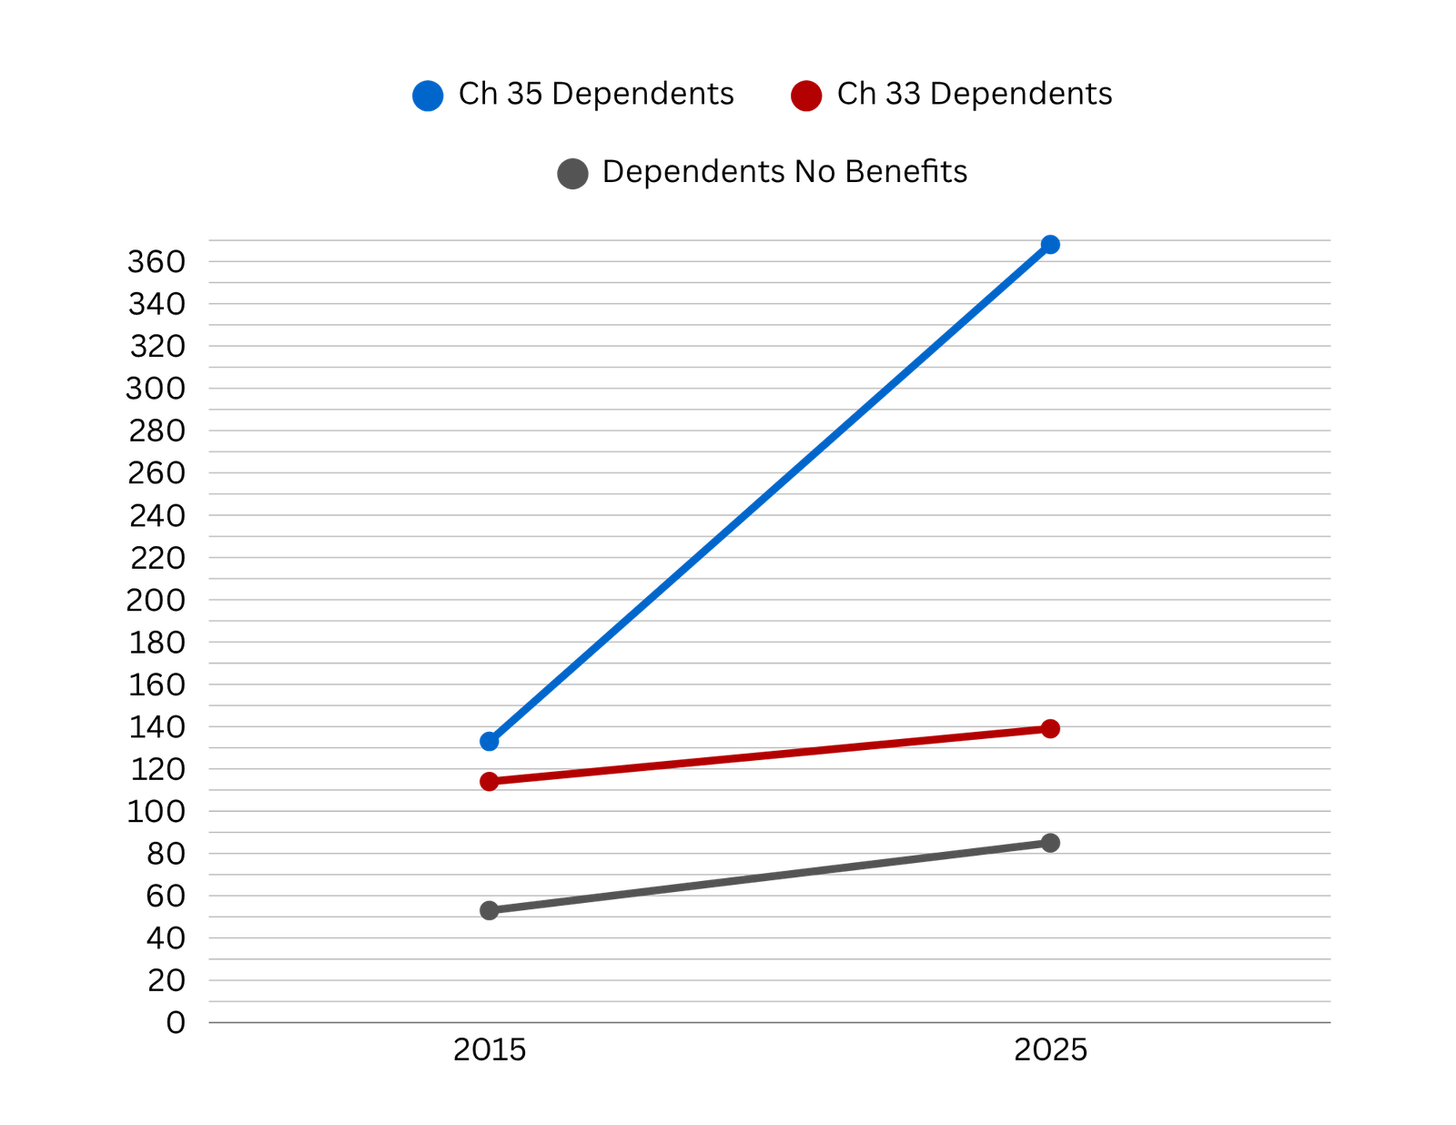
Our Growth

Slide 5
The Question:
How can we support and engage Military Dependents in meaningful and effective ways?

Slide 6


Strategy 1:
Catch

Slide 7
Strategy 1: Catch

Slide 8
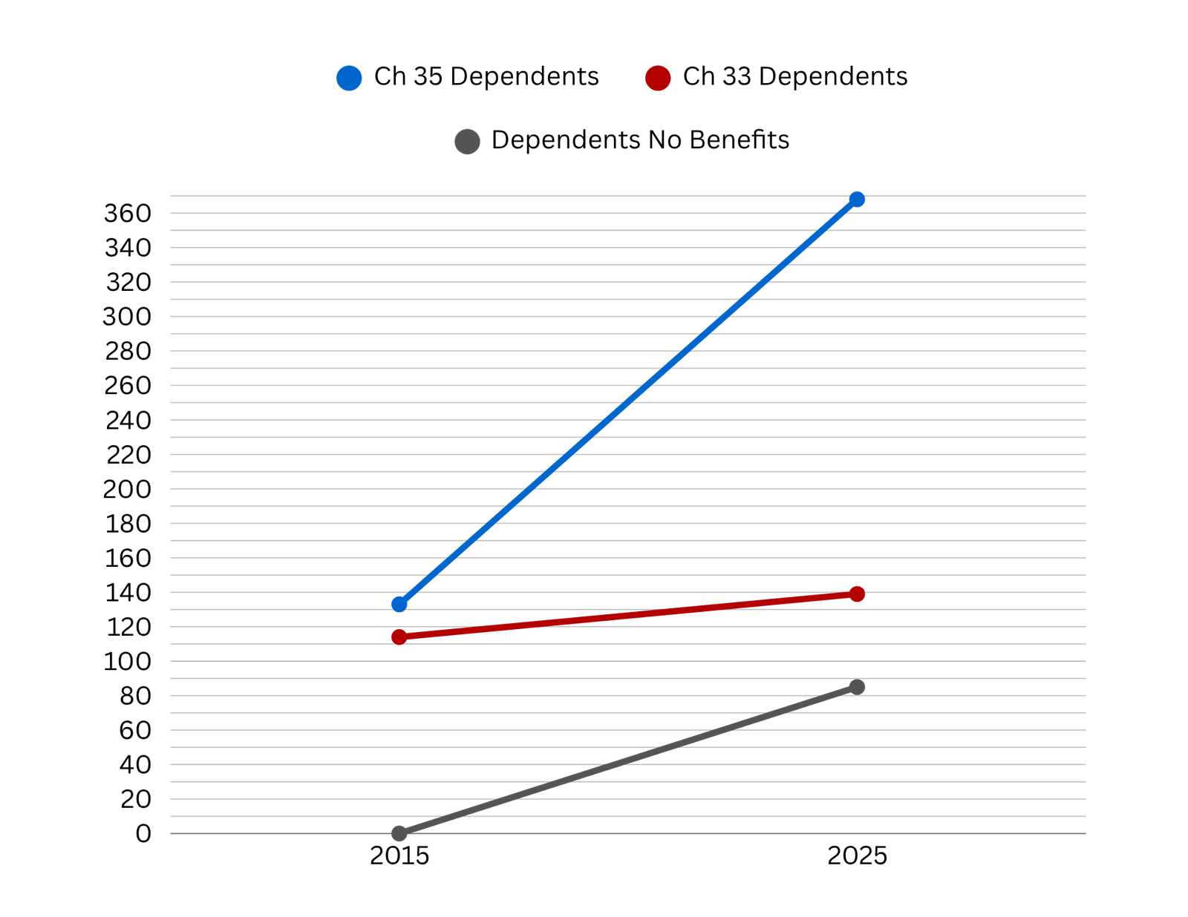
Strategy 1: Catch

Slide 9
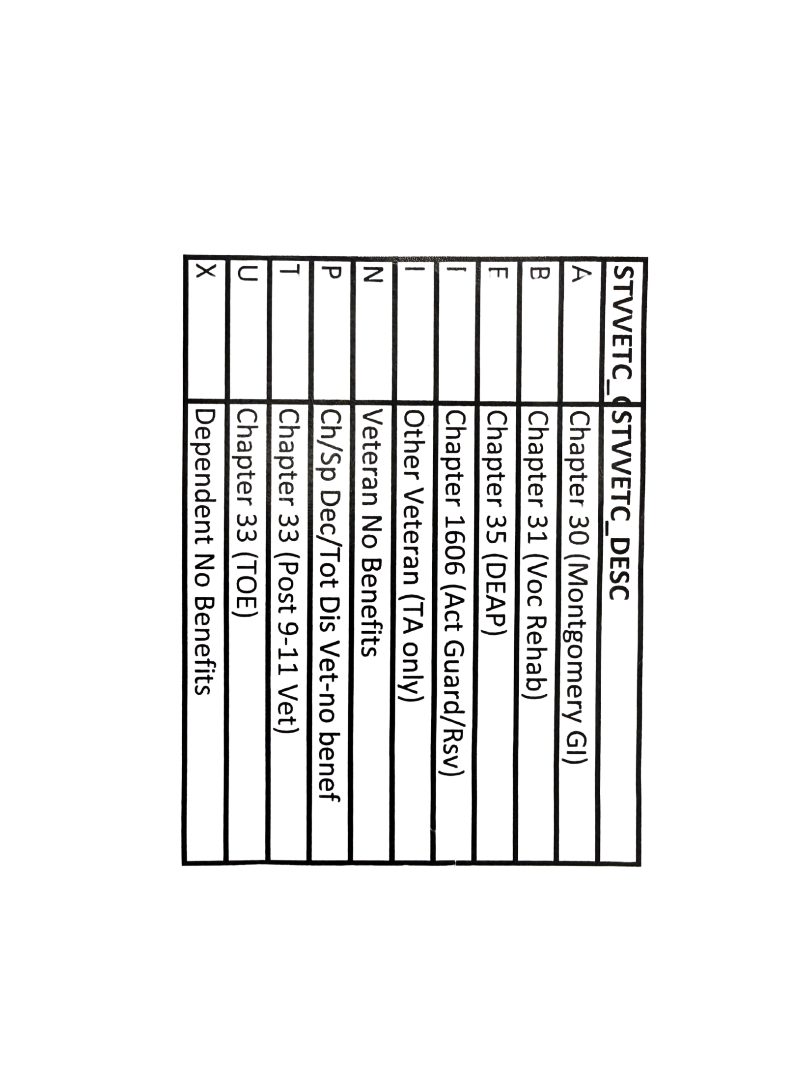
Strategy 1: Catch

Slide 10
Strategy 2:

Slide 11
Strategy 2:
Care

Slide 12
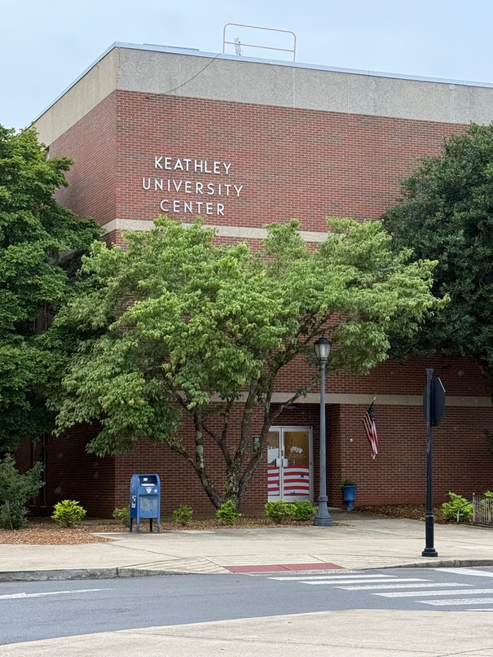
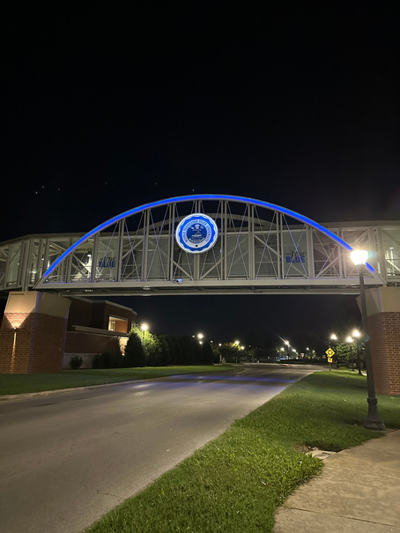
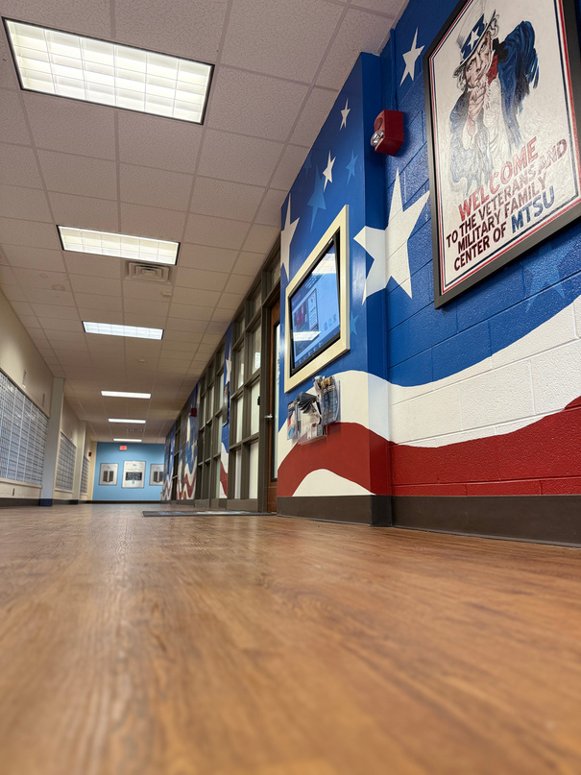
Startegy 2: Care
“EVERYONE... GOES ABOVE AND BEYOND TO HELP STUDENTS”
“I LOVE THAT THEY TAKE THE TIME TO KNOW EACH OF US PERSONALLY”
“ONLY WALKED BY AND GOT GREETED AND LEARNED A LITTLE BIT SO NOT MUCH KNOWLEDGE BUT GREAT PEOPLE”
A Military Child, Ch. 33
A Military Spouse, Ch. 35
A Military Child, no benefits

Slide 13
Strategy 2: Care
THE POINT: HOW WE ENGAGE WITH STUDENTS MATTERS
They will remember

Slide 14
Strategy 2: Care
Scholarship workshops
Dependent events
Campus refferal resources
College support
Be an ear willing to listen

Slide 15
Strategy 3:
Connect

Slide 16
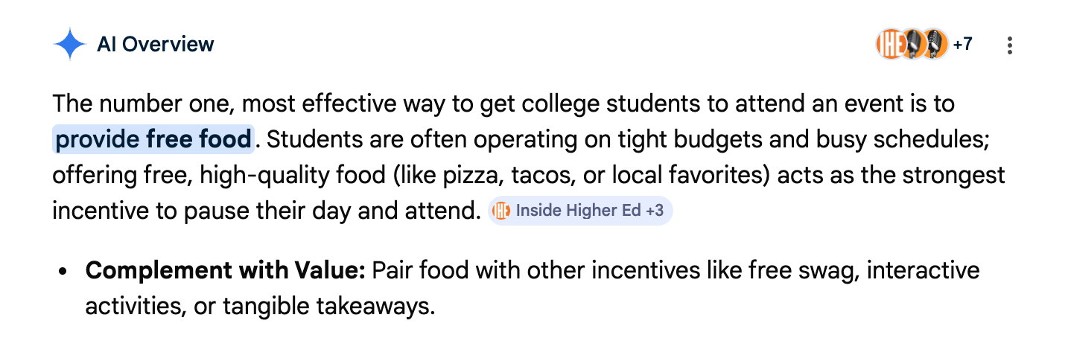
Strategy 3: Connect

Slide 17



Strategy 3: Connect

Slide 18

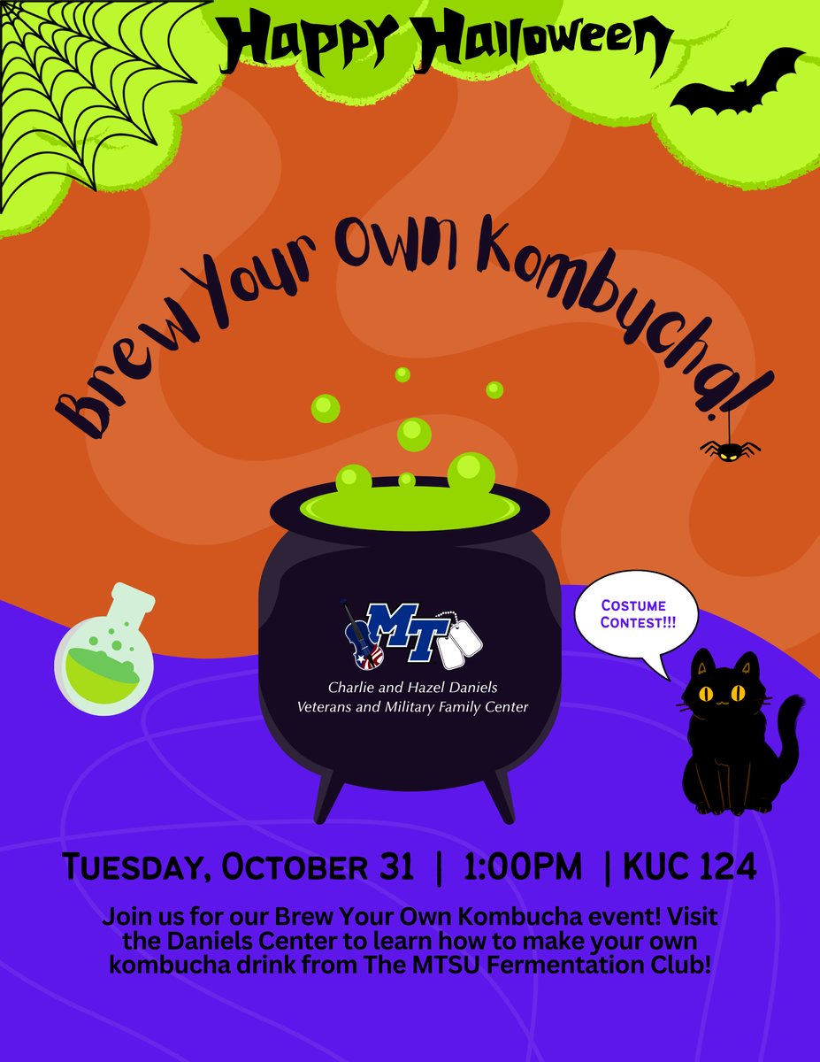

Strategy 3: Connect

Slide 19

Strategy 3: Connect
Modern Problems? Modern Solutions.
DISCORD
INSTAGRAM
FACEBOOK
E-MAIL

Slide 20
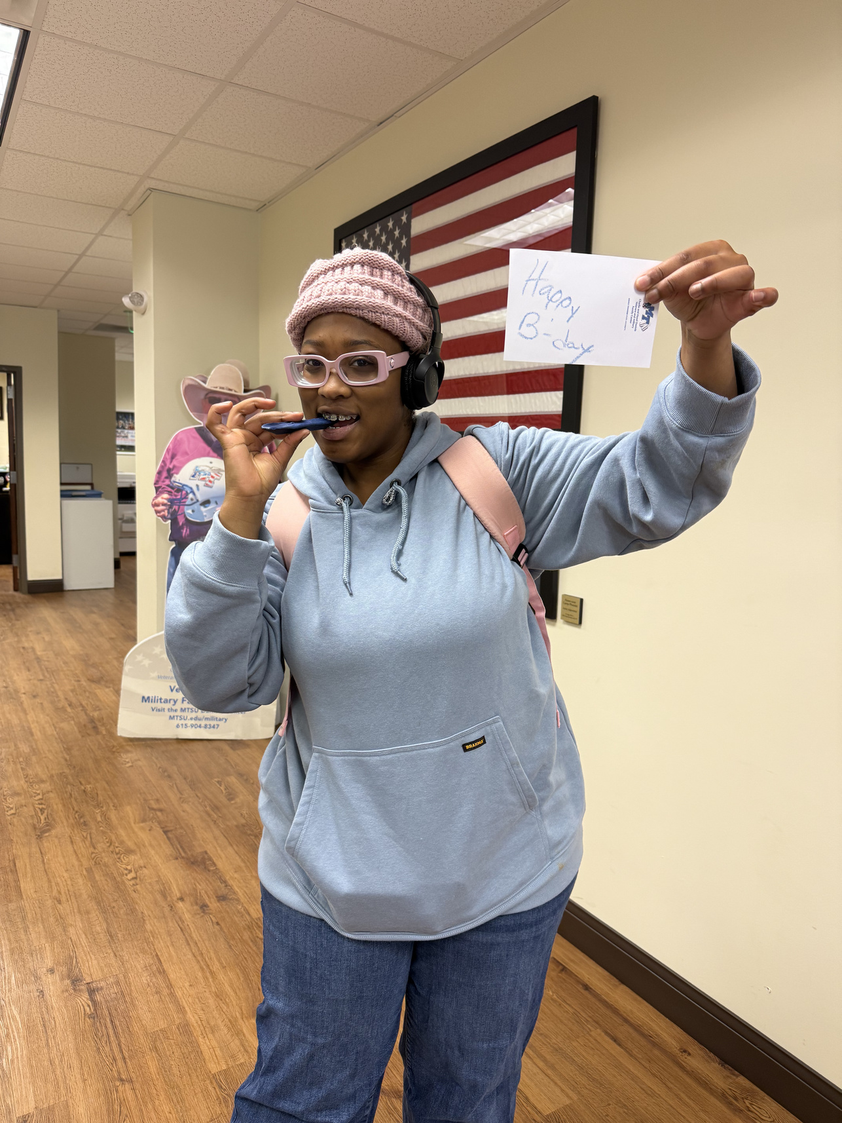
Conclusion
What can your office do to support your whole Military Community?
Catch | Care | Connect

