Slide 1

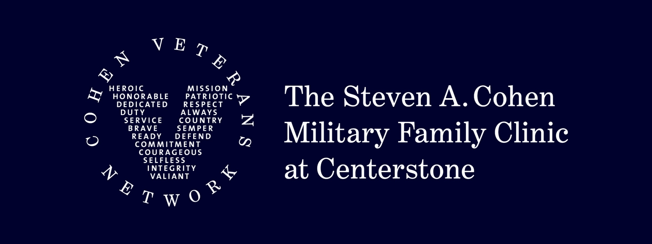
Mental Health Awareness
Presented by Melody Shipley, LPC-MHSP, Assistant Director
Steven A. Cohen Military Family Clinic at Centerstone-Clarksville

Slide 2


What is Mental Health Awareness
New Episodes of Care: 937
The ability to be aware if someone is experiencing chronic stress and a mental health challenge or an emotional response to external stressors or events.
The ability to recognize when to intervene when someone is impacted by a stressor.
The ability to encourage mental health as a priority in a workplace or school setting and reduce the stigma around struggling with a stress response or mental health challenge.
What it is not? It is NOT a diagnosis.
Currently Active Clients: 371
Discharged Clients: 722

Slide 3
What is Acute Stress
Stress is a healthy and normal process when encountering daily life events which can cause a physical response to events that make you feel threatened or upset your balance in some way. An acute stress reaction occurs when symptoms, including anxiety, avoidance and depression symptoms develop quickly as a reaction to exceptionally stressful events beyond our daily life situations.
Compounding Acute Stress:
Experiencing multiple stressful events that culminate and can worsen a typical stress reaction.
New Referrals Received (non-readmission): 876
Total Referral Population: 968
New Episodes of Care: 937
New Client Intake (non-readmission): 703
Currently Active Clients: 371
Discharged Clients: 722

Slide 4
Common Military Family Stressors
Depression
Anxiety
Post-traumatic stress disorder
Adjustment issues
Sleep problems
Substance misuse
Anger
Grief and loss
Deployment and transition challenges
Family issues
Relationship problems
Children’s behavioral problems
Parent-child interaction concerns

Slide 5
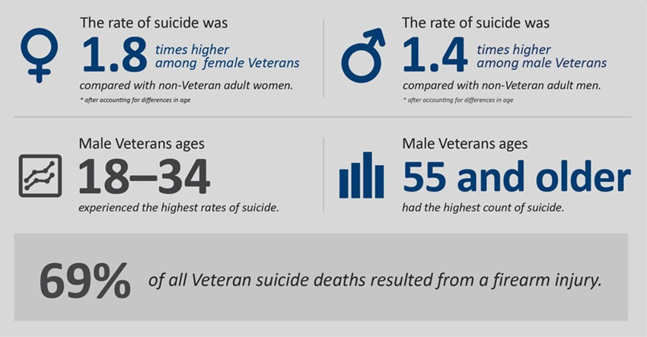
Common Military and Veteran Health Concerns
Post-Traumatic Stress Disorder
Combat and non-combat-related
Military sexual trauma
Anxiety
Adjustment disorder
Depression
Relationship distress
Increased risk for suicide
Increased risk for substance dependency
Chronic pain

Slide 6
Signs and Symptoms
Hopelessness
Anxiety
Inability to listen, avoidance
Anger and cynicism
Sleeplessness
Chronic exhaustion and/or physical ailments
Minimizing
Guilt
Preoccupation/Rumination
Intrusive thoughts/nightmares/ flashbacks
Feeling estranged/isolated/no one to talk to
Feeling trapped, inadequate, depressed
New

Slide 7
The Impact of Chronic Stress and Mental Health
Impact varies by individual but overall refers to the amount of disruption a health problem causes to a person’s ability to:
Work/or go to school
Carry out daily activities
Engage in satisfying relationships
The effects of stress on mental health can be more disabling than many chronic physical illnesses.

Slide 8

Iceberg Effect
Symptoms can exist under the surface BEFORE they are visible to others. When they reach the surface, they have been existing for a period of time and expedite the need for intervention.

Slide 9
Military Mental Health Barriers
Access to care
Stigma
Feeling “weak”
Fear of losing benefits
Fear of judgment or being misunderstood

Slide 10
Stigma:
Stigma is the fear of scrutiny for expressing mental health challenges.
Creating a culture of acceptance to express challenges is important to combat stigma.
Talk frequently about chronic stress and how it can affect us.
Acknowledge that leadership is willing to support and listen to these challenges.
New Referrals Received

Slide 11
How to approach someone I am concerned about
Create a space that is safe to express their concerns.
Private
Free of judgment and repercussions
Be Accepting
Acceptance fosters an understanding of respect
Be Genuine
Truly be interested in the concerns being shared with you.
Understand and be aware of resources that are available.
New Referrals Received

Slide 12
Clinical Interventions
Evidence-based best practices
Individual therapy
Recognition of geographic dispersal while operating in civilian work/school and military environment
What does physical and mental wellness support look like where they live
Telehealth comfortability
Psychiatric evaluation preparation
Cognitive behavioral therapy INCLUDING specialty versions (i.e. CBT-I, CBT-SP)
Exposure therapies for Post-Traumatic Stress Disorder (PTSD)
Cognitive Processing Therapy (CPT)
Prolonged Exposure (PE)
Written Exposure Therapy (WET)
Eye-Movement Desensitization and Reprocessing (EMDR)
Appropriate suicide prevention care (CAMS, BCBT-SP)
Couples therapy
The Gottman Method approach
Emotionally Focused Therapy (EFT)
Children and Family therapy
Parent-Child Interaction Therapy (PCIT)
Modular Approach to Therapy for Children with Anxiety, Depression, Trauma, or Conduct (MATCH-ADTC)
Trauma Focused Cognitive Behavioral Therapy (TF-CBT)
Emotionally Focused Family Therapy (EFFT)
Brief Strategic Family Therapy (BSFT)
New Referrals Received

Slide 13
Helpful versus Not Helpful Things to Say if I notice signs/symptoms in someone else
Not Helpful
Helpful
“You shouldn’t feel this way”
“You should get over it”
“It’s not that big of a deal”
“You shouldn’t let it effect you like this”
“I’m here to listen”
“How can I support you?”
“It’s okay to be struggling with difficult things.”
“What you say is safe with me.”
New Referrals Received

Slide 14
Internal Mental Health Awareness and How to Cope
Everyone copes differently. Don’t judge or measure your reactions by other’s reactions to the same stressful event.
Be patient with yourself. Symptoms of acute stress often catch us off guard.
Talking and sharing your feelings with others helps. Especially when others can relate.
Pay attention to your body’s needs. Exercise and balanced nutrition are essential.
Surround yourself with people who love and support you. Isolation is not good during this time.
Allow yourself both time to process the stressful event, and time to take breaks from the process.
Attempt to be more sensitive and flexible with yourself during this time. Give yourself a break.
Avoid ways of coping that could have negative effects on your mental or physical health during this time.
Seek professional help if necessary, especially if having thoughts of suicide.
New Referrals Received

Slide 15
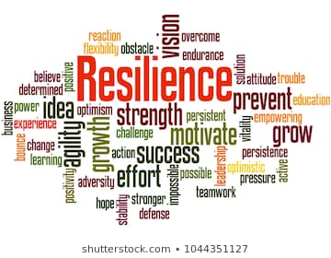
Resiliency
The ability to adapt well to challenges and bounce back quickly
Supportive Environment
Work/Life balance
Open and safe dialogue
Early detection “noticing skills”
Early Intervention
Self care
New Referrals Received

Slide 16
New Referrals Received
QUESTIONS

Slide 17
Contact Information
Call: 931-221-3850
Visit: https://centerstone.org/cohen-military-family-clinic/clarksville/
Facebook: Steven A. Cohen Military Family Clinic at Centerstone, Tennessee
Instagram: cohencliniccenterstonetn
New Referrals Received

