Slide 1
Tennessee State Approving Agency
TN-SAA

Slide 2
Program Approval and Compliance
Penny Starr, Director, Veterans Education
Irina Goodall, Director, Veterans Education
Katie Nixon-Thomas, Veterans Education Specialist

Slide 3
Types of Approvals
Re-Approval
  Completed roughly every 24 months
Modifications
  Updated Catalog
  Change of Location
  Adding or Withdrawing Programs
Ensure approvals meet 38 USC/CFR statutes/regulations & state statutes and rules; meet Cooperative Agreement (CA)

Slide 4
Re-Approval
Complete review
  VA Form 22-10288 or VA Form 22-10288- complete in full
  TN-SAA Program Submission List
  Evidence of Accreditation
  College Financing Plan
  Advertising
  Catalog
  Proof of Financial Stability
  Certificate/Diploma given upon completion
  VA Form 22-1919
  VA Form 10-1088a
  Instructor License
  State authorization
  Academic Calendar
  Tuition and Fees

Slide 5
Modification
VA Form 22-10287 or VA Form 22-10288
  You do not need to fill this out in full
Catalog
*Verification of change requested*

Slide 6
WEAMS
REVIEW YOUR WEAMS!!!
  Programs
    Requested Changes
      Name Changes
      New programs
      Withdrawn programs
    ELR Abbreviations
    Contact Information/Facility Address
Contact the TN-SAA within 72 hours

Slide 7
Education File Upload Portal
VA Form 22-8794 – Designation of Certifying Officials with training certificate(s).
EFT and Tax ID Update- Must be on organization letterhead.
VA Form 22-10215 – 85/15 reporting documents may include VA Form 22-10215a.
VA Form 22-10216 – 35% Exemption Request.
VA Form 22-1919 – Conflicting Interests Certification for Propriety Schools.
VA Form 22-0831 – List of Affected Branches/Extensions for Centralized Certification.
VA Form 22-0839 – Yellow Ribbon Program Agreement

Slide 8
Common Compliance Errors
Not evaluating prior learning transcripts
Not tracking attendance
Missing student records
No College Financing Plan/ Shopping Sheet
Not following your Institutional Policies

Slide 9
Cont. Common Compliance Errors
Not completing the second certification for Ch33 beneficiaries
Certification Errors
Not terminating certification
Not reporting changes to the VA in a timely manor
Not reporting vacation periods or leave of absences (LOA) to VA

Slide 10
Effects of Non-Compliance
Debt to the institution
Debt to the student
May lead to suspension or withdrawal of approved programs by the SAA

Slide 11
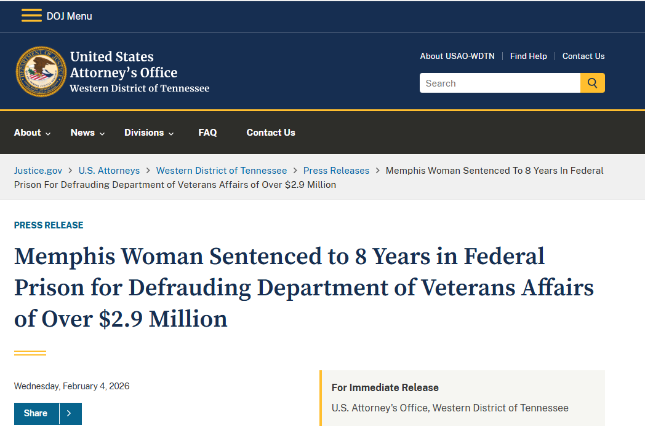
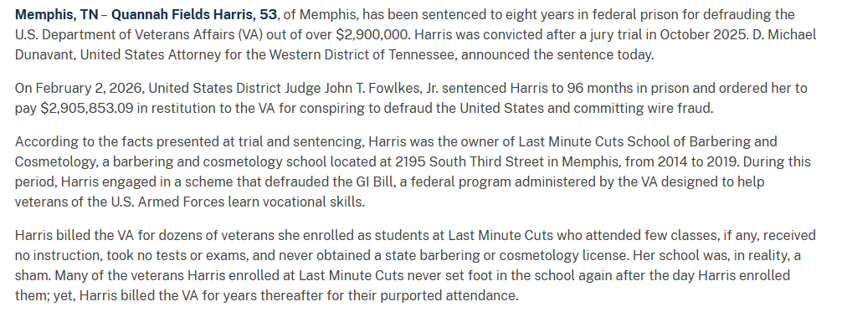
Effects of Non-Compliance
https://www.justice.gov/usao-wdtn/pr/memphis-woman-sentenced-8-years-federal-prison-defrauding-department-veterans-affairs

Slide 12
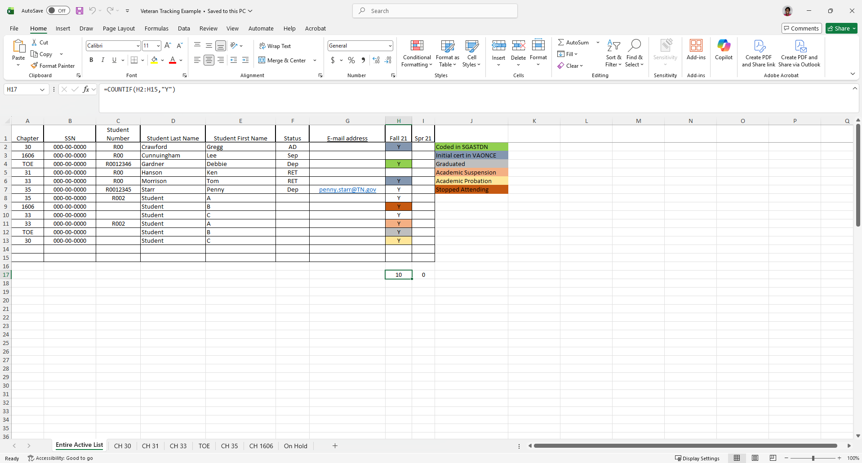
Best Practices to Avoid Errors
Creating a Veterans Tracking System

Slide 13
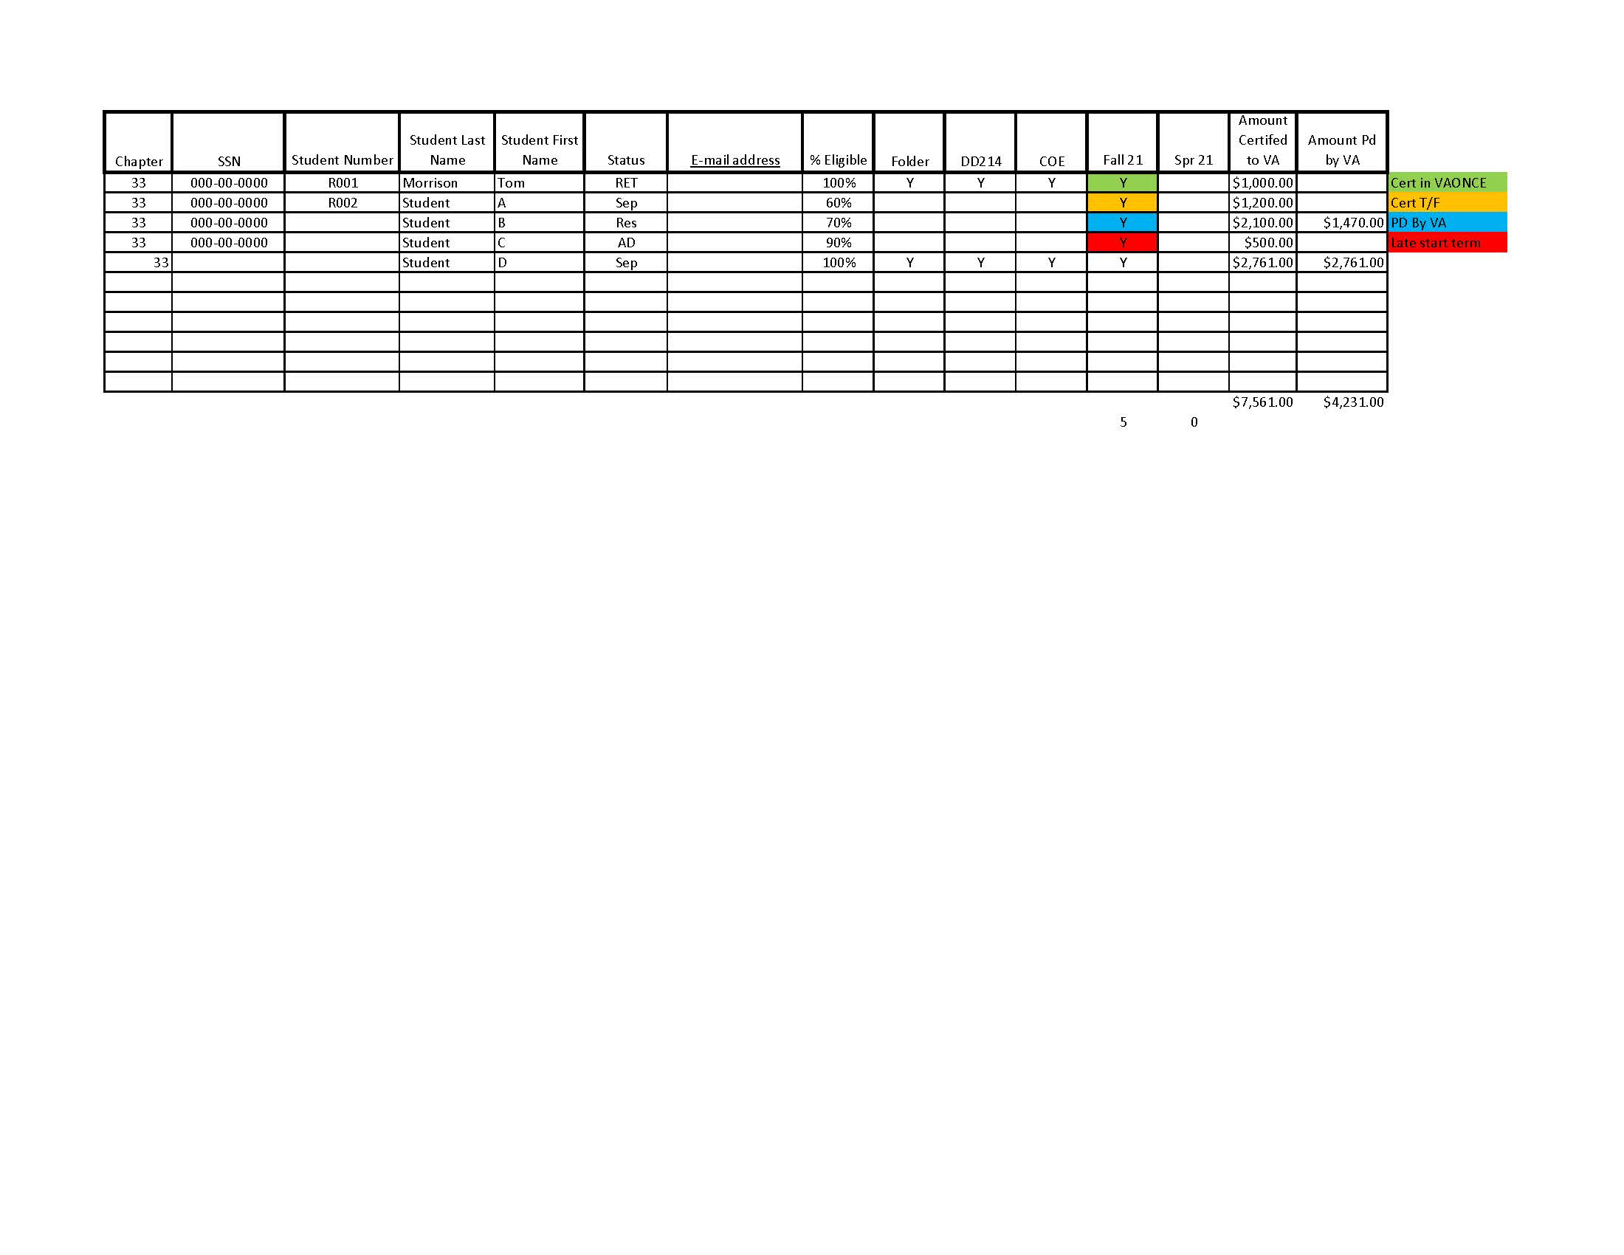
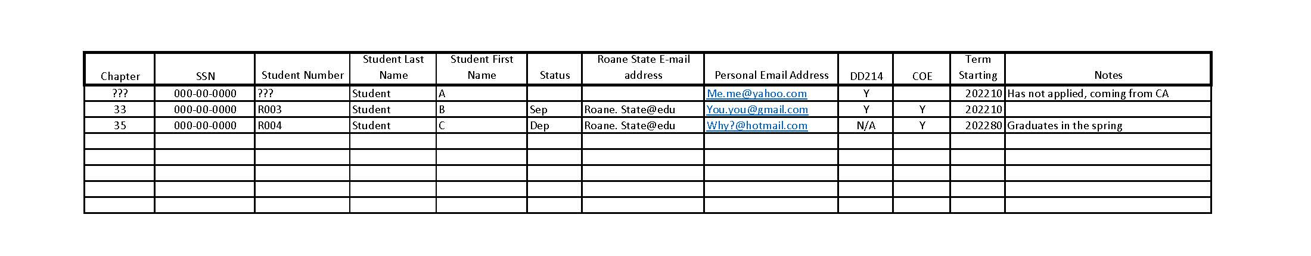

Slide 14
Best Practices to Avoid Errors
Know your institutions policies
Know the duties and responsibilities of an SCO
Create a Process Manual
Digital Filing System (paper files are not required)
Building relationships with other departments

Slide 15

Connecting the Silos
Notes:
You want me to do what? Sometimes breaking down the silos is not the best or easiest option-it could involve a culture shift for the whole organization. Top Down approach-better option would be to connect the silos.

Slide 16
Tips for Connecting the Silos
Start small-prioritize the area you want/need to collaborate with
Ask Questions-how does this work? What part do we play?
Find Common Ground/Invite them to your Silo
Include them on emails
Campus wide presentations (ex: Lunch and Learns)
Be Genuine
Learn their lingo and teach them yours
Notes:
It’s all about communication. Peer to Peer, equal footing Start with one connection

Slide 17
Tips for Connecting the Silos
Internal Examples:
Student Aid and Compliance (our Bureau)
Division of Postsecondary School Authorization
Academic Affairs and Workforce Alignment
External Examples:
Tennessee Board of Cosmetology and Barber Examiners
Tennessee Labor and Workforce Development
Apprenticeship TN (the other SAA)

Slide 18
Questions?

Slide 19
Thank You!

