Slide 1
From Numbers to Impact:
Using Veteran Data to Make Intentional Decisions

Slide 2
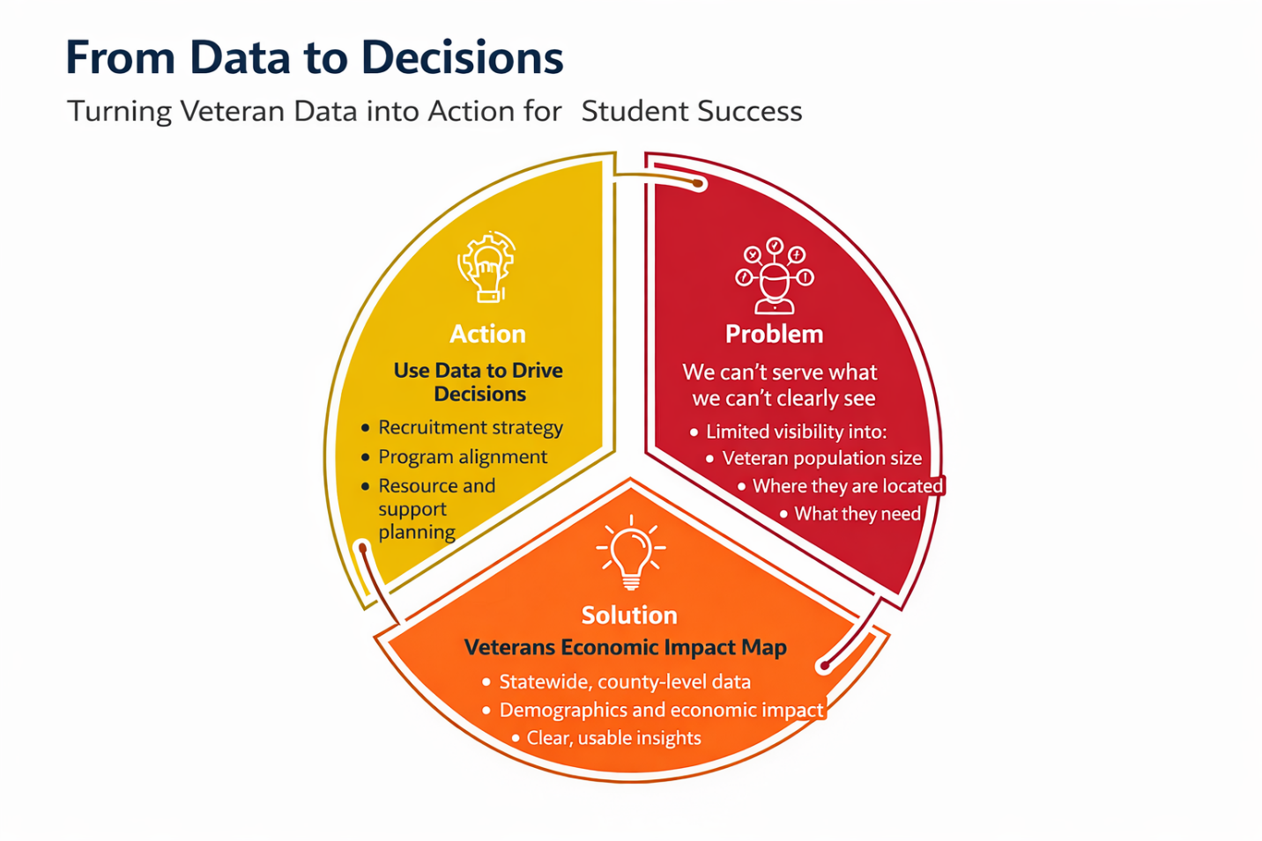
Data to Decisions
Data alone doesn’t change outcomes… decisions do.

Slide 3
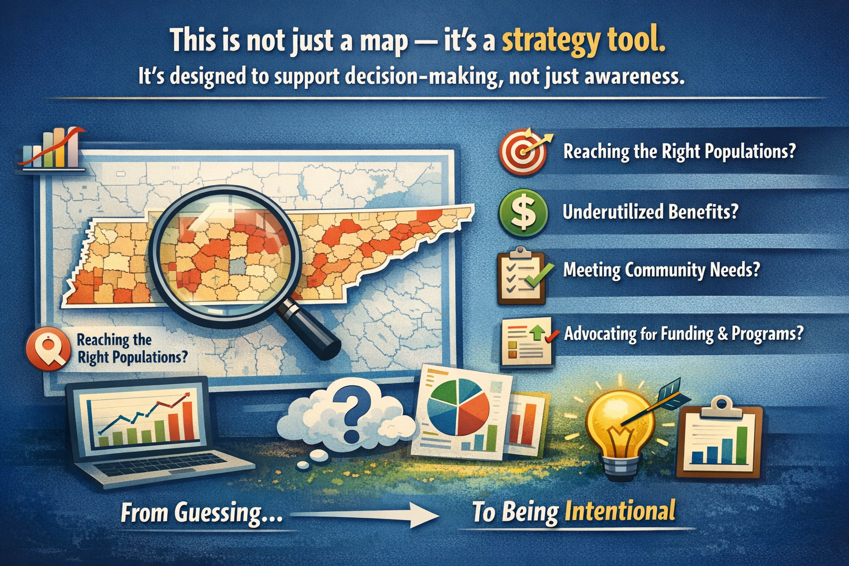
What is the Veterans Economic Impact Map

Slide 4
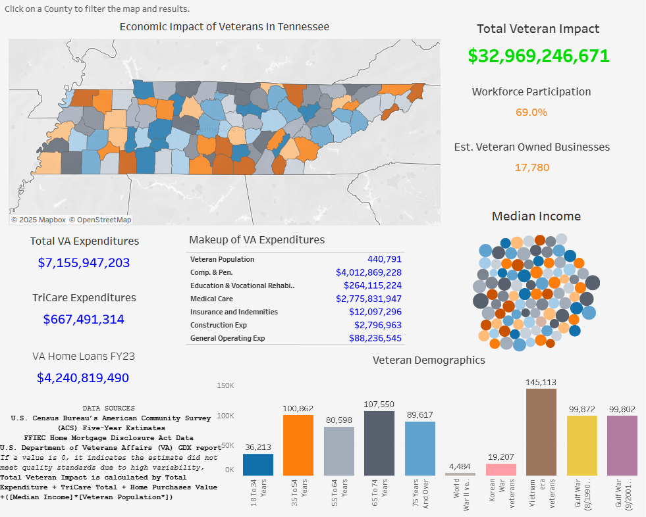
How to Read the Map

Slide 5
Where to Start?
Are you familiar with your county’s Veteran data?
What does your region’s data look like?
Focusing on your county you can learn:
  Veteran population size
  Age distribution
  Workforce indicators
This is not just telling you who lives in your community.
This is telling you who your students could be.

Slide 6
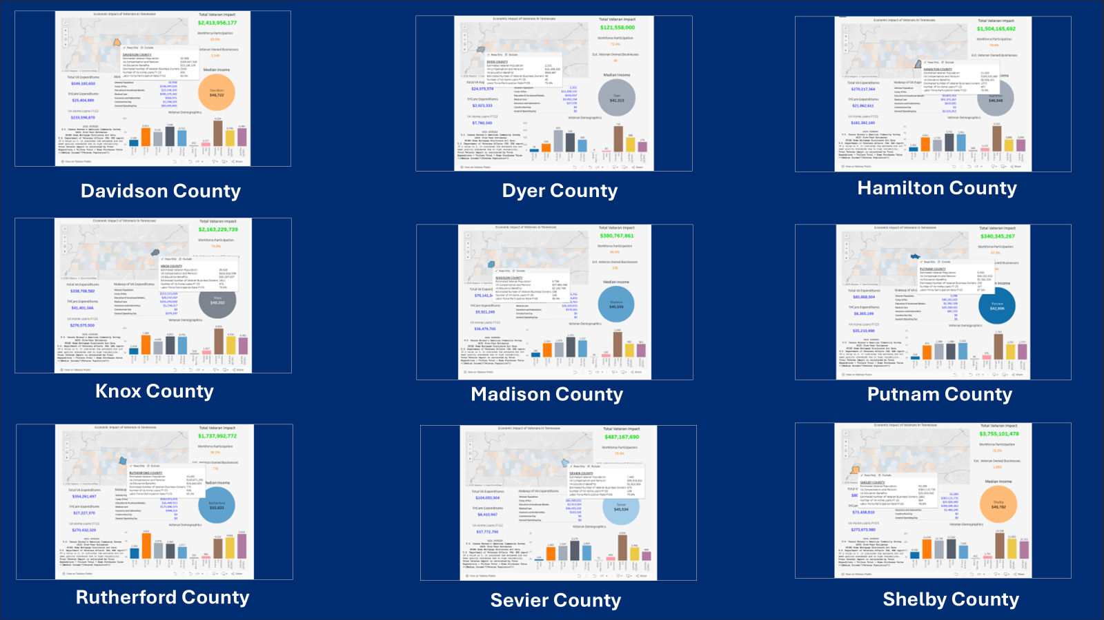
Compare Similar Counties

Slide 7
What Can This Map Help Identify?
Recruitment + Gaps
  Recruitment opportunities
  Untapped populations
  Gaps in outreach

Slide 8
Strategy and Funding
Strategy + Funding
  Align programs with need
  Strengthen funding cases
  Support grant writing

Slide 9
Connecting to Your Mission
A school needs more Veteran support services,
without data… it sounds like a request.
With this map, it becomes a case.
You can clearly show:
The size of your Veteran population
Trends over time
The surrounding communities you’re drawing from
And now—you’re not asking for resources.
You’re justifying them.

Slide 10



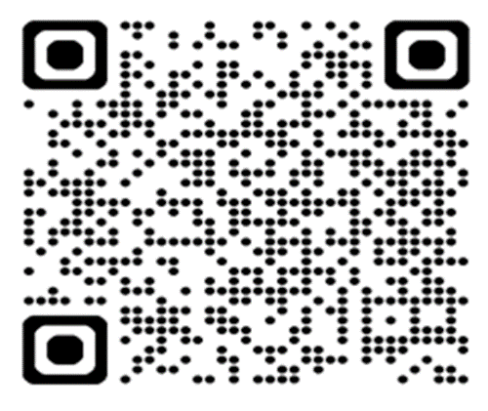

Contacts for VRBR Program
Supporting Veteran-Friendly Businesses in Tennessee
Stephen Bell
Director of State Operations
Mary Deel
Dan Moore
Sherry Pickering
Veteran Outreach Coordinators
1-615-741-2345
tdvs.doso@tn.gov
tn.gov/veteran
How did we do?
Please take this quick survey to give us your feedback.
Be sure to follow us on social media!

