Slide 1


Comprehensive Student Support for Military-Affiliated Learners: Strengthening Academic, Financial, and Well‑Being Pathways
Notes:
This session explores a comprehensive student support framework designed to assist military-affiliated learners across academic, financial, and well‑being dimensions. The session highlights an integrated approach that includes transition programming, academic coaching, benefits literacy, and mental health resource awareness. Together, these elements strengthen student belonging, promote persistence, and enhance overall success for Military-Affiliated students. Participants will gain practical strategies and cross-campus practices that can be adapted to improve support at their institutions.

Slide 2




Who We Are
Ana Pla Rosario
Coordinator of Military-Affiliated Advising
LaTara Pearson
Military-Affiliated Student Success Professional
Notes:
Role of a Military‑Student Success Professional 🤝
✅ Advocate for military‑connected students
✅ Navigator of institutional systems and policies
✅ Central point of contact and trusted supporter
✅ Partner in retention and early‑alert efforts
Speaker Notes
I often serve as a bridge between the military and higher education
Students look for clarity, consistency, and follow‑through
Trust is essential for long‑term student success

Slide 3
Session Goals:
Identify key barriers impacting Military-Affiliated student success.
Apply a comprehensive support model integrating academic, financial, and well-being practices.
Strengthen institutional resource pathways and cross-campus collaboration.
Develop an action plan for enhancing military student support structures.

Slide 4
Institutional Context
Clarksville, TN Campus
1st state university in the United States to have a dedicated building on an active U.S. Army installation in Ft. Campbell, KY.
Who We Serve at Austin Peay State University (APSU)
11,547 total students
3,754 total military-affiliated
Military-affiliated Population includes:
Veterans
Active Duty
National Guard/Reserve
Spouses
Dependents
Dedicated Military & Veterans Affairs Division (MVA)
Notes:
Adult learners, transfer students, first‑generation students
Speaker Notes
These students often bring leadership and discipline
They also face unique challenges tied to service and transition
Support must be flexible, informed, and culturally responsive

Slide 5
MVA Organizational Chart
Formerly Military Advisor to the President
From Academic Affairs
From Student Affairs
VA Employee
(#) Number of Staff Members
Vice President for Military & Veterans Affairs Division
Walt Lord
Assistant Vice President
Jasmin Linares
Director of Recruitment, Communications, & Marketing
Marisa Roberts
Executive Director of the Austin Peay Center at Fort Campbell
Ben Drummond
Coordinator
Dana Chadwick
Military-Affiliated Career Specialist
Tony Munoz
Director of Operations
Julie Mellon
Administrative Assistant
Liza Skeie
Military Outreach and Communication Specialist
Edgar Maldonado
Veterans Education Benefits Office (9)
Elizabeth Stonerock
Military-Affiliated Student Success Professional
LaTara Pearson
Veterans Upward Bound (4)
Tipnie Mack
Military Students Success Director
Tina Zanders
Coordinator of Military Affiliated Advising
Ana Pla Rosario
Custodian
Chris Henry
VetSuccess On Campus
Deandria Reed
Academic Advisor
Jennifer Gerasch

Slide 6
Distinct experiences of Military Affiliated Students (MAS)
Military‑affiliated students differ widely in areas such as:
🎖️ Connection to service: Veterans, active‑duty service members, National Guard, Reserves, spouses, dependents, and caregivers
🎓 Educational pathways: First‑time freshmen, adult learners, transfer students, part‑time students, online learners
💼 Life circumstances: Parenting responsibilities, full‑time employment, deployments, relocations, financial obligations
🧠 Support needs: Academic refreshers, mental health support, disability accommodations, financial literacy, career transition assistance
🌍 Backgrounds and identities: Age, race, ethnicity, gender identity, socioeconomic status, and prior educational experience

Slide 7
Key barriers
Key barriers impacting military-affiliated student success.
Challenges navigating campus and support services
Military credit misalignment
Financial misconceptions
Identity transition
Notes:
Ana – challenge of just getting on the FTC Army Base
Navigating Campus & Support Services
Transition from clear military structure → complex, decentralized campus systems
Unclear points of contact (“Where do I go for help?”)
Veteran resources may be hard to find or access
Leads to frustration and underutilization of support
APSU response: APSU provides a centralized Military & Veterans Affairs office that offers one-on-one guidance to help students navigate admissions, benefits, and campus resources.
Military Credit Misalignment
Military training evaluated by American Council on Education, but acceptance varies by institution
Students may repeat coursework and lose time/benefits
Can feel like prior experience is undervalued
APSU response: APSU actively evaluates military transcripts and works to maximize transfer credit to reduce redundancy and accelerate degree completion.
Financial Misconceptions
Assumption that benefits fully cover college costs
Reality with Post-9/11 GI Bill:
Coverage gaps, delays, and extra expenses
Can lead to financial stress
APSU response: APSU offers dedicated financial aid and VA benefits advising to help students understand, plan, and manage their education funding.
Identity Transition
Shift from military identity → student identity
Loss of structure, role, and sense of purpose
Possible isolation or lack of belonging
May be compounded by experiences like Post-traumatic stress disorder
APSU response: APSU fosters community through veteran-specific spaces, peer support, and programming that helps students build connection and a renewed sense of purpose.

Slide 8
How Support is Organized
Centralized division: APSU MVA
Collaboration with:
  Boyd Health Services, Disability Student Success Center (DSSC)
  Career Services
  Community Engagement (Emergency Funds)
  Educational Opportunity Center (FAFSA support)
  Financial Aid Office
  Registrar
  Student Account Services
Green Zone APSU: Training for faculty/staff to help understand understand the experience of a military affiliated student and how it fits their academic journey.
Notes:
Centralized Support Hub
Military & Veterans Affairs (MVA) serves as the primary point of contact
Assists with:
Admissions navigation
VA education benefits
Connection to campus resources
Provides one-on-one, student-centered support
Health & Accessibility Collaboration
Partners with:
Boyd Health Services
Disability Student Success Center
Supports:
Physical and mental health needs
Academic accommodations
Ensures students can fully access the learning environment
Career & Transition Support
Collaboration with Career Services
Helps students:
Translate military experience into civilian skills
Prepare resumes and interviews
Transition into the workforce
Financial & Emergency Support
Emergency assistance through Community Engagement
FAFSA and financial literacy support via Educational Opportunity Center
Additional coordination with:
Financial Aid Office
Student Account Services
Helps students manage funding, avoid disruptions, and stay enrolled
Academic & Administrative Coordination
Works with Registrar
Supports:
Enrollment processes
Course registration
Benefits certification
Reduces administrative barriers and delays
Campus-Wide Awareness
Green Zone APSU
Trains faculty and staff to:
Understand military-affiliated student experiences
Recognize academic and personal challenges
Provide informed, supportive interactions
Key Takeaway
Centralized support + campus-wide collaboration
Students are supported by both a dedicated hub (MVA) and a connected network of services

Slide 9
Military Student Support Model
Academic Integration
Financial Clarity & Navigation
Belonging & Well-Being
Cross-Campus Coordination
Military Student Support Model
Key Component 1: Academic Integration
Key Component 2: Financial Clarity & Navigation
Key Component 3: Belonging & Well-Being
Key Component 4: Cross-Campus Coordination

Slide 10
Dedicated Advising Structure
One dedicated academic advisor for each military-affiliated undergraduate student
Full academic advising across all majors
Admission inquiry support through graduation planning
Academic coaching integrated into advising
Early alert monitoring via EAB Navigate (AP Navigate)
Participation in at-risk student review committee
Academic Integration
Notes:
✅ Transition support and orientation guidance
✅ Credit evaluation and prior learning advocacy
✅ Academic coaching and faculty communication
✅ Early intervention for academic challenges
Speaker Notes
Many students struggle with credit transfer and academic expectations
Returning or deploying students need flexibility and understanding
Proactive academic support reduces frustration and withdrawal
Academic coaching is a personalized, partnership-based approach that helps students develop executive function skills, such as time management, goal setting, study strategies, and motivation

Slide 11
Priority Registration & Flexibility
Priority registration for veterans, active duty, guard/reserve
8-week term options and year-round terms
On-base course offerings
  Face to face
  Hybrid
  Video Conferencing
  Online Instruction
Flexible scheduling to accommodate military obligations
Academic Integration
Notes:
Financial navigation is shared across multiple trained professionals.

Slide 12
Military Credit Evaluation Process
Academic Integration
APSU Model:
1. Initial transfer evaluation by the registrar’s transfer team
2. Secondary review by Military-Affiliated Advisor
3. Departmental advocacy for substitutions
4. Ongoing collaboration with Registrar to improve processes
Key Practice:
Military credit is not just evaluated. It is advocated for.

Slide 13
Multi-Office Financial Navigation
Veterans Upward Bound (VUB)
Educational Opportunity Center (FAFSA assistance)
Veteran Education Benefits Office
Financial Aid Office (general aid)
Military-Affiliated Student Success Professional (financial coaching)
Scholarship targeting:
  Army Emergency Relief (AER)
  TN Helping Heroes
  MyCAA (My Career Advancement Account)
  APSU general scholarships
SOS Emergency Funds
Financial Clarity & Navigation

Slide 14
Financial Misconceptions
Financial Clarity & Navigation
Common misconception:
  “Guard Tuition Assistance + GI Bill + Pell = everything covered.”
Reality:
  Housing gaps
  Meal plans
  Fee structures
  Timing of disbursements
Practice:
  Proactive financial expectation-setting during sessions

Slide 15
Financial & Benefits Support 💰
✅ GI Bill® education benefit guidance
✅ Financial literacy conversations and referrals
✅ Support during certification delays or changes
✅ Prevention of enrollment interruptions
Financial Clarity & Navigation
Notes:
Speaker Notes
Benefits confusion is one of the biggest stressors
Small issues can quickly become stop‑out risks
Clear communication helps students stay enrolled and focused

Slide 16
Well‑Being & Holistic Support 🌱
✅ Mental health support referrals
✅ Disability and accommodation advocacy
✅ Family, work, and life‑balance conversations
✅ Safe and supportive space for students
Belonging & Well-Being
Notes:
Speaker Notes
Many military‑connected students hesitate to ask for help
Normalizing support services is critical
Well‑being directly impacts academic performance

Slide 17
Collaboration & Campus Partnerships 🤝
✅ Veterans Affairs Certifying Officials
✅ Student Success Center and Financial Aid offices
✅ Counseling center and DSSC
✅ Community and external military resources
✅ Community Donors
Cross-Campus Coordination
Notes:
Speaker Notes
Student success is a shared responsibility
Collaboration prevents students from falling through gaps
Strong partnerships strengthen institutional impact

Slide 18
Connecting the Resource to the Barrier
Barrier | APSU Institutional Response | Framework Component
Fragmented navigation | Centralized MVA + dedicated advisor | Cross-campus coordination
Military credit misalignment | Secondary review + advocacy | Academic Integration
Financial misconceptions | Multi-office financial literacy model | Financial Clarity
Identity transition | Embedded belonging + Green Zone | Well-Being
Notes:
How we respond to barriers

Slide 19
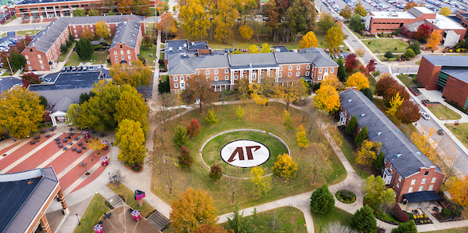
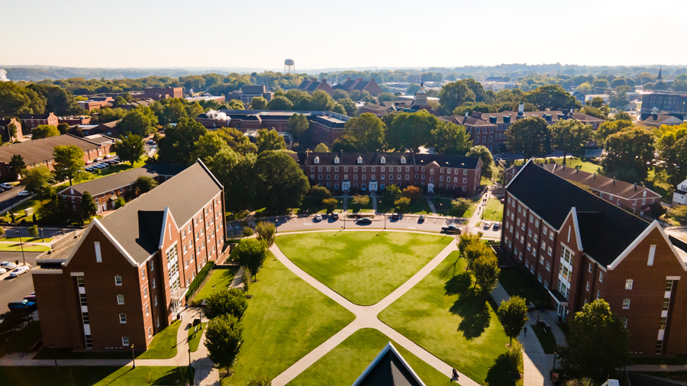
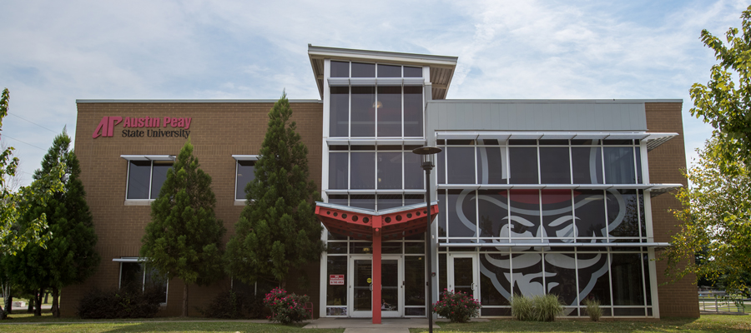
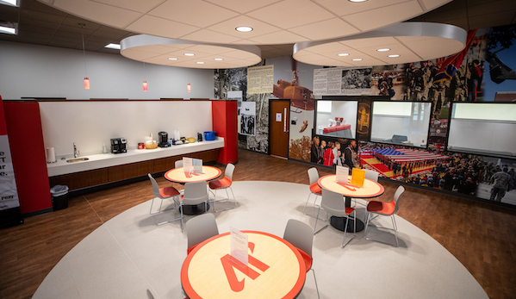
Questions?

Slide 20
⭐Let’s Do an Activity!
A student is struggling academically after a (Permanent Change of Station) PCS and doesn’t know where to go for help.
A student’s GI Bill payment is delayed, and they’re worried about being dropped from classes.
A student feels isolated and disconnected from campus life.
A student is balancing family responsibilities and coursework and feels overwhelmed.
Each group answer: Where would you go first for help? Who else might you need to talk to? What could make this process confusing or frustrating?
Notes:
The Challenge (5 minutes)Break students into small groups (3–5 students) and give each group a scenario:Sample Scenarios (pick one or assign different ones):

Slide 21
⭐Let’s Do an Activity!
Each group should discuss and be ready to share:
Where would you go first for help?
  Think which office, person, or resource is the most logical starting point.
Who else might need to be involved?
  Think of additional campus partners are critical to fully support the student.
What could make this process confusing, frustrating, or risky for you?
  Consider policies, communication gaps, timing, or campus culture.
What should the student experience if systems were working effectively?
Notes:
The Challenge (5 minutes)Break students into small groups (3–5 students) and give each group a scenario:Sample Scenarios (pick one or assign different ones):

Slide 22
Activity Scenarios 1 & 2
Military-Affiliated Student Scenarios
Read the scenario as if you are the student.
Scenario 1: PCS & Academic Disruption
You are a Military-Affiliated student who recently transferred to this institution due to a Permanent Change of Station (PCS). You arrived midway through the academic year and learned that several of your credits did not transfer as expected. You are unfamiliar with campus policies, already struggling academically, and unsure who to contact for help. You are worried about falling behind during your first term.
Scenario 2: Delayed GI Bill® Benefits
You are a veteran student using Post‑9/11 GI Bill® benefits. Early in the semester, your tuition payment and monthly housing allowance are delayed despite submitting all required paperwork on time. You receive automated emails warning about enrollment holds and possible course drops, and you are increasingly concerned about being removed from your classes or charged late fees.
Notes:
The Challenge (5 minutes)Break students into small groups (3–5 students) and give each group a scenario:Sample Scenarios (pick one or assign different ones):

Slide 23
Activity Scenarios 3 & 4
Military-Affiliated Student Scenarios
Read the scenario as if you are the student.
Scenario 3: Isolation & Loss of Belonging
You are a student veteran who feels isolated and disconnected from campus life. You commute, do not feel comfortable in traditional student spaces, and are unsure how to connect with peers or campus organizations. As an older student with military experience, you question whether you belong at the institution at all.
Scenario 4: Balancing Service, Family, and Coursework
You are a National Guard or Reserve student balancing coursework, military obligations, employment, and family responsibilities. Unexpected drill requirements and competing demands leave you overwhelmed. You are unsure how to communicate your needs to faculty and hesitant to ask for flexibility or support related to your service commitments.
Notes:
The Challenge (5 minutes)Break students into small groups (3–5 students) and give each group a scenario:Sample Scenarios (pick one or assign different ones):

Slide 24
Key Lessons
Military‑connected students often face multiple challenges at once
(academic, financial, personal, and service‑related)
The first point of contact matters
Confusion about where to start can delay support and increase stress
Systems not students create most barriers
Policies, timelines, and communication breakdowns are common pain points
No single office can support students alone
Effective outcomes require cross‑campus collaboration
Student perspective changes how support should be designed
How a process feels to students matters as much as how it functions

Slide 25
Impact & Why This Work Matters 🌟
✅ Increased retention and student success
✅ Reduced financial and administrative barriers
✅ Improved sense of belonging and confidence
✅ Stronger institutional commitment to military‑connected learners
Notes:
Speaker Notes
Comprehensive support benefits students and institutions
Military‑connected students are assets to our campuses
This work affirms service while supporting academic achievement

Slide 26
Questions?

Slide 27

Closing Remarks
When we lead with intentional, comprehensive support, military‑connected students don’t just persist—they thrive.

Slide 28
Contact us – we’d love to hear from you!
Ana Pla Rosario
Coordinator of Military-Affiliated Advising
plarosarioa@apsu.edu
linkedin.com/in/anaplarosario/
LaTara Pearson
Military-Affiliated Student Success Professional
931.221.6347
pearsonld@apsu.edu

Slide 29


Slide 30

What is Green Zone?
Green Zone is an APSU initiative that helps support student veterans and military-affiliated students by:
Designating locations recognized as safe places.
Identifying faculty and staff who are knowledgeable about military-affiliated student issues and campus resources.
Displaying the Green Zone emblem outside offices and on syllabi to show support.
Ensuring military-affiliated students receive the services necessary to succeed academically, adjust to campus life, and transition to civilian employment.
Who is a Green Zone Volunteer/Ally?
APSU faculty and staff who:
Are aware of the issues and concerns faced by military-affiliated students.
Are available to assist students when needed.
Have completed Green Zone Training.

