Slide 1
MASTER PLAN Refinement– 03.17.16
Notes:
This planning study is a refinement of the 2010 Master Plan Update. Many in the audience may have seen major portions of this plan.

Slide 2
Principles Guiding
2016 Master Plan Refinement
Creating a robust on-campus community of students
Improving the Campus Visual Experience
Reinforcing “Town & Gown” Relationships
Branding and Communicating the UT Martin Experience
Notes:
1. Create space for student interaction, Increase use of UTM Housing, Develop a UTM “Spirit”, Organize weekend activities for students 2. Through Landscaping, Entrances and Signage, Removal of Parking 3. What’s good for UTM is good for Martin.. Continuation of Martin Streetscapes, weekend “Town &Gown” activities 4. Through Internal and External social media communications

Slide 3
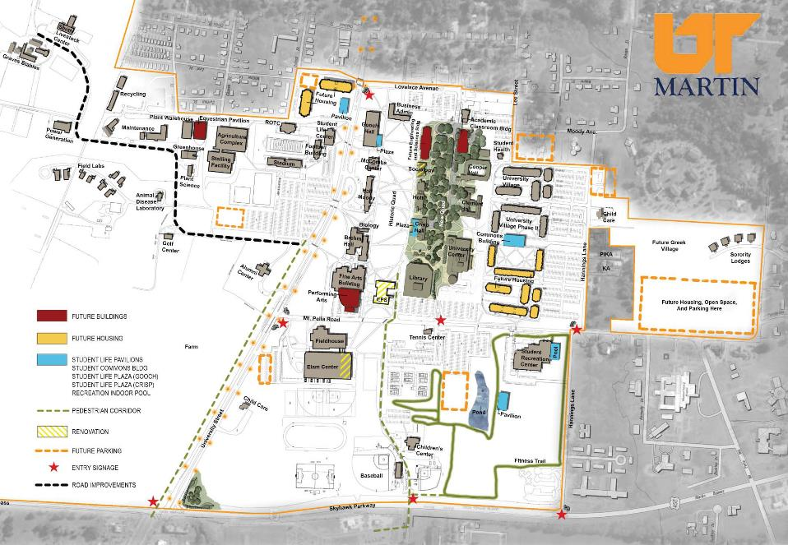
2015 Campus Master Plan Refinements
Notes:
This refined plan depicts – (Red-New Academic), (Yellow – Renovations), (Blue –Student Life) (Red Star –Campus Entrance Elements) (Orange – Student Housing) (Black dotted line – Road Improvements)
(Gold Dots – lighting/signage along University St.)

Slide 4
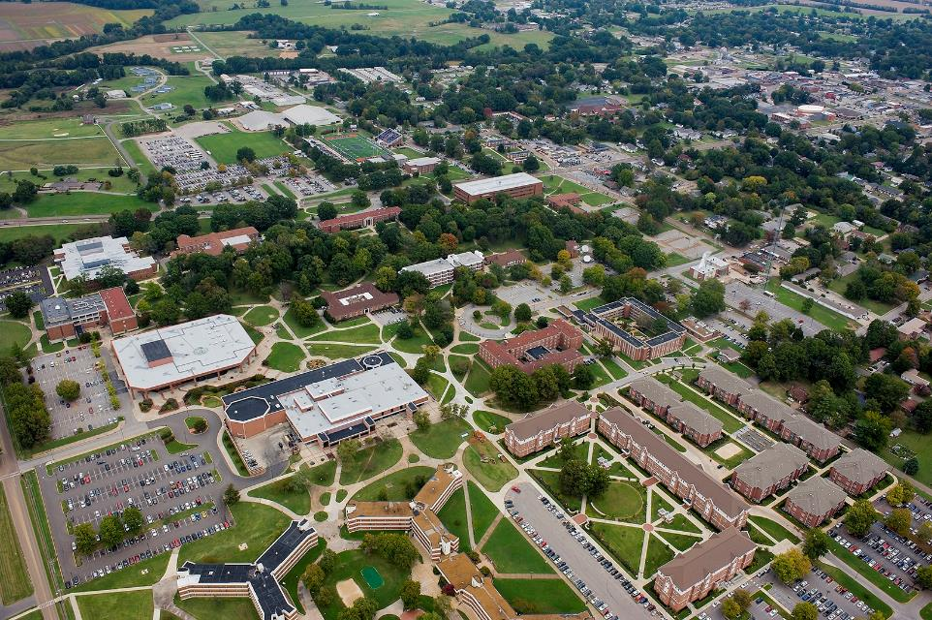
Aerial View of Campus Core

Slide 5
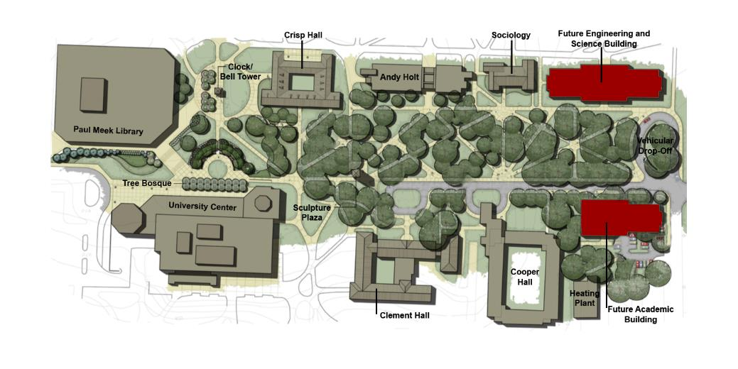
New Quadrangle Development
Notes:
Development of a New Quadrangle Improves Campus Visual Experience. Quad can be realized by interior removing 180 parking spaces to the perimeter of the campus. Solution is to expand existing parking and/or locate parking on future acquired parcels. With existing mature trees, new Bell Tower and Sculpture plazas, student nodes, grass lawns etc., this new quadrangle can visually join the heart of the campus for student use verses auto use. This transformation will be completed overtime.

Slide 6
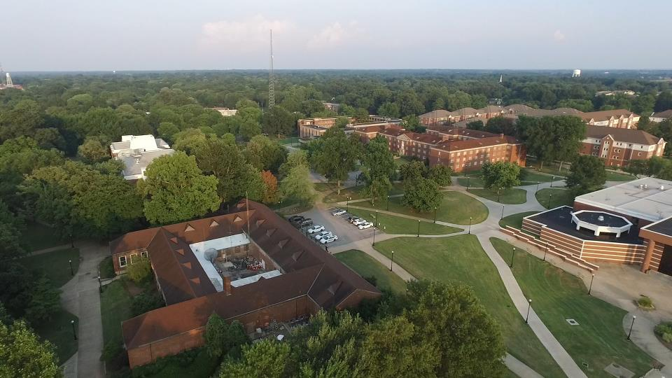
Aerial View of Crisp Hall Relationship to Campus Core
Future Location of New Crisp Hall Student Plaza on the Historic Quadrangle

Slide 7
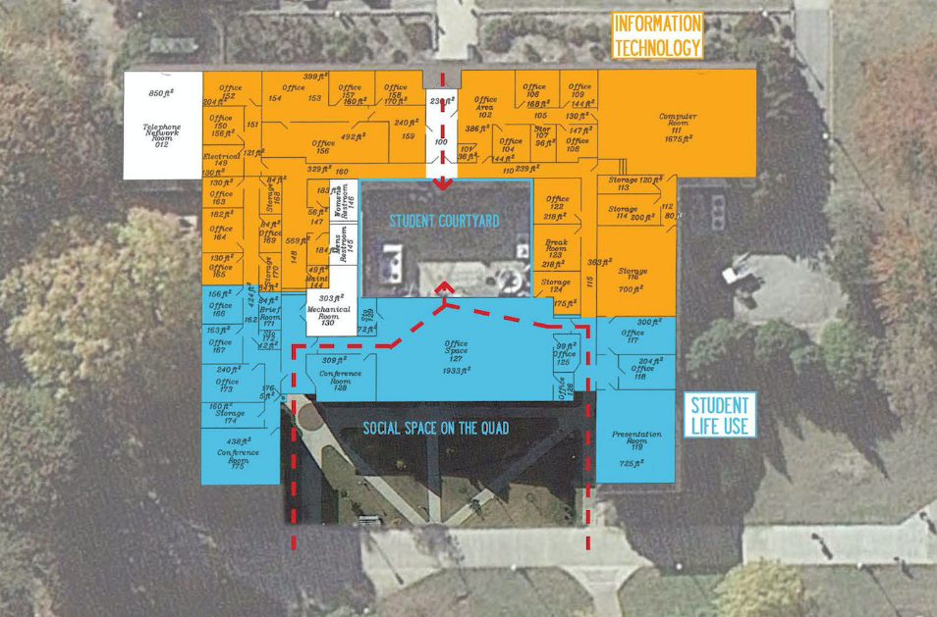
Crisp Hall Proposed Plan
Notes:
Information Technology is shown in orange and student life spaces in blue. Security relocates to Hall Moody Administration.

Slide 8
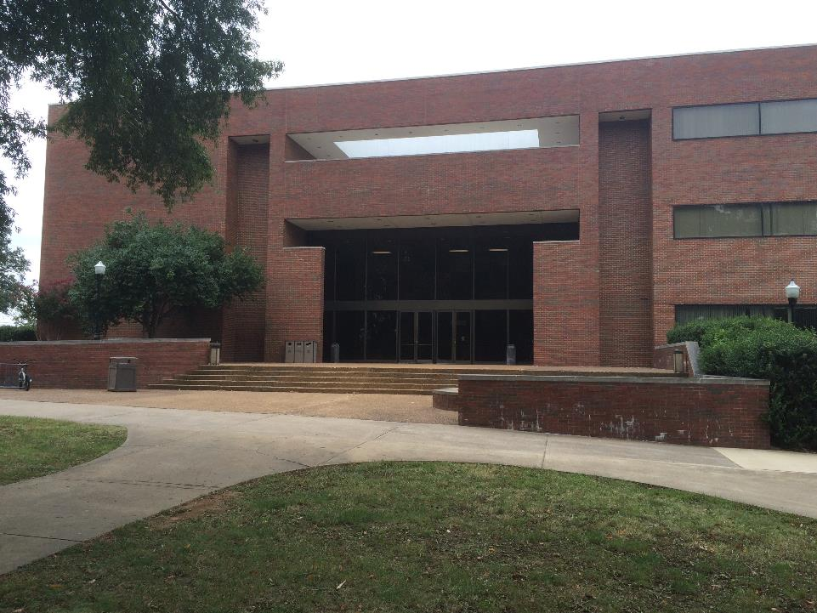
Notes:
The existing Gooch Hall plaza entry is proposed to be developed into a covered outdoor Plaza engaging the Historic Quadrangle.

Slide 9
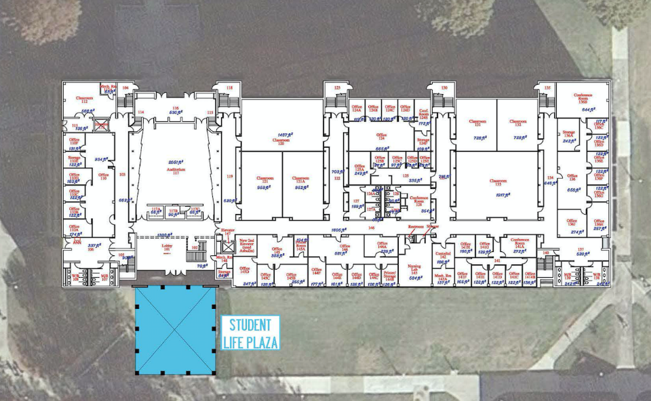
Gooch Hall Student Life Plaza
Notes:
Gooch Student life Plaza on the Historic Quadrangle for gathering and socializing in between classes

Slide 10
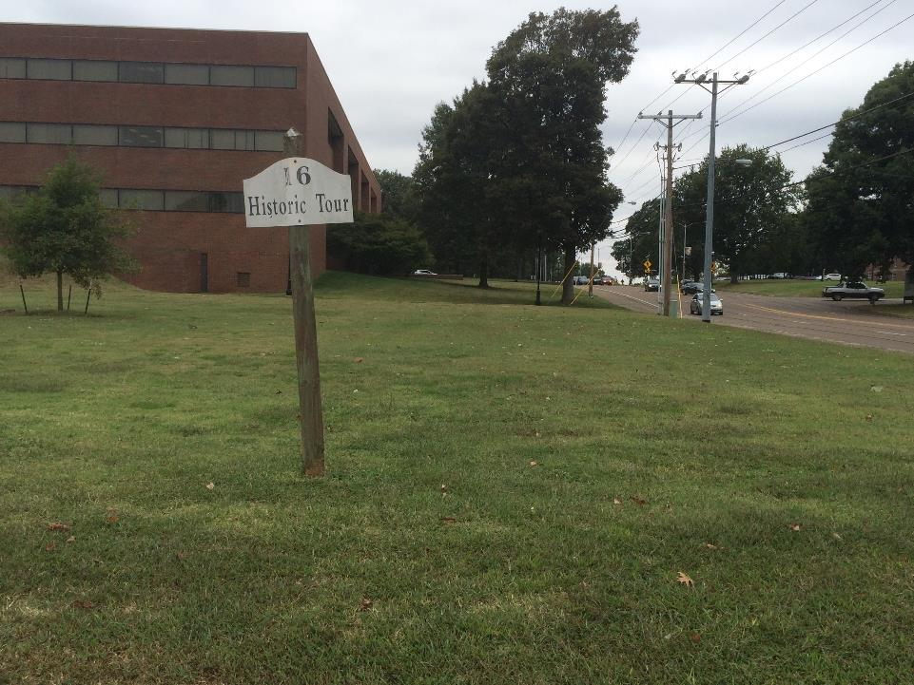
Notes:
Ceremonial Gateway entrances into the campus for vehicles and pedestrians are needed to announce entries to the campus and brand campus edges.

Slide 11
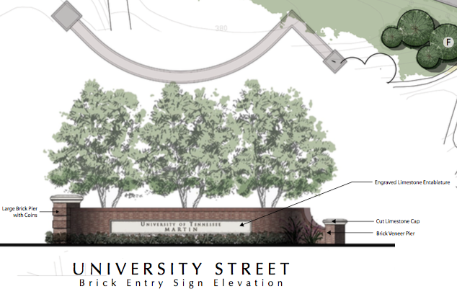
Notes:
Appropriately designed Gateways should be installed to announce boundaries and entrances into the campus.

Slide 12
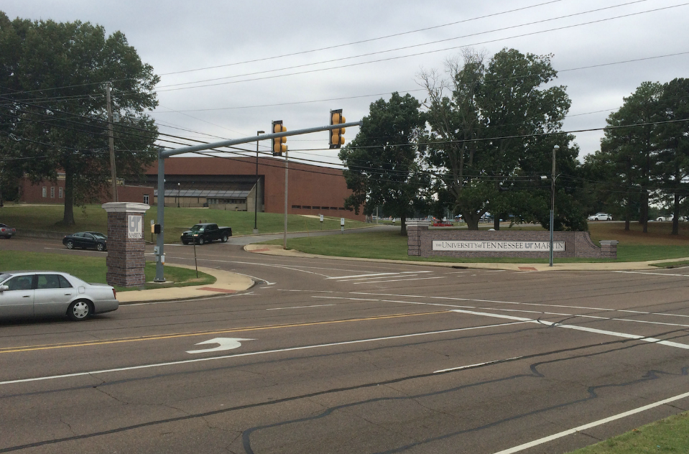
Gateway Entrance at Mt. Pelia Road
Notes:
Branding, Signage and Visual Experience - Gateway entrance at University Street and Mt Pelia Road

Slide 13
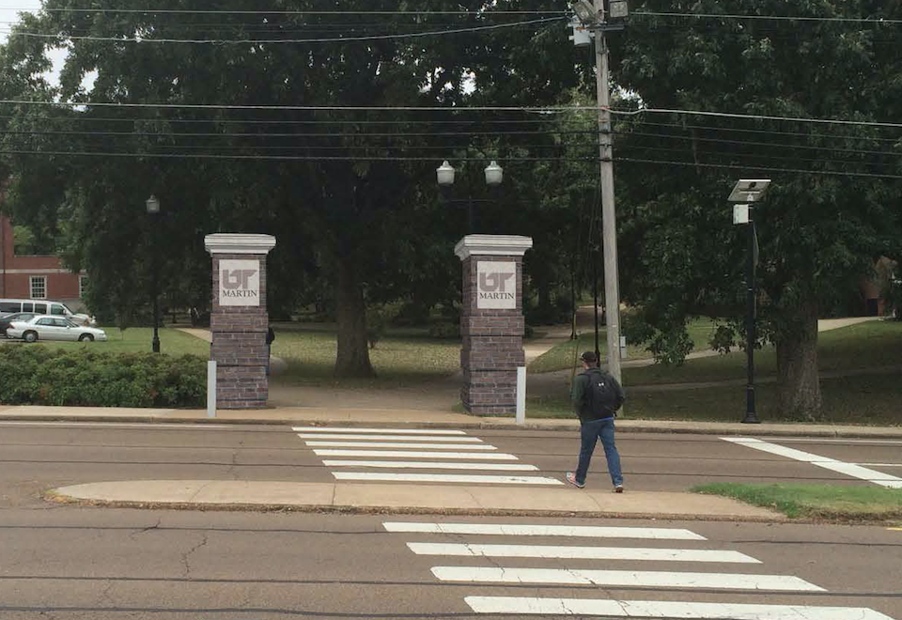
Architectural Pillars at Pedestrian Entrances
Notes:
Branding, Signage and Visual Experience - Architectural Pillars can mark serve as the mark of an entrance into the main campus

Slide 14
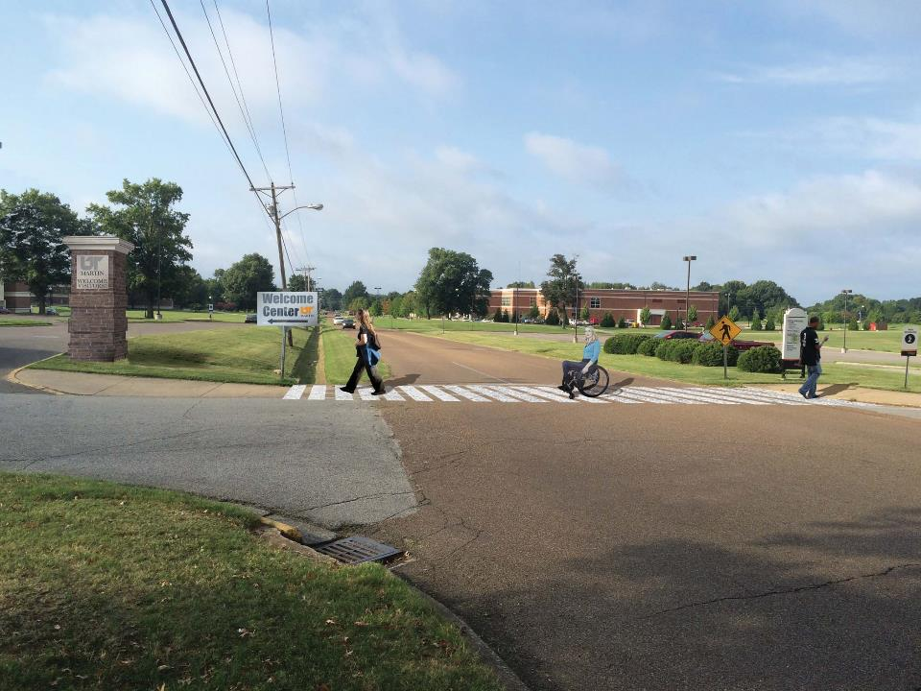
Signage for Visitor Welcome Center and Parking
Notes:
Branding, Signage and Visual Experience - Architectural Pillar and signage on Mt Pelia Road for visitor Welcome Center and parking.

Slide 15
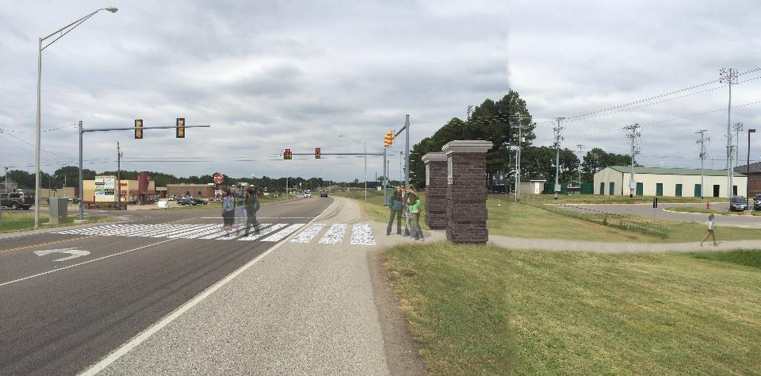
Crosswalk at Skyhawk Parkway to Access Retail
Notes:
Branding, Signage and Visual Experience - New pedestrian crosswalk connecting the new retail area being developed along Skyhawk Blvd.

Slide 16
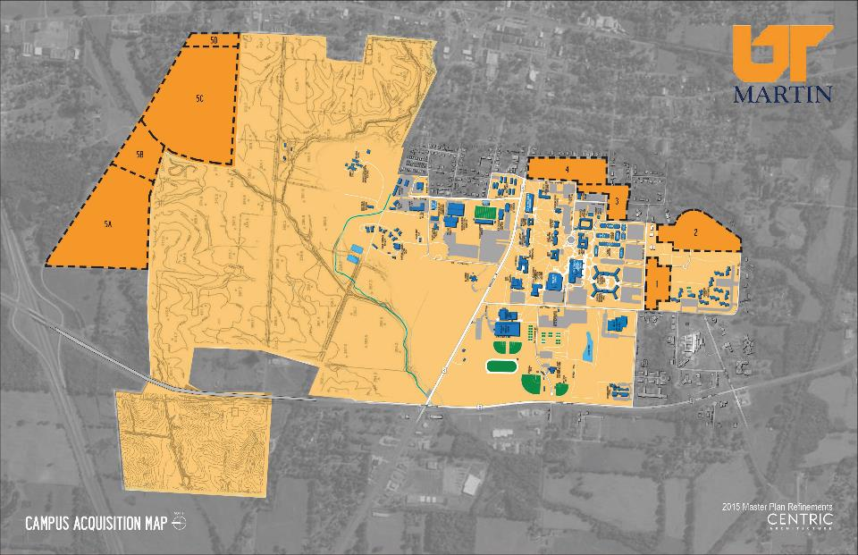
Site Acquisition Plan
Notes:
Land Acquisition of parcels 1,2,3 and 4 would allow for future building footprints, enhanced campus edges and offer strategic locations for future buildings and new and displaced parking. Acquiring parcel 5 would allow for future growth to the Agriculture program.

Slide 17
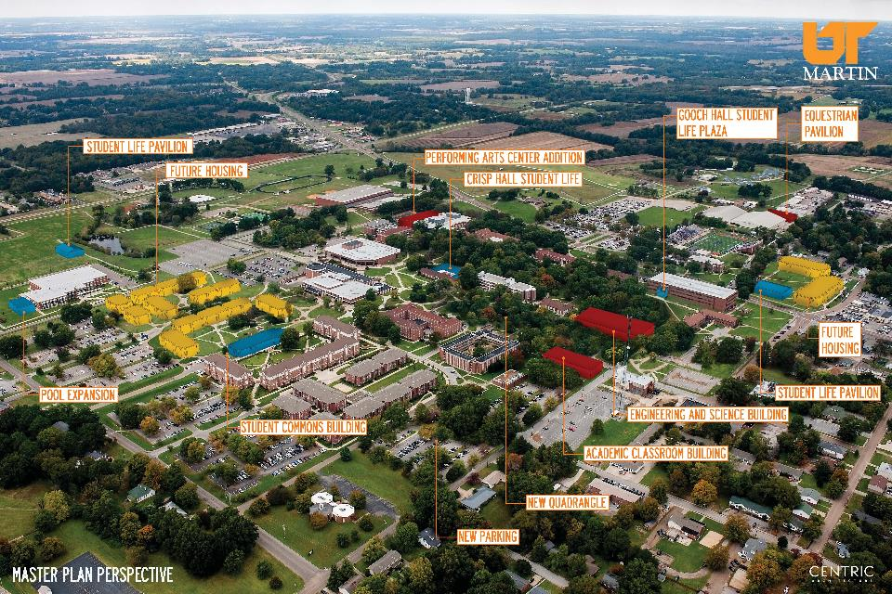
Aerial View of Future Campus

Slide 18
MASTER PLAN Refinement– 03.17.16

