Slide 1
Tennessee Promise: Fall 2015 Update
Emily House
Tennessee Higher Education Commission
Joint Meeting of SBE and THEC
January 27, 2015

Slide 2
Points of Interest
Characteristics of Tennessee Promise students
Who is participating in the program?
Composition of first-time freshmen class, as compared to prior years
Effect of Tennessee Promise on enrollment, student demographics, etc.
Notes:
This is a first look at these data – very descriptive and still preliminary. We have a lot of questions still to answer FOR SURE, these are just some of the first on the list.

Slide 3
Mar-April
Second
Mandatory
Meeting
August 1
Community
Service Deadline
Jan-Feb 5
First mandatory meeting
February 15
FAFSA Completion
Deadline
14-15 Public and Private HS Seniors: ~74,400
22,500
31,985
38,165
Nov 1
Application
Closes
43,105
58,000
Fall 2015: 16,291 enroll
Notes:
65,000 PUBLIC high school seniors, and about 10,000 PRIVATE HS seniors so 58,000 is about 90 percent of PUBLIC and 80 percent of PUBLIC AND PRIVATE. Very important to note that this final number is still moving, and we’ll have more info in the spring. This is due to certification, withdrawals and drop outs, etc.

Slide 4
Tennessee Promise Students
Where TN Promise students enroll:
85 percent community colleges (and APSU)
13 percent TCATs
2 percent Promise-eligible TICUA institutions
Of those who completed all requirements but did not enroll:
Four-year institutions (~1000 at public four-years)
Private/out of state
Did not enroll
Notes:
More to come about those who did not take advantage of TN Promise – where did they go? This will require a pull from Clearinghouse, which has not happened yet.

Slide 5
Tennessee Promise Students
 | TN Promise CC students | FTF out of HS, Fall 2014 (CCs) | FTF at CCs, Fall 2015 | FTF at CCs, Fall 2014
Race
White | 74% | 70% | 74% | 69%
African Amer | 14% | 19% | 18% | 19%
Hispanic | 4% | 5% | 3% | 4%
Female | 56% | 56% | 56% | 56%
Average ACT | 19.1 | 18.7 | 18.9 | 18.7
Average GPA | 3.05 | 3.04 | 3.00 | 3.04
Financial aid – VERY preliminary
ANY Pell | 53% | 53% | 55% | 51%
FULL Pell | 34% | 40% | 33% | 40%
Pell covers T&F | 45% | 53% | 44% | 51%
TELS | 58% | 48% | 43% | 48%
Notes:
TELS eligibility is shaky because we are still waiting for certifications. TELS seems high but makes sense, given that average GPA is 3.05.
Median EFC is $4,038; average annual TN Promise award amount is $1,020, per Tim Phelps. This only includes students for whom we have a FAFSA record – does not include those who don’t have a record for Pell, TELS, etc.

Slide 6
First-time Freshmen: Enrollment
 | Fall 2015 | Fall 2014 | Delta
FTF Enrollment
TBR CCs | 21,679 | 17,379 | 24.7%
TCATs | 10,432 | 8,691 | 20.0%
TBR Universities | 10,977 | 11,983 | -8.4%
UT | 7,611 | 7,977 | -4.6%
TOTAL | 50,699 | 46,030 | 10.1%
Notes:
This varies by institution.
Not using causal language, but this likely has a lot do to with Promise. BUT – this is not BECAUSE OF PROMISE.
Likely some new entrants, though – the decrease in 4 years is not equal to the increase in CCs and TCATs, so we must have some new people in there too.

Slide 7
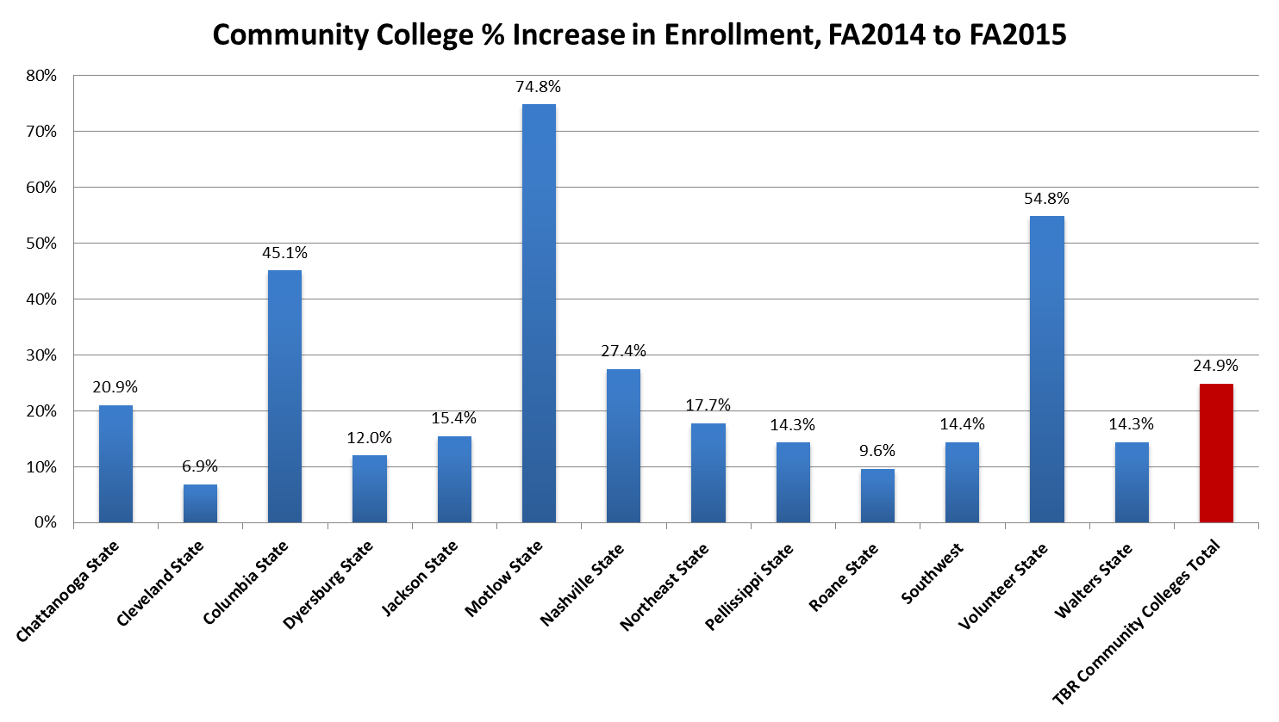

Slide 8
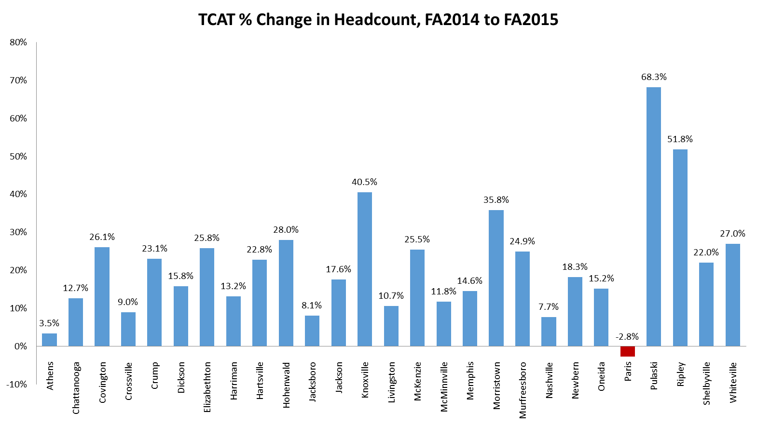
Notes:
A lot of this can be attributed to Reconnect more so than Promise, per Carol Puryear, but about 2,000 Promise kids are at TCATs.

Slide 9
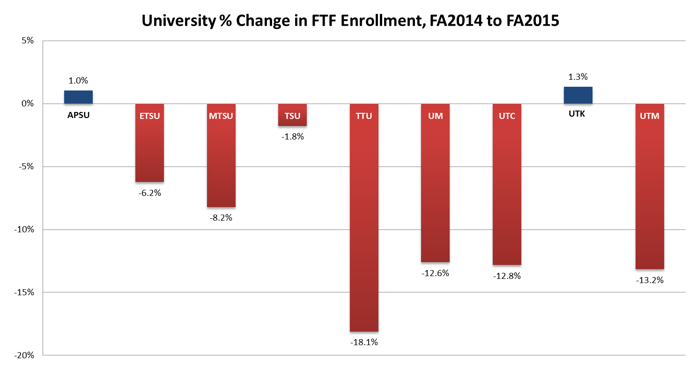

Slide 10
College-going Rate
Changes to college-going rate (CGR)
Approximately 4,000 new entrants into higher education in Tennessee.
Most at CCs and TCATs
CGR will likely increase ~5-6 percent, from approximately 57 to 62 percent.

Slide 11
CGR by state

Slide 12
CGR by state

Slide 13
Average ACT by Institution, FTF
 | Fall 2014 | Fall 2015 | Delta, Fall 14 to Fall 15
TBR Community Colleges
Chattanooga State Community College | 18.5 | 18.9 | 0.4
Cleveland State Community College | 19.0 | 18.9 | -0.1
Columbia State Community College | 19.6 | 19.9 | 0.3
Dyersburg State Community College | 18.9 | 18.7 | -0.2
Jackson State Community College | 18.6 | 18.4 | -0.2
Motlow State Community College | 19.2 | 19.1 | -0.1
Nashville State Community College | 17.6 | 18.0 | 0.4
Northeast State Community College | 19.3 | 19.2 | -0.1
Pellissippi State Community College | 19.9 | 20.1 | 0.2
Roane State Community College | 19.2 | 19.4 | 0.2
Southwest Tennessee Community College | 16.6 | 16.5 | -0.1
Volunteer State Community College | 19.3 | 19.3 | 0.0
Walters State Community College | 19.4 | 19.4 | 0.0
TBR Community Colleges Total | 18.8 | 18.9 | 0.1
Notes:
Just FTF

Slide 14
Average ACT by Institution, FTF
 | Fall 2014 | Fall 2015 | Delta, Fall 14 to Fall 15
TBR Universities
Austin Peay State University | 21.8 | 21.5 | -0.3
East Tennessee State University | 22.0 | 22.9 | 0.9
Middle Tennessee State University | 22.1 | 22.1 | 0.0
Tennessee State University | 18.0 | 17.9 | -0.1
Tennessee Technological University | 23.5 | 24.3 | 0.8
University of Memphis | 22.4 | 22.8 | 0.4
TBR Universities Total | 21.9 | 22.1 | 0.2
University of Tennessee
University of Tennessee, Chattanooga | 23.0 | 23.4 | 0.4
University of Tennessee, Knoxville | 26.0 | 26.9 | 0.9
University of Tennessee, Martin | 22.4 | 22.7 | 0.3
University of Tennessee Total | 24.7 | 25.5 | 0.8

Slide 15
Student persistence
Fall-Spring retention: we’ll know soon.
~80 percent of TN Promise students completed their community service by December 1.
Who persists without Tennessee Promise?
Similar to TELS program?
Transfer behavior?

Slide 16
Next Steps
Research, research, research
TN Promise students enrolling elsewhere
“Waterfall” – when do students drop off the TN Promise, and where do they end up?
Students enrolling in 2- vs. 4-year institutions
Variation by region, county, high school
Persistence and retention (Fall to spring, Year 1-2)
Notes:
As I said earlier, this is just a first pass using this data. We have many more questions that we can and will explore – these are just some of them.

Slide 17
Tennessee Promise – Cohort 2
59,621 high school seniors have signed up for 2016 Tennessee Promise
Deadline to sign up was November 2
Similar to Cohort 1 at this point in time
67 percent White
50 percent female
Majority state intention to attend CCs; 10 percent list TCAT as preferred institution.
Notes:
Last year, we had 58,000 and this year, applications increased by about 1,600. This is about 92 percent of public HS seniors.

Slide 18
Questions? Thank you!
emily.house@tn.gov

